Slide 1

ESS ACCSYS
Mats Lindroos on behalf of the AD and ACCSYS
Lund, 10 December 2013

Slide 2
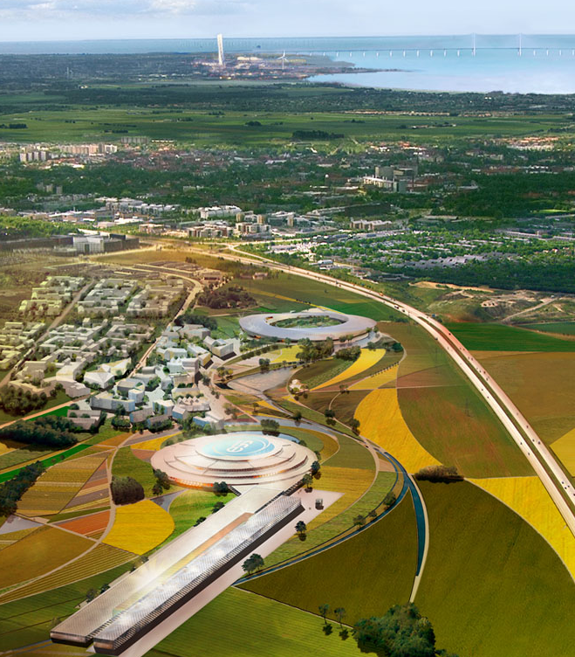
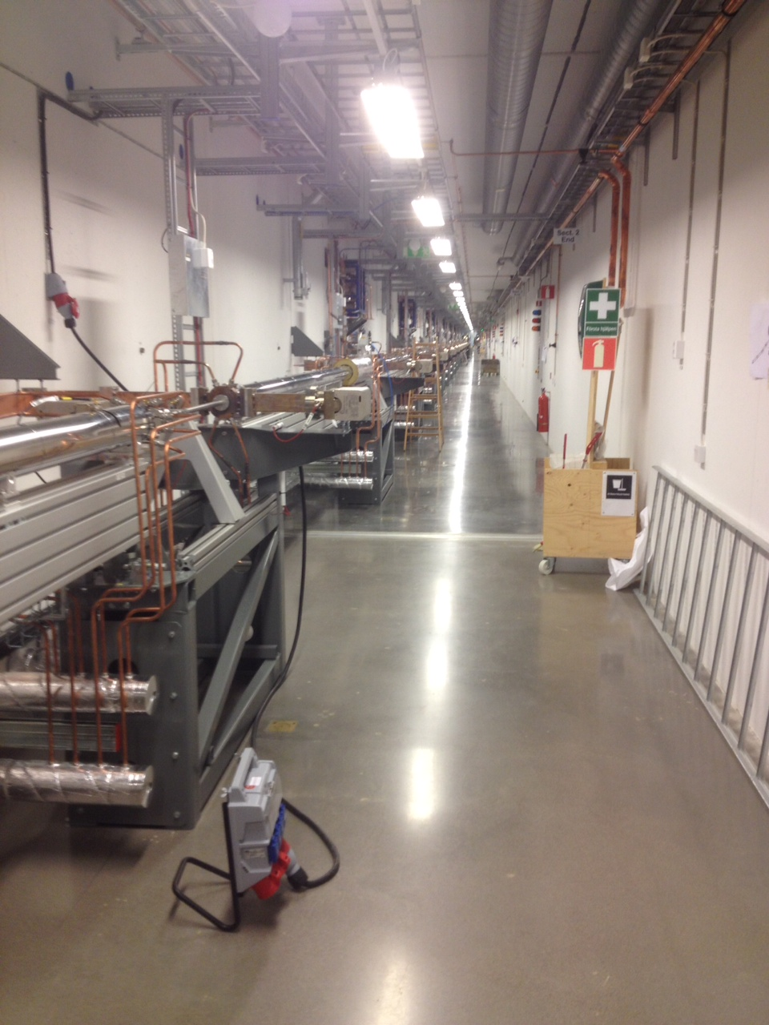
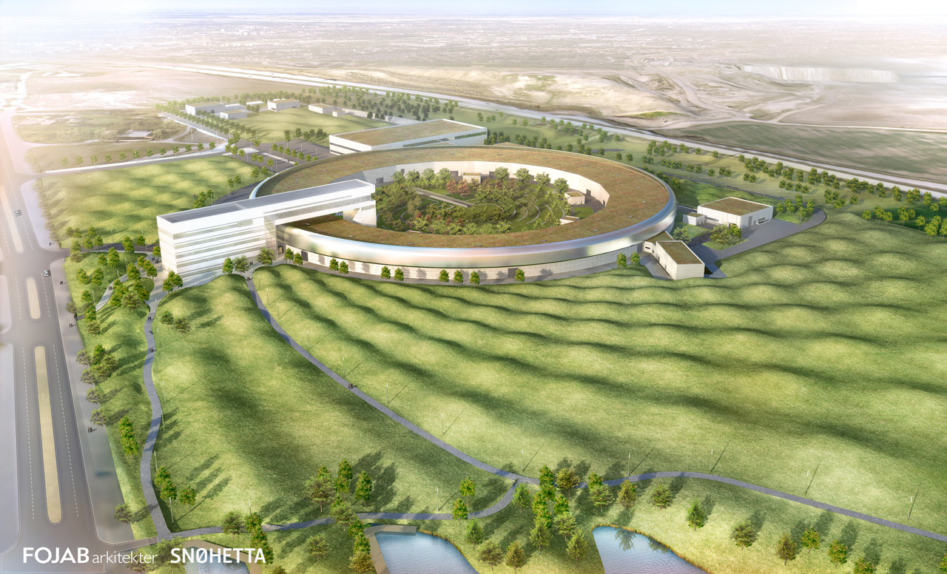


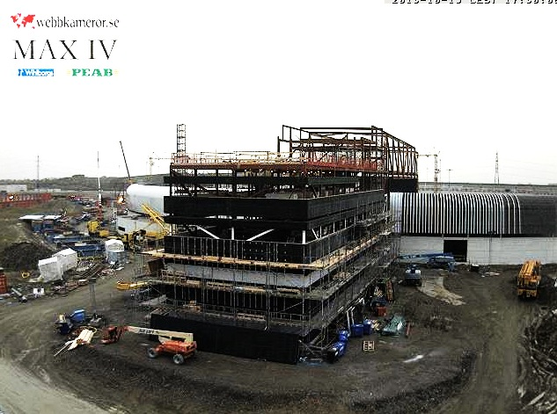


A research center for Europe
Science village Scandinavia

Slide 3

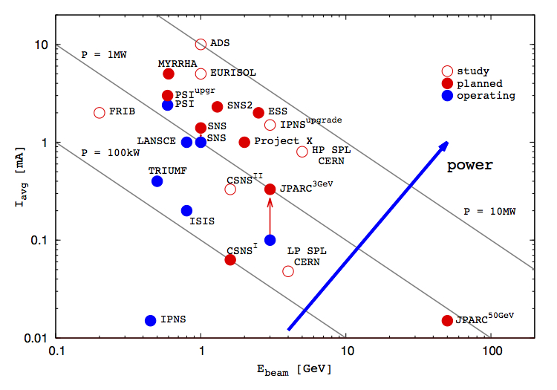
ESS - Bridging the neutron gap
10²⁰
J-PARC
ESS
SNS
MTR
NRU
HFIR
ILL
ISIS
10¹⁵
NRX
HFBR
ZINP-P/
IPNS
WNR
KENS
FRM-II
X-10
SINQ
Effective thermal neutron flux n/cm²-s
10¹⁰
CP-2
ZINP-P
CP-1
10⁵
Berkeley 37-inch cyclotron
350 mCi Ra-Be source
Steady State Sources
Pulsed Sources
1
Chadwick
1930
1940
1950
1960
1970
1980
1990
2000
2010
2020
(Updated from Neutron Scattering, K. Skold and D. L. Price, eds., Academic Press, 1986)
Notes:
Many of the reactor based neutron sources are being phased out = decline in the availability of neutrons = decline in competence and competitiveness
The vast majority of users will profit from a pulsed structure
A large fraction of users are fully satisfied by a long pulse source
Existing short pulse sources (ISIS, JPARC and SNS) can supply the present and imminent future need of short pulse users
Long pulse for physics flexibility (cold and thermal neutrons available)
++. Keep competency in communities – countries balance in science knowledge

Slide 4
ESS Linac
352.21 MHz
704.42 MHz
2.4 m
4.5 m
3.6 m
40 m
54 m
75 m
174 m
Target
Source
LEBT
RFQ
MEBT
DTL
Spokes
Medium β
High β
HEBT & Contingency
75 keV
3.6 MeV
90 MeV
220 MeV
570 MeV
2000 MeV
 | Energy (MeV) | No. of Modules | No. of Cavities | βg | Temp (K) | Cryo Length (m)
Source | 0.075 | 1 | 0 | – | ~300 | –
LEBT | 0.075 | – | 0 | – | ~300 | –
RFQ | 3.6 | 1 | 1 | – | ~300 | –
MEBT | 3.6 | – | 3 | – | ~300 | –
DTL | 90 | 5 | 5 | – | ~300 | –
Spoke | 220 | 13 | 2 (2S) × 13 | 0.5 βopt | ~2 | 4.14
Medium β | 570 | 9 | 4 (6C) × 9 | 0.67 | ~2 | 8.28
High β | 2000 | 21 | 4 (5C) × 21 | 0.86 | ~2 | 8.28
HEBT | 2000 | – | 0 | – | ~300 | –

Slide 5
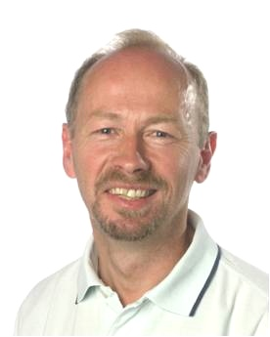
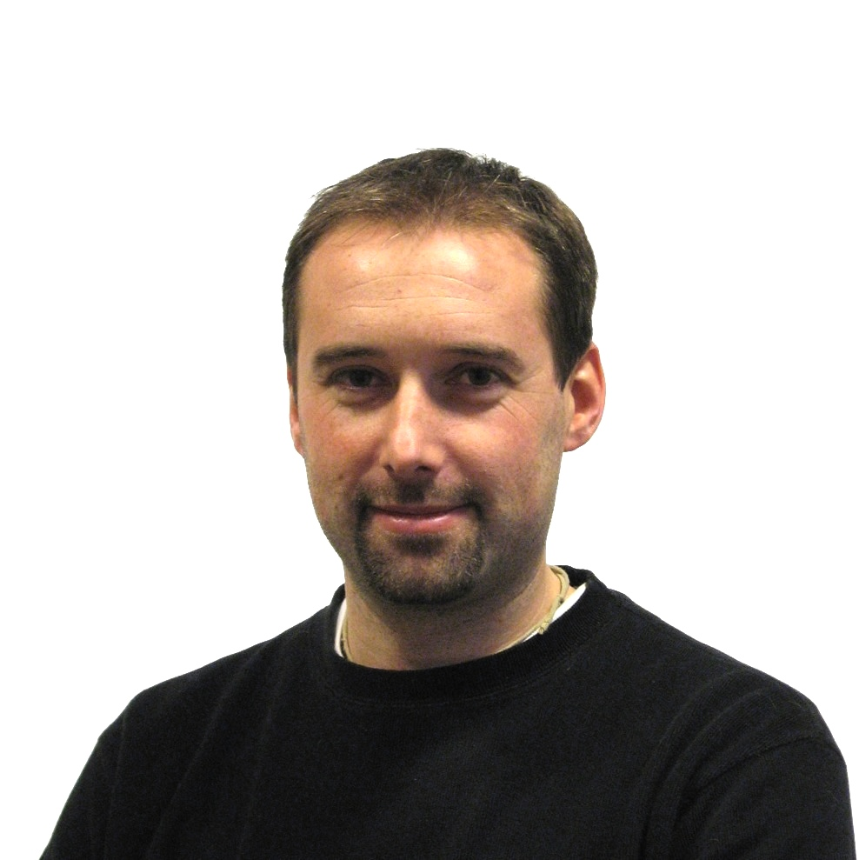


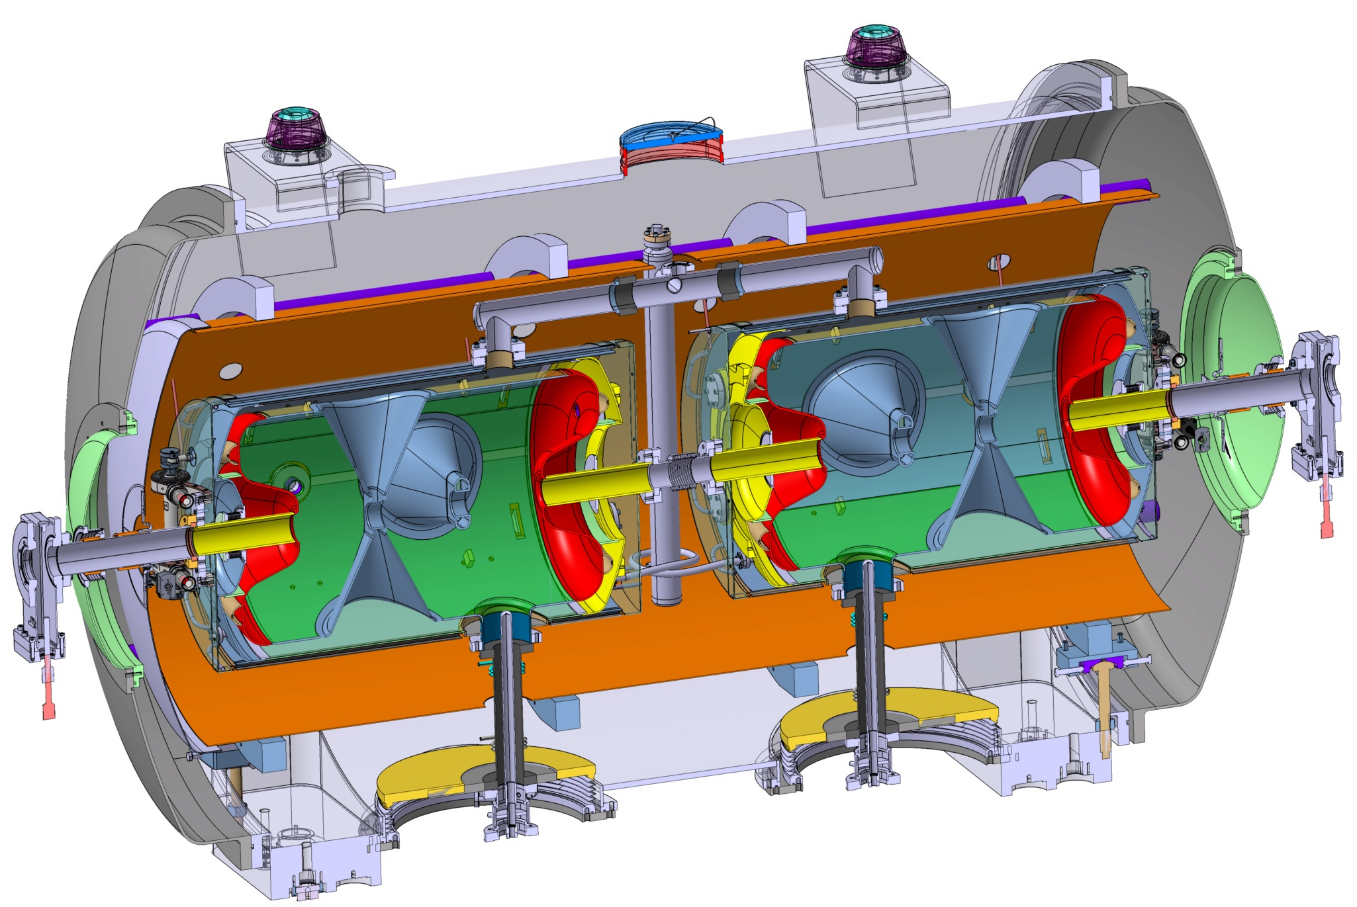
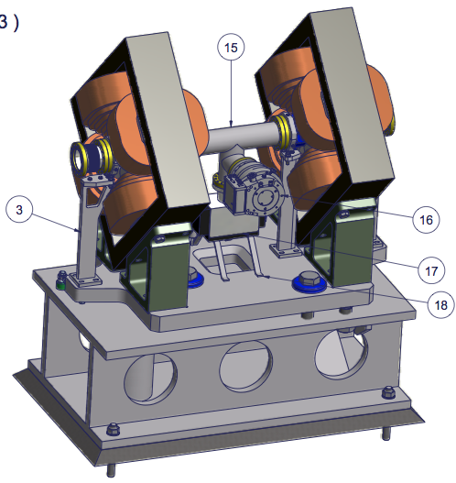

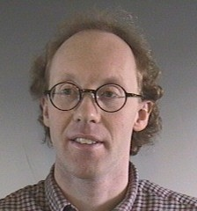


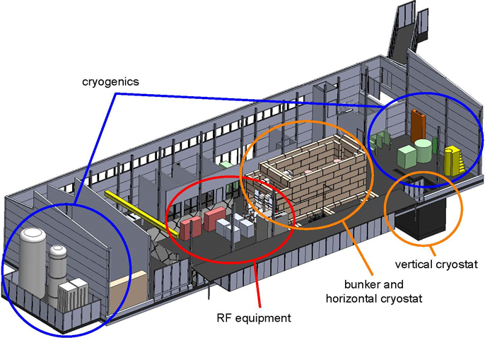
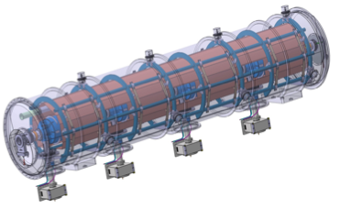

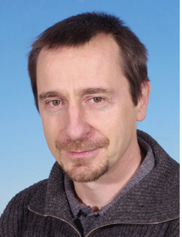
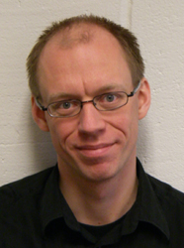
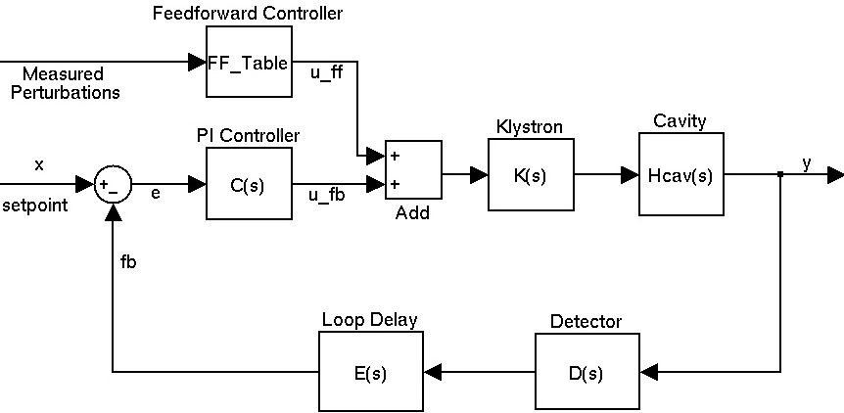

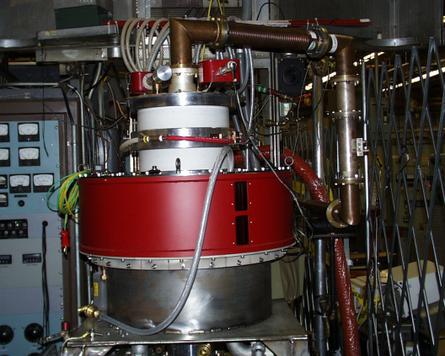


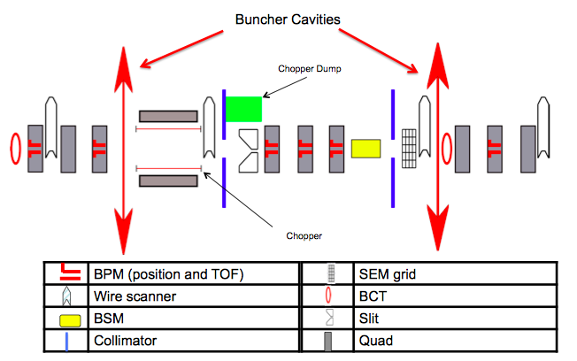
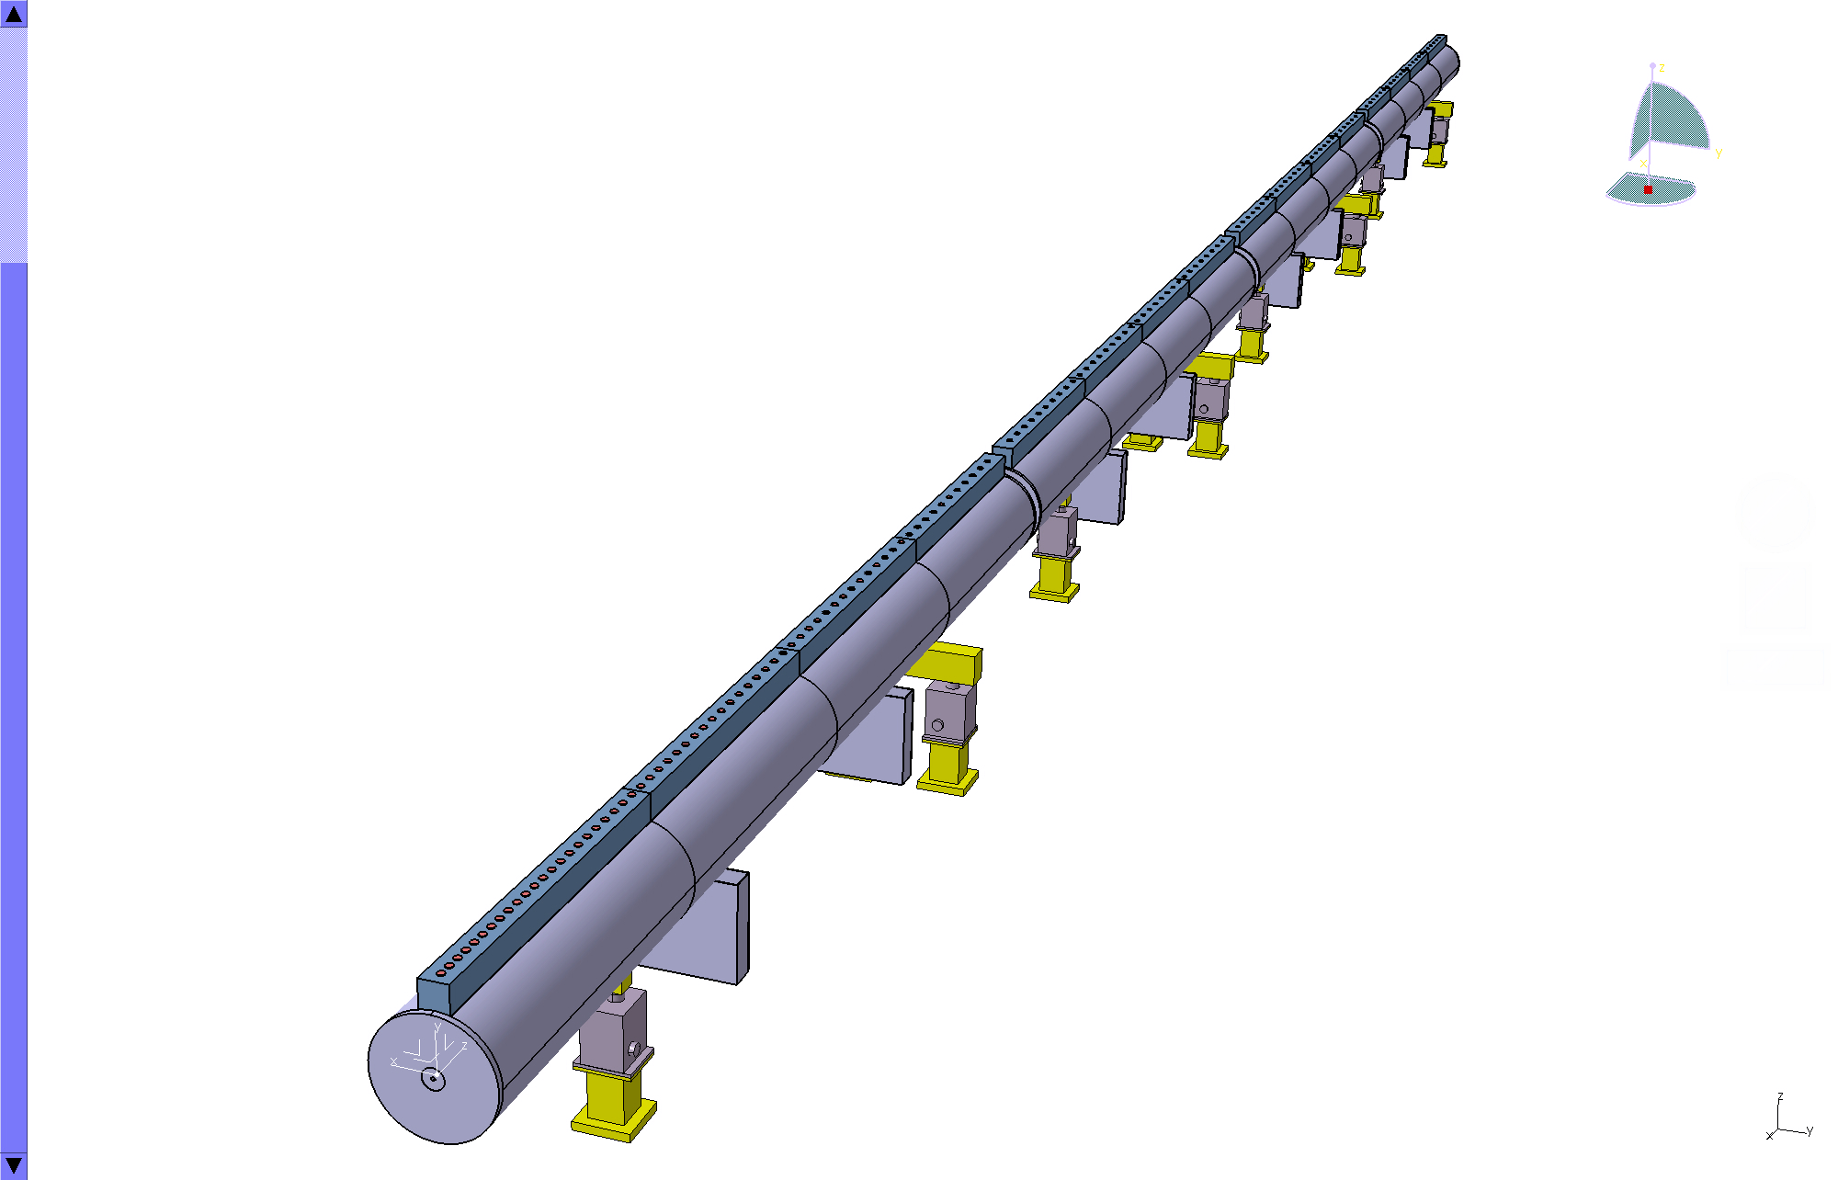
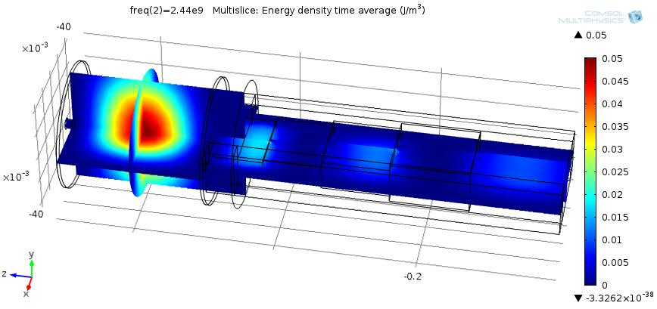
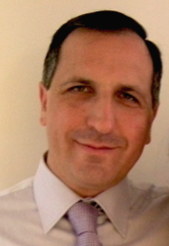


Prototyping the ESS accelerator
Søren Pape Møller
Sebastien Bousson
Roger Ruber
Pierre Bosland
Anders J
Johansson
CERN
The National Center for Nuclear Research, Swierk
Roger Barlow
Ibon Bustinduy
Santo Gammino

Slide 6
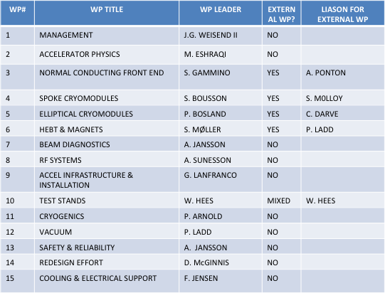
Organization and Work package leaders
Head of Accelerators
Mats Lindroos
Deputy division
Håkan Danared
Deputy project
John Weisend II
Chief engineer
David McGinnis
Safety & Availability
Andreas Jansson
Planning manager (PMO)
Mikael Klein Velderman
Division and project aligned at high level
  “WP as a group” would make for too big fragmentation
  Four WPs have external leaders
Weekly or bi-weekly meetings at ESS Accelerator Division
  Management board of project and division
  WP leaders
  Lead engineers
  Safety
Regular meetings for ACCSYS project
  Technical board (all WP leaders and reps of labs/uni. with contract) as governance and CCB on project level (6 meetings per year)
  Collaboration board with reps of director of of labs/uni. with contracts as oversight committee
  Audits yearly of every WP
  Reviews (Conceptual, design, ready to build) as required mostly co-organized with audits
Beam Physics
Håkan Danared
RF systems
Anders Sunesson
Beam Instrumentation
Andreas Jansson
Specialized Technical services
John Weisend II
Lead engineers: Aurelien Ponton, Benjamin Cheymol, Stephen Molloy, Christine Darve, Peter Ladd, Tom Shea

Slide 7
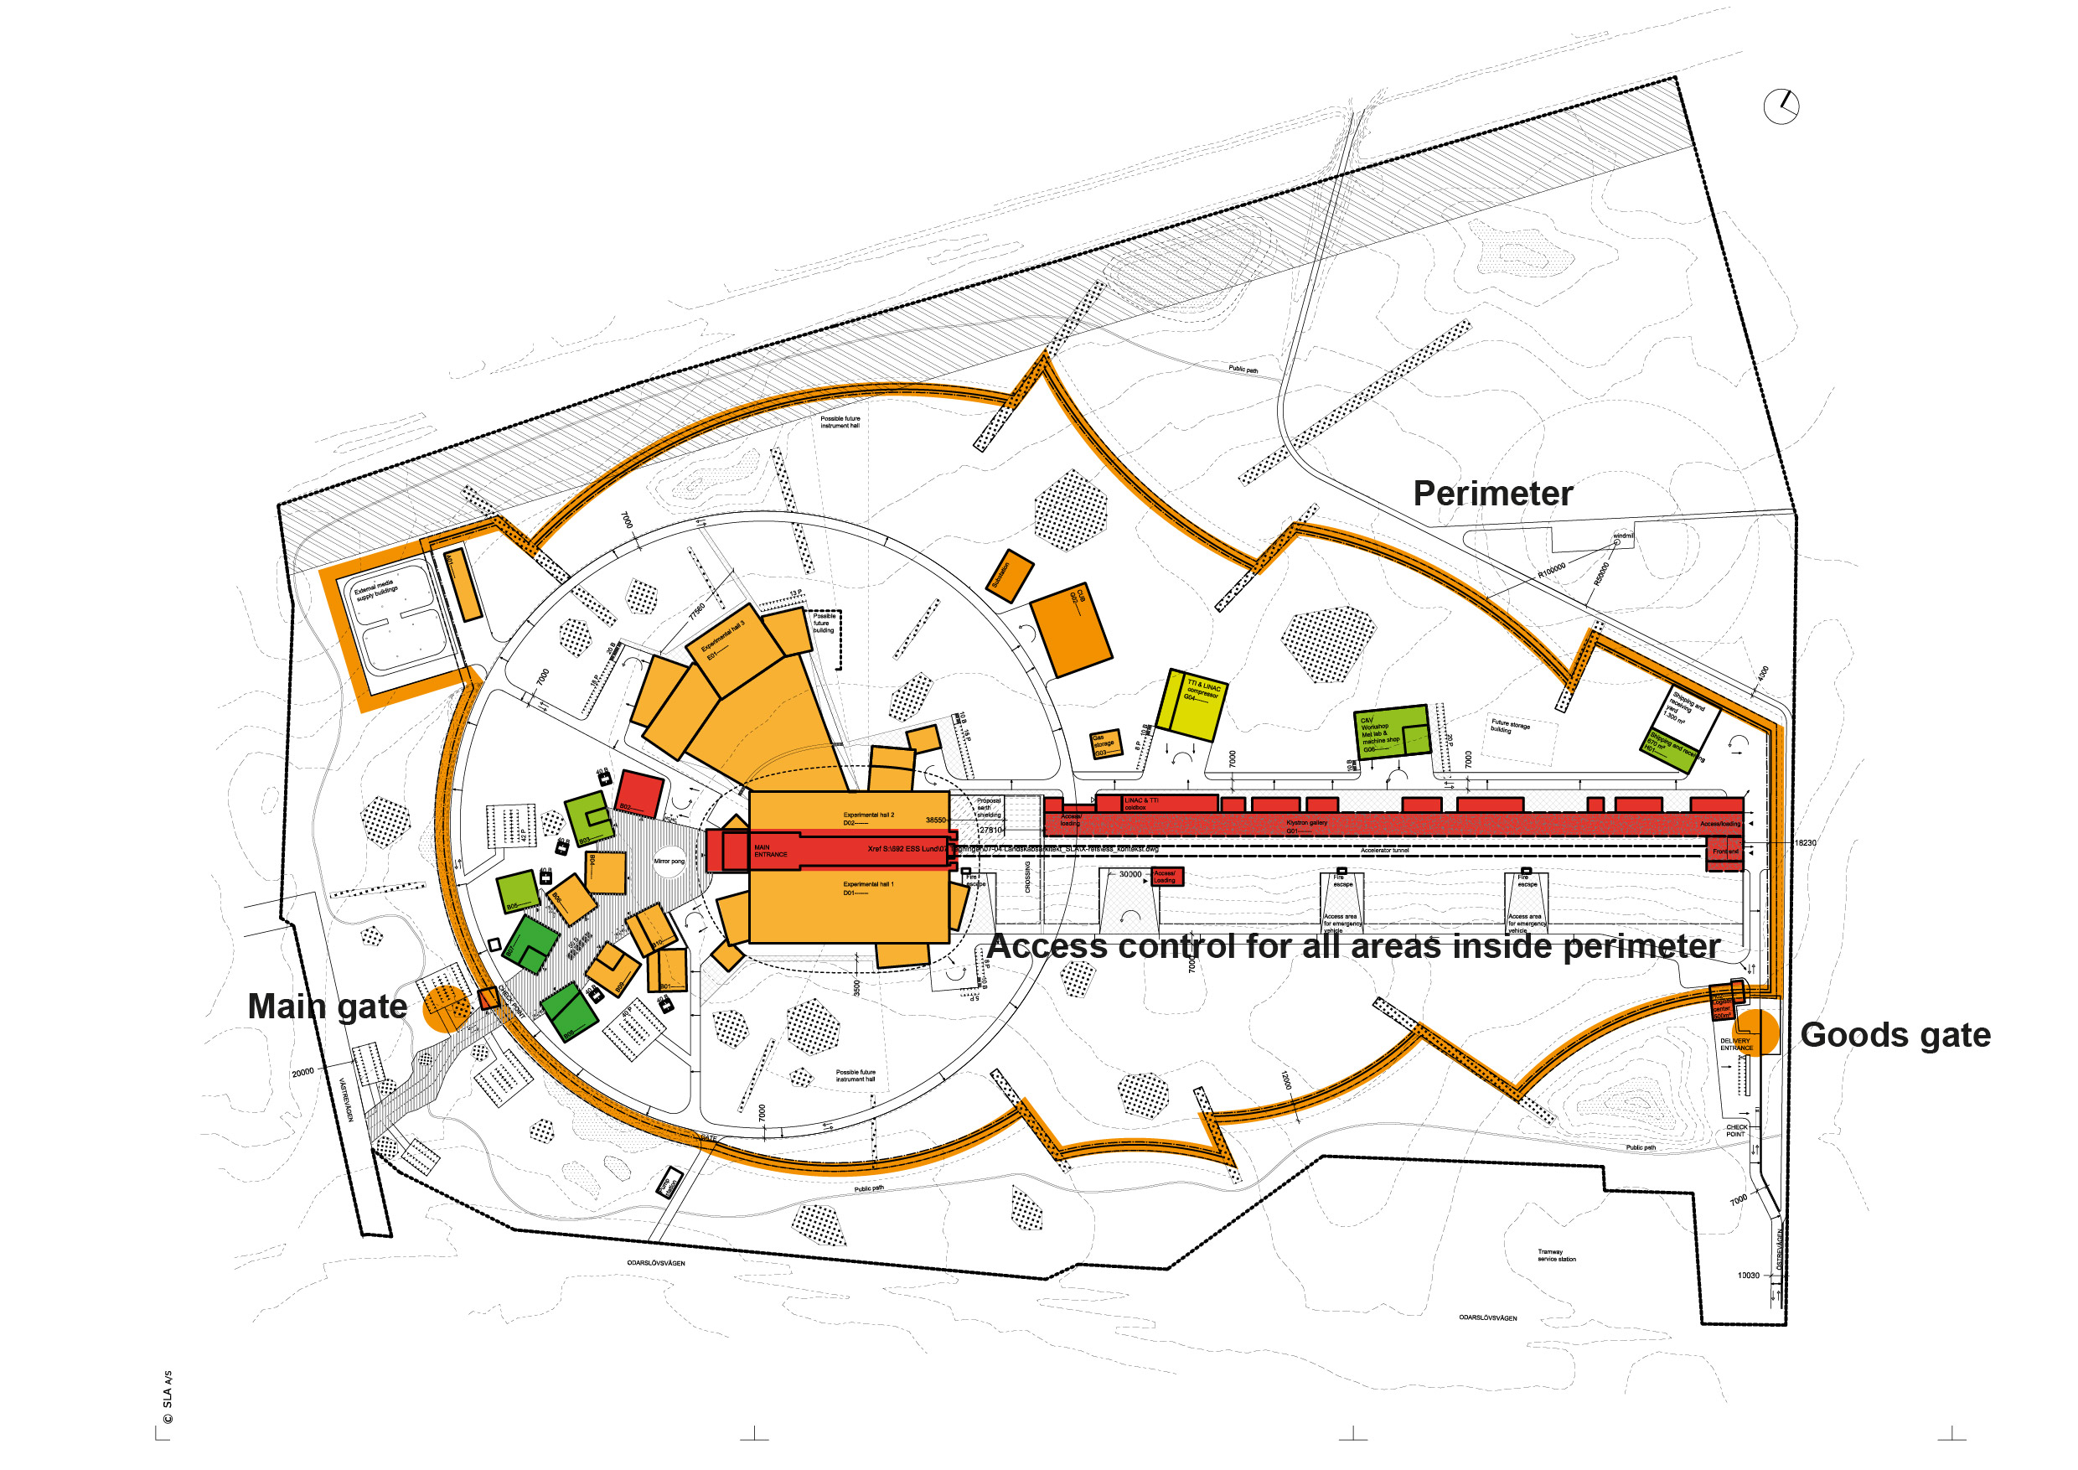
Site Plan

Slide 8
Project delivery strategies (JY)
Schedule Priority – Facility construction complete at the end of 2022 with 5 MW capability installed;
Operations Linked to Construction Progress – Initial operations in 2019 (production of 1st neutrons) and facility operations in 2023 (instruments available for the user program);
Scope Contingency - Explicit scope contingency integrated into the accelerator plans (scope that can be delayed if necessary);
Instrument Program – Technically limited schedule, leverage construction investment, plan for additional investment; and
Conventional facilities costs above the cost report value covered outside the cap by the host countries or new partners.

Slide 9
Scope contingency for 5 MW accelerator
We plan for delivering a 5 MW accelerator
The scope contingency for the accelerator is beam power. The purchasing of power supplies and RF sources necessary to go from 2.5 to 5 MW will be scheduled discretely. These purchases will be authorized after the financial requirements for delivering 2.5 MW of beam power are secure.
Each 7 M€ reduction decrease energy by 70 MeV (=175 kW at 62.5 mA)
Scope contingency
100 M€
CM and RF sources
352.21 MHz
704.42 MHz
2.4 m
4.5 m
3.6 m
40 m
54 m
75 m
174 m
Target
Source
LEBT
RFQ
MEBT
DTL
Spokes
Medium β
High β
HEBT & Contingency
75 keV
3.6 MeV
90 MeV
220 MeV
570 MeV
2000 MeV

Slide 10
Transition from construction to operations (JY)
ESS Operations can be divided into three distinct phases:
Initial Operations Phase (2019 – 2022, 4 years) – Includes one year of activities to produce first neutrons (2019) and three years of activities to improve accelerator performance and to commission instruments (experiments by friendly users);
Initial User Program Operations (2023 – 2025, 3 years) – Includes support necessary for reliable operations with public users and provides the basis for future cost sharing; and,
User Program Operations (Beginning in 2026 – ) – Routine operations including the completion and commissioning of the final 22 public instruments.

Slide 11
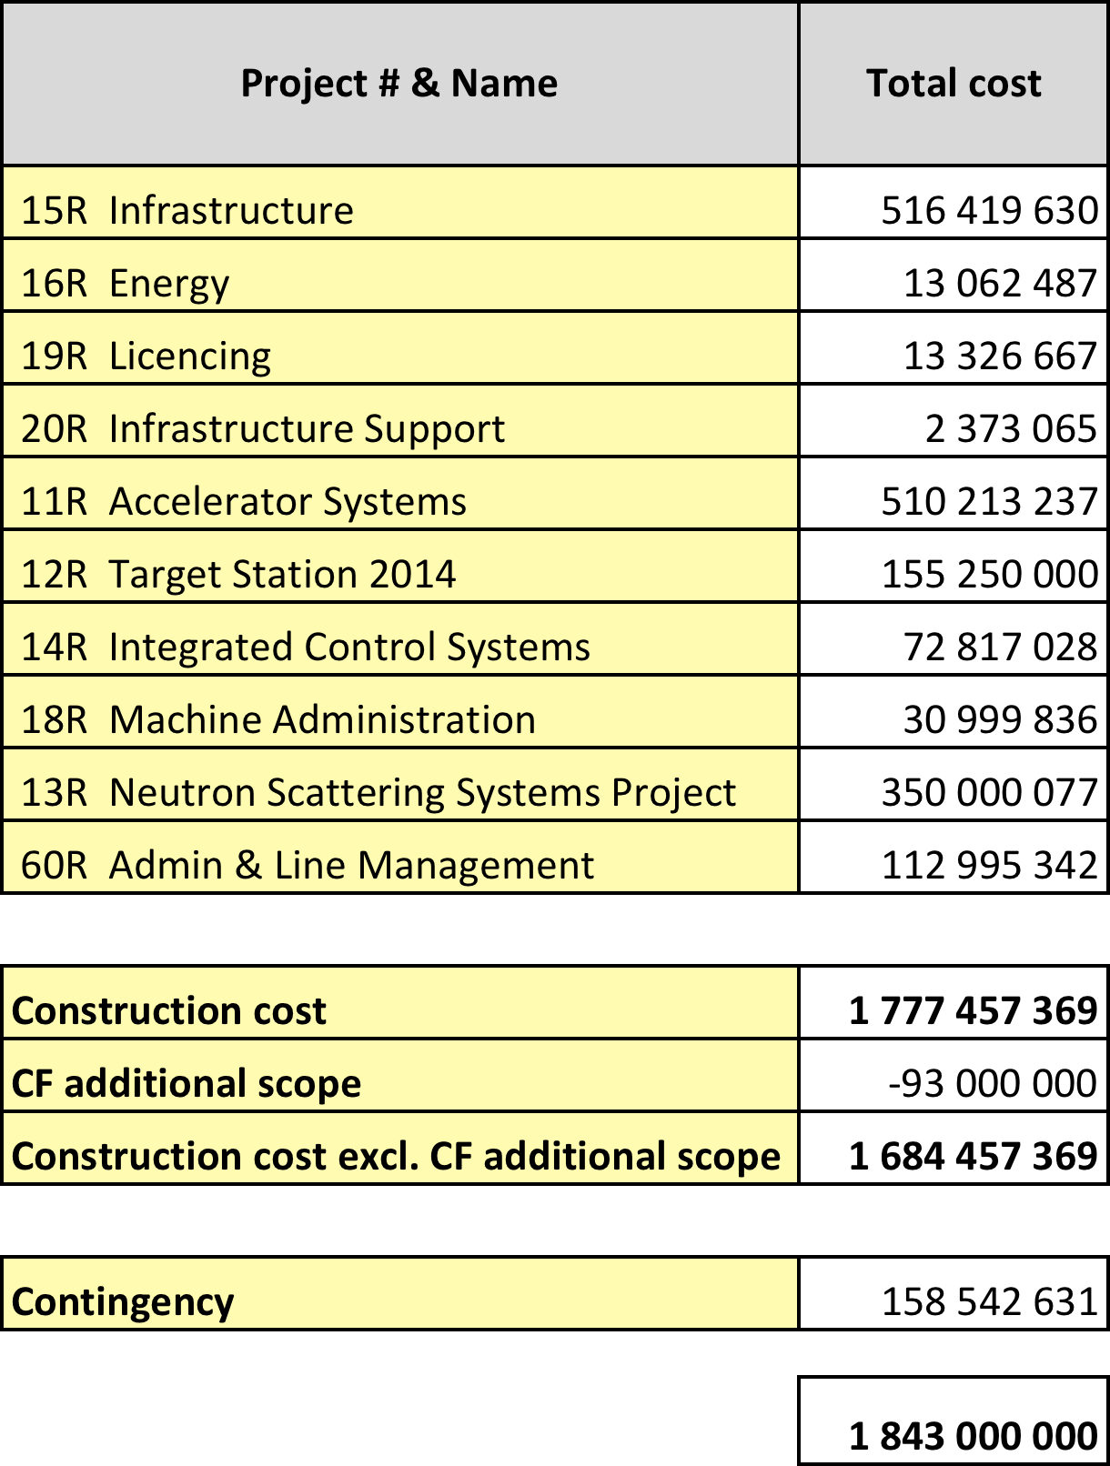
Cost Baseline (JY)
Construction cost is 1843 M€
Contingency budget is 158,5 M€
January 2013 pricing
Initial operations in 2019
Construction complete in 2025

Slide 12
Critical Path (JY)
Licencing
Accelerator Buildings
Licensing
ConvF
Spoke & Medium Beta CM
(Prod&Inst&Comm)
AccSys
NSS
High Beta CM
(Prod&Inst&Comm)
Instrument Construction
Ground break
First installations
on-site (ACCSYS)
First Beam
on Target (570 MeV)
Machine installed
for 2.0 GeV
Last of Instr Const
Instr HO to Op

Slide 13
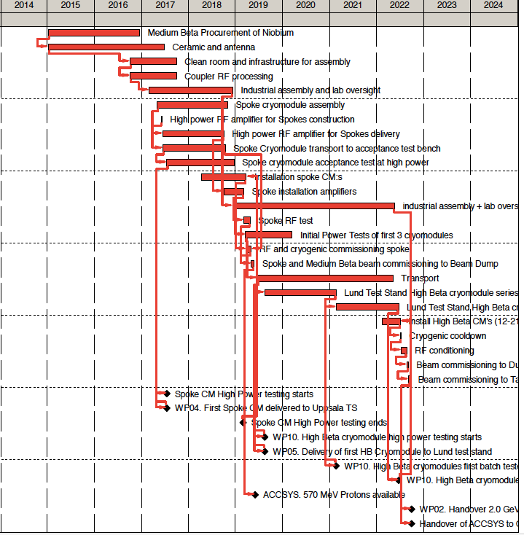
Schedule Critical Path
For first protons to target:
  CP is mainly set by cryomodule production
For final milestone for 2 GeV:
  CP is mainly set by elliptical cryomodule production
Interplay between activities at different labs critical:
  Transport
  “on the same schedule”

Slide 14
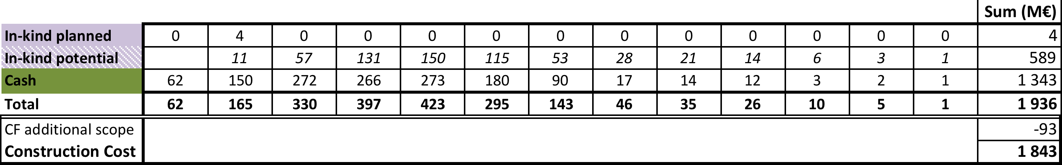
Cash vs. In-kind (JY)

Slide 15
Host and Member Funding Plans (JY)
Annual funding requirements derived from the project schedules
– Technically limited schedule with limited float
Hosts providing funding in 2013
Hosts will provide funding for 2014, assuming funding agreements with members are formalized
– Initial in-kind deliverables planned in 2014 with large increase in 2015
Two major issues to be resolved: securing 100% funding and cash flow
– Expect financial commitment at the 80-85% level in 2014
– Cash requirements high in early years to enable efficient construction
European Investment Bank loan would address both the temporary gap and the cash flow issue

Slide 16
Next 6 months ESS (JY)
1st Annual Review and resulting action plans
Letters of Intent or Agreements with Member countries
Demonstrate accelerator and target station technology readiness
– key CF, Machine, and NSS interfaces resolved for a civil construction start
Continue engagement of the scientific user community and
select initial instruments for engineering development
– first three instruments in 2013, additional instruments in 2014
Select conventional facilities partner company/start final design in Feb 2014
Secure license and permits for facility construction and establish Project Performance Measurement Baseline by May 2014
Start facility construction!

Slide 17
1st Annual Project Review
The first ESS annual review took place at LUND the 12th-14th November 2013
Present : ESS project team, 33 members of the review team organized in 7 subcommittees and 7 observers (see next slide for details)
First impressions:
The review committee congratulates the ESS team and its management for the quality of the material and presentations submitted to the reviewers
The ESS is now a real project from all points of view, well shaped and well organized. ESS is now managing to the established baseline.
A big effort was made in the last 10 months to build up an organization structure with names and clear responsibilities attached to it
The management of the project is strong, well determined, motivated and success oriented. The ESS overall schedule foresees first protons on target in December 2019. The cost cap has been fixed to 1.843 Beuro (year 2013).
ESS will start real construction work in June 2014 (ground break)

Slide 19
TOP 10 worries
Integration and technical overview of the entire project is vital and must be strengthened, in particular areas around interfaces, reviews, configuration control, installation, commissioning and anticipating unforeseen problems. There is a missing key figure in the organization.
The staffing plans are very demanding. Too many positions to be filled in short periods. To be clarified first is the ratio of staff in the various activities. Obtain clarity of rules and taxes when bringing staff from the partner institutions to ESS. Today staffing figures do not mix ESS staff and in-kind staff in a clear way.
Accelerator: basic assumption of 1 W/m used as Level 1 requirement with major implications inter alia on licencing, shielding and operation; needs to be confirmed by realistic end-to-end beam simulations including errors, showing sufficient margin. Normal operation envelope should include beam loss scenarios. (Action:Mamad Eshraqi)
Timely execution of the EDD activities for the target (cooling, …) will address most of the identified technical risks. Implications on cost and schedule might become a important issue
Planning of the remote-handling schemes for target & moderator-reflector replacement needs to be completed. The two-dimensional move of the MRP should be avoided

Slide 20
TOP 10 worries
  ICS mandate need some clarification. ICS must be available in time while components are qualified. Be more proactive in defining interfaces and in communication with other systems. All safety aspects including interlocks need to have a common approach across the organization. It would be advantageous to incorporate ICS into IKCs.
  NSS needs a workable breakdown of the budget to deliver an acceptable number and quality of instruments, including essential support systems.
  CF construction is starting in mid-2014. The project must establish internal milestones for freezing interface requirements between CF and other systems.
  423 to 516 M€ for CF, need to understand how this is handled.
  Management and integration of in-kind contributions and procurements needs strengthening. Timeline for in-kind and industrial contracts might be too aggressive. Having the right staff and procedures at the right moment is an issue.

Slide 21
1 – Accelerator Subcommittee
Carlo Bocchetta, Mikael Eriksson, Francis Perez, Philippe Lebrun, Maurizio Vretenar
Proposed list of recommendations
  Reassess beam instrumentation based on effective strategy of commissioning and needs of operation (Action: Marc Munoz)
  Recommend push for faster prototyping of all accelerating structures and raster magnet system (Action: John Weisend)
  Establish criteria for success and formalize decision process in advance for decision of IOTs (end 2017) (Action: Anders Sunesson)
  Analyse and develop IKC potential for beam instrumentation (Action: Andreas Jansson)
  Be aware of the critical importance and manage properly the communication of radiation-protection issues to the public (To Jim Yeck and EPG)
  Translate high-level requirements for reliability and availability into performance figures for elementary components and systems, identify discrepancies with state-of-the-art and implement corrective / mitigating actions (overcapacity, redundancy, reparability, “hot” spares, etc.) (Action: David McGinnis)
  Integrate utilities into reliability/availability studies (Action: Andreas Jansson)
Risks, critical items and possible showstoppers [2/2]
  Accidental beam loss: need to establish “worst case” scenarios based on risk analysis and to conduct simulations to determine appropriate shielding (interface with CF) and system interlocks for personnel protection (Action: Lali Tchelidze)

Slide 22
Next Six Months ACCSYS
Contracting prototypes for modulators, MB-IOT high power tubes, klystrons and modulators
Agreement and contracts for (early) in-kind for ion-source, MEBT, RFQ, DTL and cryomodules
Recruitment at ESS accelerator division according to staff plan
Finalizing Level 3 and 4 requirements following CCB process at ESS
Follow up on action plan from annual review
Continued project work including audits, reviews and governing meetings of the existing accelerator collaboration

Slide 23
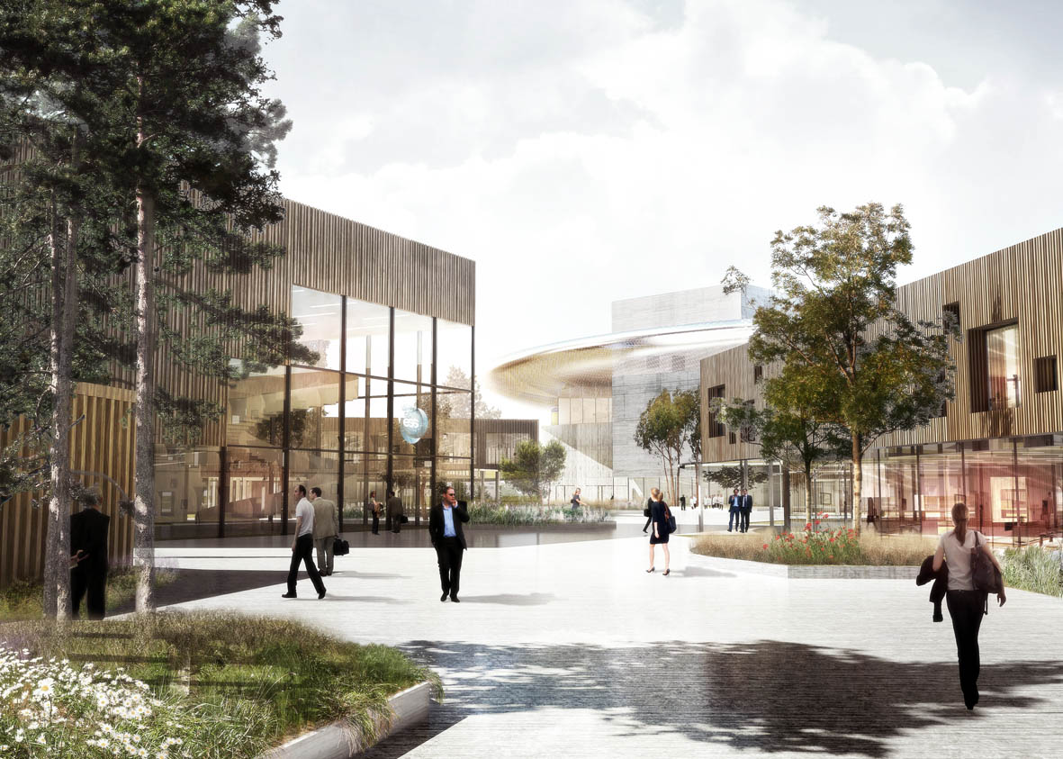

Thank you for all for the hard work in 2013!
We only have 1998 days to first beam!
Welcome

Slide 24
ESS organization

Slide 25
ESS organization

