Slide 1

Conventional Facilities
Jan Molander
Design Manager Conventional Facilities
www.europeanspallationsource.se
December 10, 2013

Slide 2
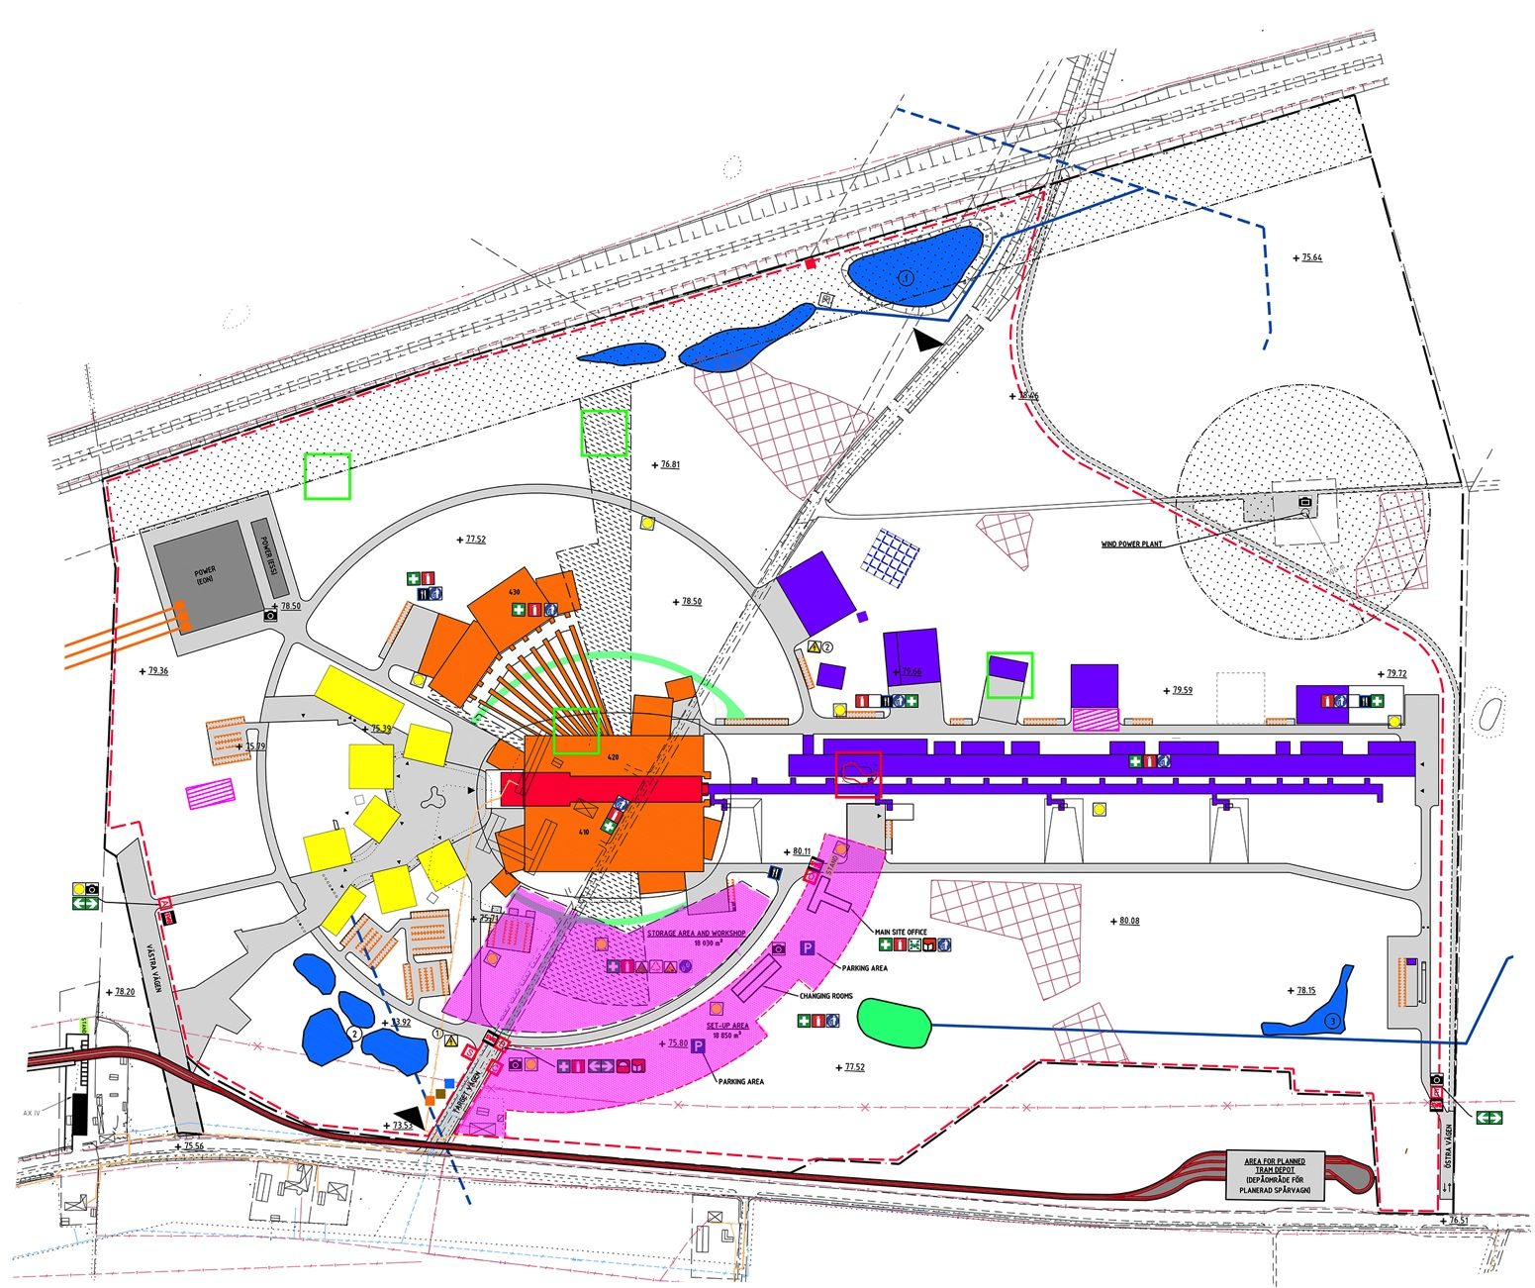
Scope

Slide 3
Organization
Staff Plan
CF | Employees | Consultants
2013 Q4 | 17 | 8
2014 Q1 | 22 | 8
2014 Q2 | 24 | 8
2014 Q3 | 26 | 9
2014 Q4 | 28 | 9

Slide 4
Conventional Facilities - Schedule
2013
2014
2015
2016
2017
2018
2019
 | 2011 | 2012 | 2013 | 2014
Building Program
Architectural Competition
Feasibility Study
Baselining/ Scrubbing
Conceptual Design
Detailed Design
Procurement Contractor
Construction Start

Slide 5
Conventional Facilities - Detailed Schedule
2013
2014
2015
2016
2017
2018
2019
Design Phases
MASTERPLAN GENERAL ARCH.
PRELIMINARY DESIGN
ACCELERATOR BLDG
DETAILED DESIGN
TARGET BLDG + EXP HALLS 1,2
EXP HALL 3 + GUIDE HALLS
AUX. BLDGS
AUX. BLDGS
MAIN UTIL.(GROUND)
EARTH WORKS
CONTRACT SIGNED
Construction Phase
START OF CONSTRUCTION
CUB OPERATIONAL
PART 1 FINAL INSPECTION
FULL ACCESS EXP. HALL 1 & 2
EARLY ACCESS COLD BOX & COMPRESSOR BLDG
FULL ACCESS ACCELERATOR
FULL ACCESS EXP. HALL 3
EARLY ACCESS KLYSTRON GALLERY
EARLY ACCESS EXP HALL 1
FULL ACCESS TARGET BLDG
EARLY ACCESS EXP HALL 2
FULL INSPECTION
EARLY ACCESS EXP HALL 3

Slide 6
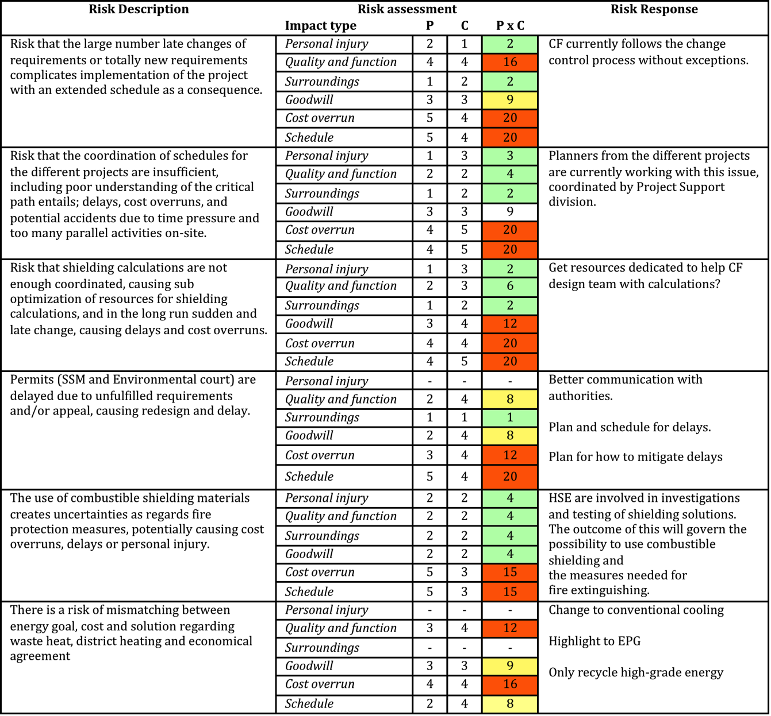
  Top Risks Conventional Facilities

Slide 7
Status
Preliminary Design / Detailed Design
Procurement Civil Works
Scope Office & Labs
Challenges / Risks
Requirements from Stakeholders
Challenges to Procurement
Start-up of Construction / Collaboration
Keep Scope within Budget

Slide 8
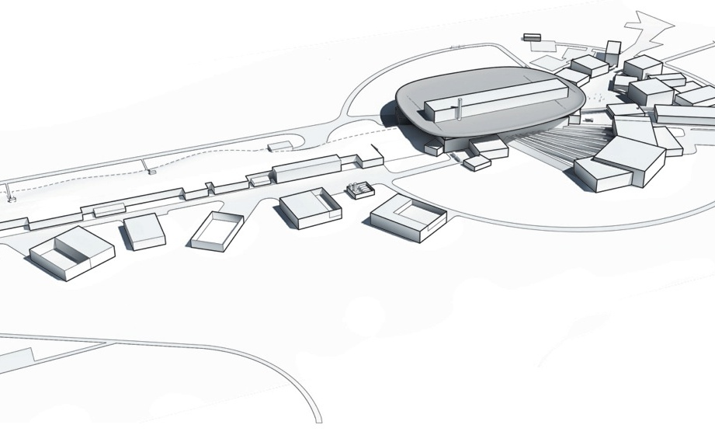
The architecture of ESS
Architectural design competition
Five architect consortia was preselected in an international architect competition and competed to design the ESS exterior. In February 2013 the winner was announced by the ESS jury: Henning Larsen Architects was selected to develop the final architectural design together with the ESS team.

Slide 9
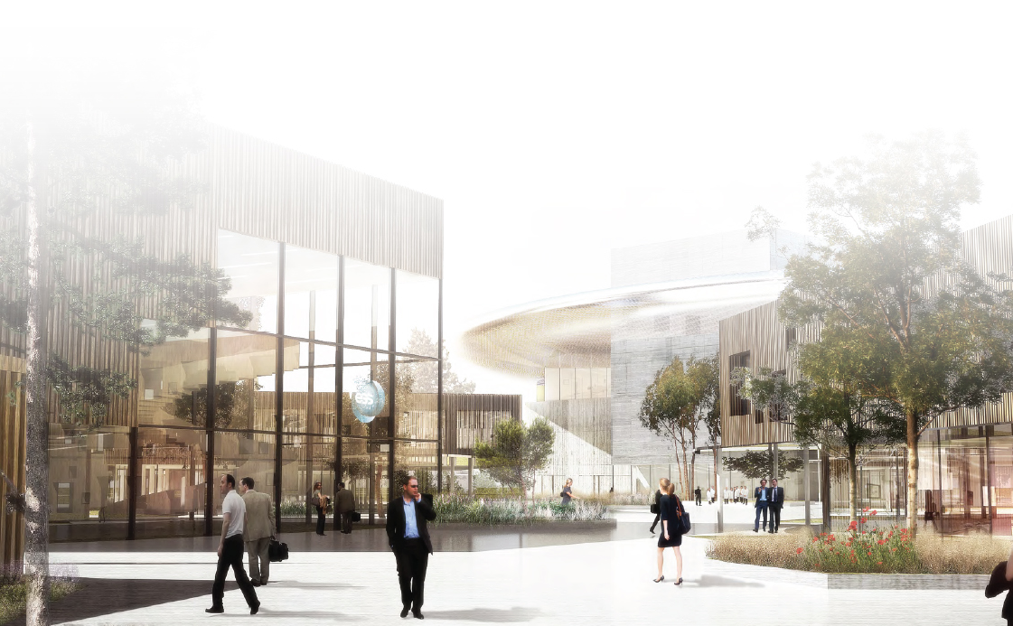
Architectural Concepts

Slide 10
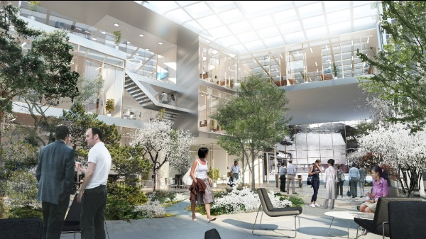
Architectural Concepts

Slide 11
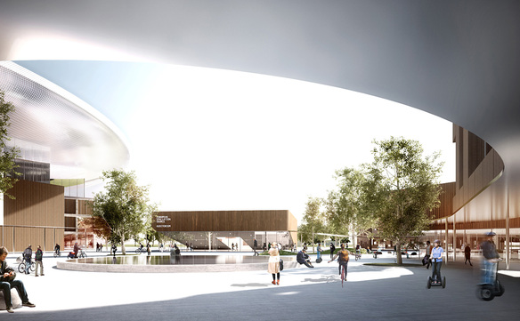
Architectural Concepts

Slide 12
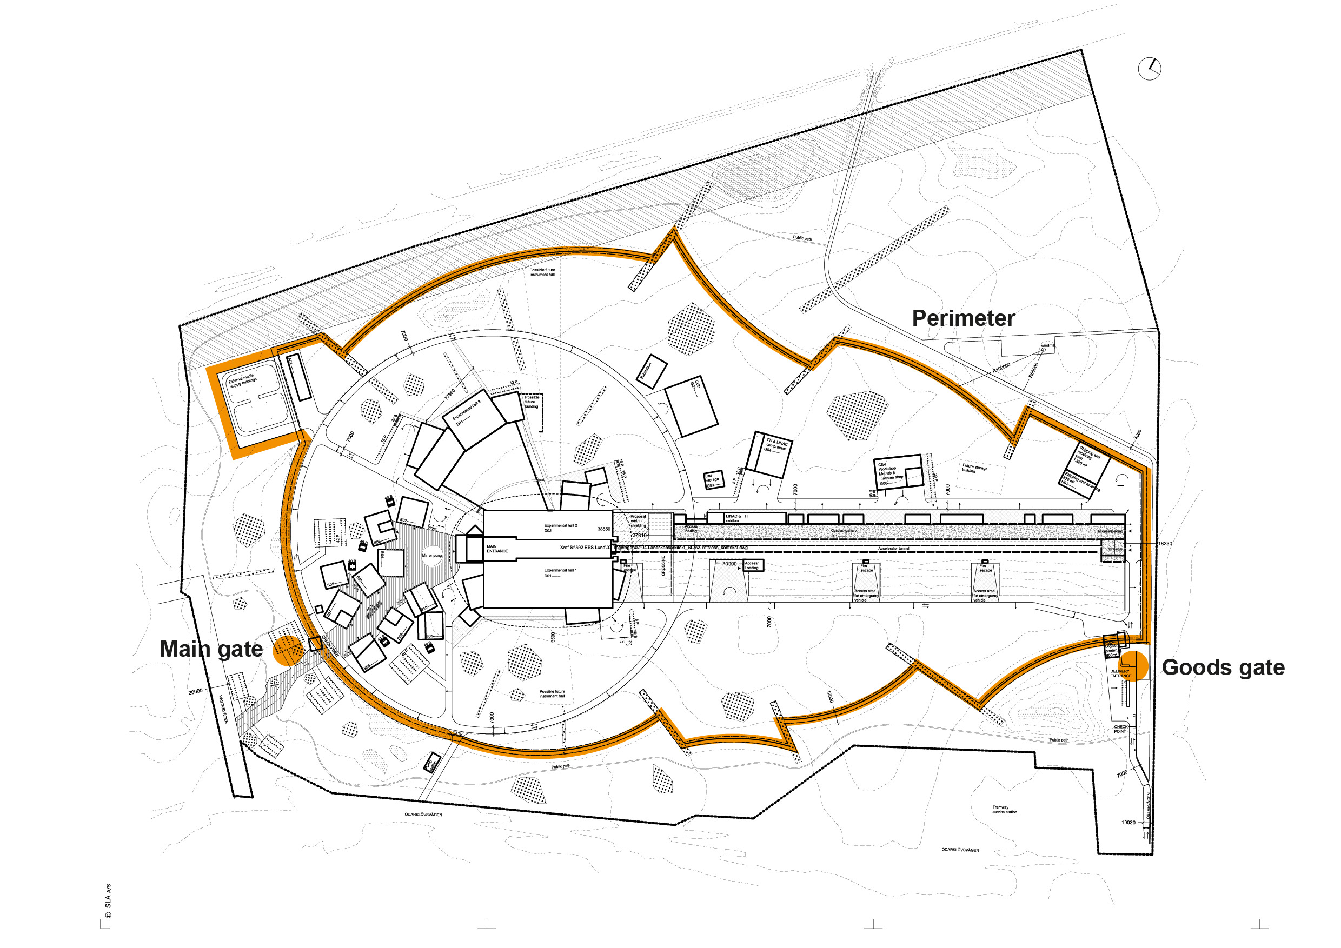

Security 2013-10-25
Conventional facilities | Masterplan Baseline

Slide 13
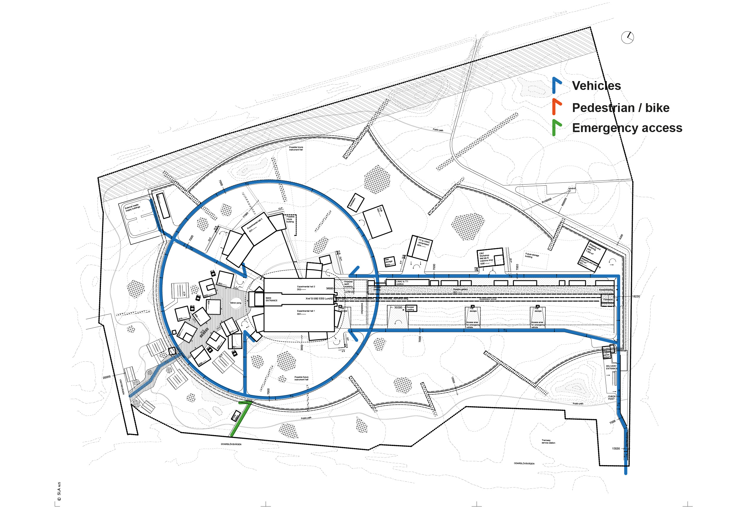
Vehicle access 2013-10-25
Conventional facilities | Masterplan Baseline

Slide 14
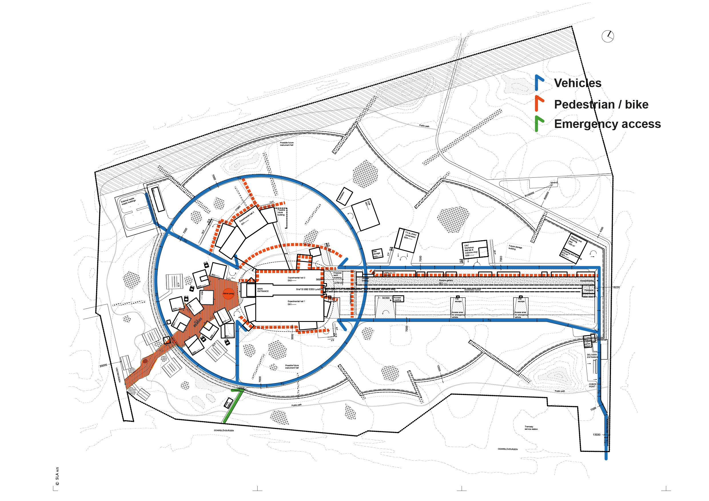
Pedestrian / bike access 2013-10-25
Conventional facilities | Masterplan Baseline

Slide 15
Design Phases
The development of all required documents and data for the Project is divided into 3 stages.
Feasibility Study
Development of concepts and viable options taking into account stakeholder needs, time and budget constraints. Resulted in a CF Baseline for Accelerator, Target & Experimental Halls in August 2013.
Preliminary Design
An Assessment of the Feasibility Study and alternative part solutions resulting in a main proposal for fulfillment of the project goals.
Detailed Design
The Detailed Design encompasses and implements the Preliminary Design decisions. All drawings and documents necessary for construction will be reviewed and collected in appropriate sub-projects.

Slide 16
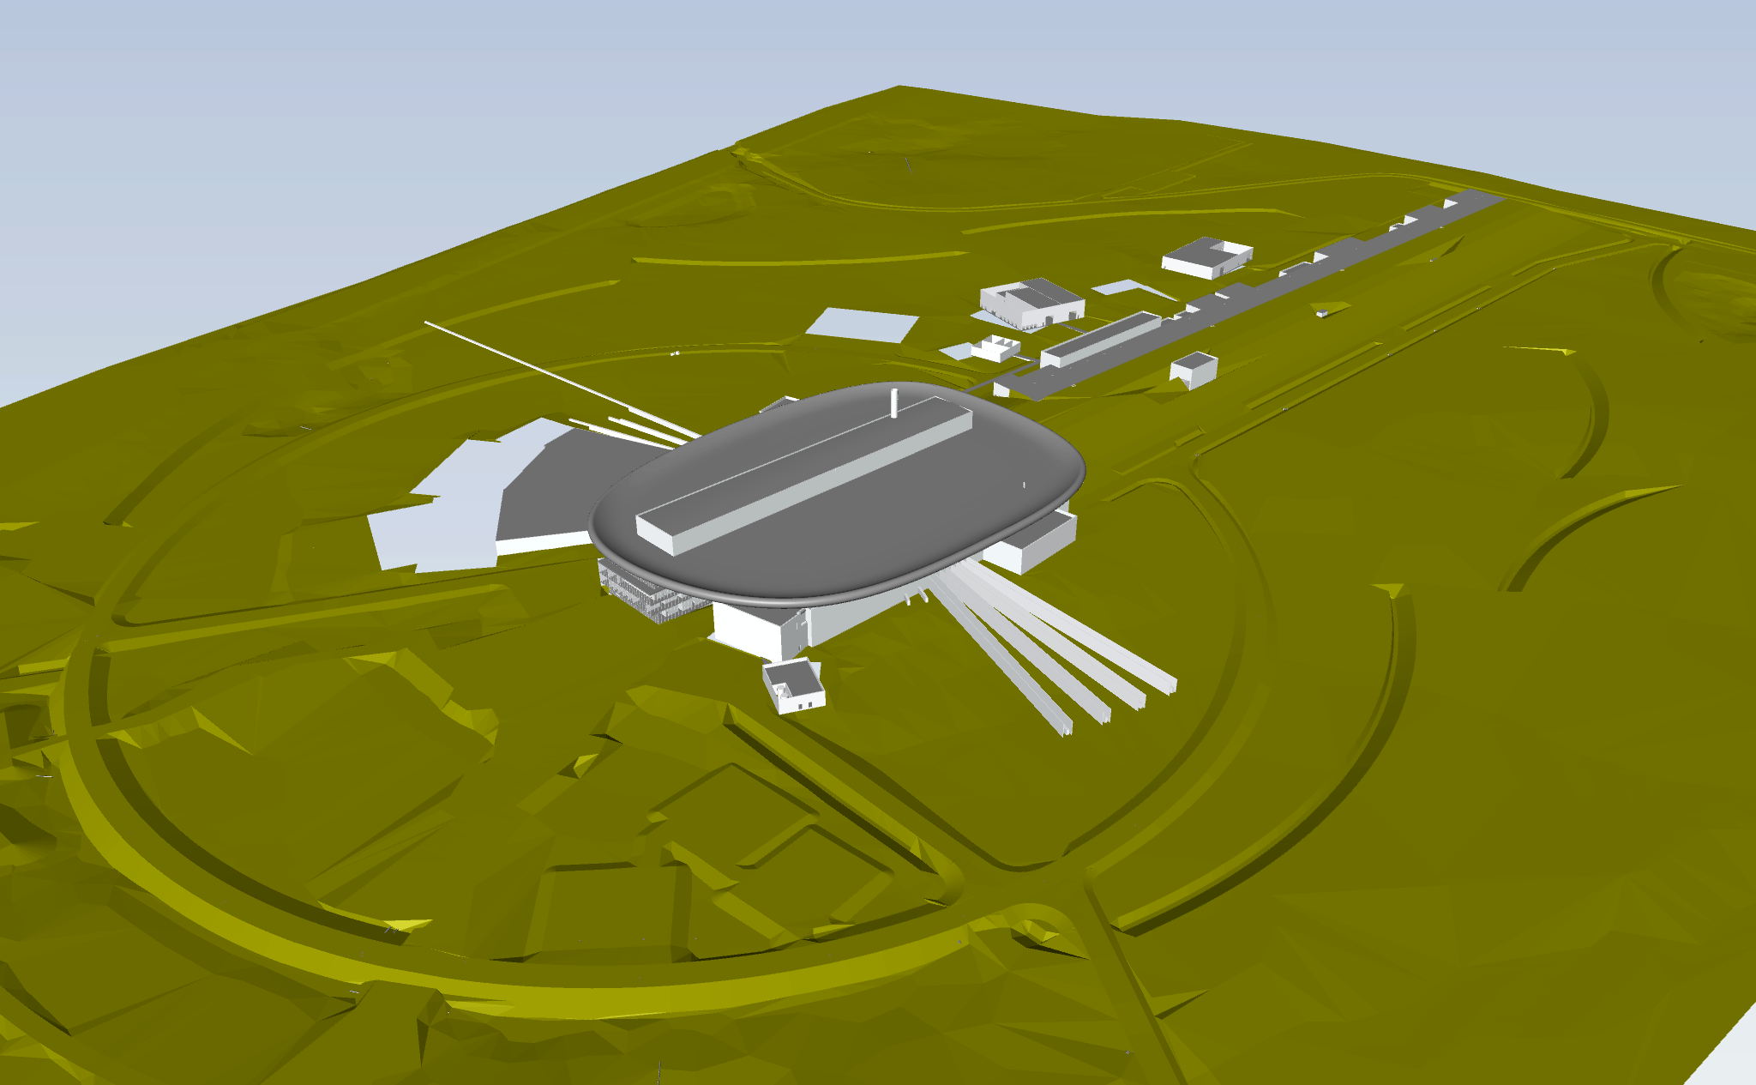
Master Plan

Slide 17
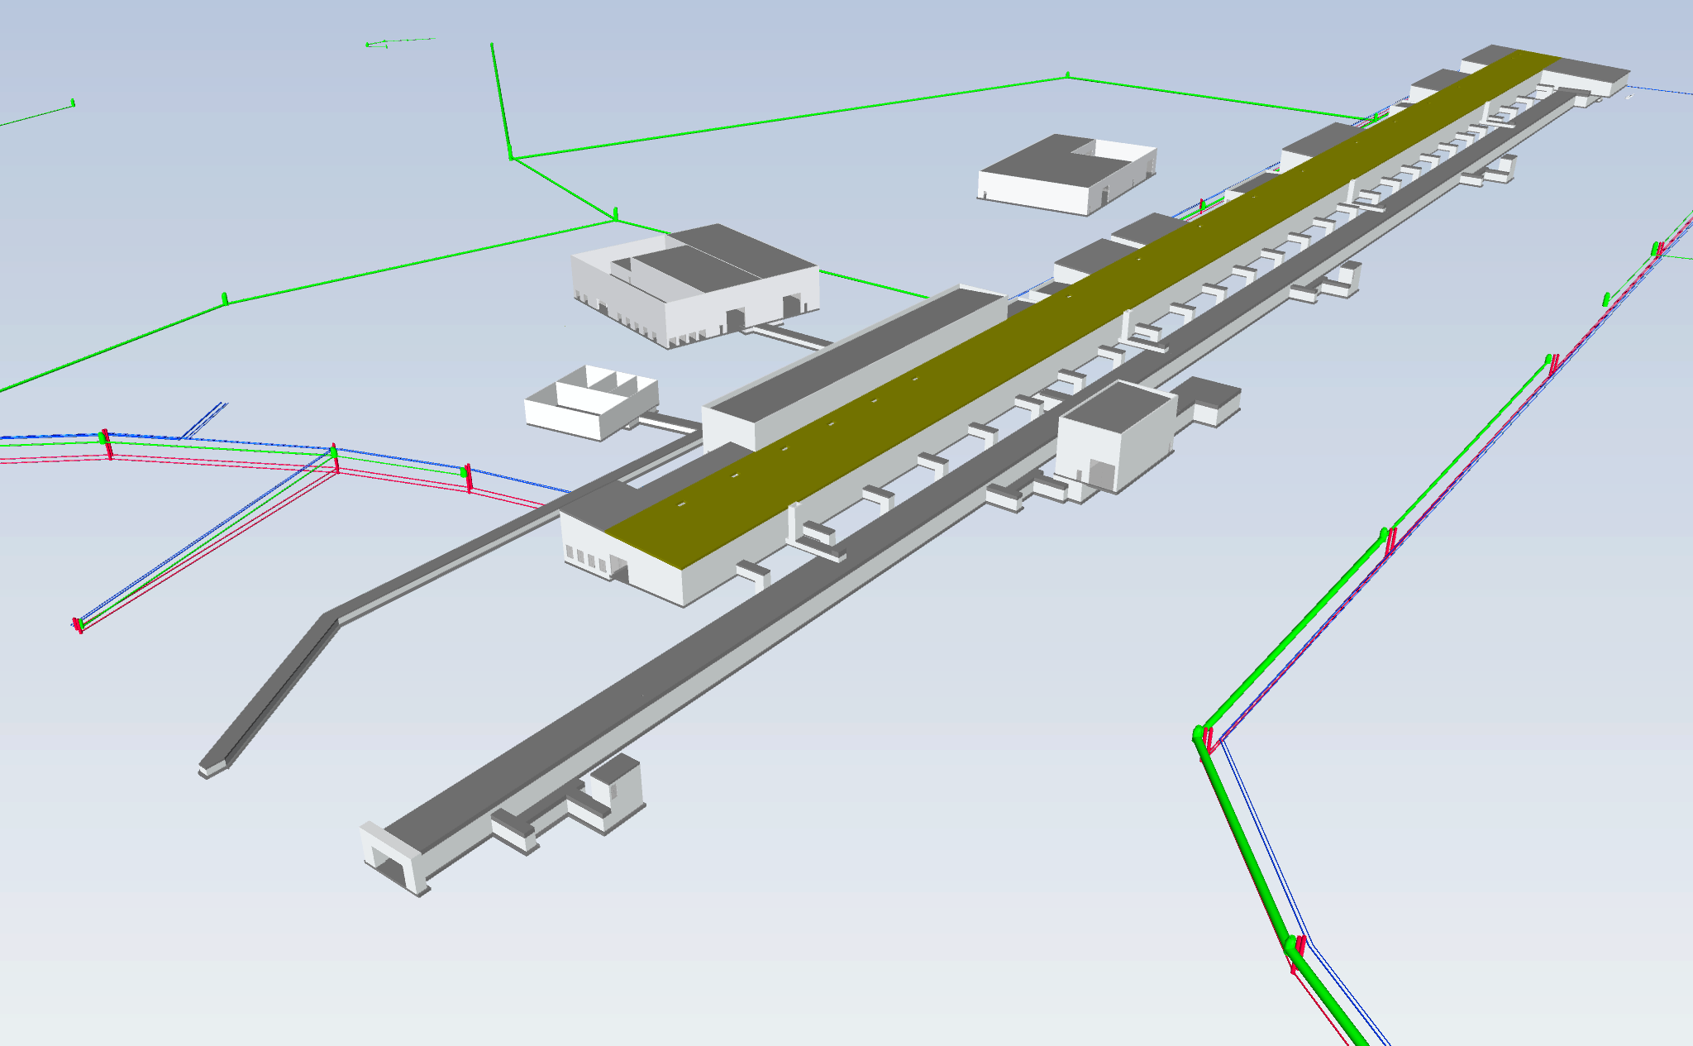
Accelerator Buildings without berm

Slide 18
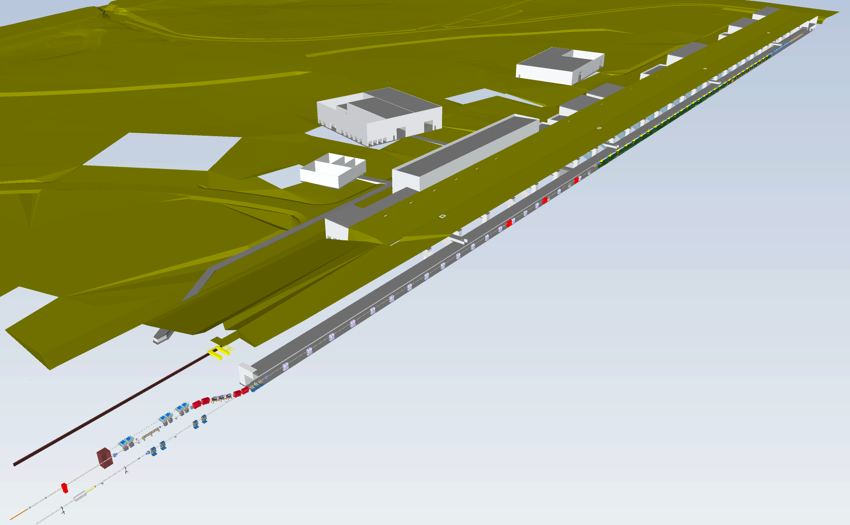
Section through Tunnel

Slide 19
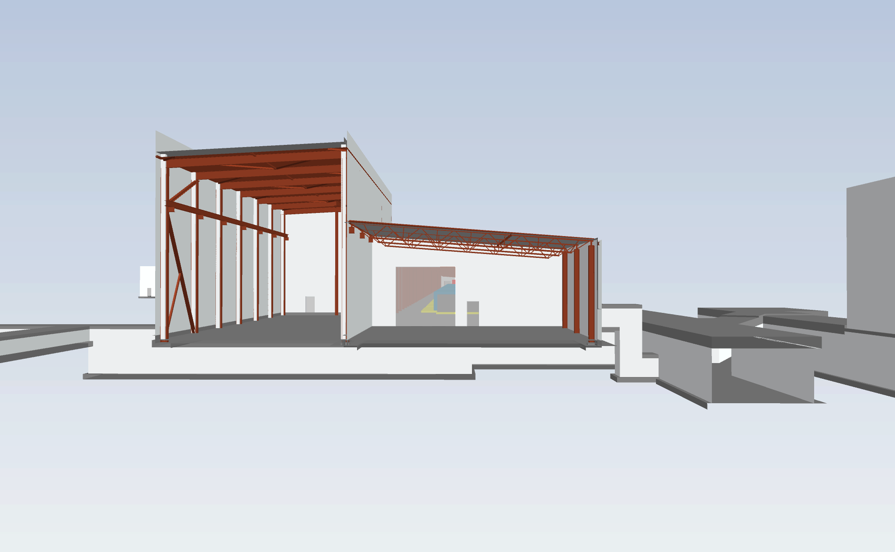
Coldbox Hall and Test Facilities

Slide 20
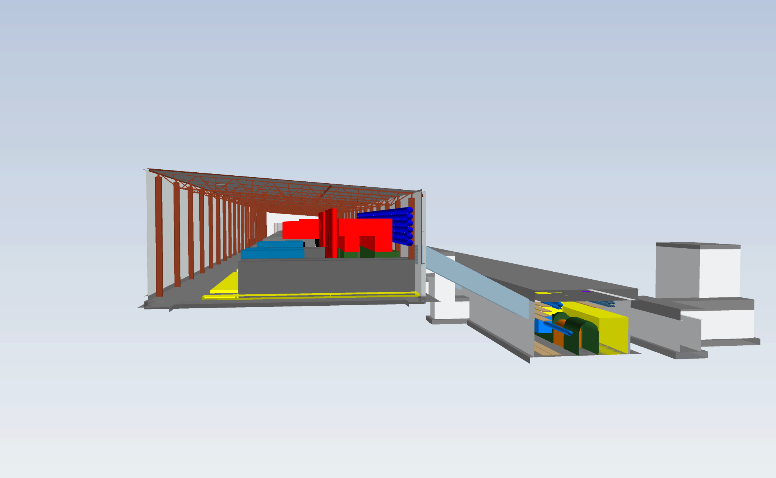
Gallery and Tunnel
Colored volumes represent the machine

Slide 21
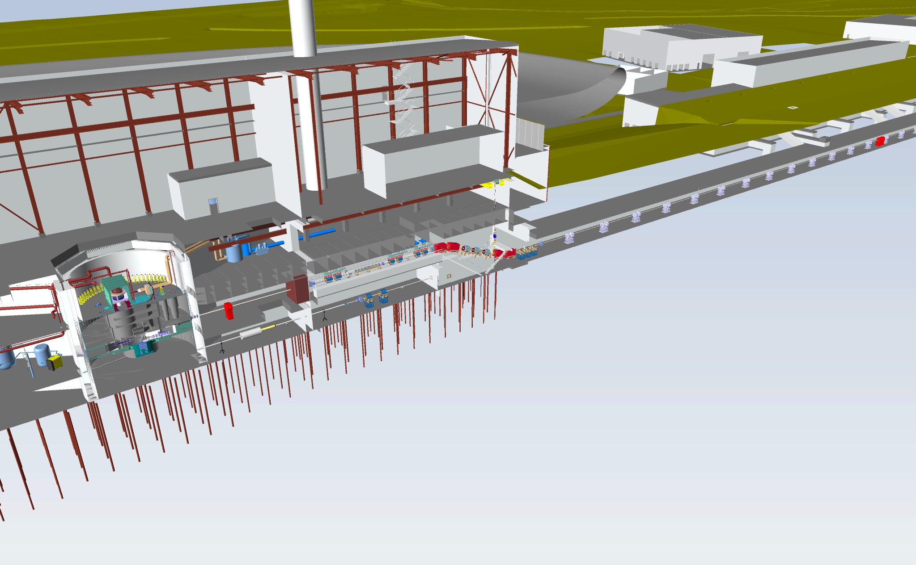
Section through A2T

Slide 22
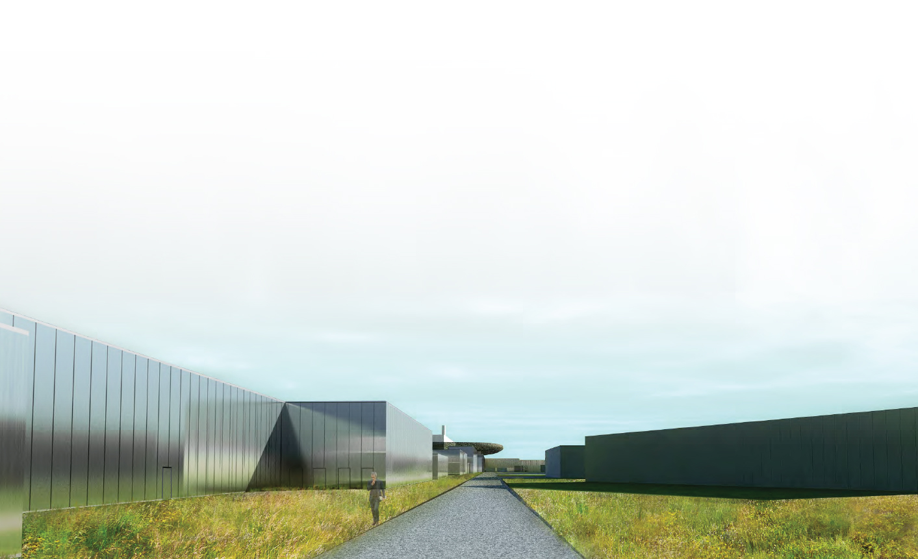
Façade Concept: Gallery

Slide 23
