Slide 1
Some Ideas about Integration Support Cases and PLC Activities at Controls Division
Daniel Piso Fernández

Slide 2
Integration and PLC Activities
Integration Support
  Conventional Facilities
  Vacuum Integration Test Facility
  Ion Source & LEBT
PLC Test Stand

Slide 3
Conventional Facilities
Relevant milestones
  Specification of controls for conventional facilities (end of Q4-2014)
  First access to accelerator building. Test Stand building (Q3-2016)
  Full access to accelerator building (end of Q1-2018)
  Target building ( Q2-2018)

Slide 4
Conventional Facilities (ii)
Specification of controls for conventional facilities (end of Q4-2014)

Slide 5
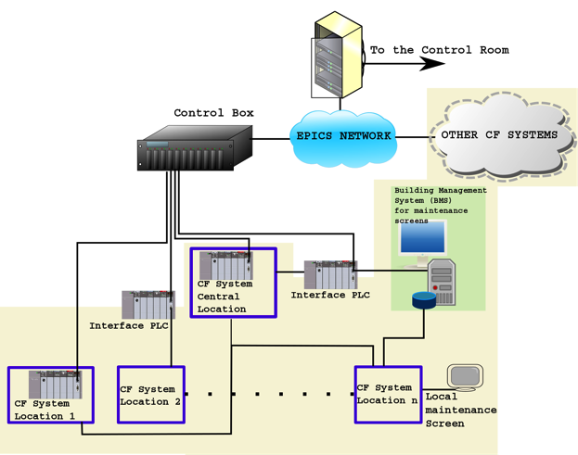
Conventional Facilities (iii)
CF/ICS INTERFACE
Preferred
interface

Slide 6
Conventional Facilities (iv)
Integration sessions
Top-Down Approach
Information to capture for each system
  Milestones of the design along 2014 (ICS/BMS)
  Is the system PLC based or not?
  Physical location of the CF system (ICS/BMS)
  Where do we need to operate/interact with the system (ICS/BMS)?
  What information/signals do we need to operate the CF system (ICS)? And for maintaining it (BMS)?
  What information should be monitored for the CF system (ICS)?
  What information should rise an alarm (ICS/BMS)?
  What information/signals are important for ESS machine operation?(ICS)

Slide 7
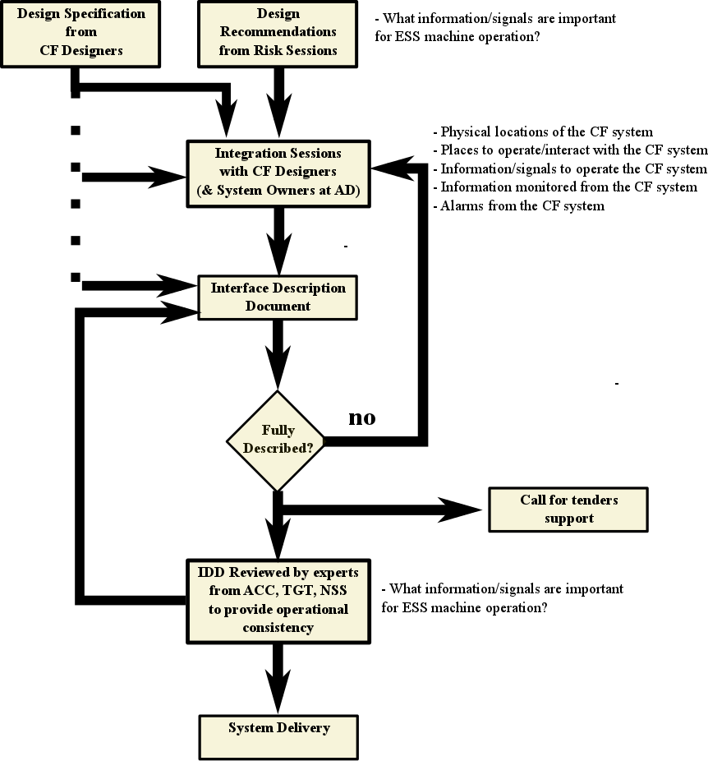
Conventional Facilities (v)
Integration sessions

Slide 8
Conventional Facilities (vi)
Integration sessions
SYSTEM NAME
SYSTEM SCOPE
PLC BASED?
ICS INTERACTS WITH THE SYSTEM?
BMS INTERACTS WITH THE SYSTEM?
  Milestones of the design along 2014 (ICS/BMS)
  Is the system PLC based or not?
  What information/signals do we need to operate the CF system (ICS)? And for maintenance(BMS)?

Slide 9
Conventional Facilities (vii)
Integration sessions
  Physical location of the CF system (ICS/BMS)
  Where do we need to operate/interact with the system (ICS/BMS)?
 | FRONT ENT BUILDING | TUNNEL | KLYSTRON GALLEY | TEST STAND BUILDING | TARGET BUILDING | INSTRUMENT HALL | CUB | EXTERNAL SUPPLY BUILDING
LOCATION 1
LOCATION 2
LOCATION 3
INTERFACE DEVICES AT LOCATION 1
INTERFACE DEVICE AT LOCATION 2

Slide 10
Conventional Facilities (viii)
Integration sessions
  What information/signals do we need to operate the CF system (ICS)? And for maintaining it (BMS)?
 | FRONT ENT BUILDING | TUNNEL | KLYSTRON GALLEY | TEST STAND BUILDING | TARGET BUILDING | INSTRUMENT HALL | CUB | EXTERNAL SUPPLY BUILDING
MAINTAINANCE SCREEN AT LOCATION 1
MAINTAINANCE SCREEN LOCATION 2
INFORMATION TO OPERATE THE SYSTEM AT LOCATION 1 (ICS)
INFORMATION TO OPERATE THE SYSTEM AT LOCATION 2 (ICS)
INFORMATION FOR MAINTAINANCE AT LOCATION 1 (BMS)
INFORMATION FOR MAINTAINANCE AT LOCATION 2 (BMS)

Slide 11
Conventional Facilities (ix)
Integration sessions
  What information/signals do we need to operate the CF system (ICS)? And for maintaining it (BMS)?
  What information should be monitored for the CF system (ICS)?
  What information should rise an alarm (ICS/BMS)?
  What information/signals are important for ESS machine operation?(ICS)
 | FRONT ENT BUILDING | TUNNEL | KLYSTRON GALLEY | TEST STAND BUILDING | TARGET BUILDING | INSTRUMENT HALL | CUB | EXTERNAL SUPPLY BUILDING
INFORMATION FOR MONITORING THE SYSTEM AT LOCATION 1 (ICS)
INFORMATION TO OPERATE THE SYSTEM AT LOCATION 2 (ICS)
INFORMATION FOR MONITORING AT LOCATION 1 (BMS)
INFORMATION FOR MONITORING AT LOCATION 2 (BMS)
INFORMATION FOR ALARMS THE SYSTEM AT LOCATION 1 (ICS)
INFORMATION FOR ALARMS THE SYSTEM AT LOCATION 2 (ICS)

Slide 12
Conventional Facilities (x)
Integration sessions
Final list of interface devices
Device ID | Location | ICS | BMS

Slide 13
Conventional Facilities (xi)
Integration sessions
Final list of signals
ESS Signal Name | CF Name | Device ID | ICS (R/W) | BMS (R/W) | Signal Type | Range | Sampling Rate | Process View | Operation in View | Comments

Slide 14
Conventional Facilities (xii)
Integration sessions
Information used for:
  Requirements for hardware, screens, etc.
  Interface design document

Slide 15
Vacuum Integration Test Facility
Relevant milestones
  Vacuum Test Stand Control System design (Q3-2014)
  Vacuum Test Stand ready for operation (Q4-2014)

Slide 16
Vacuum Integration Test Facility(ii)

Slide 17
Ion Source & LEBT
Relevant milestones Ion Source
  Ion Source Assembly (starts Q4-2014)
  Test Ion Source (starts Q2-2015)
Relevant milestones LEBT
  LEBT Technical Design Phase (starts Q1-2014)
  LEBT Procurement (starts Q4-2014)
  LEBT assembly (starts Q4-2015)
  Test Ion Source & LEBT (starts Q2-2016)

Slide 18
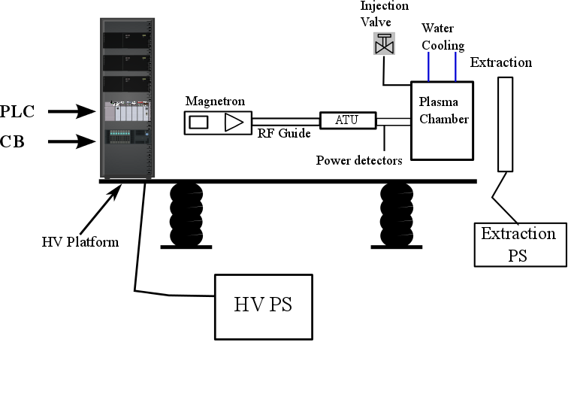
Ion Source
Collecting information for:
  Identifying control requirements
  Writing a design document
  Trying to share acquisition
Same process ongoing
for the LEBT

Slide 19
Ion Source & LEBT (ii)
*Already capturing requirements and starting a Design Document

Slide 20
PLC Test Stand
PLC test stand first version ready (Q2-2014)

Slide 21
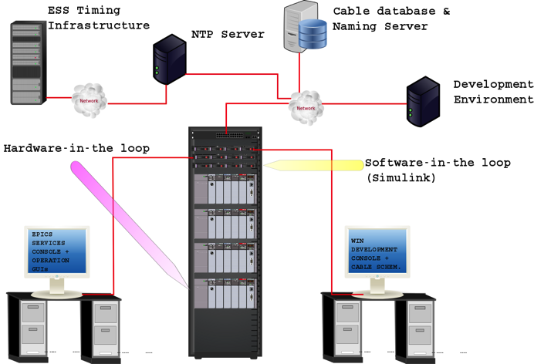
PLC Test Stand (ii)

Slide 22
PLC Test Stand (iii)
Hardware Specifications | COMMENT
Siemens PLC Hardware | Done
Rack, Power supply, Ethernet switches, other | Done
IOC | Done
Development PC | Done
Learning Protocols PLC <-> IOC
Modbus TCP/IP | EPICS-PLC-profibus-modbus-s7plc-report.doc (Section 3)
ProfiBus – documentation of the current state | EPICS-PLC-profibus-modbus-s7plc-report.doc (Section 2)
ProfiNet -documentation of the current state | PLC-protocols-Profinet.docx
ITER Siemens driver | Instructions for a simple IOC example: EPICS-Tools-modbus-s7plc-SDDs7plc-casestudy.doc
Device support for Modbus | Instructions how to configure Modbus EPICS driver: EPICS-Tools-modbus-s7plc-SDDs7plc-casestudy.doc (Section 3)
Device support for Siemens direct driver | Instructions how to configure EPICS driver: EPICS-Tools-modbus-s7plc-SDDs7plc-casestudy.doc (Section 4)
Control System Simulation
PLC and Simulink | Matlab-PLC-connection.doc
Beckhoff | Decided to test Beckhoff solution: . Matlab-PLC-connection.doc

Slide 23
PLC Test Stand (iii)
General Tasks
Hardware selection and procurement
Non-PLC hardware procurement
Timing and Event Correlation
Connect NTP Server with ESS Timing infrastructure to synchronize PLCs
Desing an experiment (using triggers) to test how well we can correlate information from different events
Distribution of triggers to PLCs and data on demand
Cryogenics Controls
Setup a cryogenics controls technical group
Testing functionality of ITER Framework
Testing functionality of UNICOS
Testing cryogenics libraries from CERN
EPICS support for Profibus DP
Have a clear picture on collaborations between institutions on this field
Having a decision about which framework to use by the end of this year
Vacuum Test Stand
Identify requirements
Coding
EPICS integration+GUI+Alarms+Archiving
New technologies & Simulation
Explore solutions to use Simulink for system simulation
Simba Box
Siemens FPGA module
EPICS Integration
Control Configuration Database
Device Configuration Database
Cabling database and Naming
Conventional Facilities
BACnet
MPS & PSS
Motion Control
Draft of activities for 2014

Slide 24
Thank you!

