Slide 1
What is all the fuss about IOTs?
Morten Jensen
AD and ICS Retreat Meeting 2013

Slide 2
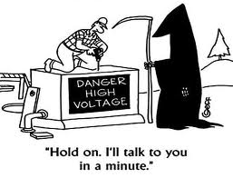
Why do we need all these amplifiers?
2 GV, 125 MW DC supply wanted!
ESS needs power at high frequency (352 and 704 MHz).
Mains power is at 50 Hz!
Convert mains AC to DC and then DC to high frequency AC
Klystrons are typically used for high power accelerators.
They exist at the power levels needed for ESS.
They are really pretty good, reliable and quite efficient.
IOTs at ESS parameters don’t exist.
They may be more complicated.
They need to be developed and carry risk.
Why all the fuss?

Slide 3
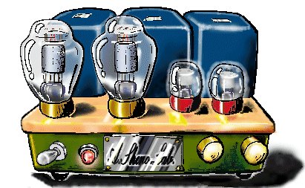
The Inductive Output Tube
Invented in 1938 by Andrew V. Haeff as a source for radar
To overcome limitation of output power by grid interception
Pass beam trough a resonant cavity
Achieved: 100 W at 450 MHz, 35% efficiency
Used first in 1939 to transmit television images from the Empire State Building to the New York World Fair
IOTs then lay dormant
Intense competition with velocity modulated tubes (klystron had just been invented by the Varian Brothers.
Difficult to manufacture
The IOT is often described as a cross between a klystron and a triode hence Eimac’s trade name ‘Klystrode’

Slide 4
How does it work?
Deceleration = RF Output
Source
Control
Beam
Acceleration
IOT
(Density modulated)
Magnetic field
Reduced velocity spread compared to klystrons
Higher efficiency
No pulsed high voltage
Cheaper modulator
RF input
Biased
Control Grid
RF output

Slide 5
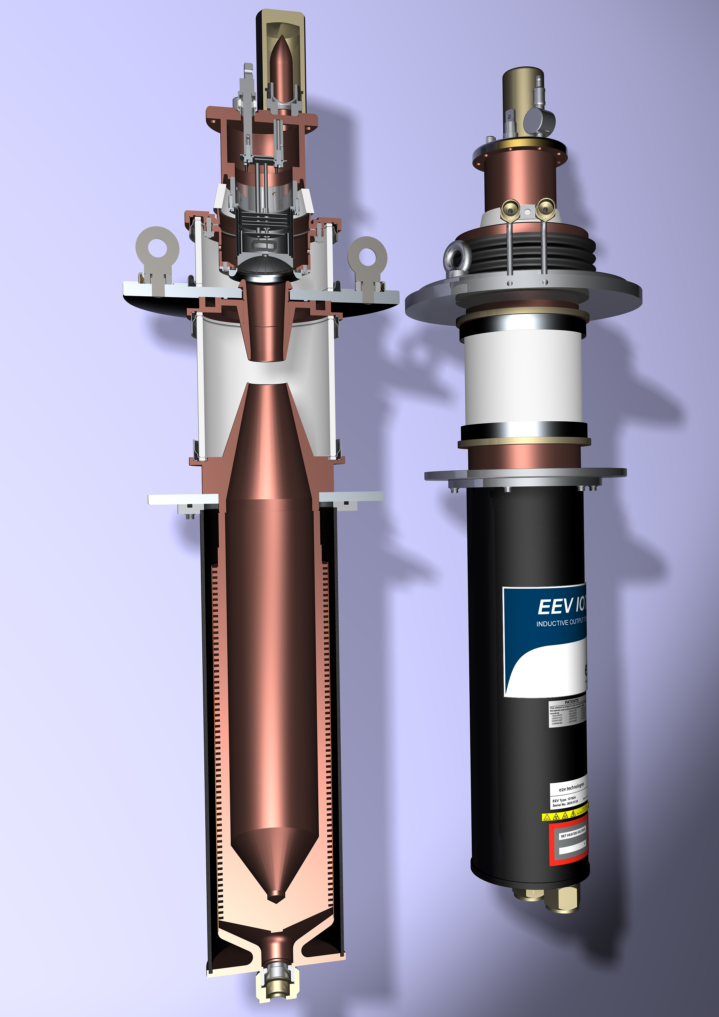
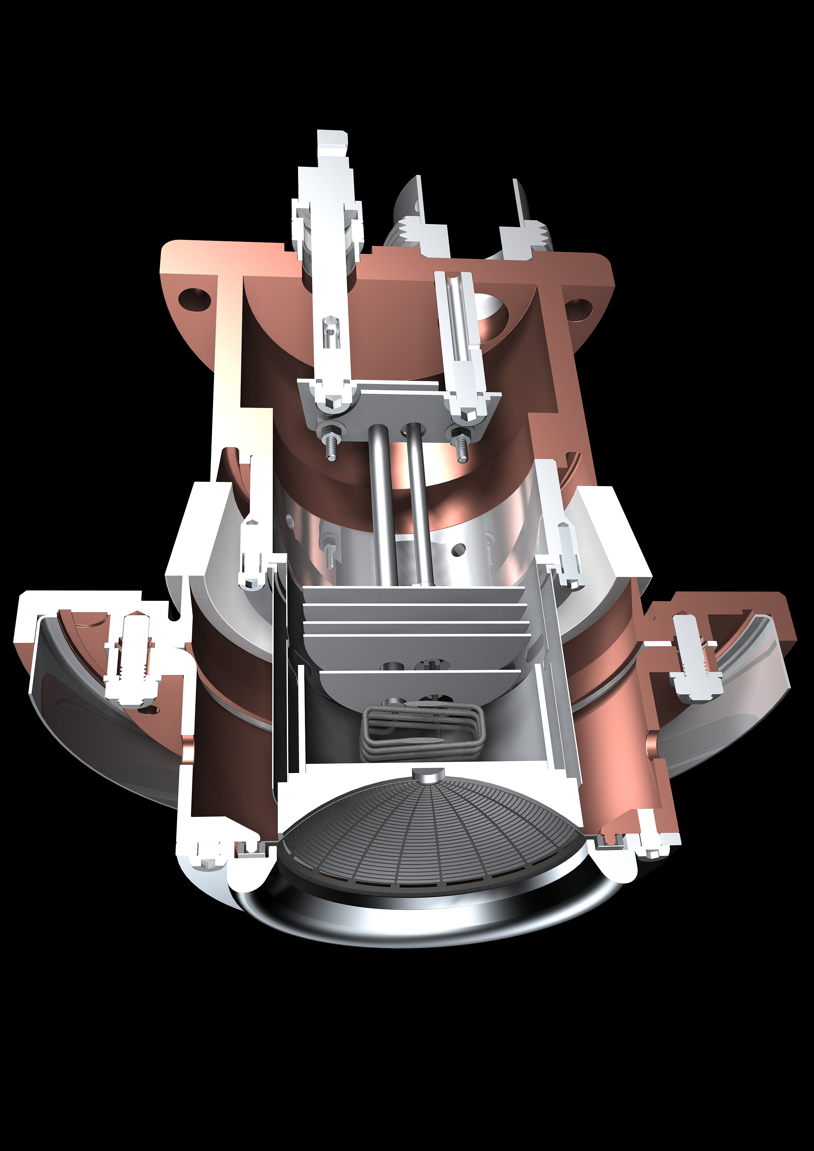
Typical Broadcast IOT
Courtesy of e2v

Slide 6
The Performance Comparison
If you understand klystrons this may help – if not it probably won’t.
IOT’s don’t saturate.
Built-in headroom for feedback.
IOT
MB-IOT
Klystron/MBK
Back-off for feedback
Short-pulse
excursions possible
η_{sat} ~ 65-68%
Operating
Power Level
Long-pulse
excursions possible
P_{out}
ESS ~ 45%
~ 70%
High gain
Courtesy of CPI
Low Gain
P_{in}

Slide 7
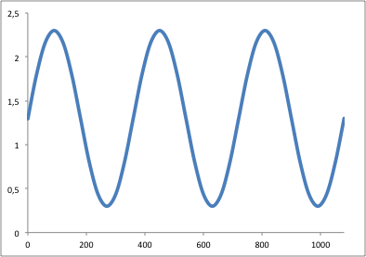
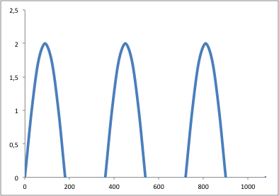
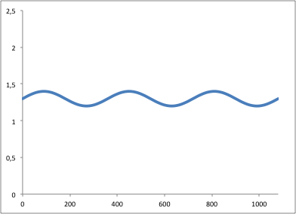
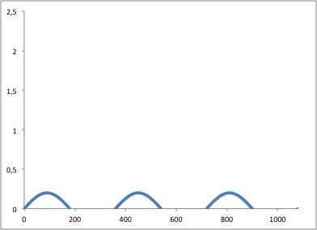
Klystrons
IOTs
Power delivered to beam
Cartoon!
Power delivered to beam
High Beam Current
Electrical Power Consumed
Low
Beam Current

Slide 8
IOT Advantages
Small
High Efficiency
Cost typically does not scale with output power
Low power consumption in standby or
for reduced output power
No pulsed HV

Slide 9
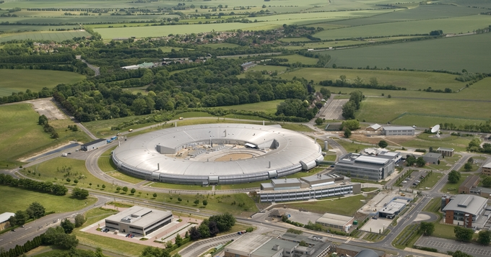
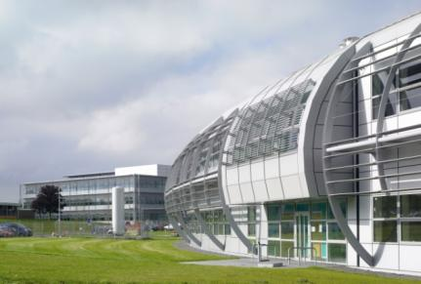
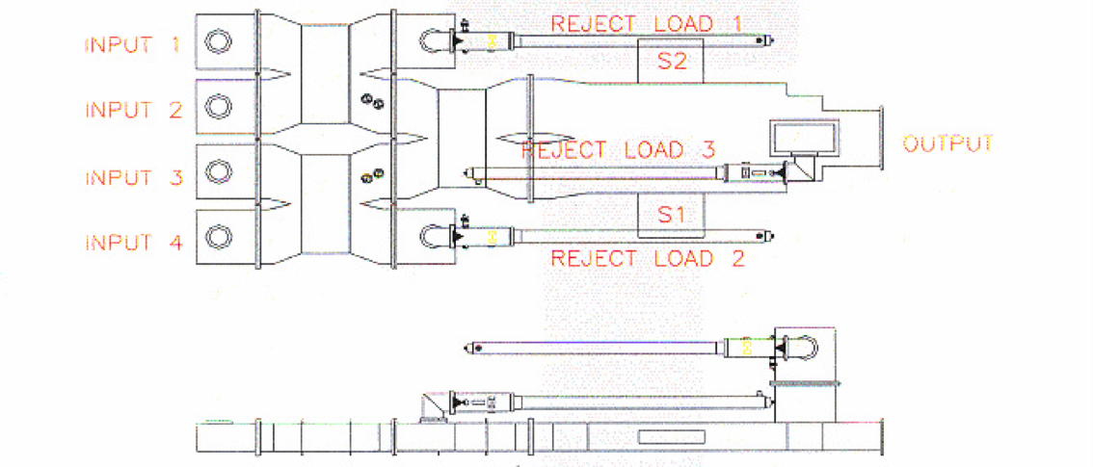
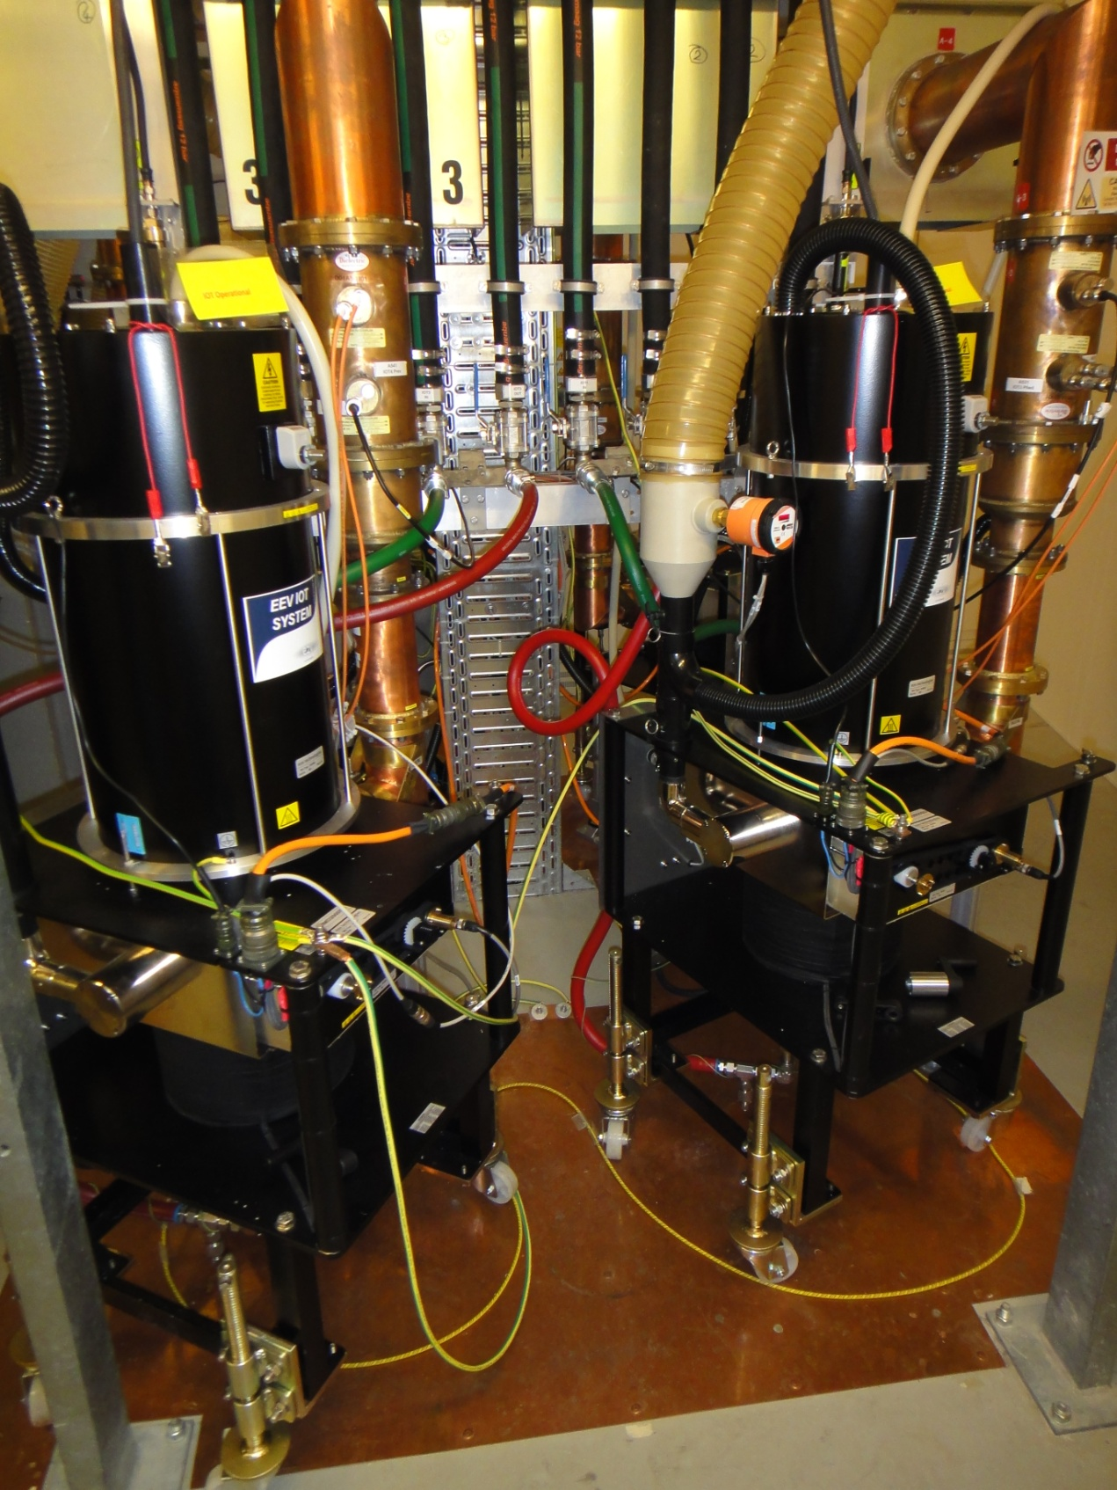
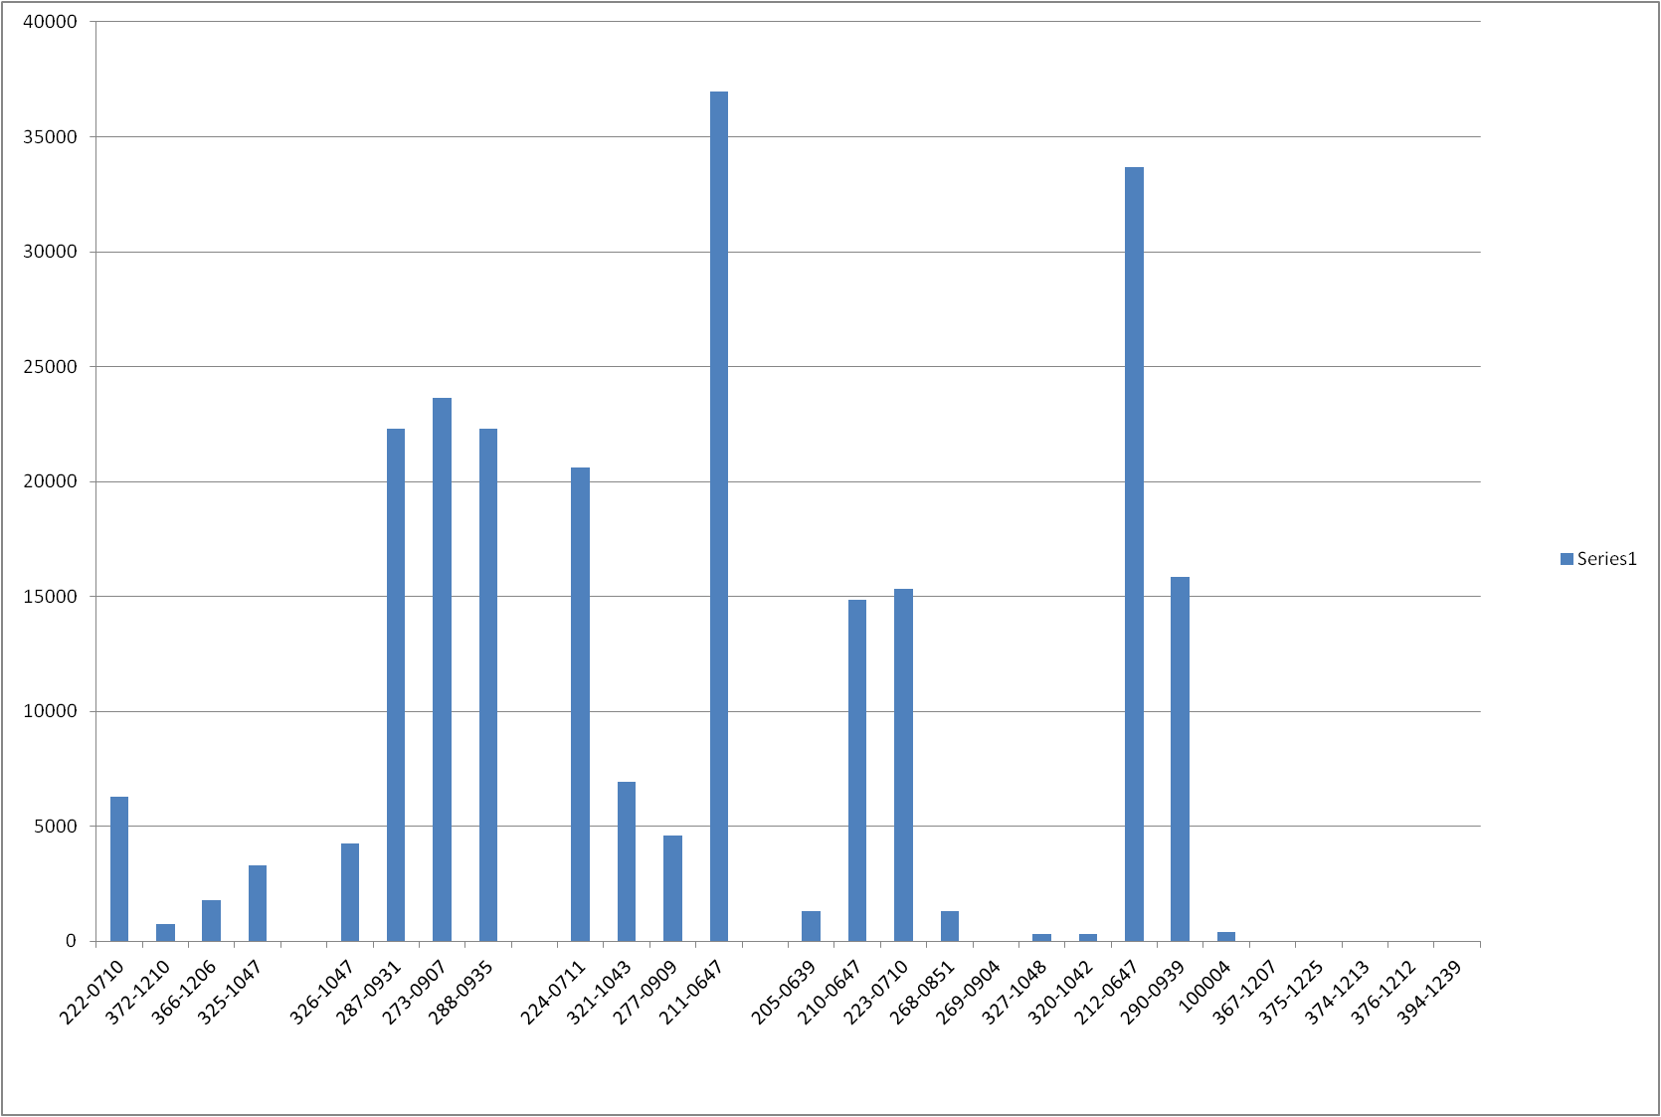
3rd Generation Light Source
Storage Ring
Three 500 MHz 300 kW amplifier for SR
- 4 x 80 kW IOT combined
One 80 kW for the Booster
Operational Hours at Diamond
30000
20000
Filament Hours
10000
Test system
Serial Number
In Operation
Peter Martin, Diamond

Slide 10
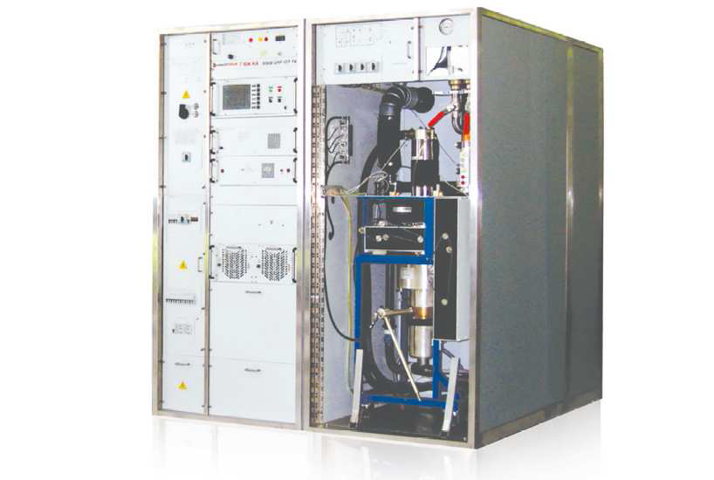
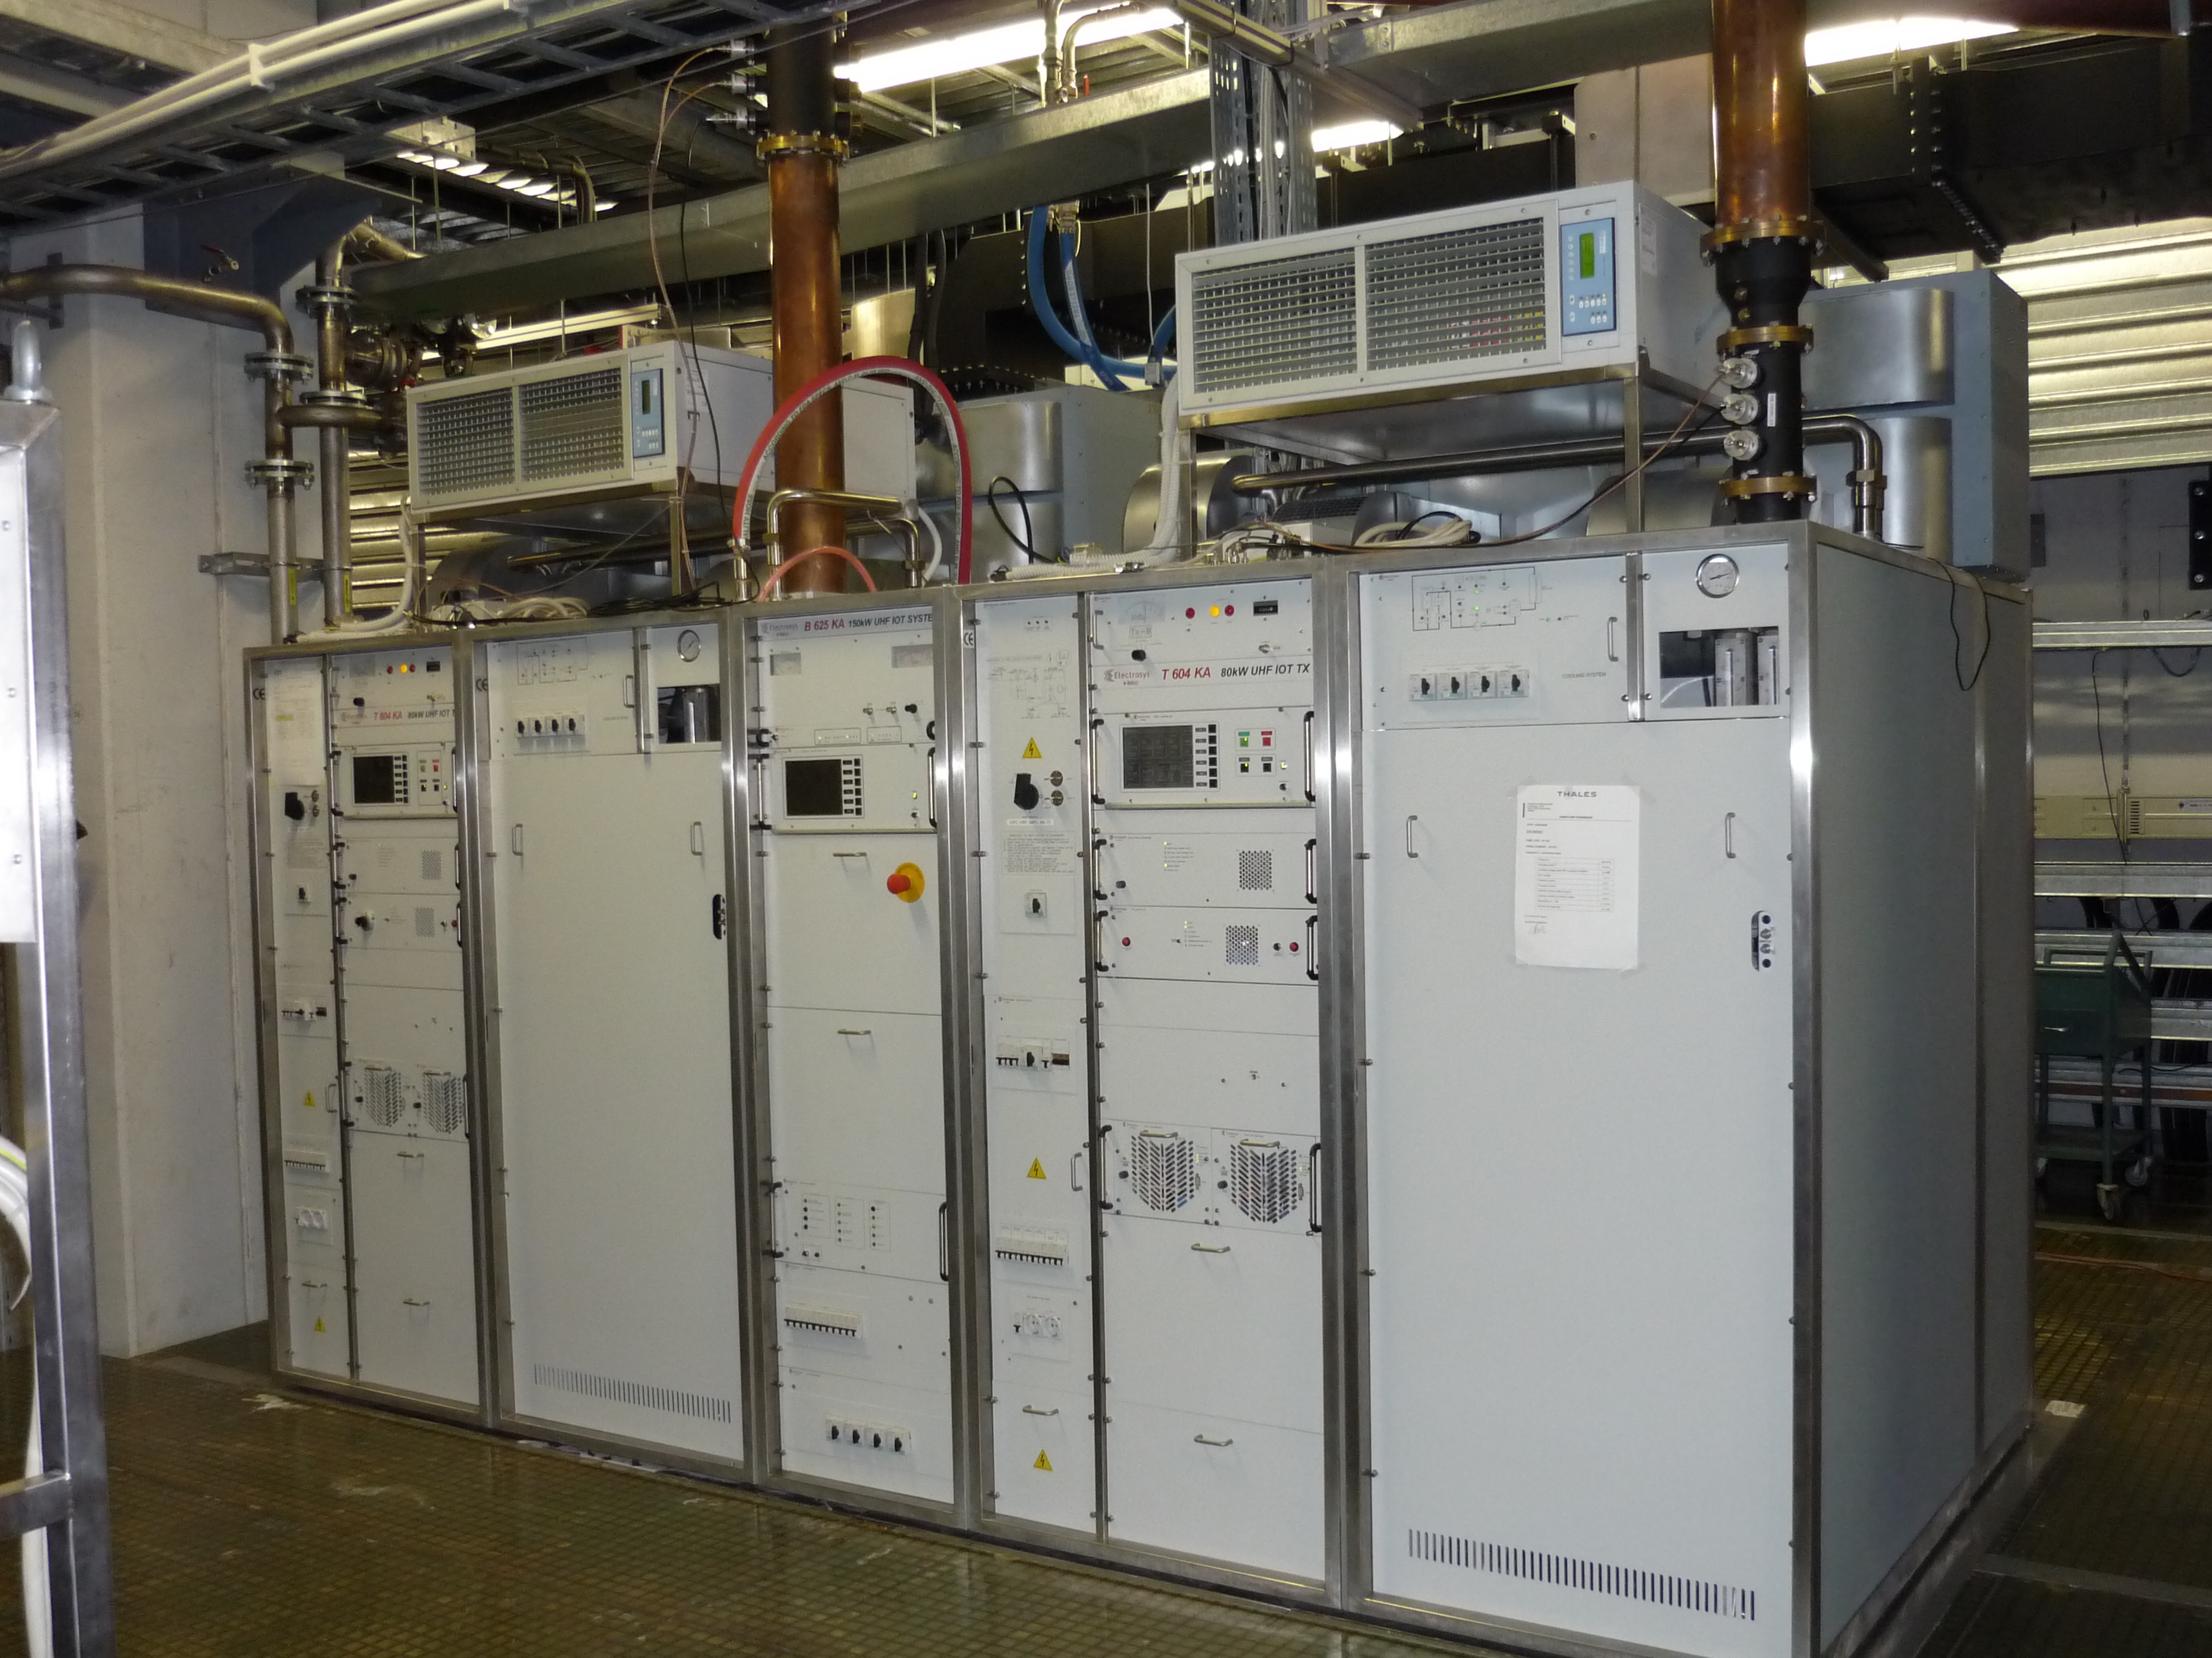
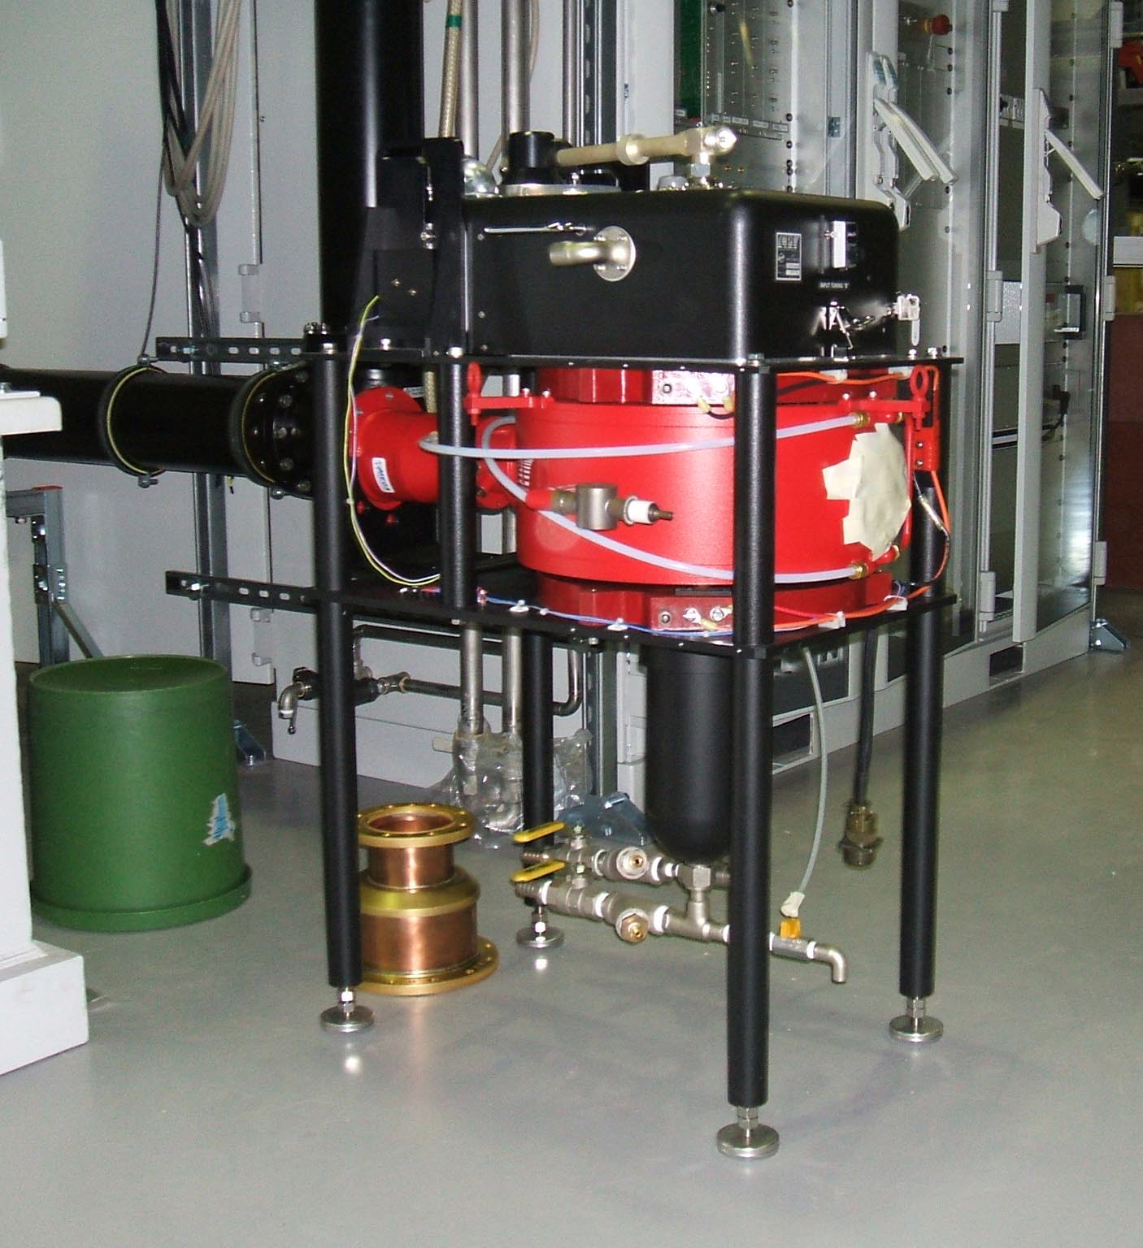
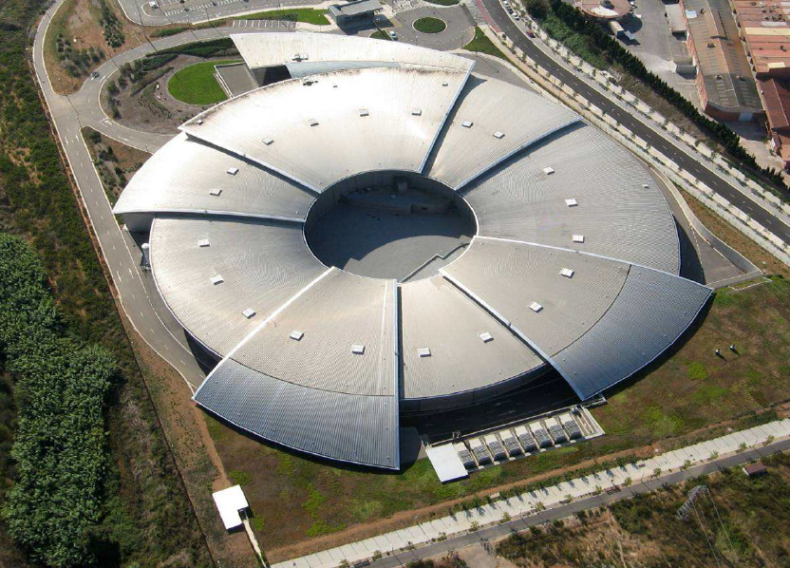
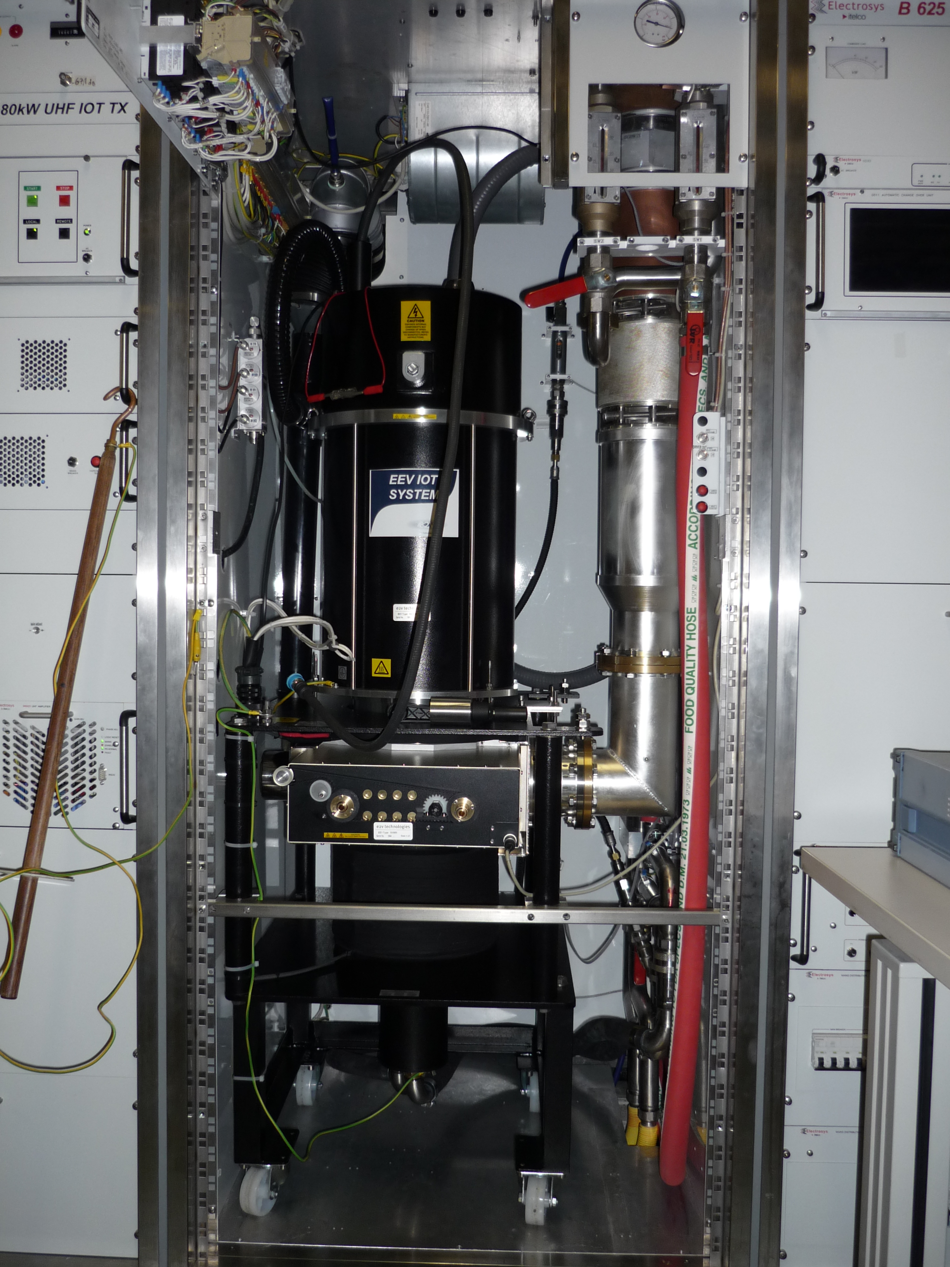
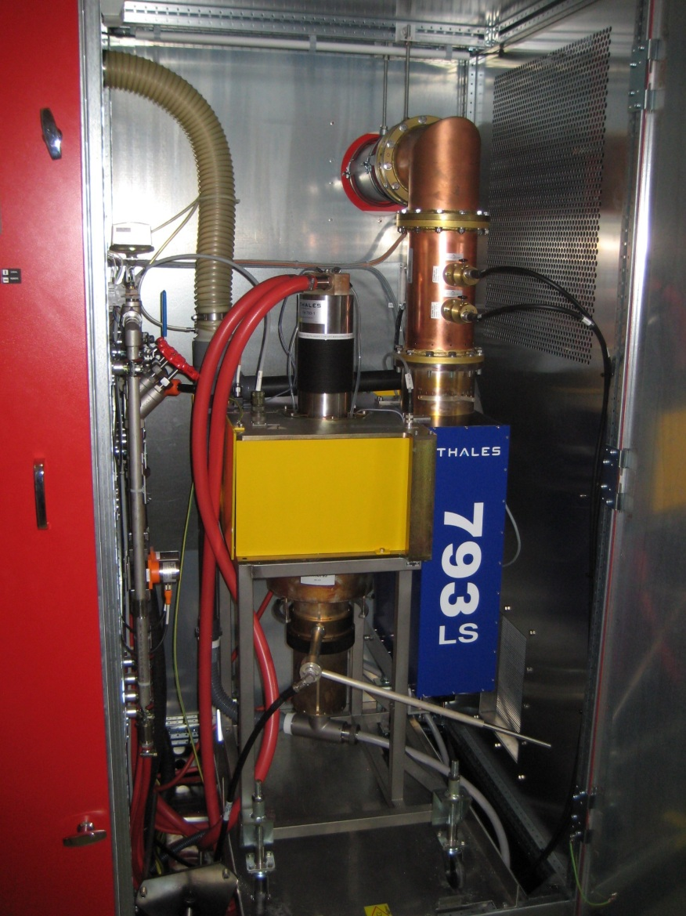
Other Facilities using IOTs
CERN
800 MHz
60 kW
Metrology Light Source
(Willy Wien Laboratory)
CPI 90 kW IOT (K5H90W1)
> 33 000 operating hours
Elettra
500 MHz
150 kW IOT based amplifier for Combination of 2x80 kW
12 IOTs

Slide 11
For high power accelerators:
Power requirement for 500 kW – 1.5 MW
Narrow band (single output cavity)
Single beam – Large cathode
High voltage
High cathode loading
Oil in the modulator and gun
Multi beam - Several smaller cathodes
Higher total perveance
-> Lower voltage
Lower cathode loading
Scalable for higher power levels
(100-140 kW per cathode)

Slide 12
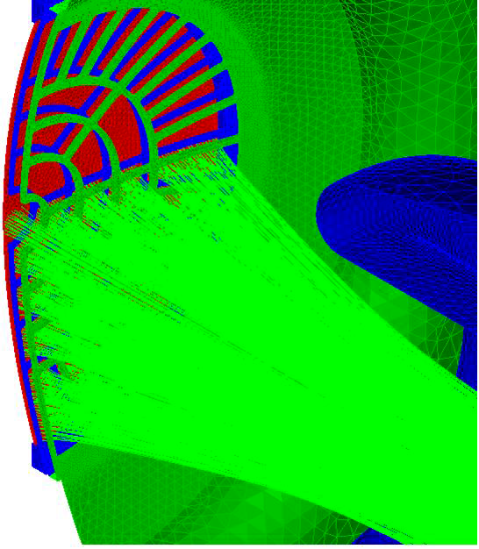
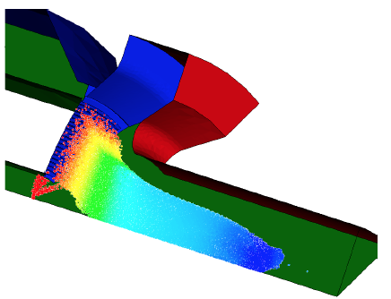
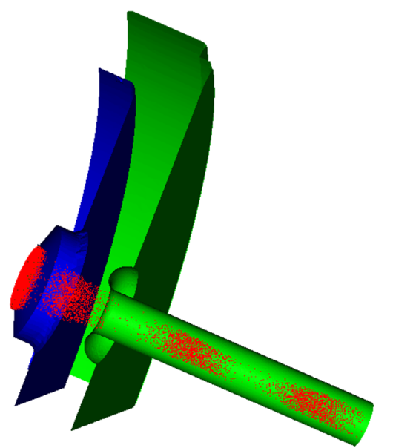
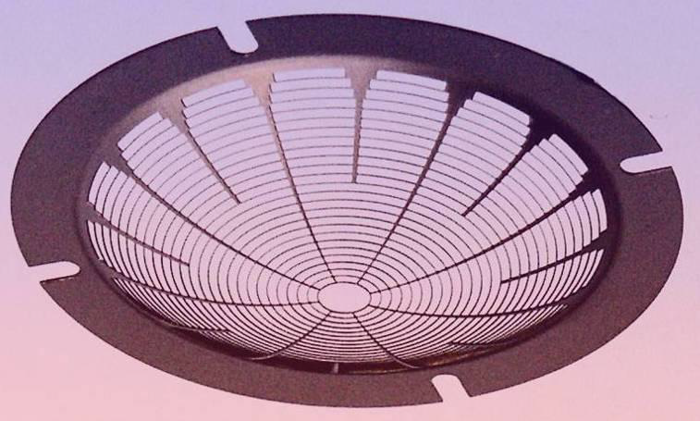
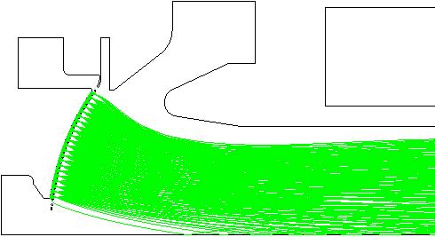
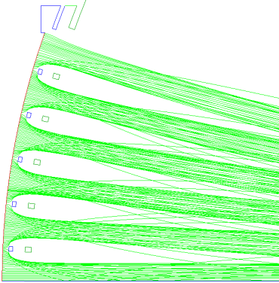
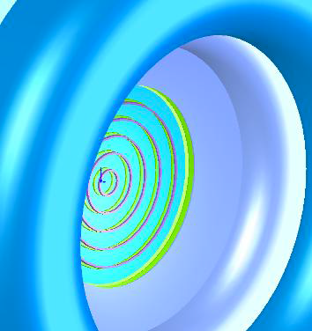
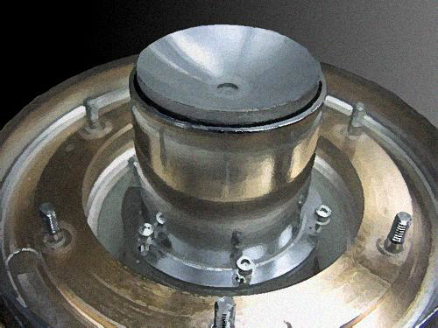
Design and Simulation
Analytical and Numerical codes available
Commercial codes well developed in addition to manufacturers own
Increased computing power allows improved simulation of grid structures, trajectory and PIC modeling
Gun simulation
TED
CPI
IVEC 2009
CPI

Slide 13
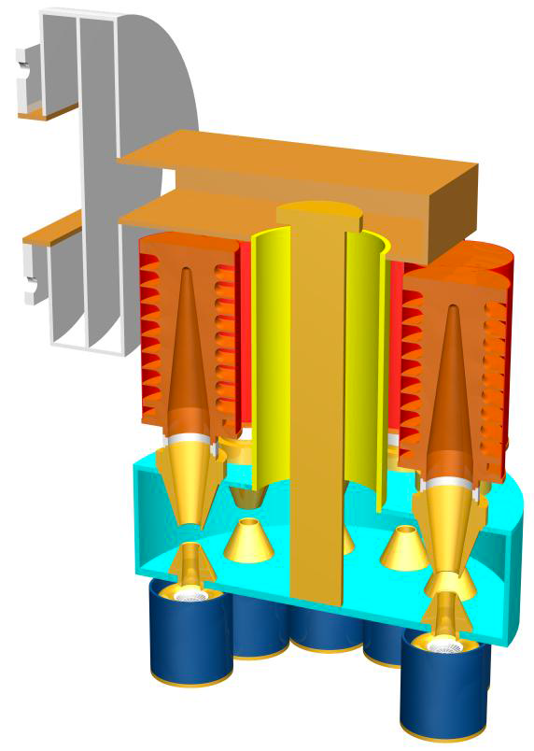
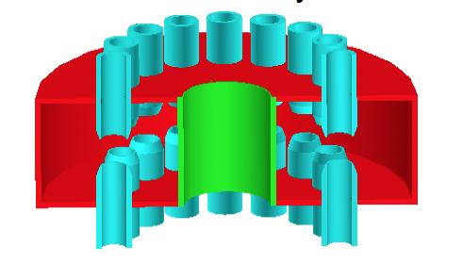
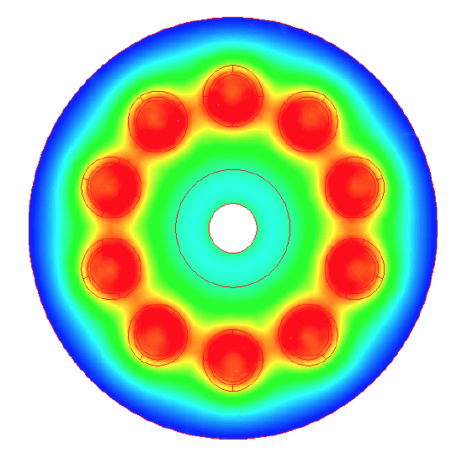
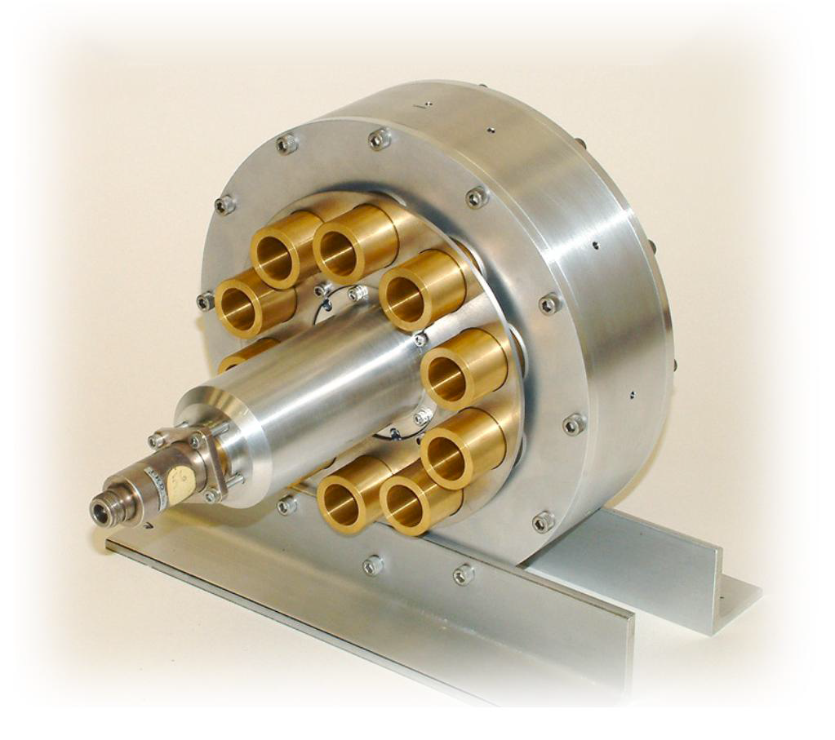
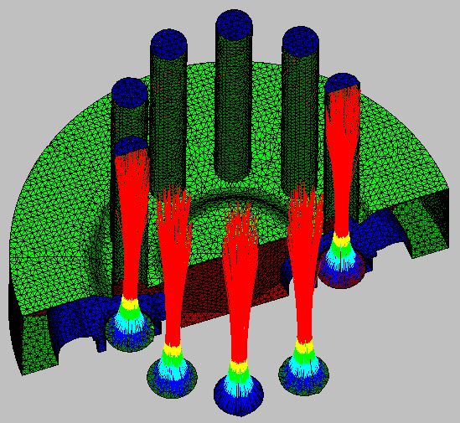
Output cavity considerations
Higher order mode pillbox cavity or toroidal
Individual beam pipes
Coaxial output coupling
Simulations include:
Field (static and RF)
Trajectory
Particle

Slide 14
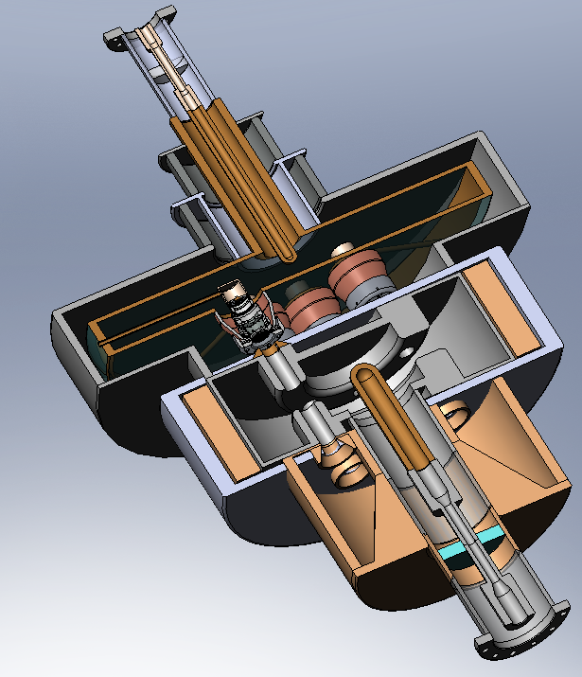
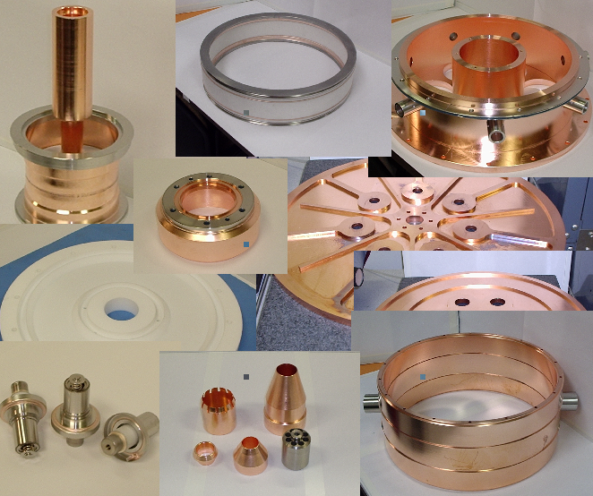
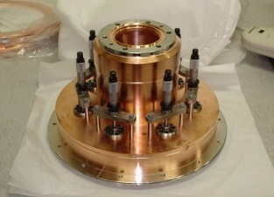
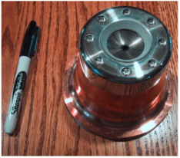
Some components being prepared (not for ESS)
Calabazas Creek Research, Inc. – 352MHz, 200 kW CW

Slide 15
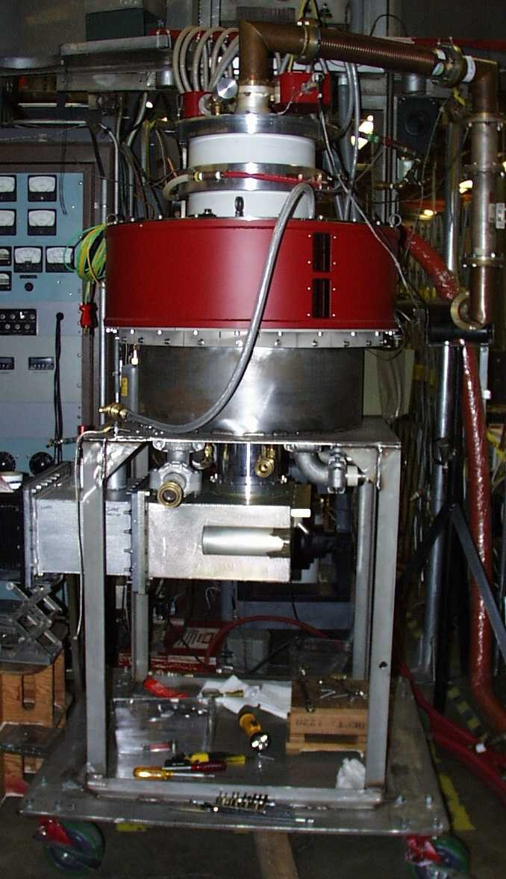
700 MHz HOM IOT Experience
CPI
VHP-8330A IOT
RF Input
Design Parameters value units
Power Output 1000 kW (min)
Beam Voltage 45 kV (max)
Beam Current 31 A (max)
Frequency 700 MHz
1dB Bandwidth ± 0.7 MHz (min)
Gain 23 dB (min)
Efficiency 71 % (min)
Diameter 30/76 in/cm
Height 51/130 in/cm
Weight 1000/450 lbs./kg
Collector Coolant Flow 220 gpm
Body Coolant Flow 10 gpm
O/P Window Cooling (Air) 35 cfm
Gun
Solenoid,
O/P Cavity
@ 31kV
RF Output
Collector
Test Results (pulsed)

Slide 16
Recent IOT publications by Laboratories
(not a comprehensive review)
Many Labs are still thinking about IOTs but we need Industry
Applications of High Power Induction Output Tubes in High Intensity Superconducting Proton Linacs
Testing of Inductive Output Tube based RF amplifier for 650 MHz SRF Cavities, A. Mandal et al, PCaPAC2012
90 kW CW IOT development at L3 Communications Electron Devices, M Boyle et al, CWRF Workshop, 2012
Development of a 402.5 MHz 140 kW IOT, M Read et al, PAC2011
The first continuous wave and long pulse operation, DESY, 2011
Simple Model of an Inductive Output Tube, R. Carter, IEEonED 2010
CPI’s 1.3 GHz, 90 kW Pulsed IOT Amplifier, M. Marks et al, IPAC2010
Modelling and Design of High-Power Inductive Output Tubes, E. Wright et al, PAC2009.
Highly stable IOT based 1.3 GHz/16kW RF Power Source for CW operated SC Linacs, SRF2009
The ALBA RF Amplifier System based on IOTs, P. Sanchez et al, EPAC2008
Installation and Commissioning of the new 150 kW plant for the Elettra RF System Upgrade, A Fabris et al, PAC07
Grid less IOT for Accelerator Applications, C. Wilson et al, PAC2007
IOT testing at the ERLP, J Orrett at al, EPAC2006
First Results of the IOT Based 300 kW 500 MHz Amplifier for the Diamond Light Source, M. Jensen et al, EPAC05
IOT RF Power Sources for Pulsed and CW Linacs, H. Bohlen et al, Lunac2004
Comparison of Klystron and Inductive Output Tubes Vacuum-Electron Devices for Amplifier service in Free-Electron Laser, EPAC04

Slide 17
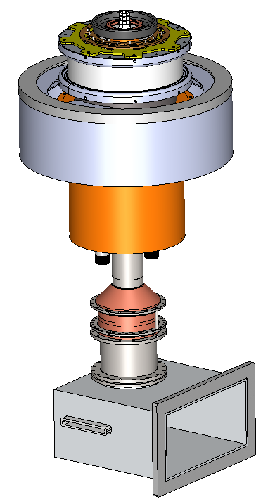
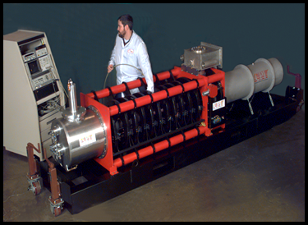
A 700 MHz Comparison
 | Single Beam Klystron | MB IOT
Peak output Power | 1 | 1 | MW
Cathode Voltage | 95 | 50 | kV
Beam Current | 21 | 31 | A
Efficiency at saturation | 65 | 65 (min) | %
Est. efficiency for operation | <45 | >60 | %
Gain | 48 | 23 | dB
0.6 m
1.3 m

Slide 18
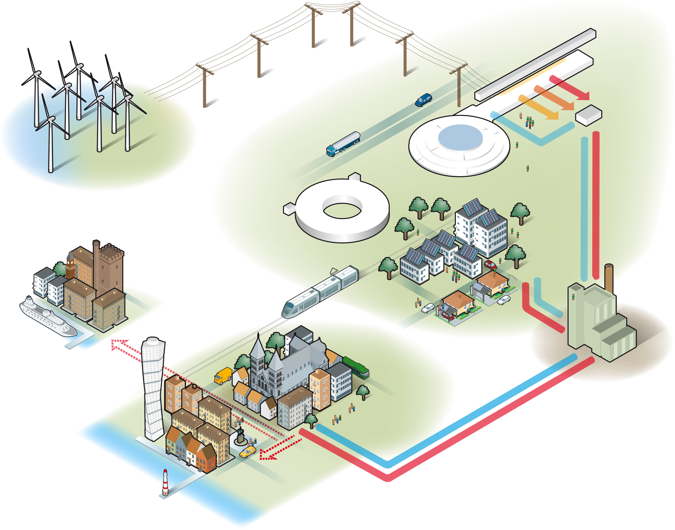
Where next?
The ESS Requirement
Carbon Neutral
Innovative
Green
Time to develop Super Power IOT
Accelerating Structure | Freq. (MHz) | Quantity | Max Power (kW)
RFQ, DTL | 352 | 5 | 2200**
Spoke | 352 | 30 | 330**
Elliptical Medium Beta | 704 | 34 | 860**
Elliptical High Beta | 704 | 86 | 1100**
Power saving from high beta – 20 GWh per year
** Plus overhead for control

Slide 19
Tenders for prototypes due back on 19 February 2014
Parameter |  | Comment
Frequency | 704.42 MHz | Bandwidth > +/- 0.5 MHz
Maximum Power | 1.2 MW | Average power during the pulse
RF Pulse length | Up to 3.5 ms | Beam pulse 2.86 ms
Duty factor | Up to 5% | Pulse rep. frequency fixed to 14 Hz
Efficiency | Target > 65%
High Voltage | Low | Expected < 50 kV
Design Lifetime | > 50,000 hrs
Target: Approval for ESS series production in 2017/18
Work is being carried out in collaboration with CERN
ESS to procure prototypes
CERN to make space and utilities available for testing

Slide 20
Thank You

