Slide 1

Modeling of the Cryogenic Distribution System
Riccard Andersson
(Part of) Master’s Thesis
AD and ICS Retreat
December 11, 2013

Slide 2
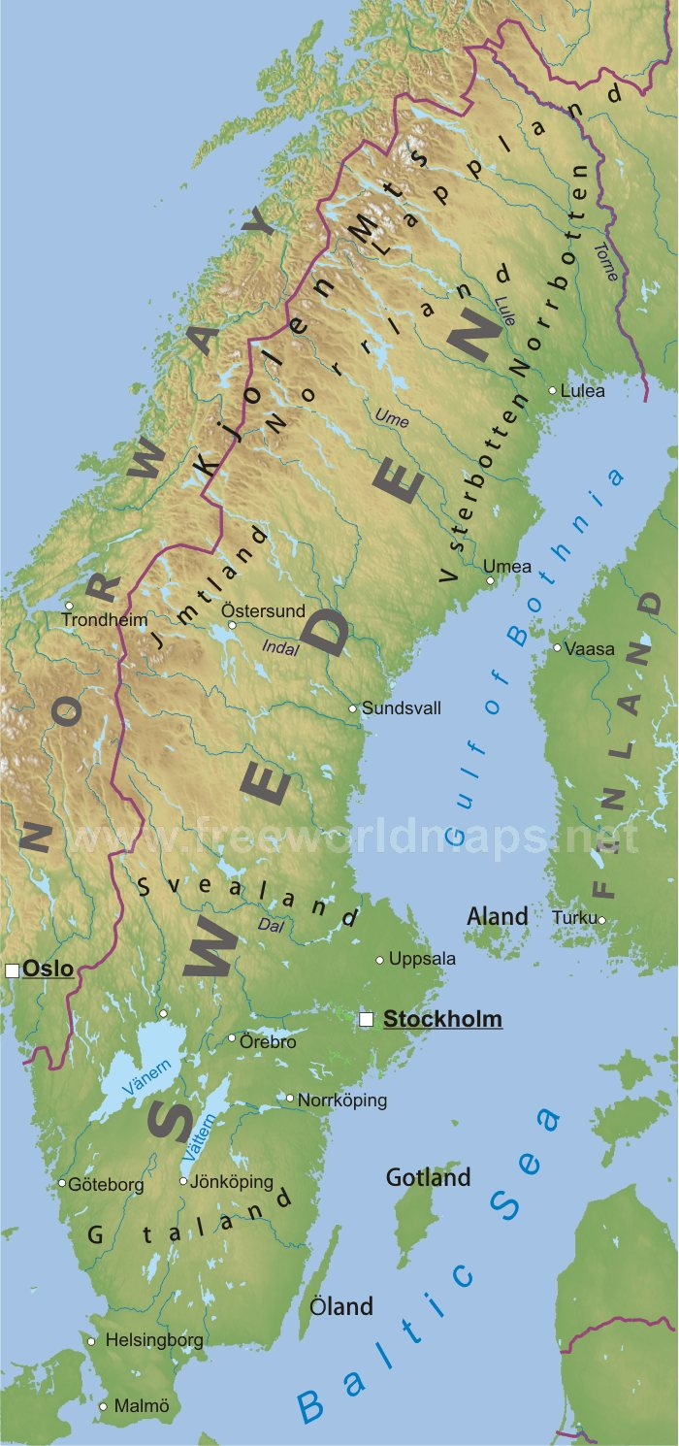
Some Quick Things About Me
Engineering Physics
  Accelerator Physics
One-year project
  Master’s thesis
  Two project courses
http://www.freeworldmaps.net/
europe/sweden/sweden-map.jpg

Slide 3
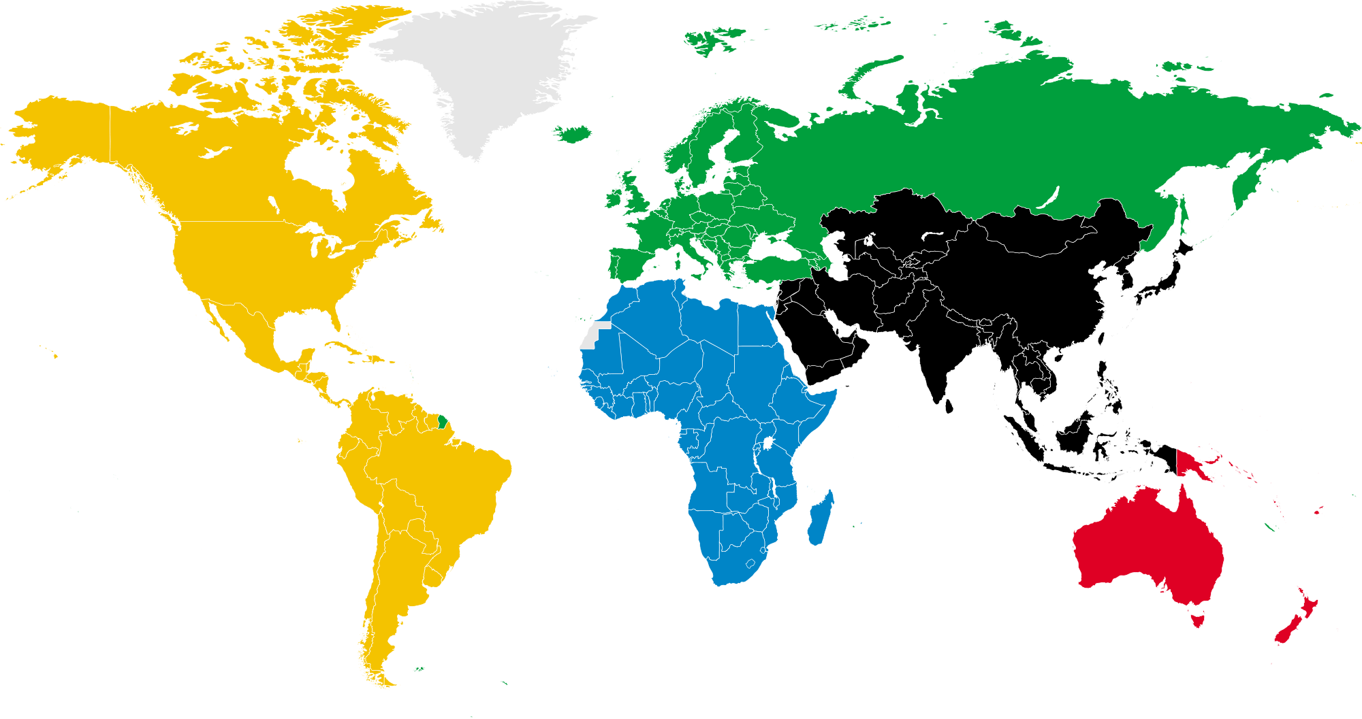
Some Quick Things About Me
http://upload.wikimedia.org/wikipedia/en/7/72/World_Map_WSF.svg.png

Slide 4
Some Quick Things About Me
Engineering Physics
  Accelerator Physics
One-year project
  Master’s thesis
  Two project courses
http://www.freeworldmaps.net/
europe/sweden/sweden-map.jpg

Slide 5
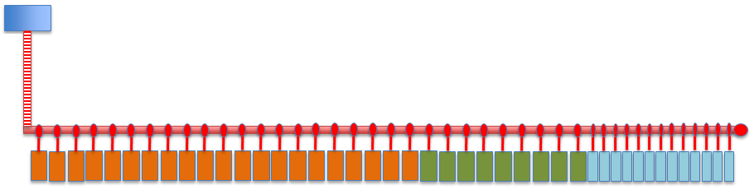
Distribution System Layout
Deliver cooling medium from cryoplant to cryomodules
  13 spoke cryomodules (light blue)
30 elliptical cryomodules
  9 medium-β (green)
  21 high-β (orange)
Cryoplant
Transfer line
Distribution line
Courtesy of J. Fydrych
High- β
Medium-β
Spoke

Slide 6
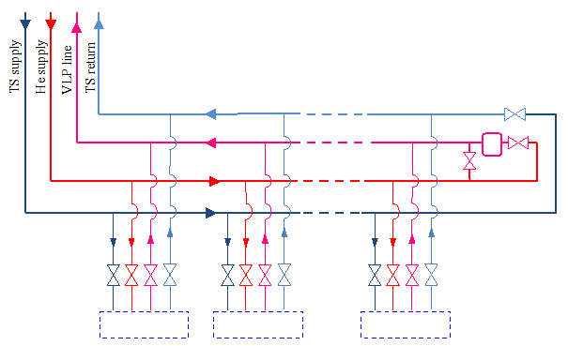
Flow Scheme
Two circuits
  Cold helium circuit
  Thermal shield circuit

Slide 7
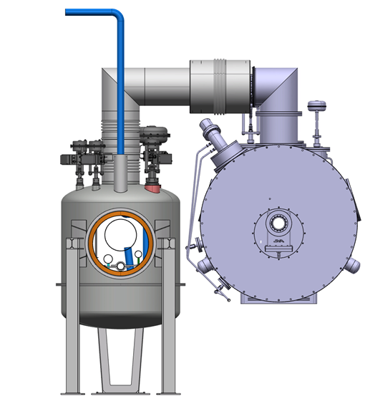
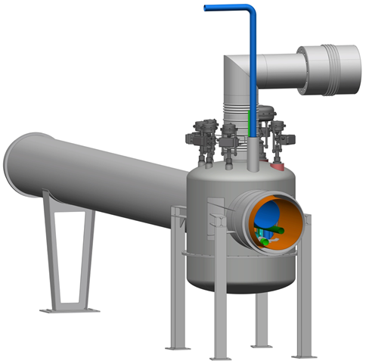
3D Model
Distribution line
Valve box
Jumper connection
Cryomodule
Jumper connection
Cryomodule
Valve box
Cryoline
Courtesy of P. Tereszkowski

Slide 8
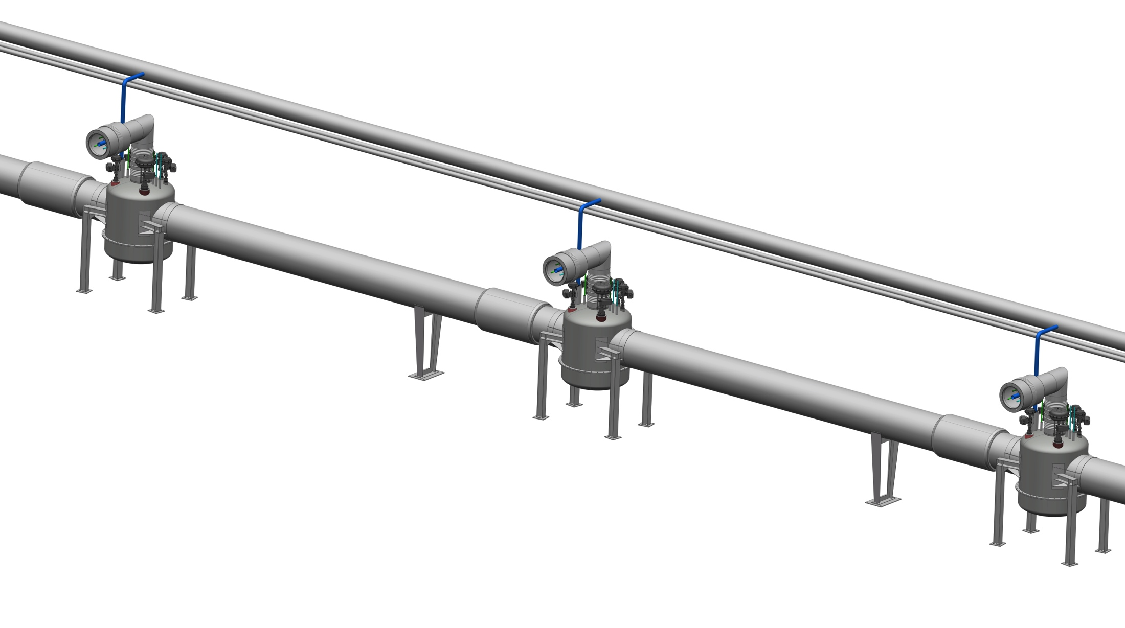
Linac CDS isometric
Modular structure
of the cryogenic distribution line
Warm lines
Jumper connection
Valve box
Cryoline
Courtesy of P. Tereszkowski

Slide 9
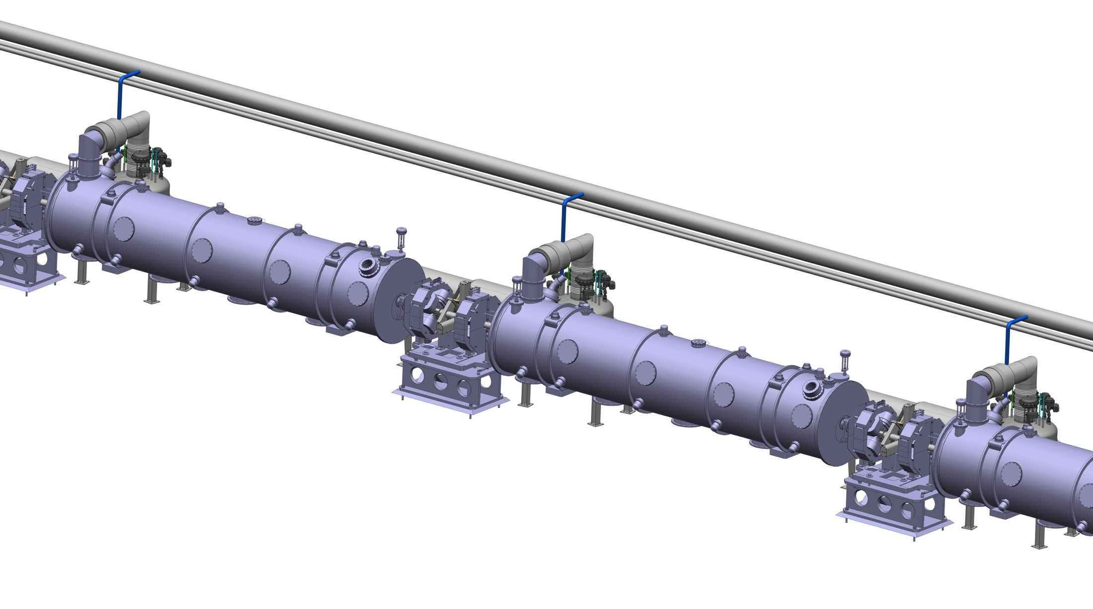
Linac CDS isometric
Modular structure
of the cryogenic distribution line
Warm lines
Jumper connection
Valve box
Cryoline
Cryomodules
Courtesy of P. Tereszkowski

Slide 10
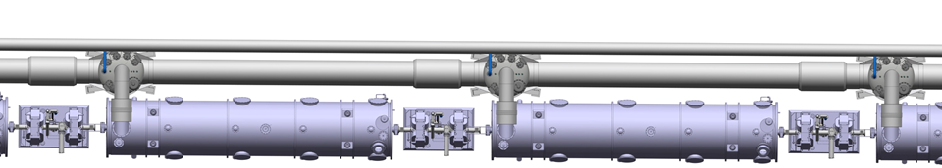
The Cryogenic Distribution Line
Pipes
One valve box
One jumper connection
One cryomodule
8.52 m
Courtesy of P.
Tereszkowski

Slide 11
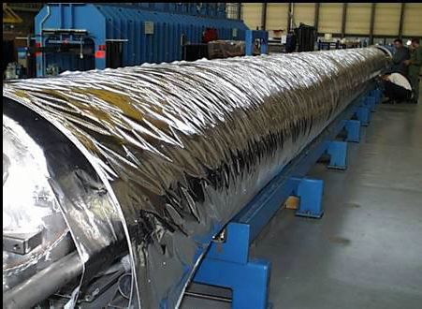
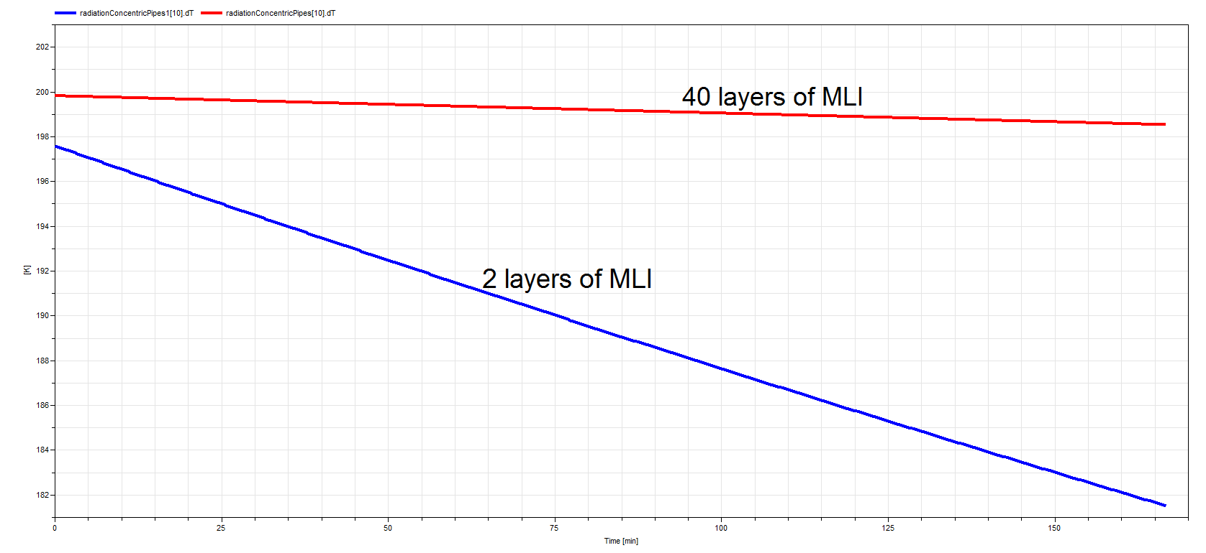
The Cryogenic Distribution Line
MultiLayer Insultation (MLI)
  Process lines: 10 layers
  Thermal shield: 30-40 layers
Lecture series by John Weisend. Michigan State University, 2012

Slide 12



Dymola (The Software)
DYnamic MOdeling LAnguage
Modelica Association
  Consulting
  Providing Modelica libraries
  Providing helium properties

Slide 13
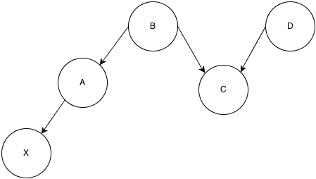
Modelica (The Language)
  Object-oriented language
    Similar to C++ syntax
Declarative equations: As derived from physics
Modelica is acausal
http://i.stack.imgur.com/gPnim.png

Slide 14
Modeling and Simulating
In Modelica models
  Model
  Default parameters
  Equations
In Dymola’s simulation environment
  Parameters
  Initial values
  Simulation setup

Slide 15
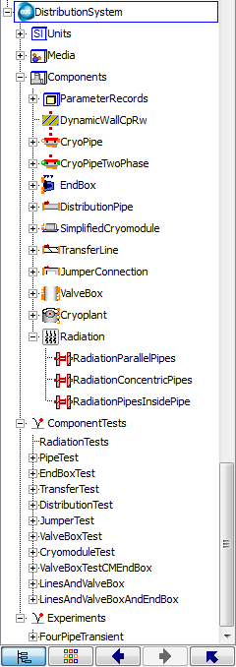
Modeling and Simulating
Component models – reusable
Parameters and components
  Scalars
  Vectorized
  Matricized
Results and plotting in Matlab

Slide 16
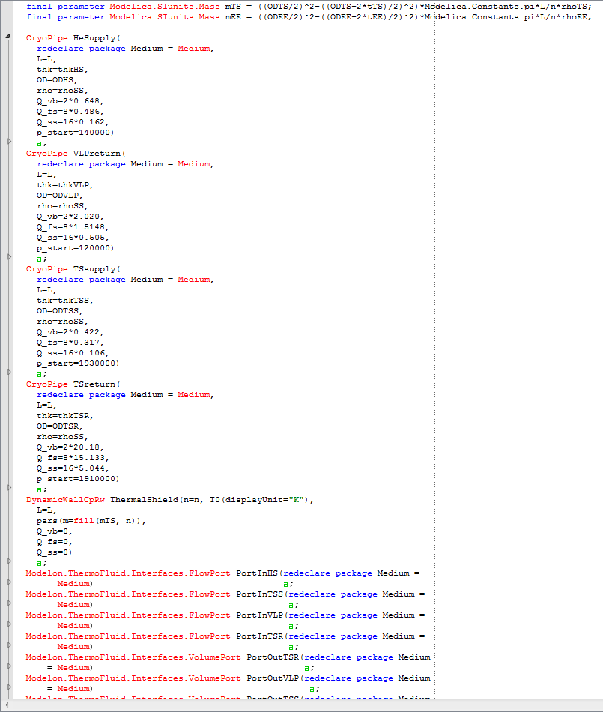
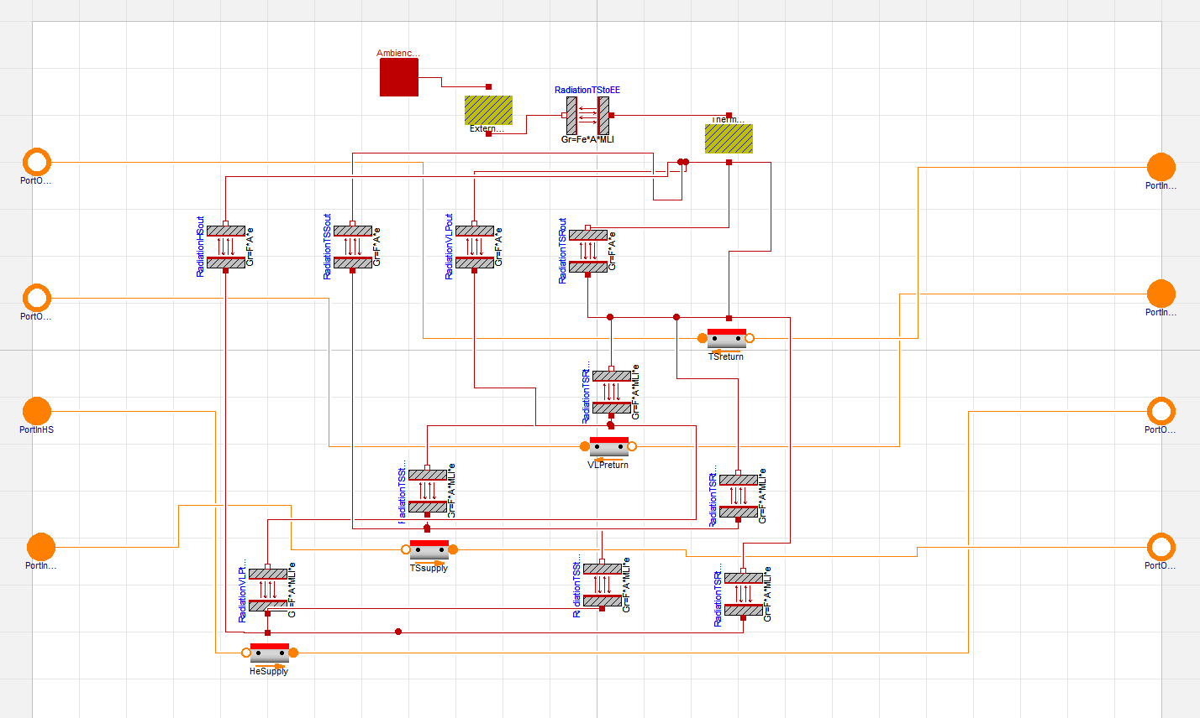
Example Model
Graphical and text layers describe the same thing

Slide 17
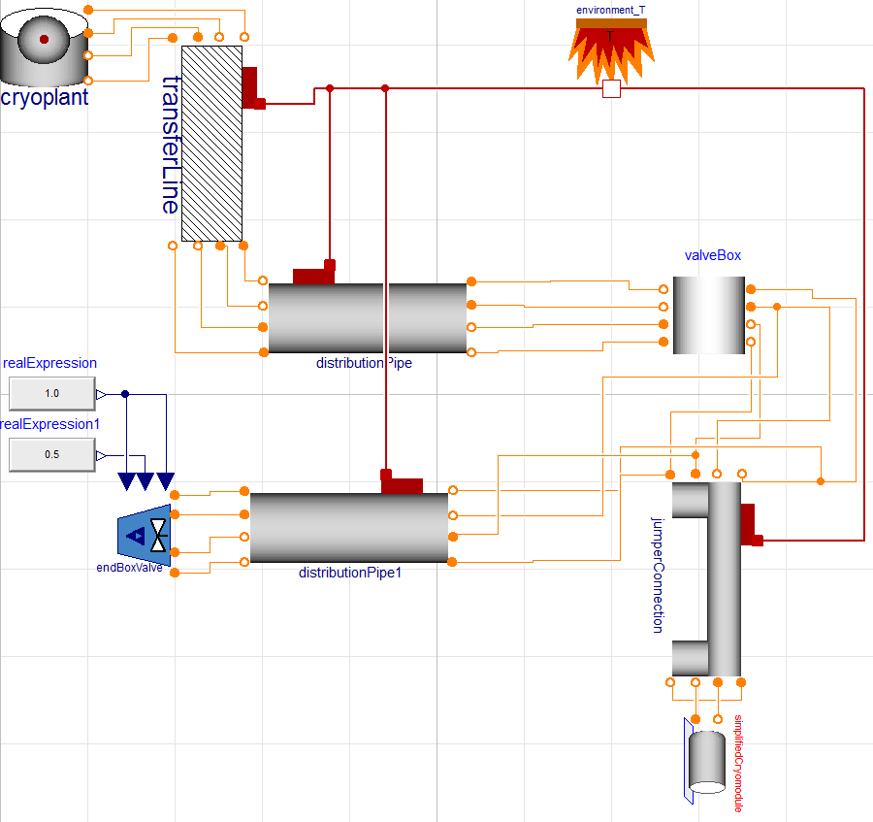
Example Model
Components
  Developed
  Tested
individually
Connected to more complex systems
Parameters propagated
to the top level

Slide 18
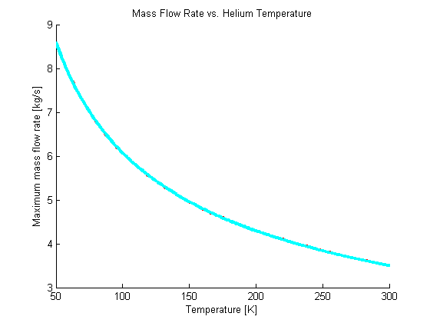
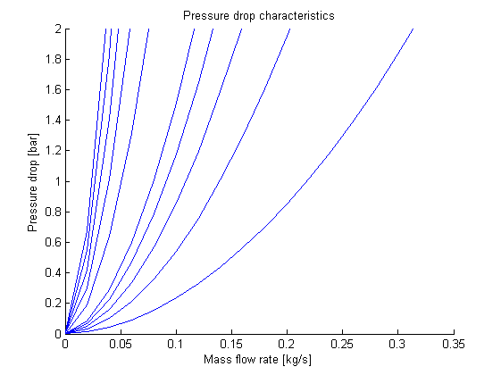
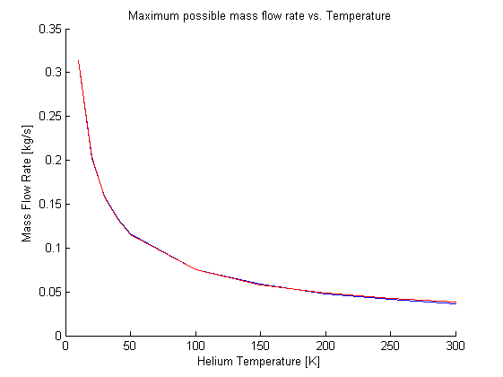
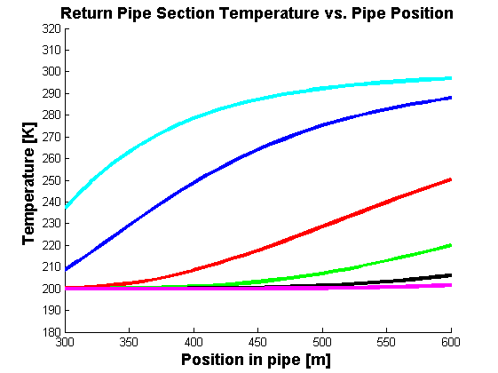
Matlab – The Sidekick of Dymola
Side scripts in Matlab:
Choked Flow
Pressure Characteristics
Plotting and results
Etcetera

Slide 19
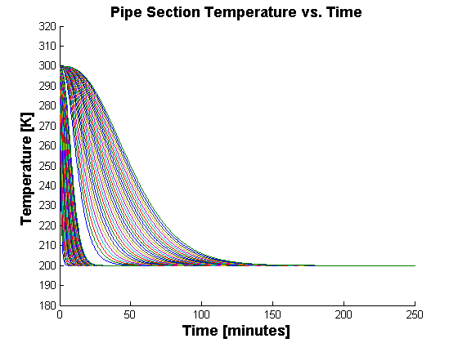
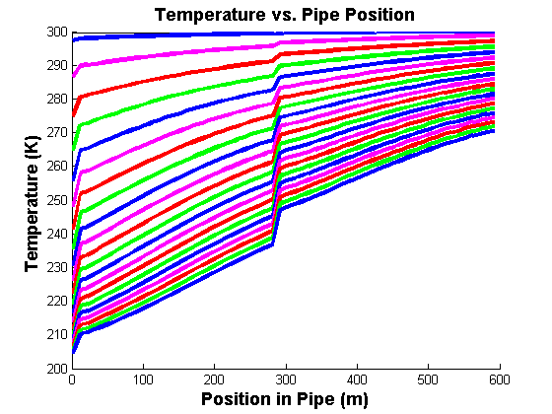
Initial Results
First project
2∙300 m stainless steel pipes
  Constant helium flow
  Matlab and Dymola

Slide 20
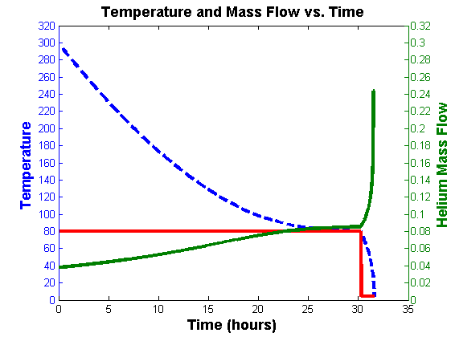
Initial Results
Matlab
  Preliminary cool-down time
  Pressure difference ➔ Limited available flow
  Initially at 80 K, then at 4.5 K
  C_{P} varies with temperature
  Result: 31.5 hours
Assuming
  Homogeneous cooling
  Friction-less flow
  No thermal radiation
  or conduction

Slide 21
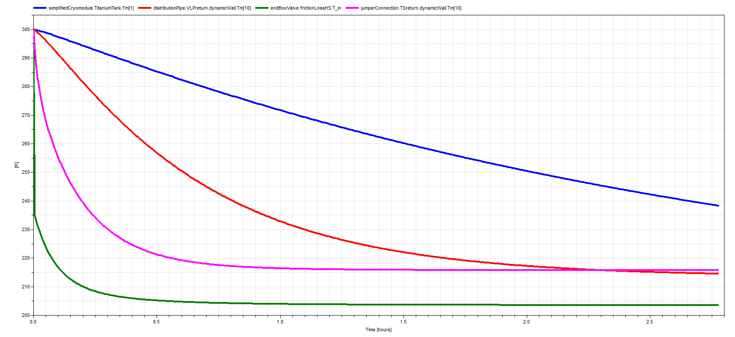
Results In Dymola
Example plot from Dymola
  Parameter plotted with one click
  Against time or any other parameter
    But that’s it

Slide 22
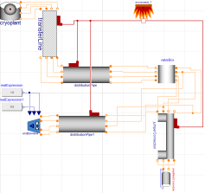
Further Work
Further development of
  Thermal radiation
  Losses and frictions
  Connections to valves
  Connecting 43 modules
Helium properties available shortly (?)
Models available for steady-state simulations etc.

Slide 23
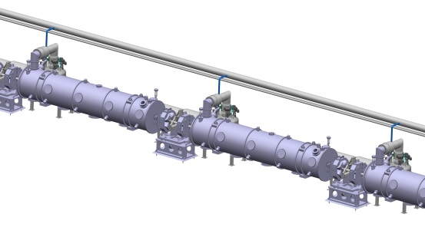
To Sum Up
Modular structure
Two circuits with flowing helium
Dymola is both graphical and code
Multi-engineering modeling

Slide 24
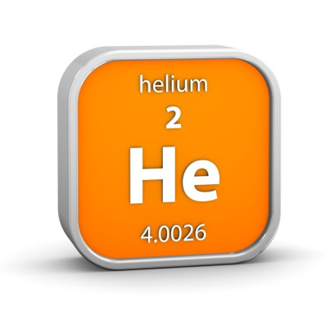
To Sum Up
Initial results: 31+ hours to cool
Some more work on components
Simulating using smoking fresh
cryogenic helium properties
http://news.psu.edu/sites/default/files/styles/
threshold-992/public/iStock_000023736179Small.jpg

Slide 25
Thank you

