Slide 1
ESS Rastering, or There and Back Again
Heine Dølrath Thomsen, ISA, Aarhus University

Slide 2
HEBT Layout – Ultimo 2013
ACH
180 m
UHB
A2T
10 RMS, X, Y,
EWU with quadrupole doublet

Slide 3
HEBT Layout – Ultimo 2013
ACH
A2T
DIPOLES
QUADRUPOLES
10 RMS, X, Y,

Slide 4
High-Power Target: Interface Challenges
Uniform beam spot
To prolong lifetimes of target vessel and proton beam window (radiation damage); cooling;
Proton beam windows
Lifetime due to irradiation, cooling problem, multiple scattering effect
Back-streaming neutrons
Very high flux, damage to devices in the beam transport line; radiation shielding burden
Beam monitoring
Monitoring beam centering and profile at target; lifetime and shielding of probes in a radiation-hard region
A2T Lead Engineer: Tom Shea
Jing-Yu Tang
Notes:
ESS has recognized the importance of this region and allocated attention

Slide 5
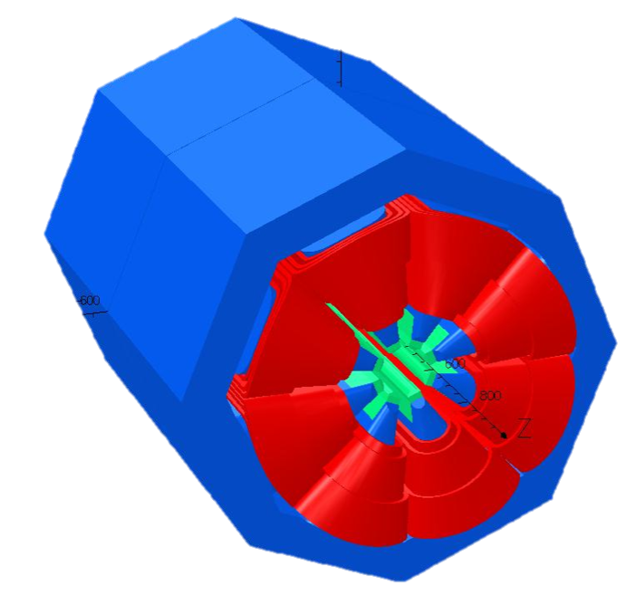
2011: 2 Expander Systems Considered
Raster Magnets
Non-Linear Magnets
Suitable for CW or long-pulse machines
Introduces a time structure
Raster pattern:
Difficult within 1 pulse
Supplies + verification
Elliptical:
Easy to verify (f, A_{x}, A_{y})
Limited benefit
DC magnets:
Same performance at all ∆t_{pulse}
Easier to verify field
Difficult to optimize?
Uniform beams can be tailored… if the input beam is well-known.
Notes:
Do not consider scattering foils
Unnecessarily complex

Slide 6
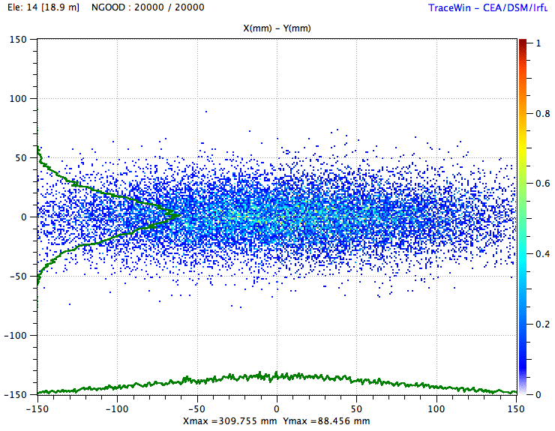
Y
Dummy footprint
X
Notes:
Sensitive towards halo
Truncated distributions

Slide 7
Over-Focusing of Halo
Focusing = (Lin. – non-lin)
Notes:
Permendur poles - 200 k€
Balance losses vs Jmax
25% increase of current!
Strongly encouraged to revisit rastering

Slide 8
Rastering Revisited – December 2012
p’s
n’s

Slide 9
‘Raster25’
Centroid
10 x RMS beamlet
BEW
QP1-4
8 x RMs
QP5,6
PBW
B_{y} B_{y} B_{x} B_{x} | B_{x} B_{x} B_{y} B_{y}
ACH
A2T
AP
2.0 GeV: B_{x} = ±3.26 mT.m, B_{y} = ±2.39 mT.m, ±5 mT.m
Notes:
QP5,6 critical to operation

Slide 10
Quadrupoles
Col.
A2T
DGLG
UHB
NSW
RMs
BD
DMPL
Mikael Andersson, ESS

Slide 11
a Déjà Vu?

Slide 12
LANL APT: Original Idea
Comb. function magnet:
Quadrupole
Octupole
Dodecapole
Area C experiment:
Understanding of application confirmed
Jitter: Distribution would skew but not move
80 W beam power, losses!
Simulations: 10⁻⁵ tails
SOTA Accelerator (€)
Notes:
6 x 24 h
Impeccable state: Minimal jitter, mismatch

Slide 14
LANL APT: Final Design
f_{y} / f_{x} = 5:4
20 ms pattern cycle
ESS Challenges:
f ~ 40 kHz, T_{p-p} = 12.5 us
x,y [arb. units]
Max(∆x) = 70 mm, max(∆y) = 16 mm,
RMS(x-∆x) = 12.6 mm, RMS(y-∆y) = 6.3 mm
One pattern cycle
Notes:
113/83

Slide 15
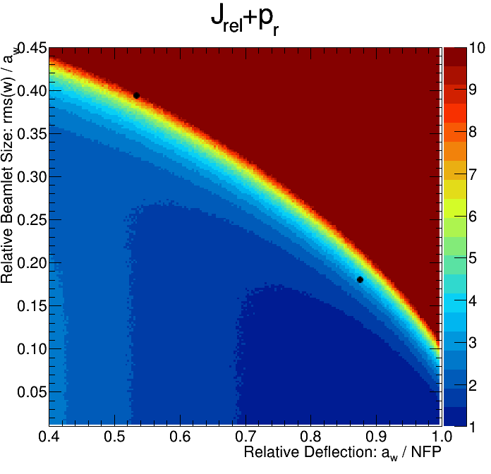
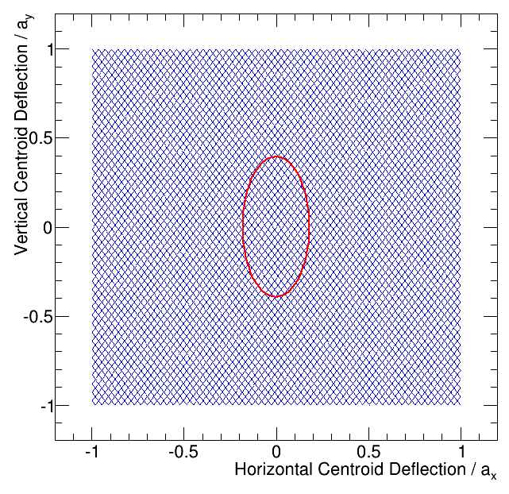
Complex Patterns
Pattern: 113 / 83
Beamlet rms size
Beamlet distribution smeared out
Gauss vs. E2E beam
Halo: only affects pattern edges
Limited impact!

Slide 16
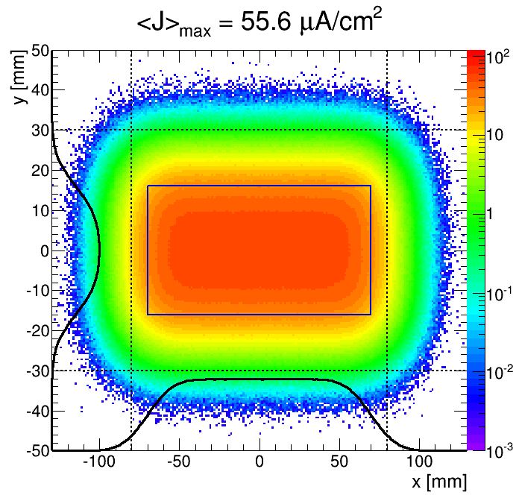
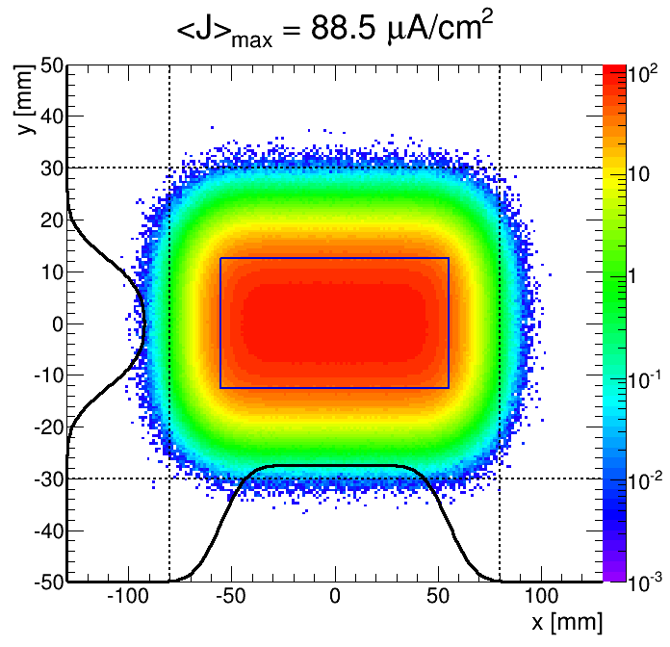
J_{max} @ BEW vs. PBW
 | Unit \ Location | PBW | BEW
amp. x | mm | 55.42 | 70.00
amp. y | mm | 12.67 | 16.00
rms (x) | mm | 10.00 | 12.64
rms (y) | mm | 5.00 | 6.32
rms(x)*rms(y) | mm^2 | 50.0 | 79.9
Jmax | uA/cm^2 | 88.2 | 55.6
Outside 160x60 | % | 0.04 | 2.40
Outside 180x64 | % |  | 0.07
Outside 180x62 | % | 0.00
Geometry: |CO <-> BEW| / |CO <-> PBW| = 1.263
Notes:
50 billion particles from E2E

Slide 17
Waist
Outdated optics!

Slide 18
Waist
Focusing = (Lin. – non-lin)

Slide 19
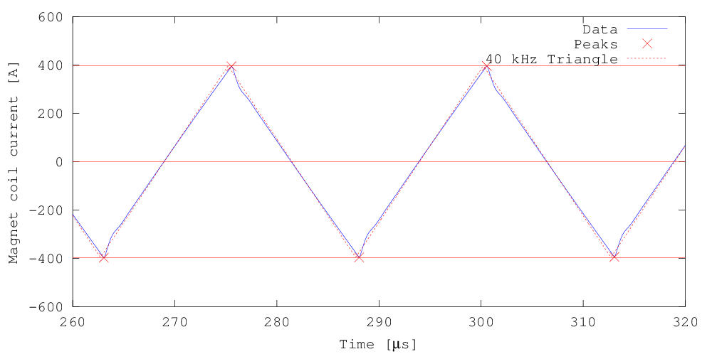
Hardware
200 mm
160 mm
Raster magnets:
Window frame ferrite yoke
Cu windings (air-cooled)
Ceramic pipe, Ø80 mm
NI = 2 x 340 A (peak)
± 5 mT.m peak field
IGBT-based H-bridge
140 mm

Slide 20
Hardware
Detailed studies: Impact of non-ideal waveforms
Notes:
Impact of non-ideal waveforms

Slide 21
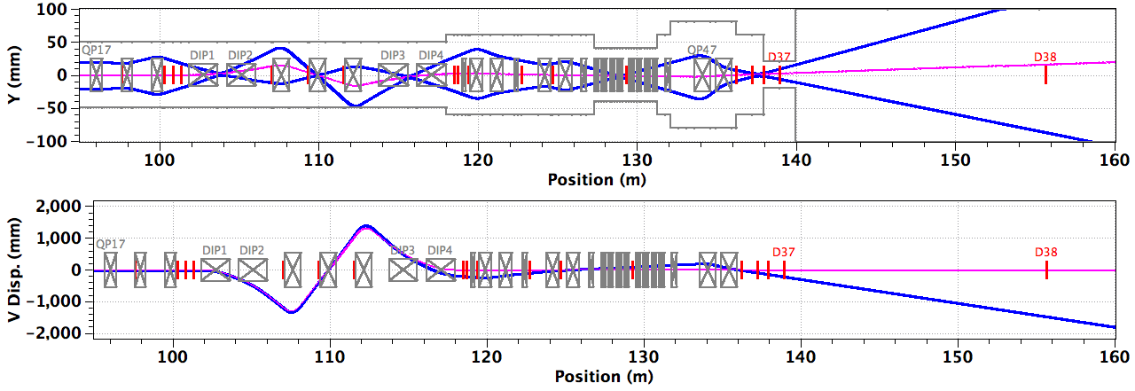
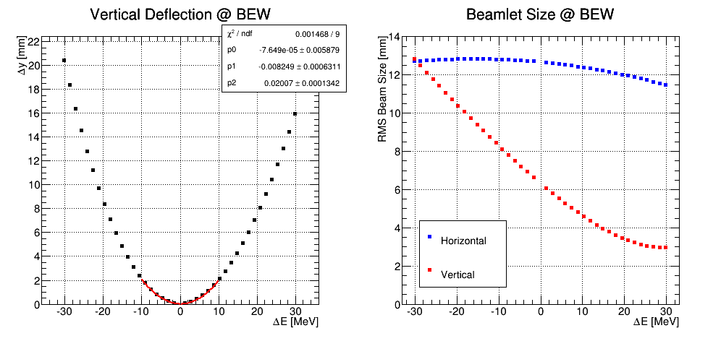
HEBT Errors & Acceptance?
ACH

Slide 22
Conclusion & Outlook
Revised A2T optics facilitating rastering
Many benefits (low J, intuitive tuning,…) and overall cost-neutral
Positive evaluation of hardware feasibility
<I> increased by 25%: deathblow to octupoles
TO DO:
Non-Ideal RM waveforms
Longitudinal acceptance
Erratic beam: losses at NSW
Enthusiastic participation:
Eric Pitcher, Carlos Martins, David McGinnis, Alan Takibayev, Phillip Bentley, Paul Henry, Pascal Sabbagh, Annika Nordt, Rüdiger Schmidt, …
CERN: Laurent Ducimetière et al.
Danfysik
Notes:
Raster25

Slide 23
EXTRA slides

Slide 24
J_{max} @ BEW vs. PBW
 | Unit \ Location | PBW | BEW
amp. x | mm | 55.42 | 70.00
amp. y | mm | 12.67 | 16.00
rms (x) | mm | 10.00 | 12.64
rms (y) | mm | 5.00 | 6.32
rms(x)*rms(y) | mm^2 | 50.0 | 79.9
Jmax | uA/cm^2 | 88.2 | 55.6
Outside 160x60 | % | 0.04 | 2.40
Outside 180x64 | % |  | 0.07
Outside 180x62 | % | 0.00
Geometry: |CO <-> BEW| / |CO <-> PBW| = 1.263
Notes:
50 billion particles from E2E

Slide 25
Nominal settings

Slide 26
71 ms failure in QP5

Slide 27
71 ms failure in QP6

Slide 28
71 ms failure in QP5+QP6

Slide 29
Comparison
Non-Linear Magnets (NLMs)
Raster Magnets (RMs)
DC magnets (lin. + non-lin.)
2 + 2 + 4 quads
2 octupoles
Δx error:
Steering O(Δx³)
Focusing O(Δx²)
Profile
Monitor I,V
DC + AC magnets (linear)
4 + 2 quads
4 + 4 RMs (air-cooled)
Ceramic vacuum chamber
Δx error:
Steering O(Δx¹)
Focusing O(Δx⁰)
Centroid(t)
Monitor |dB/dt|: |dI/dt|
Neutron shield wall
Fixed collimator?

