Slide 1
methods for measuring the beam profile in high intensity beams
Charlotte Roose

Slide 2
BEFORE ESS...
Hometown : Brussels (Belgium)
Background
University College : Institut Supérieur Industriel de Bruxelles (ISIB)
Master’s degree in Physics and Nuclear Engineering (graduated in June 2013)
Joined the Beam Diagnostics group in July 2013 as a Marie Curie Early Stage Researcher funded through the oPAC network of the FP7 Marie Curie ITN scheme

Slide 3
PROJECT
Transverse Pofile Monitor of a High Intensity Beam
Non-Invasive Methods
using interaction between the beam and the residual gas
2
2
1
1
3
1
4

Slide 4
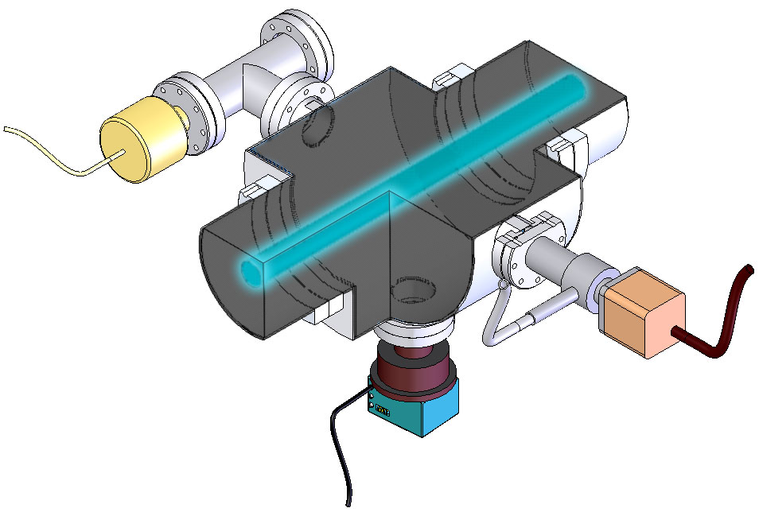
PROJECT
Luminescence
Ionization
2
2
1
1
3
1
4
Ion beam
Viewport
(1)
(2)
Picture Setup@ Zerstörungsfreie Profilmessung intensiver Schwerionenstrahlen, Frank Becker, Darmstadt, 2010
Picture Setup@GSI, T. Giacomini

Slide 5
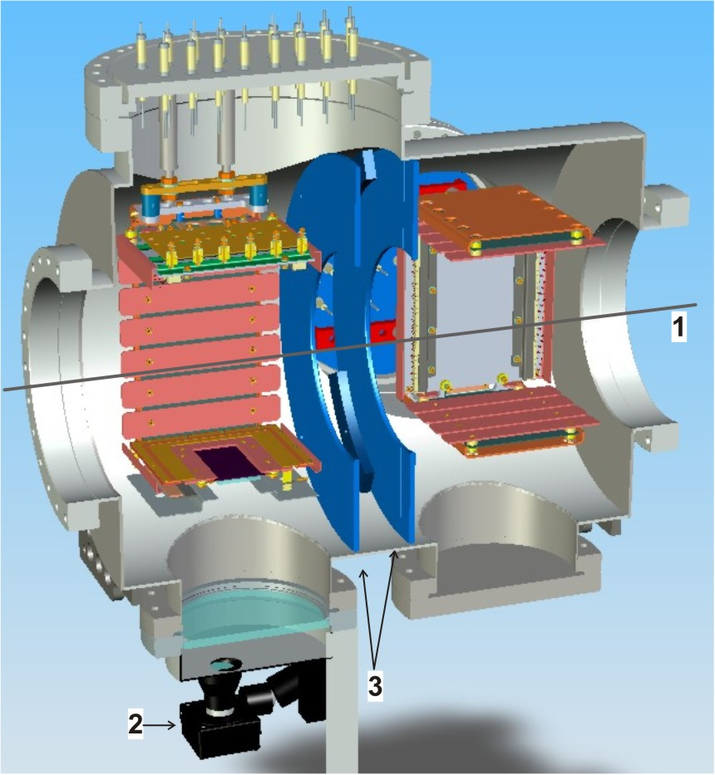
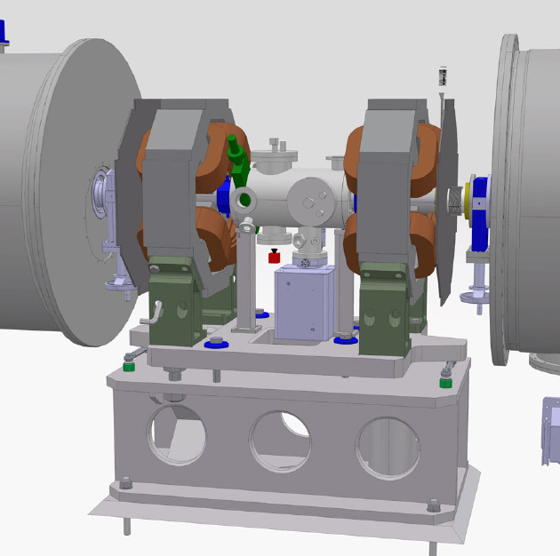
IONIZATION PROFILE MONITOR
43 cm between the magnets
1 wire scanner, 1 ionization profile monitor
Dimension = 10cm x10cm x 10cm
Electric field of 60kV/10cm

Slide 6
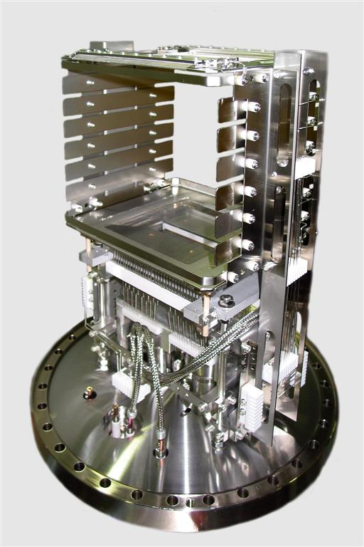
IONIZATION PROFILE MONITOR
2 designs
FRAGILE
SPARKS
(4)
(3)
(3) Picture Setup@GSI, T. Giacomini
(4) Picture Setup@Fermilab, J. Zagel

Slide 7
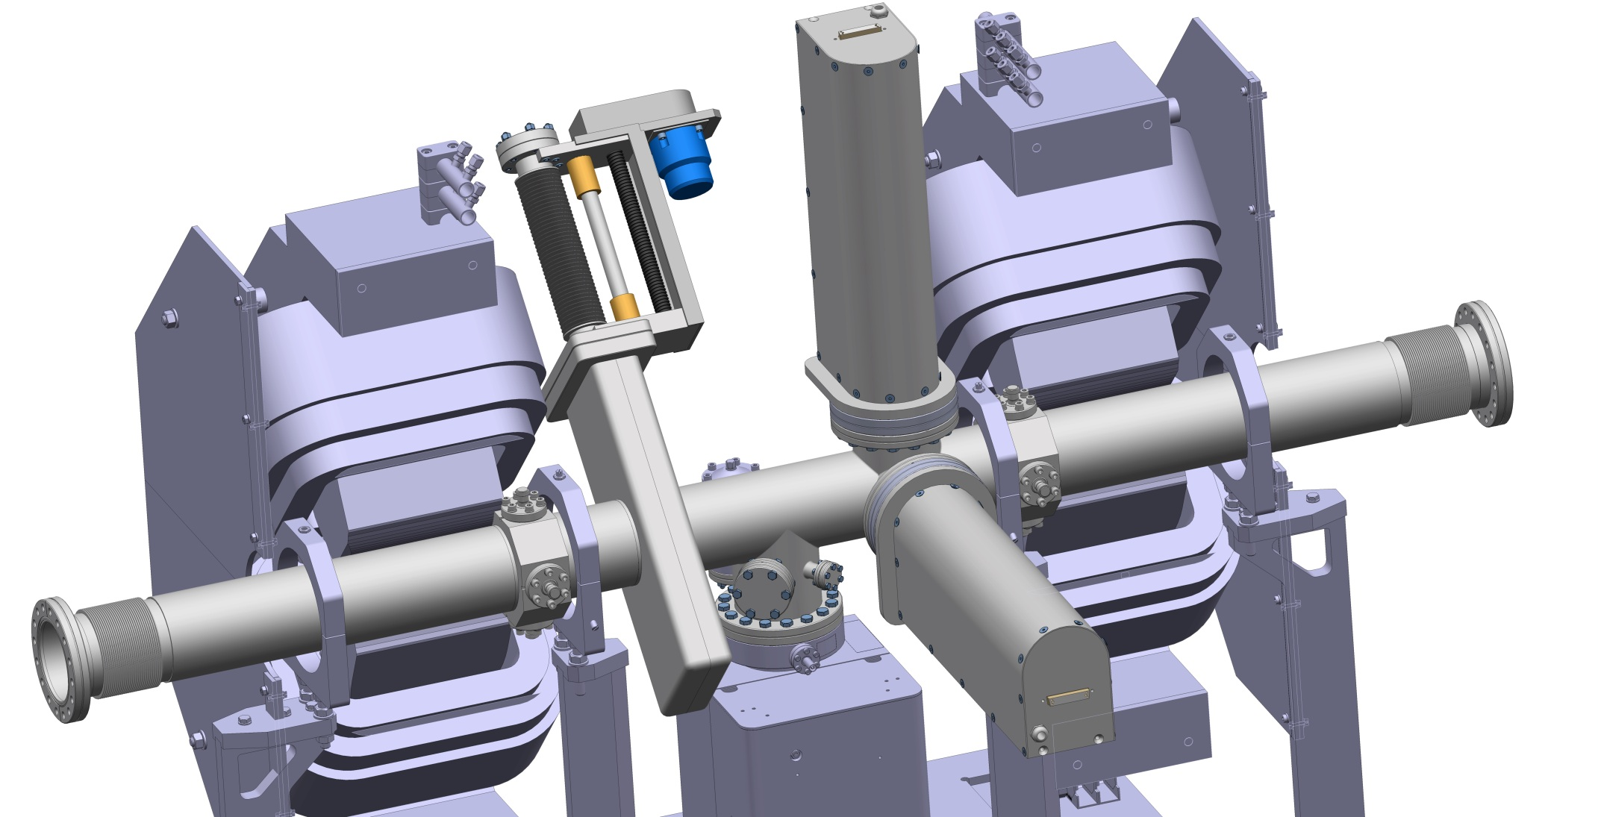
IONIZATION PROFILE MONITOR
(3) Picture Setup@GSI, T. Giacomini
(4) Picture Setup@Fermilab, J. Zagel

Slide 8
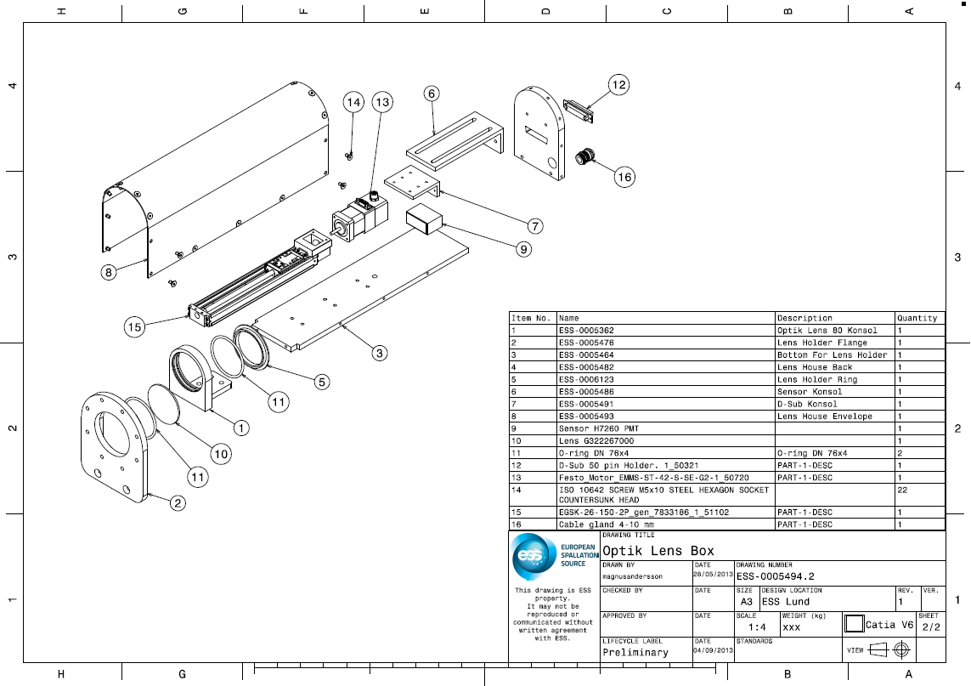
IONIZATION PROFILE MONITOR
LENS BOX
(3) Picture Setup@GSI, T. Giacomini
(4) Picture Setup@Fermilab, J. Zagel

Slide 9
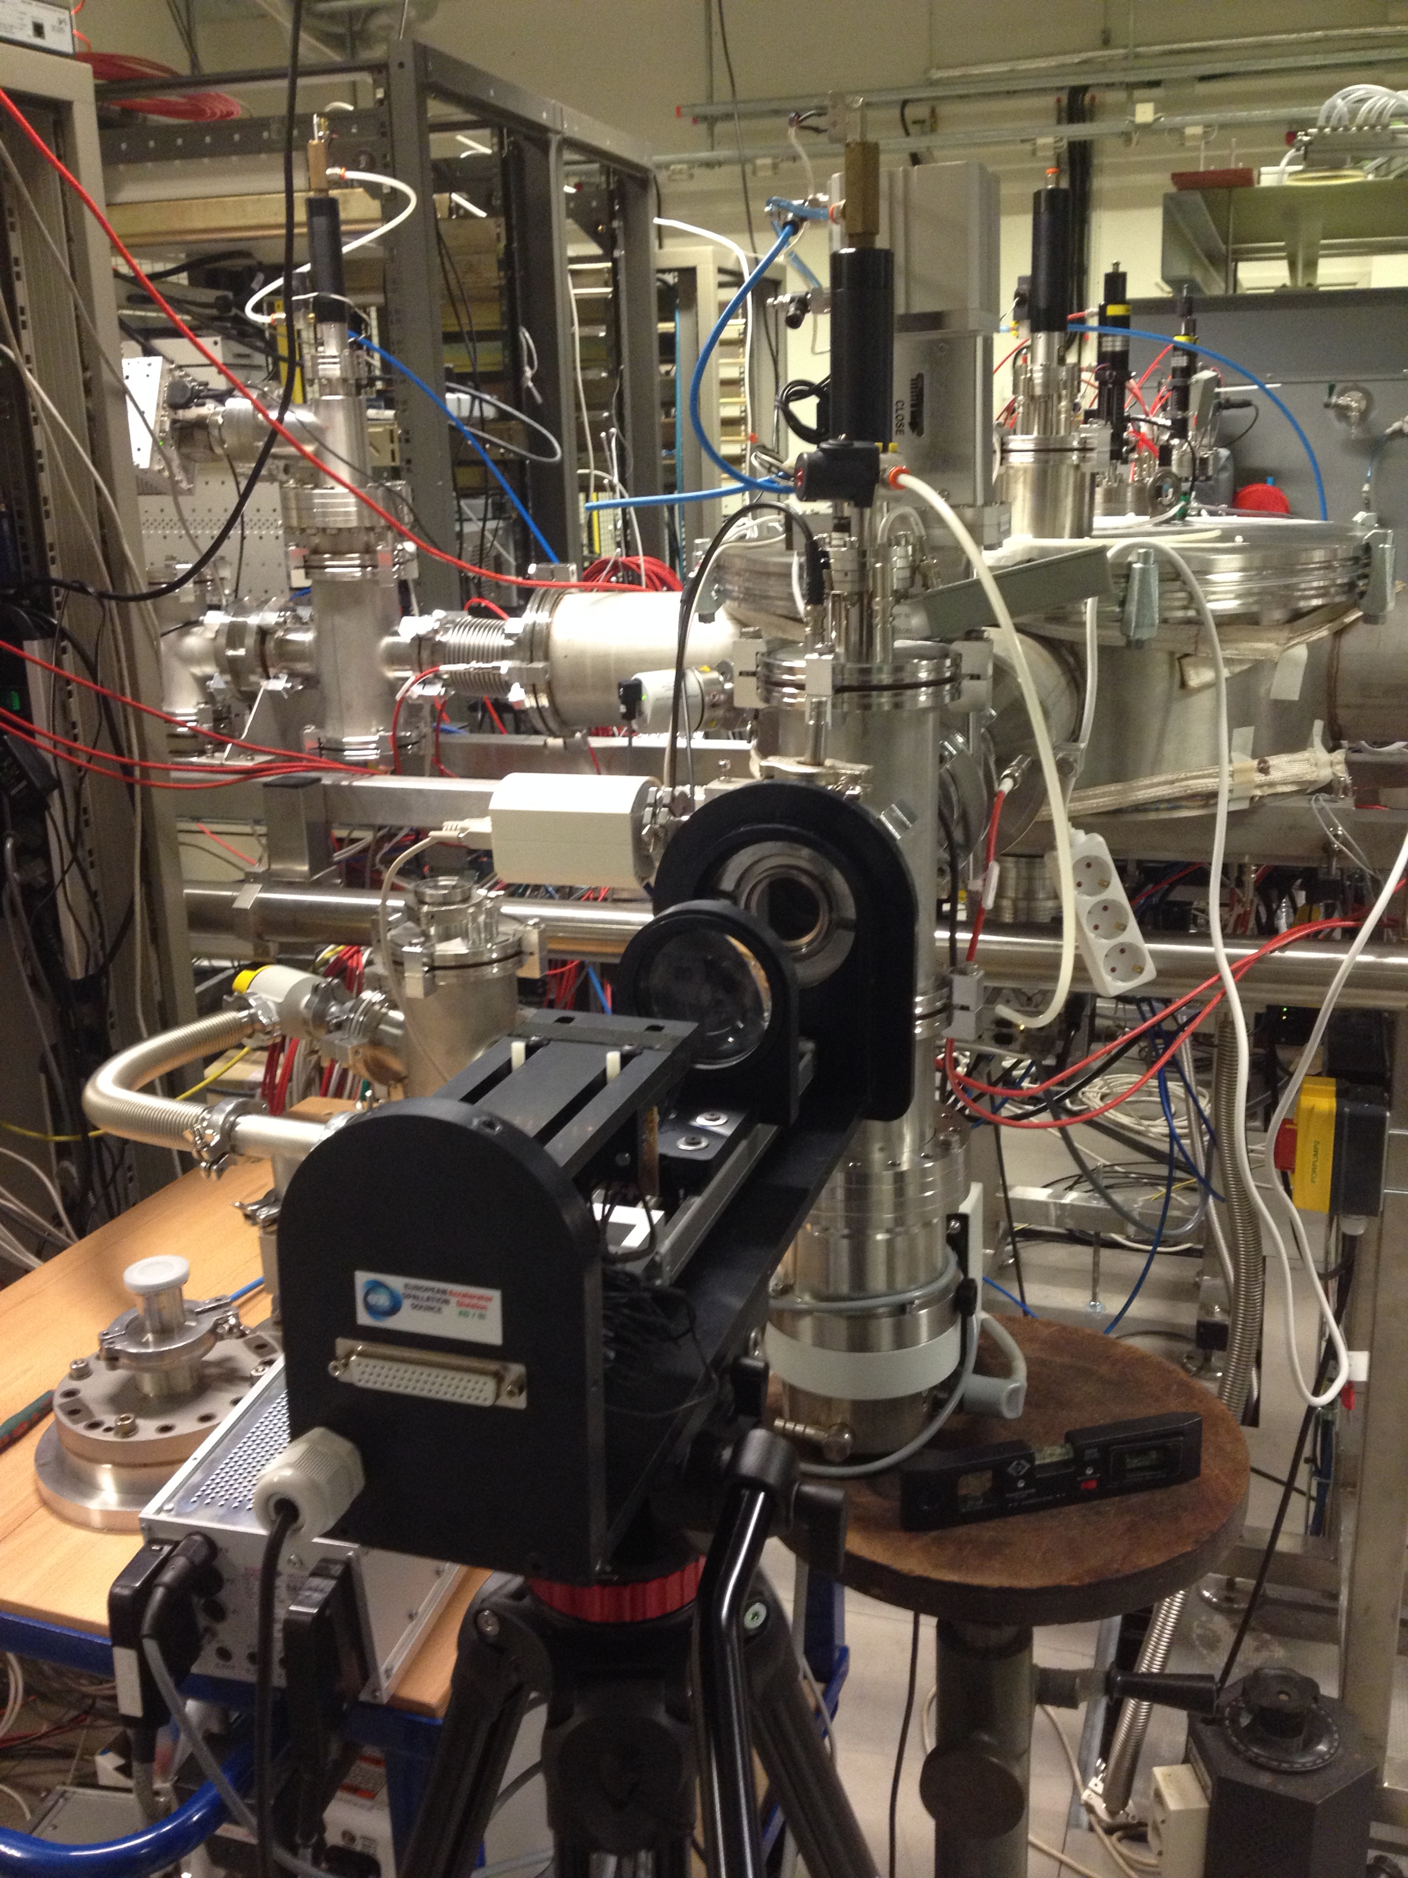
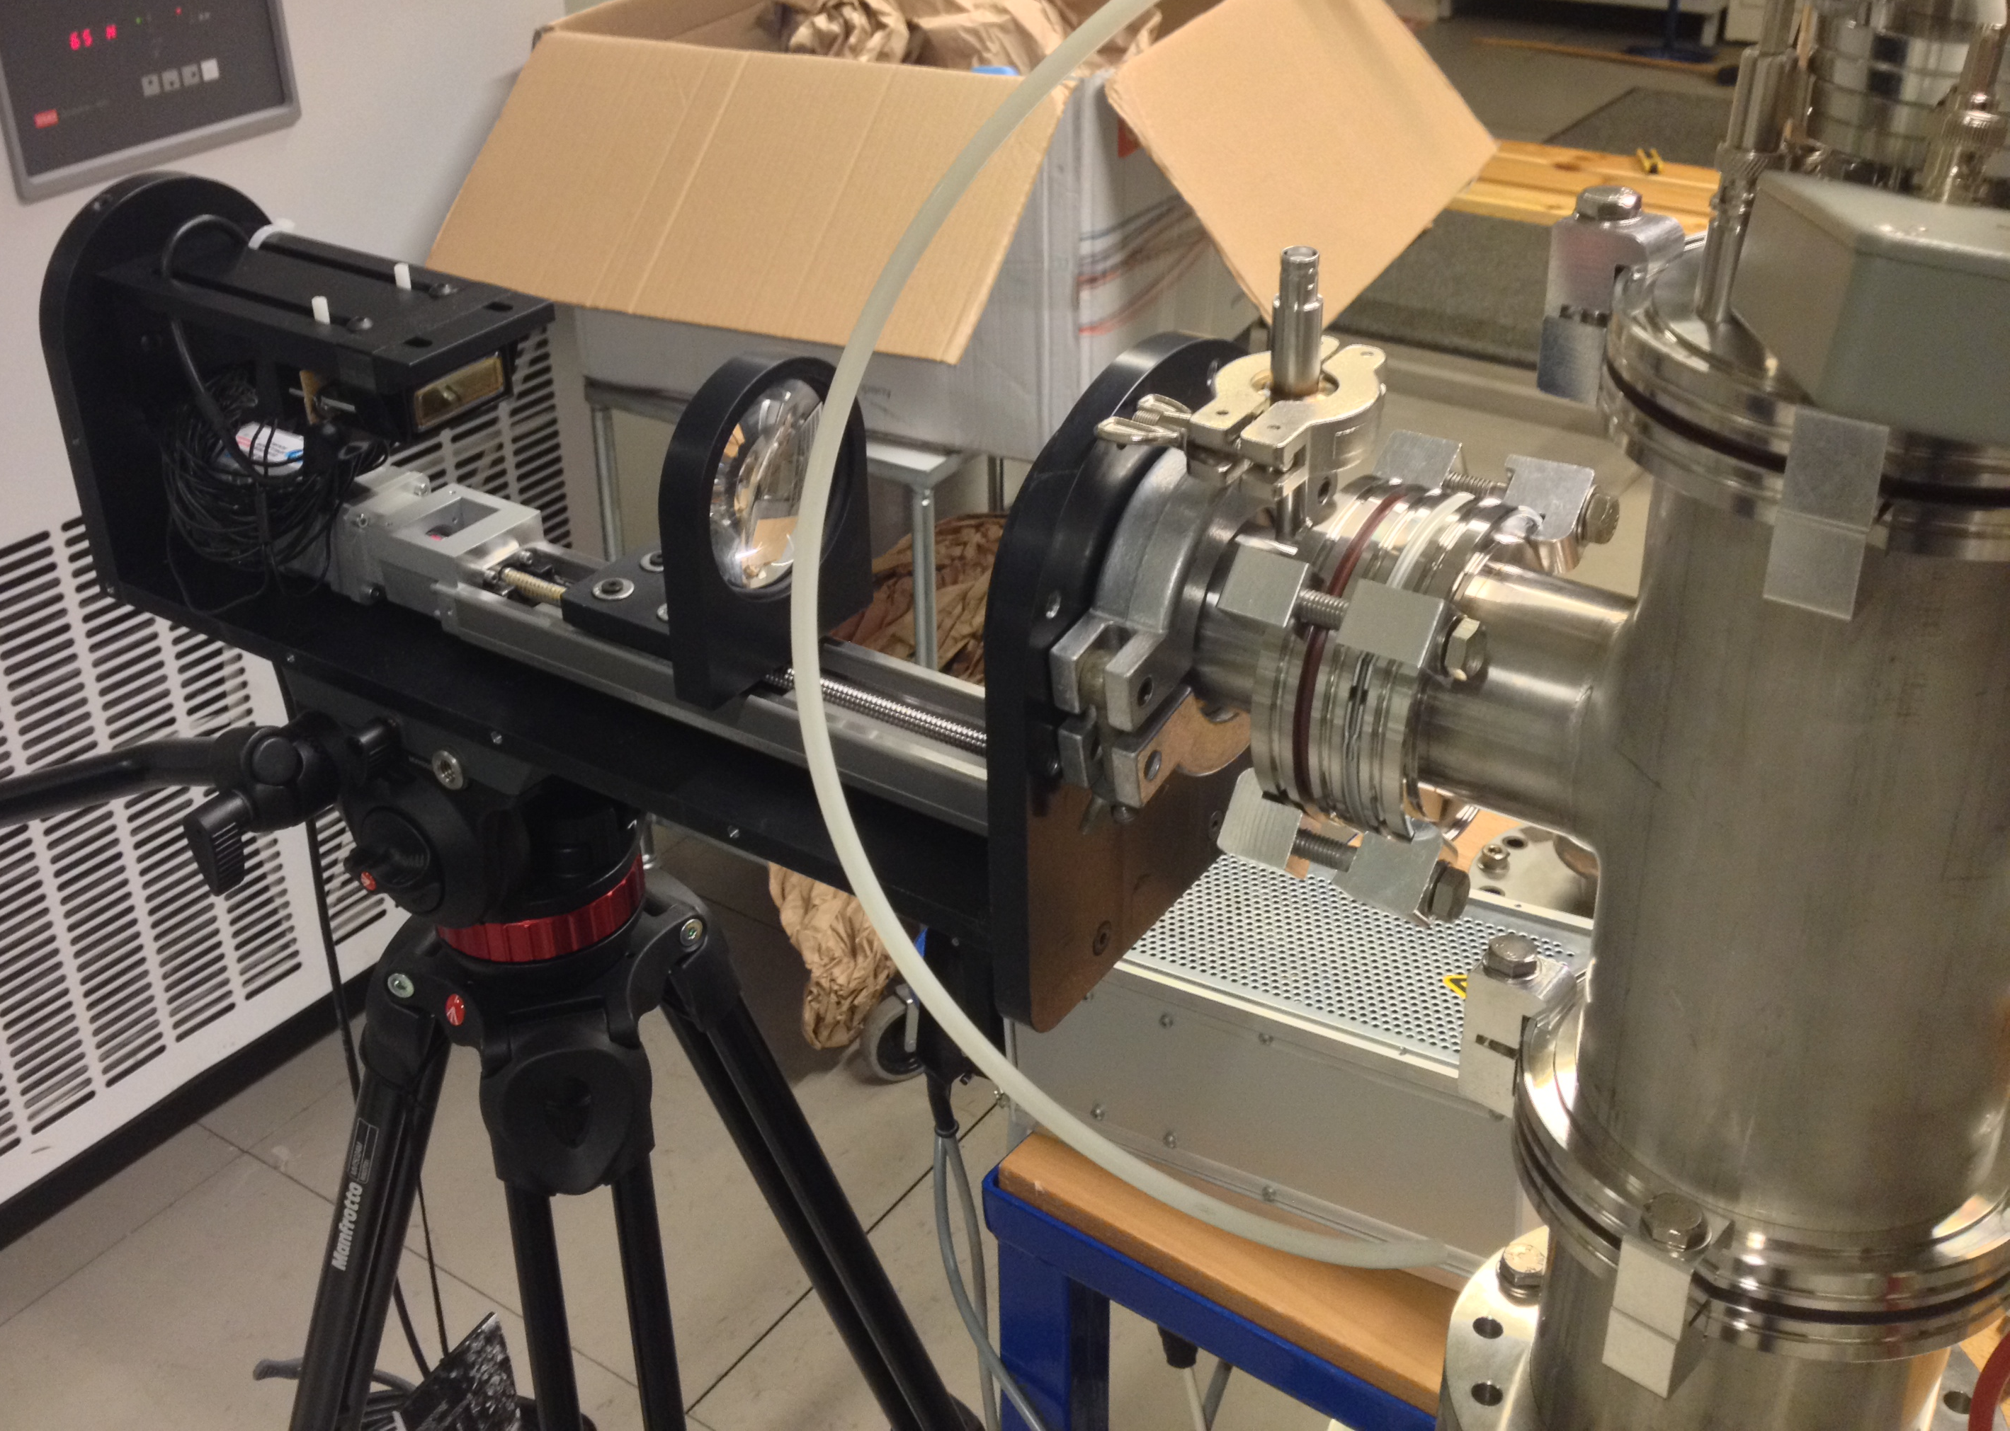
Ionization Profile Monitor
Experiments at DESIREE

Slide 10
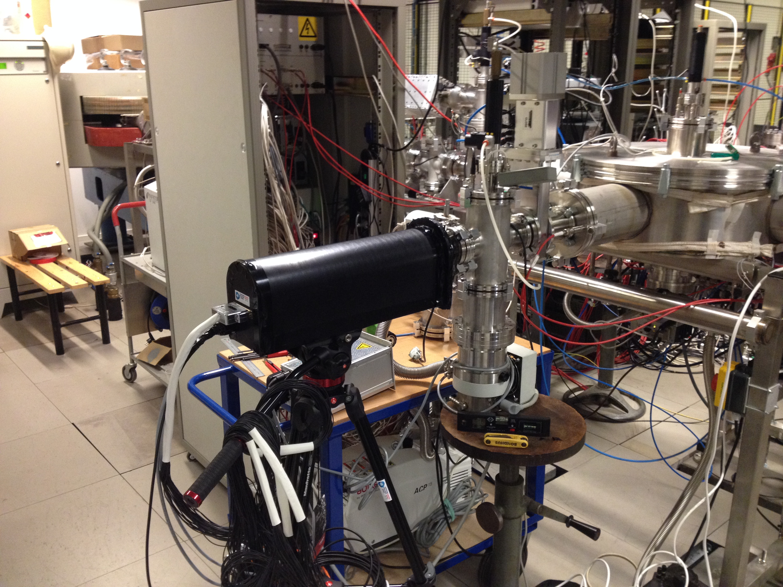
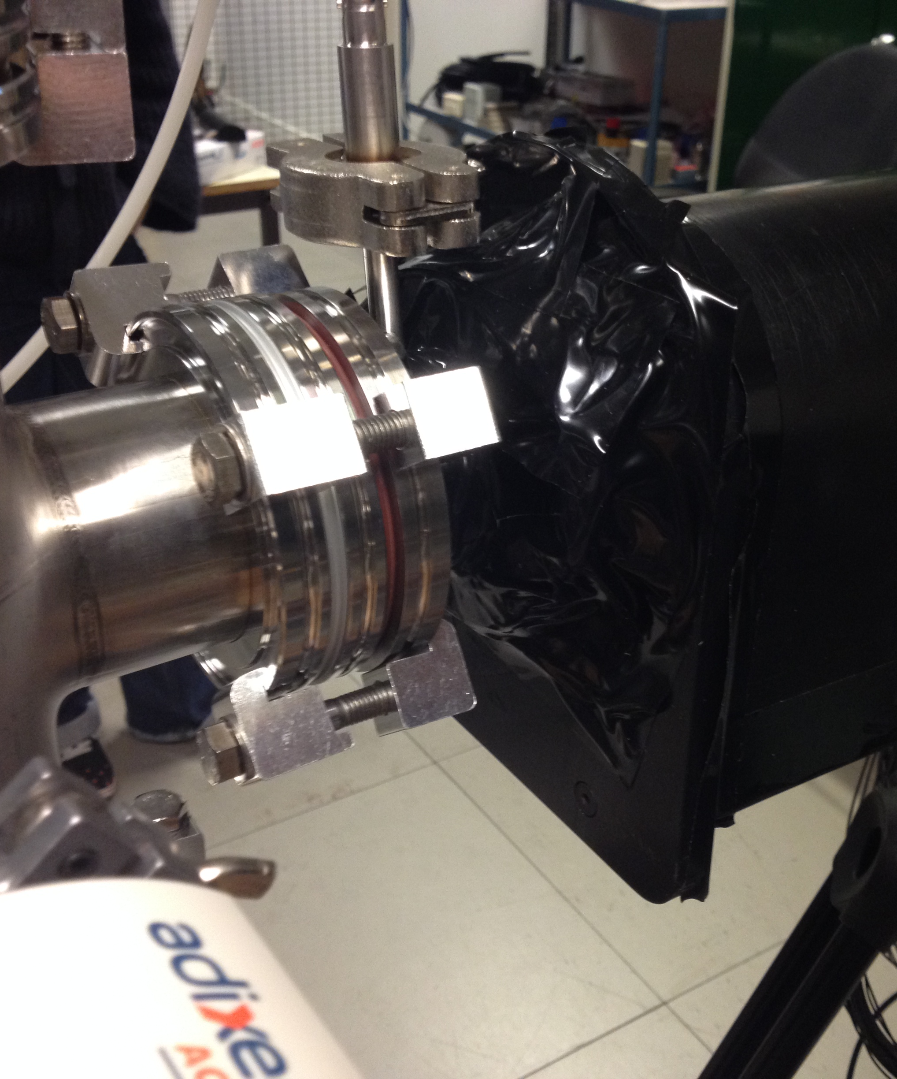
Ionization Profile Monitor
Experiments at DESIREE

Slide 11
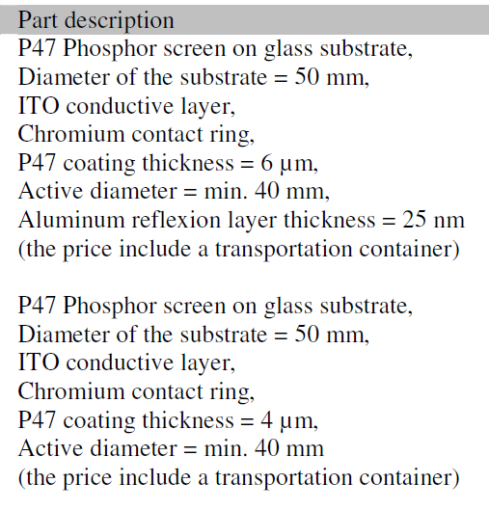
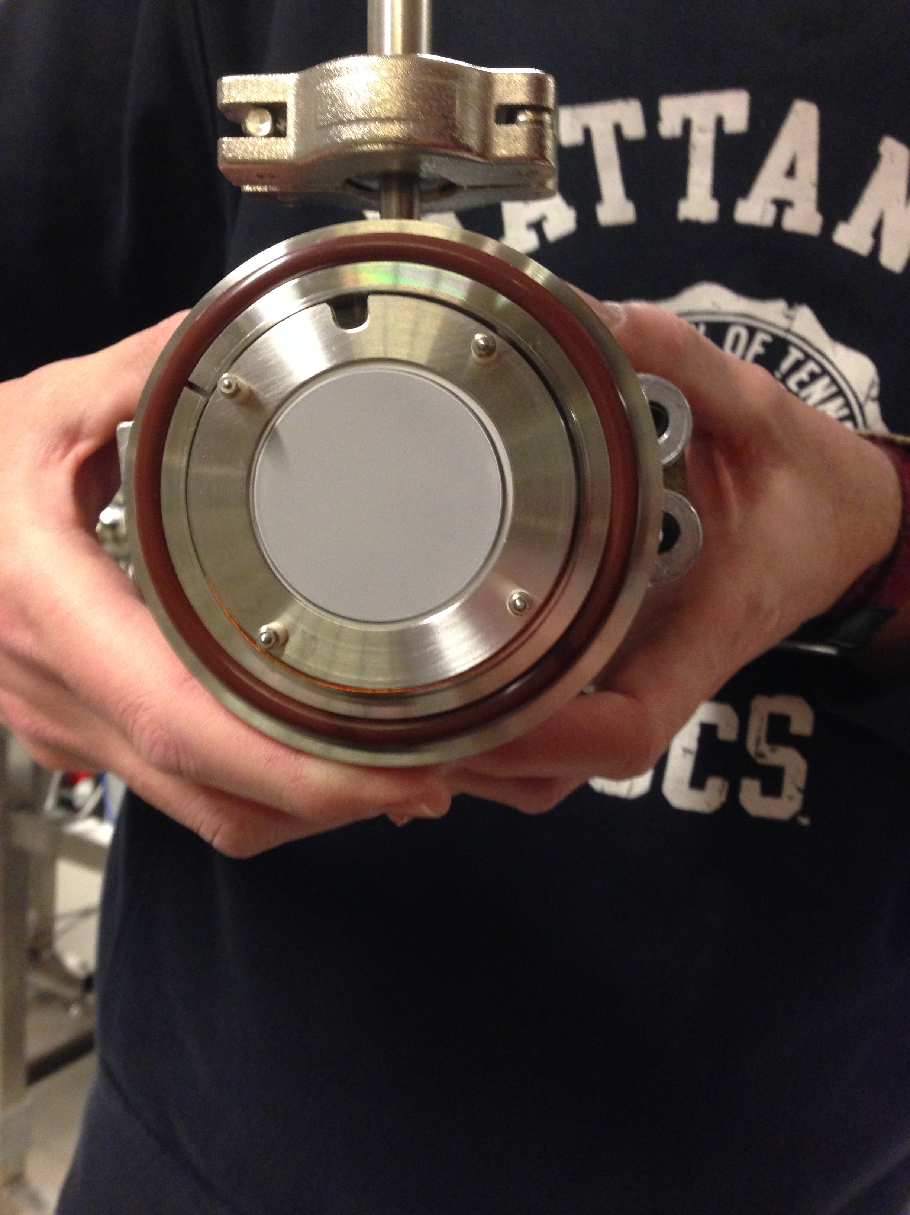
Ionization Profile Monitor
Experiments at DESIREE
Screens

Slide 12
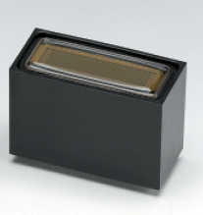
Ionization Profile Monitor
Experiments at DESIREE
PMT
Hamamatsu H7260-100
Linear Array Multianodes
0,8mm x 7mm x 32anodes
31,8mm x 7 mm

Slide 13
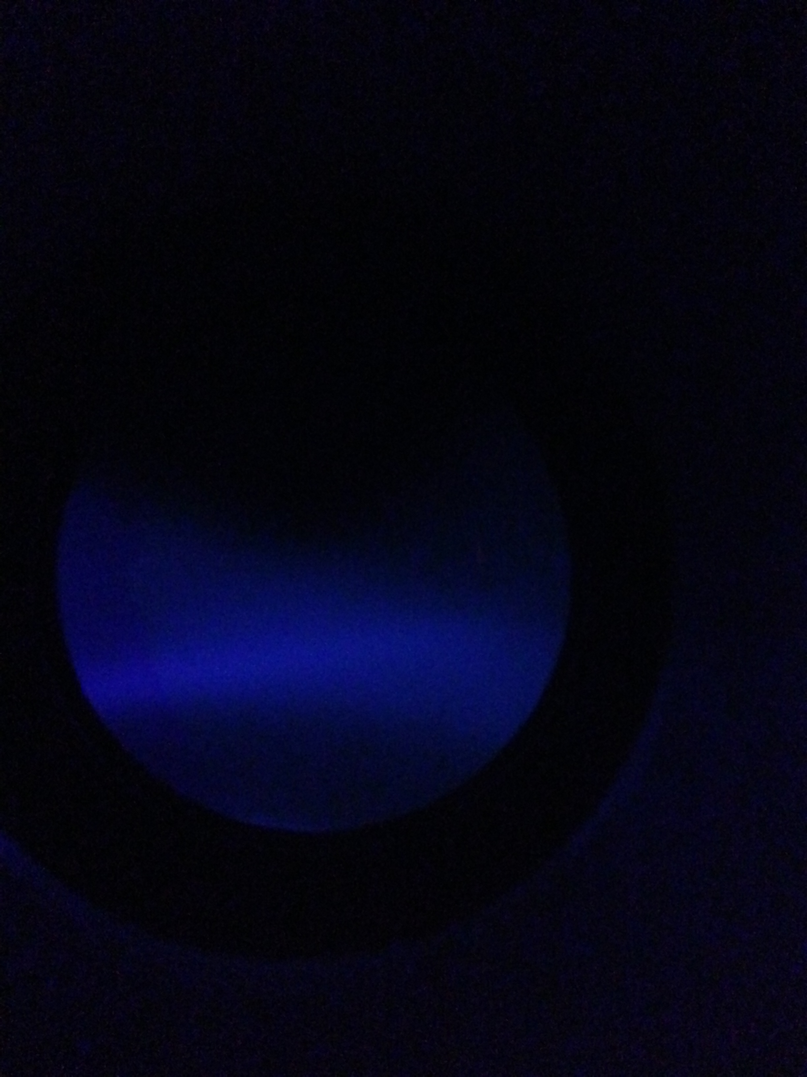
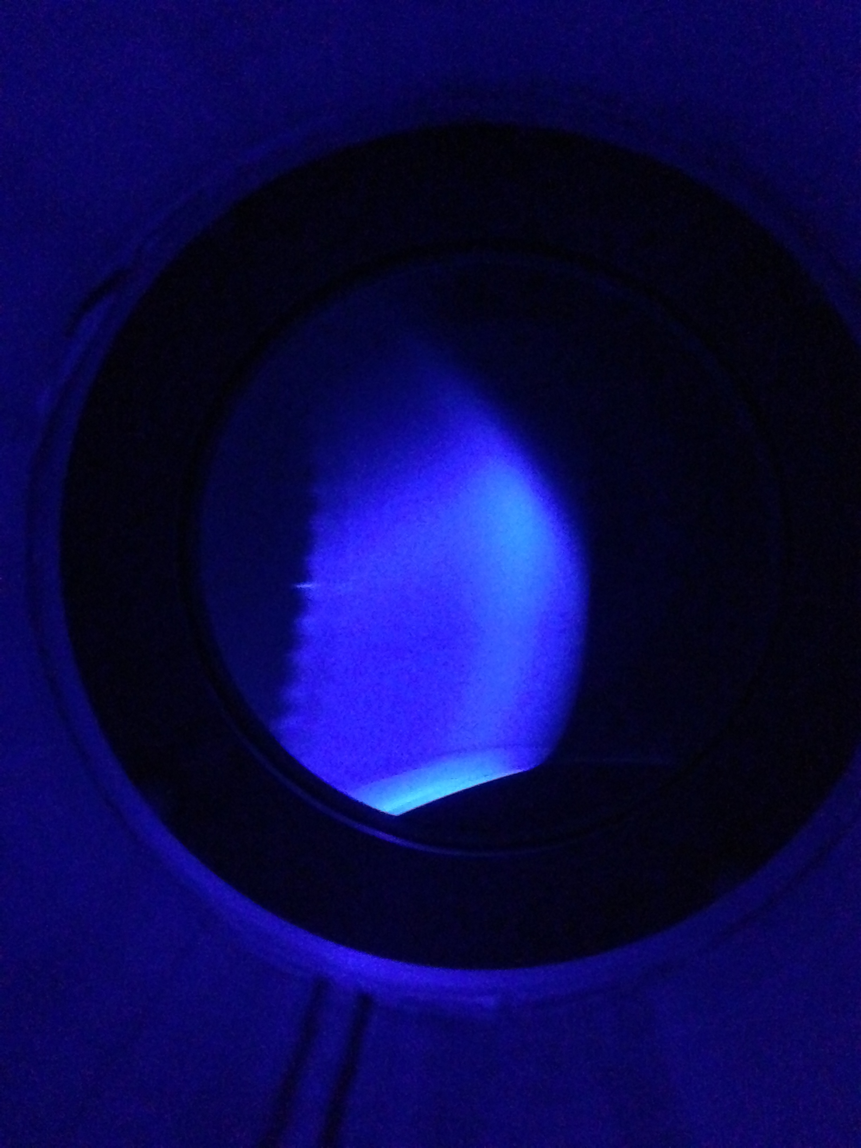
Ionization Profile Monitor
Experiments at DESIREE
Results

Slide 14
Ionization Profile Monitor
Experiments at DESIREE
Results

Slide 15
Ionization Profile Monitor
Experiments at DESIREE
Results
Beam shifted

Slide 16
Thank you for your attention

