Slide 1




Designs of the
Spoke and Elliptical Cavity Cryomodules
P. Bosland
CEA/Saclay IRFU
On behalf of the cryomodule technical demonstrator teams

Slide 2
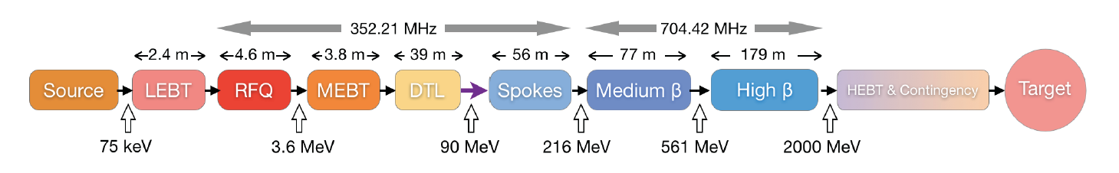
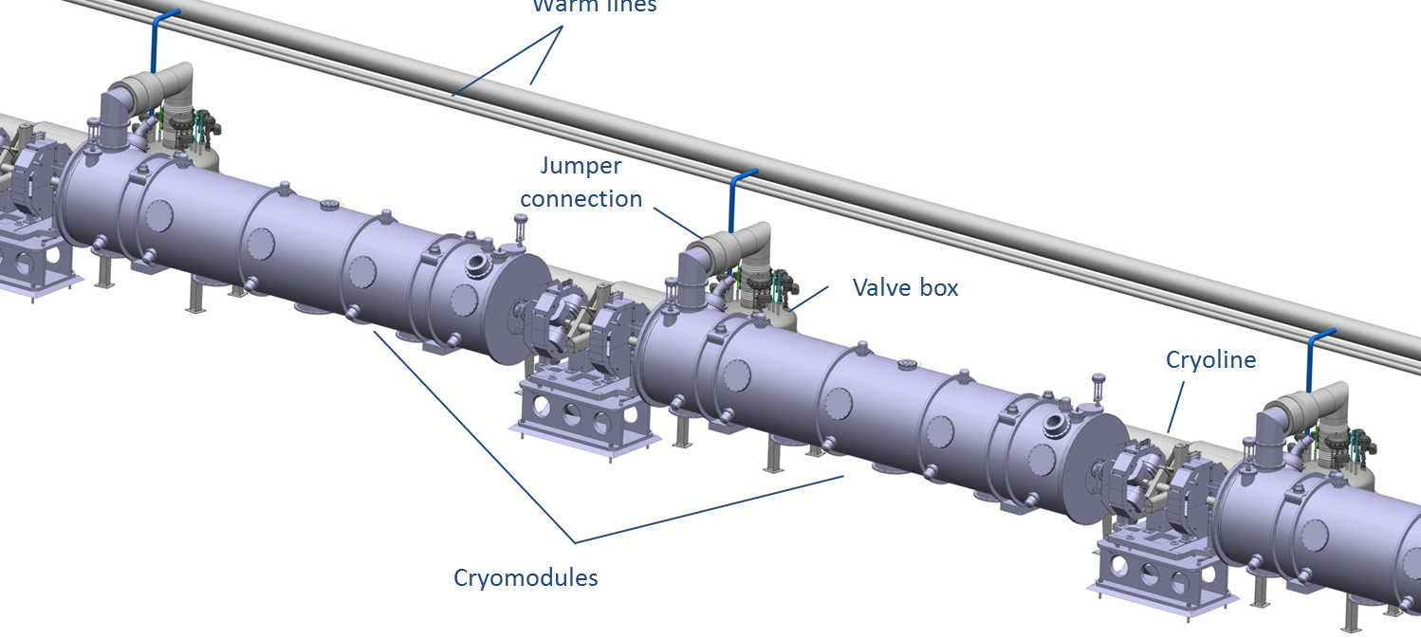
The ESS linac
Segmented, superconducting linac, with RT focusing elements
 | Num. of CMs | Num. of cavities
Spoke | 13 | 26
6-cell medium β | 9 | 36
5-cell high β | 21 | 84

Slide 3

FR – SW agreement + amendment
Technical Demonstrator
Spoke Cavity Cryomodule
IPNO
Sébastien Bousson – WP4
Stephen Molloy
IPNO in charge of the design fabrication and assembling
    Uppsala in charge of the
      * Tests stand for cryogenic and RF power tests FREIA (Yogi ‘s presentation)
      * Tests of the spoke cryomodule with IPNO

Slide 4
FR – SW agreement + amendment
Technical Demonstrator
Medium beta ECCTD
Collaboration IRFU – IPNO
P. Bosland WP5 - G. Olivier
Christine Darve
IPNO in charge of the cryostat – design and fabrication
    Vacuum vessel
    Space frame – cavity supports
    Thermal screen
    Superinsulation
    Internal cryogenic pipes
    Instrumentation
IRFU in charge of the “cavity package”, the cryomodule assembly and RF power tests:
    Cavities + helium tank
    Power coupler design, manufacturing, RF tests
    Piezo tuner
    Magnetic shield
    Tooling: field flatness, cavity preparation, cryomodule assembling, …
    Cryomodule assembly
    Tests stand for cryogenic and RF power tests
    Tests of the ECCTD cryomodule

Slide 5
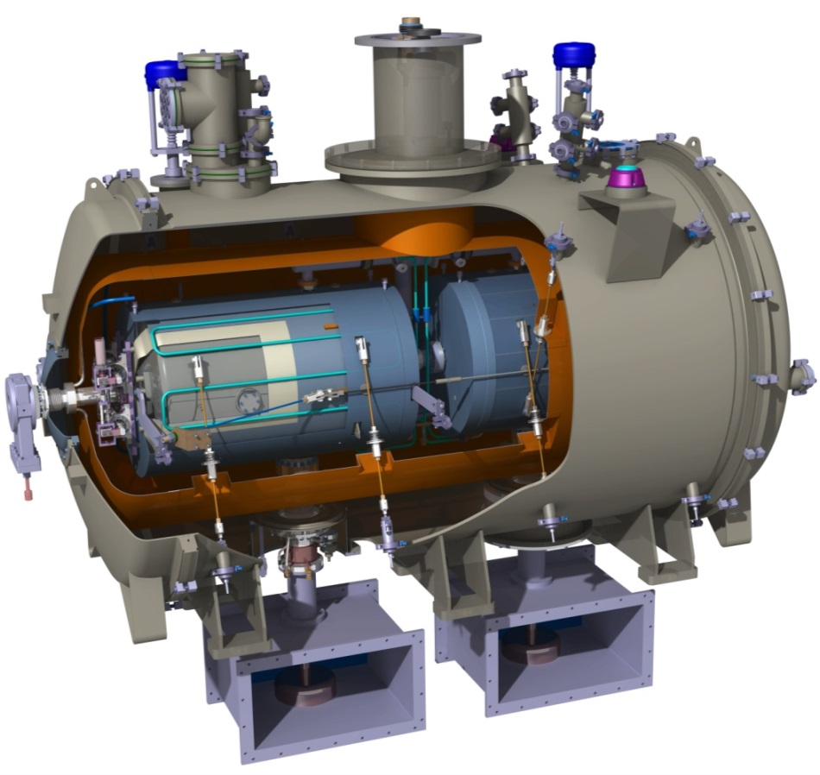
2 double spoke cavities cryomodules
Diameter
1350 mm
2900 mm

Slide 6
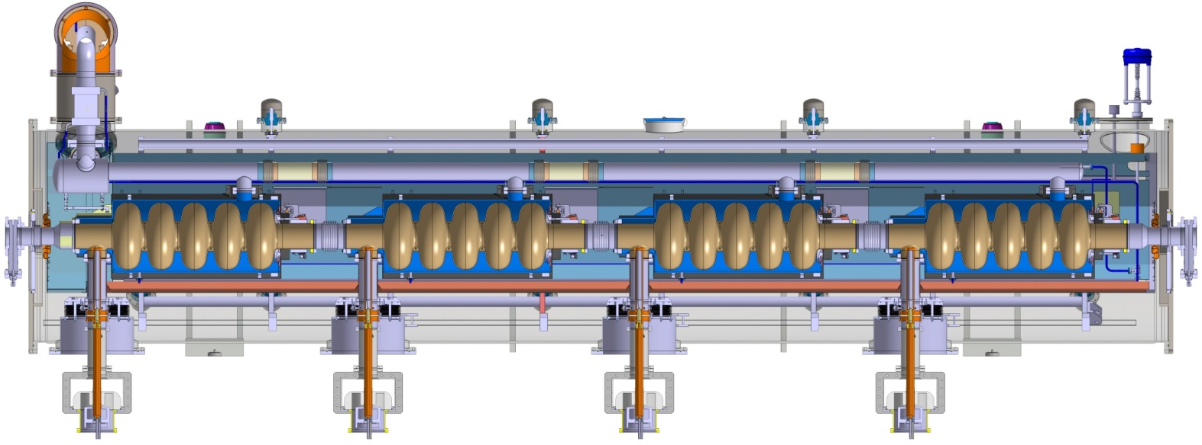
4-cavity cryomodules
Elliptical Cavity Cryomodules
ECC
Similarity with SNS in size and purpose : reuse the same concepts
Common design for medium and high beta
  Main components are identical : vaccum vessels, thermal shield, supports, alignment system, etc.
  Only few elements differ : details in cryo piping, beam pipe bellows
  57mm: length difference between 6-cell medium and 5-cell high beta cavities
Diameter
1200 mm
1500 mm
6600 mm

Slide 7
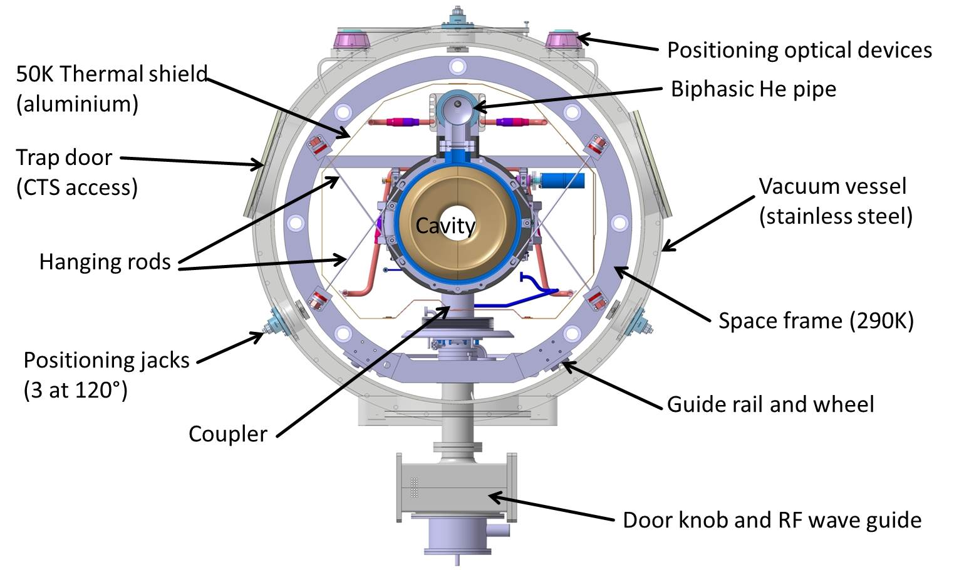
ECC cross-section
50K Thermal shield (Aluminum)
Positioning optical devices
Two phase He pipe
Lateral port
(CTS, alignment)
Vacuum vessel
(stainless steel - 1200 mm diam.)
Tie rods (TA6V)
Space frame
Positioning jacks
(3 at 120°)
Power coupler
Guide rail and wheel
Waveguide transition

Slide 8
2 double spoke cavities cryomodules
Diameter
1350 mm
Cavities supported by rods fixed on the vacuum tank
No spaceframe
2900 mm

Slide 9
RF parameters
Spoke cavities
Elliptical cavities
Frequency (MHz) | 352,2
Optimum beta | 0,50
Operating temperature (K) | 2
Nominal Accelerating gradient (MV/m) | 9
Lacc (βopt.x nb gaps x λ/2) (m) | 0,639
Bpk (mT) | 79 (max)
Epk (MV/m) | 39 (max)
Bpk/Eacc (mT/MV/m)) | <8,75
Epk/Eacc | <4,38
Beam tube diameter (mm) | 50
RF peak power (kW) | 335
G (Ω) | 130
Max R/Q (W) | 427
Qext | 2,85 10⁵
Q0 at nominal gardient | 1,5 10⁹
 | Medium | High
Geometrical beta | 0.67 | 0.86
Frequency (MHz) | 704.42
Number of cells | 6 | 5
Operating temperature (K) | 2
Epk max (MV/m) | 44 | 44
Nominal Accelerating gradient (MV/m) | 16.7 | 19.9
Q₀ at nominal gradient | > 5e9
Q_{ext} | 7.5 10⁵ | 7.6 10⁵
Iris diameter (mm) | 94 | 120
Cell to cell coupling k (%) | 1.22 | 1.8
p and 5p/6 (or 4p/5) mode separation (MHz) | 0.54 | 1.2
Epk/Eacc | 2.36 | 2.2
Bpk/Eacc (mT/(MV/m)) | 4.79 | 4.3
Maximum. r/Q (W) | 394 | 477
Optimum β | 0.705 | 0.92
G (Ω) | 196.63 | 241
RF peak power (kW) | 1100

Slide 10
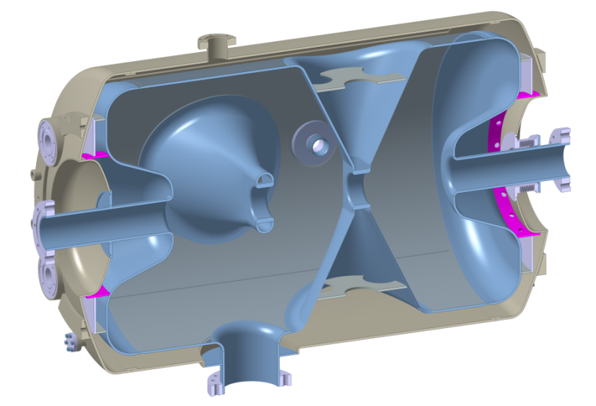
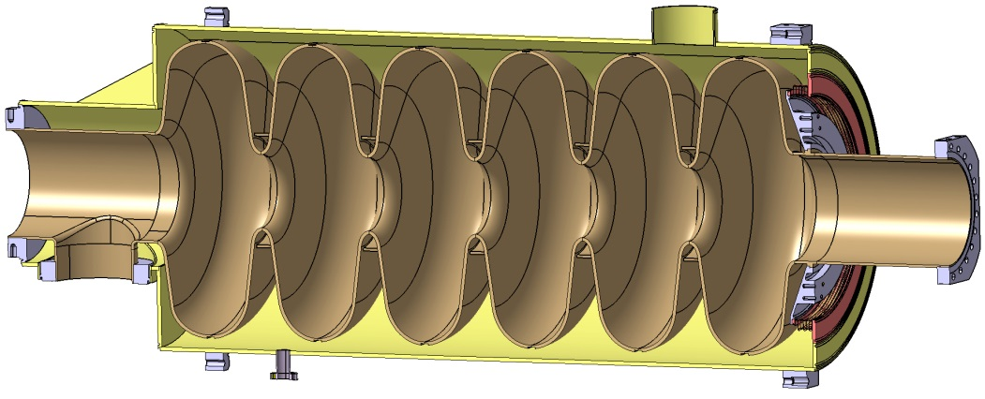
Medium beta elliptical cavity
Spoke cavity
Hydroformed Ti bellow
(+/- 3mm range)
Ti He vessel
994 mm
1259 mm
550 mm
418 mm
Stiffeners
(Lorentz force detuning compensation)
Stiffeners on the Spoke bars
(vacuum pressure)
Ti cone and tuner attachement
Power coupler port

Slide 11
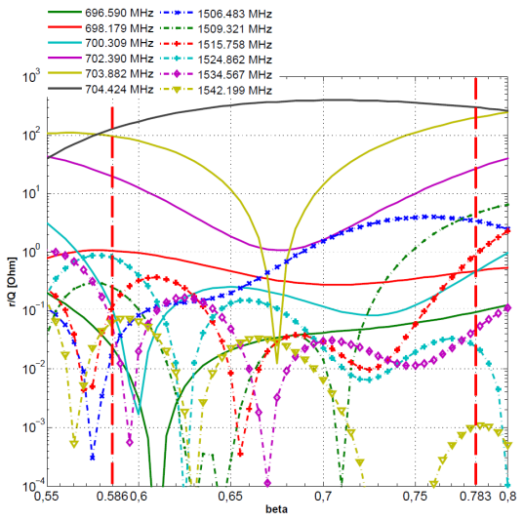
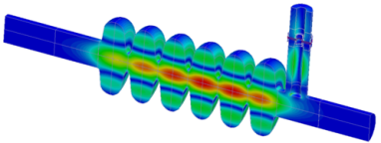
HOMs in the medium beta cavity
Medium beta
r/Q versus beta
Frequency (MHz) | r/Q (Ohm) | QL estimate
1506.48 | 0.444 | 13000
1509.32 | 0.0021 | 7000
1515.76 | 0.0020 | 5000
1524.86 | 0.127 | 3000
1534.57 | 0.0001 | 2000
1542.20 | 0.0032 | 3000
High beta has 1 L-band below cutoff

Slide 12
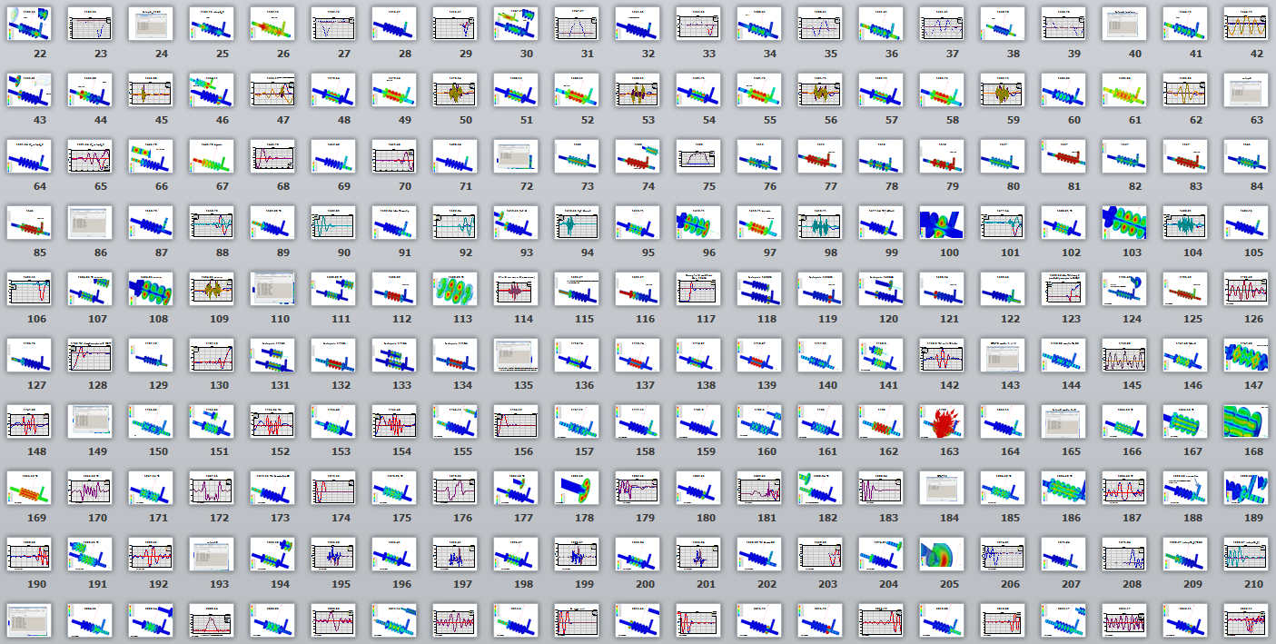
Medium beta cavity HOM catalog …
! HOM frequency 1762MHz close to 5 x beam frequency !

Slide 13
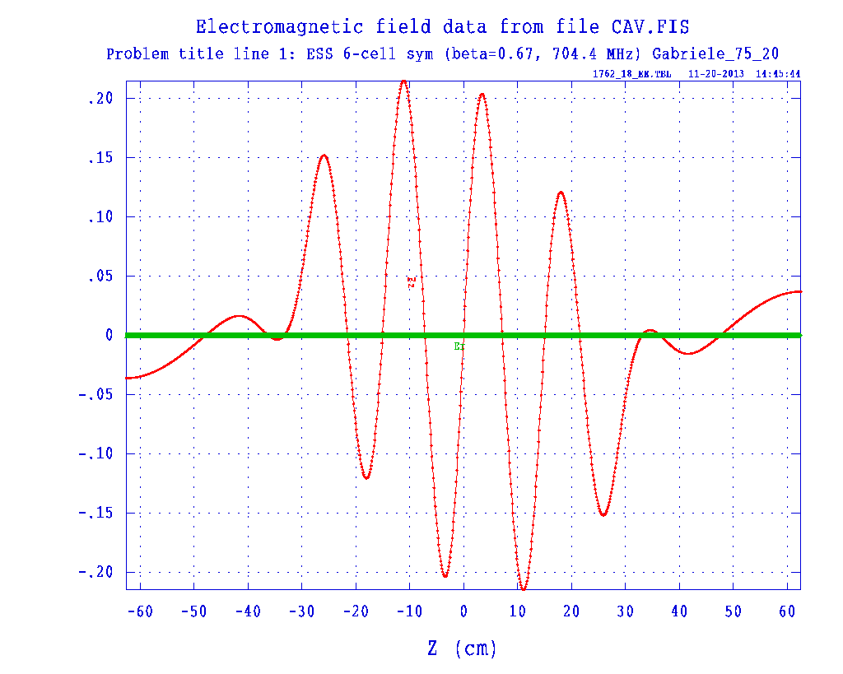
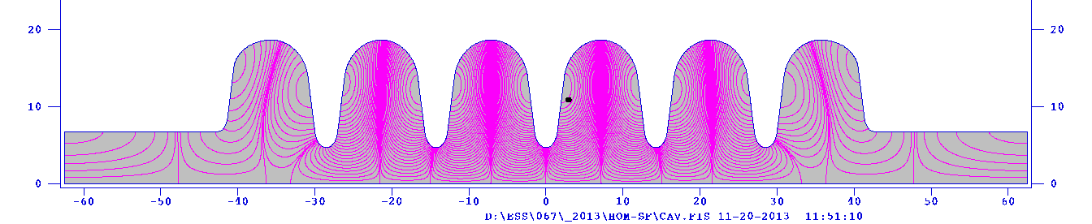
Above cutoff but…
Energy mainly trapped in the 4 inner cells

Slide 14
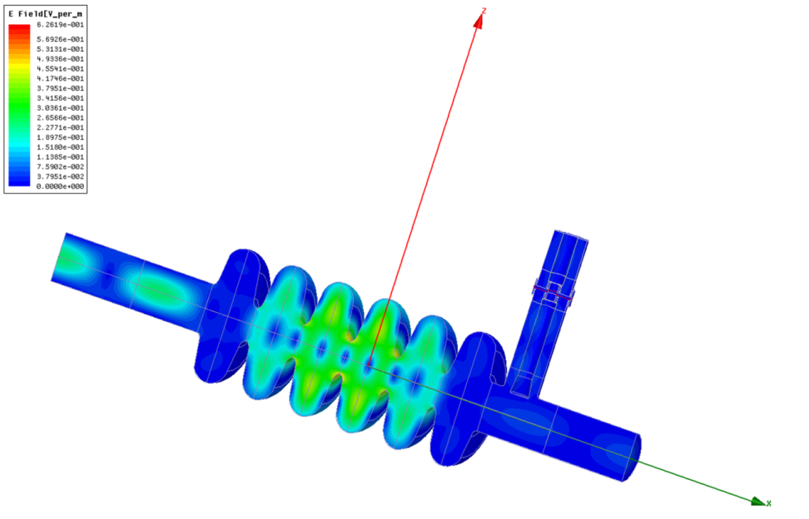
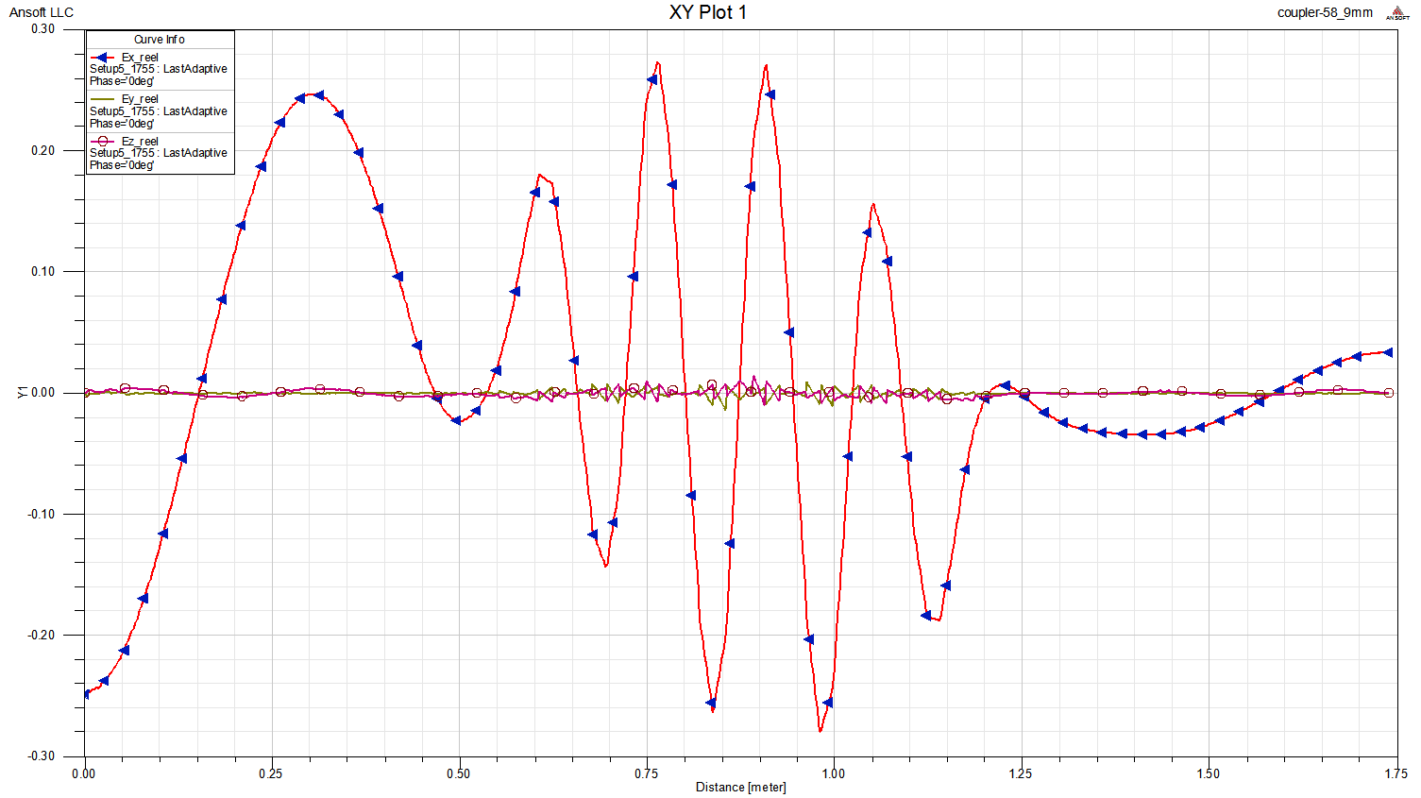
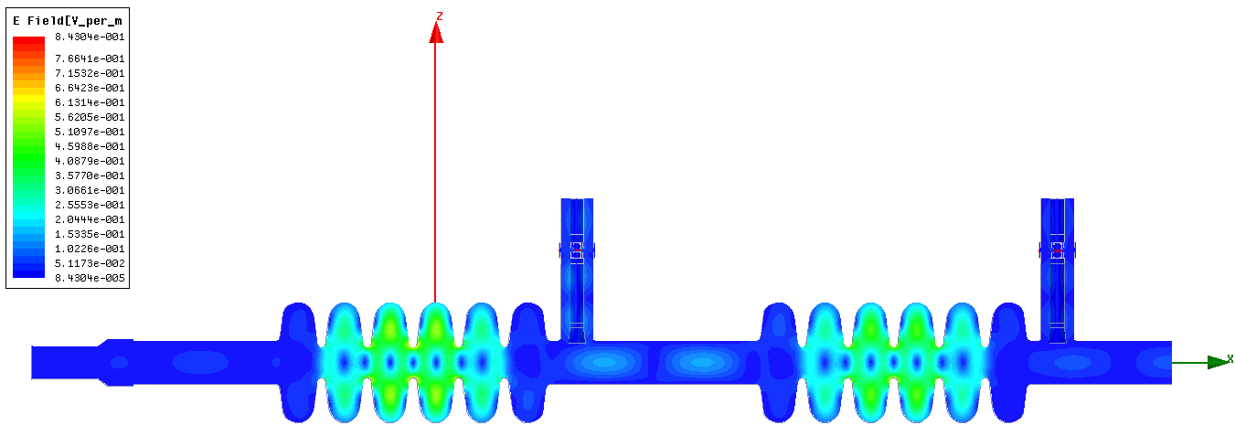
Work in progress to allow the mode to escape from the inner cells and be damped outside the cavity
Qloaded = 5.1e4

Slide 15
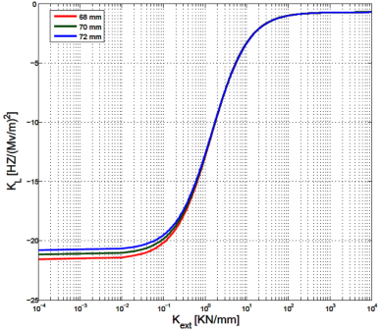
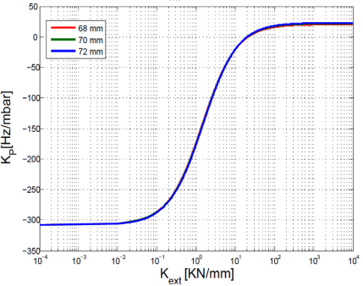
Medium beta RF/Mechanical parameters
Cavity wall thickness (mm) | 4
Tuning sensitivity (kHz/mm) | 217
Stiffness (kN/mm) | 1.47
K_{L} static Lorentz coefficient (Hz/(MV/m)²) (fixed ends) | -0.71
K_{L} static Lorentz coefficient (Hz/(MV/m)²) | -21.1
K_{L} static Lorentz coefficient (Hz/(MV/m)²) for Kext=21 kN/mm ( ) | -2.06
Max. relative pressure (bar) in He vessel at 300K keeping V.M. stress in cavity wall < 40 MPa (fixed ends, pressure test case) | 2.2
Max. Von Mises stress (MPa) in cavity wall with 1.5 bar in helium vessel | 28
R rings
R rings
Fixed
ends
Fixed
ends
Free
ends
Free
ends
Static Lorentz detuning
Pressure sensitivity

Slide 16
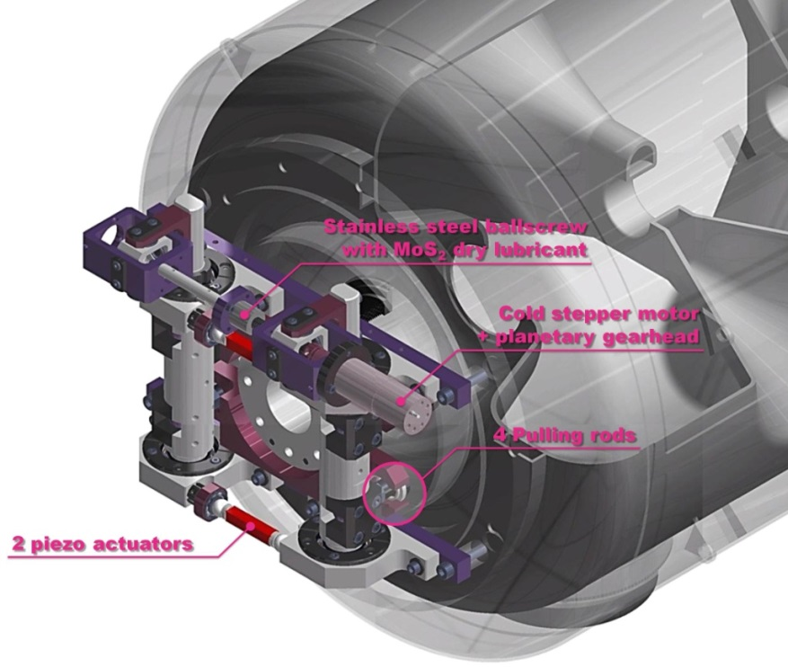
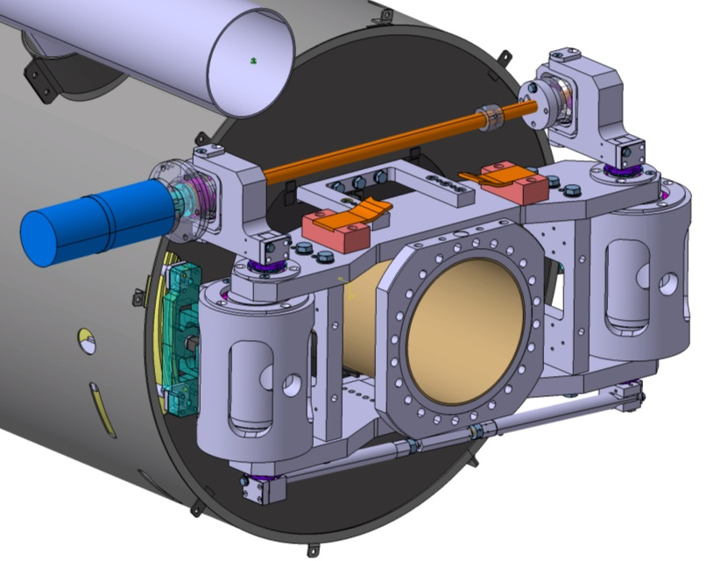
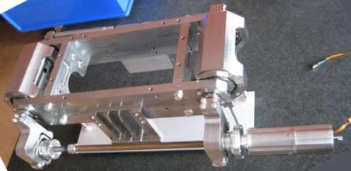
Piezo tuners working at cold
Stepper motor and planetary gearbox (1/100e) at cold and in vacuum
2 piezo stacks
Elliptical cavities:
Tuner of Saclay V type
CTS linearity at 4.2K of type V-HIPPI
Type V for SPL beta = 1 5-cell prototype - +/- 3 mm range on the cavity

Slide 17
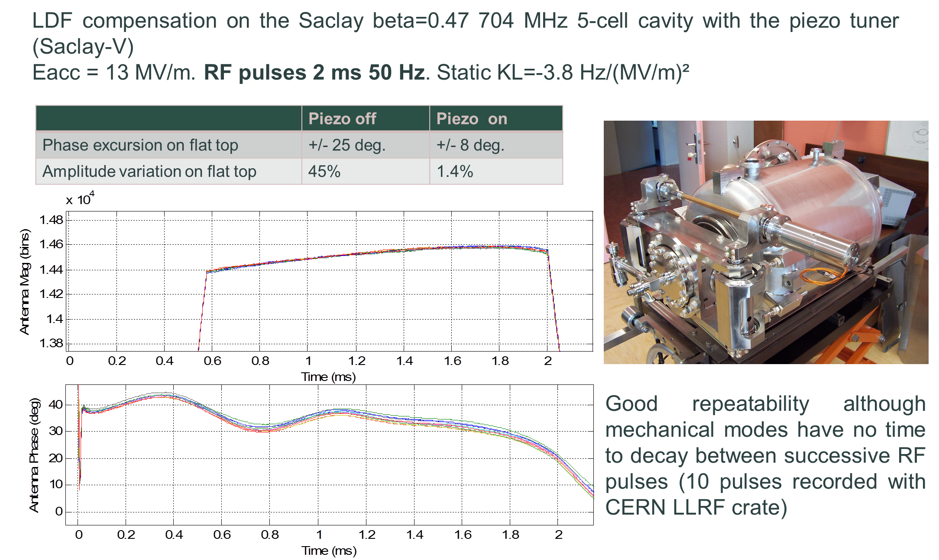
Piezo tuner – type Saclay V
tested with the HIPPI cavity

Slide 18
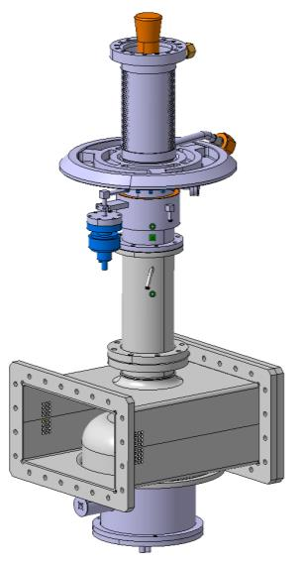
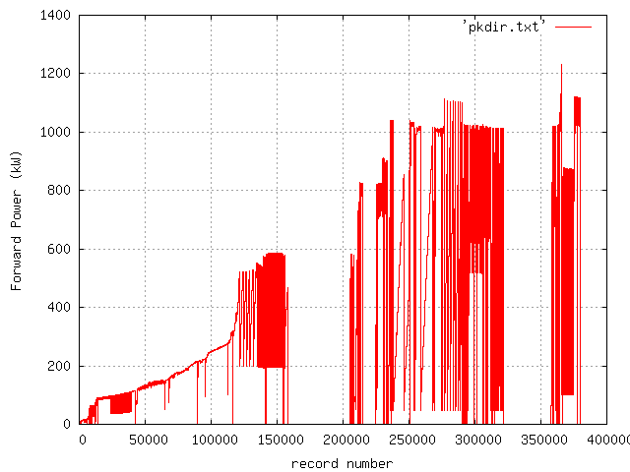
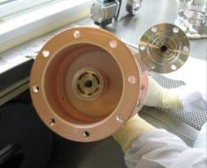
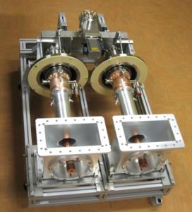
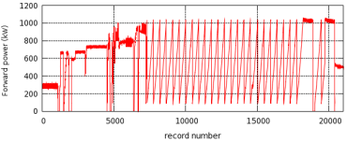
Fundamental power coupler
Spoke: 335 kW
Elliptical cavities: 1100kW
HIPPI power coupler (KEK-type window) tested to 1.2 MW, 10% Duty factor at Saclay
Test of the HIPPI power coupler on the HIPPI cavity at 1.8 K, full reflection

Slide 19
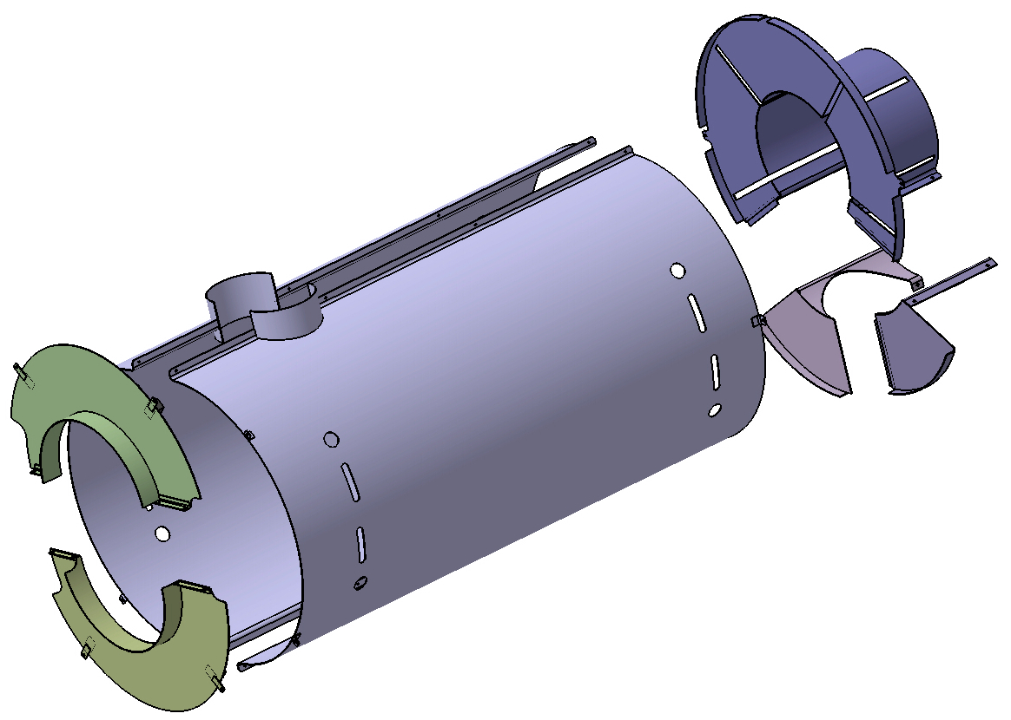
Magnetic shield
Limit contribution of the trapped flux to the surface resistance to 4 nΩ
limit the external static field to Bext = 14 mG.
→ required shielding efficiency equal to 35.
Achievable with 1.5 mm, µ_{r} =20000 shielding material
Ex: magnetic shield of the elliptical cavities

Slide 20
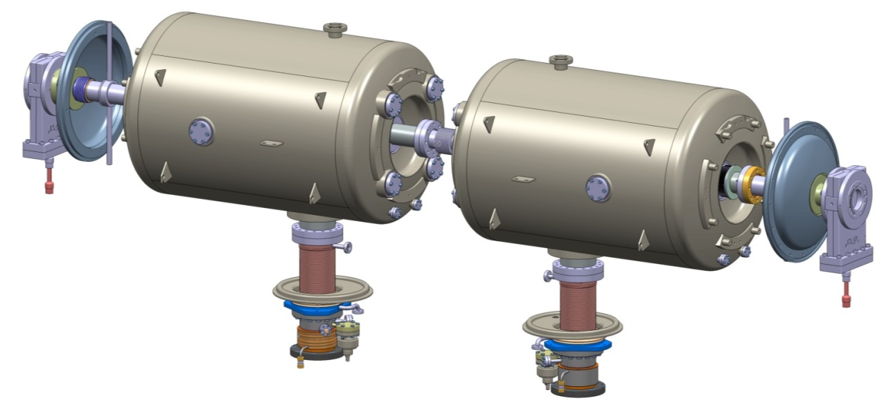
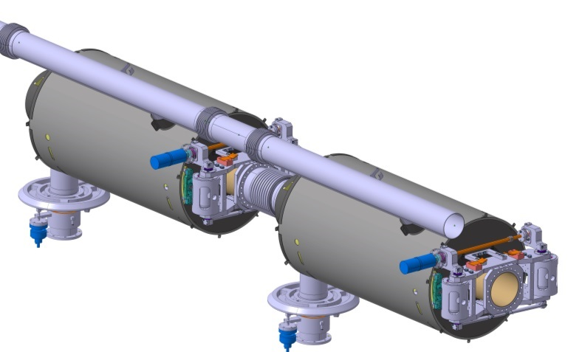
ECC Cavity strings
Spoke cavities with couplers
2 elliptical cavities with couplers, tuners and magnetic shields

Slide 21
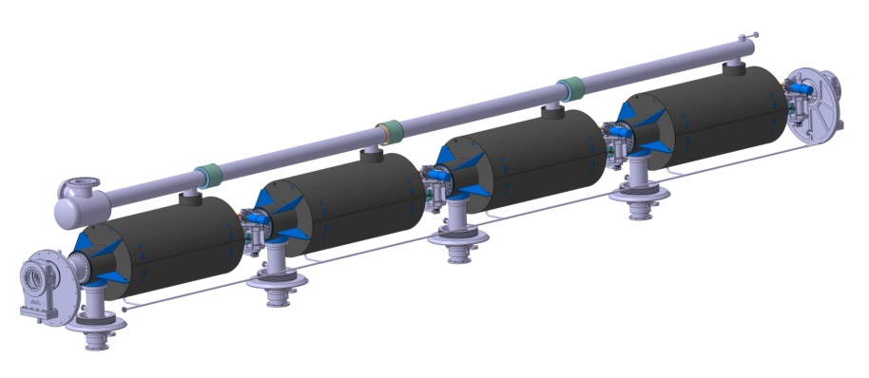
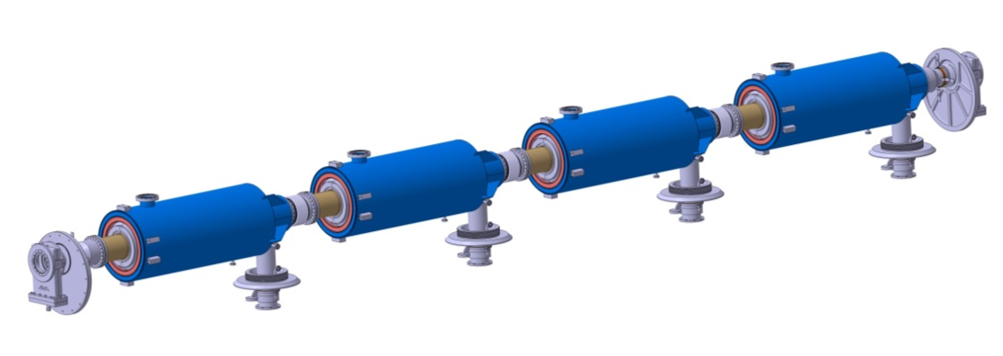
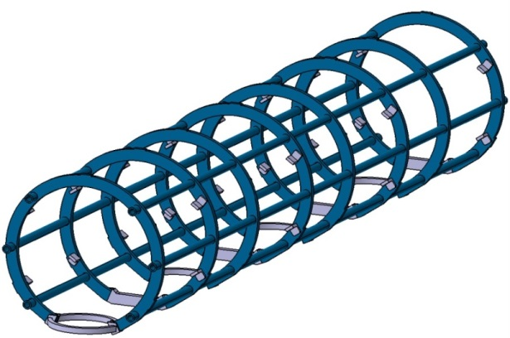
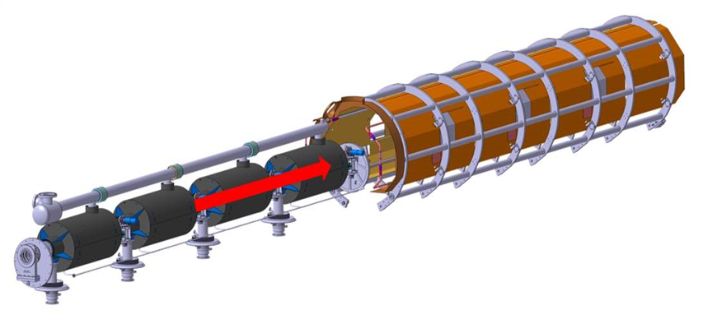
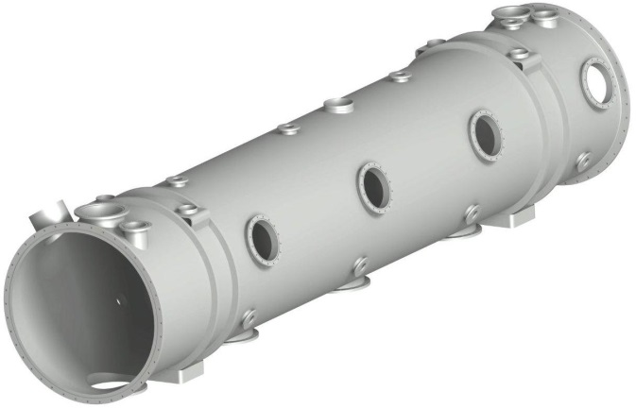
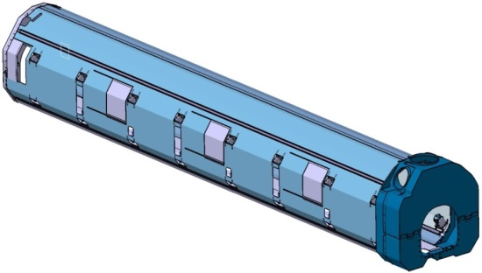
Main steps of the assembly procedure
Cavity string assembly in clean room
Cold mass assembly (outside the clean room)
Spaceframe
Thermal shield
Vacuum
vessel
Design concept of the tooling: most of the parts will be used for both types of cryomodules

Slide 22
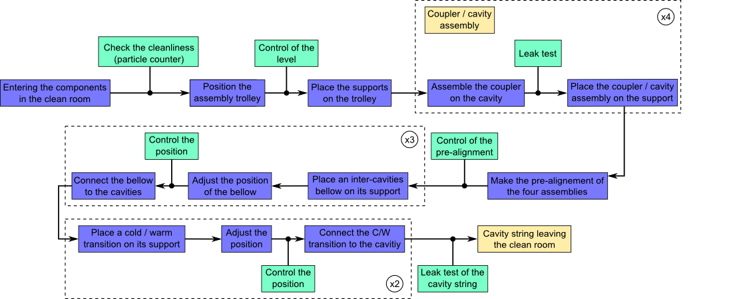
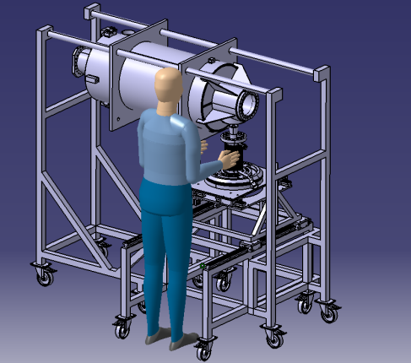
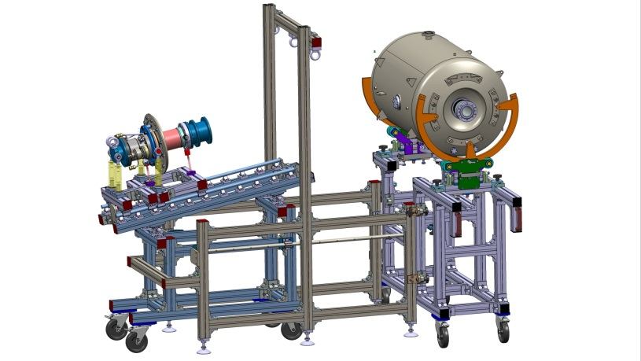
Assembly procedure in clean room
Procedure for elliptical cryomodules:
Tooling for elliptical cavities:
Tooling for spoke cavities:

Slide 23
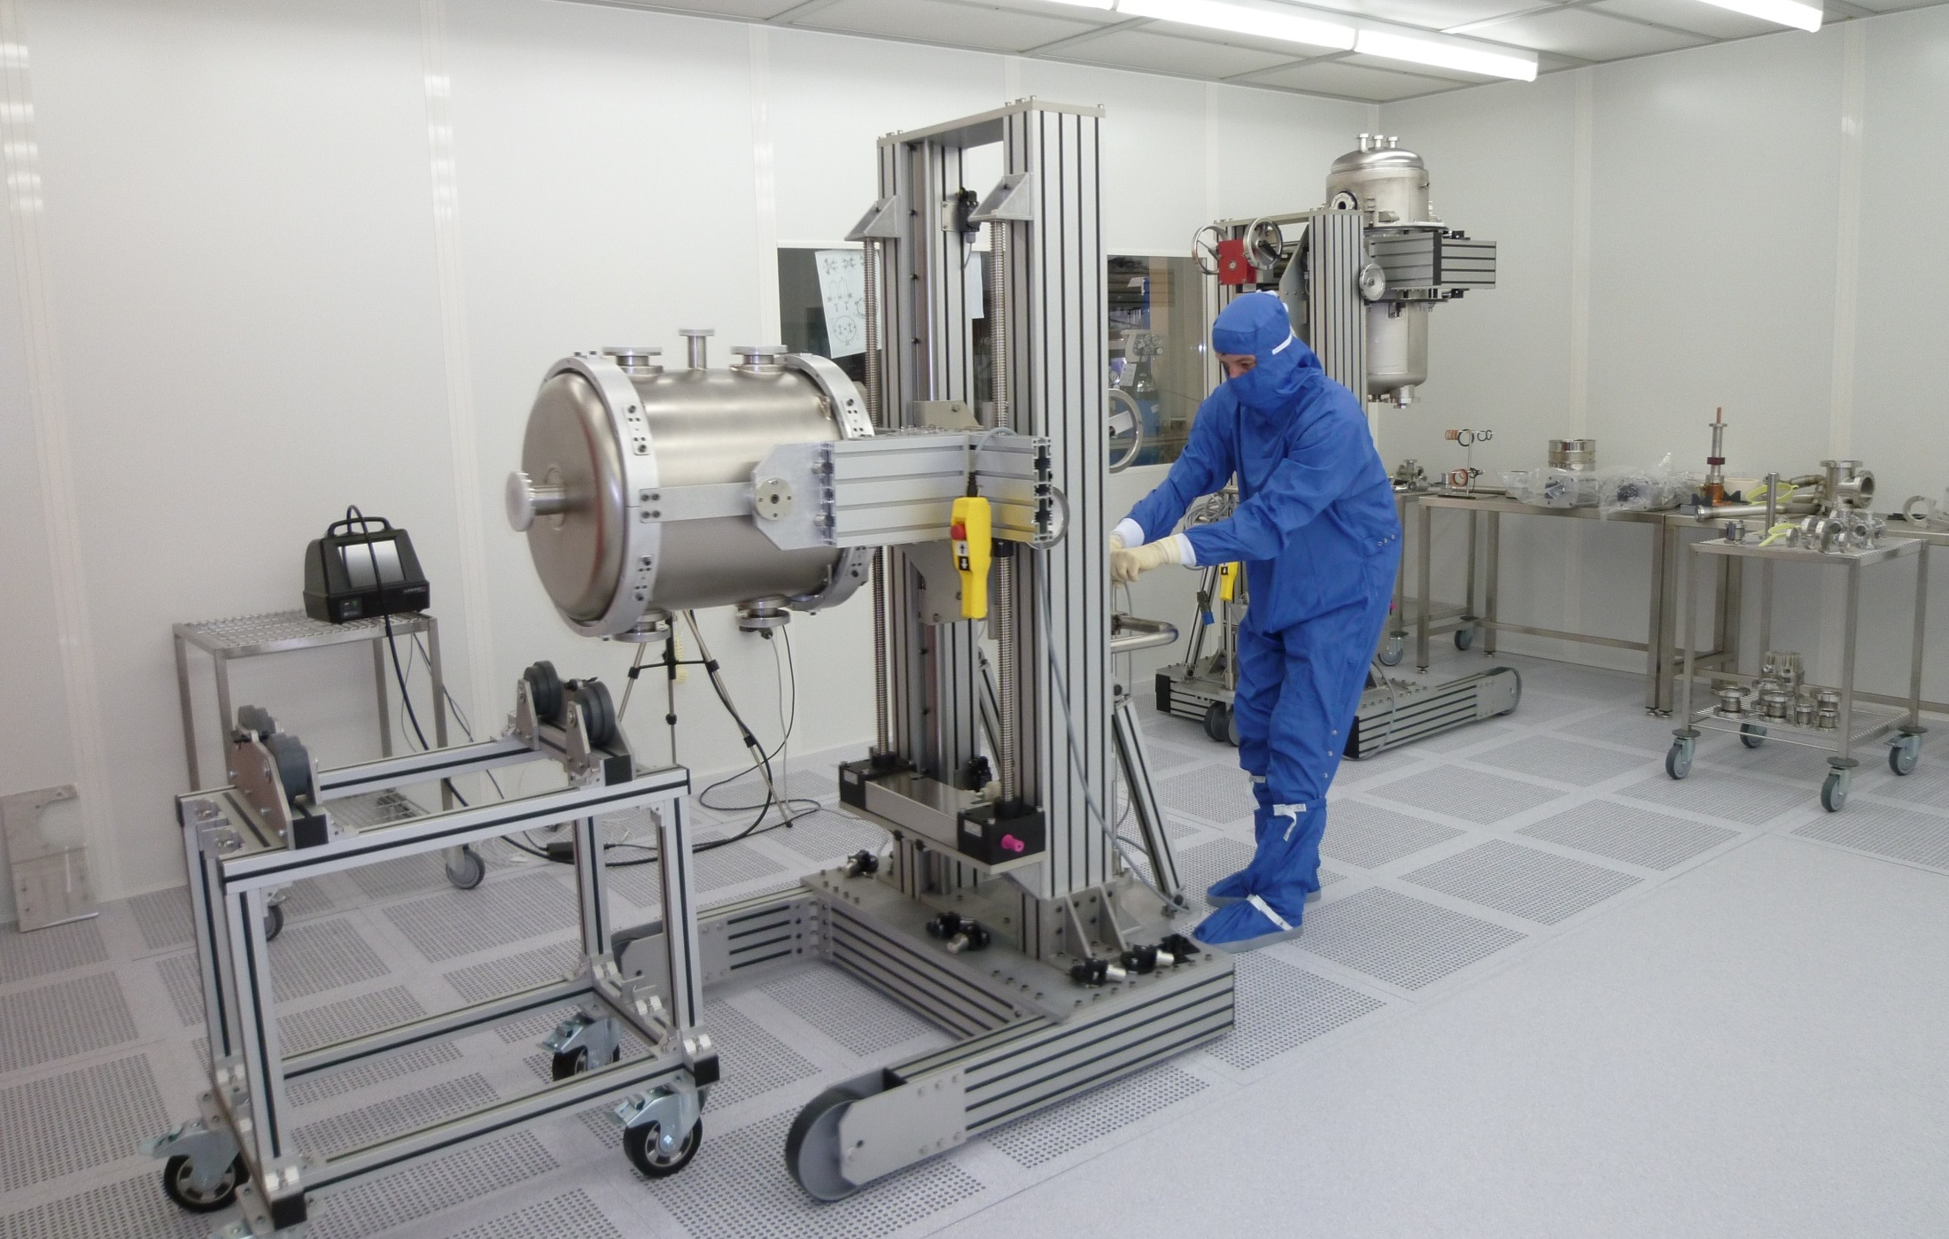
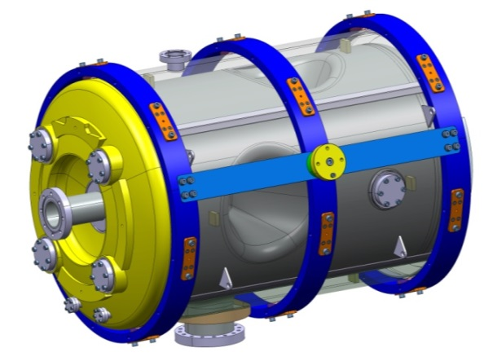
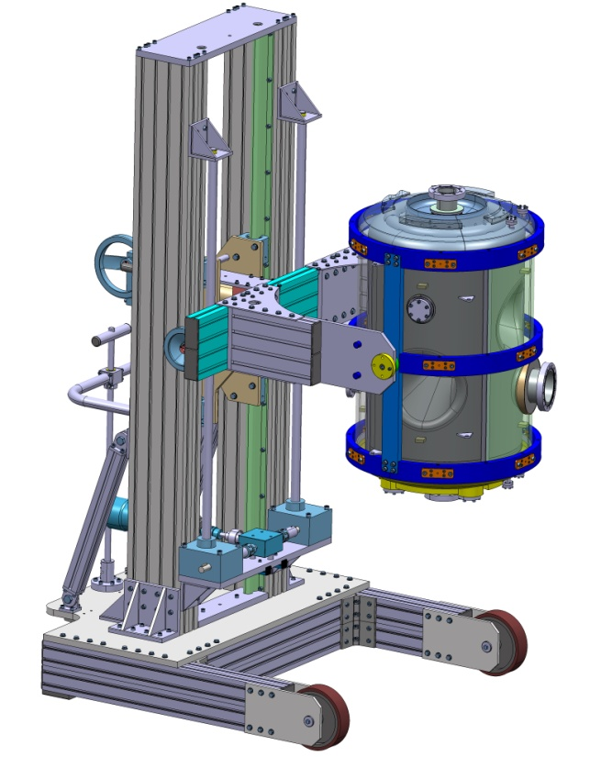
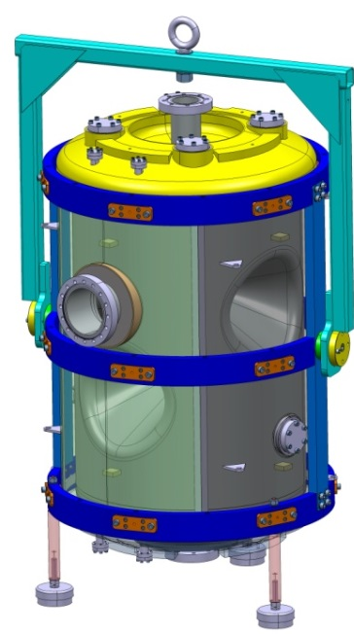
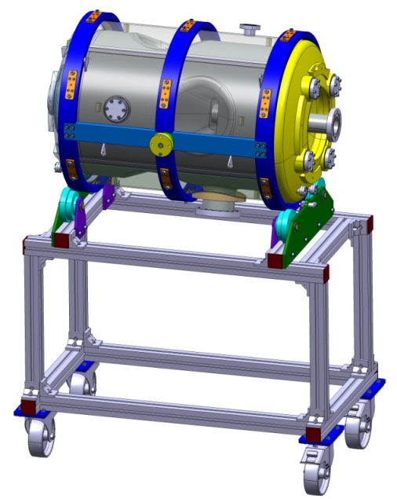
Assembling tools in clean room at IPNO

Slide 24
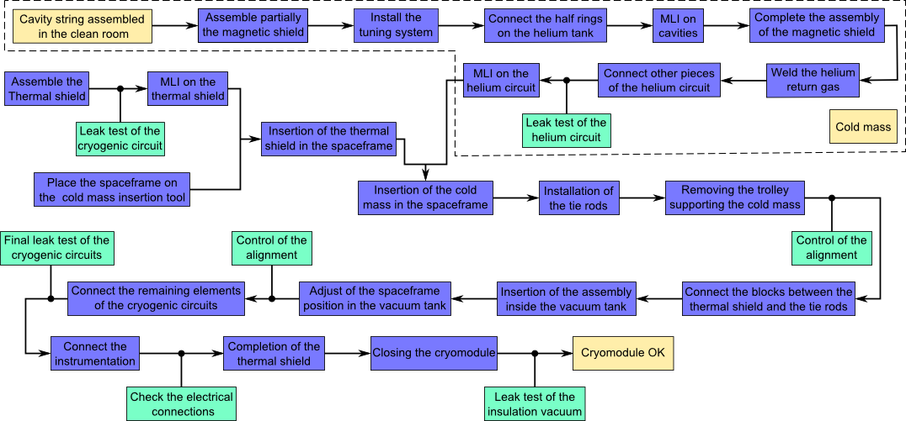
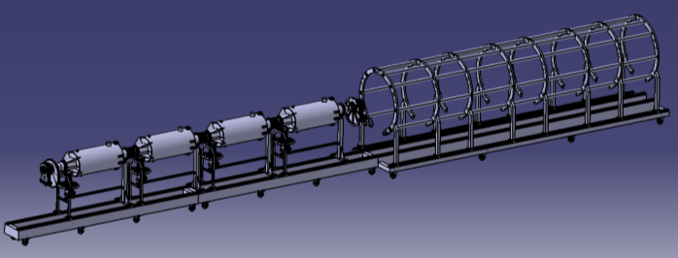
Assembly procedure:
outside the clean room
Procedure for elliptical cryomodules:

Slide 25
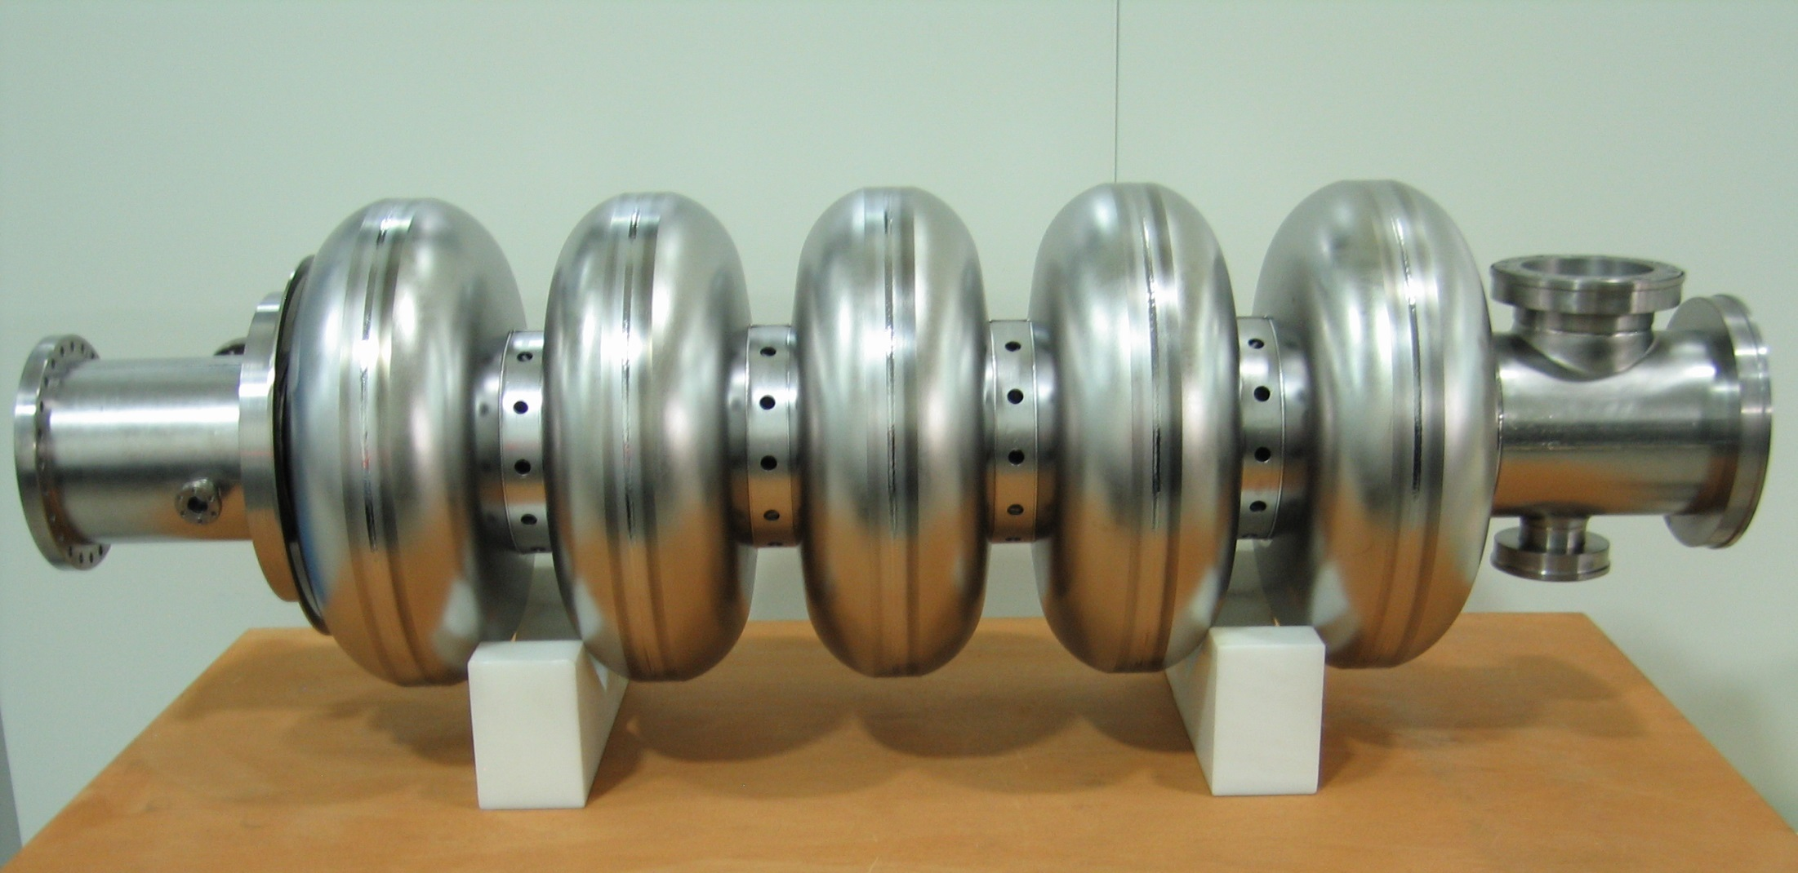
High beta prototype cavity

Slide 26
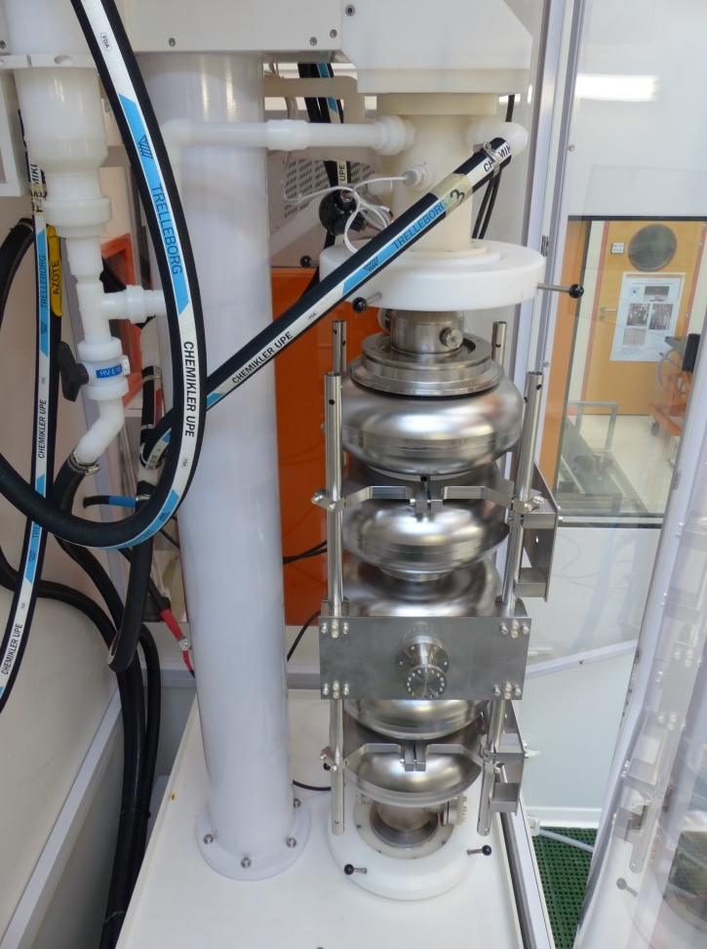
cavity preparation
Start of the development of cavity preparation with the SPL 5-cell cavity β=1
Very similar to the ESS cavities
Vertical Electropolishing system of the SPL cavity at β=1 in Saclay

Slide 27
Thank you for your attention

