Slide 1
Status of the SPL cavities at CERN
Aviles & N. Valverde
on behalf of SPL team

Slide 2
Overview
Overview
Copper cavity
Niobium cavity
Tooling
Conclusions

Slide 3
Overview
Cryogenic circuit
burst disk
Insulation vacuum
relief plate
Thermal shield
Cryogenic lines port
Vacuum vessel
Helium tank
Magnetic shielding
Two-phase pipe
He phase separator
Thermal shield tie-rod
Cavity tuner
RF coupler
Inter-cavity
support
Gate valve
Cold-to-warm
transition
Cavity
Double-walled
tube
Thanks to R. Bonomi and V. Parma

Slide 4
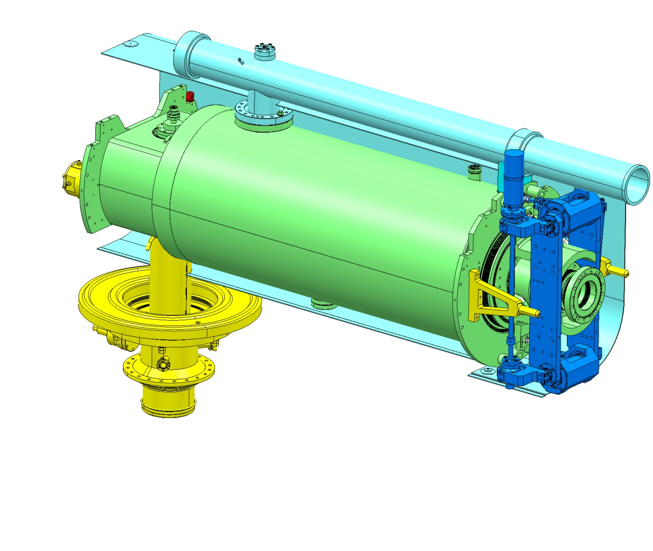
Overview
Pumping line & Magnetic shield to be provided IPN Orsay.
Bulk Niobium 5Cells cavity
Tuners provided by CEA. Under testing at CERN
4 niobium cavities under fabrication at RI – delivery beginning 2013
Stainless steel (316L /316LN) helium tank designed by CERN, supplied by CEA and welded to the cavity at CERN.
Design already validated by CERN.

Slide 5
Cooper cavity
Two copper cavities fabricated in order to:
Learn during the fabrication process
RF measurements
Bead pull measurement
Validation of the tooling for the niobium cavity
Surface treatments

Slide 6
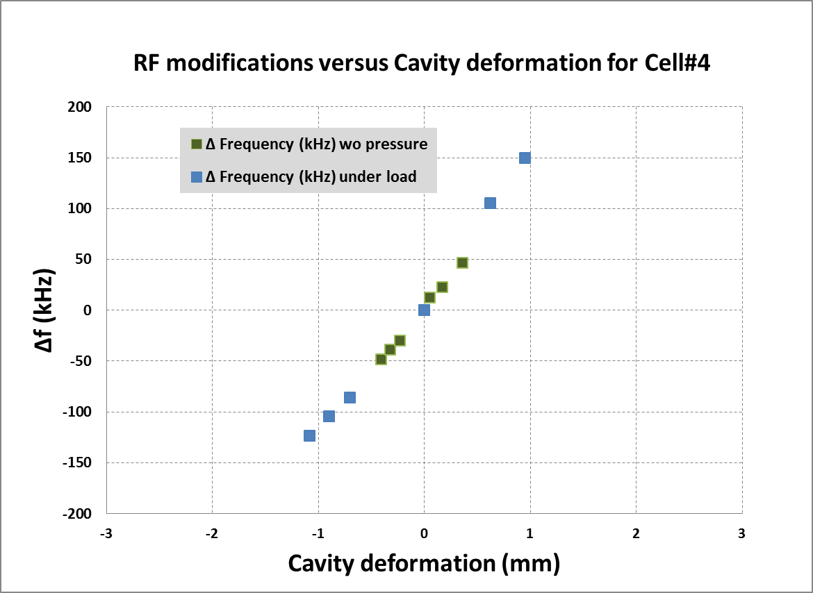
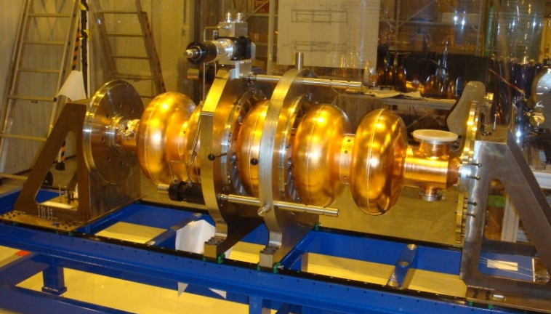
Copper cavity
Mechanical measurements: frequency shift with respect to stress and deformation
Cell-by-cell tuning system with RF bead-pull measurements
Measured cavity frequency change vs. mechanical deformation of cell no 4.

Slide 7
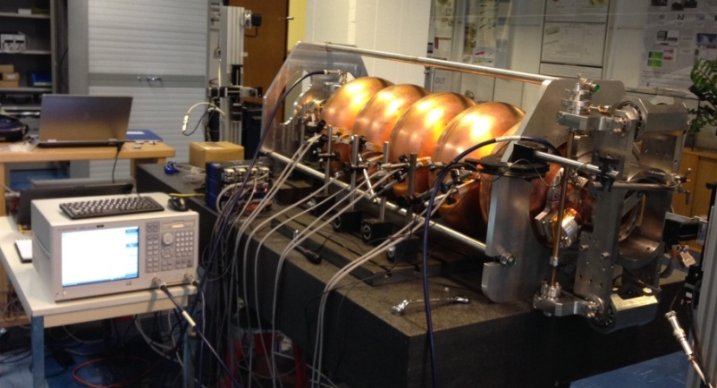
Copper cavity
Cavity tuner: measurement of cavity detuning versus mechanical deformation.

Slide 8
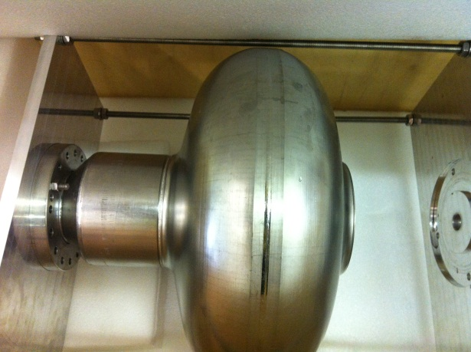
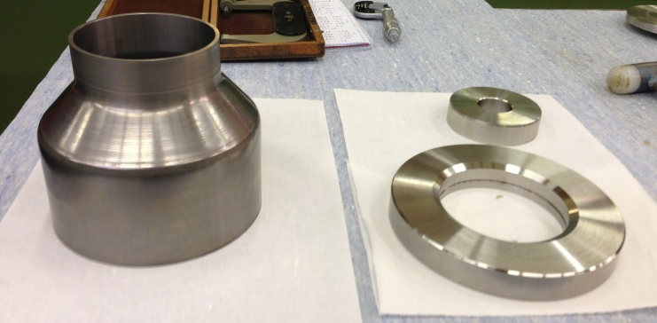
Reparation monocell from RI at CERN
The monocell has being repaired in order to continue with the electropolishing and cold tests
Brazing between niobium tube and Stainless steel (316LN) flange.
Machining (preparation before brazing)

Slide 9
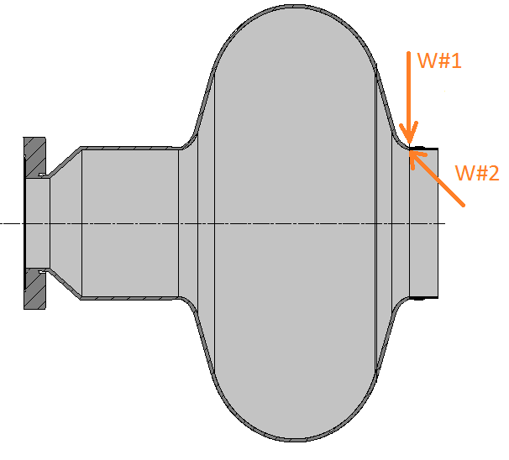
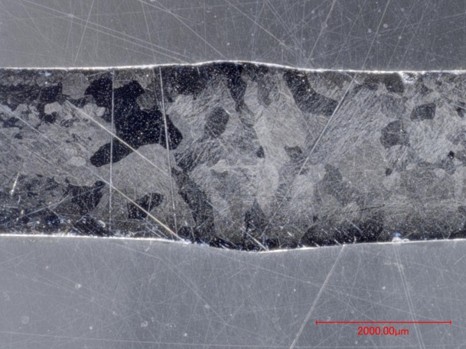
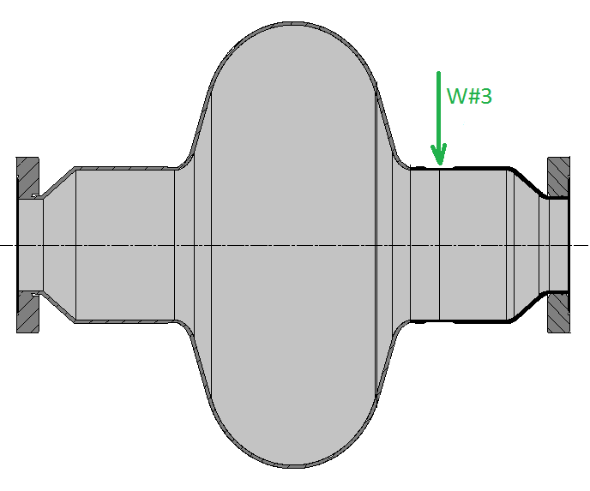
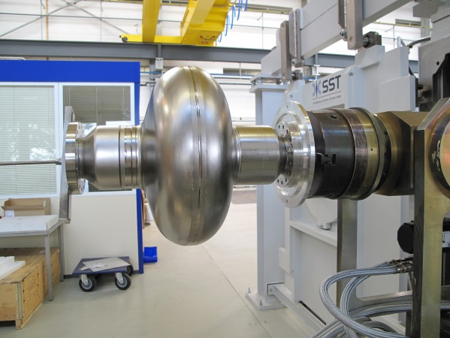
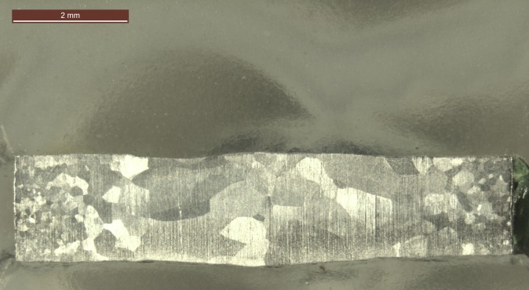
Reparation monocell from RI at CERN
EB Welding from the outside (W#1) and inside (W#2)
Full penetration: 2.4 mm
EB Welding from the outside (W#3)
Full penetration: 1.7 mm
Cross section of the EB weld (W#1 +W#2)
Cross section of the EB weld (W#3)

Slide 10
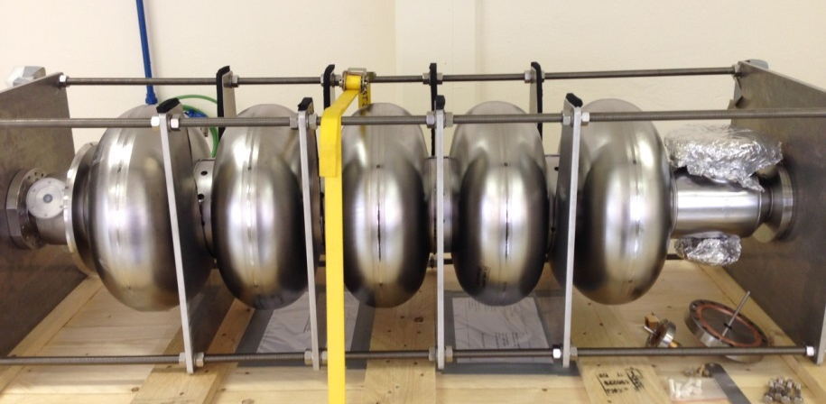
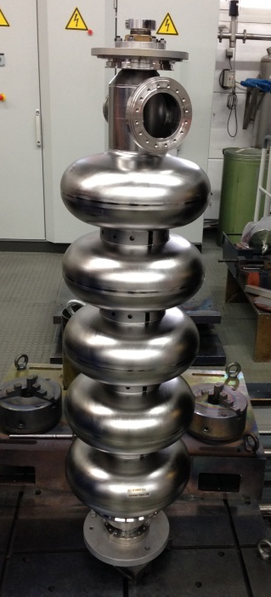
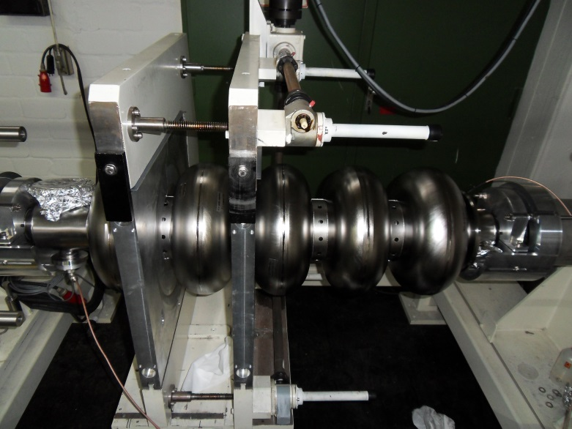
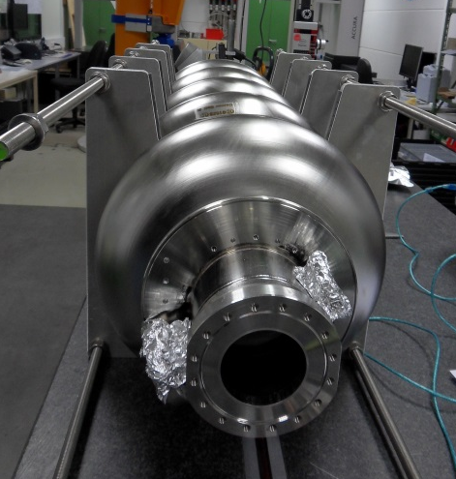
Niobium cavity at RI
4 niobium cavities fabricated by Research Instruments (RI) will arrive to CERN this year.
1 already at CERN
3 cavities will be delivered middle of December

Slide 11
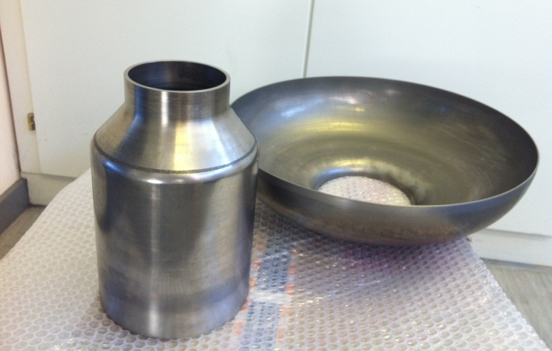
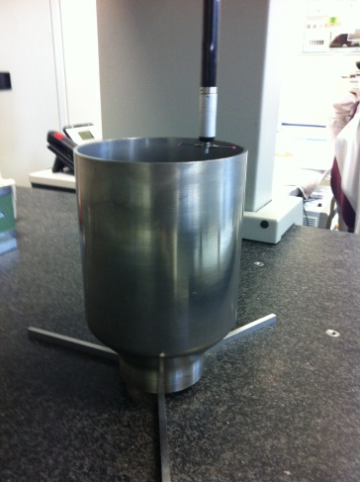
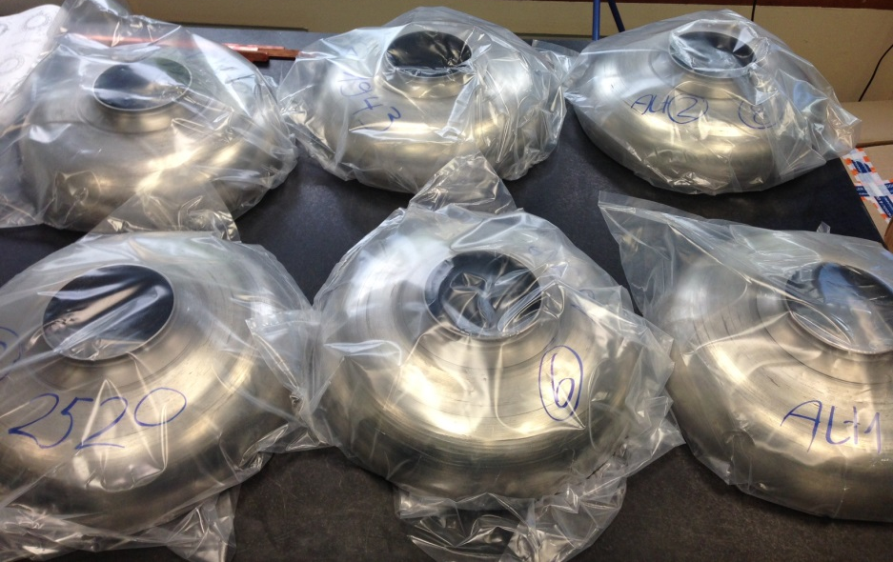
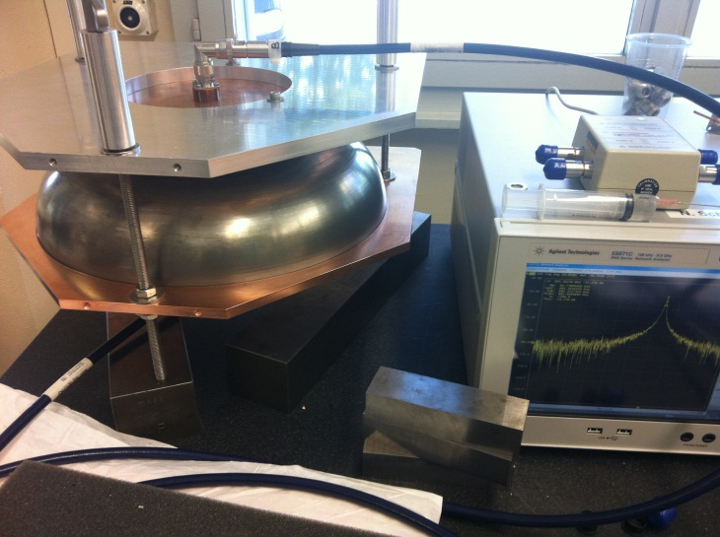
Niobium cavity at CERN
Spinning of half-cells and beam tubes at HEGGLI
Dimensional control by CMM
RF measurements.

Slide 12
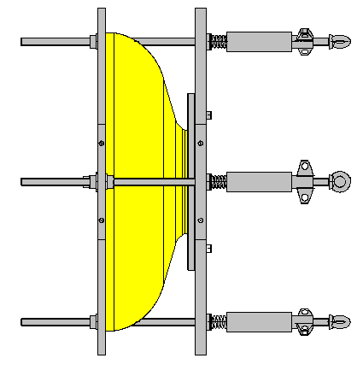
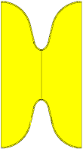
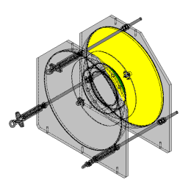
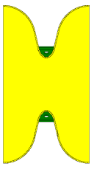
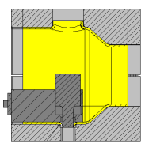
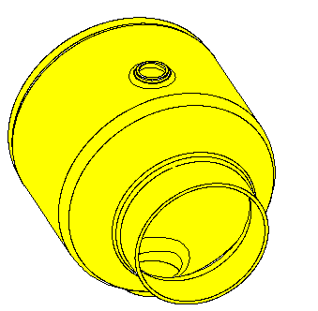
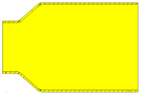
Niobium cavity at CERN
Spinning
Machining
Cutting cell length
RF measurement
CP (chemical polishing)
RF measurements
Machining – Welding preparation (Iris & rings)
Spinning
CP
HALF-CELLS
Nb
Assembly half-cell+ half-cell+ stiffening ring=> Dumb-bell
Degreasing + CP (8 h before EBW)
EBW half-cell + half-cell
Degreasing +CP (8 hours before EBW)
EBW dumb-bell+ stiffening ring
RF measurements
Trimming equators
RF measurements
Grinding and CP (if needed)
EBW
EBW
CP
EBW
DUMB-BELLS
Trimming equators
Grinding and CP (if needed)
Degreasing +CP
EBW
Nb
Spinning
Necking-out
Machining
CP
Necking-out
CP
BEAM TUBES
Spinning
Machining

Slide 13
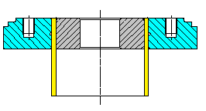
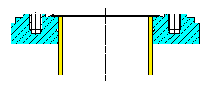
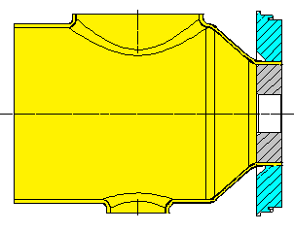
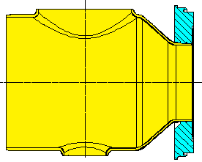
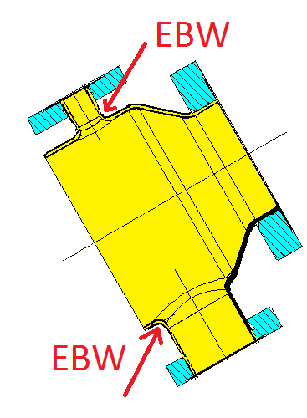
Niobium cavity at CERN
Machining SS Flange + Nb tube + SS insert
Degreasing + CP
Brazing
Machining- Removal of SS insert
Degreasing
Brazing
Machining
FLANGES
Nb
SS
SS
Machining SS Flange + Nb beam tube + SS insert
Degreasing + CP
Brazing
Machining-Removal of SS insert
Machining
Degreasing
Brazing
BEAM FLANGES
SS
SS
Nb
Machining SS Flange + Nb beam tube + SS insert
Degreasing + CP
Brazing
Machining-Removal of SS insert
TANK CONNECTOR
Brazing
Machining
SS
Nb
SS
Assembly beam tube + ports=> end group
Degreasing + CP ( 8h before EBW)
Electron beam welding (EBW)
CP
EBW
END GROUP
2

Slide 14
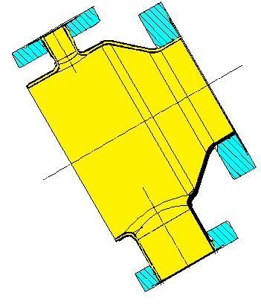
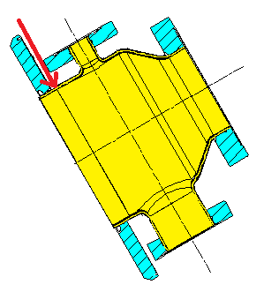
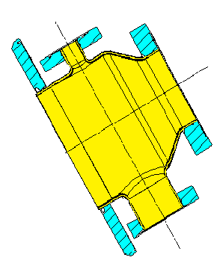
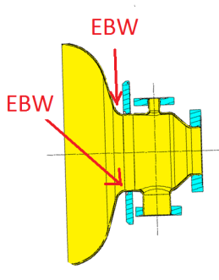
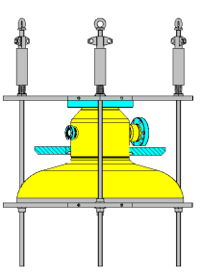
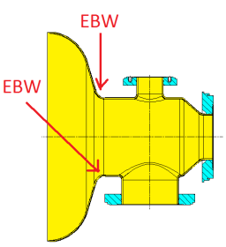
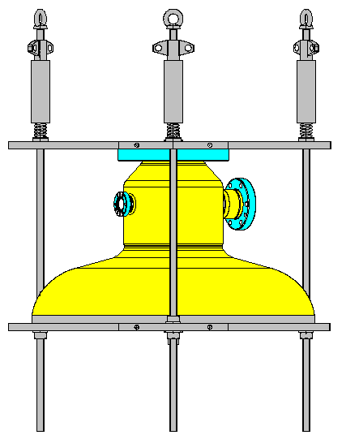
Niobium cavity at CERN
Assembly end group+ tank connector + half-cell=> extremity 1
Degreasing + CP ( 8h before EBW)
EBW end group + tank connector
Degreasing + CP ( 8h before EBW)
EBW end group + half-cell
RF measurements
Trimming equator
RF measurements
EBW
CP
EBW
EXTREMITY 1
Cp
EBW
Trimming
RF measurements
RF measurements
Assembly end group + half-cell=> extremity 2
Degreasing + CP ( 8h before EBW)
EBW end group + half-cell
RF measurements
Trimming equator
RF measurements
EXTREMITY 2
CP
EBW
Trimming
RF measurements
RF measurements

Slide 15
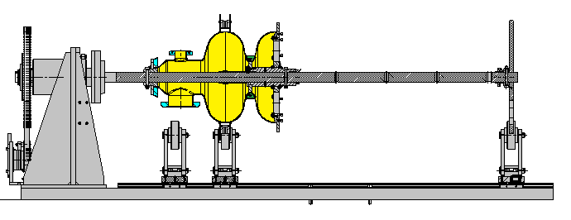
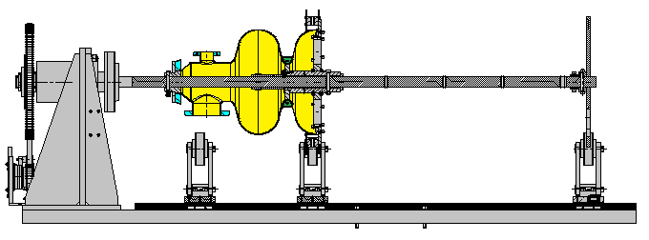
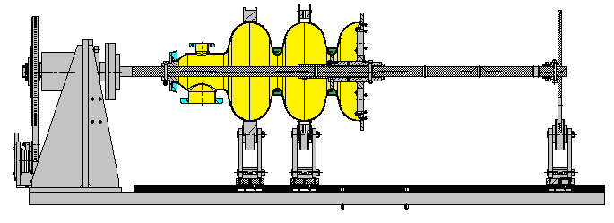
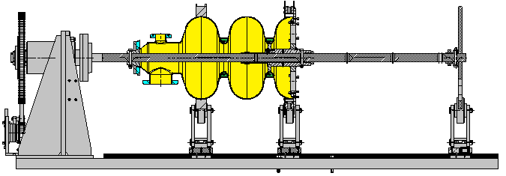
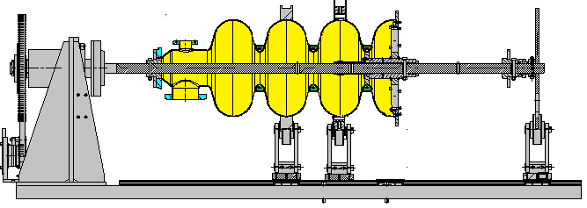
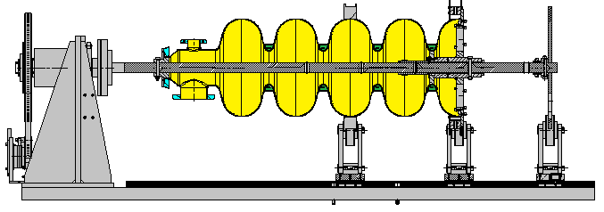
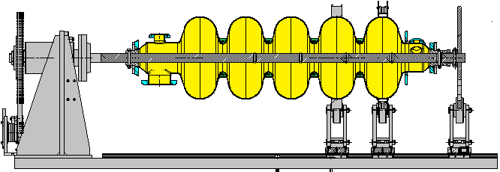
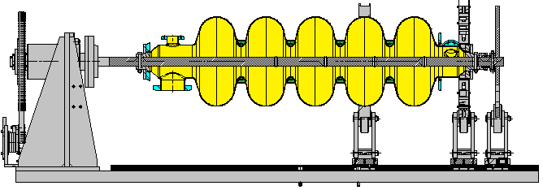
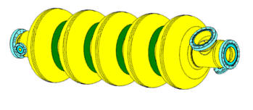
Niobium cavity at CERN
Final assembly
CP - 8 h before each EBW
EB Tack weld
EBW
EB Tack weld
EBW
EB Tack weld
EBW
EB Tack weld
EBW

Slide 16
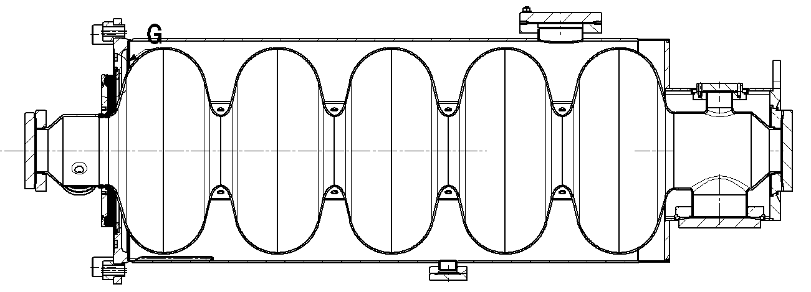
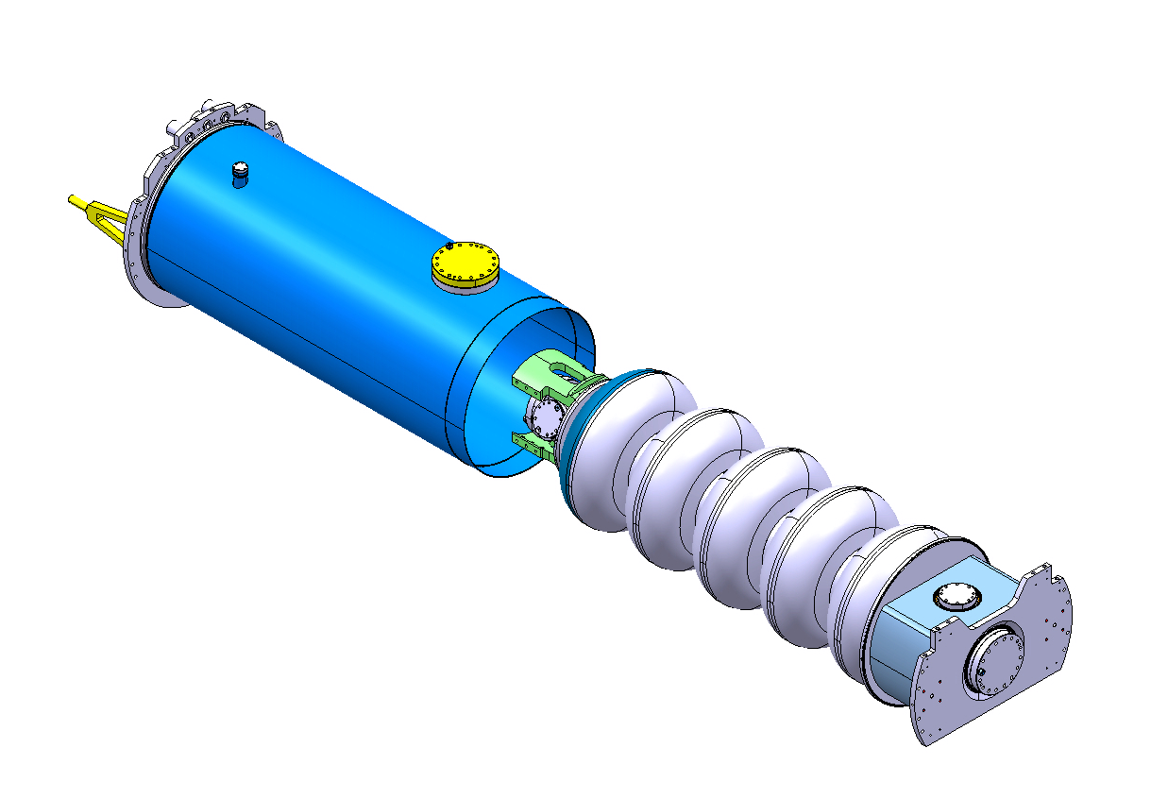
Ancillaries
5 stainless steel helium tanks (designed by CERN) will be delivered by CEA in January

Slide 17
Ancillaries
Electron beam welding tooling designed and fabricated at CERN

Slide 18
Ancillaries
Tooling already fabricated and available at CERN
Tooling for electropolishing
Tooling for cold tests

Slide 19
Conclusions
Copper cavities have proven to be very useful for the different testing campaigns carried out during the last year. The results obtained will be extremely valuable for the tuning operation of the niobium cavities
4 niobium five – cell cavities will be delivered to CERN by the end of the year
A fifth niobium cavity is under fabrication at CERN
5 helium tanks will be supplied by CEA in January 2014

Slide 20
Thank you very much
QUESTIONS??

