Slide 1
Kevin Jones Technical Director
ESS Machine Update
IKON#18, Grand Hotel Lund, 24 February 2020

Slide 2
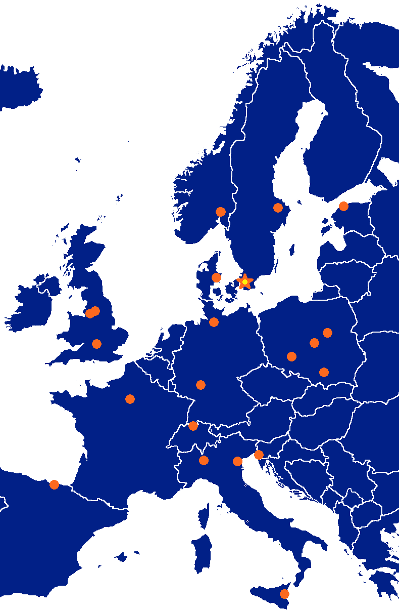
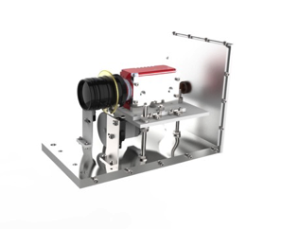
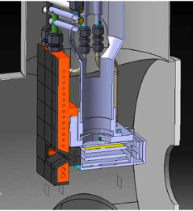
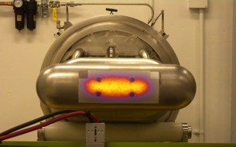
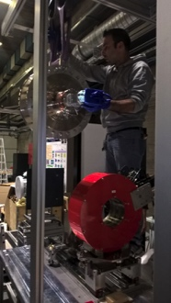
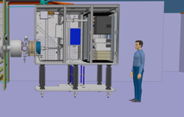
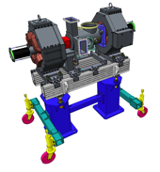
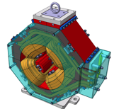
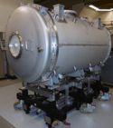
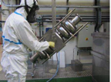
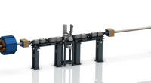
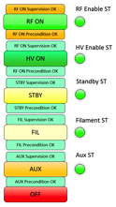
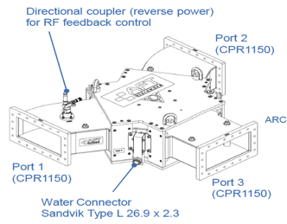
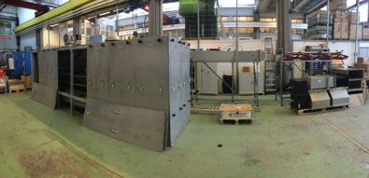
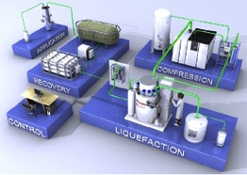
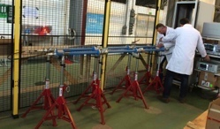
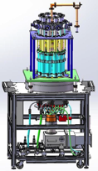
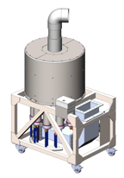
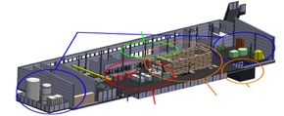
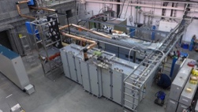
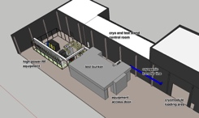
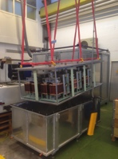
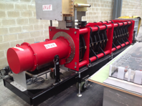
The machine is being built by a diverse collaboration
352.21 MHz
704.42 MHz
2.4 m
4.6 m
3.8 m
39 m
56 m
77 m
179 m
Target
Source
LEBT
RFQ
MEBT
DTL
Spokes
Medium β
High β
HEBT & Contingency
75 keV
3.6 MeV
90 MeV
216 MeV
571 MeV
2000 MeV

Slide 3
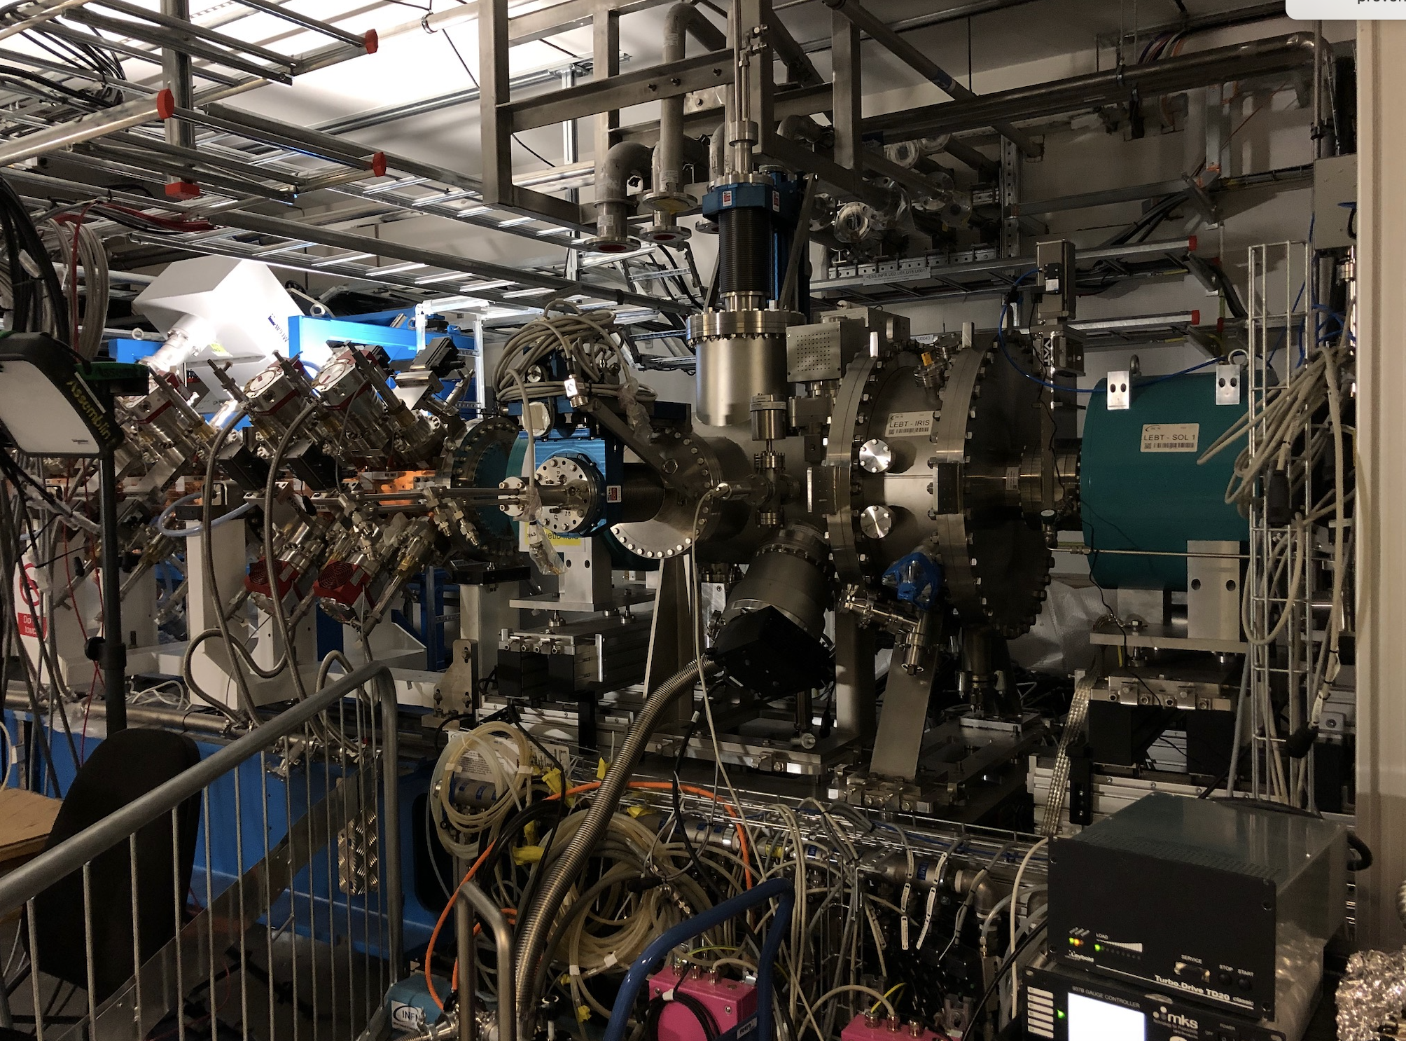
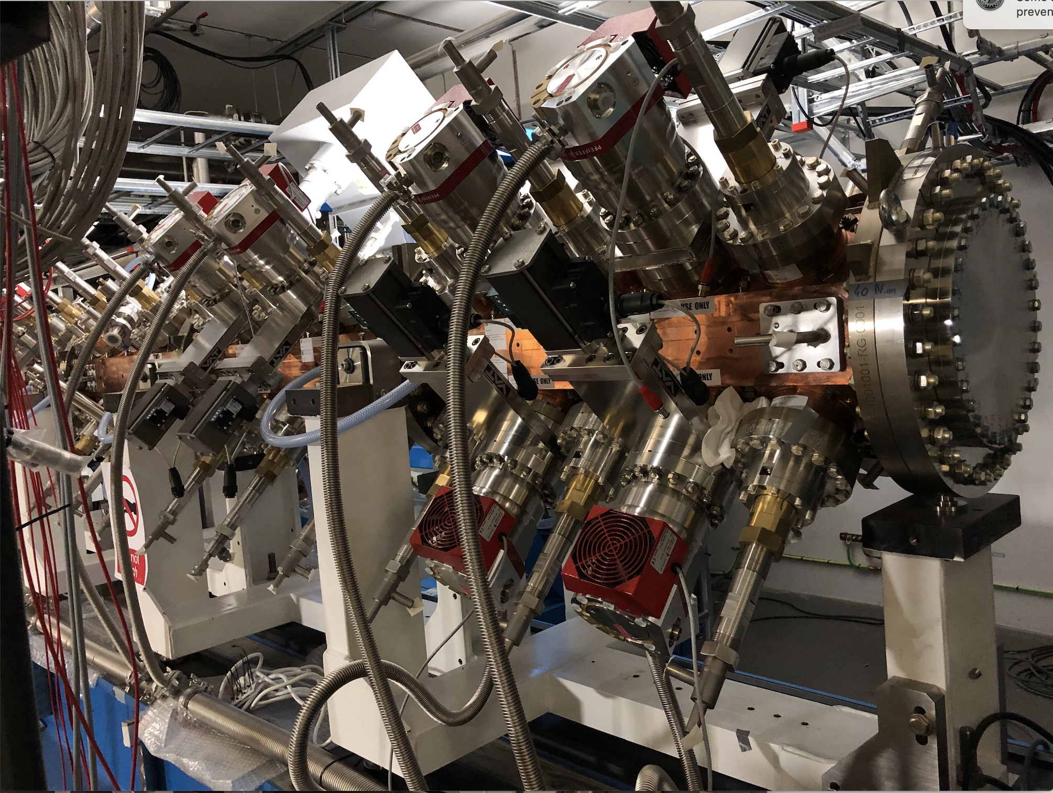
Machine Status
January 2020
Robust activity in the Accelerator Buildings (G01/G02)
Low Energy Beam Transport re-installed after modification post-commissioning, with new variable iris beam chopper
Radio-frequency Quadrupole (RFQ) accelerating structure in place, bead pull complete, and being fitted for operation

Slide 4
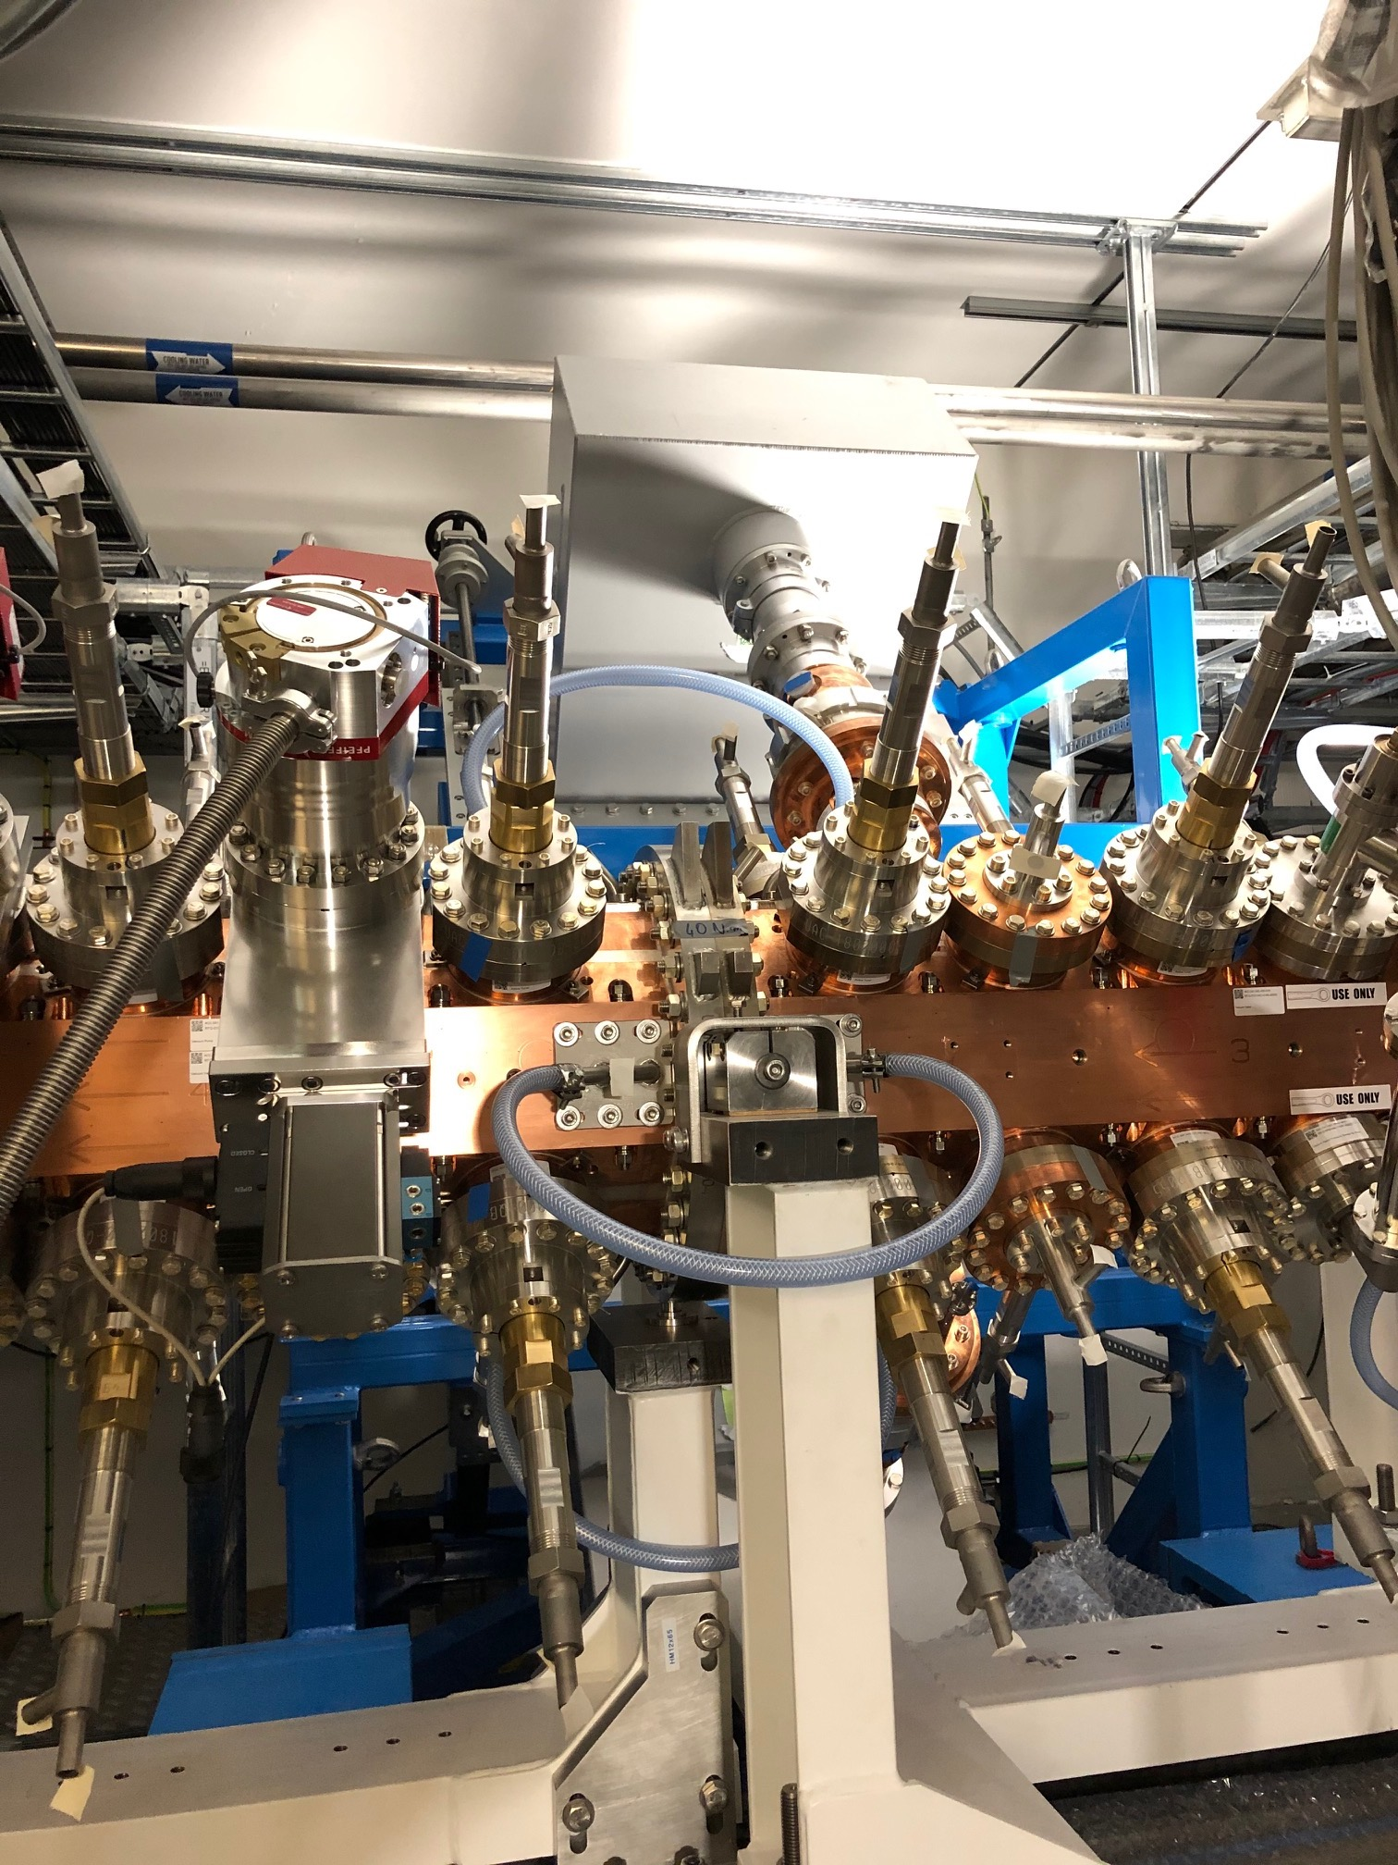
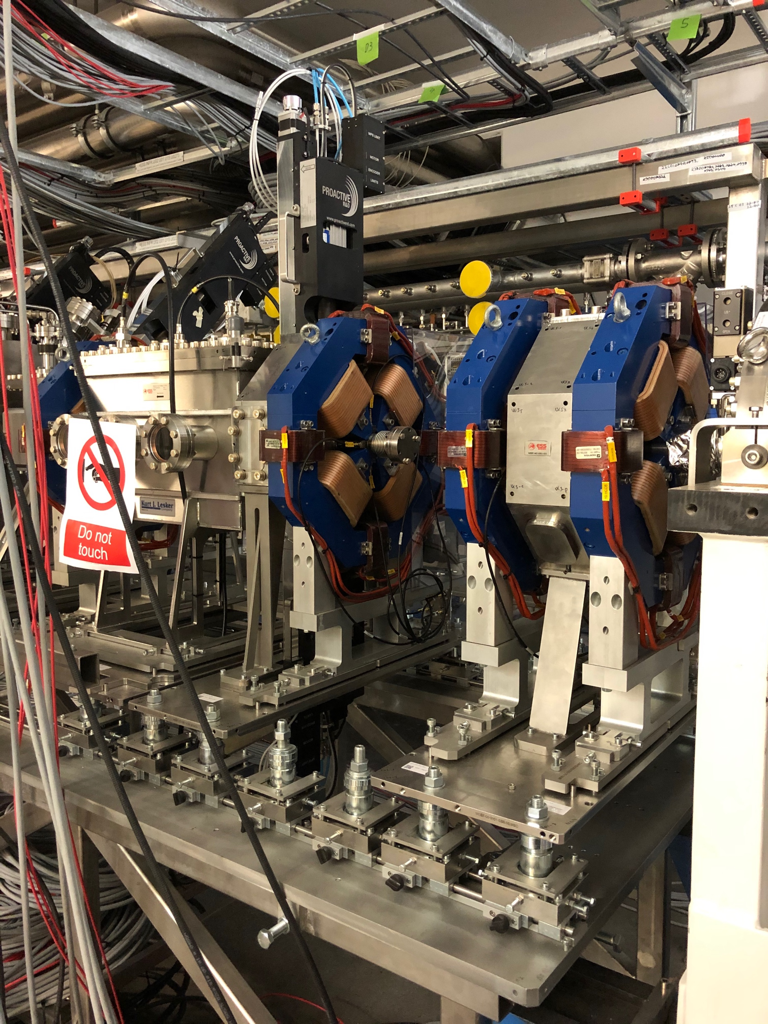
Machine Status
January 2020
Robust activity in the Accelerator Buildings (G01/G02)
RF couplers to the RFQ structure are in place, along with all waveguides
Medium Energy Beam Transport (MEBT) is in place and is being fitted with services

Slide 5
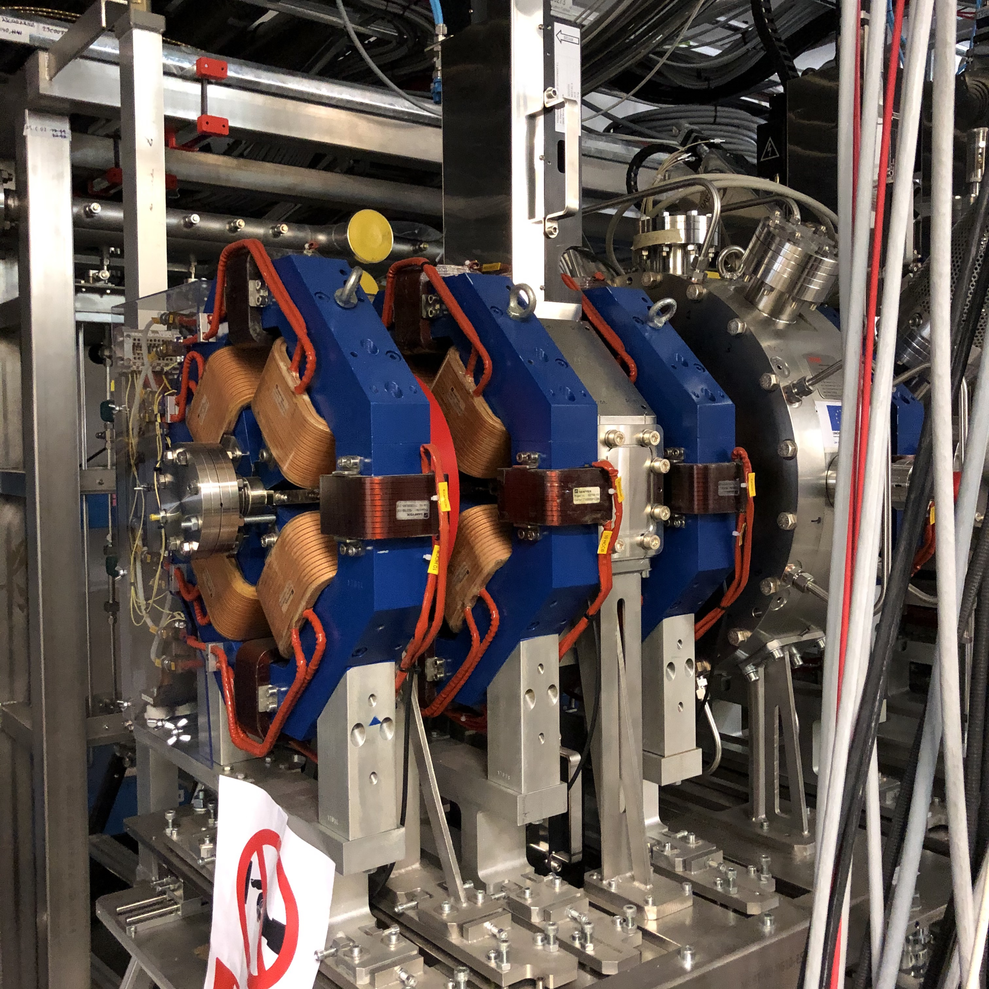
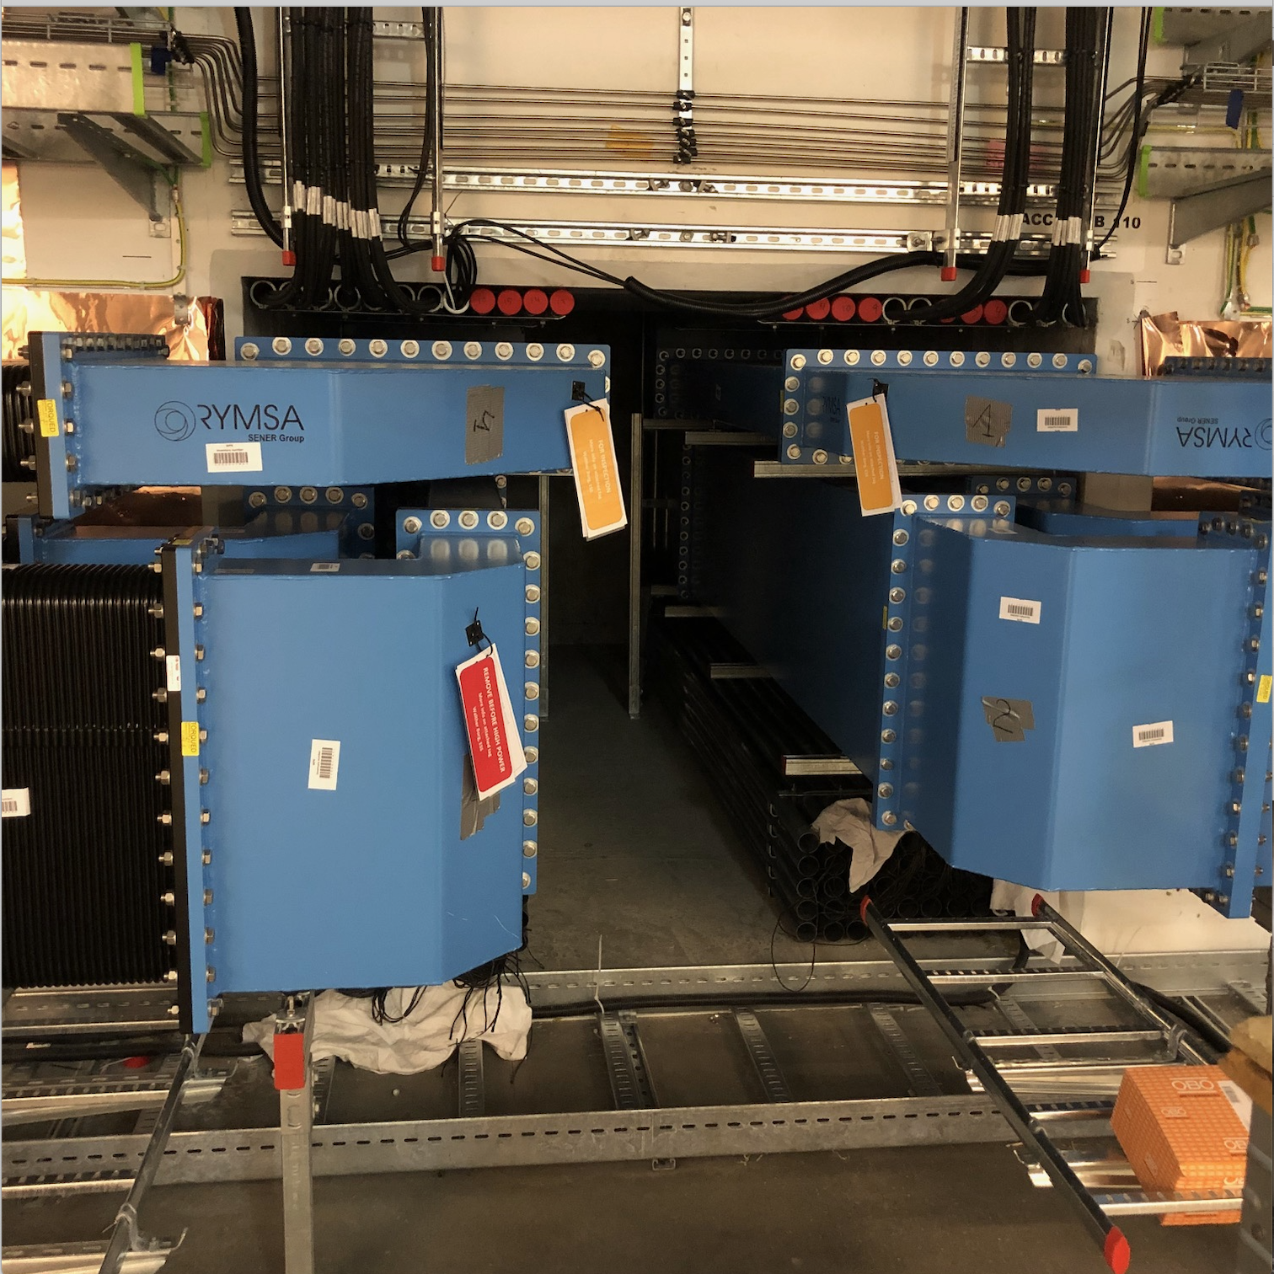
Machine Status
January 2020
Robust activity in the Accelerator Buildings (G01/G02)
Medium Energy Beam Transport (MEBT) is in place and is being fitted with services
Over 3600 pieces of high-power radio-frequency waveguide (352 and 704 MHz) have been installed throughout the machine

Slide 6
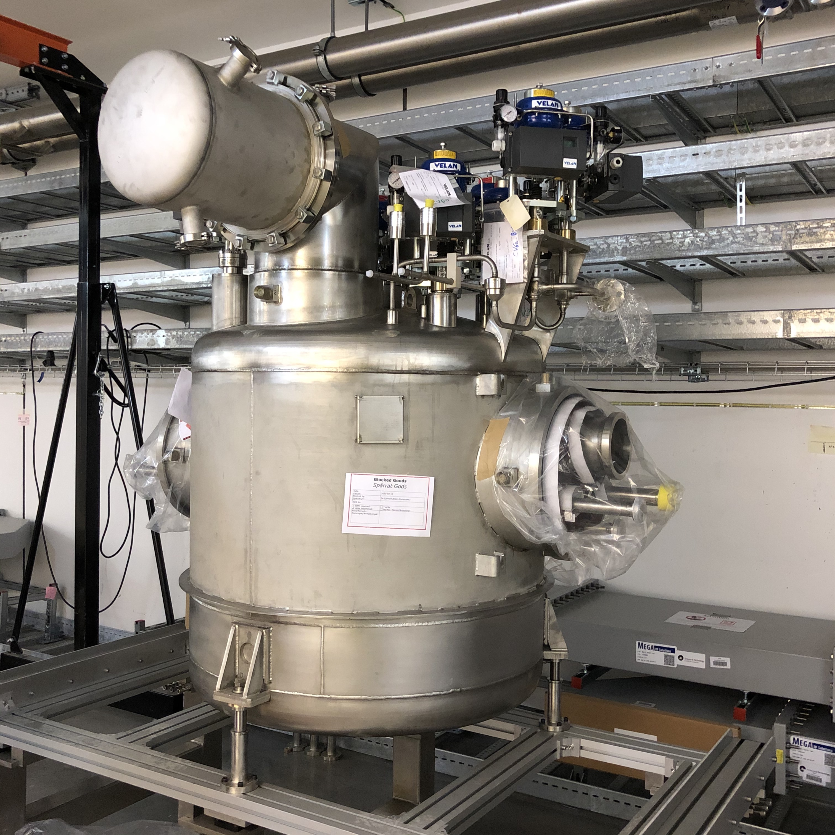
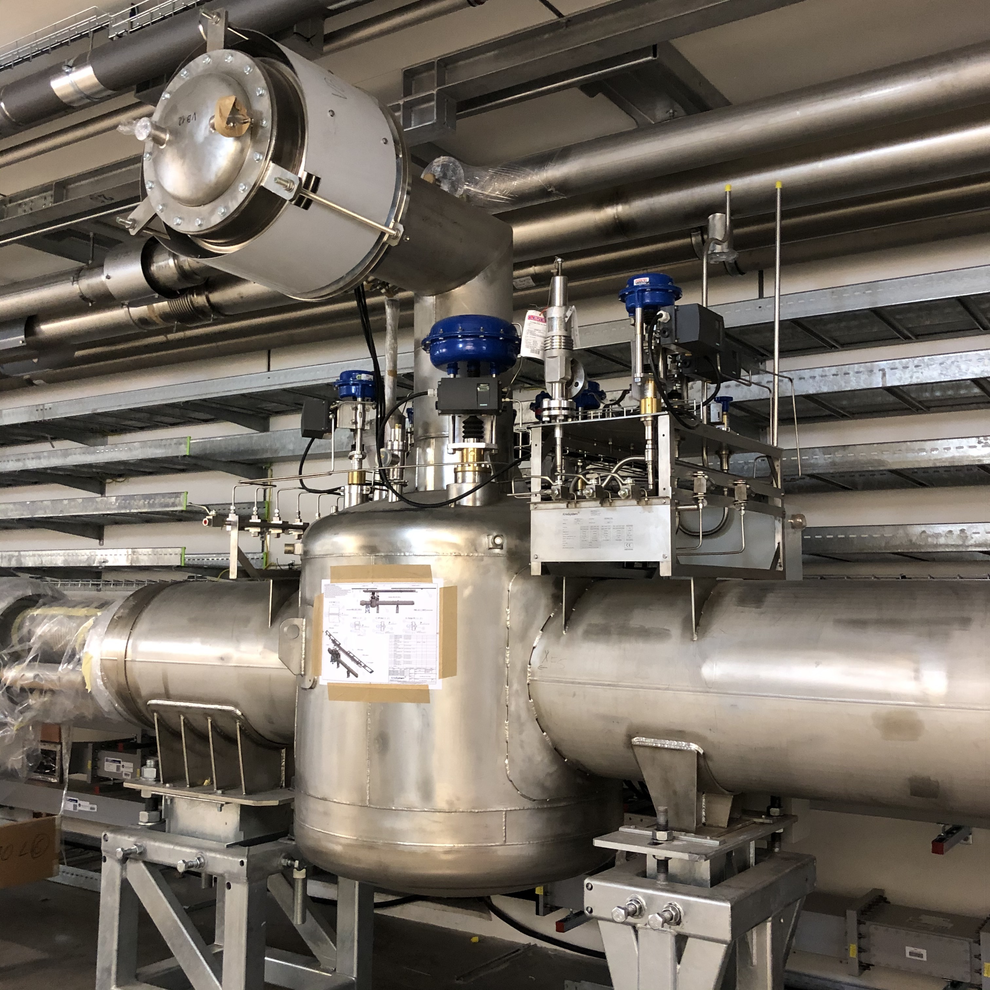
Machine Status
January 2020
Robust activity in the Accelerator Buildings (G01/G02)
Valve boxes and cryogenic service piping for the Spoke Cavity superconducting linac are being received
Valve boxes and cryogenic distribution for the medium beta linac cryomodules are in place and undergoing site acceptance testing

Slide 7
Machine Status
January 2020
Robust activity in the Accelerator Buildings (G01/G02)
Cryogen distribution and 704 MHz wave guides in the G01 tunnel
Linac Warm Units (focusing magnets and beam diagnostics) in the High Energy Beam Transport area

Slide 8
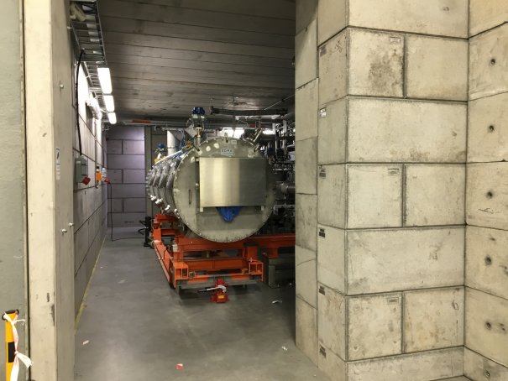
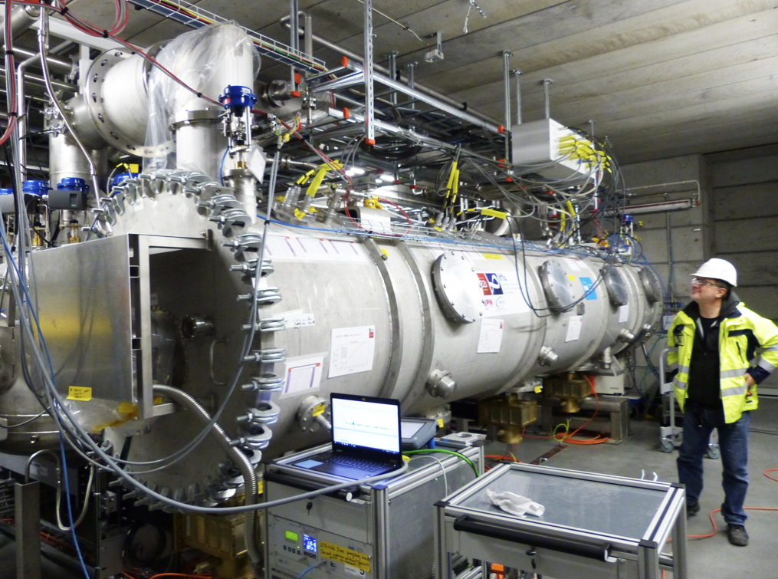
Machine Status
January 2020
Robust activity in the Accelerator Buildings (G01/G02)
The prototype medium-beta cryomodule is undergoing cryogenic testing in Test-Stand 2 in building G02 – a milestone for the cryoplant and test-stand capability – achieve 2K operation last week

Slide 9
Machine Status
January 2020
Robust activity in the Accelerator Buildings (G01/G02)
Modulators for powering klystrons in Test-Stand 3 in G02
High Power RF components being installed in G02

Slide 10
Machine Status
January 2020
Robust activity in the Accelerator Buildings (G01/G02)
Assembly of Tank 1 of the Drift Tube Linac (DTL) is well underway and will be ready for installation in the late Spring 2020

Slide 11
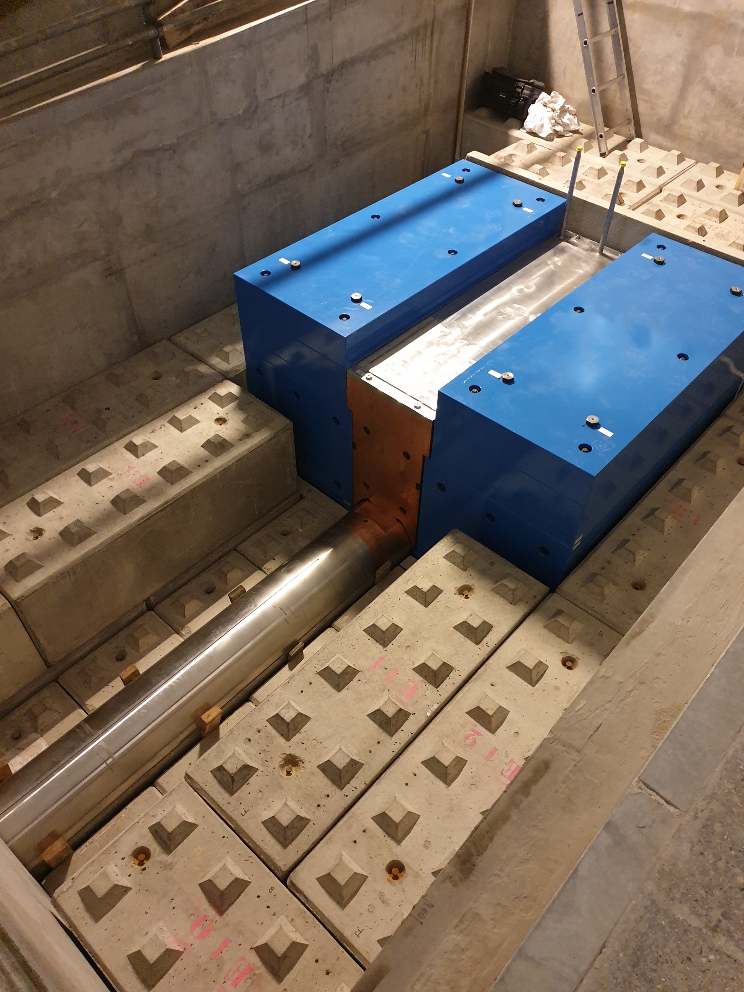
Machine Status
January 2020
Tuning Beam Dump
The tuning beam dump has been received and is being installed

Slide 12
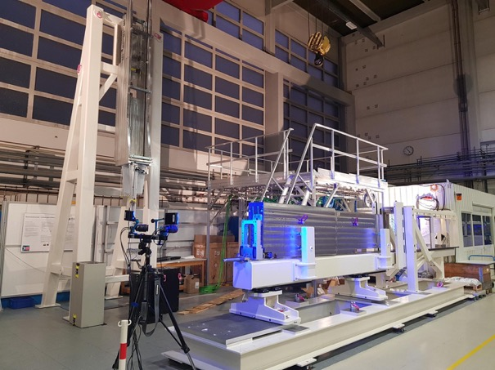
Neutron Beam Extraction System (NBEX)
January 2020
Verification of the NBPI design continues at FZJ by use of the Insert Installation Tool and the Horizontal Handling Test Stand.
Modified wheel solution has shown good results.

Slide 13
The Monolith Vessel is nearing completion
January 2020
Manufacturing ongoing.
Unforeseen fabrication challenges pushes the delivery to April.
Inside view
Lower body completely welded
Weld penetrant test detail

Slide 14
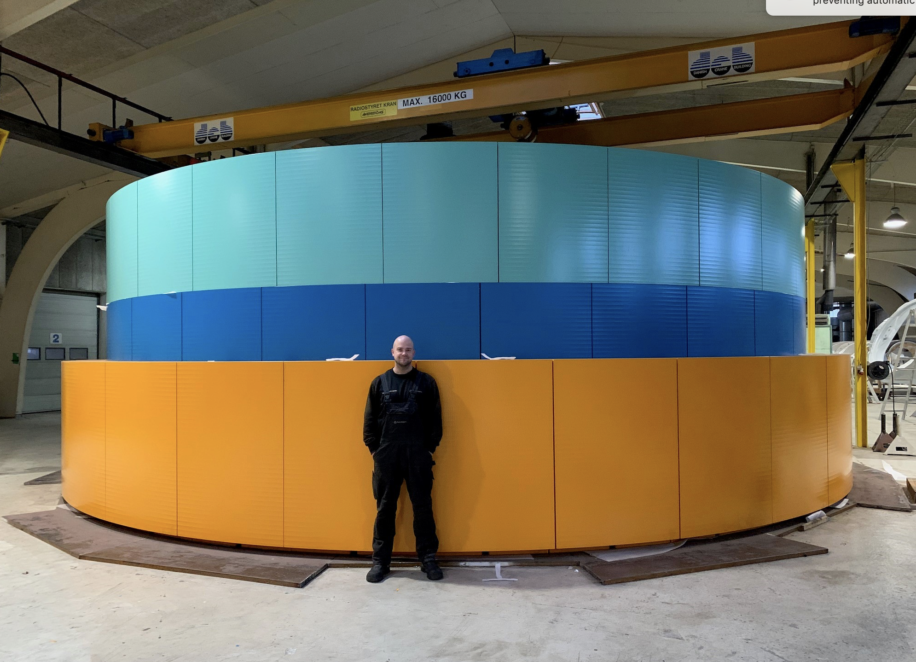
Outer monolith shielding is ready for shipment
January 2020

Slide 15
Questions?

