Slide 2
Toll-Gate & Document management
PRESENTED BY Gabor Laszlo

Slide 3
TG3 Base-line
Phase 2 and TG3 processes:
https://confluence.esss.lu.se/display/SPD/Phase+2+and+TG3+processes
Overall Document Check-list and Content:
ESS-0503621 - Phase 2 Check list
Technology Specific Guide-lines:
ESS-0189147 | Instrument Tollgate 3 SAD Checklist
ESS-0240219 | MCA TG3 Review Process for Instrument Projects
ESS-0034257 | Template for Technical specification for <<Instrument>> Neutron Chopper System
ESS-1546427 | Detector Systems Review Process for Instrument Projects at TG3

Slide 4
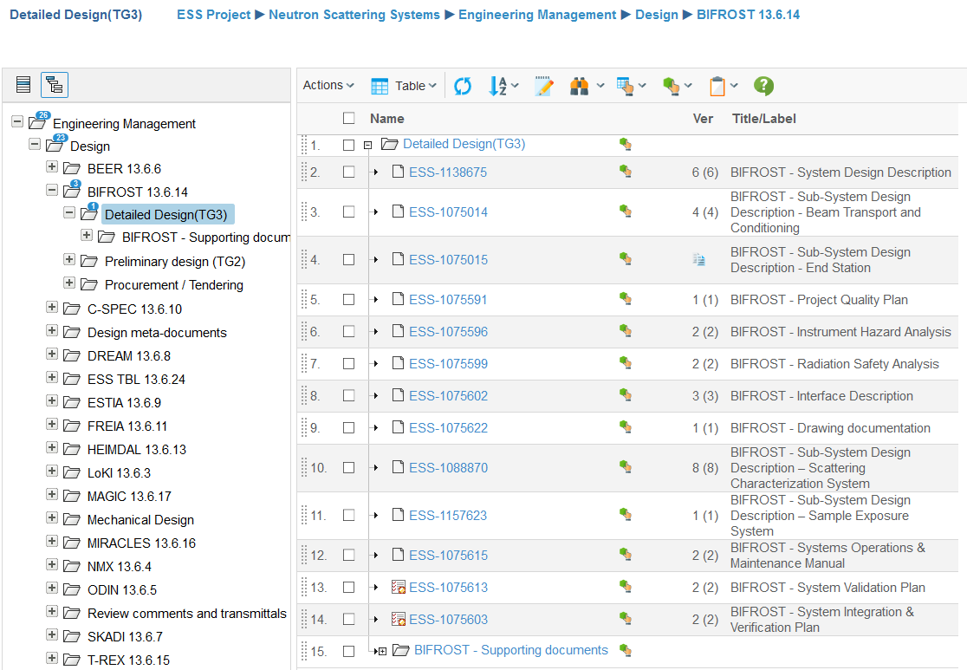
TG3 Document storage
1
1: Location in CHESS
2
3
2: Address of the repository:
https://chess.esss.lu.se/enovia/link/21308.51166.30864.31162
3:
Main documents (Controlled)
(reviewed in CHESS at TG3)
Description documents
Safety documents
Instructions
4:
Supporting documents (Open)
(not reviewed in CHESS at TG3)
4

Slide 5
TG3 Document handling
1. ESS has created the folders and documents with the review workflow, then transferred the ownership to the instrument team
2. The Instrument team shall Check-out and edit
(Save on your computer)
Subcriptions (follow)
Add file
Dowload
View
Check-out (Edit)
Check-in
Delete
3. Instrument team shall Check-in.

Slide 6
TG3 Document review
4. After the approval of the Sub-TG3, the instrument team shall start the CHESS workflow for the relevant Design Description document. (Only one document!).
You shall customize the document, based on the instructions here: https://confluence.esss.lu.se/display/SPD/Practical+information+on+TG3+deliverables
EXCEPTION: For the shielding and activation analysis, the relevant documents shall be approved in CHESS!
/H1&H2, Rad. Hazard Analysis (including Shielding&Activation analysis)

Slide 7
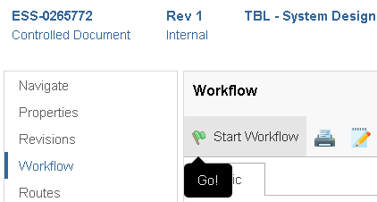
TG3 Document review
For the final TG3 all the documents and models shall be released and approved.

Slide 8
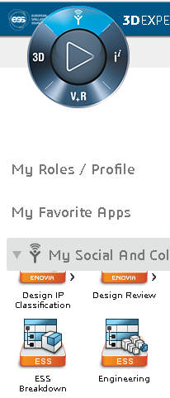
Facility Breakdown Structure
For the Electrical design (E-plan), ESS Spatial integration and asset management, the instrument components shall be represented in the ESS FBS.
The Instrument FBS´s are being created by Joakim Mayer, based on the PBS.
NMX, TBL, BIFROST FBS is ready, ESTIA is being done
All the instruments will be contacted to discuss and agree on the final breakdown soon.

Slide 9
Questions?

Slide 10
Backup slides

Slide 11
SSDD structure (reminder)
Example: TBL - System Design Description - ESS-0265772 (Draft)
General system characteristics (purpose, concept, layout, overview)
Spatial integration and context.
Description of components and technical solutions
Technical Risks
Verification of requirements
Design considerations (Standardization, Reliability, Accesibility, Maintainability, Inspectability, Alignment, Upgrade, Remote handling, Radiation Hardness )
Engineering report (Structural load bearing components, Deformation analysis for components, Verification of bearings, pressurized components, actuators, Heat expansion, lifting features, Motion controller design description, Magnetic Properties, Any functionally critical property)

