Slide 1

Readout Status
25th February 2020
Steven Alcock, Detector Group

Slide 2
Contents
A reminder of DG’s remit
Front end integration developments
  CAEN R5560
  CDT
  VMM 3A
  IDEAS Concentrator
Generic backend developments
  Assister Specification release
  Hardware procurement
  ICS integration
  DMSC integration
Next steps
Steven Alcock, Detector Group, 25th February 2020

Slide 3
The Role of Detector Group Readout
Ensure that the DAQ chain is commissionable, operable and maintainable with minimal resource requirements for the lifetime of the instrument.
How?
  Support instruments in the choice and development of readout front ends (digitisers and associated logic).
  Provision a generic framework for science data, slow control and timing for these front ends.
  Manage and facilitate the integration of these front ends into this generic readout framework.
Detector
Analog Front End
Digital Front End
Generic Back End
DMSC/ICS
Steven Alcock, Detector Group, 25th February 2020

Slide 4
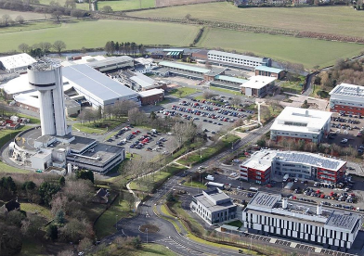
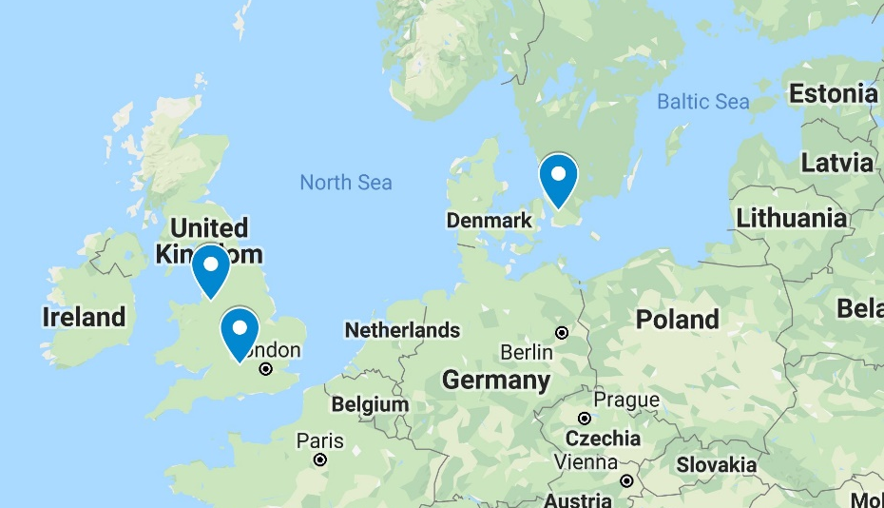
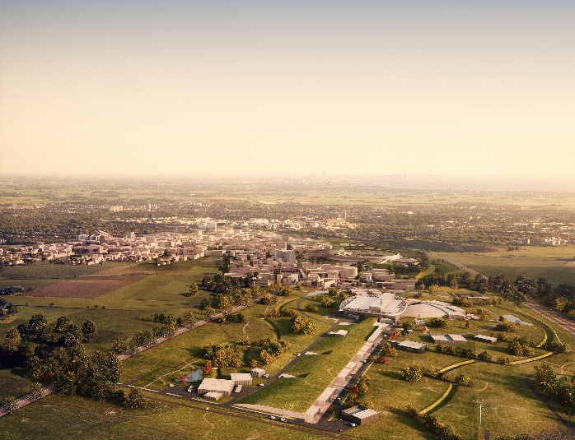
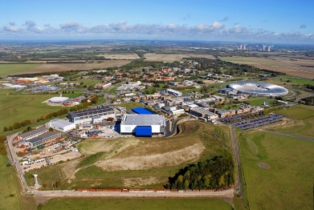


In-Kind Collaboration
Significant development and integration activity, as well as hardware procurement, has been undertaken by the Science & Technology Facilities Council at Rutherford Appleton and Daresbury Laboratories.
Steven Alcock, Detector Group, 25th February 2020

Slide 5
The Choice of Front End
The majority of instruments (10 out of 15) have converged on three front ends:
  CAEN R5560 (LoKI, BIFROST)
  CDT CiPIX (DREAM, MAGIC, HEIMDAL)
  Brookhaven VMM 3A (CSPEC, TREX, ESTIA, FREIA, NMX)
The CAEN R5560 and CDT CiPIX have been developed in collaboration with ESS such that they are easy(ish) to integrate into the generic framework.
The VMM3A is the primary choice for the MultiBlade, MultiGrid and NMX detectors in order to satisfy high channel count requirements. Dorothea Pfeiffer will say more about this in the next talk.
We are holding discussions with the remaining instruments this IKON, or at the next available opportunity.
Steven Alcock, Detector Group, 25th February 2020

Slide 6
LoKI Integration
Before Christmas, we proved that the CAEN R5560 is broadly compatible with the generic readout framework.
We distributed timestamps over a small ring (3 nodes), and demonstrated simple slow control and bulk data communication.
This year, we are integrating the ISIS-specific signal processing firmware into the generic readout framework.
We are very close to being able to test a small-scale end-to-end system with real neutrons (weeks, not months).
There have been a few problems associated with early-release hardware: support has been good but documentation is incomplete.
There are longer-term issues concerning version control and the maintenance of the ISIS firmware to be resolved.
Steven Alcock, Detector Group, 25th February 2020

Slide 7
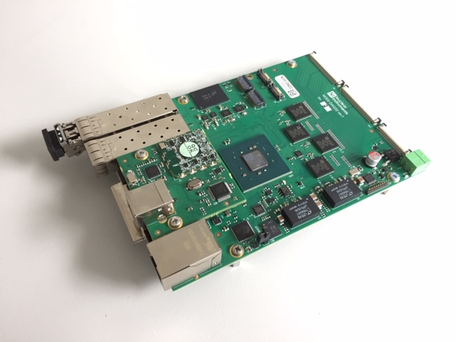
Bifrost Integration
Reached agreement with the Instrument team to use the R5560 for readout, instead of an earlier CAEN model (V1740).
This allows some of the work done on LoKI to be leveraged for Bifrost and means we do not have to support two different hardware platforms.
Currently liaising with CAEN and the ILL to ensure existing front-end firmware can be repurposed.
Hope to start initial work to start around April, and basic demonstration of integration by the end of summer.
Steven Alcock, Detector Group, 25th February 2020

Slide 8
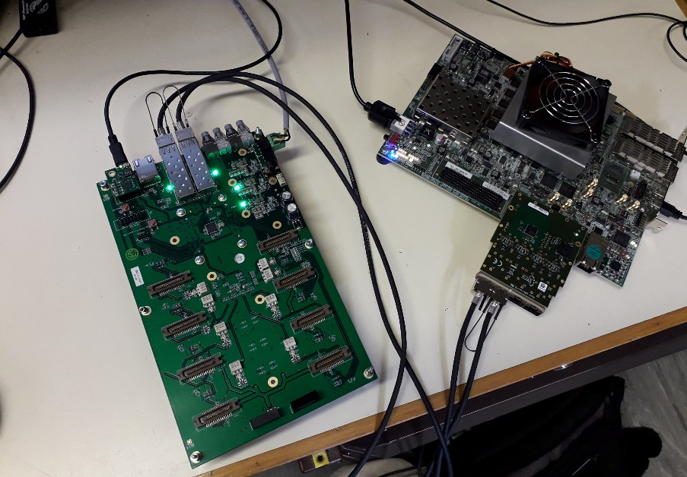
CDT Integration
An ESS-compliant CDT board has been sent to STFC for compatibility testing.
The ESS assister firmware has been successfully instantiated on the FPGA and basic data link connectivity established.
An issue has been found with the FPGA speed-grade - once resolved, full integration and testing with the CDT firmware can commence.
Instrument-specific testing is not yet planned but will be essential – a loose target might be the second half of this year.
Steven Alcock, Detector Group, 25th February 2020

Slide 9
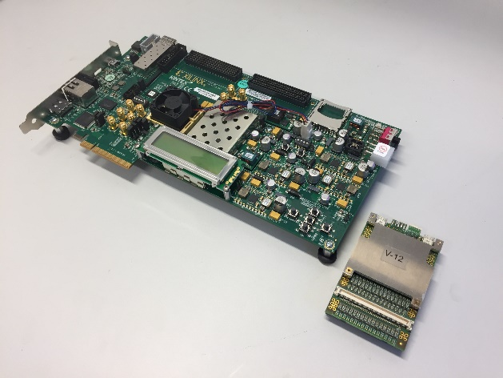
VMM Integration
Integration of the VMM ASIC into the standard ESS readout framework is underway.
This will integrate the already-proven RD51 VMM Hybrid PCB with a commercially-available FPGA board, which in turn connects to the ESS readout framework.
The VMM Hybrid was developed by CERN and the firmware was developed and commissioned by CERN and ESS as part of BrightnESS.
This approach requires (almost) no new hardware development, and is therefore quick and low-risk.
Expect simple demonstration within next couple of months.
Dorothea Pfeiffer will talk more about this in the next talk.
Steven Alcock, Detector Group, 25th February 2020

Slide 10
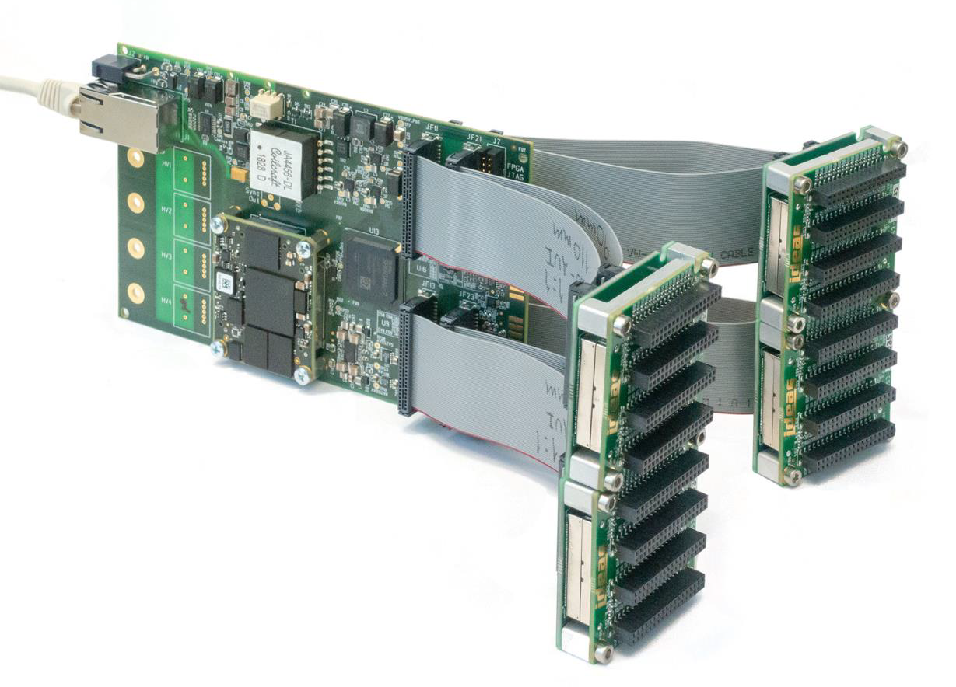
SKADI Integration
SKADI’s front end is a commercial readout board developed by IDEAS.
The integration model was agreed with the Instrument team in May 2019.
Due to the interfaces available on the IDEAS board, it will integrate directly into the Master and will not use the Assister firmware (so-called “Type X” integration).
We have recently made good progress in proving the interfaces and expect further successes later this year when hardware becomes available.
Steven Alcock, Detector Group, 25th February 2020
Source: IDEAS SoNDe CB Application Note (2019)

Slide 11

Remaining Instruments
BEER, VESPA, MIRACLES, (ODIN) – we would like to talk to you!
Steven Alcock, Detector Group, 25th February 2020

Slide 12
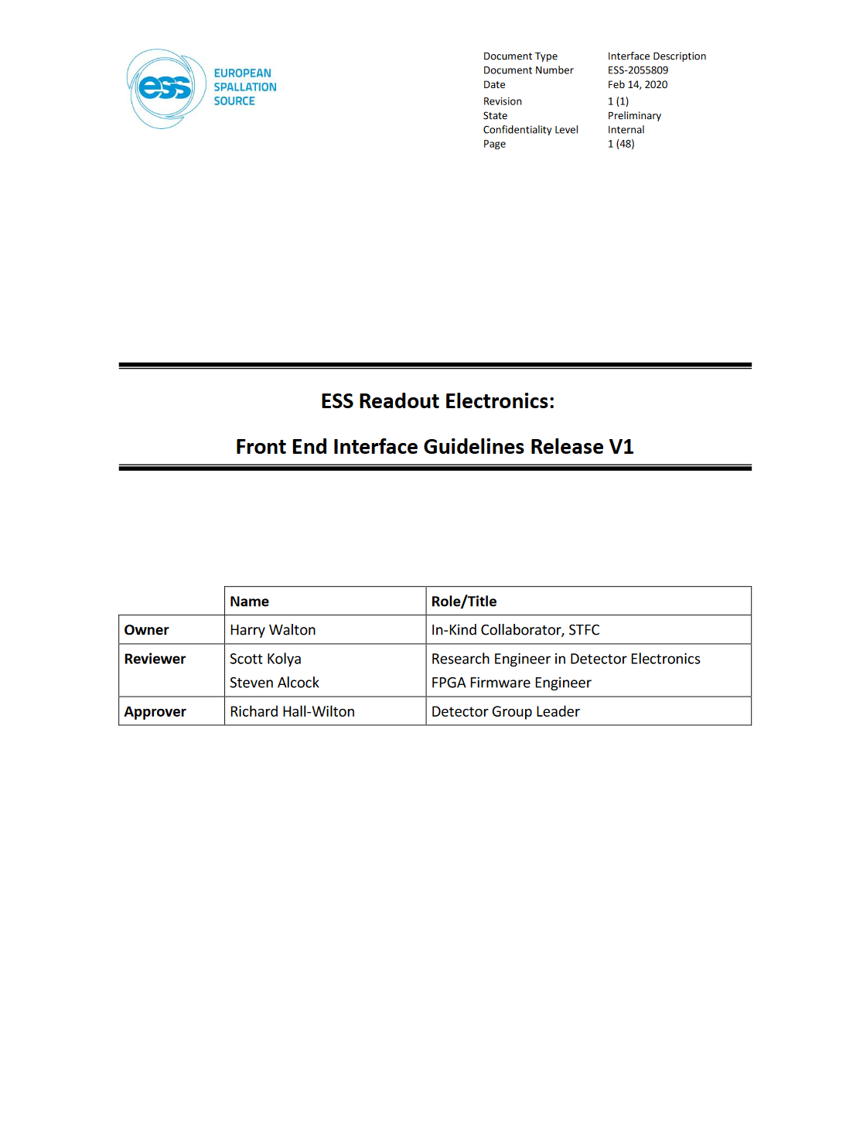
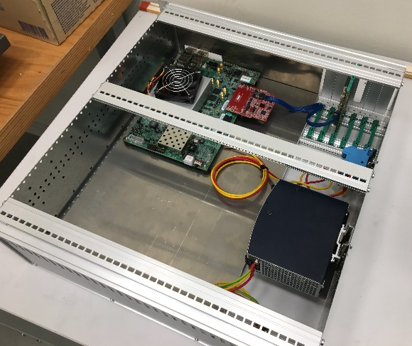
Backend Developments
Assister specification document now available in CHESS: ESS-2055809
Majority of backend hardware procurement underway - early release Masters can be made available to Instruments in summer (but please give us notice).
Good progress in scaling up existing demonstrators to production throughputs (this requires refinements to the firmware).
Work continues with the DMSC to develop appropriate data formats and load-balancing schemes.
Work continues with the ICS to develop appropriate EPICS interfaces for controlling the entire readout system.
Steven Alcock, Detector Group, 25th February 2020

Slide 13
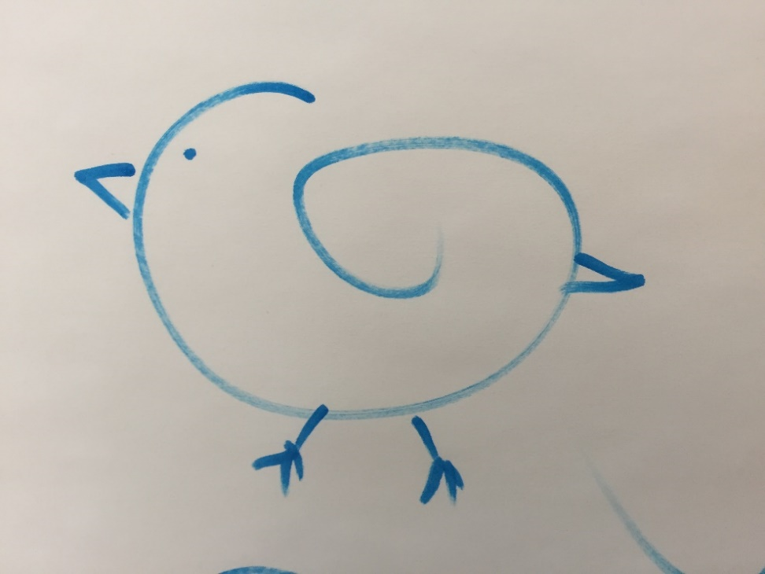
Outlook
The backend readout framework is mostly feature-complete, at least according to the “good enough for now” principle.
The challenge for this year will be integrating front ends (which are now available!) and continuing our work with the ICS and DMSC.
There has been lots of progress! But we need to do more development, a lot of testing, and a lot of documentation.
Steven Alcock, Detector Group, 25th February 2020

Slide 14
Questions

