Slide 2
Update from the Scientific Activities Division
Highlights from scientific coordination & user office, laboratory & sample services, sample environment
PRESENTED BY zoË Fisher and Arno Hiess

Slide 3
Agenda
1 Welcome & STAP membership
2 Team
3 NSS construction scope and initial operations
4 Scientific Coordination and User Office
5 Deuteration and Macromolecular Crystallisation
6 User Laboratories and Sample Services
7 Sample Environment
8 STAP charge

Slide 4
1
Welcome
and
STAP membership

Slide 5
STAP Membership
A special welcome to the new members
STAP Sample and User Services
T. Darwish (P. Holden), ANSTO, AU
K. Edler, U Bath, UK
M. Everett, SNS, US (Chair)
J. Lakey, U Newcastle, UK
K. Lefmann, U Copenhagen, DK
I. Lommatzsch, MLZ-FZJ, DE (Co-Chair)
R. Smith, STFC, UK
STAP Sample Environment
R. Barker, U Kent, UK
M. Bartkowiak, PSI, CH
E. Blackburn, U Lund, SE (Chair)
A. Boothroyd, U Oxford
S. Carlson, MAXI IV, SE (Co-Chair)
A. Church, STFC, UK
Y. Hernandez, NIST, US
S. Klotz, U Paris, FR

Slide 6
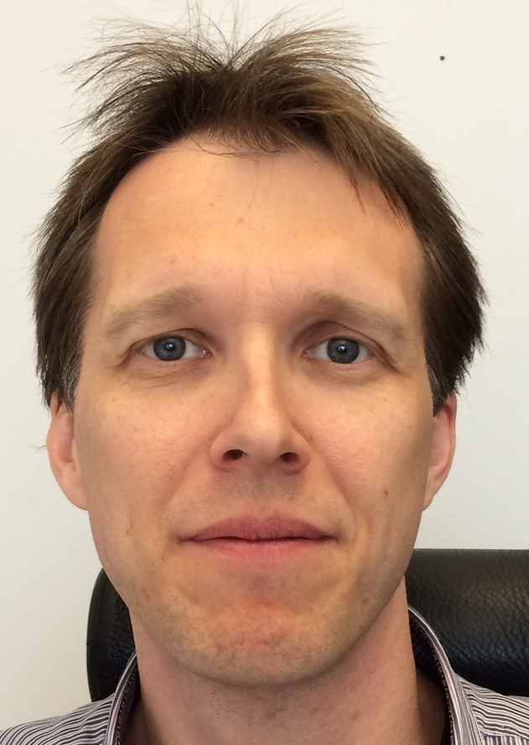

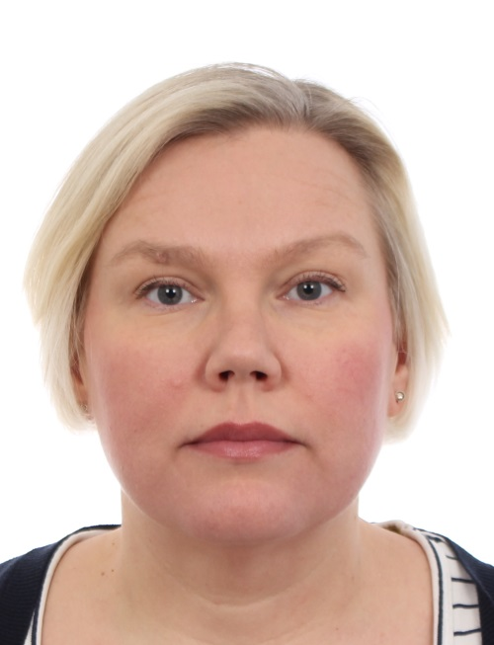
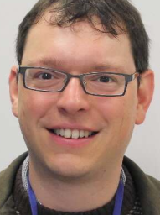

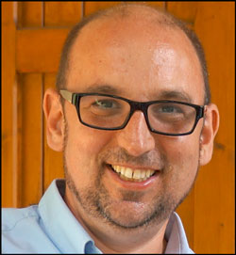
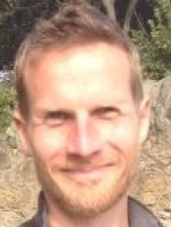
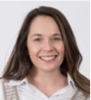
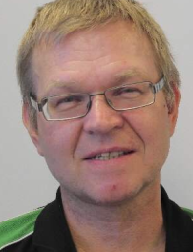
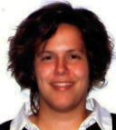
2
Team

Slide 7
SAD Team
performing operational functions as part of Science Directorate
  Line organisation matching operational functions – 17 FTE;
  Some leverage via external grants; Anders matrixed 50% from data management division DMSC
  On-going recruitments:
  Group Leader for Sample Environment
  Mechanical Design Engineer for Sample Environment – matrixed from TD/NSS project division
  Postdoctoral Research Fellow ‘dynamics of cyanobacterial membranes’ (HFSP grant).
  Deuteration Chemist – 1 yr maternity coverage
Scientific Activities Division
DEMAX
Deuteration & macromolecular Crystallization Group
SULF
Sample and User Labs Group
SCUO
Scientific Coord. and User Office
SAMPLE ENVIRONMENT GROUP
TEFI
Temperatures and Fields
PREMP
High Pressure & Mech. Process.
FLUCO
Fluids incl Gases, Vapor, Compl. Fl.
MESI
Mechatronics & System Integr.
7
7

Slide 8
3
NSS construction scope and initial operations

Slide 9
Construction Scope and Initial Operation
Current activities are funded from different funding streams
NSS/SSS Construction Scope remains unchanged
  All (active) in-kind projects involving partners from Estonia, France, United Kingdom
  All self-performed construction projects: workshop fit-out incl. mechanical tools; pressure testing facility; cryogenics incl. magnet refurbishment & helium management.
Initial Operation Planning adjusted to new baseline
  all operational activities including maintenance moved into initial operation budget.
  ramp up of resources for operational activities adjusted to new baseline
    catering for first instruments #1-8 (shortly) after BoT 26 FTE in 2023
    postpone hot commissioning of instrument #9-12 until 2026 (only) 30 FTE in 2025
    instrument #13-15 until 2028 e.g. no SE investment part of initial operation 35 FTE in 2028

Slide 10

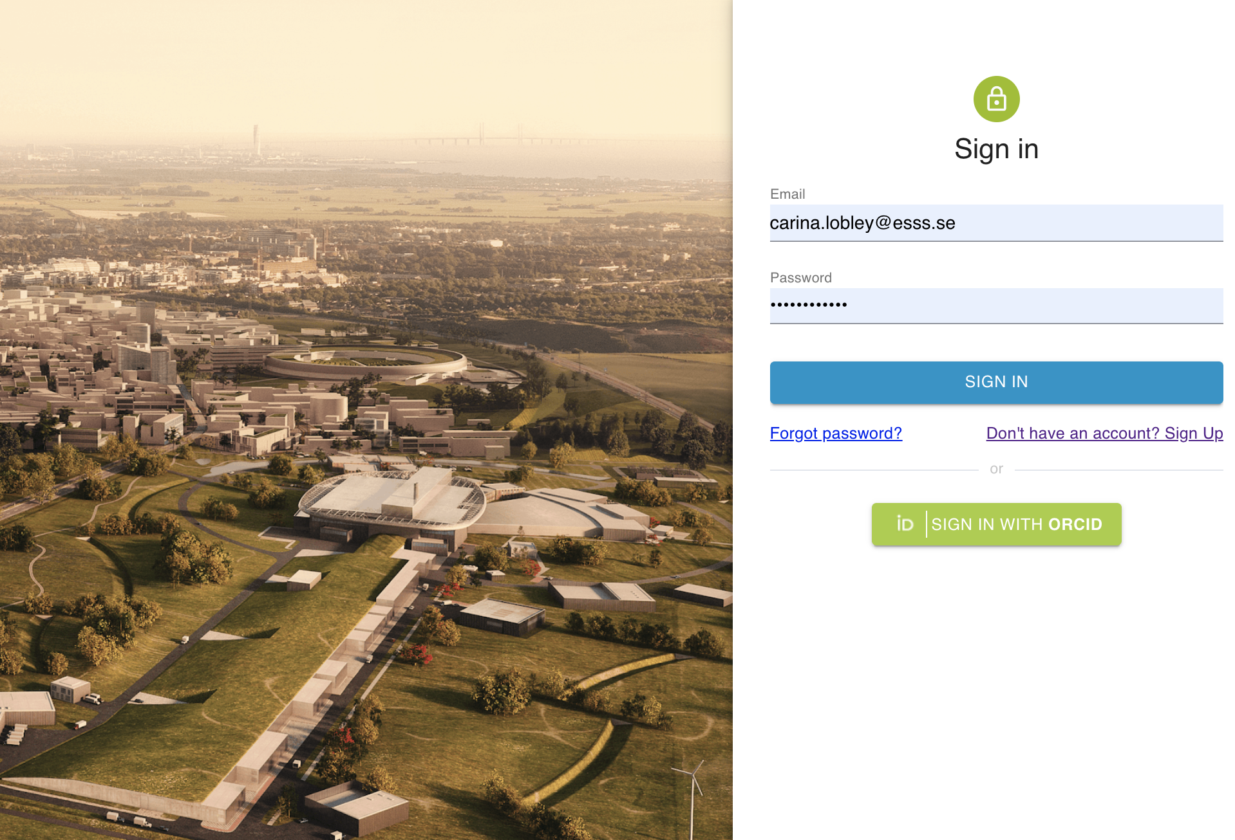
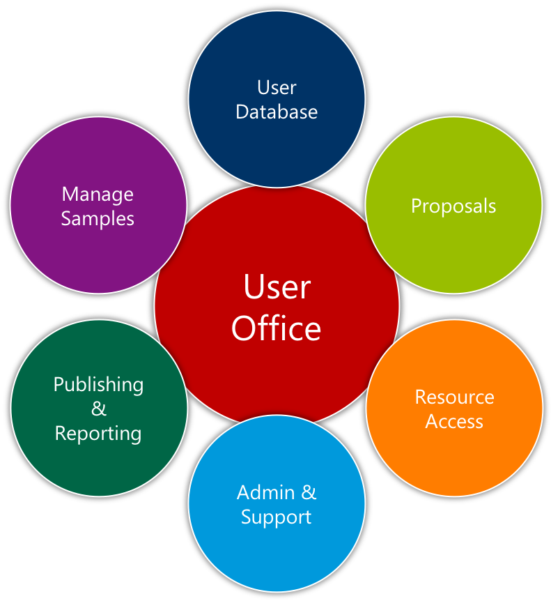
4
Scientific Coordination
and
User Office

Slide 11
Scientific Coordination and User Office
Achievement | Enables
User policies on evaluation / access and publication drafted, (to be) presented to SMT, STAP, SAC, Council | Implementation of procedures and guidelines for future user programme
Supporting 2nd DEMAX pilot call exploiting DMSC-developed User Office Software | ‘Hot commissioning’ user programme and providing feedback on software features needed
Mapping of required SCUO functions / responsibilities: (On-site) user services Easy reporting against (ESFRI-recommended) KPIs Industrial access incl. industrial advisory board | Centring ESS activities on user needs and streamlining required ESS resources for successful user programme
Challenge | Mitigation
Emerging scientific events: ESS Science Day 2020 cancelled SXNS postponed to 2021 ESS-ILL user meeting in autumn at risk depending on COVID-19 developments | With stakeholders watching situation and adjusting the plan
Mid-term planning for user engagement and on-site user services not a priority (yet) for ESS stakeholders | Multi-stakeholder activity requiring additional care (communication) in work-from-home environment

Slide 12



4
Scientific Coordination
and
User Office

Slide 13
Scientific Coordination and User Office
Achievement | Enables
User policies on evaluation / access, publication drafted | Implementation of procedures and guidelines
Support 2nd DEMAX call exploiting User Office Software | ‘Hot commissioning’ user programme
Mapping of required SCUO functions / responsibilities | Centre activities on user needs, streamline resources
Challenge | Mitigation
Scientific events incl. ESS-ILL user meeting at risk | watching situation and adjusting the plan
Planning for user engagement & services not a priority | Multi-stakeholder activity requiring additional care

Slide 14
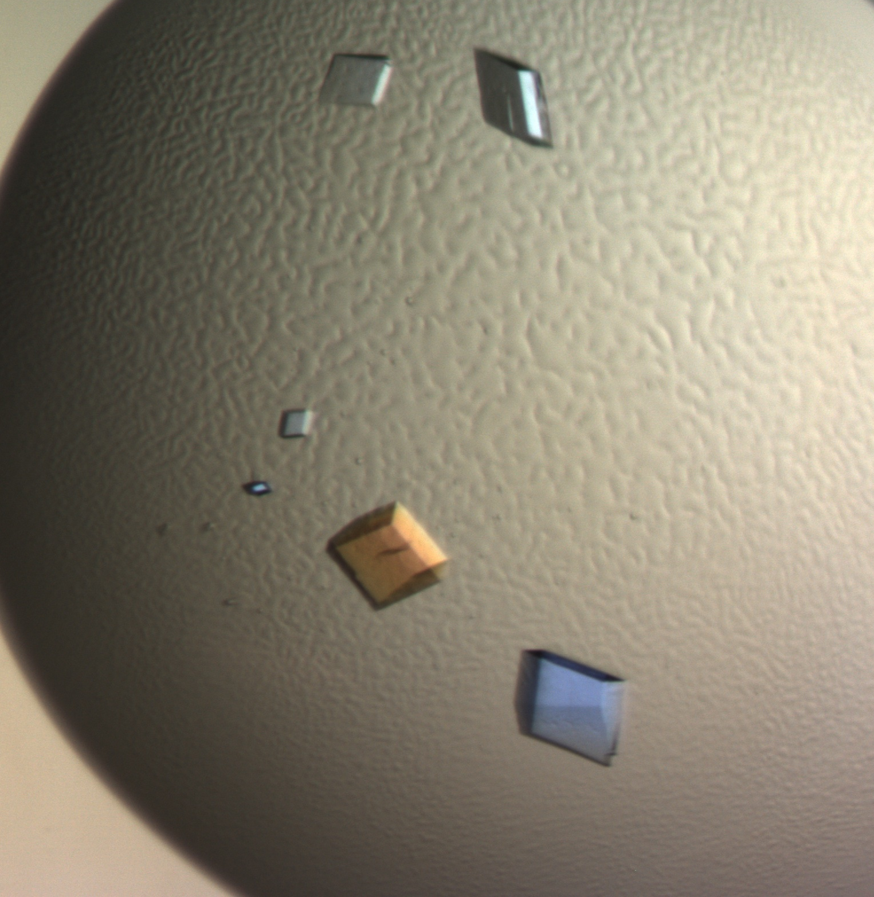
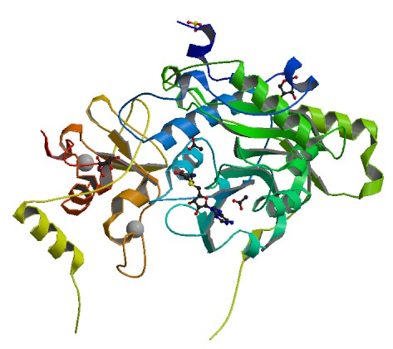
5
Deuteration and Macromolecular Crystallisation

Slide 15
Deuteration & Macromolecular Crystallisation
Achievement | Enables
Priority access for COVID-19 projects building on established capabilities and pilot user calls | ESS team supports fighting health-related societal challenges.
1st pilot call: successfully concluded on 16 accepted proposals; last materials being worked on as planned 2nd pilot call: 17 proposals received and now evaluated via user office software supported by SCUO & DMSC | Hot commissioning user programme and refine SCUO software, supported neutron user community for access to deuterated materials & crystals in life science, chemistry, soft matter, enabled scientific research in our key (future) user community to ensure first science
Collaborations and grant activities: SINE2020 and iNEXT successfully concluded Brightness2 and 2x VR incl. PhD student progressing Coordination of DEUNET and LENS PA ‘health’ | Expands scientific capability to support users and scientific research (11 publications in 2019-2020), work synergistically with other facilities and attracts funding
Challenge | Mitigation
Understaffed in key positions to support user proposals while growing to be ready for First Science lacking in life science/biology expertise | Recruitment for maternity coverage on-going, but need to recruit to meet demand for first science: 2nd synthetic chemist for small organic molecules (LoKI, Skadi, C-SPEC, Estia) biodeuteration/life science specialist (LoKI, NMX, Estia, ODIN, C-SPEC)
Ensure long-term home for chemical deuteration labs | Renew lease for MV space for 5 year term beyond 2023

Slide 16
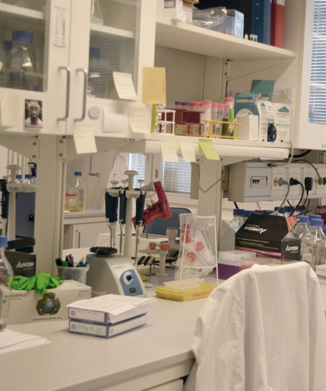
5
Deuteration and Macromolecular Crystallisation

Slide 17
Deuteration & Macromolecular Crystallisation
Achievement | Enables
Priority access COVID-19 projects building on pilots | ESS team supports fighting societal challenges
1st call: successfully concluded, last materials ready 2nd call: 17 proposals received, evaluated via SCUO SW | Hot commissioning user programme, refine SCUO SW, support user community with deuterated material
SINE2020, iNEXT concluded, Brightness2, VRs ongoing Coordination of DEUNET and LENS PA ‘health’ | Expands scientific capability, 11 publications 2019, work synergistically with other facilities and attracts funding
Challenge | Mitigation
Understaffed to support proposals in life science/ bio | Recruitments: 2nd synthetic chemist, biodeuteration)
Ensure long-term home for chemical deuteration labs | Renew lease for MV space for 5 year term beyond 2023

Slide 18
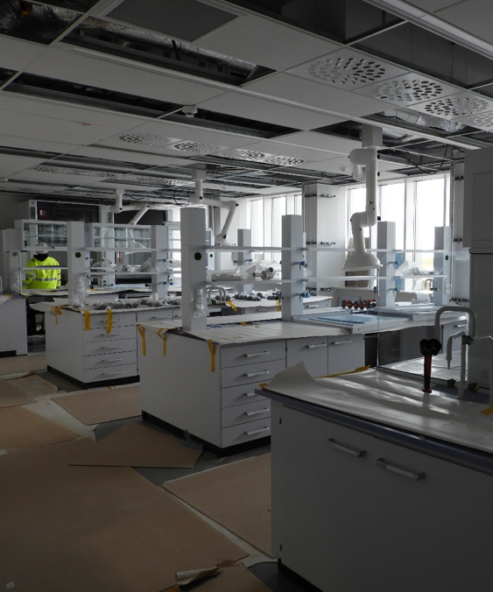
6
User Laboratories
and
Sample Services

Slide 19
User Laboratories and Sample Services
Achievement | Enables
Area coordination of construction and declassified spaces in E03/E04. Following successful IRR, fit-out of laboratory (80-90% complete) and technical workshop spaces (started) ahead of schedule. | Installation of laboratory equipment and glove boxes (temporary); commissioning of on-site chemistry and life-science services for hot commissioning and first science.
Analytical support to ESS construction project: Ortho-/para-hydrogen, luminescence screen beam diagnostics, bunker / target concrete analysis, radiation-hardened grease, beam dump water analysis | Essential for TD/ SD engineers to advance ESS construction project and ensuring ESS project delivery
PostDoc recruitment for HFSP grant started | boosts life science and soft condensed matter expertise and equipment, e.g. DLS instrument.
Challenge | Mitigation
Related to COVID-19 crisis (in-kind) installation team has been ordered back to UK and fit-out of on-site E03 / E04 laboratories has stopped. | Partner revising installation plans (~3m float) as well as updating as-built documentation Revise schedule to advance ESS self-performed infrastructure installation Information on access for D buildings required

Slide 20
User Laboratories and Sample Services
Achievement | Enables
E03/E04 area coordination; successful IRR, fit-out labs 80-90% complete, technical workshops started | Install lab equipment & glove boxes, commissioning on-site chemistry / lifescience services for FS
Analytical support to ESS construction project | Essential to advance ESS construction project
PostDoc recruitment for HFSP grant started | boosts life science and soft condensed matter expertise
Challenge | Mitigation
Related to COVID-19 IK installation team back UK; fit-out of on-site E03 / E04 labs has stopped. | Partner revising installation plans, as-built doc., ESS schedule to advance self-performed infrastructure

Slide 21
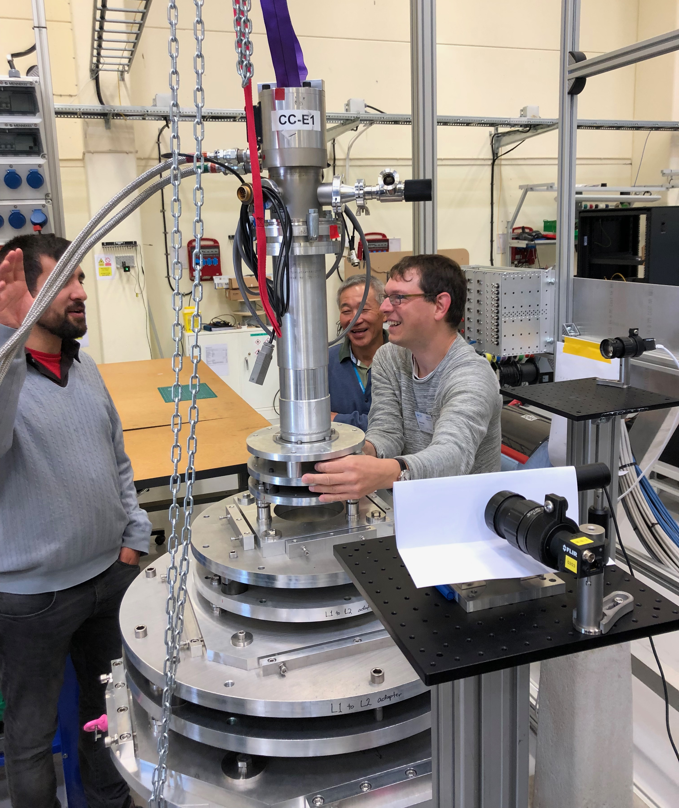
7
Sample Environment

Slide 22
Sample Environment
Achievement | Enables
Standardised floor-mounted mechanical interface validated & ready for instrument implementation | Eases change-over & operation of sample env. on all instruments; helps hot commission & first science
Planning for E03 workshop fit-out and infrastructure incl. mechanical tools enclosure, hot works area, helium recovery ready to be executed | Fit-out once UK partner resumes on-site work; Installation machine tools and commissioning of first sample environment systems
All in-kind TAs agreed and all – but one –activated | Manufacturing for critical sample environment systems
High pressure blow-out tests performed; plans for on-site testing facility progressing | Safety assessment, safety validation and life-cycle management of high pressure equipment
PE high pressure system assembled with hydraulic system and specific anvils for MAGIC and DREAM | High pressure diffraction experiments on first instruments
Progress on instrument-specific sample environment: CTV 8T magnet (MAGIC) and cryo-furnace (DREAM) Kick-off SANS changer (LOKI) & solid-liquid (ESTIA) Stress rig #1 available for control integration | Prioritised critical sample environment systems required for hot commissioning and first science
Mechanical and control Integration of wet cryogenic systems converging; 15T magnet ready for shipment. | Low temperature experiments; magnet essential for BIFROST first science
Communication protocol SECoP: SINE2020 project successful, ready for ESS implementation via ECDC/ICS | Standardised meta-data, validation of control develop. platform); cross-facility operation of sample env.

Slide 23
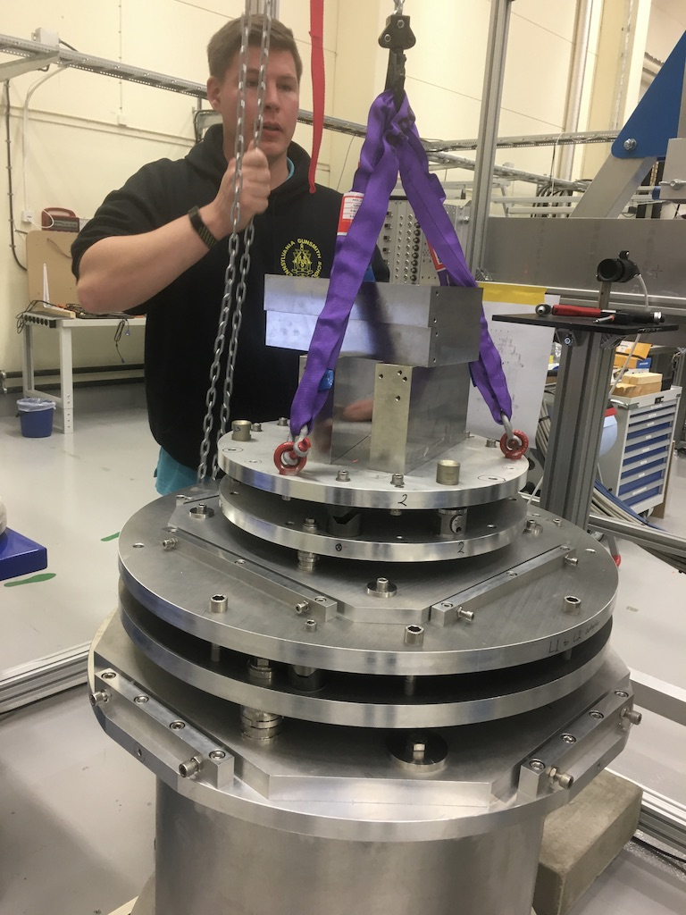
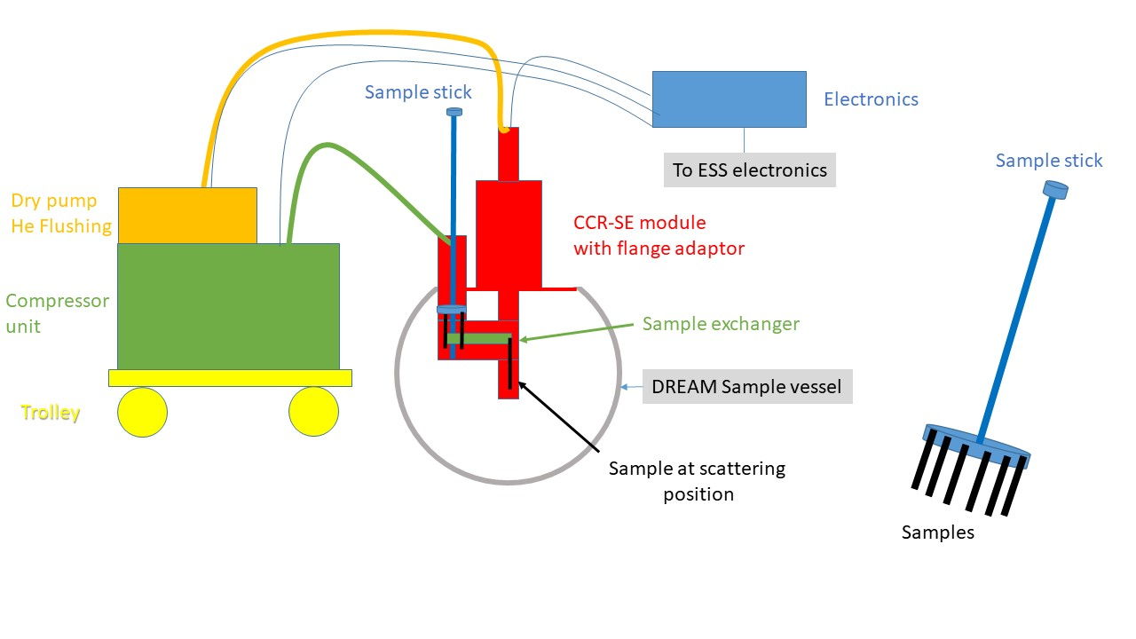
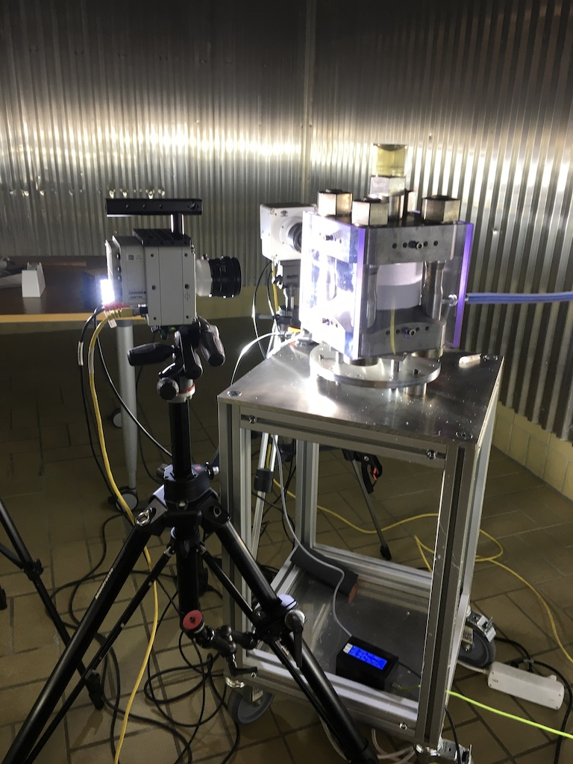
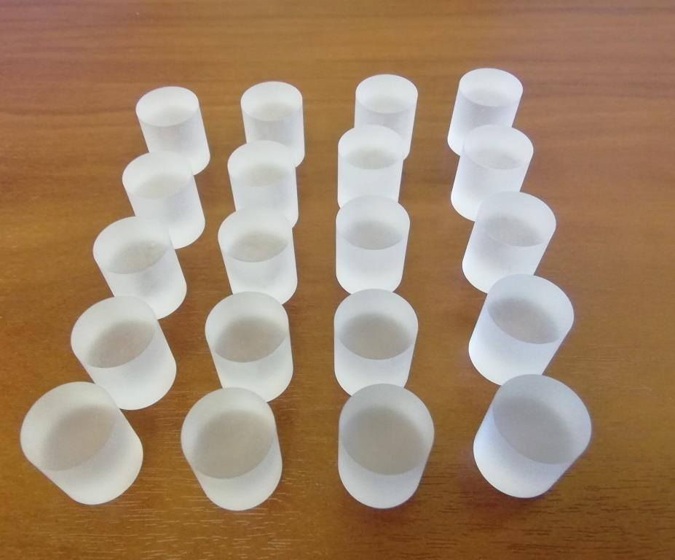
Sample Environment
Challenge | Mitigation
Related to COVID-19 crisis (in-kind) installation team has been ordered back to UK and fit-out of on-site E03 / E04 workshops has stopped | Revise schedule to advance ESS self-performed infrastructure installation Information on access for D buildings required Use of temporary workshops (Utgård, MV)
Related to COVID-19 crisis in-kind partners in Estonia and France temporary suspended /reduced work | Follow up with partners to adjust delivery schedule.
Partial closure of vendor developing non-magnetic components resulting in uncertain dimensions and delays of spatial integration (CSPEC & DREAM tank) | Overcome pending recruitment of design engineer to quantify effect on critical parameters in instrument design and support spatial integration

Slide 24
Sample Environment
Achievement | Enables
Standardised floor-mounted mechanical interface validated & ready for instrument implementation | Eases change-over & operation of sample env. on all instruments; helps hot commission & first science
Planning for E03 workshop fit-out and infrastructure | Fit-out once UK partner resumes on-site work
All in-kind TAs agreed and all – but one –activated | Manufacturing for critical sample environment systems
High pressure blow-out test; plans E03 testing facility | Safety assessment & validation, life-cycle management
PE system with hydraulic system, specific instr. anvils | High pressure diffraction exp. on first instruments
Progress on instrument-specific sample environment | Prioritised critical sample environment systems for FS
Mechanical and control Integration of wet cryogenic systems converging; 15T magnet ready for shipment. | Low temperature experiments; magnet essential for FS
Communication protocol SECoP: SINE2020 successful | Standardised meta-data, validation of control platform

Slide 25
Sample Environment
Challenge | Mitigation
Related to COVID-19 IK installation team back UK; fit-out of on-site E03 / E04 labs has stopped. | Advance self-performed infrastructure; Use of temporary workshops (Utgård, MV)
Related to COVID-19 IK partners reduced work | Follow up with partners to adjust delivery schedule.
Partial closure of vendor for non-magnetic components | Overcome pending design engineer recruitment

Slide 26
SE Priorities for Imaging & Engineering
as required for hot commissioning and first science of different instruments
BEER
Platform | System | Details | partners
PREMP | Stress strain rig 1 | 100kN ’workhorse’ | NPI
PREMP | Stress strain rig 2 | 40kN with rotation for imaging, torsion | NPI / MLZ / commercial
PREMP | Dilatometer |  | commercial
ODIN
Platform | System | Details | partners
PREMP | Stress strain rig 2 | 40kN with rotation for imaging, torsion | NPI / MLZ / commercial
PREMP | Gas / liquid cells | 5 kbar gas / liquid cell | LLB
  Some (pool) SE systems shown more than once – matching SE reference suite
  Details on delivery schedule provided by later presentations.

Slide 27
SE Priorities for Diffraction
DREAM
Platform | System | Details | partners
TEFI | Cryofurnace | Instr. specific; multi-position changer | LLB
TEFI | Wet Cryostat | Standard Orange Cryostat | LLB
TEFI | Magnet | Asymmetric 8T + Dilution / ³He | LLB
TEFI | Furnace | HT vacuum furnace | ESS
PREMP | Clamp, PE, DAC pressure cells | 2, 20, 50 Gpa + low T | LLB, LLB, SNS
FLUCO | Gas Processing | Automated | EE
MAGIC
Platform | System | Details | partners
TEFI | Magnet | Asymmetric 8T + Dilution / ³He | LLB
TEFI | Wet Cryostat | Instrument specific | LLB
PREMP | Clamp, PE, DAC pressure cells | 2, 20, 50 Gpa + low T | LLB, LLB, SNS

Slide 28
SE Priorities for Spectroscopy
CSPEC
Platform | System | Details | partners
TEFI | 6.5 T Magnet | Ex-HZB VM-2 +Dilution insert | ESS/HZB
TEFI | Cryofurnace | Inst. specific 6 pos. changer | LLB
TEFI | Wet cryostat | Standard Orange Cryostat | LLB
PREMP | Clamp + DAC uniaxial | 2 GPa + low T | LLB, U Copenhagen
PREMP | Gas liquid cells | 10 kbar gas/liquid cell | LLB
FLUCO | Humidity cell | Wide angular access | ESS/EE
FLUCO | Pump-probe | In-situ laser trigger | EE
BIFROST
Platform | System | Details | partners
TEFI | 15T Magnet | Ex HZB VM1B +Dil. | ESS/HZB
TEFI | Wet Cryostat | Specific Orange Cryo 100mm | BIFROST
PREMP | Clamp, PE, DAC pressure cells | 2, 20, 50 Gpa + low T | LLB, LLB, SNS

Slide 29
SE Priorities for Large Scale Structures
LOKI
Platform | System | Details | partners
FLUCO | SANS changer | Inst. spec.; (indiv.) thermalized, tumbler | ESS
FLUCO | (Stopped) Flow cells | Inst. spec.; incl. pumps | ESS, EE
FLUCO | In-situ techniques | Supplied via external grants | External / ops
TEFI | Low field magnet | HTSC warm bore or electromagnet | LLB
PREMP | stress-strain rig 3 | 5-10 kN versatile rig | LLB
ESTIA
Platform | System | Details | partners
TEFI | Low field magnet | 2T HTSC warm bore magnet | LLB
TEFI | Flow cryostat | Instrument specific | PSI
FLUCO | Solid Liquid Cells | Instrument specific | ESS

Slide 30
8
STAP Charge

Slide 31
STAP Charge
In view of hot commissioning 2022, first science 2023 & impact from COVID-19:
Common Topics
  Progress towards completion of construction project “science support systems”
  Progress of on- and off-site labs and workshops, equipment, staffing, and capabilities.
  Updated guidelines on required instrument provisions including infrastructure, mechanical interfaces, utility supplies, control infrastructure, and sample workflow.
  Delivering collaborative research and development activities, incl. grants and LENS PAs.
  Prioritising construction deliverables and operational activities following the COVID-19 crisis in view of ensuring hot commissioning in 2022 and first science in 2023.

Slide 32
STAP Charge
In view of hot commissioning 2022, first science 2023 & impact from COVID-19:
Topics for STAP Sample and User Services
  Revision of policies related to user access, affiliation, and scientific publications.
  Participation in development of user office & proposal software tools.
  Suitability of minimal set of requirements for the user office & proposal software tools.
  Operating deuteration services (pilot calls) incl. prioritised access COVID-19 research.
  Evaluation of laboratory spaces, equipment priorities and competences for (future) staff.
  Progress on installing / using on-site (user) labs and sample management.

Slide 33
STAP Charge
In view of hot commissioning 2022, first science 2023 & impact from COVID-19:
Topics for STAP Sample Environment
  Prioritisation and progress on ‘Day 1’ sample environment systems
  Proposed strategy and ways-of-working related to mechanical integration, controls, safety, maintenance in view of schedule and available resources.
  Progress on fitting and using on- and off-site sample environment workshops.

Slide 34
Thank You !

