Slide 1

ESS Science Directorate Update
STAP Meetings – April 2020
PRESENTED BY Andreas Schreyer

Slide 2
ESS Update
Coronavirus
  We have been on work-from-home since 19th March
  Sweden does not have severe lockdown, so some ESS activity on site is continuing e.g. NMX cave installation, Accelerator installation
  We are continuing to perform reviews (CTV, IDR, Tollgates) as most of these were by correspondence/video conference in any case.
  Partner countries do have more severe controls in place – this is the major challenge.
  Skanska continue to work at ~80% level, so CF timeline is not going to be severely affected yet.
  Weekly updated tracking of impacts due to coronavirus is taking place. Of note so far:
    Lab installation stopped due to installation team returning to UK
    Engineering and procurement significantly slowed in France
    Production of equipment (Monolith vessel, target wheel, instrument vacuum vessels) stopped in Spain
    Production of beamport inserts will be delayed in Germany

Slide 3
Critical Path
Status Feb 2020 w/o Corona impact
Red diamonds are
NOT a revised
schedule
3

Slide 4
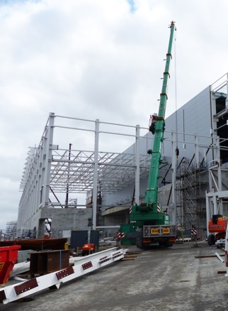
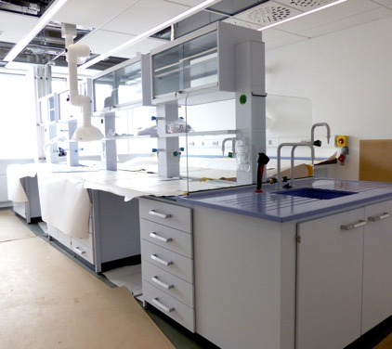
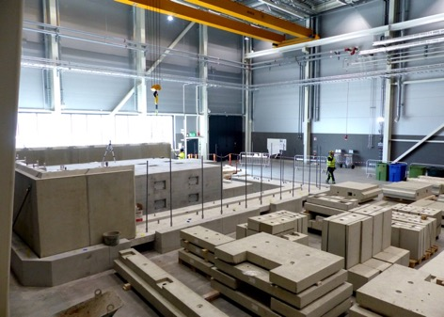
ESS Update
Construction and Installation Activities
  Buildings
    D building structures are going up
    D03 roof trusses on
    D01 support wall frame erected
  Labs
    Installation work on labs in E buildings had started. Successfully negotiated out of hours/unsocial hours work regime for supervisory staff to maximise work time of contractors. SAD team were on a rotation of supervision duties to cover the extended working day until installation stopped.
  Instruments
    NMX : cave being installed
    CSPEC : guide shielding base installed
    BIFROST : control hutch installed
D03 frame & trusses
E04 Lab fitout
BIFROST Hutch
NMX Cave

Slide 5
ESS Update
Organisation
  Re-organisation completed:
    Staff from Neutron Instruments Division in the Science Directorate have transferred to new Instrument Scientists Group within NSS Project Division in the Technical Directorate.
    Experimental Control & Data Curation Group (DMSC), Chopper Group & Detector Group (ITD) all moved from Science Directorate to NSS Project Division in the Technical Directorate alongside new Instrument Scientists Group.
    NSS Project Division has also Technical Projects Group (engineering), and Planning and Coordination Group
    Will all return to Science Directorate at or after BOT with defined milestones
    First Science is scope of Science Directorate
  Andrew Jackson replaces Ken Andersen who has moved to SNS
    Group Leader for Instrument Scientists Group
    Also represents instrument scientists and instrument operations within the Science Management Team in the Science Directorate)
    At least 20% of instrument scientists time is still allocated to research, outreach and community development to ensure adequate preparation for early science and start of user operations.

Slide 6
Challenges
Initial operations replanning:
  Council has asked ESS management to plan with 10% less initial operations budget from 2019-2025
  Huge challenge for the whole organisation
  Internal replanning is ongoing
  Delayed by Corona pandemic
Preparations for First Science:
  First Science is the major milestone the whole organisation is working towards
  Science Directorate has to ensure that we focus on the right things
  STAP advice during the next years will be highly valued

Slide 7
New Setup for STAPs
  We are now on a regular schedule
    2 STAP meetings per year, synchronised with SAC meetings
    Reporting to SAC meeting
    Spring:
      Focus on DMSC, Samples and Users, and Sample Environment STAPs
      Held during 3 days before SAC meeting
      STAP chairs to attend SAC meeting and present summary
    Autumn:
      Focus on Instrument STAPs
      Held during 3 days before SAC meeting
      STAP chairs to attend SAC meeting and present summary

Slide 8
Big Instrument Paper
Finally published!

Slide 9
Big Instrument Paper
Finally published!
Thanks to everybody !

Slide 10
Joint ESS – MAX IV Science Colloquia 2019
10

Slide 11
Joint ESS – MAX IV Science Colloquia 2020
Adapting to the pandemic: Webcast
11

Slide 12
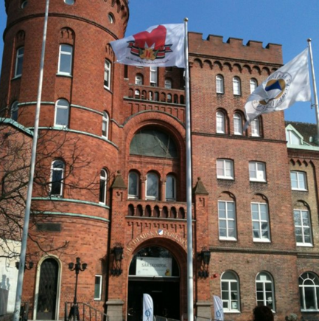
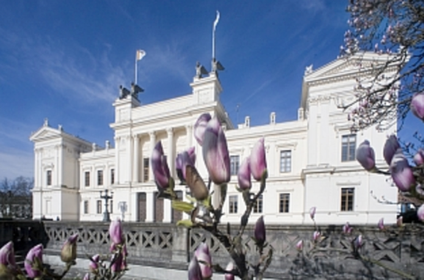

Joint ESS ILL User Meeting 2020
Date and Venue
Wed 23rd – Fri 25th September 2020
Lund: Rooms in AF Borgen, Universitetshuset and Palaestra
12

Slide 13
Summary and Outlook
Major Goal for the Science Directorate 2019
”Begin installation of instruments” achieved
TA’s for 6 more instruments approved, i.e. now for 13 out of the 15
Bunker installation started
D01 and 03 are coming up!

Slide 14
Summary and Outlook
Major Goal for the Science Directorate 2019
”Begin installation of instruments” achieved
TA’s for 6 more instruments approved, i.e. now for 13 out of the 15
Bunker installation started
D01 and 03 are coming up!

Slide 15
Summary and Outlook
Major Goal for the Science Directorate 2019
”Begin installation of instruments” achieved
TA’s for 6 more instruments approved, i.e. now for 13 out of the 15
Bunker installation started
D01 and 03 are coming up!
2020:
Initial Operations replanning,
continue Installation in E-Buildings,
Move into E-Building Science and NSS/TD,
User meeting in September
Corona impact yet unknown

