Slide 2
SCUO Presentation
Spring STAP 2020
PRESENTED BY Carina Lobley

Slide 3
Agenda
1 Policies and Guidelines
2 Key Performance Indicators
3 Science Focus and User Meeting 2020
4 DEMAX Call for Proposals
5 User Office Software

Slide 4
1
Policies and Guidelines

Slide 5
SCUO Policies and Guidelines
User Access
Scientific Evaluation and Access Policy
Policy documents will be high level, outlining the basic principles.
Users will be provided with guidelines to detail how to comply with the policy.
User Office will work to procedures to ensure application of the policy.
Approved = ESS Council has approved
SAC = SAC has approved but it still needs to be approved by ESS Council
SMT = Discussed with STAP, but needs final approval by SMT before SAC and then ESS Council
Policy for User Scientific Publications
SAC
Policy for Scientific Data
SMT
Approved

Slide 6
SCUO Policies and Guidelines
Science Directorate Staff
Guidelines to support Science Directorate affiliated staff how to record their ESS and other affiliations in publications.
Guidelines to support SCUO and the Science Management Team in determining when to sponsor science events.
Consistency and transparency are critical.
Both documents await SMT approval after which they will be implemented.
Guidelines for Science Directorate Publications and Affiliations
Guidelines for Science Directorate Sponsorship

Slide 7
2
Key Performance Indicators

Slide 8
Key Performance Indicators
ESFRI Report and Brightness²
ESFRI have produced report that describes 21 KPIs across 9 relevant business areas.
In addition Brightness² list of recommended KPIs covering similar topics
Some KPIs can be reported now:
Number of publications
Percentage of top cited publications
Training of people who are not RI staff
Outreach and engagement achieved by direct contact
https://www.esfri.eu/sites/default/files/ESFRI_WG_Monitoring_Report.pdf

Slide 9
Key Performance Indicators
ESFRI Report and Brightness²
ESS publications are identified using the author address in Web of Science.
Training and science directorate outreach activities are not currently recorded systematically. Several activities are in progress:
Define training, science event and science outreach
Determine recording methods activities hosted by ESS
How and what to capture ESS staff activities beyond ESS?

Slide 10
3
Science Focus and User Meeting 2020

Slide 11
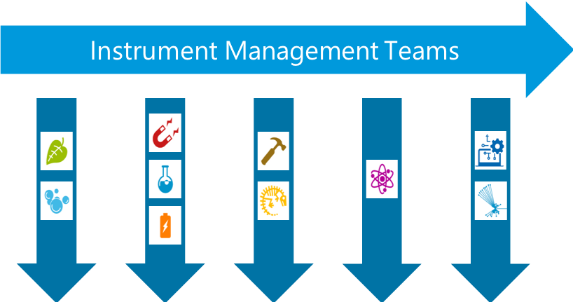
Science Focus
Science Activities in SCUO
Gradually increasing number of science seminars and activities at ESS (before COVID-19).
SCUO focus to actively support the Science Focus Teams.
ESS and MAX IV are jointly hosting SXNS16 – now in June 2021.
ESS and ILL are hosting the second joint User Meeting, hopefully in September 2020.
SCUO are working to adjust the perception of First Science 2023 – 2023 will not be the first point ESS and ESS employees have produced science!

Slide 12
4
DEMAX call for proposals

Slide 13
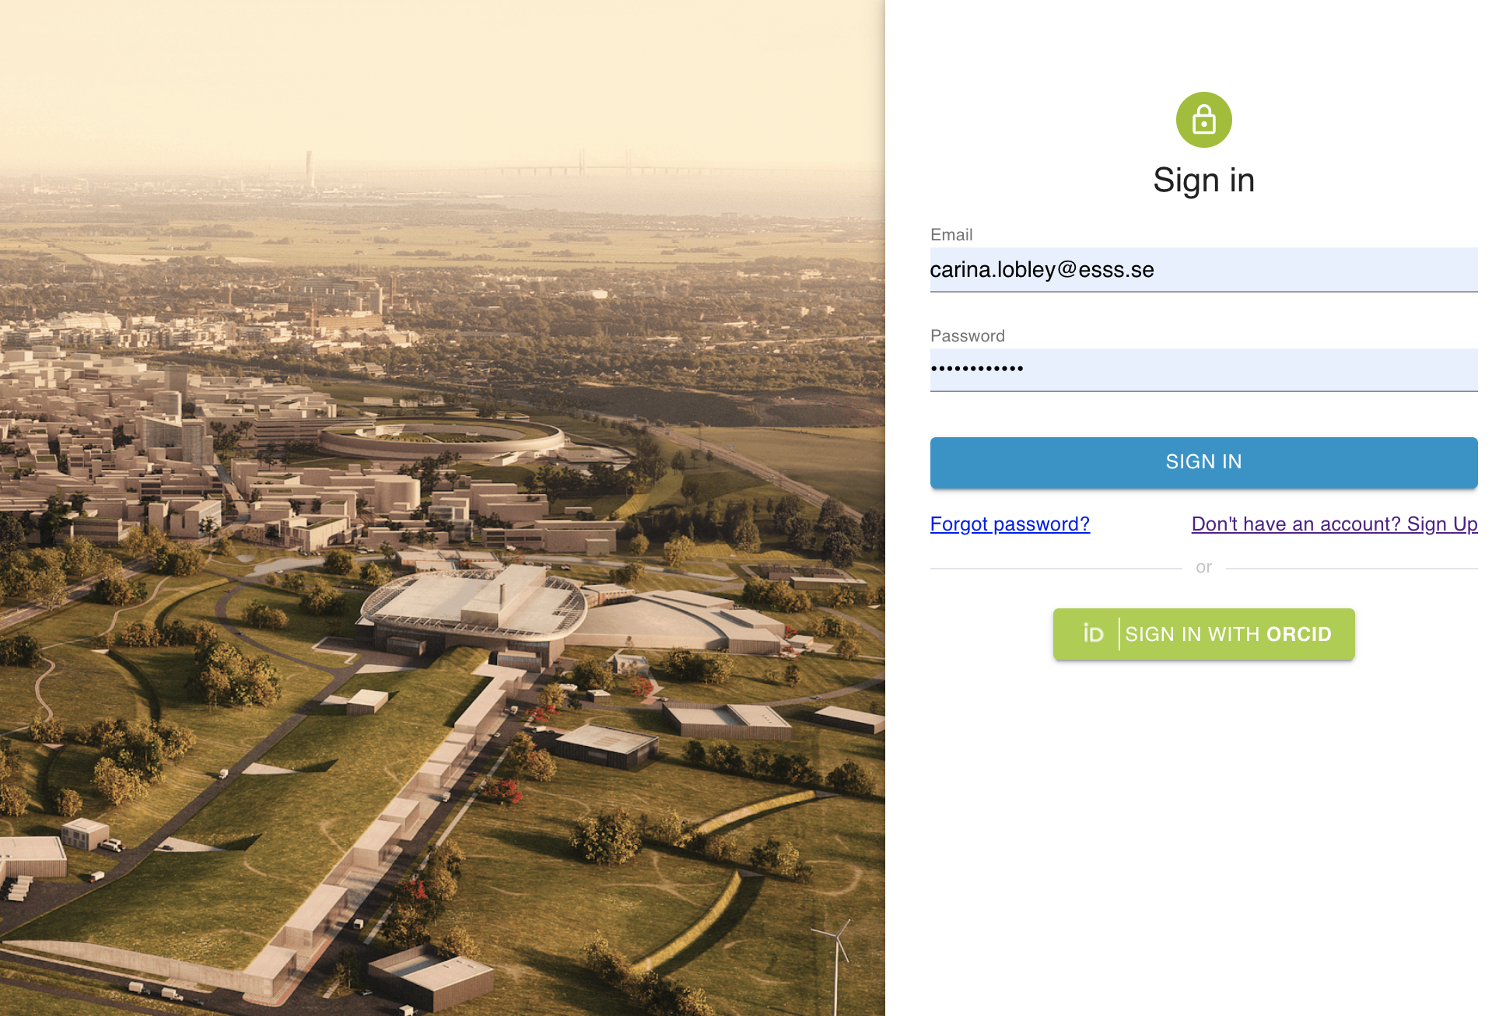
DEMAX Call For Proposals
2nd Pilot Call: December 2019-February 2020
The 2nd pilot call for proposals for DEMAX has used the ESS User Office Software under development
Components of the software in operation:
User Registration
Proposal Submission
Internal Proposal Review
Components of the software under development:
External Proposal Review
Also need consolidation:
Multiple, concurrent calls for proposals
Additional sections for instrument proposals (?)

Slide 14
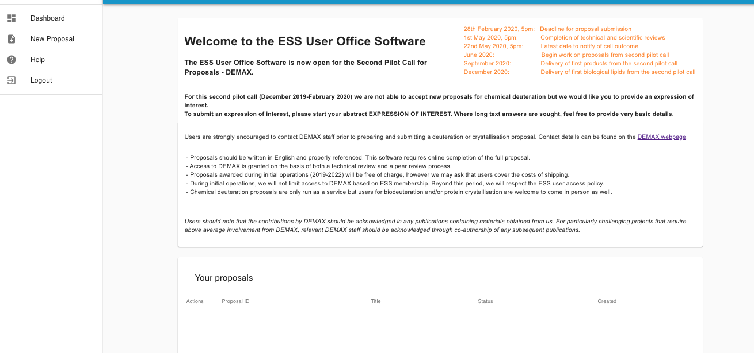
DEMAX Call For Proposals
User Office Software: User View
Key Dates
Call info
Navigation pane
Proposal hints
List of proposals involving this user

Slide 15
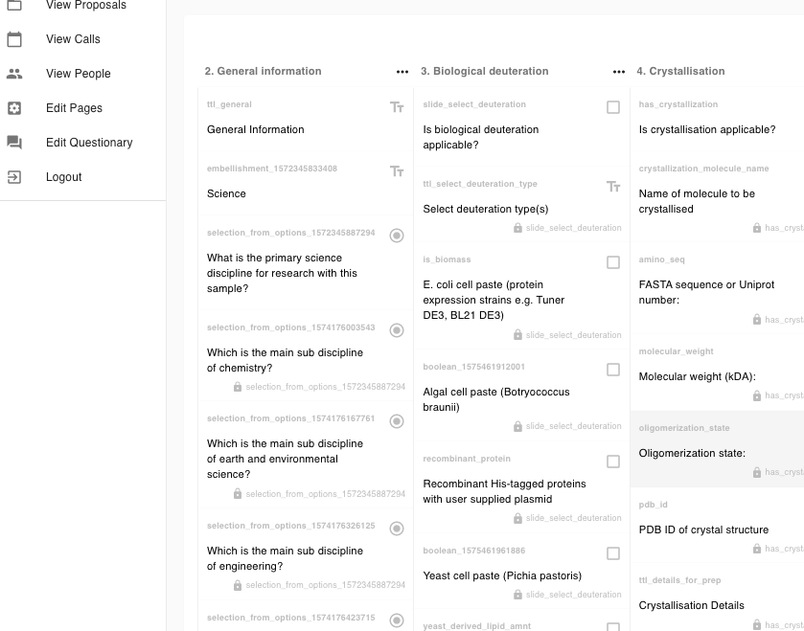
DEMAX Call For Proposals
User Office Software: Questionary
Proposal prepared like any online form builder or survey site
Complete flexibility so no requirement for software skills in redesigning the proposal questions
Easy to make dynamic questions
Very powerful throughout the software

Slide 16
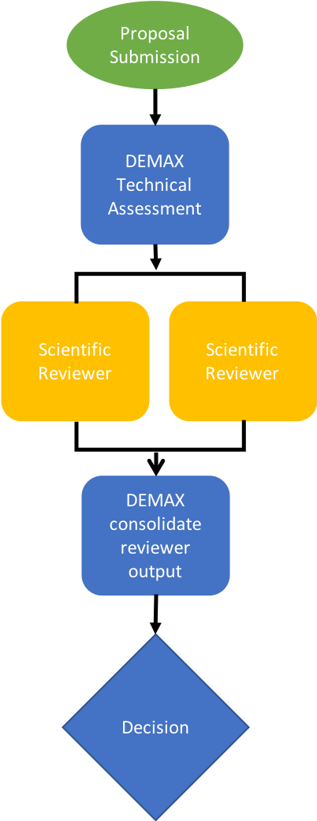
DEMAX Call For Proposals
Review Process
The DEMAX proposal review process has been implemented in the User Office Software.
Due to DEMAX needs we have already implemented:
Preparing bookmarked pdf ‘bundle’ of proposals
Internal review of proposals
Inviting reviewers to register in the User Office Software with role of ‘Reviewer’
External grade and comment for proposals
The review outcome and decision email should be ready by the time the external reviews are completed.

Slide 17
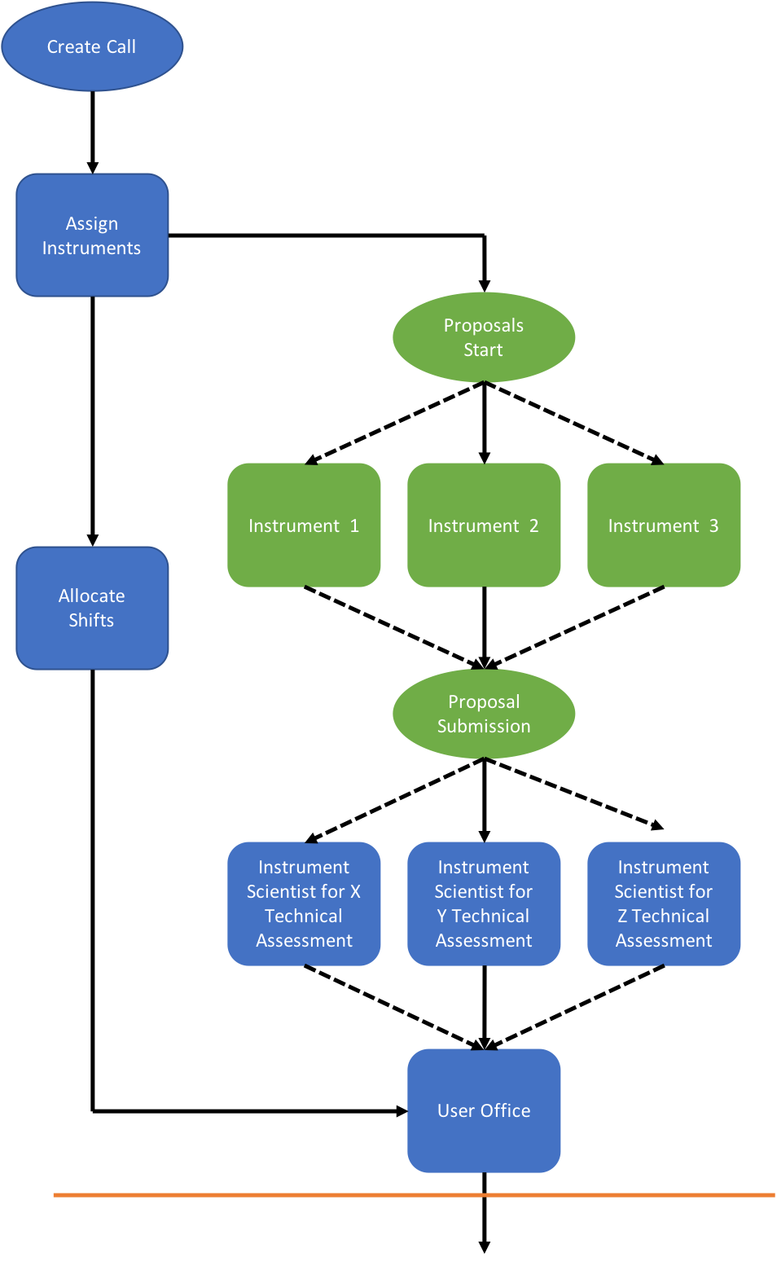
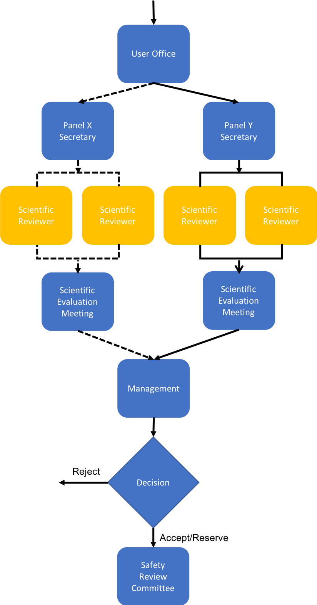
DEMAX Call For Proposals
ESS Complete Review Process
Additional features required to implement the full process include:
Creating specific calls for proposals
Creating scientific evaluation panels
Inviting reviewers to a specific science evaluation panel
Assigning proposals to a specific science evaluation panel
Facilitating a scientific evaluation meeting
Collating the meeting outcome in to a clear output for management to review

Slide 18
5
User Office Software

Slide 19
User Office Software
Beyond Proposal Management
User Database
User Office Software usually goes beyond providing a database of users and proposal management.
User requirement: smooth interaction with ESS in a series of consistently presented tools.
ESS requirement: happy users and a clear understanding of how all the elements of user office work will be tied together.
Manage Samples
Proposals
User Office
Publishing & Reporting
Resource Access
Admin & Support

Slide 20
User Office Software
User Journey in Software Interactions
Element | Software Solution | Comments
User Registration | User Office Software | Data to be stored in IAM after IAM is procured.
Proposal Submission | User Office Software | How much information should be included in the proposal? Experiment and sample for safety/data management plan?
Proposal Science Review | User Office Software | This includes technical and excellence reviews.
Proposal Safety Review | ? | This requires the experiment plan and sample information as input and will have control measures as output.
Experiment Scheduling | ? | This includes collecting user ‘bad dates’ and scheduling the instrument, sample environment, local contact, on call scientist …
User ESS Site Training | Learning Management System | Software currently being installed. The completion of training should be required before a visit can be planned.
User Visit Planning | ? | User notifies ESS which scientists are coming and when. Also what arrangements they require ESS to make.
Sample Shipping to ESS | Enterprise Asset Management | Samples shipped to ESS will start a tracking record at this stage.
Sample Registration at ESS | Enterprise Asset Management (?) | Samples brought to ESS will need to be registered for tracking. This is not strictly in the EAM planning.
User Site Access | UOS/IAM/LMS/? | Complex since requires communication between software not yet specified or procured.

Slide 21
User Office Software
User Journey in Software Interactions
Element | Software Solution | Comments
User Radiation Protection | Dosiserve | Currently being implemented by Health Physics.
User Welcome | User Office Software | The User Office Software should provide sufficient information to facilitate contact at gatehouse and reception (if needed).
On-Site User Training | Learning Management System | Software currently being installed. No clear ownership for user training.
On-Site Experience | ? | Here to flag - user cards might also carry credit for food, credited by the facility or the user – there are no details.
Sample Tracking | Enterprise Asset Management | EAM will record which samples are exposed to neutrons and which are activated by the experiment.
Sample Information | ? | The data collection software should know which samples the user can select. This will inform the data catalogue process.
Waste Management | SVALA | In place.
User Cost Reimbursement | ? | Where ESS is covering user costs reimbursement may be necessary. Aspire: to be invoiced directly for all costs by provider?
User Satisfaction Survey | ? | For reporting and improvement – must be completed within 3 months or user cannot submit another proposal.
Publications | ? | A record of the science published as a result of each proposal. Should this provide self archiving tool?

Slide 22
User Office Software
Resources and Timelines
Software development working really well but the team is understaffed
Options:
Increase staffing
Push back delivery (beyond mid 2023)
Reduce specification
Rather than build in house, use ESS IT to buy in some components ‘off the shelf’
A big challenge is that the ESS processes are developed as the software is developed => it is not easy to see what exactly is needed or who owns each component.
Personal preference: plan to deliver a well thought out single user interface, where sensible use existing tools and start with simplified functionality, with a view to adding more complexity as it becomes clear what is needed
example: user visit planning becomes a tool for the user to notify the user office who is coming to ESS when, not an integration to travel and hotel booking

Slide 23
Summary
1 Policies and Guidelines | The core documents are prepared and in the review process
2 Key Performance Indicators | We are identifying KPIs that should be reported by the Science Directorate: tools for recording and reporting are being developed
3 Science Focus and User Meeting 2020 | We are maintaining and building the scientific life of the organisation
4 DEMAX Call for Proposals | DEMAX has had a successful call for proposals using the User Office Software
5 User Office Software | Development is in progress: really need a clear decision as to scope for User Office Software and scope to be fulfilled with other solutions

Slide 24
Thank you for your attention. I look forward to your questions on 27th April!

