Slide 1
The ESS Deuteration and Macromolecular Crystallization Platform
Virtual STAP Spring 2020

Slide 2
Outline
DEMAX overview: Scope, Premises, People
1st pilot proposal call in 2019 – Status, lessons learned
Current 2020 call – software, schedule, scope
Collaborative and R&D projects

Slide 3
What is DEMAX?
DEMAX is the ESS user support lab that offers deuteration and crystallization service & support
Access is proposal based (peer review, merit) and free
Our efforts are aligned to enable high impact science on ESS instruments in life science, soft matter, chemistry
Entered operations January 2019, plan for 3 rounds of pilot calls to streamline our processes, proposal software, proposal review, grow the team and expertise

Slide 4


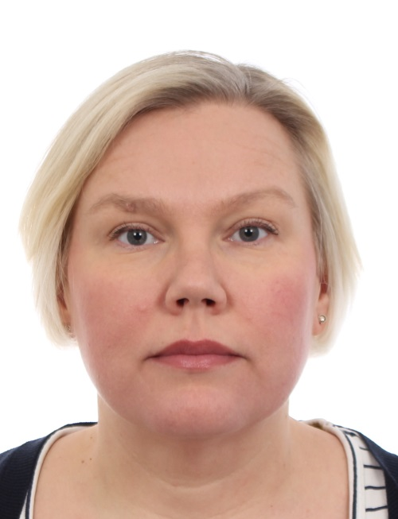
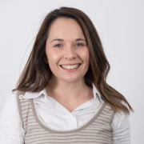
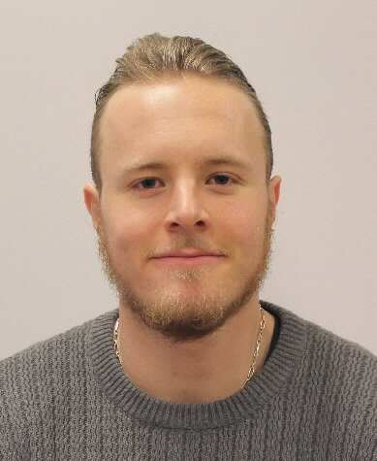
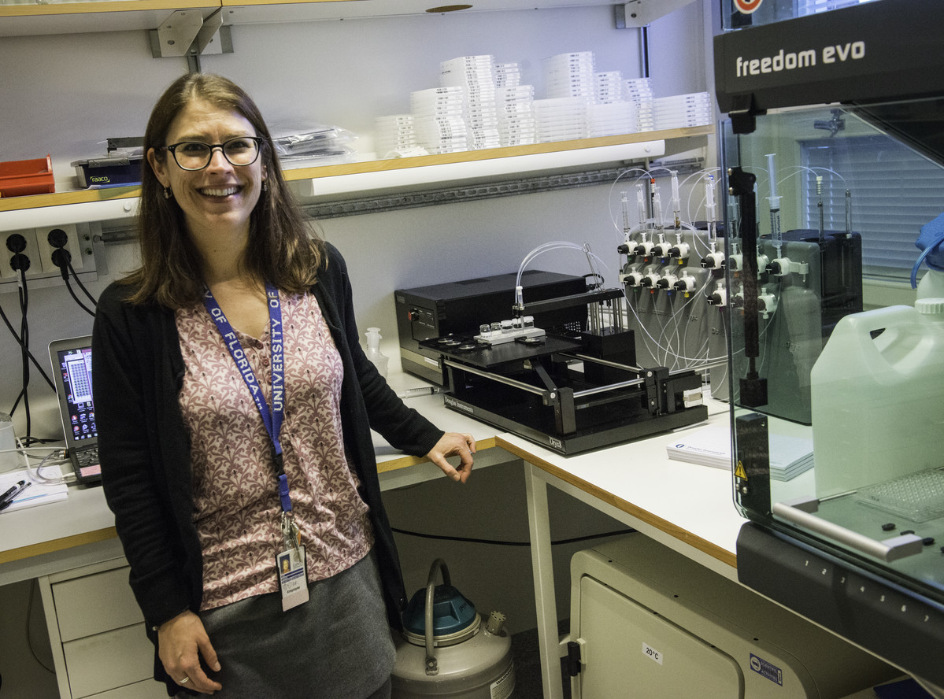
DEMAX offers 3 pillars of support
ESS Deuteration and Macromolecular Crystallization (DEMAX) Platform
Chemical Deuteration
Organic & enzymatic synthesis of ”small” molecules
Separate, analyze a range of molecules
Biomass-derived lipid extraction, analysis and purification
Biological Deuteration
Deuterated biomass production (algae, bacteria, yeast)
Extract labeled protein, DNA
Biophysical characterization (Concentration, T_{m}, purity)
D incorporation with ESI-MS
Macromolecular Crystallization
Screening & Large volume crystallization
Optimization (macro/micro seeding, temperature)
X-ray testing @ BioMAX
H/D exchange
0.5 FTE
(LU)

Slide 5
ESS
MAX IV
Chem Lab
Biolab & Crystallization

Slide 6
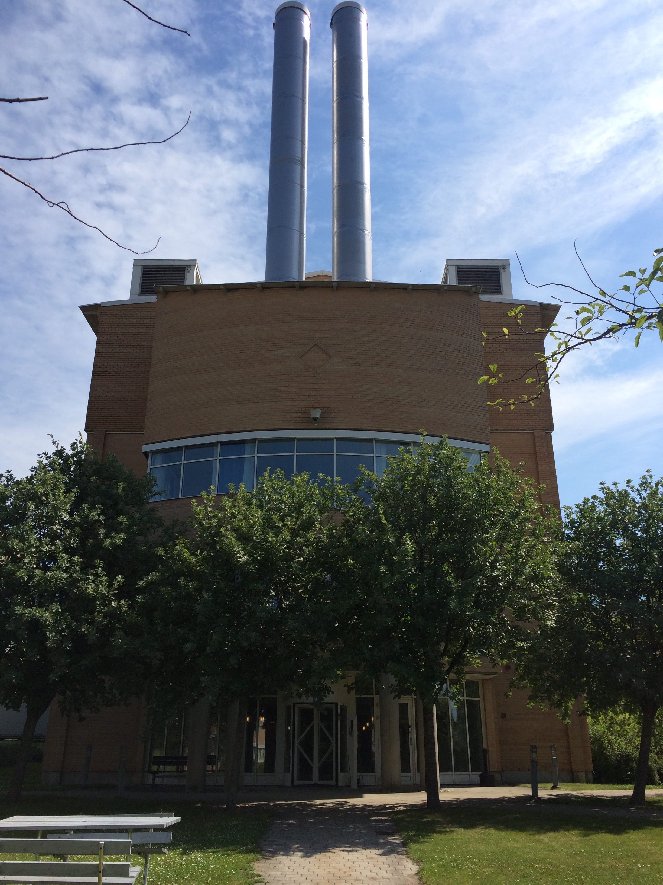
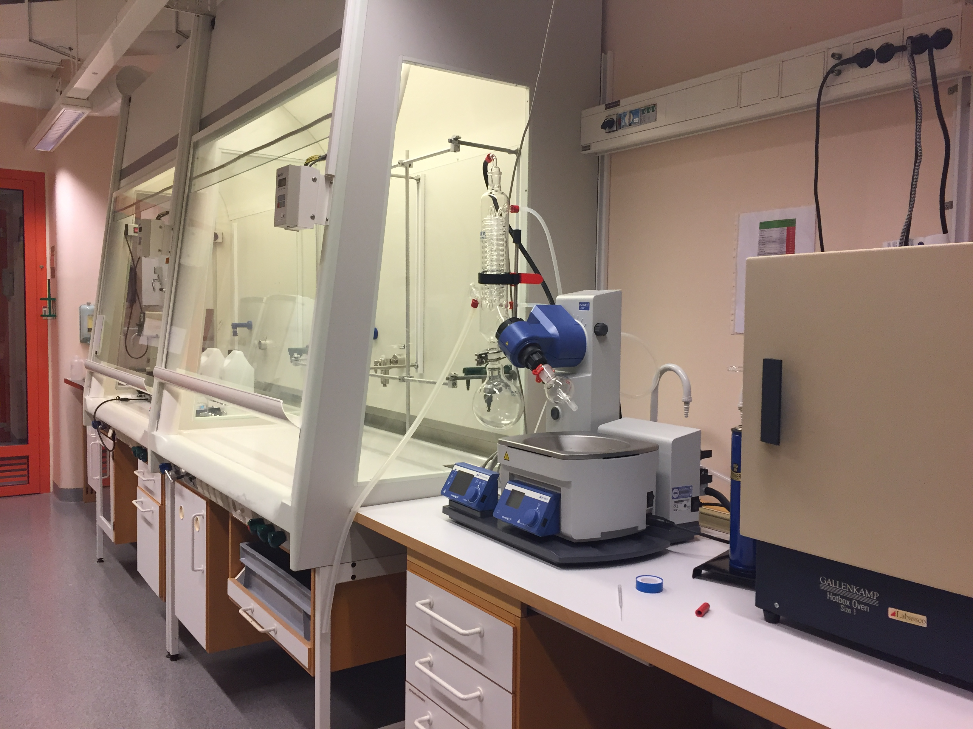
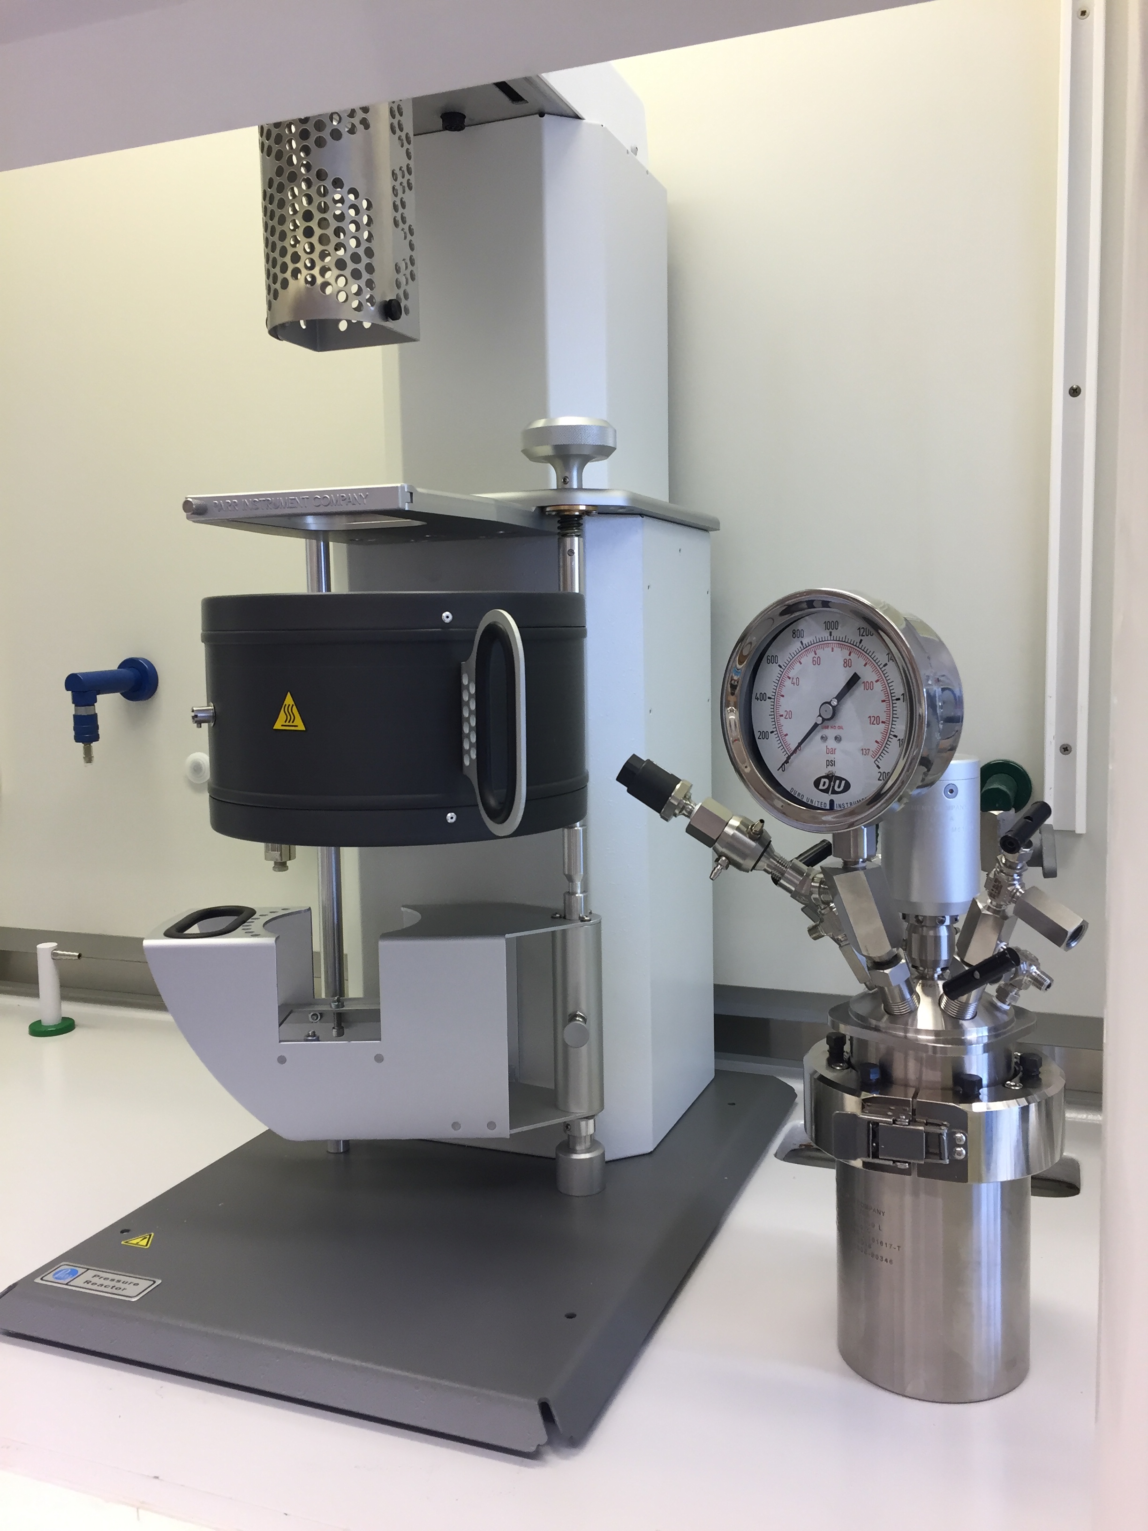
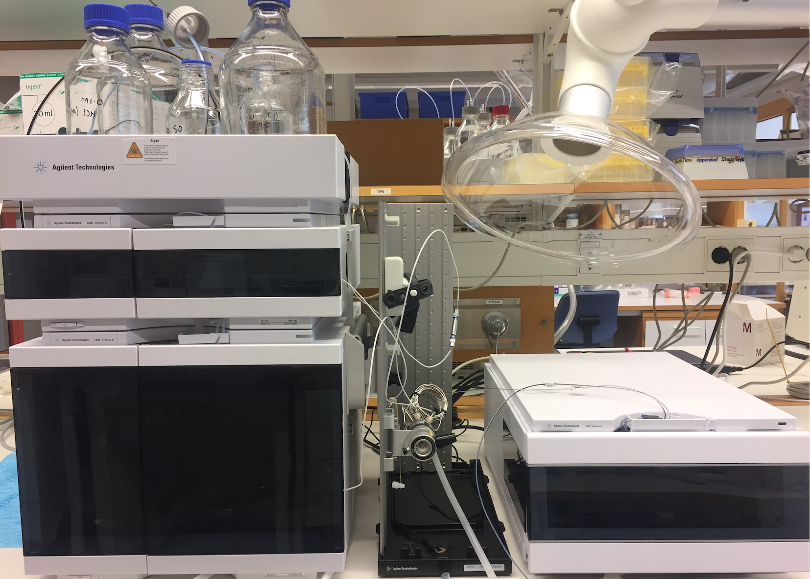
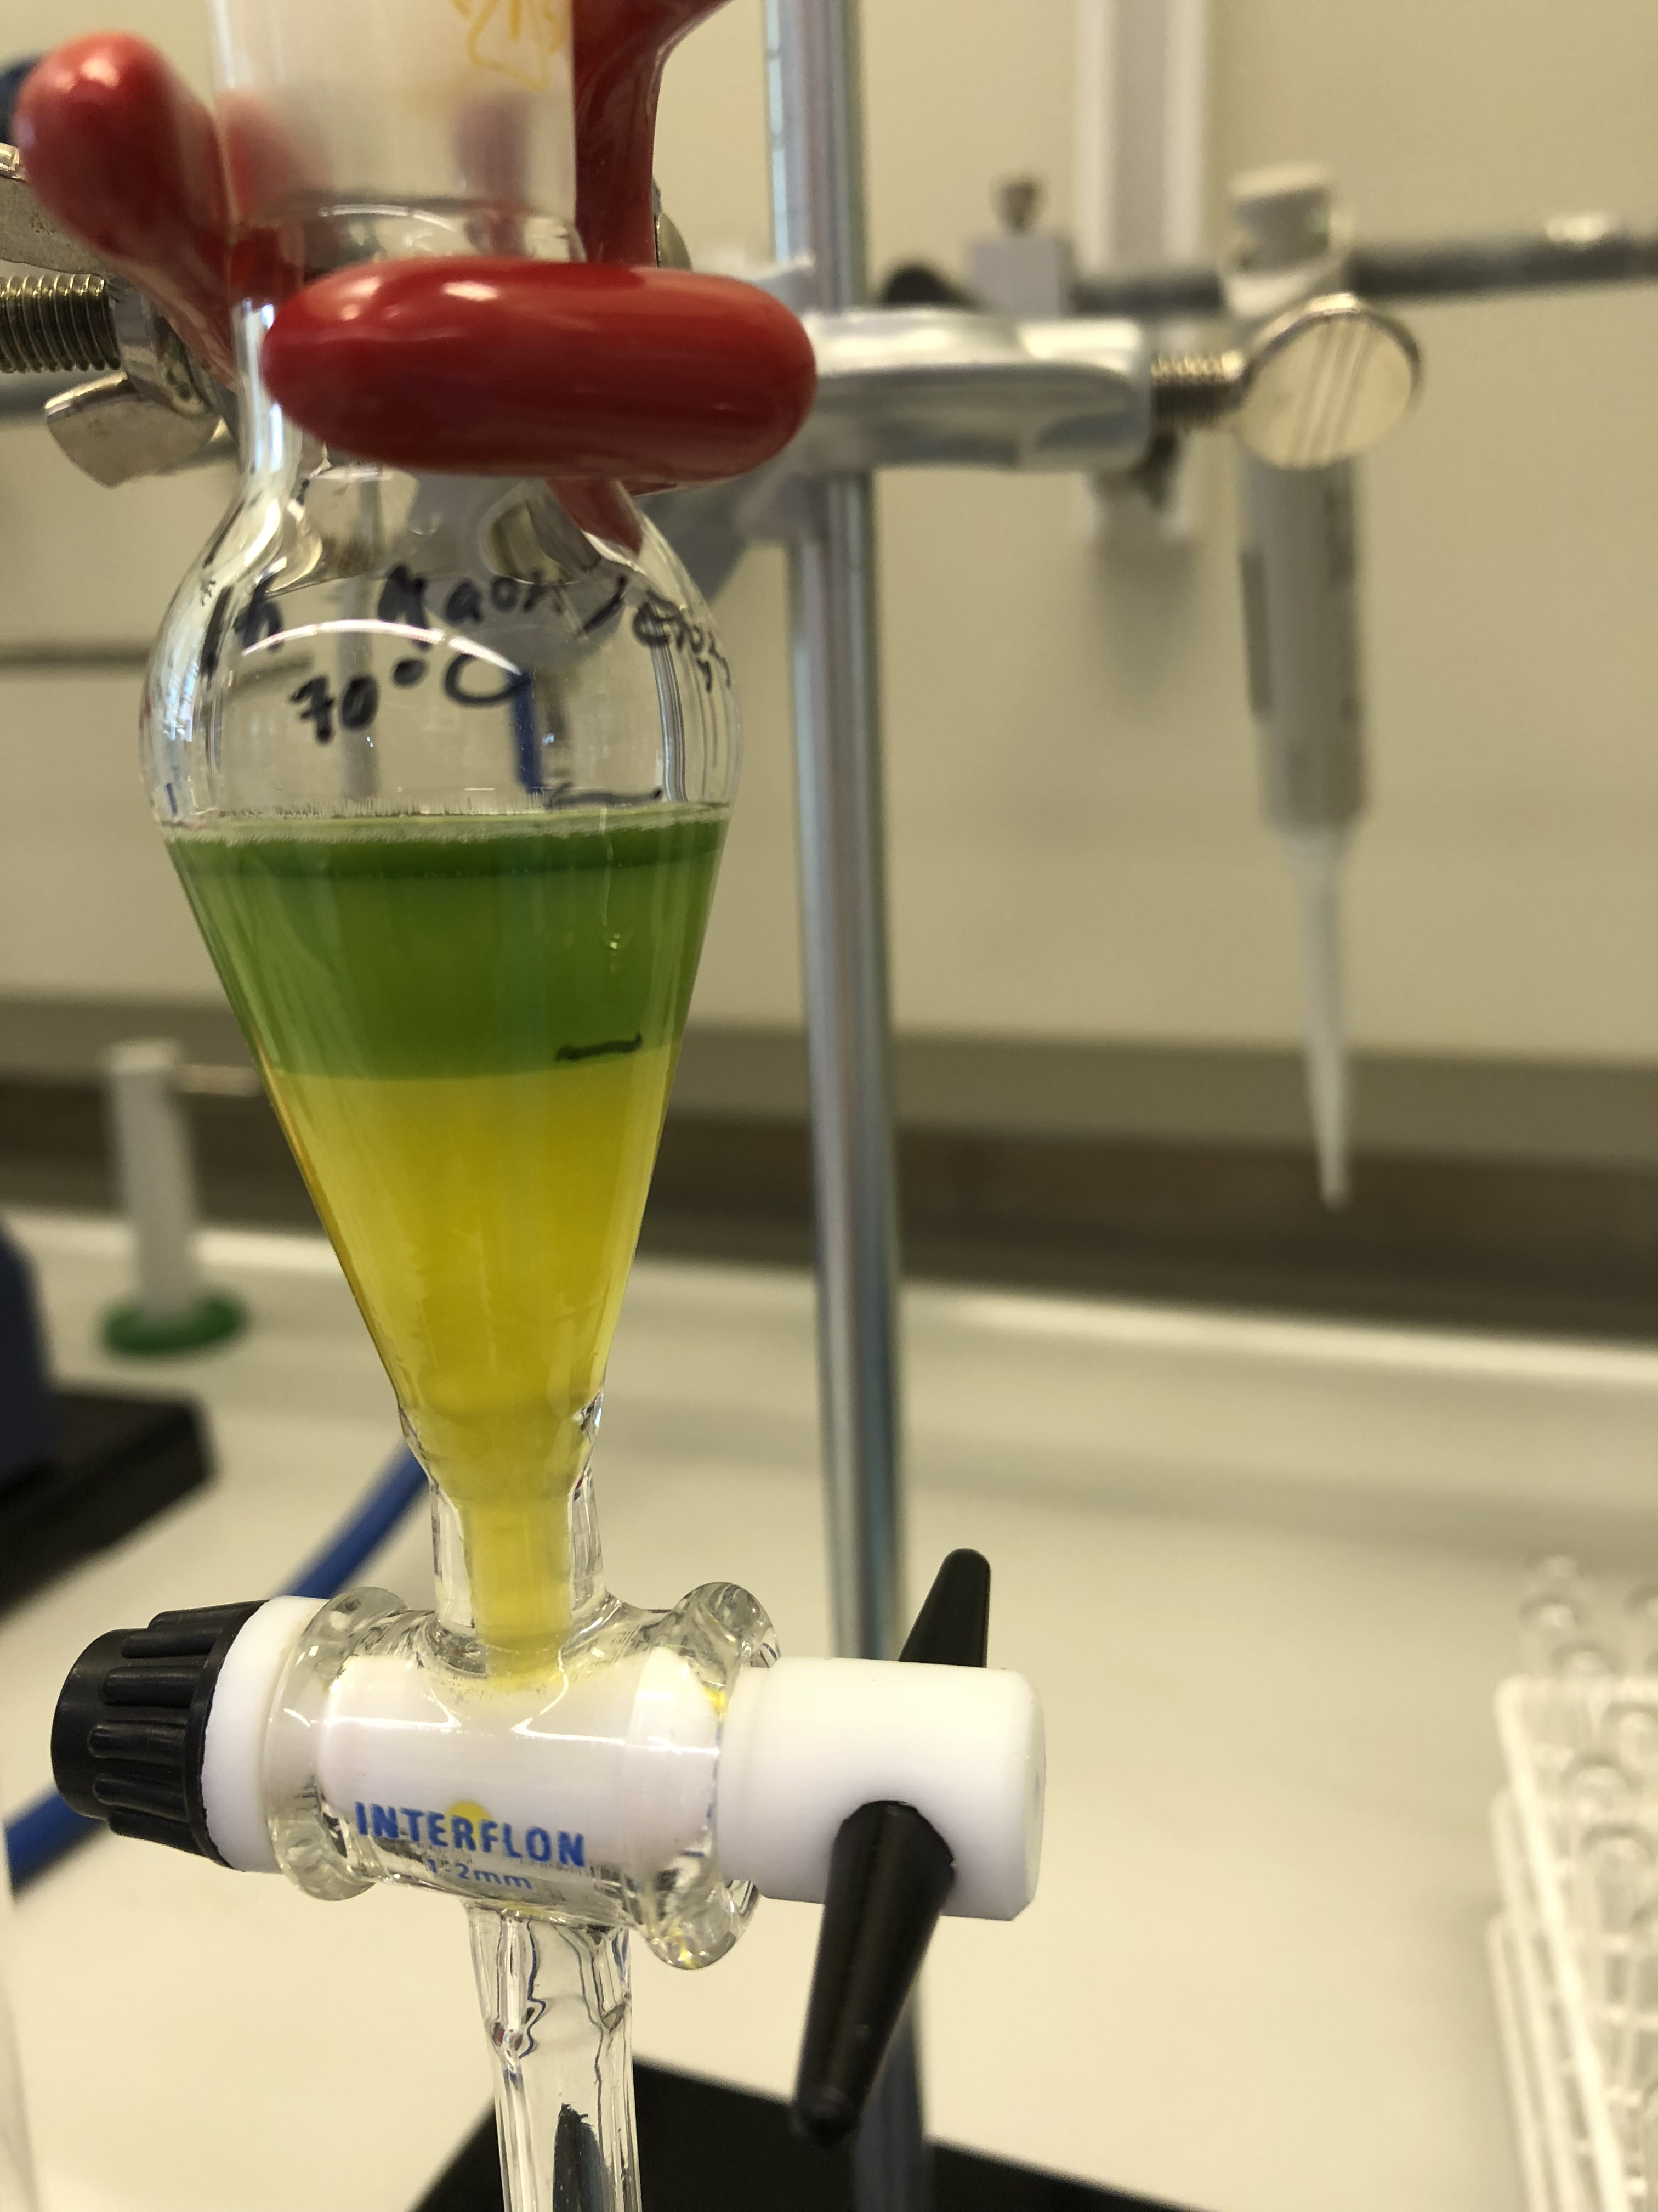
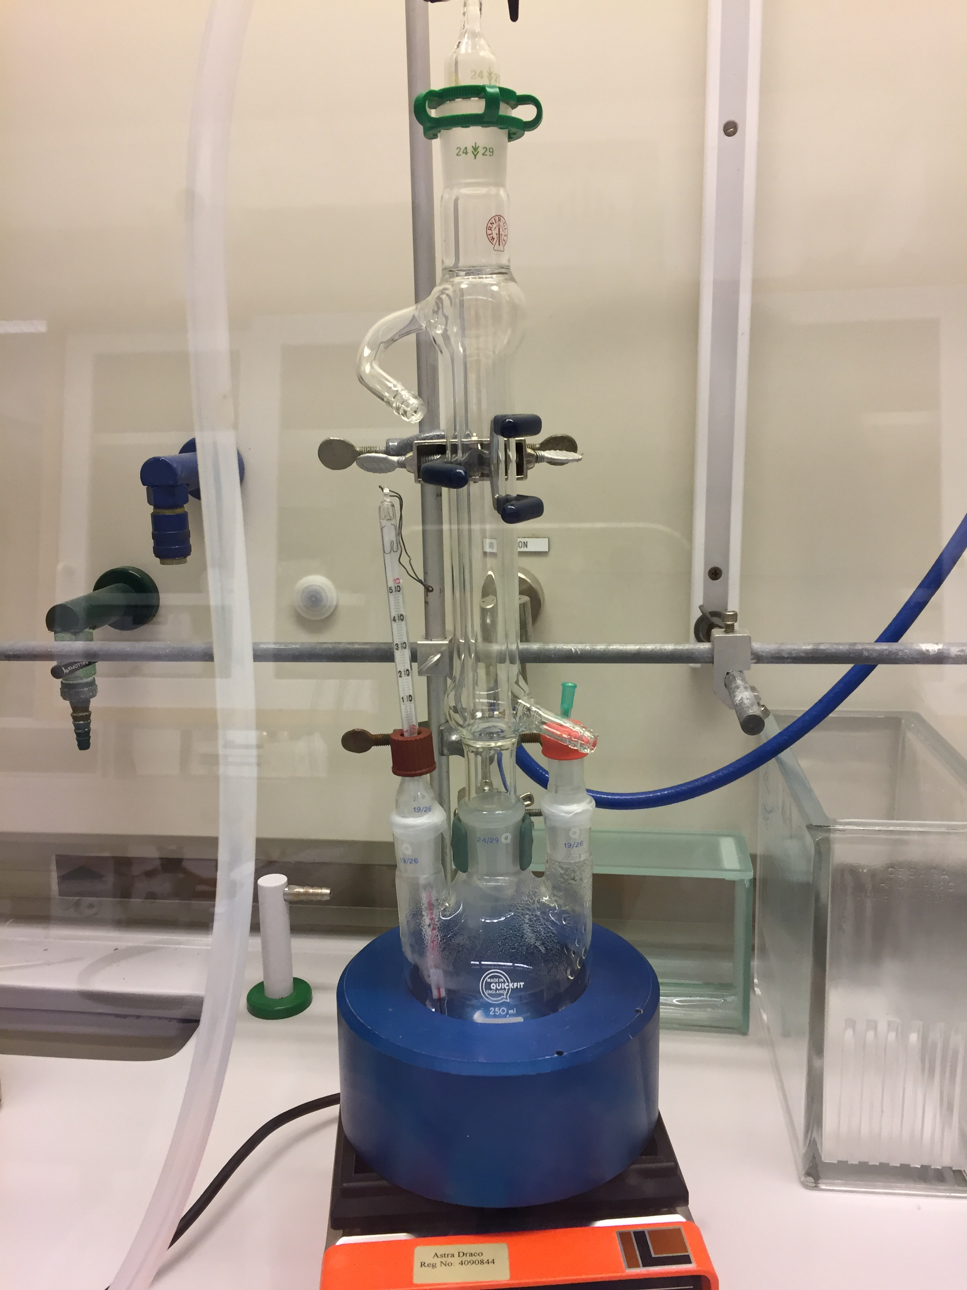
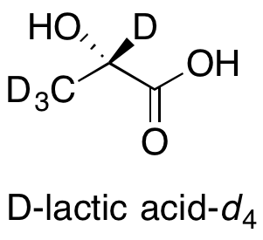
Chemical Deuteration
Sharing leased space in MV with other groups at ESS.
Functioning chemistry lab with essential equipment is in place for synthesis, separation, characterization.
For some characterization needs (e.g. NMR, MS) we have service arrangements with Red Glead & LU Chemistry.

Slide 7
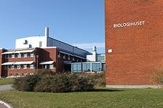

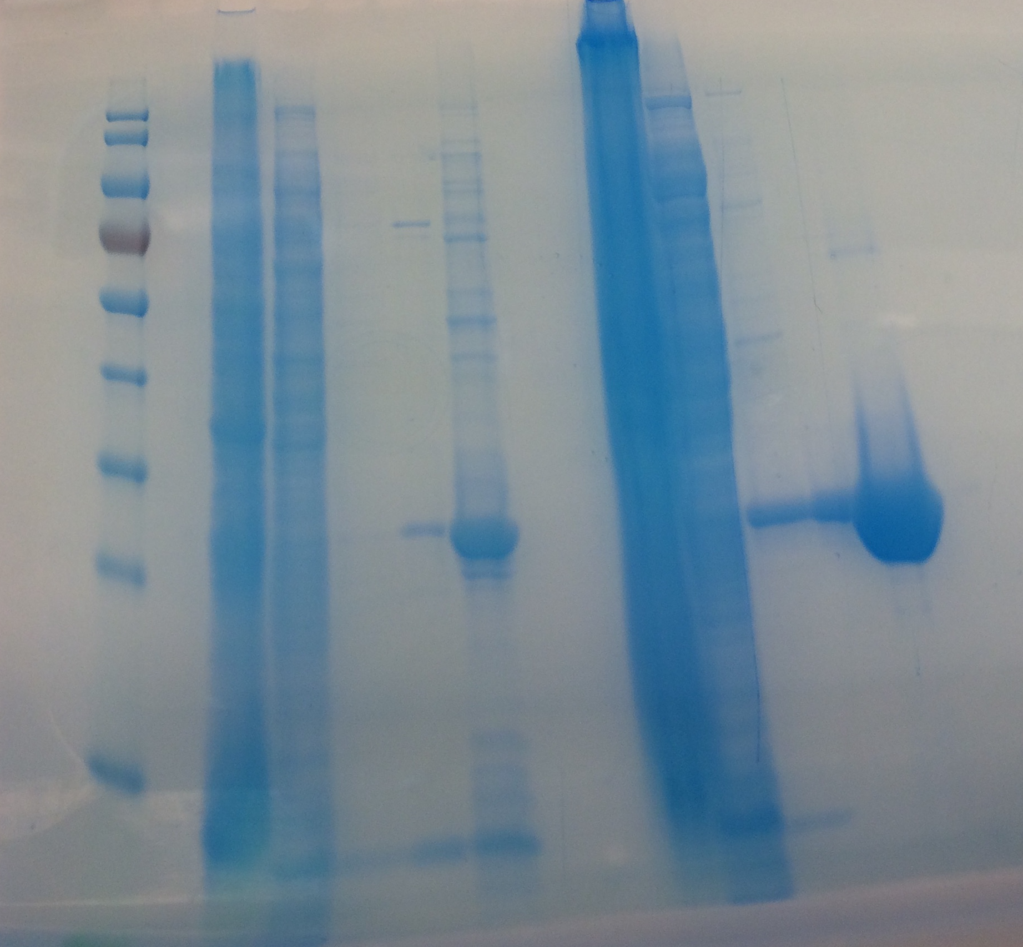
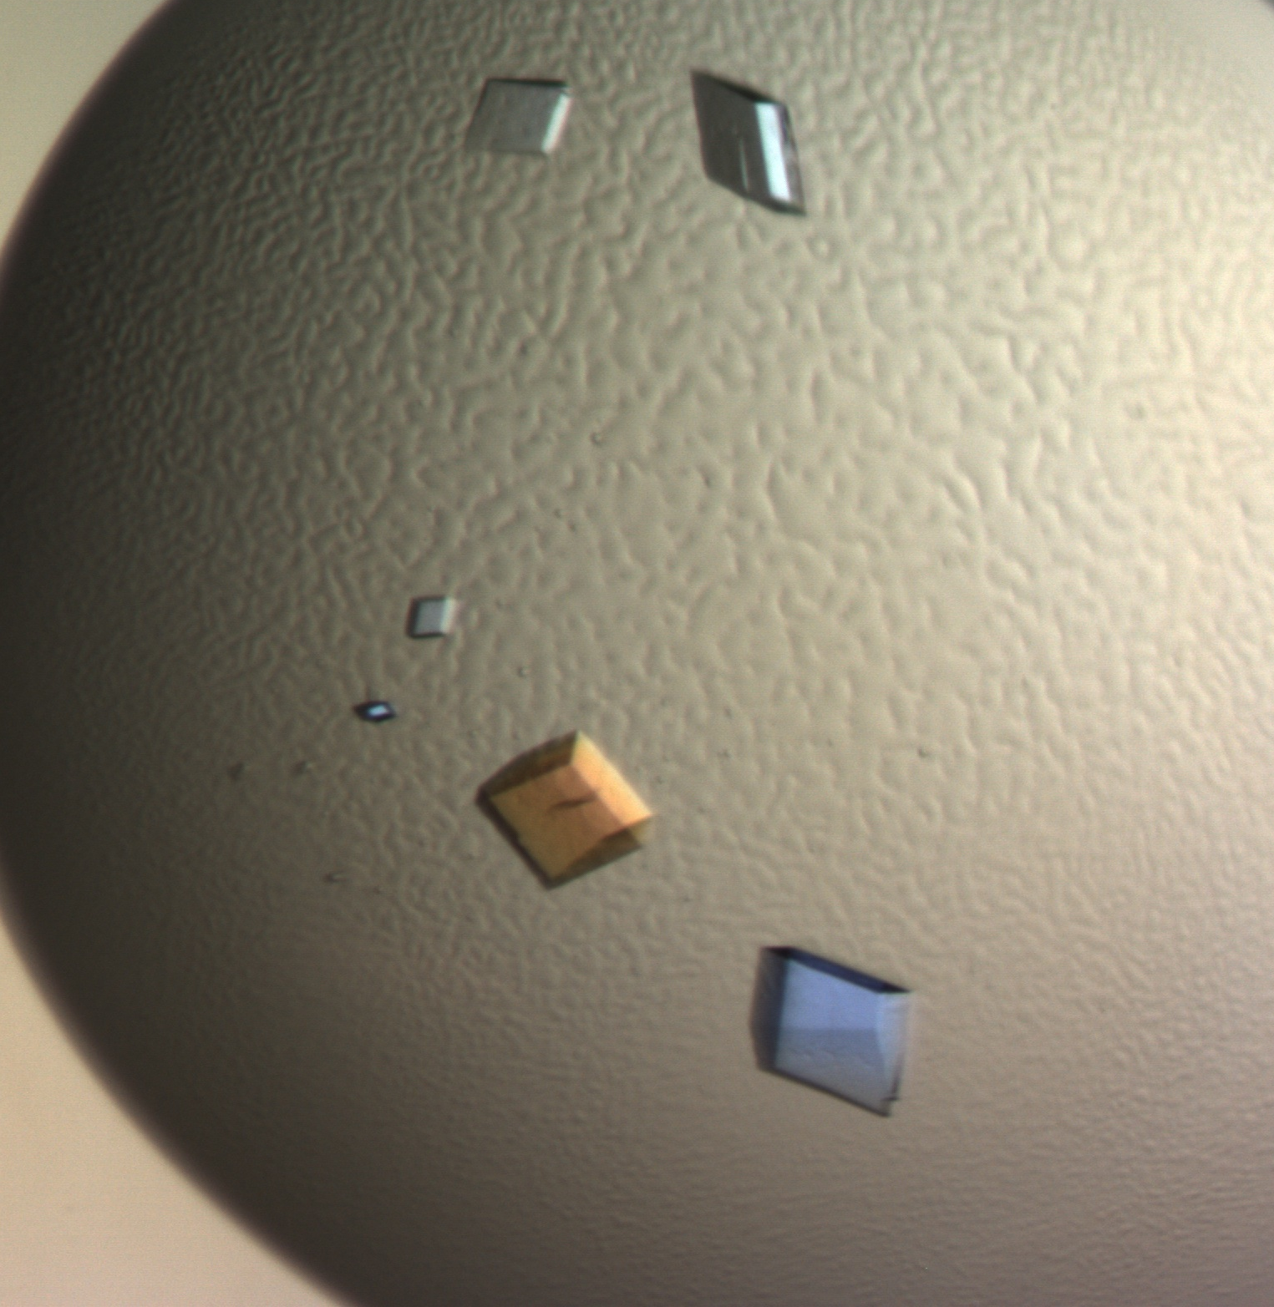
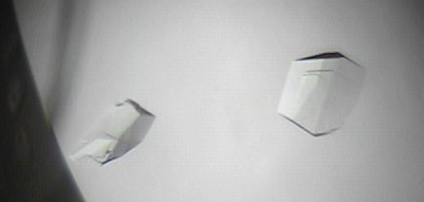
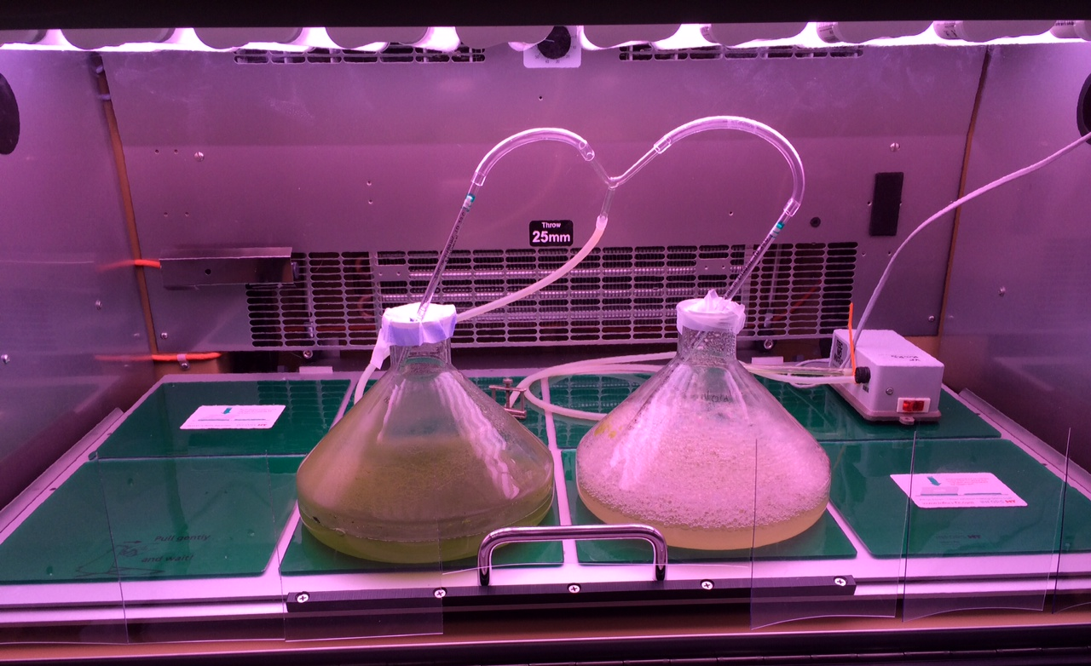
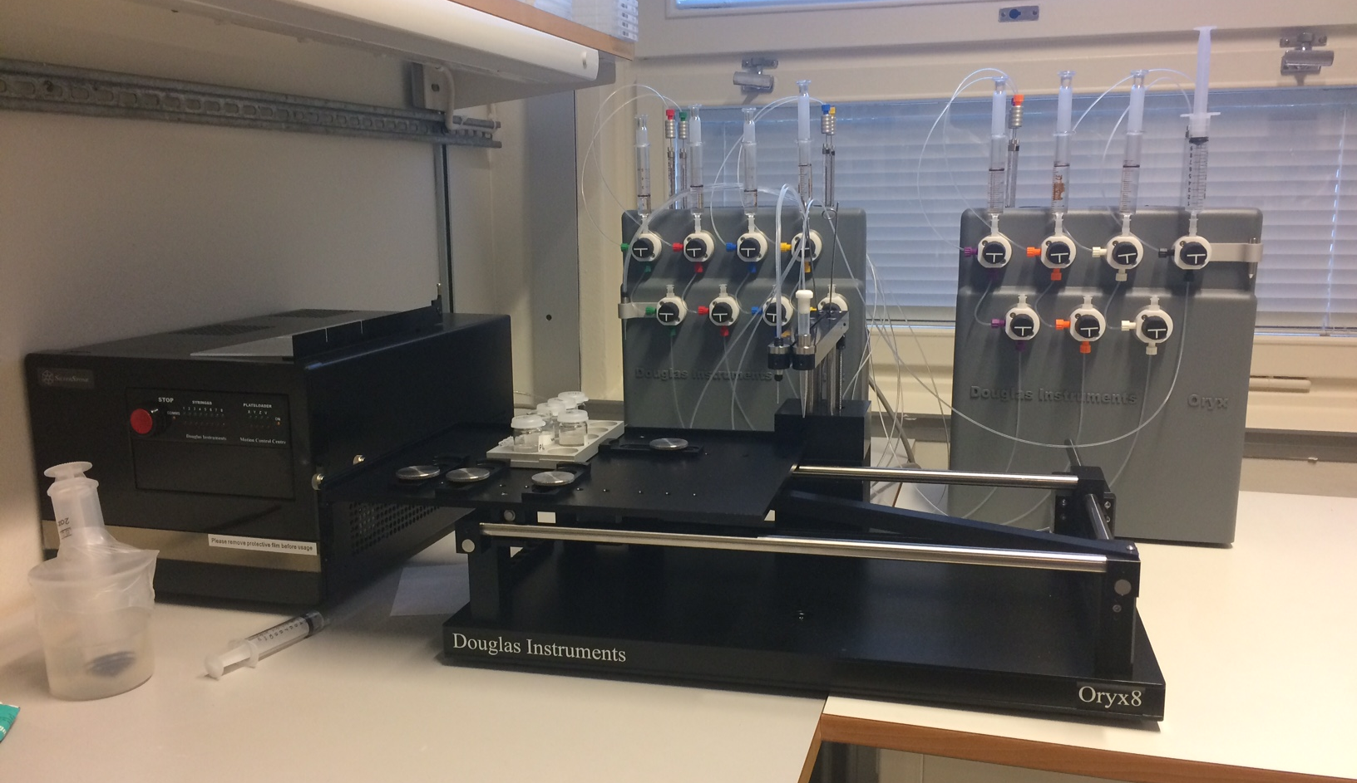

Biological Deuteration & Crystallization
Co-located with LP3 in Biology Department (LU)
Service agreement & shared technician FTE
Essential equipment in place (some ESS-owned)
X-ray testing at MAX lab; ESI-MS for D-incorporation measurements with Karolinska Institute
https://www.biology.lu.se/services/lp3-lund-protein-production-platform

Slide 8
Staffing Summary
Currently staffing is lean in all areas, we don’t overlap in tasks or expertise (risk)
Oliver is leaving, Anna going on leave
Recruiting now for 1 year chemist to work in the lab with Hanna, support for different projects
Recruiting soon for a second permanent deuteration chemist, to start in Q2 of 2021
Next focus: biodeuteration (crystallization) in 2023
This is to help us support First Science in 2023 (hot commissioning on first instruments)

Slide 9

Premises Summary
Premises are stable for the moment (re-negotiate 5 year agreement with LU/LP3 in 2020; current rent with MV is until 2023)
We need long-term stable homes for our labs and appropriate community to be able to learn and grow and network
Pros: share space with SULF, FLUCO; mitigate alone work; access to equipment “in house” (e.g. NMR, MS, other).
Cons: space can be very crowded at times; services not always available/reliable; risk being “invisible” to parts of ESS; long-term stability is a risk (5-year leases).

Slide 10
2019 1st Proposal Round
19 proposals received and assessed, asking for 31 “things”
3 Rejected, based on feasibility/safety issues and some on scientific merit
To date, 8 have fully concluded; 5 are continuing in 2020
3 were accepted but then we could not deliver due to external factors (user canceled or supplier and/or safety issues)

Slide 11
User and proposal statistics
54 registered users
Heavy on “local” requests (ie Sweden)
Quite a few not directly from our ESS partner sphere

Slide 12
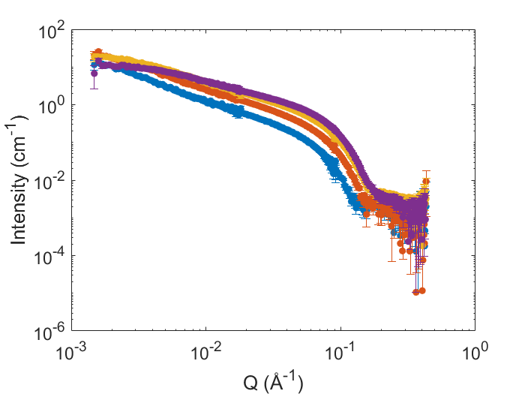
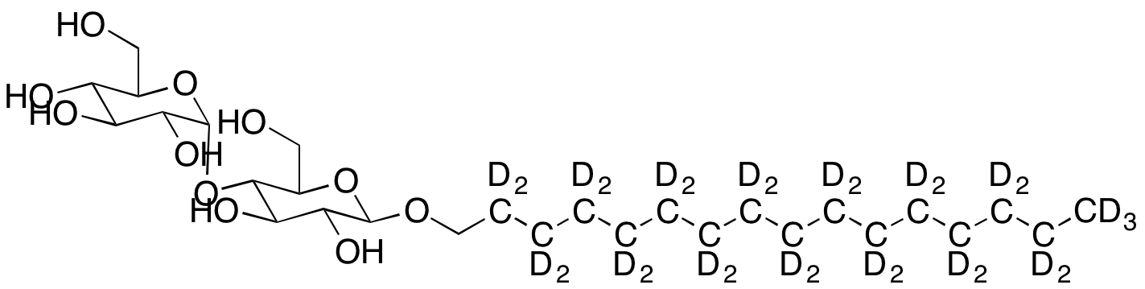
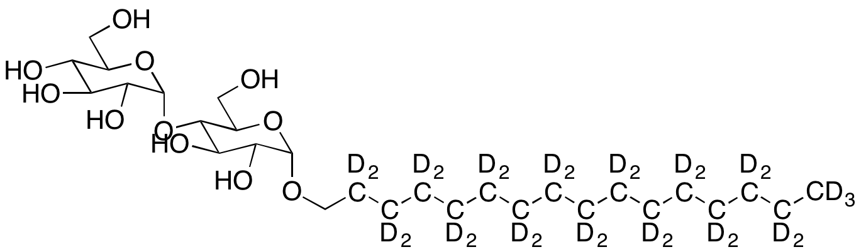
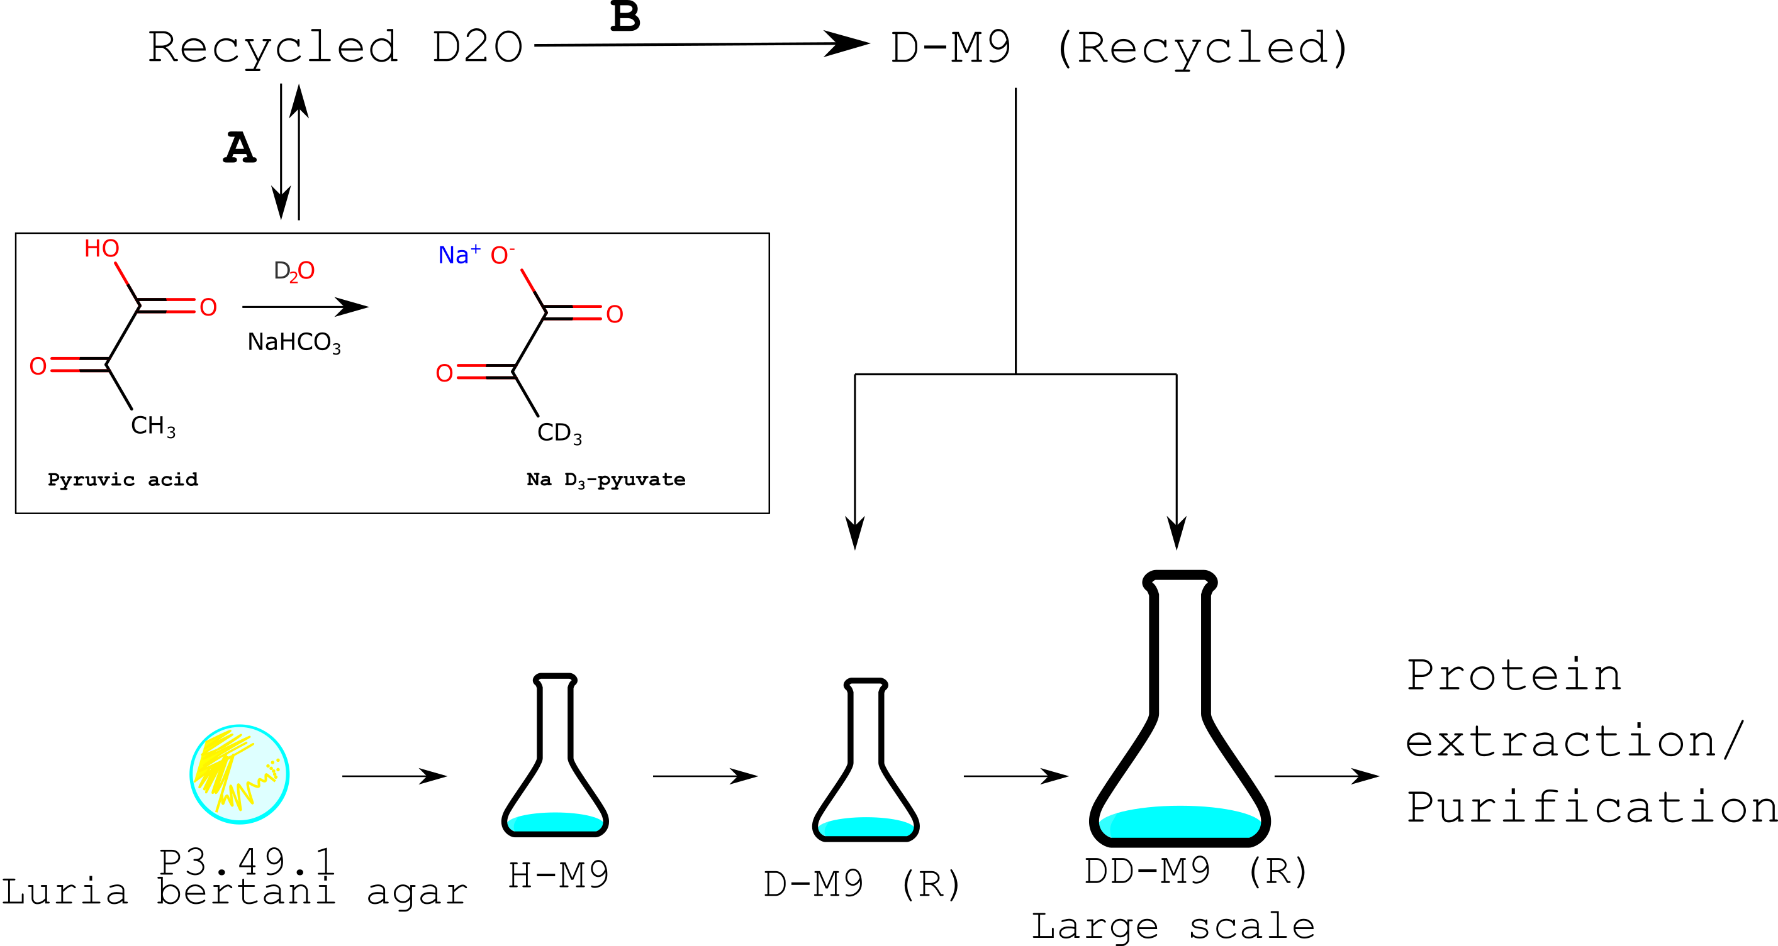
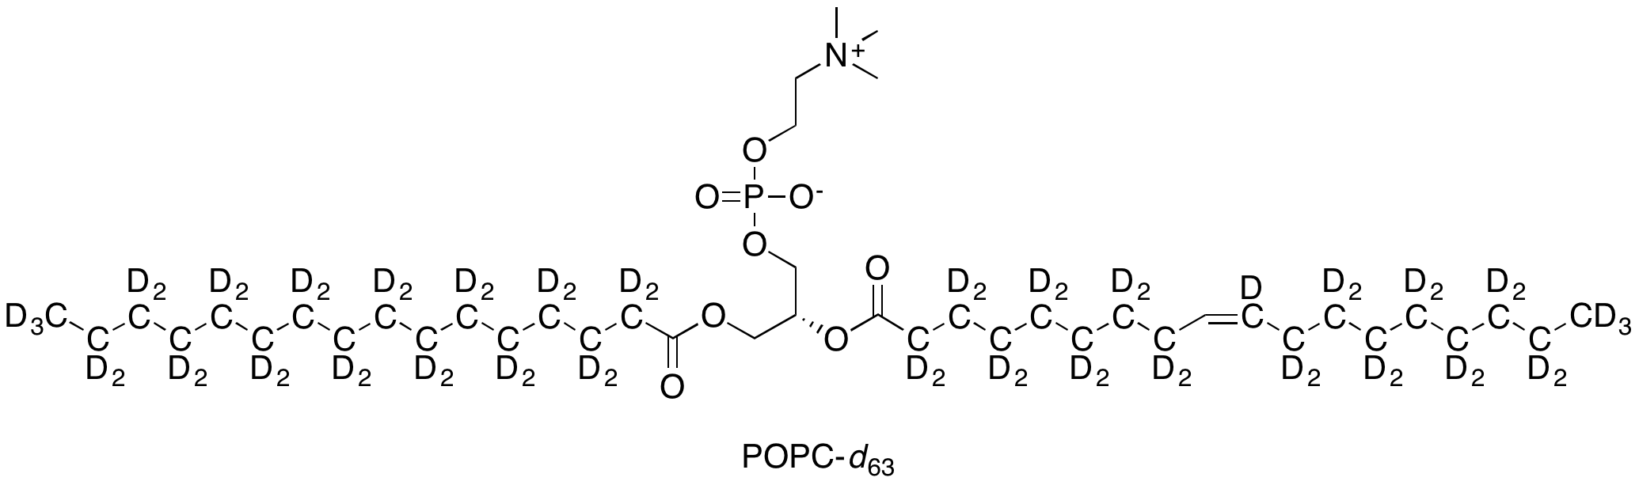
Impact from 1st Round DEMAX proposals
Sodium pyruvate-d₃ was used as an alternative deuterated food source for E. coli to produce perdeuterated (92%) triose-phosphate isomerase for NPX.
Alpha-(top) and beta-(bottom) hexadecyl maltoside-d₃₁ for investigation of self-assembly processes in surfactant mixtures, with applications in formulations of foods and cosmetics; SANS data collected on D11 (ILL).
Deuterated capsid protein from hepatitis B virus to study capsid assembly processes; SANS data collected at SANS2D (STFC) & D11 (ILL).
POPC-d₆₃ as an inner mitochondrial membrane mimic to study membrane protein structure and composition using NR and SANS some data collected at D-22 (ILL).

Slide 13
Lessons Learned from first call
Feasibility reviews and estimating PW effort takes a significant amount of time but is very important for successful project execution (allocate more time for feasibility reviews)
Time to execute all the accepted proposals needs to consider the challenges of a lab just starting up (stretch the execution time to allow for back-ordered items, supplier issues, downtime in summer etc.)
Manual handling of proposals and reviews was tedious and required a major time investment (SCUO& DMSC instrumental in improved functionality in user office software, provided a way to make process smoother and less ”manual”)
Optimism & ambition is good but accepted too many proposals (take more time to assess possible challenges and build in extra time for each deliverable)

Slide 14
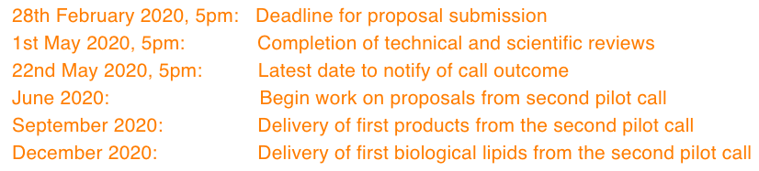
2020 proposal call (2nd pilot)
DATES, cycle
Scope of current call is restricted to biodeuteration (yeast-derived lipids, plasmid DNA, proteins, bacteria/yeast/algal cell paste and possibly other products), and crystallization support
Chemical deuteration: requested user to submit EoI and we see if we can do any of them
Proposals received: 17 total (6 of those are EoIs)

Slide 15
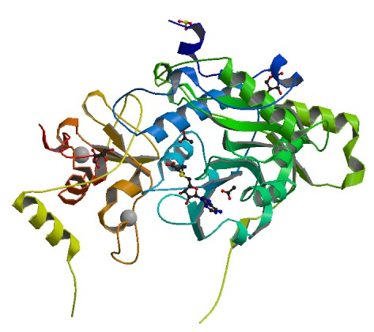
Covid-19 support
DEMAX have made a call for Covid-19 related projects
One request so far:
LP3 is executing the protein expression, purification of 6 constructs, ESS supporting labour & consumables
HT screening for crystals will start soon, fragment-based screening (piplelines for both at MAX lab; Diamond)
Large crystal growth of neutron suitable targets (DEMAX, MLZ)
SANS/SAXS experiments of these proteins possible (MLZ)
At the moment it is not interfering with regular DEMAX proposals

Slide 16
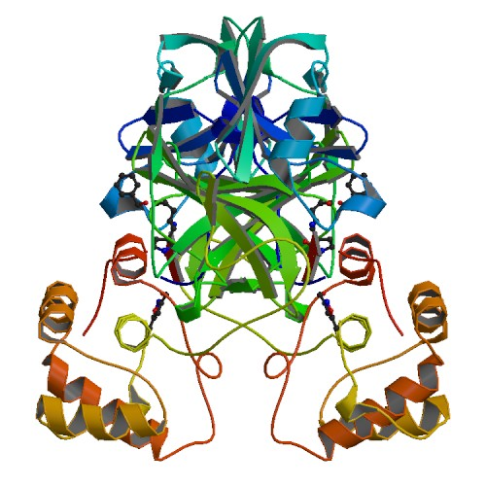
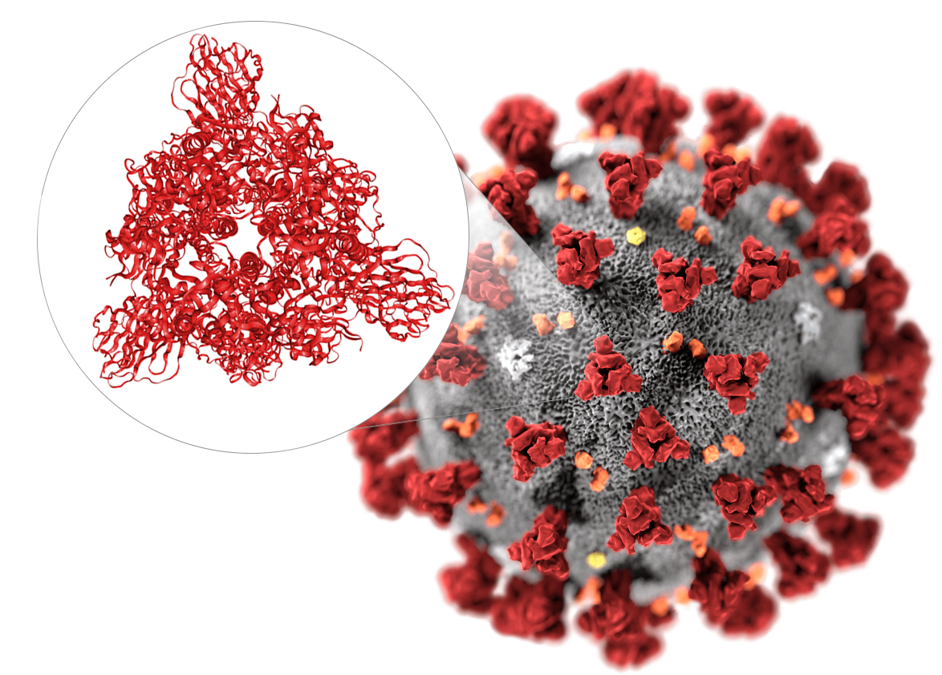
Covid-19 impact
Our users’ beamtime is impacted by Covid19
Many facilities are either shut down or prioritizing virus-related projects
Our continued lab access depends on “landlords” and already MV and LU have restricted activities and access
How do we keep supporting users, keep them engaged but also keep working during these uncertain times?
Beamtimes are postponed/canceled and some materials can be made and kept, others can not.
What tasks and projects could we focus on in the meantime?
There are always grants, data to analyse, papers to write, experiments to plan

Slide 17


External funds, collaborative activities
VR-funded projects (end by 2021):
1) 2016-01164 “Role of membrane lipids and sterols in antifungal susceptibility, resistance and virulence mechanisms in pathogenic yeast”, at LU Biology – covers 30% FTE Hanna’s time for producing yeast lipids and for neutron experiments.
2) 2016-06963 ”Organization of mitochondrial membranes under oxidative stress: Implications for their active role in regulation of apoptosis”, at Umeå University in collaboration with STFC (L. Clifton).
PhD student funded by Science Faculty, LU (M. Orozco). Project involves reconstitution of membrane-bound enzymes into mitochondrial membrane mimics for neutron scattering studies (Main supervisor W. Knecht, ESS co-supervisor Z. Fisher, ILL co-supervisor G. Fragneto).
BrightnESS² deuteration pilot (end 2021): enzymatic modification of chemically or biologically produced lipids for soft matter/life sciences research (in collaboration with P. Li and J. Webster at STFC).

Slide 18
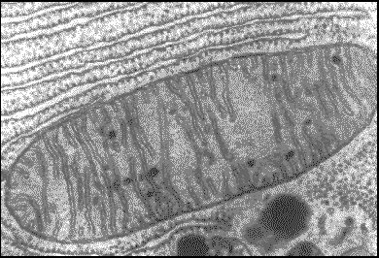
https://www.lens-initiative.org
WG3: Synergies in Technological Development and Operation
Deuteration technologies – deuteration
Sample environments – automation
Technologies for polarized neutrons
Priority Action 3: Role of cell membranes in health and disease
Hanna Wacklin-Knecht, ESS; Anne Martel/Giovanna Fragneto, ILL; John Webster, STFC; Jürgen Allgaier, JCNS + many others
Goal: Develop experimental and analytical strategies to support neutron studies of disease mechanism and treatments for global health challenges (cancer, Covid-19, drug delivery, etc)
$$$: Position teams and science case to apply for future funding calls
ESS focus: deuteration tasks for relevant mitochondrial lipids (POPE, oxidized lipids, yeast phospholipids) and automation for sample environment for liquid samples for NR (ESTIA/FREIA)
Connect to user communities, other networks and other infrastructures

Slide 19





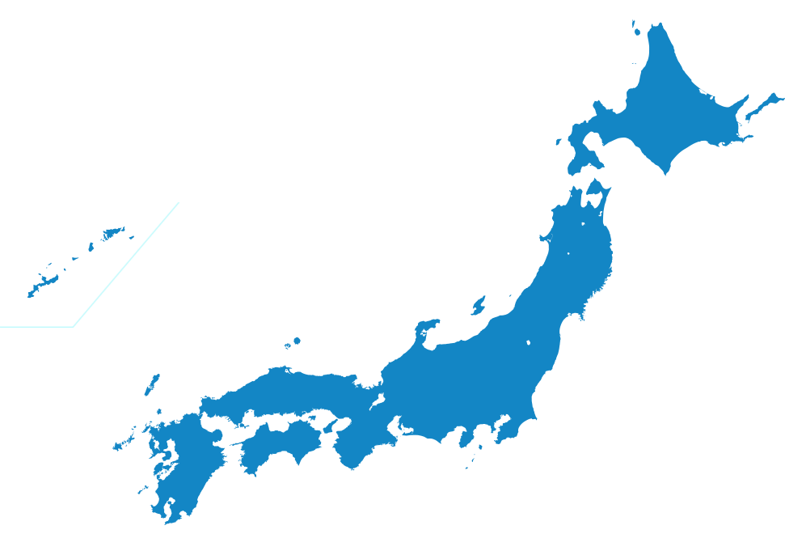



DEUNET continues activities under LENS
Chemical & biological deuteration, crystal growth
Chemical synthesis
Monomer and polymer synthesis
Observers (Chemical & biological deuteration)
Biological and lipid deuteration
www.deuteration.net
deuteration_net

Slide 20
Questions to the STAP
(extracted from the written report)
We would like the STAP to comment on mitigation steps we took to address our challenges in the first call.
In view of Covid-19: we would like advice on how to proceed with proposals that will be accepted, with regards to many facilities closing and user beamtimes being postponed/canceled.
We would like the STAP to comment on our current premises and set-up for external services.
Second deuteration chemist: our preference is to have an overlap in skills with Anna so that both can run projects independently and in parallel. Does the STAP think it could be useful to send a new chemist to another D-lab (e.g. NDF at ANSTO) for training purposes?
We would also like a comment from the STAP on our current and future needs for dedicated biologist to run biodeuteration for cell production, DNA/protein purification, and crystallization.

Slide 21
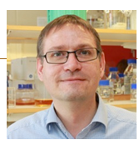



Thanks to DEMAX team members & LP3 @ LU
Dr. Hanna Wacklin-Knecht
Oliver
Bogojevic
Dr. Wolfgang Knecht
Dr. Anna Leung
Dr. Zoë Fisher

