Slide 1

Dear Audience,
this is a semi-automatic presentation: The audio recordings will start automatically, but the slides will only proceed once you click on the green arrow (see bottom right of this slide). The arrow will appear after the recordings for each slide. ---- Please click on it now.

Slide 2
SULF – Sample and User Laboratory Facilities
STAP Samples and User – April 2020
PRESENTED BY Monika Hartl, Melissa sharp AND Katrin Michel

Slide 3
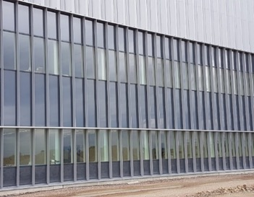
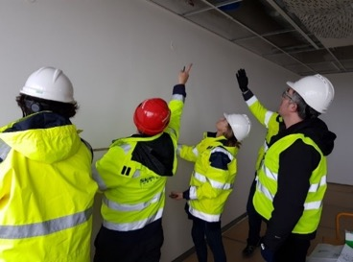
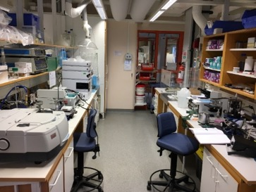
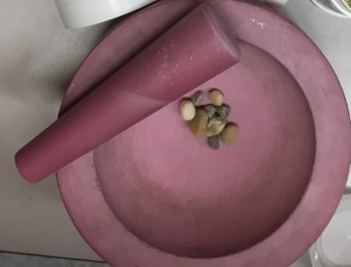
Agenda
1 SULF introduction and status | Monika Hartl
2 SULF on-site installation of the labs in E04 | Melissa Sharp
3 SULF plans on moving to the new labs in E04 | Katrin Michel
4 SULF chemistry lab services for the ESS project | Monika Hartl, Alice Corani
1
2
3
4
SULF Status
On-site installation
Move to site
Lab services
& projects

Slide 4
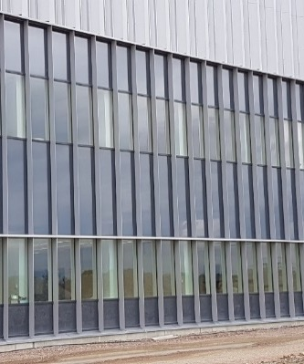
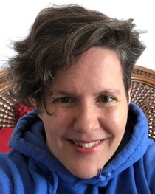
1
SULF
introduction and status
Presented by
Monika Hartl
Scientist / GL

Slide 5
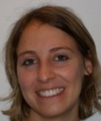
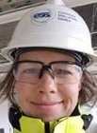


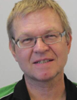
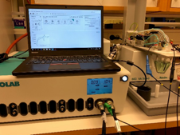
Sample and User Laboratory Facilities SULF
SULF: Monika Hartl, Katrin Michel, Melissa Sharp, Alice Corani
SULF: Sample and User Laboratory Facilities
supports sample handling & preparation & characterization for ESS neutron scattering users
Today: focusses on establishing functioning labs and supporting the ESS project;
Key facts (construction)
€2,62 M budget
Currently 2.75 FTE: 1.25 SCI + 1.5 TECH (2021: 4 FTE)
€1M labs fit-out (STFC in-kind)
€70k glove boxes (U. Tartu in-kind; for RML)
Electrochemistry Cell (in-kind with U. Tartu)
Gas handling manifold
Levitator
SULF
(2.75 FTE)
from lab to in-situ
neutron scattering
Sampe environment/ FLUCO
Fluids incl Gases, Vapor, Compl. Fl.
0.5 0.5
FTE FTE
0.5 1.0 0.75
FTE FTE FTE

Slide 6
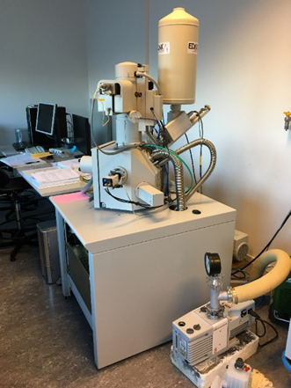
Why are user laboratories necessary?
Short, medium and long term needs (see part 4 on project support)
Short term needs:
  Support for the construction project for critical path sub-projects to ensure “ready-for-beam-on-target” (RBOT) and “beam-on-target” (BOT).
Medium term needs:
  Support for the commission phase (initial ops) of the machine
  Providing Radioactive Materials Laboratory in time for BOT
Long term needs:
  Preparing for First Science
  ESS operations support
Well-functioning labs come with expertise of the scientific and technical staff.

Slide 7
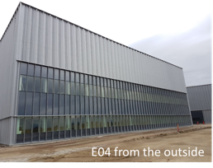
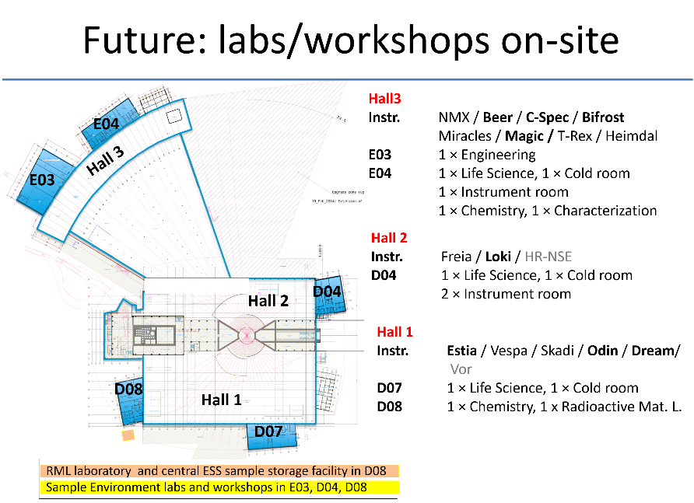
What we will deliver – user labs
Lab installation started Jan. 16, 2020 – first lab expected May 2020
Handover E03/E04 12/2019
Laboratory fit-out started 01/2020
Work stopped 14.03.2020
Critical for BOT
Radioactive Materials Lab
fit-out 01/2021

Slide 8
Timeline / Schedule (January 2020)
Radioactive Materials Laboratory on critical path for BOT
Lab ready for
operations
D08
D04
RML (D08)
RML is on critical path for BOT!
E03/E04
E04 / E03
D04
D08
Full access:
2018 | 2019 | 2020 | 2021 | 2022 | 2023 | 2024 | 2025
BOT
FS
SOUP
BOT = Beam On Target
FS = First Science
SOUP = Start of User
Program
BEER/ MAGIC / CSPEC / BIFROST / ESTIA
ODIN/ DREAM / LOKI
Installation & Integration
Hot commissioning First science
Operation
Notes:
D04: hand-over March 30, 2021
D08: hand-over August 10, 2021
D08: partial access
NOW
Basic setups for chemistry incl. soft condensed matter and life science (E04) and engineering (E03).
Radiological Materials Laboratory (RML) for handling activated samples and materials
LATER
Fit-out of remaining labs in D04, D07 and D08
Capital investments into the specific science areas for the instruments to provide complementary lab equipment
ALWAYS
support the ESS project and operations with materials characterization (Accelerator, Target, Science)

Slide 9
Timeline / Schedule (January March 2020)
Still on track provided no further delays from SKANSKA or due to pandemic
Lab ready for
operations
D08
D08
Early access for fit-out
possible in RML and D04!
D04
D04
RML (D08)
RML (D08)
RML is on critical path for BOT!
E03/E04
E04 / E03
D04
D08
D08
D04
Full access:
2018 | 2019 | 2020 | 2021 | 2022 | 2023 | 2024 | 2025
RBOT
BOT
FS
SOUP
BOT = Beam On Target
FS = First Science
SOUP = Start of User
Program
BEER/ MAGIC / CSPEC / BIFROST / ESTIA
ODIN/ DREAM / LOKI
Installation & Integration
Hot commissioning First science
Operation
Notes:
D04: hand-over March 30, 2021
D08: hand-over August 10, 2021
D08: partial access
NOW
Basic setups for chemistry incl. soft condensed matter and life science (E04) and engineering (E03).
Radiological Materials Laboratory (RML) for handling activated samples and materials
LATER
Fit-out of remaining labs in D04, D07 and D08
Capital investments into the specific science areas for the instruments to provide complementary lab equipment
ALWAYS
support the ESS project and operations with materials characterization (Accelerator, Target, Science)

Slide 10
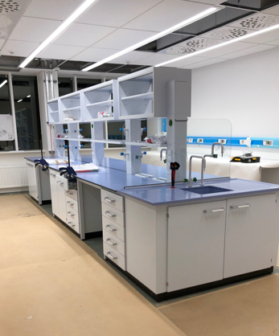
Mitigations for Covid-19 related delays
What can SULF do
  Prepare the move and start moving as much as we can (see part 3)
  Prepare safety documentation for E04 labs (ongoing)
    In collaboration with OHS, training,…
  Prepare continuation of construction (see part 2)
    Documentation for quality, drawings
  Keep close contact with lab-outfitter (Sanber), receive deliveries, establish to-do list to prepare for worker’s return (hiring of equipment, training, scheduling…)
  Get construction work done that is not part of the fit-out (corrective action on building, data patch panels, safety evaluation of power distribution boxes, cleaning of floors, touch-up for walls, …)

Slide 11


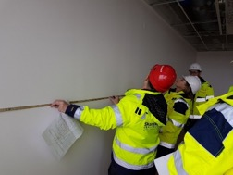
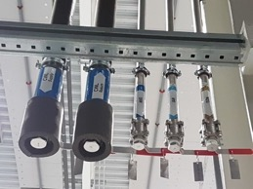
Project Interactions
Construction Support and Lab Coordination (see part 4 for ESS “sci. support”)
Conventional Facilities (CF)
  Assuring requirements are met, services are supplied
  Change-requests (electrical distribution panels, house vacuum, waste water….)
  Facilitating information exchange between in-kind partner and CF
NSS Instruments
  Support for instrument specific laboratories (information on safety, utilities, chem. vent., solvent cabinets…)
  Containment ventilation for the caves (gas flow exp., vacuum exhaust)
Area coord., safety, quality
  Keep track of work in E03/E04 incl. risk assessment
  Stay on top of safety and housekeeping in the area
  Define requirements for lab services and quality
SULF and partner measuring
Connection
points for instruments
Notes:
Assuring requirements are met and services are supplied in the correct locations
Change-requests (electrical distribution panels, house vacuum, waste water….)
Facilitating information exchange between our in-kind partner and CF for lab fit-out
Interface when related to laboratories and chemistry
Support for instrument specific laboratories (information on safety, utilities, …)
including chemical ventilation (fume hoods,…)
Containment ventilation for the caves (gas flow experiments, & decomposition; gas & vacuum exhaust

Slide 12


Project Interactions
Construction Support (see part 4 for ESS “scientific support”)
Application to SSM (Swedish Radiation Authorities)
Supporting the application for operations in the area of:
Accident Analysis (radiation) for experimental halls and surrounding buildings.
Sample Management Procedure
Laboratory Safety for on-site laboratories
  Safety documentation for on-site labs
  Establish training for labs
  Quarterly safety meeting for chemical laboratories
Establish services for ESS on-site labs
  Gas delivery, l-N2 tank, DI water
  Chemical inventory system
  Delivery points
  Delivery of perishable items directly to freezer
Notes:
Assuring requirements are met and services are supplied in the correct locations
Change-requests (electrical distribution panels, house vacuum, waste water….)
Facilitating information exchange between our in-kind partner and CF for lab fit-out
Interface when related to laboratories and chemistry
Support for instrument specific laboratories (information on safety, utilities, …)
including chemical ventilation (fume hoods,…)
Containment ventilation for the caves (gas flow experiments, & decomposition; gas & vacuum exhaust

Slide 13












SULF: what are the focus points now ?
Katrin (100%), Melissa (50%), Monika (75%), Alice Corani (50%) = 2.75 FTE
lab & in-kind coord.
MV lab operation
ESS Lab operation
Construct. Support
Scientific Support
SSM
Katrin Michel – laboratory technician (100% SULF)
  Hand-over MV to DEMAX • Move to site •project support
Melissa Sharp – laboratory scientist (50% SULF, 50% CF Interaction)
  Construction (CF, building) • Life Science Grant/Postdoc • Installation
Monika Hartl – laboratory scientist/GL (75% SULF, 20% SSM, 5% VESPA)
  Construction (Safety, quality) • in-kind projects • SSM
Alice Corani: laboratory technician FLUCO (50% FLUCO, 50% SULF)
  Support for SULF on site • electrochemistry (coll. FLUCO)
+3.25 FTE
(rad)
(chem)
(bio)
Notes:
So, who is doing what in the SULF team and to what percentage? We have three SULF members currently out of which Katrin is the only one 100% working for SULF. Melissa and Monika are 50% and 70% respectively. We are currently in the process of hiring a lab technician for FLUCO that will work 50% of the time for SULF. That leaves us with 3.5 FTEs left to hire before we start the user program.
In our SULF retreat we took one day to focus on distributing our the work on our six topics among the three SULF members. As you can see, each of us is leading two tasks. If we look in detail, however, all of us are contributing in all areas. The future lab technician that we will share with FLUCO will be focusing on laboratory work in Medicon Village and executing collaborative work with FLUCO (between sample environment and labs). The 3.5 lab technicians that we are planning on hiring will likely be focusing on radiological chemistry, general chemistry and soft matter with focus on bio.
When we look in detail at the group members you can see that our expertise actually fits together - ….

Slide 14
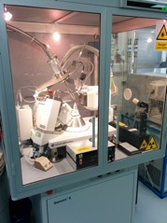
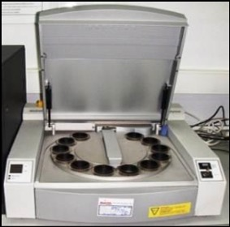
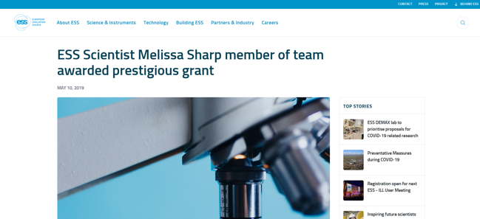
SULF achievements
Grants and instrumentation
Agilent Single Crystal X-ray machine (Cu and Mo tube) - used
Awaiting shipping from ISIS, STFC to E04,
X-ray lab in E04
Melissa received Human Frontier Science Program grant (UK, Sweden, New Zealand) – 3 years, start Jan. 2020
“Do hydrocarbons induce membrane curvature in photosynthetic organisms?”
X-ray fluorescence machine (Panalytical MiniPal) - used
Has been shipped from ISIS, STFC and set up in E04;
Permission from SSM to operate has been given – awaiting internal permission
Others:
E. Wiklund (chemical engineering student from LU) applied for internship with SULF; topic: construction materials for ESS – summer 2020
https://europeanspallationsource.se/article/2019/05/10/ess-scientist-melissa-sharp-member-team-awarded-prestigious-grant
FLUCO in-kind on electrochemical cell for neutron scattering (Alice Corani)
Started – SULF is collaborator.

Slide 15
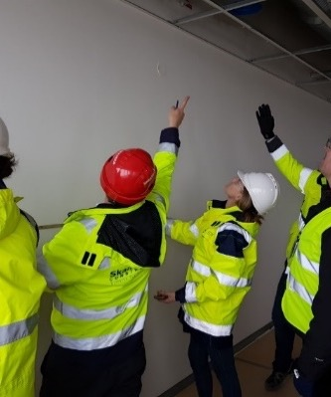
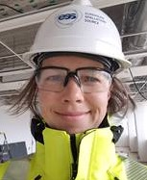
2
SULF –
on-site installation of the labs in E04
Presented by
Melissa Sharp
Scientist

Slide 16
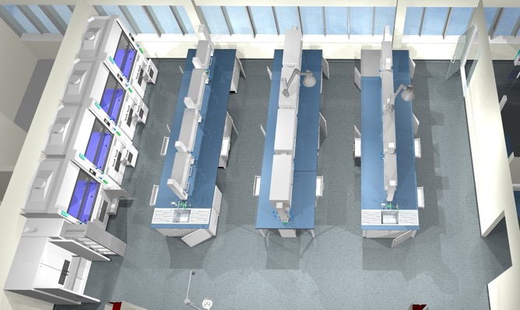
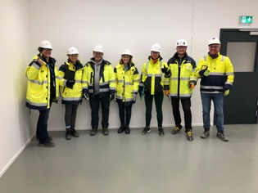
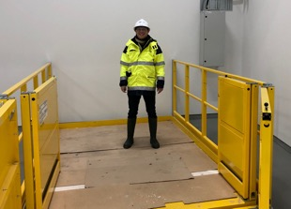
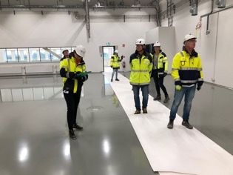
Project overview
Installation of chemical and technical laboratories
Background / Timeline :
  2014: Design start
  2015: Technical annex with in-kind partner Marek Jura (STFC)
  end 2018: PDR/CDR (design reviews) for lab
  summer 2019: Tender for laboratory furniture
  November 2019: Tender for installation work
  December 2019: hand-over E03/E04
  December 2019: delivery of furniture
  Jan. 9th 2020: final Installation readiness
  Jan. 13th 2020: Start of installation

Slide 17
Reminder: In-kind STFC laboratories to be fitted out
E04: level 100
  Large LS&SCM laboratory with appliance room and fridge/freezer room (4 FC, 2 extraction points)
  Physical Characterization with cutting& polishing lab
E04: level 110
  Large Chemistry Laboratory (4 FC, 4 extraction points)
D04: level 100/110
  Large chemistry laboratory with appliance room, instrument room and fridge/freezer room (5 FC, 4 extraction points)
D08:
  Radiological Materials Laboratory (4 FC)
Additional fit-outs, where we support and coordinate on NSS behalf: Sample Env., Detectors, MCA, Optics
Notes:
This is a 3D picture of one of our large laboratories. The list on the right shows the laboratories that were part of our in-kind tender that was won by SANBER LTD, UK. As we informed you last time, we had issues with VAT tax that had to be paid for installation work by our UK in-kind partner. Our solution is now that the in-kind partner STFC will pay for the furniture and hardware while ESS will pay for the installation work out of the SAD installation budget. We will use the same company that won the bid for tender.

Slide 18
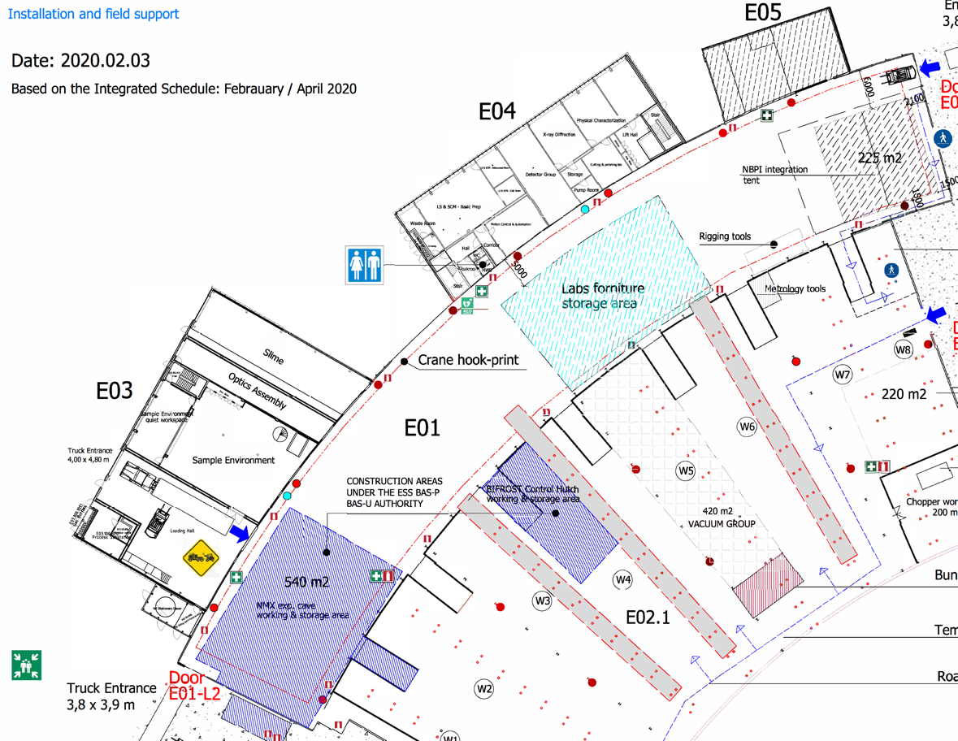
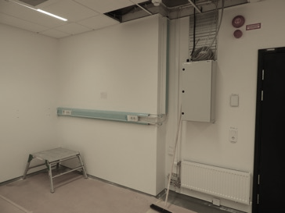
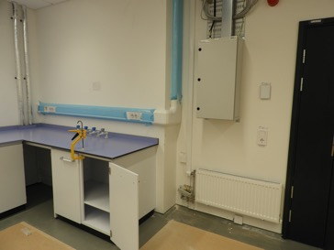
Installation Location E03/E04
Chemical and technical laboratories (SULF, SE, Optics, Detector, MC)
Installation details:
  installation: Jan. 13th - Aug, 2020
  Storage area now: E01, later: SLIME
new end date TBC
– post-Covid-19
Type of installations:
  Services above the ceiling (electrical, gas, water, cooling water, DI water)
  Laboratory furniture

Slide 19
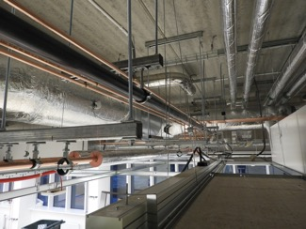
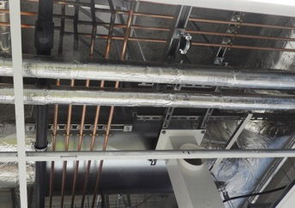
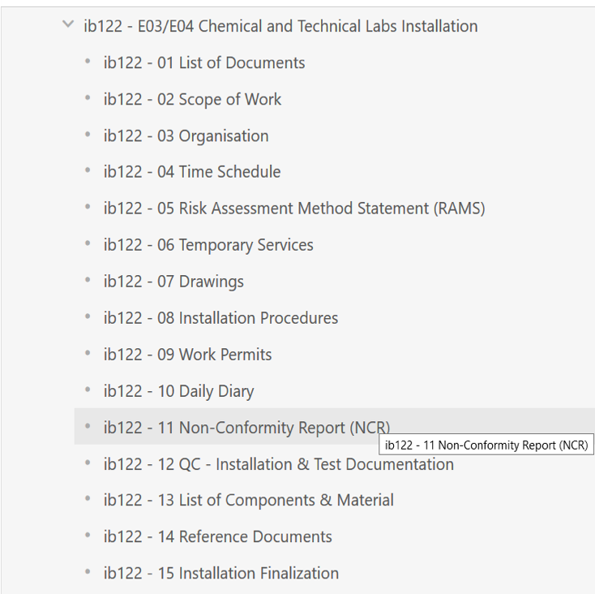


Installation Readiness Review (IRR)
Completing the binder and timeline for review
  Lot of useful information in one spot, e.g. safety documents, supervisors+contact details, organization
  However, also overwhelming amounts of information (drawings, procedures, materials specifications)
  Or difficult requests: detailed CAD models for our installation, when as-built drawings do not yet exist!
  Or never-ending requests: ESS internal
  IRR goes over all parts of the installation to assure it is ready to go (safety, project structure, drawings, quality, materials,….)
  IRR for labs:
  Started information exchange summer 2019
  1st: Nov. 18th, 2019 - missing information (QA)
  2nd: Dec. 16th, 2019 – clarification what is needed pre-start/post-start (QA)
  3rd: Jan. 9th, 2020 – permission to start installation
  Workers arrived Jan. 12th from UK!
  We are still completing post-start requirements!
-> useful tool to organize the installation
-> labs: training records/drawings elsewhere

Slide 20
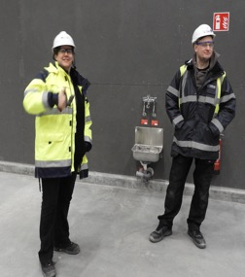
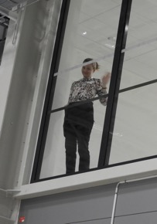
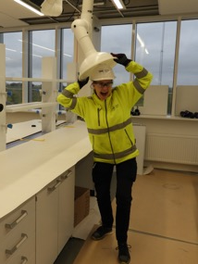
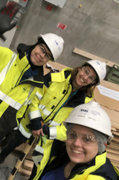
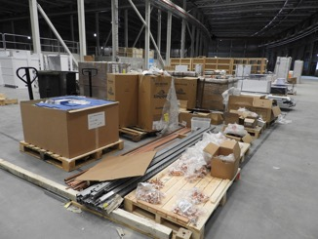
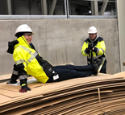
Structure of lab project
“How we work”
Main contractor: Sanber LTD (UK)
  Subcontractors for
    Electrical (Optimum Electrical Engineering LTD)
    Mechanical (JD Engineering)
    Gases (Medical Pipeline Services LTD)
    Furniture (Bracci Installations LTD)
  one SANBER supervisor for all workers
Main ESS contact: SULF
  Daily ESS contact (SAD plus techn. teams)
    Walk-throughs, assure workers have what they need, help with deliveries, hot works permits,… “keep the installation going smoothly”
  work day and weekend (7 am to 6 pm): ESS contact present when work is ongoing
  Area coordinator E03/E04: M. Hartl
“one foreman for all” works well
construction smoother when “customer” on site!
being close to construction is very motivating

Slide 21
Structure of lab project
“How we work”
Typical schedule for ESS supervision on site

Slide 22
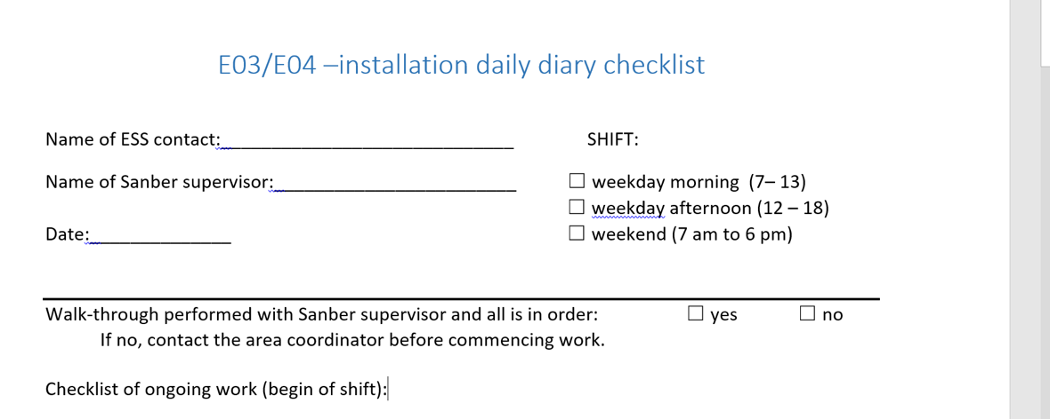
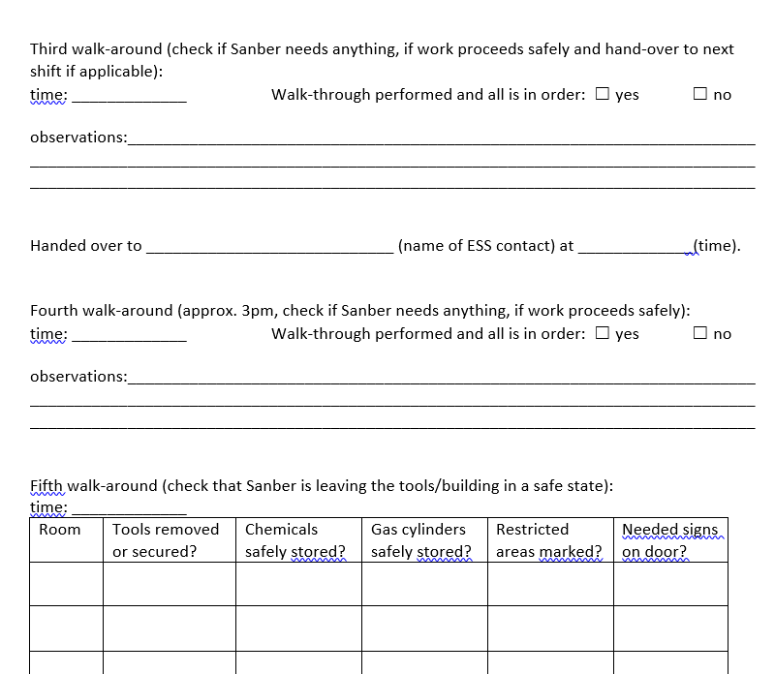
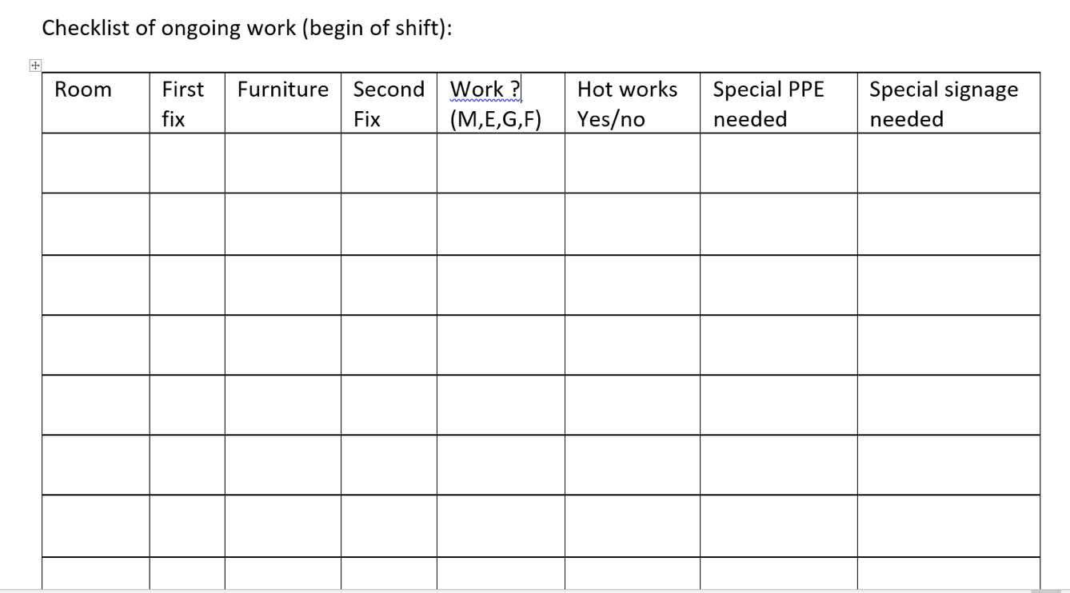
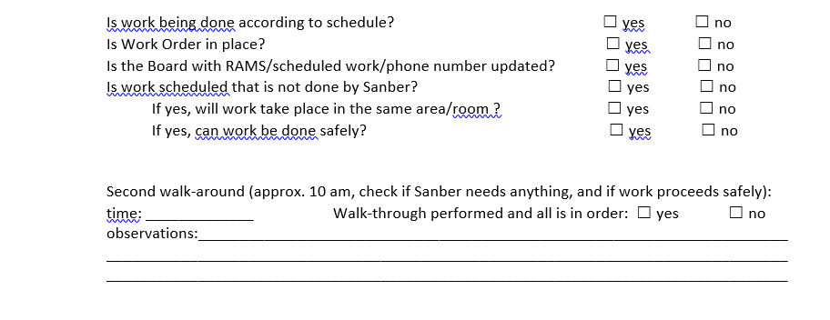
Structure of lab project
“How we work”
Each day a checklist is completed, highlighting work being done, and any issues or tasks needed from our side

Slide 23
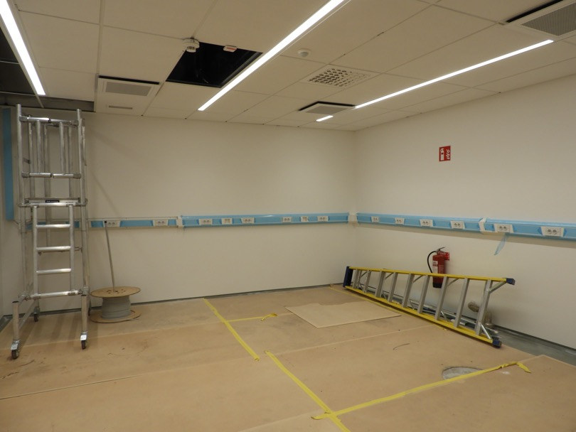

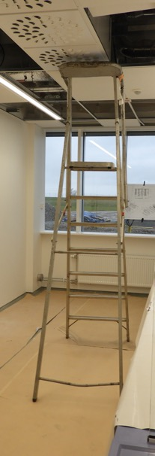


Safety during Installation
Inform your contractors in time to establish safety culture
  OHS group always helpful and pragmatic
  Focus is on keeping people safe but also to find solutions
  RAMS (risk assessment method statement) templates are quite clearly structured – understandable for contractors
Challenge:
  Not all things can be taken care off ahead of time
  Some times equipment that is considered safe in another country is not considered safe in Sweden or at the construction site
  Contractors might be reluctant to change work to follow local rules
X
Correct ladder not tall enough for our workers!
Or our workers not tall enough for ladder?

Slide 24
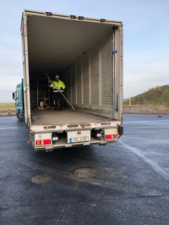
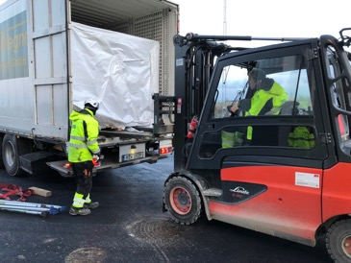
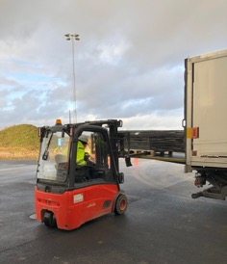
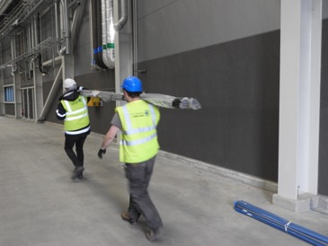
Logistics / Rigging needs
How to receive goods on-site and how to unload them
  Logistics/rigging team: always helpful
  Teams find solution whenever possible!
Challenges
  Warehouse only available to ESS-owned items (no acceptance of in-kind/contractor materials (DAP!))
  Too few vehicles for ESS site-2-site transport
  Logistics trucks too short for long items ( > 6m)
  Unannounced shipments are an issue – companies order parts directly to ESS, shipped via distributor
  Need for details for each shipment (times, date, driver, number plate, company, weight/size)
  Service always needs to be requested ahead of time (48h or more)
-Large, costly items easy to unload as details known
-Small deliveries from third parties complicated
-Do empty truck first, then move items
Have been able to accept goods
during COVID-19 situation
Notes:
notice -> had to send truck away with piping materials

Slide 25
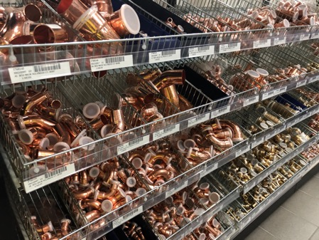
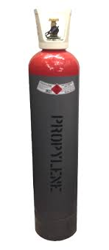

Other experiences
How to request things “out of the ordinary”
How to order as non-Swedish
company in Sweden
  Easy, once contact between parties is established – but can take 7-10 days to set up
  Existing ESS frameworks can support until company is registered
  Some things are really smooth and fast – changes needed w/r building systems (ventilation or fire alarm on/off, …)
  Waste separation provided and automatic
  Installation & Area coordinator support, (labs: FM is responsive and helpful)
Challenges
  Sometimes slow response when fast answer is needed (drilling holes, storage), finding the right “channels” to ask
  Special permission needed for storage of some items (gas cylinders, chemicals)
- assisting the contractors helps avoid delays
- small stock of necessary things (tape, PPE, floor covering, screws,…) useful

Slide 26
Good progress (until Covid-19…)
Level of completion per lab
Lab Ref: E04.100.2021 - LS & SCM – Basic Prep | % complete mid-March
Laboratory Furniture | 85%
Electrical and Data | 80%
Plumbing | 80%
Duct | 80%
Laboratory Gases | 98%
Lab Ref: E04.100.2022 & 2023 - LS & SCM – Instrument Room/Cold Room
Laboratory Furniture | 85%
Electrical and Data | 90%
Plumbing | 90%
Duct | 80%
Laboratory Gases | 80%
Lab Ref: E04.100.2032 - Physical Characterisation
Laboratory Furniture | 85%
Electrical and Data | 80%
Plumbing | 80%
Duct | 80%
Laboratory Gases | 30%
Lab Ref: E04.100.2034 - Cutting & Polishing
Laboratory Furniture | 85%
Electrical and Data | 80%
Plumbing | 80%
Duct | 30%
Laboratory Gases | 30%
Lab Ref: E04.110.2021 - Chem / Phys Basic Chemistry
Laboratory Furniture | 85%
Electrical and Data | 80%
Plumbing | 90%
Duct | 80%
Laboratory Gases | 80%
Lab Ref: E03.100.1004 - SLIME
Laboratory Furniture | 0%
Electrical and Data | 80%
Plumbing | 30%
Duct | 0%
Laboratory Gases | 30%
Lab Ref: D08.100.5027 - Radioactive Materials Laboratory
Laboratory Furniture | 0%
Electrical and Data | 0%
Plumbing | 0%
Duct | 0%
Laboratory Gases | 0%
Handover D08 2021

Slide 27
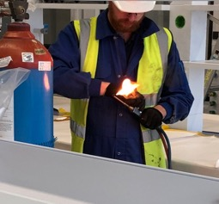






Good progress (until Covid-19…)
Pragmatic approach to installation
Our construction workers have found ways of making good progress – even when there have been delays in supplies or decisions
Next step is getting testing approved and done for finished labs and permissions for moving them into operation
Construction workers are experts in their fields – asking questions and understanding what is happening will create better results

Slide 28


3
SULF –
plans on moving to the new labs in E04
Presented by
Katrin Michel
Chemical Technical Assistant (CTA)

Slide 29










Where does SULF work?
Locations overview
E04
Chemistry Lab at Medicon Village (MV) shared with DEMAX
UTGÅRD
SULF’s Storage at Utgård
Notes:
We plan to move our equipment in a way to keep up our scientific activities and capabilities as much as possible.
That means we will move equipment according to the readily installed supplies. Therefore, we have created 4 work packages, which are presented here.
Our work packages are called:
Electric, without utilities
Water, DI water, ventilation and eventually a permission for gas
Followed by, House gas and house vacuum
And Permission for Chemicals and the mercury license for the new location.
[CLICK] Each work package is dependent on the OK from Quality and the ESH/OHS group.
I will get back to this and more in another slide.

Slide 30





The idea
Each step depends on the handover
March – September/October 2020
4 work packages
Electric, without utilities
1st move Utgård / Medicon Village
glassware, small equipment (scales, vacuum oven, tube furnace, levitator + UV/VIS, small centrifuge, pumps (TA-1/MV), tool case (H-lab: tools), cryostat (H-lab), shaker, water bath, sonicator, ball mill, microscope (TA-1), light microscope, Swagelok tubing, gloves, soap, brushes
*Lathe (Harald), Drill (Harald), Harald (Ship 6) -> cutting/polishing lab
Water, DI water, permission for gas, ventilation
2nd move Medicon Village:
Large centrifuge, Office (Katrin)
tool box, rotation evaporator, BET, AccuPyc,
FLUCO’s HPLC pump, FLUCO’s gas manifold
House gas, house vacuum
3rd move Sensitive instruments Medicon Village
DTA/DSC, Nicolet FTIR, glove box
Permission for Chemicals, Hg license
4th move Medicon Village
All SULF chemicals, Metrohm Electrochemistry (Hg license)
Notes:
We plan to move our equipment in a way to keep up our scientific activities and capabilities as much as possible.
That means we will move equipment according to the readily installed supplies. Therefore, we have created 4 work packages, which are presented here.
Our work packages are called:
Electric, without utilities
Water, DI water, ventilation and eventually a permission for gas
Followed by, House gas and house vacuum
And Permission for Chemicals and the mercury license for the new location.
[CLICK] Each work package is dependent on the OK from Quality and the ESH/OHS group.
I will get back to this and more in another slide.

Slide 31


Handover to DEMAX
Timeline
  Handover as smooth as possible
2020 September
KLARA chemical inventory system
Information about shared equipment
DEMAX reacted and bought scales, fridges/freezer
Labcoat laundry and ordering
Waste Handling (Stena contact for waste collection, ordering labels and other supplies)
Safety/Lab Responsibility
Communication Medicon Village
SULF still owner of the laboratory until move out completed
Until then DEMAX can manage day-to-day tasks and can ask questions to SULF
DEMAX / SULF
shared lab
Notes:
Before, I would like to explain how we communicate with DEMAX, in order to make the move out from Medicon Village as smooth as possible for them, as they are in operation and it’s important for them to work without major interruption.
In the timeline you can see my idea of things, that need to be transferred to DEMAX.
The ticked points on the left, are things, that are officially communicated and handed over.
All team members know at least the basic functions of the chemical inventory system KLARA, have access and can use it on a daily basis.
DEMAX knows SULF´s move out plan and they were given the timeline, at which we will have a look in a moment.
In general, Anna and Hanna have been there before me and know all the duties, but just in case, I am willing to help before I must turn to duties in the new lab.
The underlying idea is, that until September SULF will be the lab owner, but DEMAX will be given the responsibility for day to day tasks.

Slide 32
The schedule
Moving from Storage, Medicon Village
Utgård Storage
1st move Medicon Village
2nd move Medicon Village
Sensitive instruments
Chemicals
Electrochemistry setup
(Hg license)
March | April | May | June | July | August | September | October
Large centrifuge transport
Involve companies
Guidelines for E04 Labs
Application for Hg license
DI
S
Notes:
Picking up what I have shown in my first slide, I have made a schedule about when we want to move the equipment.
Starting with what we already have on site- room for storage. Later, we will move equipment that requires electric, ventilation, water, vacuum and gas whenever ready and handed over.
In March we have moved items, mostly glassware, that were bought in 2017 and 2018 from our storage in Utgård, into E04. (pictures) This move is completed. [CLICK]
We also included two heavy machines from FLUCO – a lather and a standing drill.
The 1st move from Medicon Village was planned to take place in the mid of April, but [CLICK]

Slide 33

The schedule
Changes due to Sars-Cov-2
Utgård Storage
1st move Medicon Village
2nd move Medicon Village
Sensitive instruments
Chemicals
Electrochemistry setup
(Hg license)
March | April | May | June | July | August | September | October
Large centrifuge transport
Involve companies
Guidelines for E04 Labs
Application for Hg license
DI
S
https://qz.com/1820422/coronavirus-why-wont-who-use-the-name-sars-cov-2/
Notes:
….due to the virus pandemic we expect a delay of at least a month.
However, there is plenty of preparation to do for all the other moves. Therefore, I take the time and get in touch with companies and our logistics team to have it ready for the move. The preparation time is shown here with the pale bars.
We might still be able to move most chemicals in August, given that we have ventilated storage and a fridge.
However, the move of chemicals that require storage in protective gas might be delayed until September.
For the mercury license I expect to move the electrochemistry setup in October, as I can’t tell how fast the renewal of the license will happen.
The electrochemistry, of all equipment SULF owns, will be the last item to move.

Slide 34



Preparation
Moving equipment and chemicals
KLARA chemical inventory system helpful tool to keep track on amounts and UN numbers of chemicals
Equipment
Logistics offers service- Site Transport via essNOW (SNOW)
Office support can help pack up and provides moving boxes and some cages
Other packing material and moving service from external (paid by us)
Chemicals
In touch with Logistics and Conny Wendt about moving chemicals in August
Logistics: ADR driver available
requirement for move: paperwork, packaging, labelling required – SULF has ADR Kow-How
Labelling: UN numbers sent to Conny Wendt
Packaging: currently collect all package material available. Stocking up.
OHS: In touch with OHS to feed back status and double check legislation
License for mercury to be re-newed and updated to new location
paperwork according ess rules for laboratories
SULF Know-How ADR
Notes:
For example, we will need to get in touch with companies like Netzsch and Nicolet to provide us with packing material. Eventually, we will book a technician to help us pack up and later service the instrument, after the move.
SULF, together with OHS and Logistics need to sort out paperwork to move the chemicals and also establish laboratory guidelines for ESS.
SULF has a big advantage of having Know-How about ADR. That will save time our time on chasing down people for information.

Slide 35


4
SULF –
chemistry services
for the ESS project
Presented by
Monika Hartl
Scientist / GL
Alice Corani
SE technician

Slide 36
SULF – one chemistry lab for ESS
Expertise and experience resides in SULF
REASONS to have one chemistry lab for all ESS located at ESS instead of several small scale labs in each division:
  The expertise is in SULF as shown by various involvements, nationally and internationally.
  Having to go to an outside lab is expensive and takes longer.
  Activated materials cannot easily be sent outside.
We have the expertise and the experience
  Neutron scattering & working at chemistry (incl. chemistry work for accelerator and target)
  Internal and external collaborations/projects
  Close collaborations with sample environment and materials group will benefit both sides.

Slide 37


Why are user laboratories necessary?
SNS user
lab
Short, medium and long term needs
Short term needs of ESS:
  Support for the construction project for critical path sub-projects to ensure RBOT and BOT.
    Material site-acceptance test for the bunker project.
    Support target moderator workpackage & in-kind partner (FZJ) in developing setup for online ortho/para-hydrogen ratio verification of the liquid hydrogen moderator.
    Support for the radiation hardness of grease project (critical material decision for the target wheel workpackage)
    Support for target system engineering material configuration management (collaboration with spallation physics group) – Be, beam dump water analysis, target concrete analysis,….
Short term needs of SAD:
  Provide infrastructure for user beamtime preparation with regards to sample environment (mostly FLUCO – shared technician):
    Electrochemistry (see talk by Alice)
    Levitator
    Gas handling

Slide 38











SULF short term support
for the ESS construction project and initial ops
Radiation Hardness of Grease
(collab. Lena Reactor/U. Pavia)
Elemental Analysis of
Bunker materials
Bunker and
shielding materials
Target wheel, choppers,…
Target Moderator/ online monitoring
Ortho-para Hydrogen research
for moderator (collab. ESS/JPARC/SNS)
ISIS beamtime
June 2019
Beam Dump Cooling water
Analysis of water from the beam dump cooling loop
Added capability:
instrumentation
experience
=> asking ESS for ICP-OES
Notes:
Goal: elemental composition of ESS bunker construction materials
preparing samples for measurements
measuring XRF (currently in collaboration SNS/ISIS)
facilitating ICP-OES measurements (LU)
density measurements with SULF gas pycnometer
Added capability for SULF for the user program:
Ball mill has been ordered (project funds) -> useful for obtaining powders, synthesis & activation of samples
Used XRF is on the way -> useful tool for determining elemental composition for elements heavier than Na
ICP-OES procurement is being evaluated -> elemental composition for elements (also light elements)

Slide 39



Why are user laboratories necessary?
Short, medium and long term needs
Medium term needs:
  Support for the commission phase (initial ops) of the machine
    Support for accelerator on the material choice for the luminescence screen on target wheel. (beam steering, performance and safety critical)
    Provide cooling water and material analysis as needed
    Support installation of ortho/parahydrogen monitoring system
  Providing Radioactive Materials Laboratory in time for BOT
    Only permanent area at ESS for analysing activated materials
Beam Diagnostics
Luminescence Screen on target wheel (collab. SNS)

Slide 40



Why are user laboratories necessary?
Short, medium and long term needs
Long term needs:
  Preparing for First Science (ESS is built for small samples and in-situ experiments ->SULF needs to cater to these requirements.
    prepare, modify and load samples
    characterize samples before, during and after the experiment
    Last minute adjustments => saving beam time & costs
  ESS operations support
    Materials/failure analysis for machine and science directorate
    Cooling water analysis for target
ISIS
User labs
SNS user
lab
ISIS
Materials
labs
Well-functioning labs come with expertise of the scientific and technical staff.
State-of-the-art neutron sources have labs not just sample loading stations !

Slide 41




SULF Collaborative Science
Outreach: Building up the regional user base
LU-Combustion Physics (Local User) F. Ossler
Laboratory support for local neutron scattering users as needed and as time is available…
Human Frontier Science Program grant (UK, Sweden, New Zealand)
“Do hydrocarbons induce membrane curvature in photosynthetic organisms?” M. Sharp
Swedish Water Research/ Sydvatten (Industrial Partner) –> project complete
“Water dynamics on bisphenol-covered silica as model for water purification filters”
1 year joint VINNOVA industrial pilot project
Added capability:
- collaborations and access to capabilities
- instrumentation

Slide 42



SULF collaborative science for ESS
From user lab to sample environment for neutron scattering (A. Corani)
  User Lab
  Basic analytical tool
    Wet chemistry
    Polarography
    Impedance measurement
  Sample preparation
    Glove box
    Clean area
    Prepare charge/discharge
  Sample Environment
  In kind 2 years projects EE
  Cells compatible with neutron experiment, in situ and operando
      Coin cell, SANS measurements.
      Annular cell for inelastic, diffraction exp.
Beam Dump cooling water
Cyclovoltammogram
Useful for the ESS project,
e.g. corrosion,
elemental identification
current / A
Fe²⁺/Fe³⁺
Potential vs. Ag/AgCl

Slide 43




SULF: Current operations in rented lab
Supporting construction, initial ops and preparing for start of the user program
Collaboration within ESS
ESS Project support
Small collaborative science projects
Gaining/maintaining experience
Increasing/sharing capabilities
Supporting ESS
  FT-IR, Raman (*), UV/VIS spectroscopy
  Small glove box and Ultrasonic horn & bath
  DSC/DTA, BET, gas pycnometer
  Electrochemistry potentiostats (FLUCO/SULF)
  Levitator (FLUCO/SULF)
  Furnace (tube and box), vacuum furnace,
  Glassware/stirrers/heaters/autoclaves,…
  XRF, ball mill
  Gas handling manifold (FLUCO/SULF)
  XRD is being shipped
  Planned in 2020
  DLS (grant), ICP-OES (ESS project)

Slide 44
SULF - conclusions
Catering to all 15 neutron scattering instruments
… but with focus on the first eight instruments
SULF is on track with
Laboratory fit-out (started 2020) and move of our lab to the ESS-site (Q3/2020)
Preparation for the user program including safety and sample handling
SULF adds value
scientific support to the engineers in machine and science directorate already during construction
building up capabilities in time for First Science in collaboration with other groups
SULF is crucial
Support for in-situ experiments / experiments with sensitive samples
Minimizing beam time loss by checking/modifying samples
Support for materials characterization to all of ESS during operations

Slide 45

Thank you for your attention
SULF Group
We sulf problems !

