Slide 1
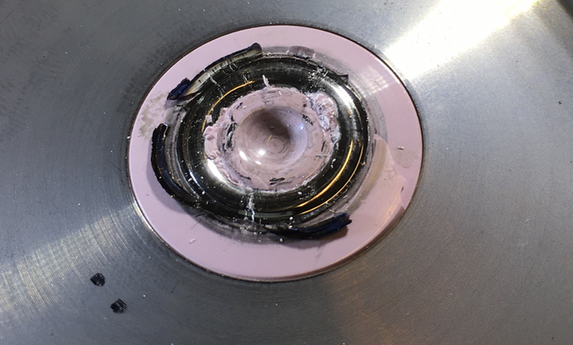
PREMP Sample Environment Systems for First Science
Prioritised sample environment systems to be used on instruments #1-8
PRESENTED BY Malcolm Guthrie

Slide 2
Agenda
1 PREMP System Prioritisation and Strategy
2 Status update of prioritised systems
3 Status update of general PREMP procedures for operations

Slide 3
Prioritisation Strategy for Hot Comm. and First Science: High Pressure
Factors affecting equipment prioritisation
In early days, beam power will be low => emphasis on larger volume, lower pressure
larger volume samples also minimise alignment and background challenges
Strong interest from instruments in combining HP with low temperatures

Slide 4
Prioritisation Strategy for Hot Comm. and First Science: High Pressure
Priority 1: Deliver a safe and stable platform for conducting high-pressure science at ESS
Priority 2: Provide baseline of “traditional” HP equipment: gas, clamp and PE-type cells all with low T capability.

Slide 5
Prioritisation Strategy for Hot Comm. and First Science: Mechanical Processing
Clear priority to deliver Inst. Specific equipment for BEER.
Strain rigs are core business for BEER and important for ODIN and LOKI
Dilatometer is second most critical item of equipment

Slide 6
Prioritisation Strategy for Hot Comm. and First Science: Mechanical Processing
Priority 1: Deliver a safe and stable platform for conducting mechanical processing science at ESS
Priority 2: Deliver suite of rig (for BEER, ODIN, LOKI)
Priority 3: Deliver instrument-specific dilatometer for BEER

Slide 7
2
PREMP
Status update Prioritised systems

Slide 8
Summary of prioritised systems
Defined simple scoring system considering:
number of instruments requiring system
priority of system on given instrument
Treated MP and HP separately
High Pressure
System | “Overall priority”
Clamp | 1
gas/liquid | 2
PE | 3
DAC | 4
NIK 3.7 (CEA)

Slide 9
Summary of prioritised systems
Defined simple scoring system considering:
number of instruments requiring system
priority of system on given instrument
Treated MP and HP separately
Mechanical Processing
System | “Overall priority”
“rigs” | 1
Dilatometer | 2

Slide 10
Clamp cells for DREAM, MAGIC, CSPEC, BIFROST Provides < 2GPa and <1K
1. System Overview and Deliverables (ref ESS-1545382)
Clamp devices will follow LLB and Sine2020 designs
0.3cc vol
TiZr <1 GPa* and CuBe < 1.5 GPa*
Training to enable in house construction of cells
2. Schedule, Milestones and Reviews
see NIK 3-7 slide later
3. Integration, Safety, Verification, Validation
Primary installation via cryostat stick (design pending)
Safety/Quality see later slide
Verification/validation requires Pressure Testing Facility
4. Achievements and Challenges
TA (almost) at signing stage. Target: 24th April
Main challenge is if this slips due to COVID
Sine 2020 developed clamp cell
(WP7 report)

Slide 11
GAS/LIQUID cells for DREAM, MAGIC, CSPEC, BIFROST... Provides < 1GPa and <1K
1. System Overview and Deliverables (ref ESS-1545382)
Gas/Liquid cells follow LLB and Sine2020 designs
two std volumes: 0.5 cc and 1.0 cc
TiZr <0.5 GPa*, Al < 0.4 GPa*, BeCu 1.0 GPa
Training to enable in house construction of cells
1.0 GPa He gas compressor
2. Schedule, Milestones and Reviews
see NIK 3-7 slide later
3. Integration, Safety, Verification, Validation
Primary installation via cryostat stick (design pending)
Safety/Quality see later slide
Verification/validation requires Pressure Testing Facility
4. Achievements and Challenges
TA (almost) at signing stage. Target: 24th April
Main challenge is if this slips due to COVID

Slide 12
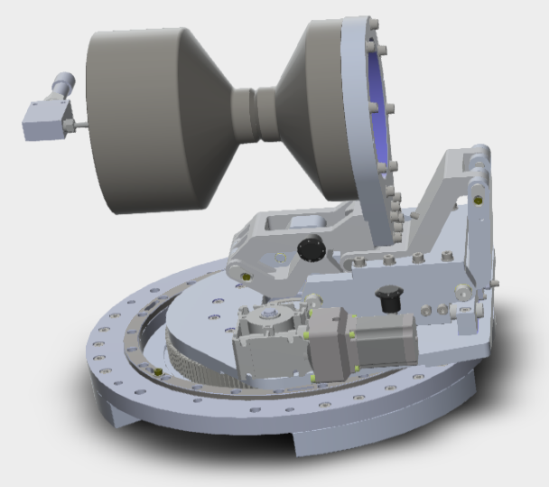
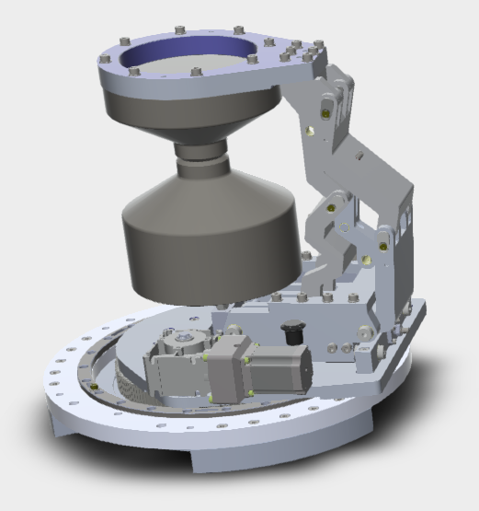
PE cells for DREAM, MAGIC, BIFROST Provides < 20GPa and <4K
1. System Overview and Deliverables (ref ESS-1545382)
PE cells: 1x VX5 (AW819), 2x VX1 tonne (BeCu)
CCR-based cryostat for PE
Gas-loader for PE (also suitable for DACs)
2. Schedule, Milestones and Reviews
see NIK 3-7 slide later
3. Integration, Safety, Verification, Validation
FAT conducted for RT mount for PE cell (Q1 2020)
Low T mounting part of cryostat design
Safety/Quality see later slide
4. Achievements and Challenges
TA (almost) at signing stage. Target: 24th April
Tender completed for hyd. pump: Vinci system
Parallel project to increase angular aperture of PE anvils (DREAM + MAGIC)

Slide 13
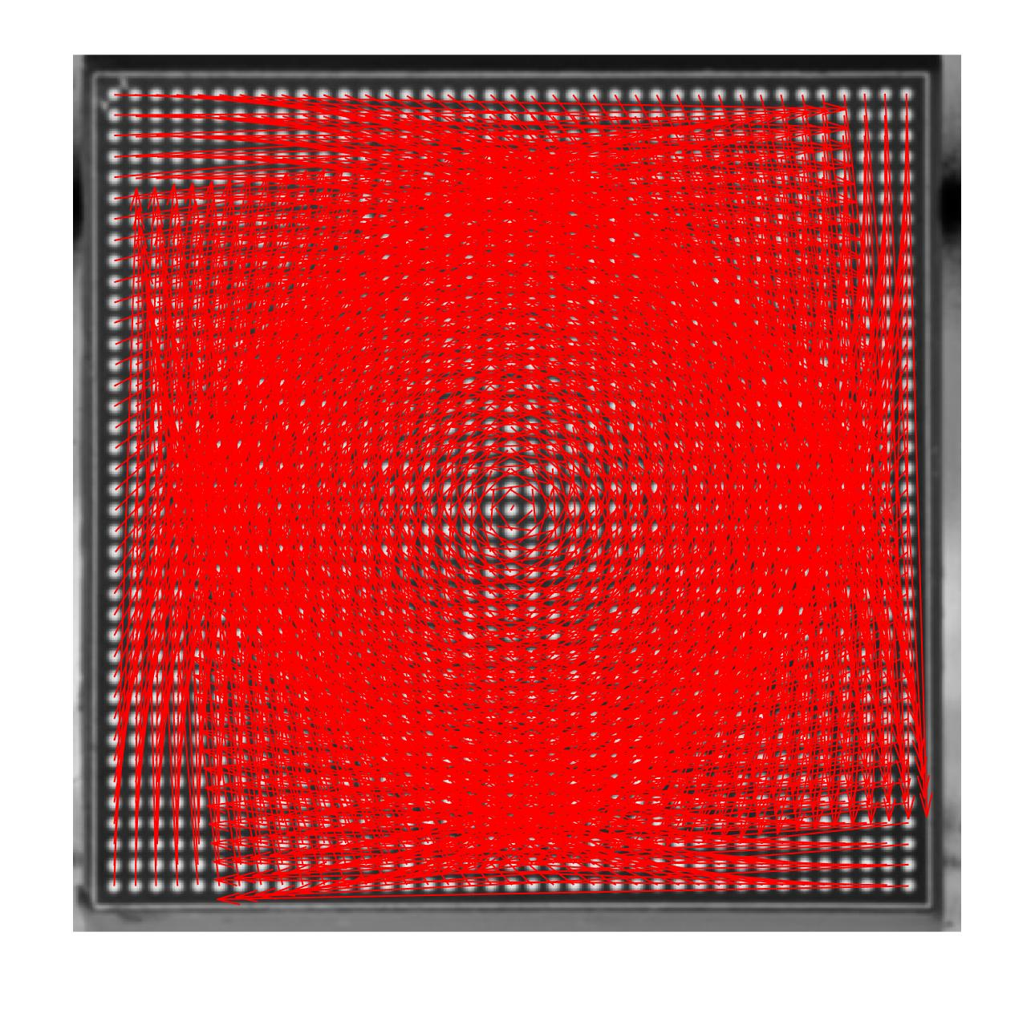
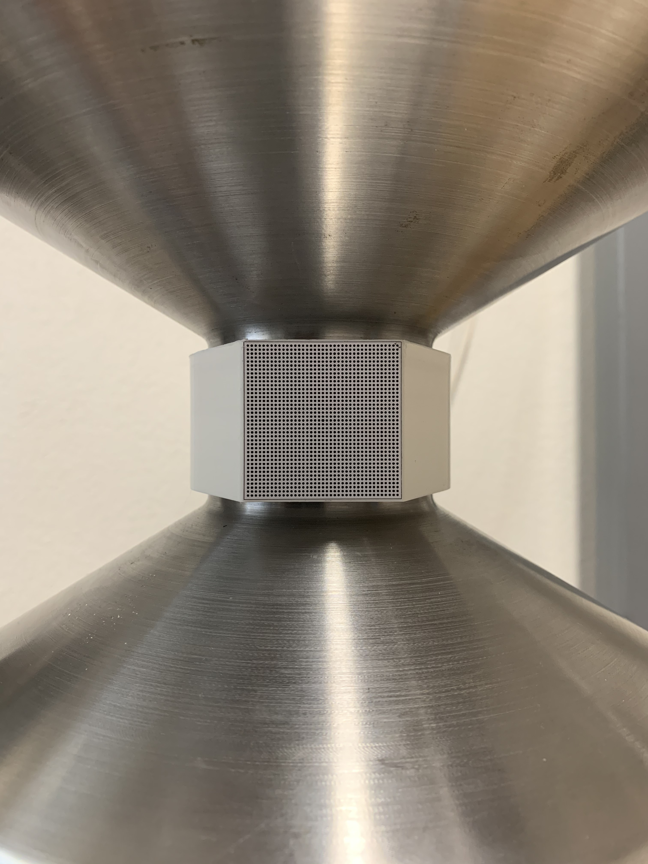
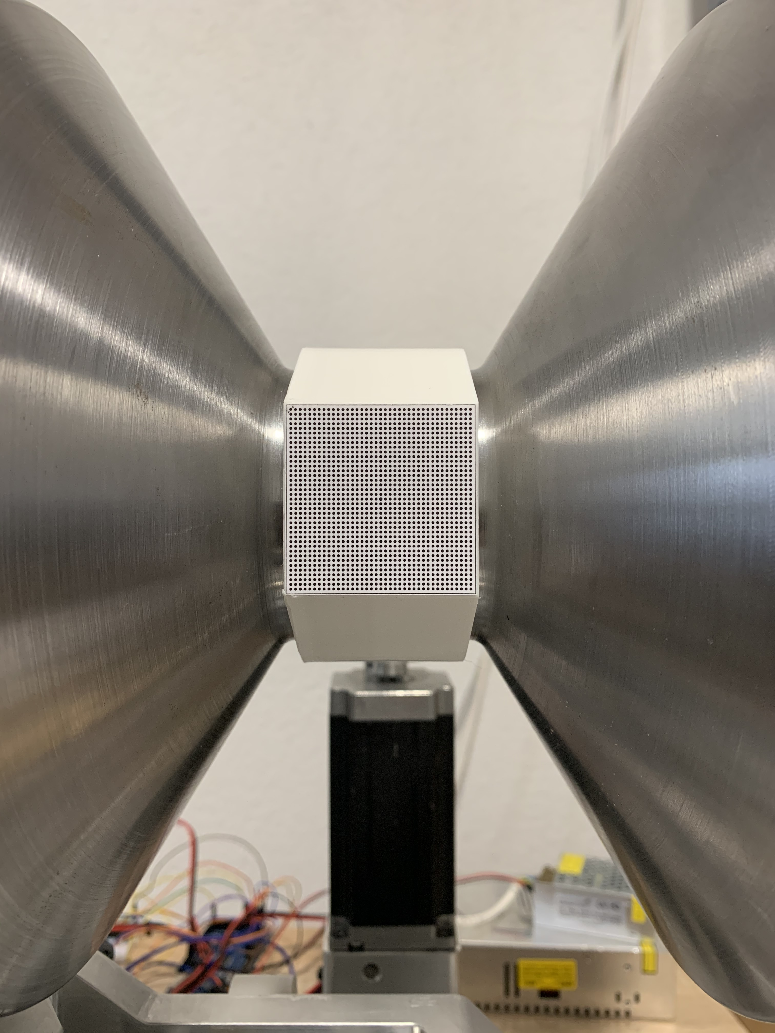
Aside: FAT for PE mount
Two orientations imaged by fixed camera.
Reference grid fixed relative to cell
Red arrows show displacement of each point on reference grid
Confirms ‘magic spot’ unmoved to < 0.17mm,
0.78mm from centre of grid.

Slide 14
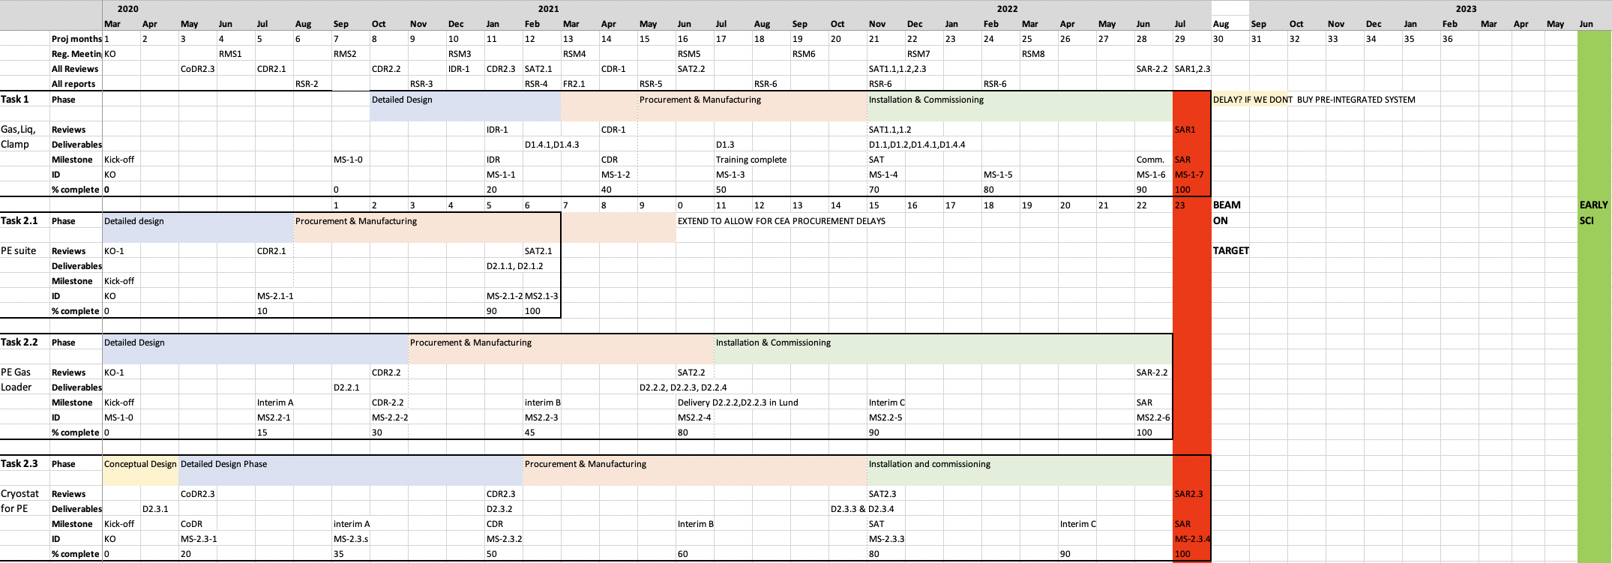
NIK3.7 schedule, milestones, reviews
Type | Acronym | Meaning
Meetings | RSM | Regular Status Meeting
 | KO | Kick Off Meeting
Reviews | IDR | Intermediate Design Review
 | CoDR | Conceptual Design Review
 | CDR | Critical Design Review
 | SAT | Site Acceptance Test
 | SAR | Site Acceptance Review
Reports | RSR | Regular Status Report
 | FR | Final Report
Deliverables | D | Deliverable
Milestones | MS | Milestone
 | IMS | Interim milestone
Detailed plan for project (milestones reviews verifications etc)
COVID delay primarily impacts PE systems
< 6 months delay should be manageable (other Hot comm. priorities)

Slide 15
Rigs for BEER, ODIN, LOKI Provides < 100kN, <1000K
1. System Overview and Deliverables (ref ESS-1545382)
Rig 1: 100kN workhorse strain rig for BEER
RIg 2: 45kN rig with rotation/torsion
Rig 3: 15kN exchangable load cells
2. Schedule, Milestones and Reviews
Rig 1 constructed, integration by Q4 2020
Rig 2&3 conceptual design, gathering specification
See next page...
3. Integration, Safety, Verification, Validation
Rig 1 integration: defined requirements on time-stamping resolution (ECDG)
Hope to get Rig 1 to Lund in 2020
Beginning safety/Quality assessment (use “Robin Woracek’s rig to develop this, due in Lund summer 2020)
Hope to get Rig 1 in Lund 2021
4. Achievements and Challenges
VR-funded furnace project floundering.

Slide 16
Rigs Schedule
2019 | 2020 |  |  |  | 2021 |  |  |  | 2022
Q4 | Q1 | Q2 | Q3 | Q4 | Q1 | Q2 | Q3 | Q4 | Q1 | Q2
RIG 1
RIG 2
RIG 3
INTEGRATION
COMMISSIONING IN LUND
CONCEPT. DESIGN
DETAIL. DESIGN
PROC,MFG,ASSEMBLY
INTEGRATION
COMM LUND
CONCEPT. DESIGN
DETAIL. DESIGN
PROC,MFG,ASSEMBLY
INTEGRATION
COMM LUND
BOT
Rig 1 Controls integration project being set up
Rig 1 Mechanical integration collecting requirements
Rig 2 & 3 conceptual design due 20 April (reviewed in I&E STAP 22 April)

Slide 17
3
PREMP
Status update general procedures for operations

Slide 18
PREMP operations strategy
Key factors:
Operating and maintenance procedures for all PREMP equipment
Includes legally required maintenance and calibration schedules
Regular testing of devices requires a Pressure testing facility (aka PTF ”pressure Bunker”)
Documented and reviewed risk assessments for all equipment
Created: ESS-1419285 “PREMP systems operations and maintenance manual (PSOMM)

Slide 19
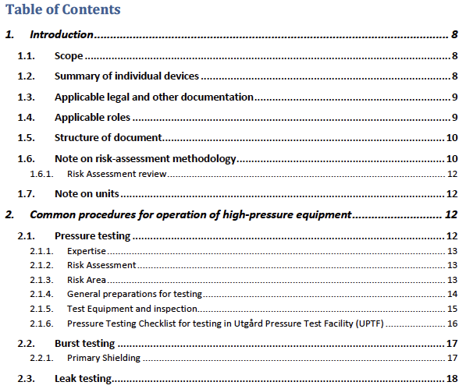
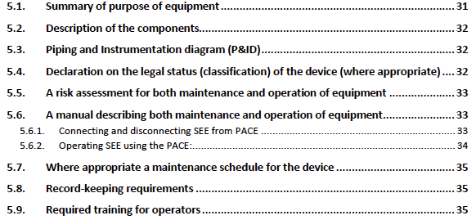
PSOMM
Overall considerations:
Content for specific Equipment:
Above repeated for each item of equipment

Slide 20
Required records
Series of required records (legally) required:
Risk Assessments
Specific activity and area hazard analyses
Calibration certificates
Maintenance records
Log of safety-specific devices (burst discs, P relief valves etc)
Currently stored in confluence: https://confluence.esss.lu.se/display/SA/High-Pressure+Safety%2C+Manuals%2C+Documentation%2C+Classification%2C+Calibration
Plan to move to ESS Inventory system “EAM”

Slide 21
Verification of systems and regular pressure testing
Pressure testing is (legally) needed:
To verify new systems are safe
To re-verify a system is safe after any change or maintenance
To routinely check performance of safety devices (such as pressure relief valve)
REQUIRES A SAFE PRESSURE TESTING FACILITY
Have established basic procedures and risk assessments in Utgård prototype system,
have run tests “in anger” (PE cell blow and burst disc blowouts)
“Real” facility will be in E03
Pursuing an agreement with Swedish Defence Research Agency (FOI) to run calculations
One idea is to use a small container
Logistical challenge to get upstairs into E03 (but no harder than crane...)

Slide 22
Specific questions for STAP
Does prioritisation correctly match instrument (and user) needs?
Is level of progress sufficient that PREMP will be ready in time for First Science?
Is the overarching operational framework (PSOMM document) mature and comparable with other facilities

Slide 23
Finish presentation

