Slide 1
Mechatronics and Systems Integration
Work package (WP) Update
PRESENTED BY anders pettersson
ECDC ( ..50% MESI )

Slide 2
Prelude: Anders in ECDC and the ECDC Interfaces
Instruments
NSS
Chopper Group
Detector Group
Science
Motion Control and Automation
Sample Environment
Data Analysis and Modelling
Data Systems and Technologies
ICS
WP12
Infrastructure
Always:
+ in kind partners

Slide 3
Agenda
1 MESI interfaces
2 Development projects highlights (SECoP etc next presentation)
3 SES Integration
4 Utgård, Ymir and moving to site
5 Summary: Highlights and challenges

Slide 4
MESI WP update
Main interfaces
Integrated Control systems Division (ICS)
Communication works well (Utgård!)
Work on integration tasks is well structured
Functional infrastructure provided
Experiment Control and Data Curation (ECDC)
MESI integration workflow feeds in to ECDC
Start to see synergies in development projects
Facilitates cross tech group discussions
Starts to get an “overview” of instrument control needs
Motion Control and Automation (MC&A)
3axis SCAN project -> lessons learned
->Improved understanding and communication
Wishlist: timestamping and flexibility
Sample Environment (SE) Internally
In general good communication, and improving
SES projects and Integration projects still need better alignment
Few available details on future projects

Slide 5
2
Development project highlights

Slide 6
MESI WP update
Development projects highlights
2BLUE racks
Mobile SES racks dedicated for controls development
1 LS336 each + e.g. pwr suppl, PLC, etc..
Always available
For dev of PnP, mobility, modularity, configuration/calibration handling etc..
SES Plug and Play and Network mobility
Network structure is being setup for prototype testing
Native NICOS PnP will be tested Q3

Slide 7
MESI WP update
Development projects highlights
Timestamping
Better then 10ms resolution and accuracy
Essential for e.g. sweep-scans, oscillatory exp
First use case: Stress/Strain rig project
3 technical solutions endorsed by ESS:
PTP (Precision Time Protocol)
NTP+PPS (Pulse Per Second)
ESS ADC hardware setup
MESI will setup a system for development and evaluation

Slide 8
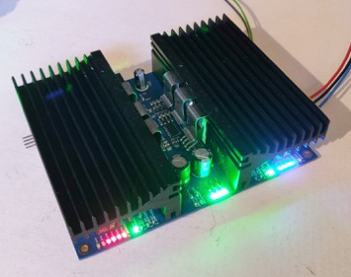
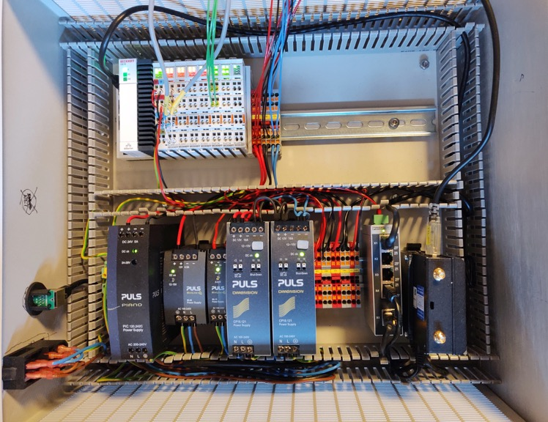
MESI WP update
Development projects highlights
In-house electronics and PLC for SE signals toolbox
Positive experience with Beckhoff for generic control
Beckhoff compatible with ESS timestamping approach
Beckhoff is MC&A motion control standard
In-house electronics for generic tasks
Power amplifier
Generic IO
Built in monitoring and fault detection

Slide 9
MESI WP update
Development projects highlights
Multichannel project with FLUCO
8ch Multichannel modular prototype basic control near ready (for LOKI changer)
PLC hardware crate ready and connectors/cabling ongoing
PID loops and monitoring ready for test
Power amplifier design/PCB ready(v1), but..
Some delay induced by:
An unfortunate power amplifier design
Delayed hardware
Communication issue with Beckhoff (and SECoP)
Normal development project experience. Solutions will be found. Valuable lessons will be learned.
MESI supporting the original Huginn SES running EPICS during experiment at HZB

Slide 10
MESI WP update
Development projects highlights
Mobile robotics platform project.
Project led by MC&A, MESI coordinating SE input
In-kind by Juelich
No exciting pictures yet but there will be a critical design review next week (MESI is in review panel)

Slide 11
3
SES integration

Slide 12
MESI WP update
SE
Initiates a new integration process with MESI
MESI
Starts integration project
ECDC
Prioritizes tasks
ICS
EPICS integration
Raises task with ECDC
Raises to ICS
Receives tasks from groups
( SES controls hw/sw)
Coordination/development
Integration projects workflow
Alignment between SE projects and the Jira workflow used by ICS, ECDC and MESI need to be improved
Integration requirements and system design are as essential as good communication in a successful integration project
A SE integration project need to be an active collaboration. Projects need to be discussed, tested and iterated…continuously
Currently ICS have very few SE tasks active
Simplified view of workflow for SES integration at ESS.

Slide 13
How to start and run a project?
Meeting to explain the system with all stakeholders, at least around the time the critical mass of hardware arrives to sensibly start the integration
Valuable Information:
What does the system do?
How will the average user use the system, including API and UI?
What functions are needed for commissioning or maintenance?
At least one master ticket in Jira (BCG)
We may create more tickets for subtasks
We do expect some interaction on these tickets
There will be intermediate integration milestones to tick off, i.e. review
A final test should be done at Ymir with NICOS (or better alternative).

Slide 14
MESI WP update
Integration projects
PREMP Stress/strain rig “Rig1”
MESI supporting the Rig1 early for timestamping and integration
The required timestamping is under development at ESS
Communication with NPI is good and progress is being made.
TEFI Orange cryostat project
Project “restarted” with new JIRA structure
Next is motion control of needlevalve

Slide 15
MESI WP update
Integration projects
FLUCO Syringe pump and Resistor decade
Both projects restarted
Baseline integration available
Only demo and test of integration required to finalize projects (baseline integration)

Slide 16
4
Utgård, Ymir and moving to site

Slide 17
MESI WP update
MESI Utgård workshop area
MESI workspace, as good as, fully functional
Increasing electronics support capability
Fruitful and frequent interactions with: SE team, ICS, ECDC, MC&A and others
Network infrastructure functional with tools allowing us to setup IP for new equipment, config virtual networks, or start virtual machines etc.
The YMIR is available
Cold as hell….
YMIR cave
MESI area

Slide 18
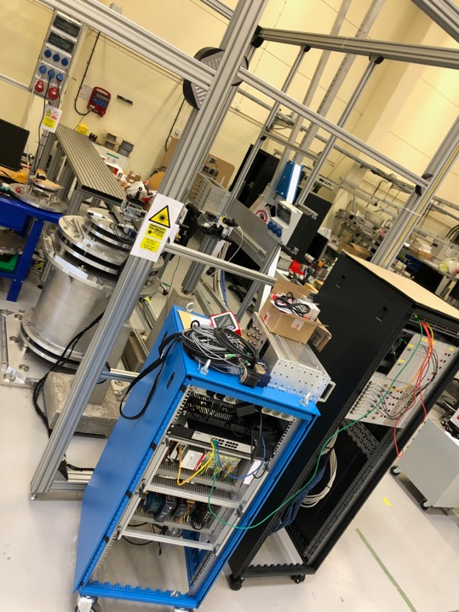
MESI WP update
MESI for YMIR
YMIR: a “beamline” for controls development
YMIR endorsed to be next step in integration development testbed, ECDC leading.
Runs a separate (virtual ) network to simulate real instrument
Mobile PREMP 3 Axis SCAN system available
Access to a ESS timing system testing network
Planned to enable development and testing of:
SES mobility between networks
SES Plug n Play functionality
High accuracy and resolution timestamping for SES

Slide 19
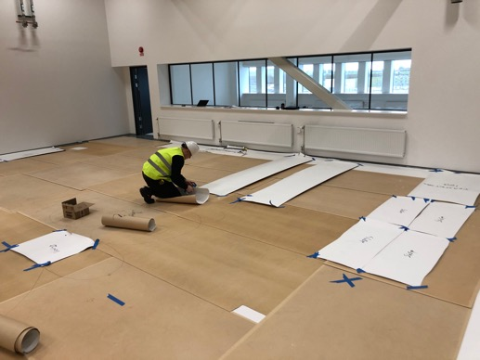
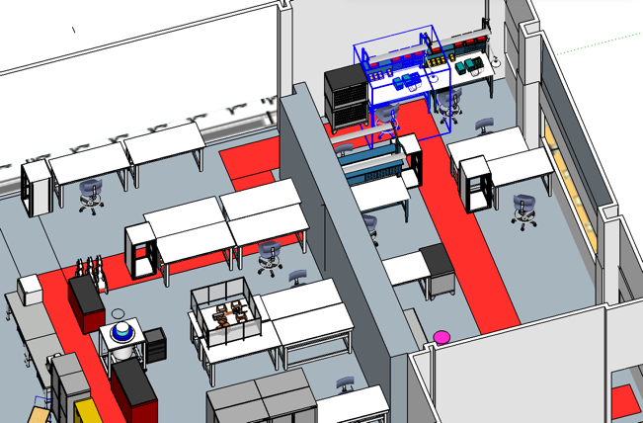
MESI WP update
Moving to site
Planning layout
Providing input on
Infrastructure: power, coolingwater, timingsystem, network etc
“operations” infrastructure and support required
Network functionality , EPICS, Archiver , CSEntry, ALARM handler, etc
“live” planning transferred to detailed schematic drawing

Slide 20
5
Summary

Slide 21
MESI WP update
Summary
Good things
MESIs interfaces are working quite OK
Our workshop (utgård,YMIR) is functional
ICS and ECDC have provided functional tools
We have a way forward for timestamping
Multichannel prototype is progressing
SECoP a suitable for work from home
YMIR Table→ asked ESS workshop for help ->table appeared!
Challenges
Ensure seamless transfer and continued cooperation when moving to site location

Slide 22
MESI WP update
Summary²
Summary
MESI puts much effort now to develop efficient tools and structures for the future.
Efficiency
Modularity
Flexibility and stability
Developing hardware
All with focus/ambition to supporting the SE team and being compliant with ESS

Slide 23
Fin

