Slide 1
Sample Environment Controls
Update on SE controls: SECoP, Octopy, EPICS and NICOS
PRESENTED BY anders pettersson
ECDC (..50% MESI )

Slide 2
Agenda
1 SECoP at ESS
2 Octopy: a SECoP and EPICS compatible SE control system
3 EPICS
4 NICOS

Slide 3
﻿{
"equipment_id":”ESS_DUAL_JULABO_01",
"description":"2 individually controlled temperature
controlled fluid bath with circulation
and setpoints.",
"firmware":"123.456",
"implementor":”AP",
"timeout":”2"
"modules":{
"Tctrl_01":{
"description":"A temperature controlled fluid
bath with circulation (over EPICS).",
"interface_classes":[“driveable”]
},
"accessibles":{
"value":{
"description":"Waterbath internal
Temperature",
"readonly":true,
"datainfo":{
"type":"double",
"min":0,
"max":100
},
},
"target":{},
"stop":{},
"status":{},
"circulation":{}
}, "Tctrl_02":{}
},
}
1
SECoP at ESS
Sample
Environment
Communication
Protocol

Slide 4
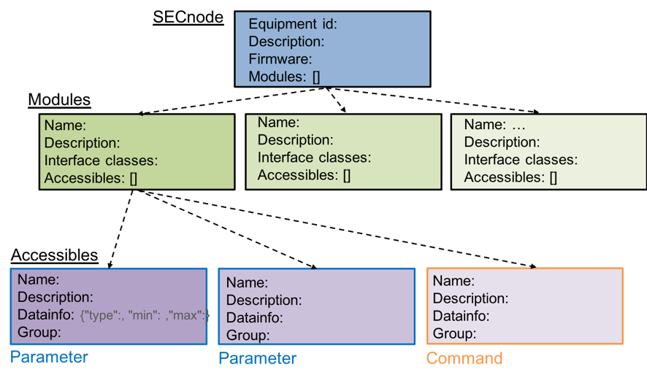
Sample Environment Controls
What is SECoP and what is it not! (a refresh)
SECoP is:
A defined communication interface for SE
A collection of defined words meanings and functions
A syntax (V2019-09-16 v1.0)
A structure inclusive of essential metadata
SECoP allow self description of a system
SECoP is a best practice for integration of SE systems
SECoP is not:
It is not a control system
It is not logic
It is not safety

Slide 5
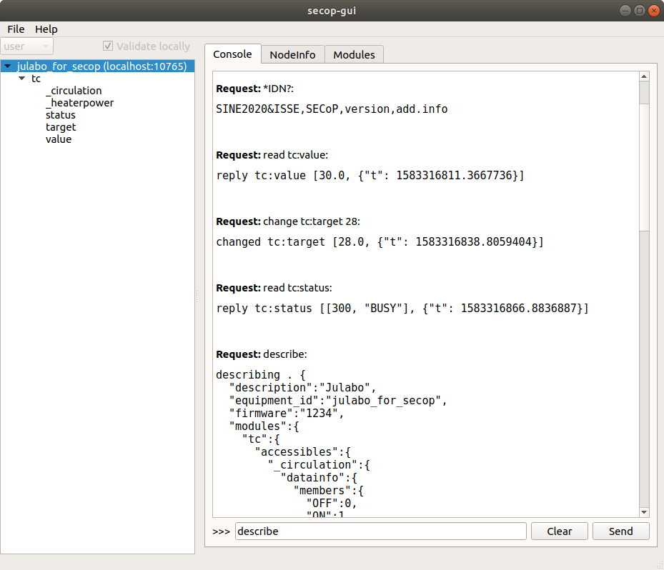
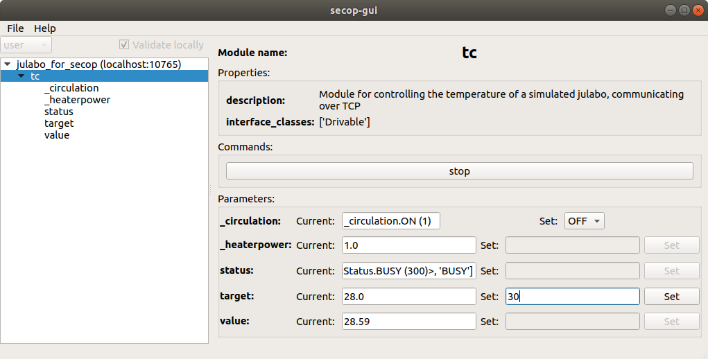
Sample Environment Controls
SECoP status Q1 2020
Available demonstrators:
A Julabo accessible over SECoP (TCP/IP)

Slide 6
Sample Environment Controls
SECoP status Q1 2020
Available demonstrators:
A Julabo accessible over SECoP (TCP/IP)
A socket SE and an EPICS SE integrated in Octopy and presented on a EPICS CSS UI through dynamically created PVs.

Slide 7
Sample Environment Controls
SECoP status Q1 2020
Available demonstrators:
A Julabo accessible over SECoP (TCP/IP)
A socket SE and an EPICS SE integrated in Octopy and presented on a EPICS CSS UI through dynamically created PVs.
Demonstrating injecting timestamp (status, live metadata etc.) from the hardware side and into the ECS side EPICS PVs.
Prototype UI to configure a SECnode
Development is ongoing.
Focus have been to produce a working concept, not “production” code at this point in time.

Slide 8
Sample Environment Controls
SECoP moving forward at ESS
In agreement with ECDC (DMSC) the plan is to integrate a specific SES both with SECoP and EPICS in parallel and evaluate pros and cons.
At this stage MESI will try to involve ICS more for the EPICS interfaces
SECoP is also further incorporated in SE control systems
MESI have budget for a time limited contractor for additional resources on the development.

Slide 9
Sample Environment Controls
Resources
1-1.5 FTE is required for SECoP and Octopy development
All MESI is involved in development
An additional contractor is planned for coding on limited contract (months)
ICS need to support the development of the EPICS interfaces

Slide 10
MESI WP update
SECoP summary
Good things
The SINE2020 SECoP project provided a solid baseline (definitions, syntax, etc)
MESI now have:
A functional implementation prototype
Defined interfaces
Structured repository
There is an agreed way forward at ESS for the next step
SECoP have an active core team in ISSE
The positive aspects of SECoP are acknowledged by SE, ECDC and ICS
Challenges
Still much work required for development and stability
Suggested solution need to be endorsed by ICS
Integration resources are limited and should be well used
SECoP is young BUT need to work soon..

Slide 11
2
Octopy

Slide 12
Presentation headline
What is Octopy?
Octopy the ESS implementation of SECoP
It has become an MESI SE control system project that is EPICS compatible and SECoP native
It is also a response to meet the need for internal controls development not fully met by EPICS or NICOS
It is aimed to provide modular, efficient and intuitive integration

Slide 13
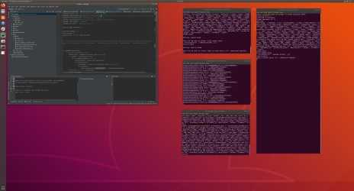
Presentation headline
Octopy design and structure
Octopy aims to provide:
easy integration
high modularity
flexibility
.. perceived as essential for SE controls
The design Is in itself aimed to be highly modular.
Programmed in python
JSON, ASCII and MQTT standards are used for inter process communication
JSON – JavaScript Object Notation, ASCII – American Standard Code for Information Interchange, MQTT – Message Queuing Telemetry Transport

Slide 14
Octopy structure and API
!
Only PV to FW
Any Octopy -> PV
Dynamic
Or SECoP!

Slide 15
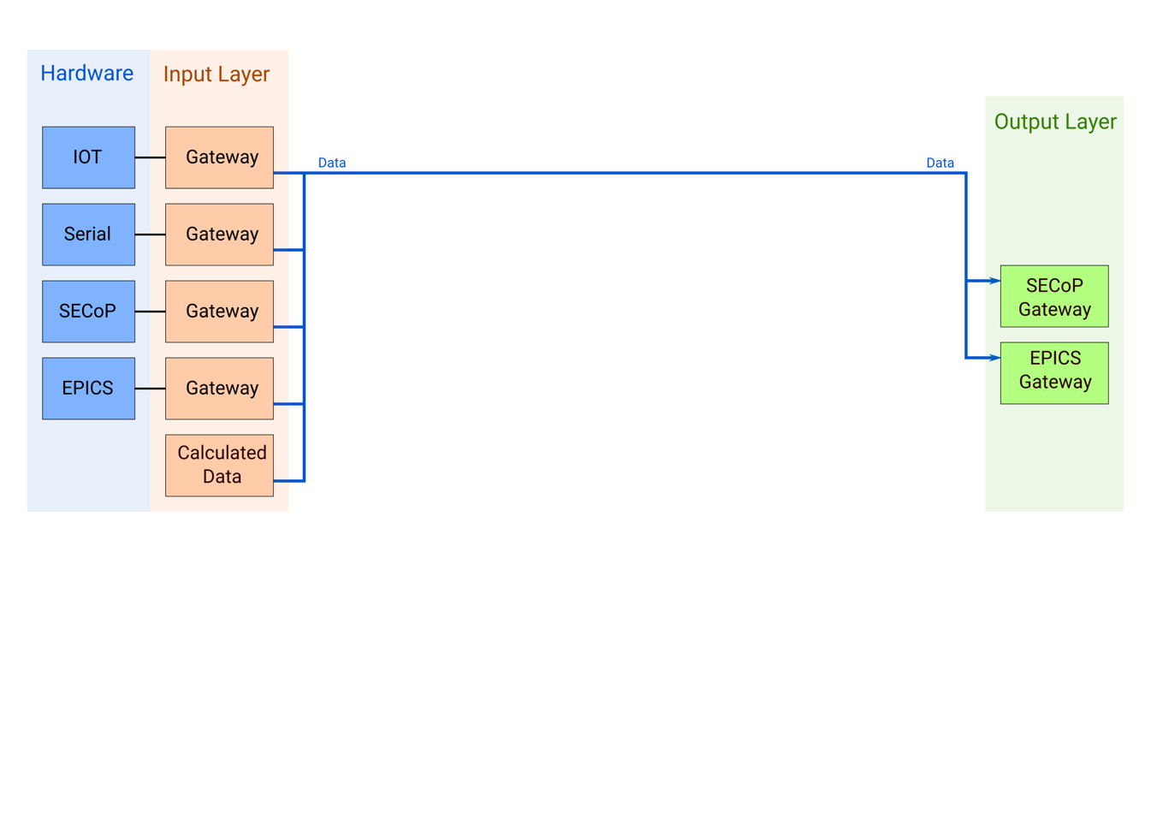
Octopy at SES runtime

Slide 16
Sample Environment Controls
Octopy plans
ICS support (take ownership? ) the EPICS gateway to ensure compatibility.(-> SE gets internal flexibility)
EPICS mainly used as signal backbone
All SE communication available for NICOS as PV
Possible future development: SECoP over TCP/IP and NICOS utilising self describe can be developed over time.
The gateway creating dynamic PVs and the SECoP self describing feature can make SE integration process more efficient at ESS.
The proposed solution allows suitable solutions, requiring common skills, to be used in SE systems.
The EPICS gateway provides EPICS PVs compatible with the rest of the facility
Integration effort increases on MESI side (reduced on EPICS(ICS))
NICOS integration can remain the same, or potentially utilise the self describing feature.

Slide 17
3
NICOS

Slide 18
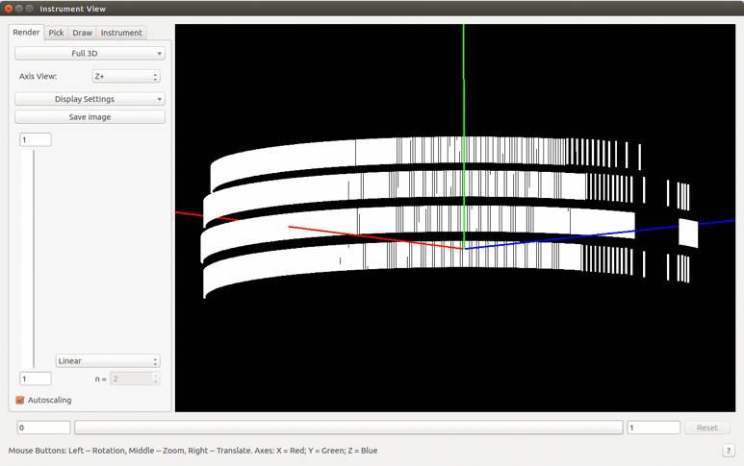
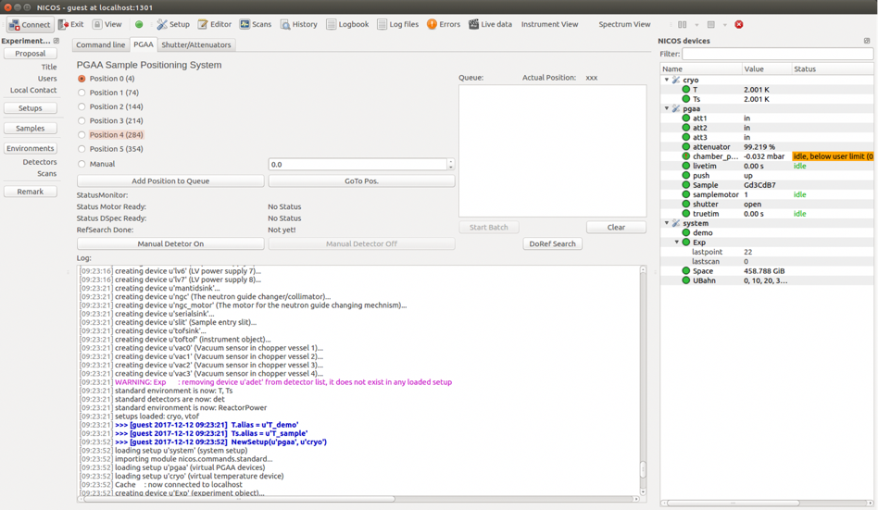
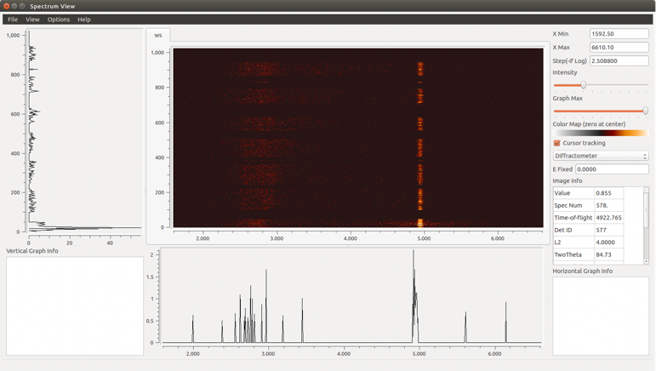
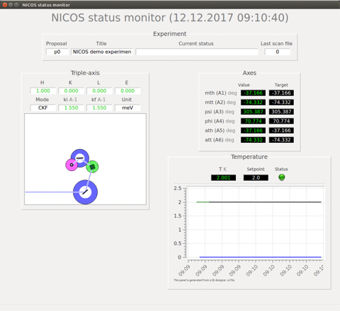
Experiment Control – NICOS
Feature complete and customizable
Acts as a high level interface to low level EPICS controls
Python CLI
Qt GUI

Slide 19
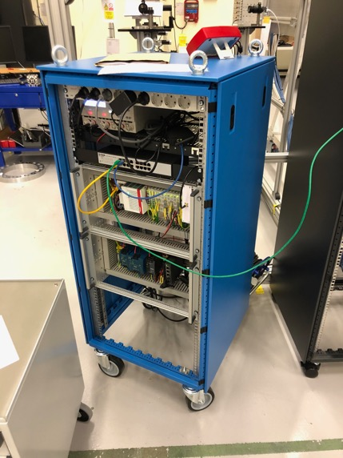
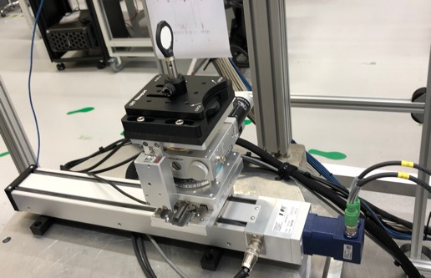
Presentation headline
NICOS Experiment Control System
NICOS is operational at Utgård and supported by ECDC
A “user station” is available for the SE staff in YMIR to control integrated SES. Utilisation have been moderate.
In Q2 ECDC plan(ned) to start rollout a separate NICOS for SE teams starting with PREMP
It is important to get feedback from the SE team , AND for ECDC to provide support.
The PREMP 3 axis SCAN SES running a scan script in NICOS

Slide 20
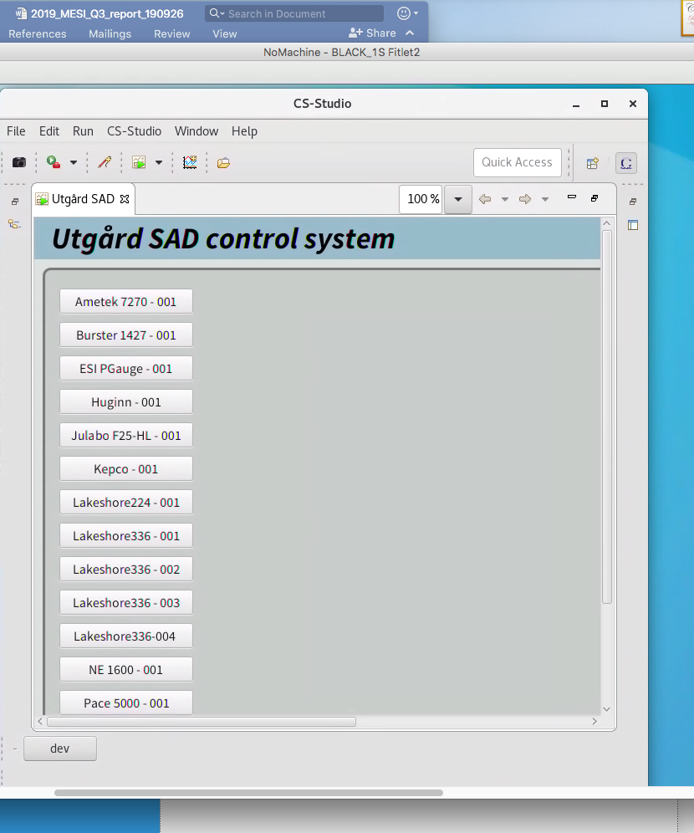
4
EPICS

Slide 21
Presentation headline
EPICS control system
ICS WP12 is providing EPICS integration for SES
A growing number of devices have so far been integrated
SE team have CS studio (not the ESS ECS!) UIs available for all integrated devices
A smooth deployment of EPICS IOCs have been provided (initial one not suitable for SES)
The PREMP 3 axis SCAN SES running by an EPICS IOC controlling the Beckhoff motion controller and the laser detector readout module.

Slide 22
Fin

