Slide 1
Helium recovery update
STAP April 2020
PRESENTED BY Alex Holmes with thanks to Philipp Arnold, Roy Montheli

Slide 2
Agenda
1 ESS cryogenic system
2 Test and Instrument Cryoplant (TICP)
3 Helium recovery backbone
4 Summary

Slide 3
ESS Cryogenic System Block Diagram
Pure Helium
Gas Storage
Standalone Helium Purifier
Helium Recovery System
Target Moderator
Cryoplant
Accelerator
Cryoplant
20 m³ LHe Tank
5 m³
LHe Tank
Test & Instrument Cryoplant
Target Cryodistribution System
LHe Mobile Dewars
Test Stand Cryodistribution System
Cryodistribution System for Elliptical Linac
Cryodistribution System for
Spoke Linac
LN2 Storage Tanks
Hydrogen Circulation Box
Elliptical
Cryomodules
Spoke
Cryomodules
LN2 Mobile Dewars
Instruments & Experiments
Test Stand Lund 2
Hydrogen Moderator

Slide 4
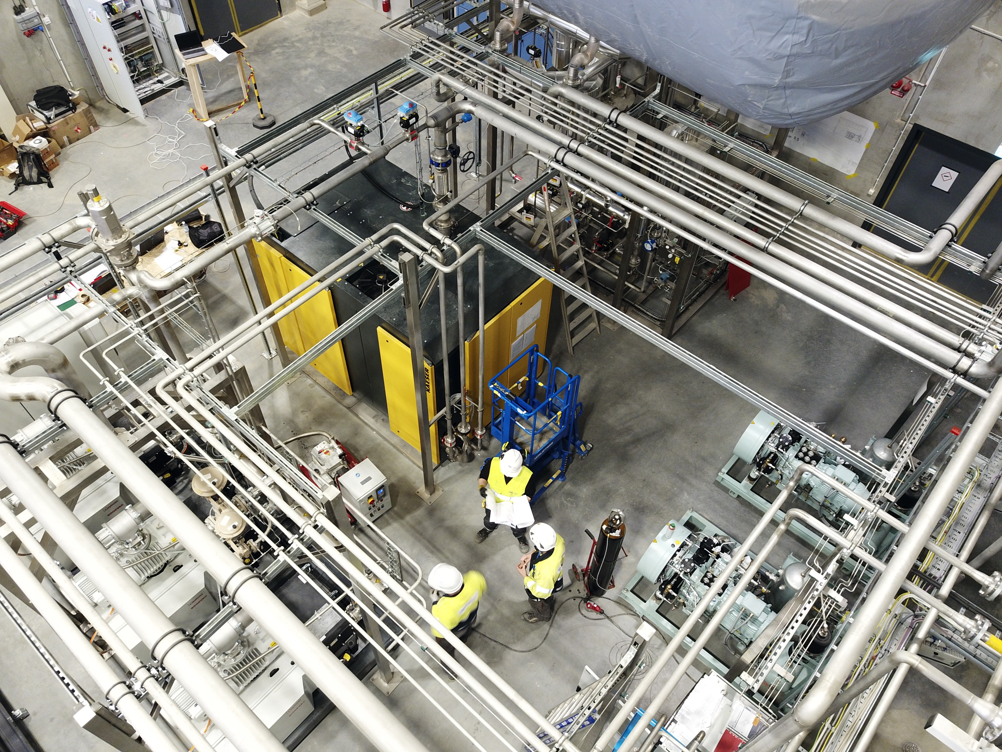
TICP liquefier status (Oct 2019)
Recovery system and external purifier operational since summer 2018
TICP entirely operational since December 2018
Documentation completed in summer 2019
Several improvements by ESS, particularly controls
More than 3600 l liquefied (and partly recovered) from Lund University and MAX IV
Cryodistribution for CM teststand tested

Slide 5
Design work starting in E01
Main pipework
⌀ 50-80 mm
Instruments connections
⌀ 25mm
One gas bag in compressor building

Slide 6
Helium recovery for instruments in E01
Recovery pipework

Slide 7
He recovery connection in workshop and loading bay
He recovery
revised position
Dewar parking zone

Slide 8
Summary
Achievements:
Helium liquefier running and already providing lHe to MAX IV and Lund University.
Infrastructure group now taking lead on design of main pipe network with input from SAD and cryogenics.
Space claim nearly complete, ready to start detailed design on E01 of central pipework.
Priority is instrument interfaces.
ESS signed up to HZB-STFC-ILL collaboration agreement for helium management.
Next steps:
Specification followed by detailed design for instrument, workshop and parking station connections.
Development Helium management system, based on systems at existing facilities
Challenges:
Many stakeholders (SAD, Instruments, CF, Cryogenics, logistics…), competing priorities.

