Slide 2
Sample Environment Systems for First Science – Temperature and Fields
Prioritised sample environment systems to be used on instruments #1-8
PRESENTED BY Alex Holmes

Slide 3
Agenda
1 Overview
2 Individual systems
3 E03 workshop planning

Slide 4
1
Overview

Slide 5
Sample Environment Systems for Diffraction
MAGiC
Section | System | Details | partners | Status
TEFI (pool) | Magnet | Assymetric 8T | LLB | TA approved, CTV passed
TEFI (pool) | Dilution, He3 | Matched to magnet | LLB | TA approved
TEFI (instr) | Wet Cryostat | Specific | LLB | Not yet started
DREAM
Section | System | Details | partners | Status
TEFI (Instr) | Cryofurnace | 20 pos. Inst specific | LLB | CTV passed
TEFI (Pool) | Wet Cryofurnace | Top loading | LLB | Generic OC integration started
TEFI (pool) | HT vac furnace | ILL style top loading | LLB | Not started
TEFI (pool) | Magnet | Assymetric 8T + ULT | LLB | TA approved, CTV passed

Slide 6
Sample Environment Systems for Spectroscopy
BIFROST
Section | System | Details | partners | Status
TEFI (pool) | 15T Magnet | Ex HZB VM1B +Dil. | ESS/HZB | Ready for delivery (delayed by COVID19)
TEFI (Instr) | Wet Cryostat | Specific OC 100mm | BIFROST/DTU | Specs being defined
CSPEC
Section | System | Details | partners | Status
TEFI (pool) | 6.5 T Magnet | Ex-HZB VM-2 +Dil | ESS/HZB | Verbal agreement
TEFI (Instr) | Cryofurnace changer | Inst specific 6 pos. | LLB | To be started
TEFI (pool) | Wet Cryostat | Standard OC | LLB | To be started
N.b. High field magnet desired for CSPEC but not prioritised

Slide 7
Sample Environment Systems for LSS
LOKI
Section | System | Details | partners | Status
TEFI (pool) | Warm bore magnet | 2T cryomagnet | LLB | TA agreed
TEFI (pool) | Electromagnet | 1T | ESS | Discussion with MCA for shared magnet
ESTIA
Section | System | Details | partners | Status
TEFI (pool) | Warm bore | 2T magnet | LLB | TA agreed
TEFI (inst) | Flow cryostat | Instrument specific | PSI | Not yet started
N.b. High field magnet with sapphire windows desired for ESTIA/SKADI but not prioritised

Slide 8
2
TEFI Individual systems

Slide 9
8T Magnet for MAGiC, DREAM, HEIMDAL
Providing 8T, 1.6K (or 50/300 mK with ULT inserts)
4. Achievements and Challenges
Completing CTV!
Finite procurement bandwidth.
1. System Overview and Deliverables
+15°/-35° vertical field wet cryomagnet
2. Schedule, Milestones and Reviews
Call for tender review (CTV) complete.
Waiting in procurement queue at LLB, likely publication October
⇒ delivery late 2022/early 2023
3. Integration, Safety, Verification, Validation
Requires mechanical integration with kin. mounts, magnetic field safely checks & policy
Procurement
Design
Manufacture
Acceptance/Integration
 | Q1/20 | Q2/20 | Q3/20 | Q4/20 | Q1/21 | Q2/21 | Q3/21 | Q4/21 | Q1/22 | Q2/22 | Q3/22 | Q4/22 | Q1/23
8T Magnet
Notes:
A

Slide 10
New ULT systems for ‘8T magnet + OC’
Providing ‘parameter range’ 50/300mK – 300K
1. System Overview and Deliverables
2 dilution systems
1 ³He sorption
Matched to 8T magnet, usable in wet cryo.
2. Schedule, Milestones and Reviews
Have model tender docs from ANSTO CTV to be complete ASAP.
3. Integration, Safety, Verification, Validation
Must be compatible with other systems.
4. Achievements and Challenges
Technician Richard Ammer has participated in a number of dilution cooldowns.
 | Q1/20 | Q2/20 | Q3/20 | Q4/20 | Q1/21 | Q2/21 | Q3/21 | Q4/21 | Q1/22 | Q2/22 | Q3/22 | Q4/22 | Q1/23
ULT Systems
Notes:
B

Slide 11
'15T magnet’ for ‘BIFROST’
Second hand magnet
1. System Overview and Deliverables
15 T magnet ‘VM1B’ formerly from HZB
Agreement to get further ULT inserts
2. Schedule, Milestones and Reviews
Due for delivery as COVID19 lockdown started
3. Integration, Safety, Verification, Validation
Requires mechanical integration onto L1 kinematic mounts. Updating auxiliary eqt.
4. Achievements and Challenges
Technician RA attended final cooldown at HZB
Delayed delivery due to COVID19 situation.
Notes:
F

Slide 12
Warm bore for ESTIA, LOKI
Providing 2.5T magnetic field FR in-kind via LLB
1. System Overview and Deliverables
Based on TOFTOF HTS110 magnet with minor modifications.
2. Schedule, Milestones and Reviews
CTV to be carried out shortly
3. Integration, Safety, Verification, Validation
Mounting agreed with LOKI and ESTIA
4. Achievements and Challenges
Procurement logjams, potential COVID19 supply issues.
Procurement
Design
Manufacture
Acceptance/Integration
 | Q1/20 | Q2/20 | Q3/20 | Q4/20 | Q1/21 | Q2/21 | Q3/21 | Q4/21 | Q1/22 | Q2/22 | Q3/22 | Q4/22 | Q1/23
2.5 T Warm bore
Notes:
J

Slide 13
Flow cryostat for ESTIA
Instrument specific flow cryostat 5-300K
1. System Overview and Deliverables
Helium flow cryostat
2. Schedule, Milestones and Reviews
Part of Instrument scheduling
3. Integration, Safety, Verification, Validation
Integrated with hexapod, used with 2.5T warm bore magnet
Example from
https://ilt.kharkov.ua/bvi/technology/oc/optical%20cryostat.htm
Notes:
L

Slide 14
6.5T Cryomagnet for CSPEC, TREX
Second hand assymetric cryomagnet from HZB
1. System Overview and Deliverables
Cryomagnet and compatible dilution system
2. Schedule, Milestones and Reviews
Informal agreement with HZB, to be finalised
Read for first science on CSPEC
3. Integration, Safety, Verification, Validation
Needs top loading adaptor, possibly new tail.
4. Achievements and Challenges
Delivery delayed by COVID19
Notes:
H

Slide 15
'20 position Cryofurnace’ for ‘DREAM’
Providing 20 samples, 4 K-800 K at measurement position, sample storage at 90 K
1. System Overview and Deliverables
Instrument specific multi position dry cryofurnace
2. Schedule, Milestones and Reviews
Part of DREAM instrument schedule
CTV complete
3. Integration, Safety, Verification, Validation
Fits with top loading
4. Achievements and Challenges
CTV passed
Very ambitions specs - need a plan B
Notes:
D

Slide 16
‘Wet cryostat’ for ‘MAGiC’
Instrument specific cryostat providing 1.5K-300K
1. System Overview and Deliverables
Orange-type or Variox wet cryostat system
2. Schedule, Milestones and Reviews
Not yet fixed
3. Integration, Safety, Verification, Validation
Mechanical integration with XYZ coils and kinematic mount
4. Achievements and Challenges
JCNS has Variox available for donation.
Notes:
C

Slide 17
‘Wet cryofurnace’ for ‘DREAM’
Pool cryostat providing 1.5K-600K
1. System Overview and Deliverables
Orange-type wet cryofurnace
2. Schedule, Milestones and Reviews
To be fixed – ready by first science milestone
3. Integration, Safety, Verification, Validation
Top loading
Needs special tail materials.
4. Achievements and Challenges
Tail materials may not be compatible with spectroscopy. V/TiZr vs Al
Notes:
E

Slide 18
Vacuum furnace for DREAM
Pool HT vacuum furnace RT - 1300 K
1. System Overview and Deliverables
ILL type vacuum furnace
2. Schedule, Milestones and Reviews
To be fixed – ready by first science milestone
3. Integration, Safety, Verification, Validation
Needs special tail materials.
4. Achievements and Challenges
Furnace expertise needs building
Notes:
E

Slide 19
‘Wet cryostat’ for ‘instruments BIFROST’
Instrument specific cryostat 1.5 K - 300 K
1. System Overview and Deliverables
Wet orange type-cryostat 100mm VTI
2. Schedule, Milestones and Reviews
Follows instrument schedule. Specifications under discussion now.
3. Integration, Safety, Verification, Validation
Integration on to L2 floor mounts
4. Achievements and Challenges
Agreeing on main
NB: similar slides for all prioritised systems
Notes:
C

Slide 20
1T Electromagnet for LOKI
1T electromagnet
1. System Overview and Deliverables
Low field electromagnet, to be procured by Motion Control and Automation Group, with power supply
2. Schedule, Milestones and Reviews
Procurement planned this year for testing of motor components in stray field.
3. Integration, Safety, Verification, Validation
Controls, supply mechanical integration.
4. Achievements and Challenges
Coordinate with MCAG
Notes:
K

Slide 21
‘Cryofurnace changer’ for ‘CSPEC’
Providing ‘parameter range’ 1.5-600K
1. System Overview and Deliverables
6 position cryofurnance changer
Detailed specifications to be determined
2. Schedule, Milestones and Reviews
To be finalised

Slide 22
3
E03 sample environment workshop planning
-

Slide 23
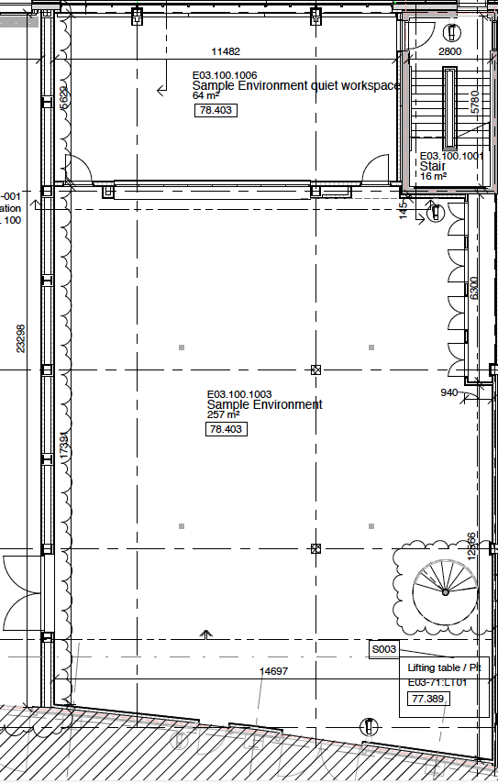
E03 100
TEFI-cryo
TEFI-Furnace
Hot works/
Alignment
TEFI-Furnace
Storage
Storage/prep
TEFI-cryomag
Storage
TEFI-cryo
Crane
Storg (n-mag)
Fume hood
Fume hoods with water, power, gas.
Fume hood
Storage
Gas bottles
benches
walkway
Storage
Crane
Sample Environment Equipment prep area
5m

Slide 24
The end (of the beginning)

