Slide 1


Dear Audience,
this is a semi-automatic presentation: The audio recordings will start automatically, but the slides will only proceed once you click on the green arrow (see bottom right of this slide). The arrow will appear after the recordings for each slide. ---- Please click on it now.

Slide 2
Sample environment utility supply requirements
Sample environment utility supply requirements
Two utility supply subsets for the ESS SES suite are required per instrument
The SES utility supplies are part of the Instrument utility supply
Instrument utility supply :
Electrical Power distribution
NEUS-PLC, Non Electrical Utility Supplies - PLC
Cooling water supply
Compressed Air
Gases [ supply : N₂]. He-recovery
Patch panel for electrical signals, prototype by MESI
SES Utility Supply Subset 1
-On Beam
Instrument
utility
supply
SES Utility Supply Subset 2
-Off Beam, prep. area
SES : Sample Environment System
Notes:
Present experience: fragemtnation, only partly supporting all topics …
New approach …mainaining balance; bringing it colse to the user

Slide 3
SE utility supply requirements
Sample environment utility supply requirements
Summarized Requirements for one subset
SES Supply For each subset | Main characteristic | # | Connector type | Valve/ regulator/ IP class | Meter, control NEUS- PLC ª | General
Cooling water | Cooling water, 5°C | 0 |  |  |  | Main cooling loop. Likely not required by SES (TBD)
 | Cooling water , 14°C TBD | 3 | Defined | Y/N | Yes | Secondary loop at instrument. Capacity 20kW
Pwr. Conn. sum | 230V / 400V {16A;32A} | 8/2/2 | CEE | IP44^{b} |  | Power monitoring, slow fuses
Box #1 | 230V / 400V {16A;32A} | 2/1/1 | CEE | IP44^{b} |  | Power monitoring, slow fuses
Box #2 | 230V / 400V {16A;32A} | 6/1/1 | CEE | IP44^{b} |  | Power monitoring, slow fuses
Box #3 | 230V / 3x10A/15min | 3 |  | IP44^{b} |  | UPS, Power monitoring
Gases | Nitrogen | 2 |  | Y/Y | Yes | ESS supply, independent extraction points
 | Compressed air | 3 |  | Y/Y | Yes | ESS supply, independent extraction points
 | He Recovery | 3 | > KF DN 25 | Y/N
extract from document – “SE utility supplies” , ESS-0038163
Notes:
Present experience: fragemtnation, only partly supporting all topics …
New approach …mainaining balance; bringing it colse to the user

Slide 4
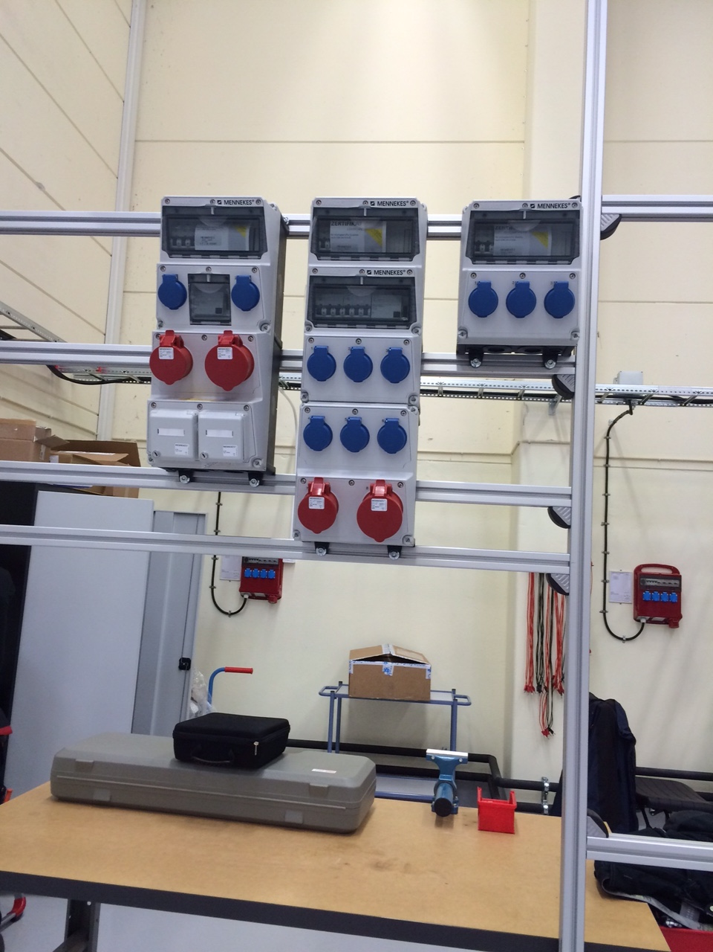
SE utility supply requirements
Electrical Supply for one subset
Box_1 – 2 x [5 x 25 mm²] & 4 x Cat.6 Ethernet
Box_2 – 2 x [5 x 25 mm²]
Box_3 – 1 x [5 x 10 mm²] , UPS
Boxes including RCD (30mA) and cut out switches :
Box 1 : MENNEKES 950004
Box 2 : MENNEKES 940018
Box 3 : MENNEKES 920003
All boxes are regarding IP44 class.
The instrument cave, sample area, preparation area
and nearest area around the shielding with
electronic racks are all on the same ground.
Notes:
Present experience: fragemtnation, only partly supporting all topics …
New approach …mainaining balance; bringing it colse to the user

Slide 5
SE utility supply requirements
Sample environment utility supply
requirements
Schematic – simplified structure of NEUS-PLC
Brief description of the schematic drawing:
1) Cooling water control, Red
2) Technical gases, Orange
3) He recovery, Black
4) Pump exhaust (rough vacuum) , Violet
5) Compressed air, Light Blue
6) Galvanic (electrical isolated) contacts for SE equipment, Grey
7) PLC, Dark Blue
8) PLC interface (hard-/software) to EPICS , Green
Notes:
Present experience: fragemtnation, only partly supporting all topics …
New approach …mainaining balance; bringing it colse to the user

Slide 6
SE utility supply requirements
Sample environment utility supply
requirements
Infrastructure/media supply-PLC(S5/S7) , NEUS-PLC for sample
environment needs at the instruments and dedicated laboratories
Hardware interlocks
-6
Cooling-Water Supply
PLC
-2
Output contacts for hardw.
interl.to appr.10 x (opt. more)
Triggered by supplies
Interface
EPICS,
Instrument
Control
….
Access to data(meas.)
and actions(valves),remote
Function
Technical Gas-supply
He, Ar, N2,…up to 5
Mag./pneum. Valve
-8
Up to 5 loops , of cooling
water control
2 * Sample environment
3 * Instrument
Mag./pneum. Valve, f. each
Nonret.Valve
-7
Supply
Return
Timer on Flow -> Auto off
PLC, or Hardware
Flow. Meas.for each gas
-1
Press. Meas.for each gas
Temp.Meas.
Temp.Meas.
Read/Alert
Out/Valve
He-recovery, integrated non return valve
Flow. Meas.
Flow. Meas.
Read+Compare
Out/Valve
Press. Meas.
Press. Meas.
Read/Alert
Out/Valve
-3
Read/Alert
Out
Flow. Meas.
Press. Meas.
Inlet,Supply
Outlet,Return
Pump exhaust, intergrated non ret. valve
Flow direction
Flow direction
Read/Alert
Out/Valve
Read/Alert
Out
Read/Alert
Out
-4
Flow direction
Flow. Meas.
Press. Meas.
Flow direction
Compressed air supply
Compressors, furnaces
apparatus which needs
cooling water
-5
Up to 5 (optional more)
water sensors
Flow. Meas.
Flow direction
Pump exhaust
Experiment/instrument
He-recovery, from
experiment
Gas usage, of
experiment
Press. Meas.
Compressed air supply, experiment/instrument
Notes:
Present experience: fragemtnation, only partly supporting all topics …
New approach …mainaining balance; bringing it colse to the user

Slide 7
SE utility supply requirements
Sample environment utility supply
requirements
Existing prototype for utility supply in Utgård
Infrastructure/media supply-PLC(S5/S7) , NEUS-PLC for sample
environment needs at the instruments and dedicated laboratories
Hardware interlocks
-6
Cooling-Water Supply
PLC
-2
Output contacts for hardw.
interl.to appr.10 x (opt. more)
Triggered by supplies
Interface
EPICS,
Instrument
Control
….
Access to data(meas.)
and actions(valves),remote
Function
Technical Gas-supply
He, Ar, N2,…up to 5
Mag./pneum. Valve
-8
Up to 5 loops , of cooling
water control
2 * Sample environment
3 * Instrument
Mag./pneum. Valve, f. each
Nonret.Valve
-7
Supply
Return
Timer on Flow -> Auto off
PLC, or Hardware
Flow. Meas.for each gas
-1
Press. Meas.for each gas
Temp.Meas.
Temp.Meas.
Read/Alert
Out/Valve
He-recovery, integrated non return valve
Flow. Meas.
Flow. Meas.
Read+Compare
Out/Valve
Press. Meas.
Press. Meas.
Read/Alert
Out/Valve
-3
Read/Alert
Out
Flow. Meas.
Inlet,Supply
Outlet,Return
Press. Meas.
Pump exhaust, intergrated non ret. valve
Flow direction
Flow direction
Read/Alert
Out/Valve
Read/Alert
Out
Read/Alert
Out
-4
Flow direction
Flow. Meas.
Press. Meas.
Flow direction
Compressed air supply
Compressors, furnaces
apparatus which needs
cooling water
-5
Up to 5 (optional more)
water sensors
Flow. Meas.
Flow direction
Pump exhaust
Experiment/instrument
He-recovery, from
experiment
Gas usage, of
experiment
Press. Meas.
Compressed air supply, experiment/instrument
Notes:
Present experience: fragemtnation, only partly supporting all topics …
New approach …mainaining balance; bringing it colse to the user

Slide 8
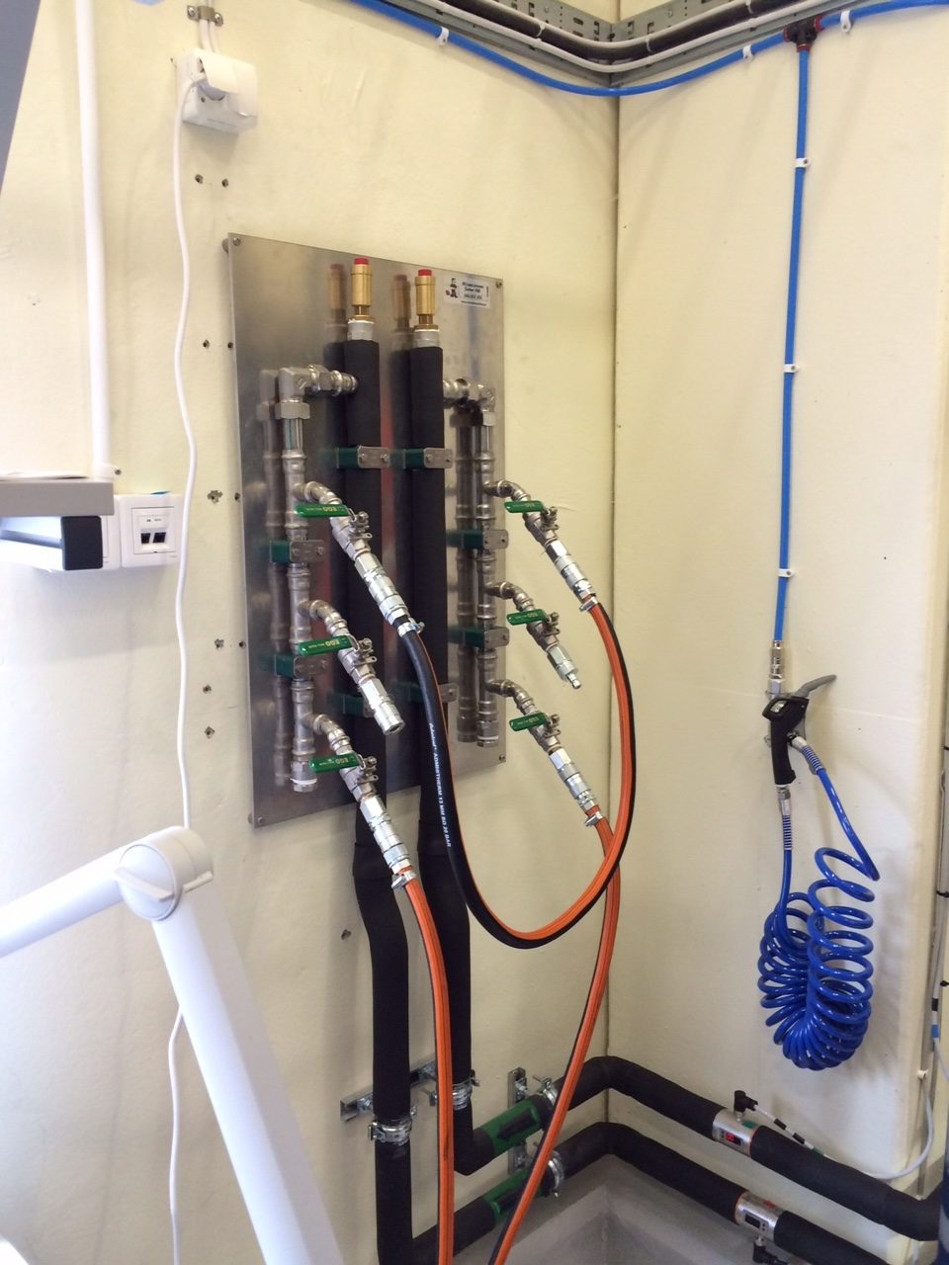
SE utility supply requirements
Sample environment utility supply requirements
Cooling water supply for one subset
Cooling water supply for one subset
Leak detection by NEUS-PLC
[ Non Electrical Utility Supplies – PLC ]
Ball valves , 1 each
Connectors , Stainless Steel
Cold outlet to SES device (Pin)
Warm inlet from SES device (Socket)
Purpose/flow | Position | Type | Supplier
CV = 1.17 ~16-17 l/min | Cold outlet to SEE device | LP-007-2-WR521-01-2 | Walther-Precision
CV = 1.17 ~16-17 l/min | Warm inlet from SEE device | LP-007-0-WR521-01-2 | Walther-Precision
Notes:
Present experience: fragemtnation, only partly supporting all topics …
New approach …mainaining balance; bringing it colse to the user

Slide 9
SE utility supply requirements
Sample environment utility supply requirements
Cooling water schematics
Notes:
Present experience: fragemtnation, only partly supporting all topics …
New approach …mainaining balance; bringing it colse to the user

Slide 10
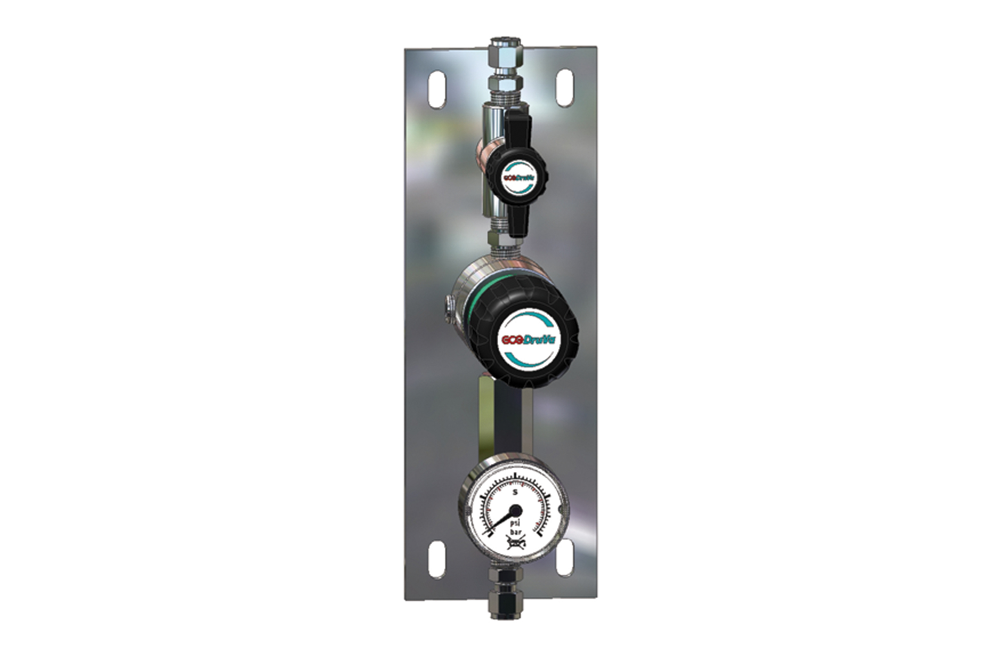
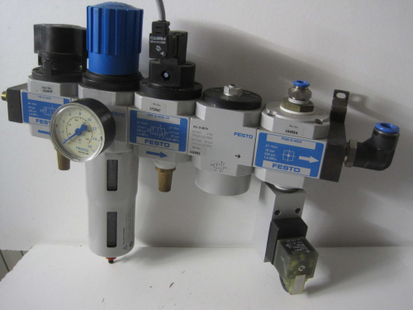
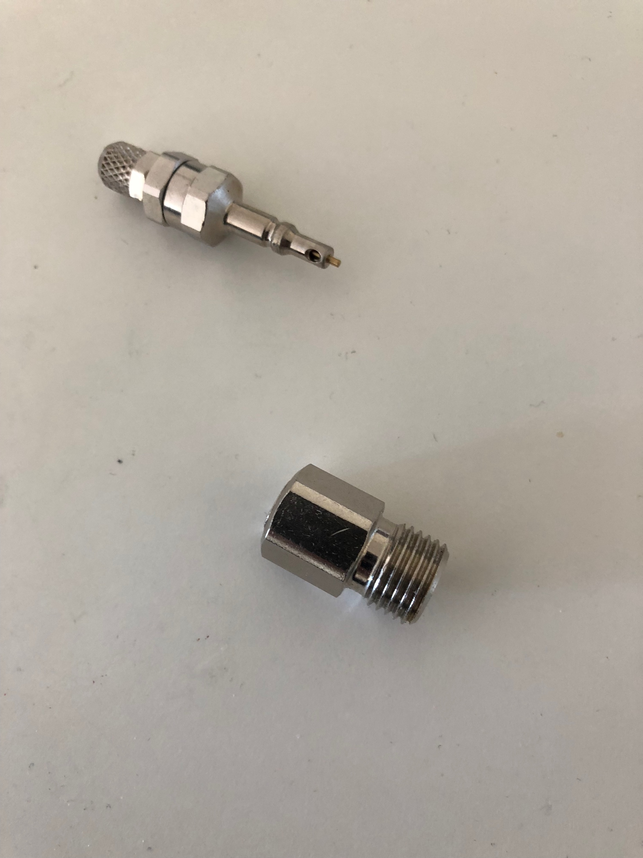
SE utility supply requirements
Sample environment utility supply requirements
Gas supply – suggested standard connectors
Compressed air processing unit
Gas supply
Gas supply connectors Staeubli , both sides closed, mech. pressure alignment, auto un-plug
MCR-TYPE
Patch panel for electrical signals , prototype by MESI done
Notes:
Present experience: fragemtnation, only partly supporting all topics …
New approach …mainaining balance; bringing it colse to the user

Slide 11
SE utility supply requirements
Sample environment utility supply
requirements
Status
On going work/ discussions
Searching / selecting gauges and valves
Synchronization of gen. Instrument utility supplies with SE needs
Installation work – responsibility (wiring/mounting,...)
MESI/ICS doing coordination and programming
Notes:
Present experience: fragemtnation, only partly supporting all topics …
New approach …mainaining balance; bringing it colse to the user

