Slide 1
Dear Audience,
this is a semi-automatic presentation: The audio recordings will start automatically, but the slides will only proceed once you click on the green arrow (see bottom right of this slide). The arrow will appear after the recordings for each slide. ---- Please click on it now.

Slide 2
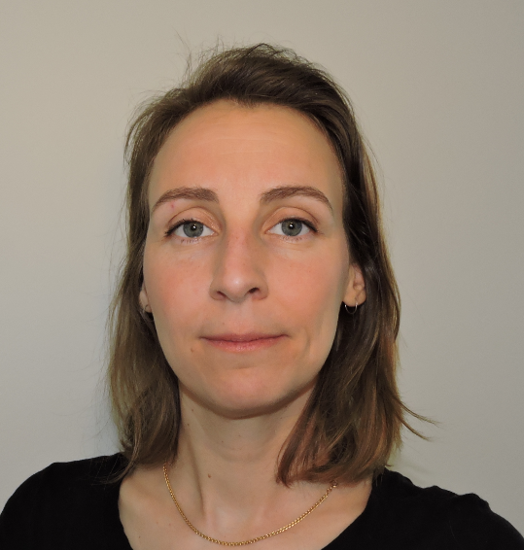
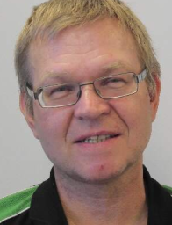
FLUCO
FLUids incl. gases, vapors and COmplex fluids
A. Corani / H. Schneider
PRESENTED BY Harald schneider

Slide 3
Agenda
1 FLUCO
2 Electrochemistry

Slide 4
1
FLUCO
Presented by H. Schneider
2020-04-21

Slide 5
FLUCO
FLUids incl. gases, vapour and COmplex fluids
FLUCO provides Sample Environment Systems (SES) *and devices* for:
Biology
Soft condensed
matter
Material
Science
engineering
Electrochemistry
-NEW-
By subject matter expert
A. Corani
………
Fill in
FLUCO SES
Main usage at large scale instruments
SANS { LOKI , SKADI }
Reflectometer { ESTIA , FREIA }
Spectrometer { CSPEC , MIRACLES , VESPA }
But, used also at other instruments
Useful for all instruments
FLUCO devices
* SES = Humidity chamber , devices = humidity cell, humidity generator, temperature controller, gas supply
* SES = Orange cryostat , devices = cryostat mech. , temperature controller, pumping unit, level meter, LHe/LN₂

Slide 6
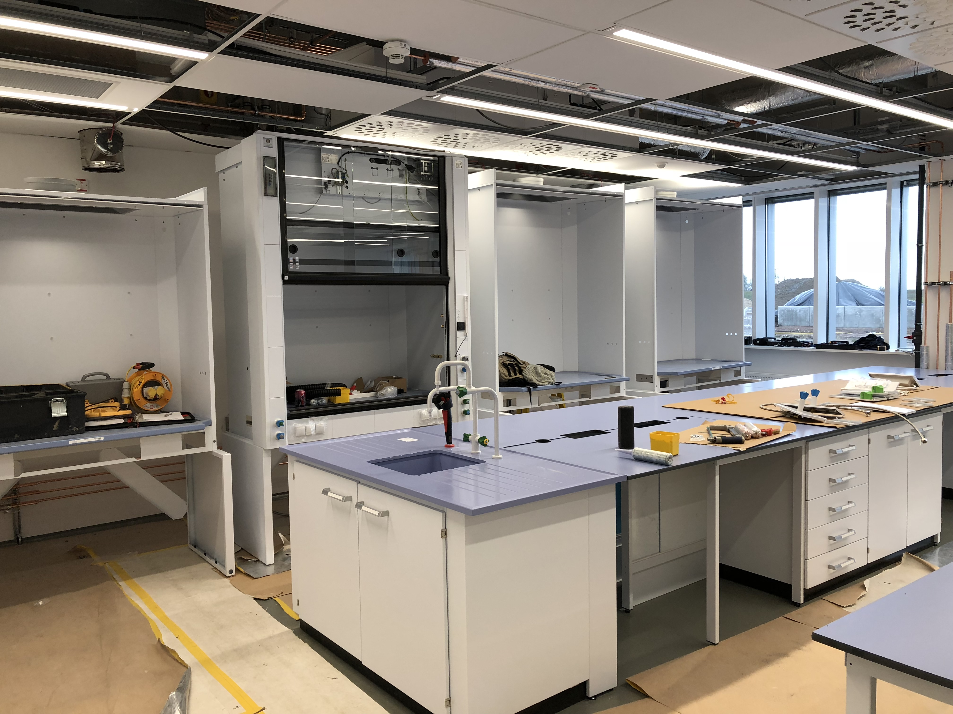
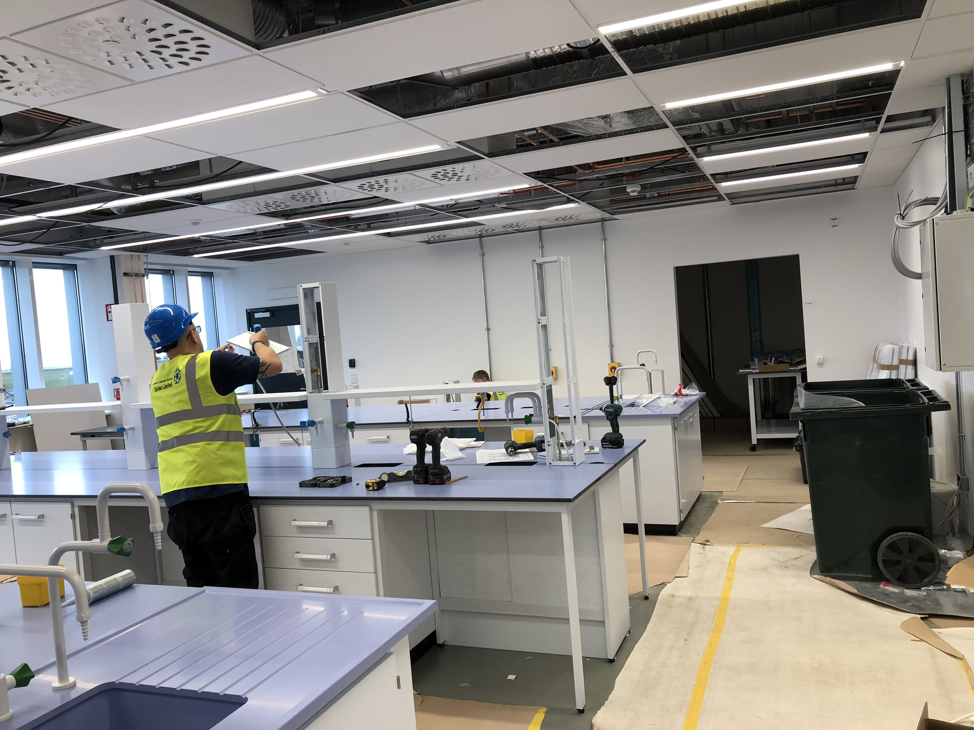
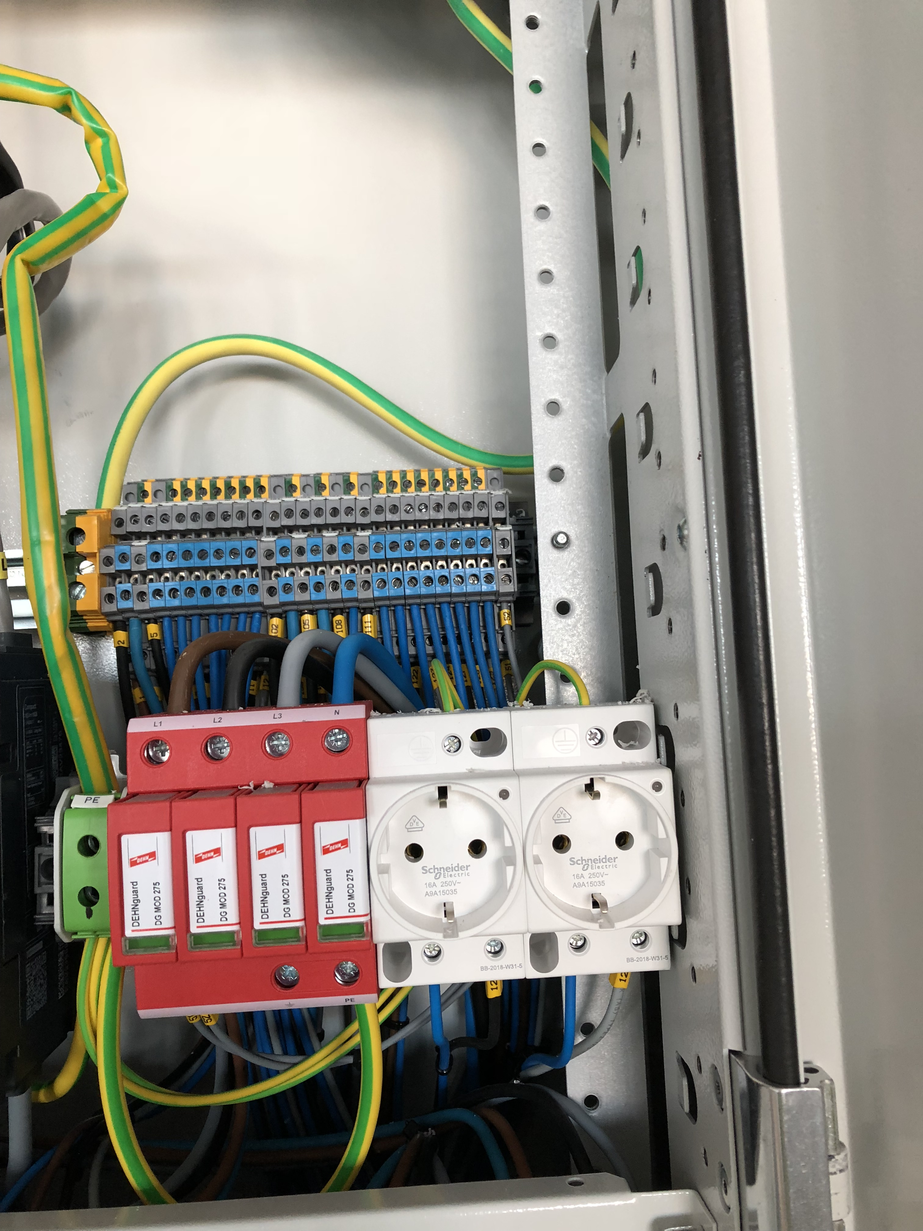
FLUCO
FLUids incl. gases, vapour and COmplex fluids
The FLUCO team is also active part of the E03/E04 installation team
Participating in the shift operation on support of external technicians
H. Schneider is the electrical operations leader for the E03/E04 building
At this time the FLUCO staff moved to the “On-Site-Offices”

Slide 7
FLUCO
FLUids incl. gases, vapour and COmplex fluids
Planned suite of sample environment systems & devices, ESS/construction
Humidity Chamber(s)
Rheometer (RheoSANS), Shear cells, Cuette cells
Stopped Flow devices
Syringe Pumps , Peristaltic Pumps
Gas Process Handling, Manifolds
Water (Oil) bath circulating devices.
Magazines (multiple samples) , Rotating cells, Peltier driven devices
Thermalizing gas blower
Liquid-Solid-Cells, Electro-chemistry cells for ”In situ” /”operando” measurements
Planned suite of sample environment systems & devices, ESS/construction
Humidity Chamber(s)
Rheometer (RheoSANS), Shear cells, Cuette cells
Stopped Flow devices
Syringe Pumps , Peristaltic Pumps
Gas Process Handling, Manifolds
Water (Oil) bath circulating devices.
Magazines (multiple samples) , Rotating cells, Peltier driven devices
Thermalizing gas blower
Liquid-Solid-Cells, Electro-chemistry cells for ”In Situ” /”operando” measurements
Provided as part of instrument budgets :
Sample changer CSPEC/MIRACLES TUM, Ger, Esp.
Troughs, trough changer FREIA STFC, GB /NN
SANSMAG LOKI/SKADI/ESS STFC/FZJ ; GB/Ger
Sample changer VESPA STFC , GB
HPLC Pump LOKI/FREIA/ESTIA STFC/PSI ; GB/CH
Liquid-Solid-Cells FREIA/ESTIA STFC/PSI ; GB/CH
Cryostream NMX ESS , DK, FR
Humidifier NMX ESS , DK, FR
Provided as part of instrument budgets :
Sample changer , multiple samples, 8 pos. CSPEC/MIRACLES TUM, Ger, Esp.
Troughs, Langmuir troughs, trough changer FREIA STFC, GB /NN
SANSMAG LOKI/SKADI/ESS STFC/FZJ ; GB/Ger
Sample changer VESPA STFC , GB
HPLC Pump LOKI/FREIA/ESTIA STFC/PSI ; GB/CH
Liquid-Solid-Cells FREIA/ESTIA STFC/PSI ; GB/CH
Cryostream NMX ESS , DK, FR
Humidifier NMX ESS , DK, FR

Slide 8
FLUCO
FLUids incl. gases, vapour and COmplex fluids
The FLUCO-toolbox for user service is based on 4 pillars
Sample Environment Systems
In Kind - Cash
In Kind contributions
Tool box with
permanent growing no.s and
kind of devices
Internal R&D
Collaboration
8

Slide 9
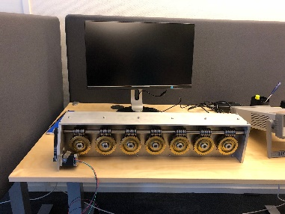
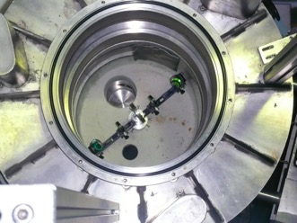
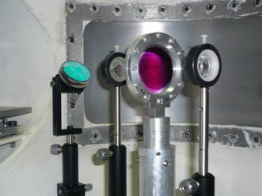
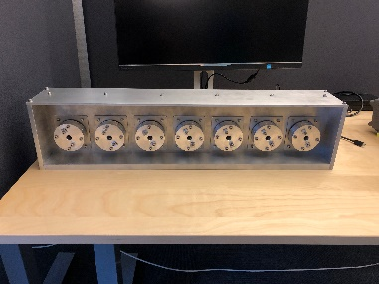
FLUCO
FLUids incl. gases, vapour and COmplex fluids
Gas process handling system
P < 200 bar
Flushing, pressurizing, filling
Simple adsorption measurement
T <= 773 K
N₂, O₂, H₂, D₂ He, Ne, Ar, CO, CO₂
expandable
Principle sketch of the device
Cuvette holder w. Peltier elements
Thermalized base plate
In-Kind Partner, Univ Tartu, Est
In-Kind Partner: B Jakobson, C Niss, RUC
Tumbler, Basque interns/ESS
Laser pump probe
Optical trigger
for photosynthesis
Laser pump probe II
Thermal stimuli of sample
In-Kind Partner, Prof. J. Pieper Univ Tartu, Est
Notes:
Disolve this slide or use as summary; link to SAC comments
Needs to specifc what it want from the pool and what they build for their instrument.
Instrumet team takes team during construction (and potentially in operation)

Slide 10
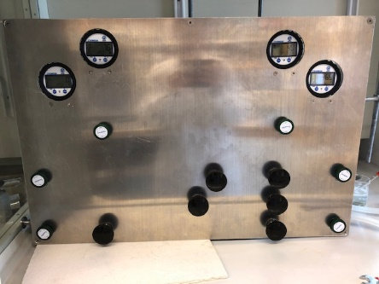
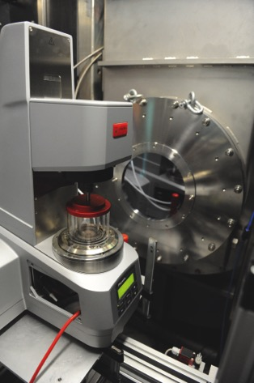
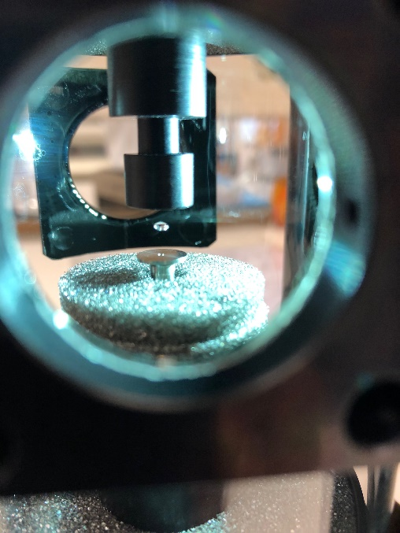
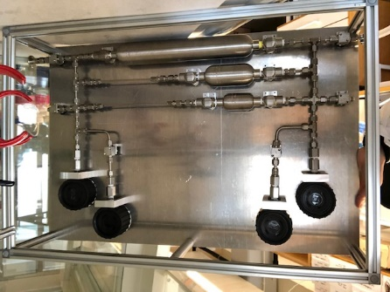
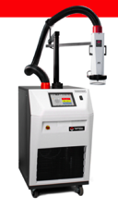
FLUCO
FLUids incl. gases, vapour and COmplex fluids
Both , moved to OPS
H₂ gas manifold
Ultrasonic Levitator
Rheometer
Various setups
e,.g shear cell
Taylor-Cuette cell
Quench technique
JCNS , Outstation at FRM2 , MLZ
Gas stream thermalizer
In Test thermal solutions
Internal, ESS
Potential In-Kind Partner, FZJ ,Ge
Test operation at MV Lab,
Collaboration with SULF
Stopped flow cell
6 channels.
278 K – 368 K
In-Kind with Univ. Tartu
Notes:
Disolve this slide or use as summary; link to SAC comments
Needs to specifc what it want from the pool and what they build for their instrument.
Instrumet team takes team during construction (and potentially in operation)

Slide 11
FLUCO
FLUids incl. gases, vapour and COmplex fluids
FlexiProb , A German BMBF funded project
Additional equipment and methods available by FlexiProb project
BMBF funded project by University of Bielefeld, TU-Darmstadt, TU-Muenchen
FZ-Juelich incl. the SKADI team.
Development of experimental setup’s for ESS experiments at SANS instr.
Some topics:
Foams : Structure, dynamics/kinetics Prof. R. von Klitzing
Humidity cells, GISANS, In Situ UV VIS, WL-Spectroscopy Prof. P. Mueller-Buschbaum
In situ light scattering setup , DLS, SLS Prof. Th. Hellweg
Notes:
Disolve this slide or use as summary; link to SAC comments
Needs to specifc what it want from the pool and what they build for their instrument.
Instrumet team takes team during construction (and potentially in operation)

Slide 12
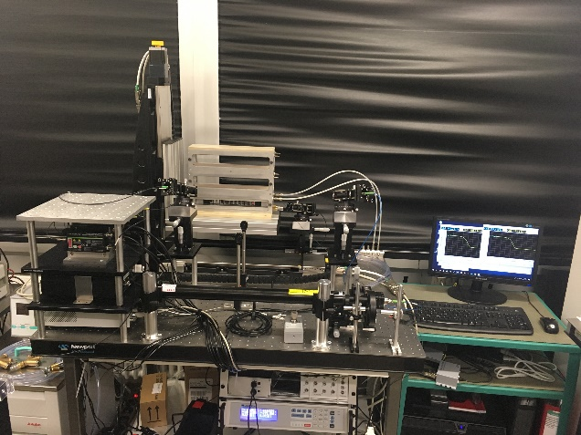
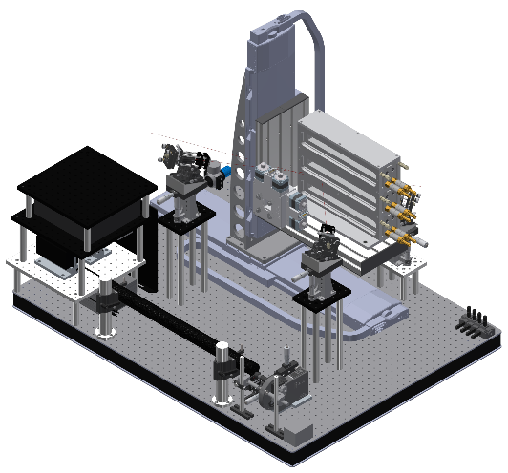
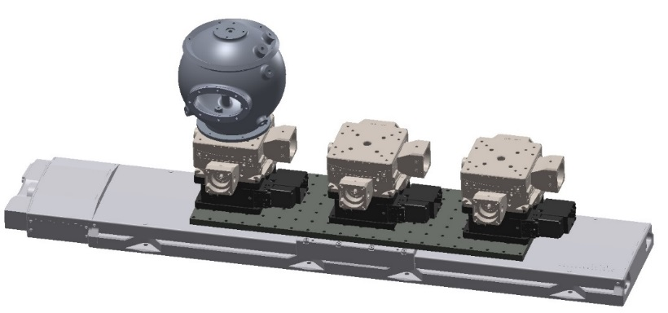
FLUCO
FLUids incl. gases, vapour and COmplex fluids
FlexiProb , A German BMBF funded project
Successful renewal for 3 more years (2019-2022)
Optimize the design for routine use:
Transportability
Ease of set up
Ease of integration
Notes:
Disolve this slide or use as summary; link to SAC comments
Needs to specifc what it want from the pool and what they build for their instrument.
Instrumet team takes team during construction (and potentially in operation)

Slide 13
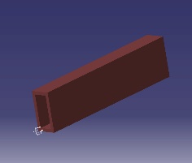
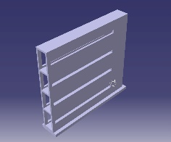
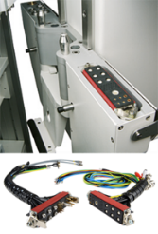
FLUCO
FLUids incl. gases, vapour and COmplex fluids
SANSMAG : Challenging, parameters altered, LOKI needs 45˚ outgoing scattering angle.
4 Modules are planned initially, more to be developed later :
8 pos. individually thermalized modules (Peltier elements), based on Beckhoff PLC development by MESI just started.
10/20 pos. same temperature module , driven by JULABO device, standard and 2x standard cuvettes
Tumbler with 7 positions, “Bonsai” version of existing one (Sonja G. S.)
Development of dry gas environment around SANSMAG to run also T<= 5˚C
ESS-internally:
SANS priority for Sample Environment, start Q2 2020
Actual :
Finalizing pre design
Finalizing TA and establish project plan
Starting with detailed design (ESS), manufacturing end Q2/2020
Expecting first prototype, frame/modules, mid 2021
ESS/PSI,CH
Development of Solid-Liquid-Cell, based on ILL/STFC design, project start Q2 2020
Notes:
Disolve this slide or use as summary; link to SAC comments
Needs to specifc what it want from the pool and what they build for their instrument.
Instrumet team takes team during construction (and potentially in operation)

Slide 14
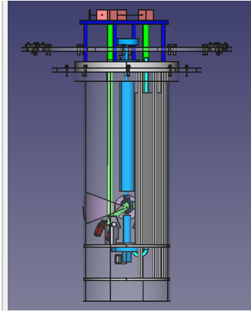
FLUCO
FLUids incl. gases, vapour and COmplex fluids
Laser path
Neutron path
Sample
PP chamber is embedded into the Vessel of Miracles instrument

Slide 15
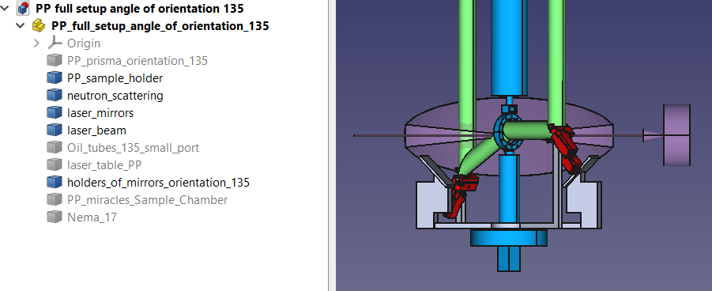
FLUCO
FLUids incl. gases, vapour and COmplex fluids
Sample cell
Laser path
Neutron path
The angle of scattered neutrons is from -22 to 22 degree
The laser mirror is placed to be out from the solid angle of neutron scattering and reflects the laser under the angle of 60 degree to illuminate the sample

Slide 16
FLUCO
FLUids incl. gases, vapour and COmplex fluids
WP | Partner | 16 | 17 | 18 | 19 | 20 | 21 | 22 | 23 | 24 | 25
Gas-processing-system | U.Tartu(Est)
Laser Pump Probe | U.Tartu(Est)
Laser Pump Probe 2 | U.Tartu(Est)
Stopped-flow-Cell | U.Tartu(Est)
Humidity Chamber | U.Tartu(Est)
Rheometer | FZJ (G)
Light scattering | FlexiProb
5x SANS-Peltier | RUC
Rotating cells | ESS
Thermalizing Bl. | FZJ (G)
Cell/El.Chemistry | ESS
Cells/solid-liquid | ESS
Lab Eq./Devices | ESS
SANSMAG | ESS/STFC/FZJ
MESI/ICS, Integr. Delay
Pool Equipment available
-> Tested and integrated
Ready to run
at instruments
Successfully finished
MESI/ICS, Integr
MESI/ICS, Integr.
MESI/ICS, Integr.
Pool
Equipment
Cost reduction exercise → Moved
Follow up project
Successfully finished
MESI:Multi-chan-devel.
Successfully finished
MCA-Integr.
Cost reduction exercise → Moved
R&D , Sample changer
Planned
Lab building, D04, available
Started, on going
Beam on target , BOT
In discussion
Hot commissioning first instruments
Users > =2023 - SOUP
First 8 instruments
Notes:
Disolve this slide or use as summary; link to SAC comments
Needs to specifc what it want from the pool and what they build for their instrument.
Instrumet team takes team during construction (and potentially in operation)

Slide 17
FLUCO
FLUids incl. gases, vapour and COmplex fluids
Staffing development up to 2025 as envisaged start of steady state operation ,
First technician is on the way , application is open, start at least 09/2019.
personnel | 15 | 16 | 17 | 18 | 19 | 20 | 21 | 22 | 23 | 24 | 25
Scientific engineer | 5/12 | 1 | 1 | 1 | 1 | 1 | 1 | 1 | 2 | 2 | 2
Technician 1 | - | - | - | - | 0.5 | 1 | 1 | 1 | 2 | 3 | 3
Lab building available
Hot commissioning first instruments
Users >= 2023
FTE : 5 , ( Full Time Equivalent )
Management 0.3 FTE = 6%
R & D 1.0 FTE = 20%, or minimum 1 person
FLUCO Infrastructure 0.2 FTE = 4%
User operation / support 2.5 FTE = 50%
Platform service 1.0 FTE = 20%
Leading , fixed No’s are 20 % R & D and service providing 50 %.
Notes:
Disolve this slide or use as summary; link to SAC comments
Needs to specifc what it want from the pool and what they build for their instrument.
Instrumet team takes team during construction (and potentially in operation)

Slide 18
FLUCO
FLUids incl. gases, vapour and COmplex fluids
So ….
The most needed pool equipment is defined and with In-Kind projects and ”Cash” on the way, signed or in discussion.
The Gas-Process-Handling-System is on the way (Estonia)
Some other projects for Stopped flow and Humidity chamber are on going (Estonia)
Also FLUCO’s own developments are started and first low value devices are procured, thermalizers/syringe pumps/HPLC pump/H₂ gas manifold (build), peristaltic pump, levitator (ultrasonic)
Actually testing the possibilities of ultrasonic levitation as sample holder, in collaboration with SULF.
Also a approach to find Field Flow Fractionation using with Neutron scattering @ SANS/GISANS has started.
Notes:
Disolve this slide or use as summary; link to SAC comments
Needs to specifc what it want from the pool and what they build for their instrument.
Instrumet team takes team during construction (and potentially in operation)

Slide 19
FLUCO
FLUids incl. gases, vapour and COmplex fluids
Conclusions about the FLUCO platform
For the hot commissioning and the first users for the first 8 instruments, the mandatory pool equipment will be available.
With the BMBF Flexiprob project a very promising complementary partner for the ESS arises. The first project was finished successful and another period of 3 more years is accepted by the BMBF
As well as by the staffing plan and by increasing resources there is enough space left for future new needs and developments.
Notes:
Disolve this slide or use as summary; link to SAC comments
Needs to specifc what it want from the pool and what they build for their instrument.
Instrumet team takes team during construction (and potentially in operation)

Slide 20
2
Electrochemistry
User lab and Sample Environment
SULF/FLUCO
Presented by A. Corani
2020-04-21

Slide 21
Agenda
1 Electrochemistry
2 User lab to Sample Environment
3 In-Kind Electrochemistry cell
4 FLUCO support

Slide 22
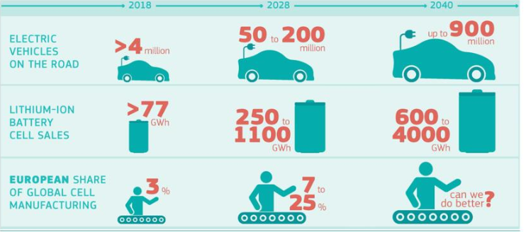
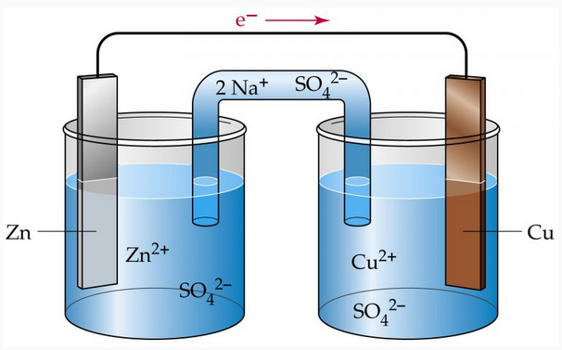
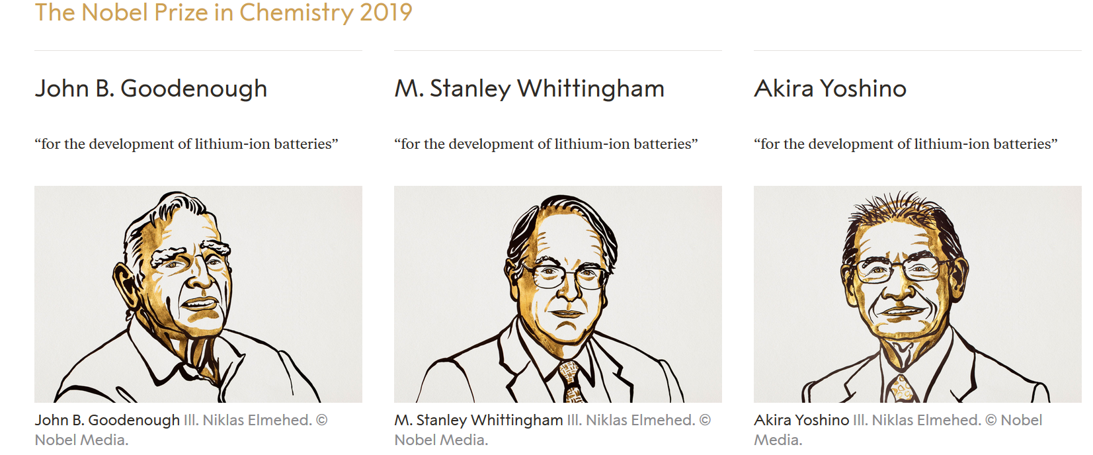
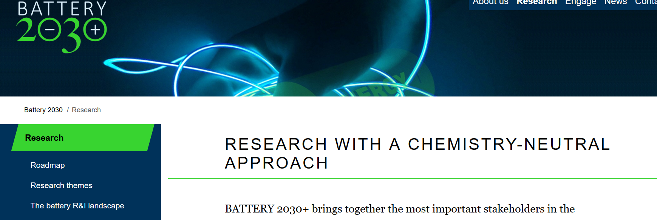
Electrochemistry
Overview
Not a new or modern technique
General analytical tool in a chemistry lab
Electrosynthesis
Surface treatments
Energy Storage and conversion
Material Analysis
Corrosion
Increasing interest Energy Storage and conversion
Battery
Reduce CO₂ emission
Scientific community challenges
Interfaces/ Interphases charge transfer
New materials
Lithium ion battery demand and supply European Commission April 2019

Slide 23
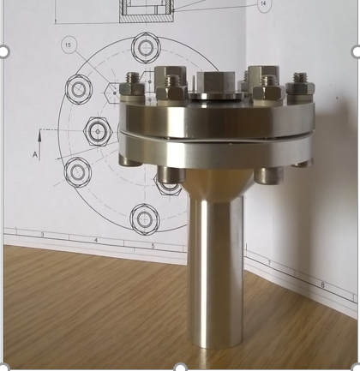
Electrochemistry
User lab / Sample environment
User Lab
Basic analytical tool
Wet chemistry
Polarography
Impedance measurement
Sample preparation
Glove box
Clean area
Prepare charge/discharge
Sample Environment
In kind 2 years projects EE
Cells compatible with neutron experiment, in situ and operando
Coin cell, SANS measurements.
Annular cell for inelastic, diffraction exp.
Provide the tools
Temperature control (10 K to 500 K)
Potentiostat
Cells
Testing/cycling opportunity

Slide 24
Electrochemistry
In Kind – Tartu University
2 years projects
WP | Partner | 2020 | 2021 | 2022
Electrochemical cell | Uni. Tartu (EE) | Selection/ definition of parameters, selection of material | Design of cells, CDR, Manufacture | Test of the cell in neutron scattering exp. with calibration sample | Documentation, handover including CAT
Instruments
Structure and dynamic studies :
DREAM, CSPEC, T-REX, VESPA, HEIMDAL and MIRACLE ESS
Large scale structure experiments:
LOKI, FREIA, ESTIA, SKADI

Slide 25
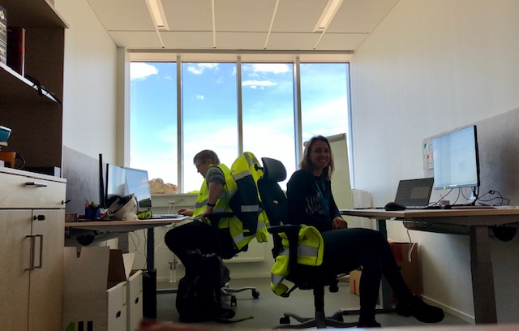
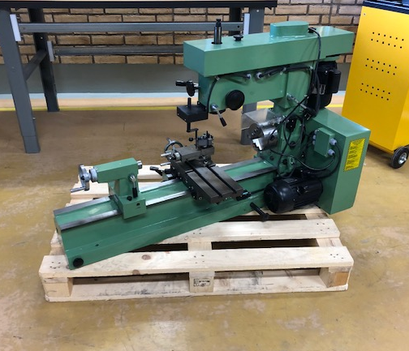
FLUCO platform
Support
Inventory
Using EAM system
Calibration schedule
Confluence pages
Organisation
Update
Move FLUCO office/equipment to E04
Collaboration with SULF
EPICS integration of FLUCO devices
Collaboration with MESI/ICS

Slide 26
Thank you for your attention Questions ? Notes, Remarks,… .

