Slide 2
SWAP Presentation
April STAP 2020
PRESENTED BY Fredrik Bolmsten

Slide 3
Agenda
1 Team
2 SciChat
3 SciCAT & PaNOSC
4 User Office Software
5 Summary

Slide 4
1
Team

Slide 5
Team
Staff profiles
Fredrik Bolmsten - Section lead
Jekabs Karklins - Software Engineer
Henrik Nilsson - Software Engineer PaNOSC (3 year contract)
Martin Trajanovski – Consultant PaNOSC (6 months)
Gareth Murphy (Ad for replacement out)

Slide 6
2
SciChat

Slide 7
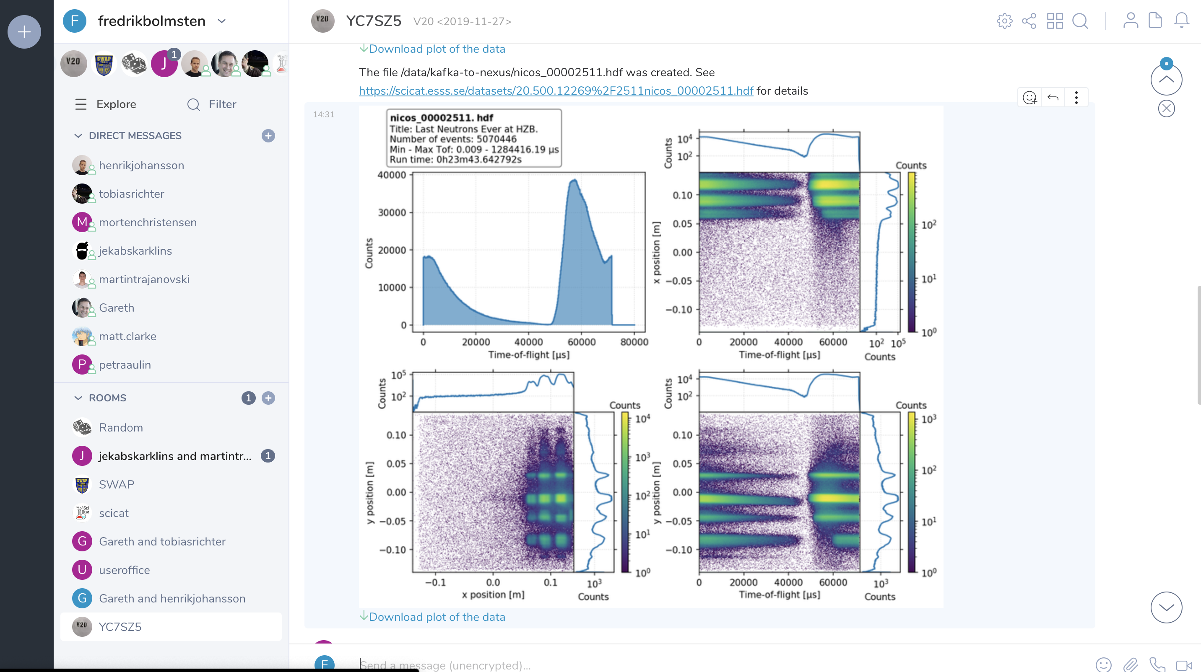
SciChat
Electronic logbook
In use today by ECDC and SWAP for daily communications
Used successfully at V20 experiments in December
New concept of automatic messages posted by data processing pipelines and data collection software
Working on integration with YMIR beamline

Slide 8
3
SciCat & PaNOSC

Slide 9
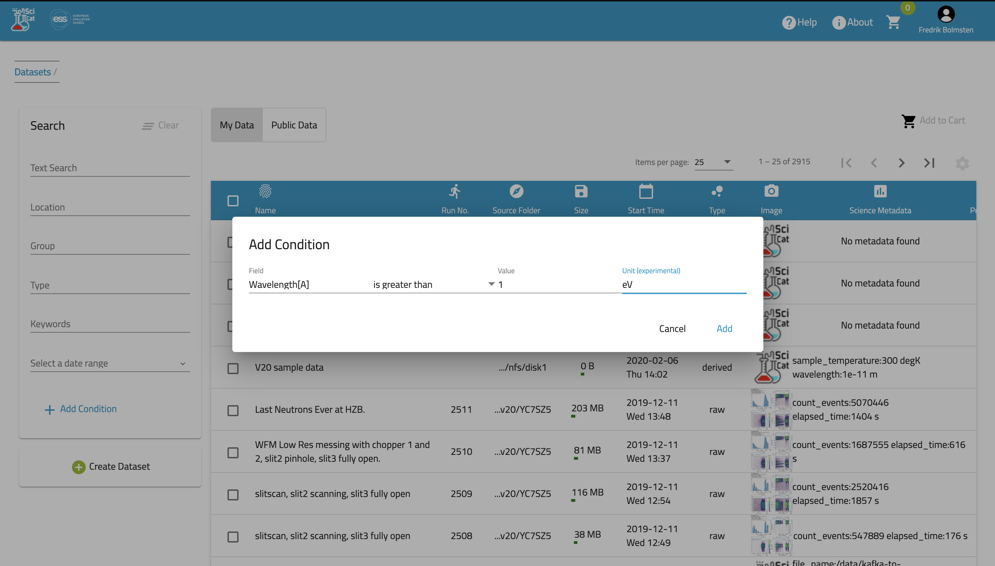
SciCat
Metadata catalogue
Support for search of arbitrary metadata with units
Ingesting NCL/beam data
Maturing software by providing more documentation and refining functionality
Continued development with PSI & Max IV
Increased interest from different facilities

Slide 10
PaNOSC
Making data available
ESS data is being made available to a broader audience through the PaNOSC project.
A goal for ESS is to make data available and increase reuse of data, this has been achieved by opening up SciCat for querying/harvesting from other applications such as:
B2FIND
OpenAire
PaNOSC search

Slide 11
4
User Office

Slide 12
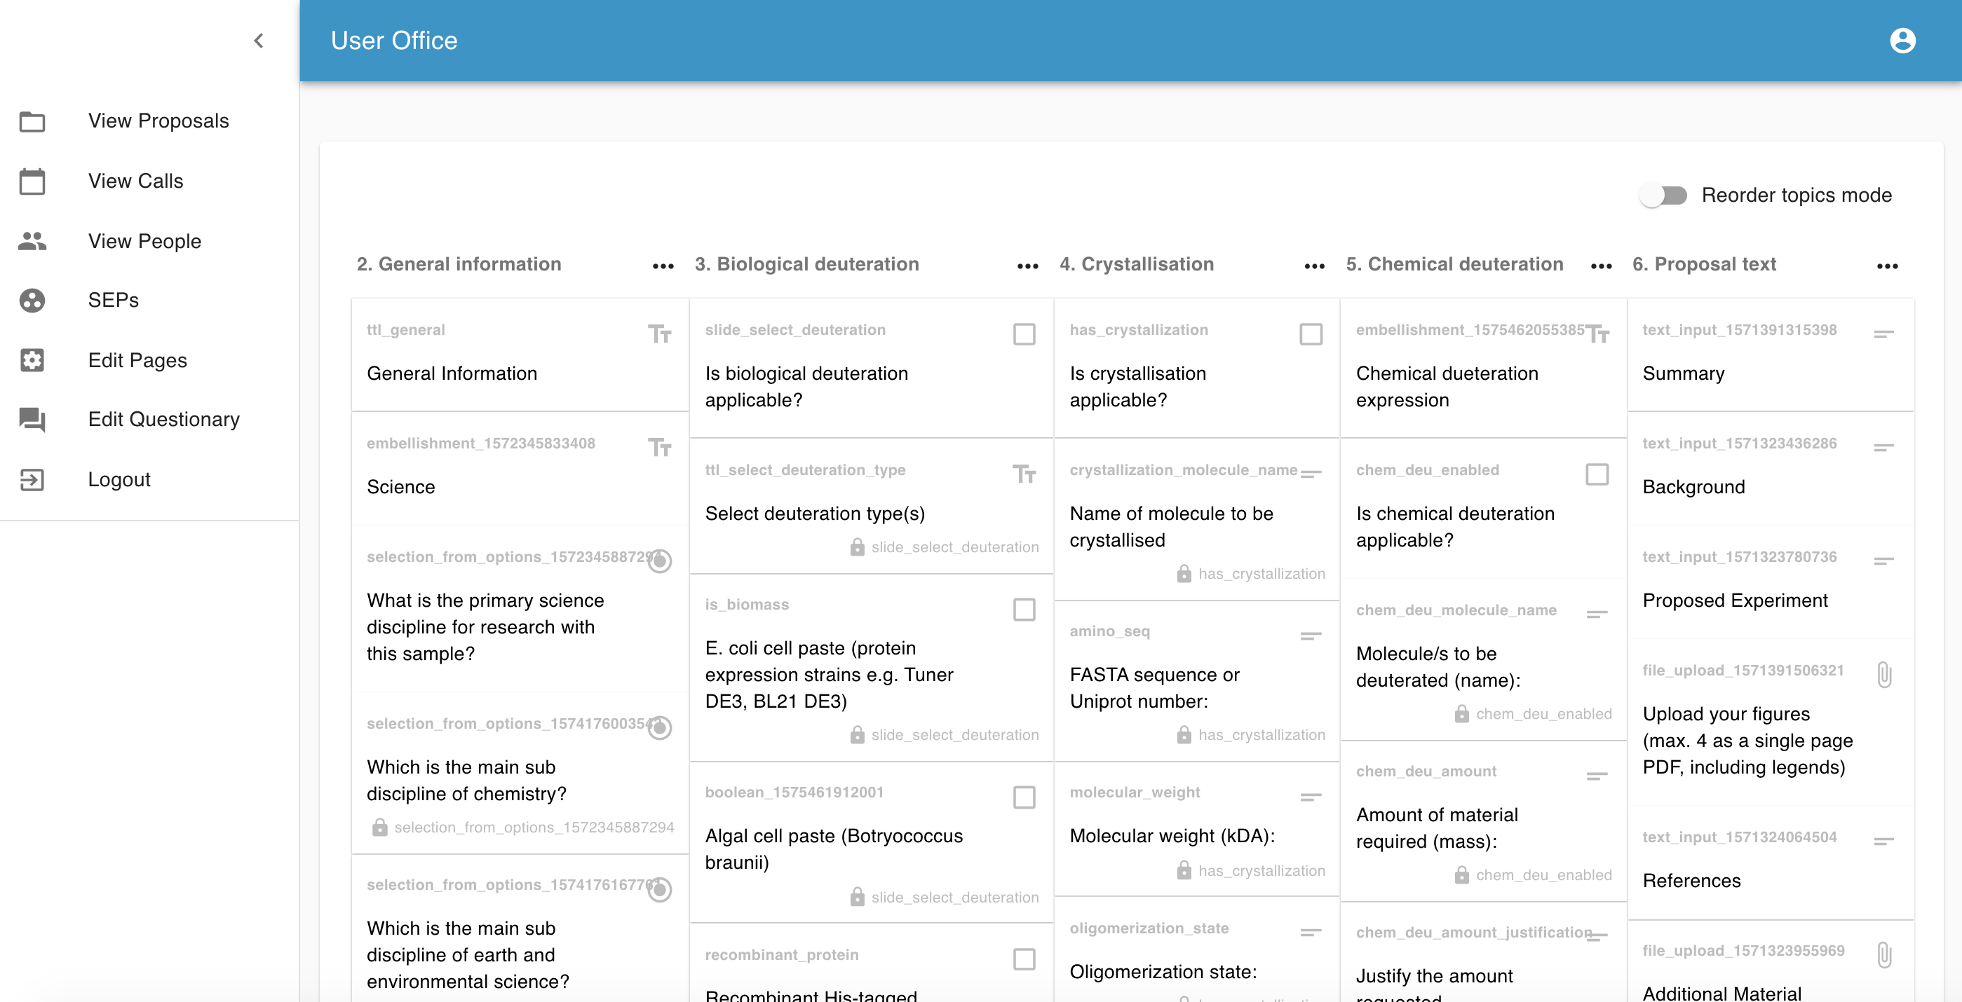
DEMAX
First released in December
First versions of functionality in operation:
User Registration
Proposal Submission
Internal Proposal Review
External Proposal Review
Functionality under development:
Full scope external proposal review
Multiple, concurrent calls for proposals

Slide 13
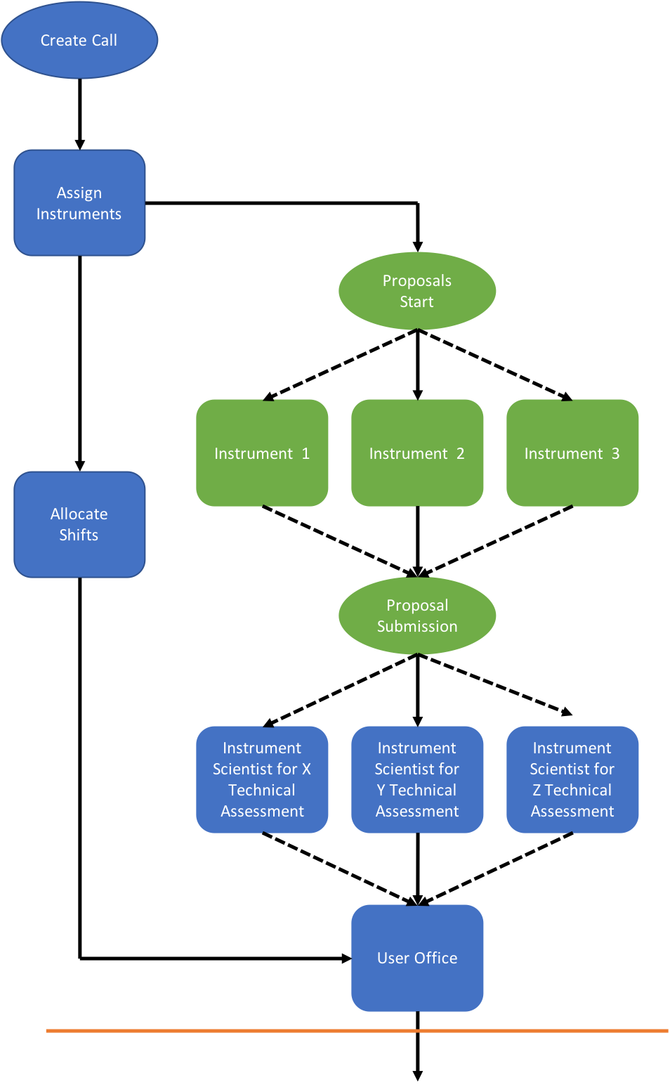
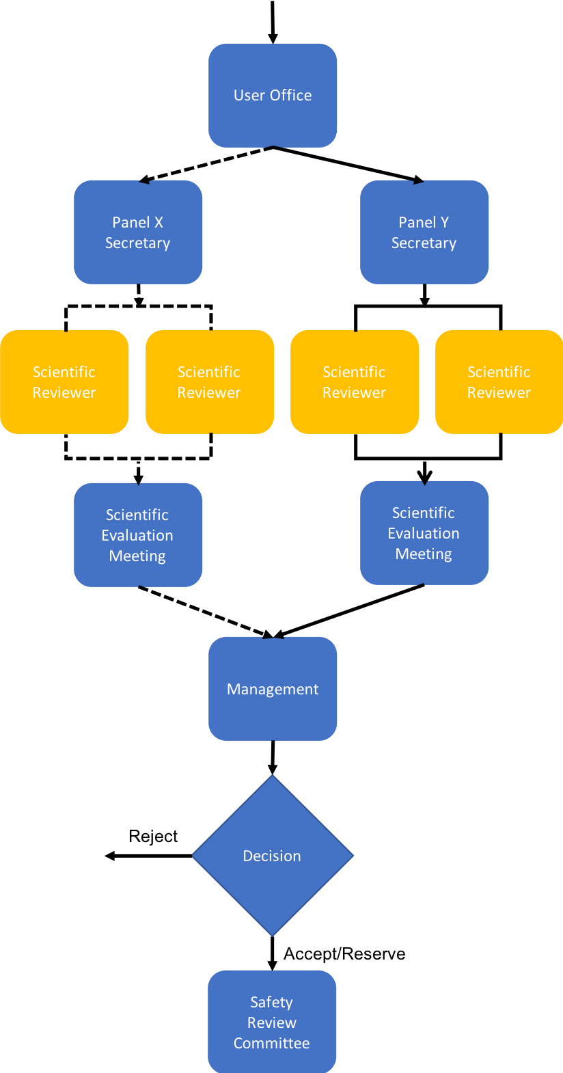
Specifying new functionality
ESS Complete Review Process
“While developing the User Office Software is going well, at every stage it is the development of the software implementation that is driving the design of the process.”

Slide 14
User Journey
User Journey in steps

Slide 15
User Office Software
User Journey in Software Interactions
Element | Software Solution | Comments
User Registration | User Office Software | Data to be stored in IAM after IAM is procured.
Proposal Submission | User Office Software | How much information should be included in the proposal? Experiment and sample for safety/data management plan?
Proposal Science Review | User Office Software | This includes technical and excellence reviews.
Proposal Safety Review | ? | This requires the experiment plan and sample information as input and will have control measures as output.
Experiment Scheduling | User Office Software | This includes collecting user ‘bad dates’ and scheduling the instrument, sample environment, local contact, on call scientist …
User ESS Site Training | Learning Management System | Software currently being installed. The completion of training should be required before a visit can be planned.
User Visit Planning | User Office Software(?) | User notifies ESS which scientists are coming and when. Also what arrangements they require ESS to make.
Sample Shipping to ESS | Enterprise Asset Management(?) | Samples shipped to ESS will start a tracking record at this stage.
Sample Registration at ESS | Enterprise Asset Management (?) | Samples brought to ESS will need to be registered for tracking. This is not strictly in the EAM planning.
User Site Access | UOS/IAM/LMS/? | Complex since requires communication between software not yet specified or procured.

Slide 16
User Office Software
User Journey in Software Interactions
Element | Software Solution | Comments
User Radiation Protection | Dosiserve | Currently being implemented by Health Physics.
User Welcome | User Office Software | The User Office Software should provide sufficient information to facilitate contact at gatehouse and reception (if needed).
On-Site User Training | Learning Management System | Software currently being installed. No clear ownership for user training.
On-Site Experience | ? | Here to flag - user cards might also carry credit for food, credited by the facility or the user – there are no details.
Sample Tracking | Enterprise Asset Management | EAM will record which samples are exposed to neutrons and which are activated by the experiment.
Sample Information | ? | The data collection software should know which samples the user can select. This will inform the data catalogue process.
Waste Management | SVALA | In place.
User Cost Reimbursement | ? | Where ESS is covering user costs reimbursement may be necessary. Aspire: to be invoiced directly for all costs by provider?
User Satisfaction Survey | ? | For reporting and improvement – must be completed within 3 months or user cannot submit another proposal.
Publications | ? | A record of the science published as a result of each proposal. Should this provide self archiving tool?

Slide 17
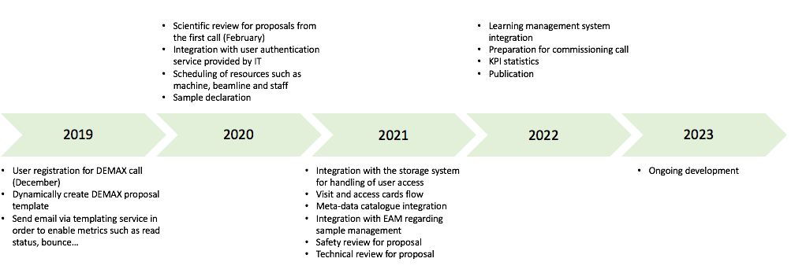
User Office Software Timeline
Milestones

Slide 18
User Office Software
Resources
Software development in general is going well but progress is slowed as resources are missing. Good contact with SCUO and DEMAX group has enabled an agile way of working.
Team currently dependent of external funding for development as resources has been continuously pushed forward by ESS management.
Options:
Increase staffing
Use contractors
Push back delivery (beyond mid 2023)
Reduce specification

Slide 19
Summary
1 Team | Remains small and is dependent on external funding to handle workload
2 SciChat | Currently used by ECDC and SWAP. New functionality added by automatic posting of messages
3 SciCAT | Added support for searching complex metadata with units and started ingesting data from other parts of the organisation
4 PaNOSC | Created first API proposal and opened SciChat for harvesting by OpenAire and B2FIND
5 User Office Software | Development is in progress: really need a clear decision as to scope and resources

