Slide 2
Data Systems and Technologies (DST)
STAP presentation April 2020
PRESENTED BY Jesper Rude selknæs

Slide 3
Agenda
Presentation of the DST team
Status report
Work planned for 2020
COVID-19 impact on DST

Slide 4
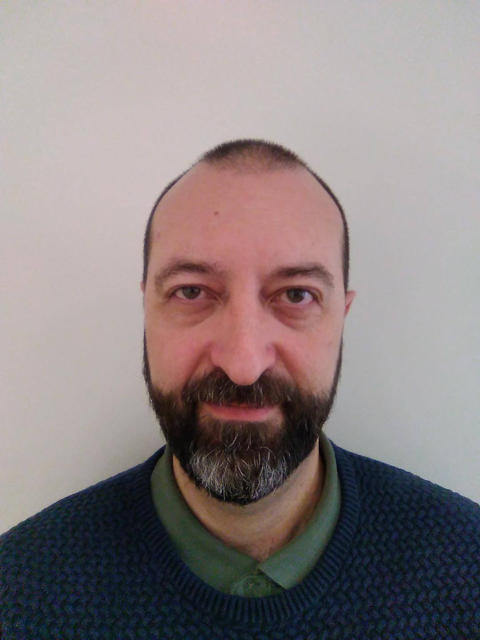
The DST team
Jesper Rude Selknæs
Jacinto Vera Garcia
Brian Lindgren Jensen
Alexandre Stefanov
Kareem Galal
Ashok Nulguda
Lottie Greenwoold

Slide 5
Status report
What has been accomplished since the September 2019 STAP:
Task | Date | Description | Status
End of construction (2019) | December 2019 |  | Done
Server-room (CPH) (dstk-1493) | Week 48 – permanent power connection in January 2020 | The CPH server room in COBIS has been constructed and SAT test has been conducted. | Done
Move: Phase B (dstk-3271) | Week 39 2019 | DMSC virtualization stack moved from interim datacenter to COBIS data center. | Done
Link ready (dstk-2006) | Week 40 2020 | Intersite MPLS link established and IP traffic verified. | Done, fine tuning is an ongoing task as initial operations progresses.
LDPC 2019 (dstk-3232) | December 2019 |  | Done
Beamline servers: (dstk-3331) | December 2019 | Procurement, installation and deployment of 5 servers acting as test beamline servers for the EOC tests. | Done
EoC Test (dstk-3795) | Week 46 2019 | See slide XX | Done
EoC Report (dstk-3862) | Week 48 2019 | Report ready and circulated to DMT. | Done

Slide 6
Status report
What has been accomplished since the September 2019 STAP:
Task | Date | Description | Status
Services |  |  | On-going
OwnCloud for ESS | N/A | Providing ownCloud for the wider ESS is an on-going task of expansion, improvement and support. | On-going
InfoSec (ESS) | N/A | On-going collaboration across ESS on IT-security. | On-going
Integration with IT and ICS | N/A | On-going collaboration across ESS on IT in general. | On-going
Office expansion | November 2019 | Small office expansion supported with network etc. | Done
Virtuel Desktop Env. for DMSC | N/A | Providing remote desktop and/or interfaces to the DMSC systems is an o-going effort currently dominated by PaNOSC WP6 | On-going
Ubuntu provisioning | March 2020 | Ubuntu can be deployed by puppet. | Done – fine tuning on-going

Slide 7
Status report
What has been accomplished since the September 2019 STAP:
Task | Date | Description | Status
Cold Commissioning preperation |  | Work to prepare for the cold commissioning phase for instruments, | On-going
Network infrastructure (ESS) | N/A | On-going collaboration in the ESS network team. GPN is under construction, | On-going
Procurement (HPC, Storage and VM) | December 2019 | These procurements where postponed until Q1/Q2 2020 due to uncertainty about the initialops budget and on the readiness of the CUB server room. | On-going – all tenders are out and some equipment has arrived.
Site installations | September 2019 | Comms rooms in the E buildings inspected and verified. Work in 2020 will advance the site installations even further. | Done
Server-hall (CUB) | May 2020 | The construction of the CUB server room has been delayed. Latest due to the COVID-19 access is expected in May 2020. | On-going
Data Center Design IV | March 2020 | Detailed conceptual design of DMSC systems. | Done

Slide 8
Status report
What has been accomplished since the September 2019 STAP:
Task | Date | Description | Status
Systems/Technical Debt |  | Operating the DMSC systems | On-going
DevOps Improvements and deployment/provisioning | August 2020 | Efforts to expand the DevOPS method for all DST systems and for all sites | On-going
Cluster Upgrade | August 2020 | DMSC cluster upgrade to latest CentOS | Not started.
Asset mgt & lifecycle control | December 2019 | Automatic asset management & lifecycle control in place (GLPI) | Done
Standard Op. Procedures | N/A | On-going work to ensure SOPs for all ops related activities is in place | On-going
Test harness (backup) | February 2020 | Test that our backup system works. | Done
Datacenter Operations | N/A | On-going work for managing and operation the DMSC data centers. | On-going
Monitoring 3 | December 2019 | Improvements to the current monitoring scheme. | On-going due to prioritization of deployment of systems in Utgaard
LDAP password policies / IAM | August 2020 | Formulate policy for LDAP paswords and engage in the ESS wide IAM work. | LDAP PW policy done – IAM work in on-going.

Slide 9
Status report
What has been accomplished since the September 2019 STAP:
Task | Date | Description | Status
PaNOSC
WP4 | 2022 | Data analysis (JHUB) | On-going
WP6 | 2022 | Remote access | On-going
WP8 | 2022 | Support the E-learning effort. | On-going
Multisite deployment and provisioning | March 2020 | Work to establish deployment and provisioning of systems for the ECDC group in the Utgaard lab | Done – fine tuning on-going
Extending ESS networks from CPH to Utgaard | March 2020 | The network assigned to the data acquisition (DAQ-network) is established both in the DMSC DC and in Utgaard using the inter-site link. | Done
Establish deployment capabilities in Utgaard | March 2020 | Smartproxy etc. setup so that a machines can be deployed on the DAQ-network | Done
Provide deployment unit for ECDC | March 2020 | A clone of the DST Puppet deployment unit is available for ECDC | Done
Training and migration | N/A | Helping ECDC to use the system | On-going

Slide 10
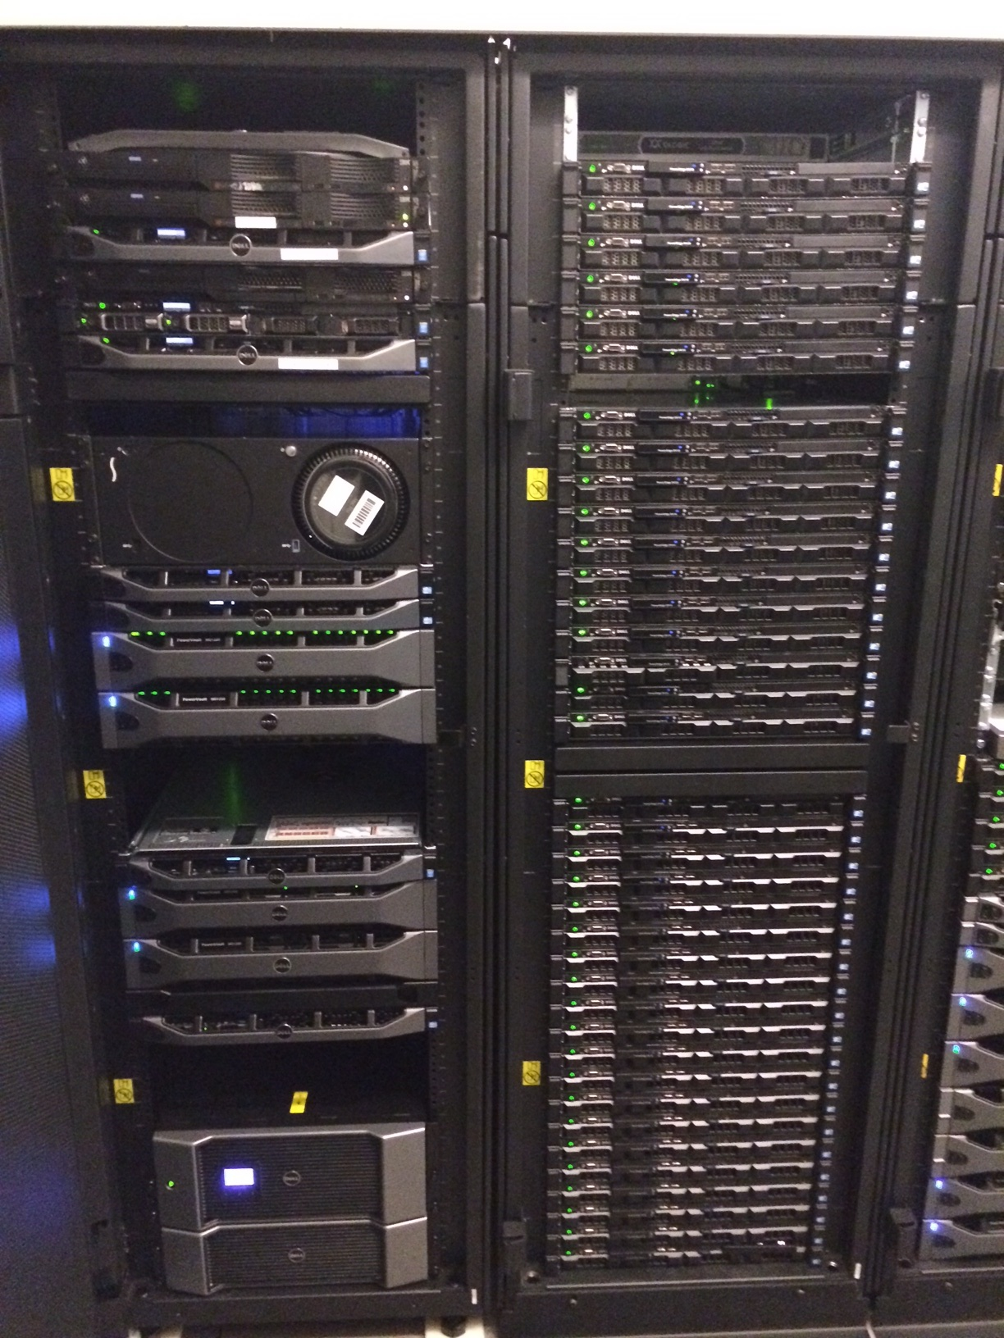
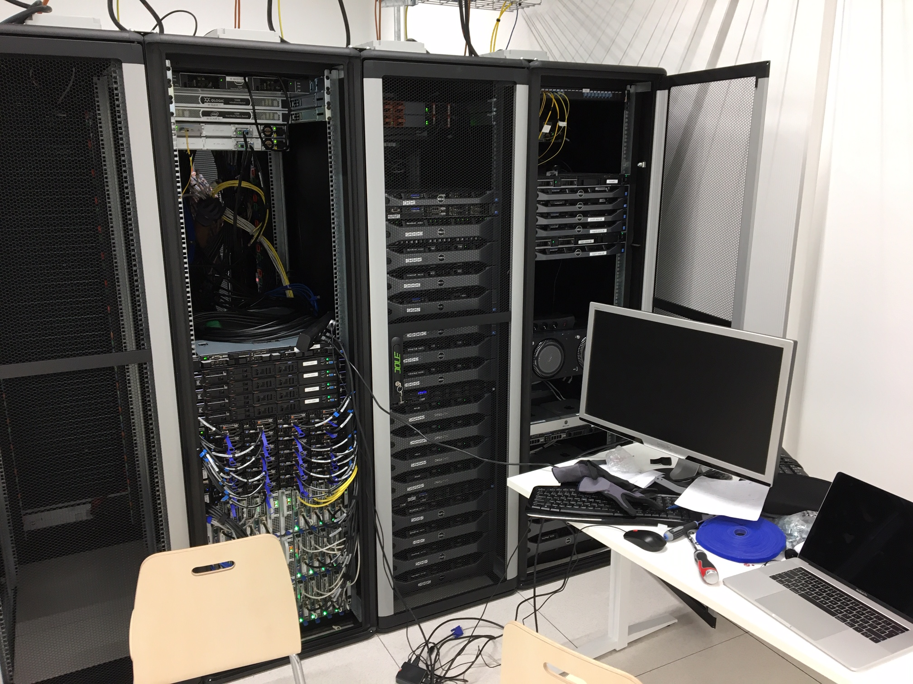
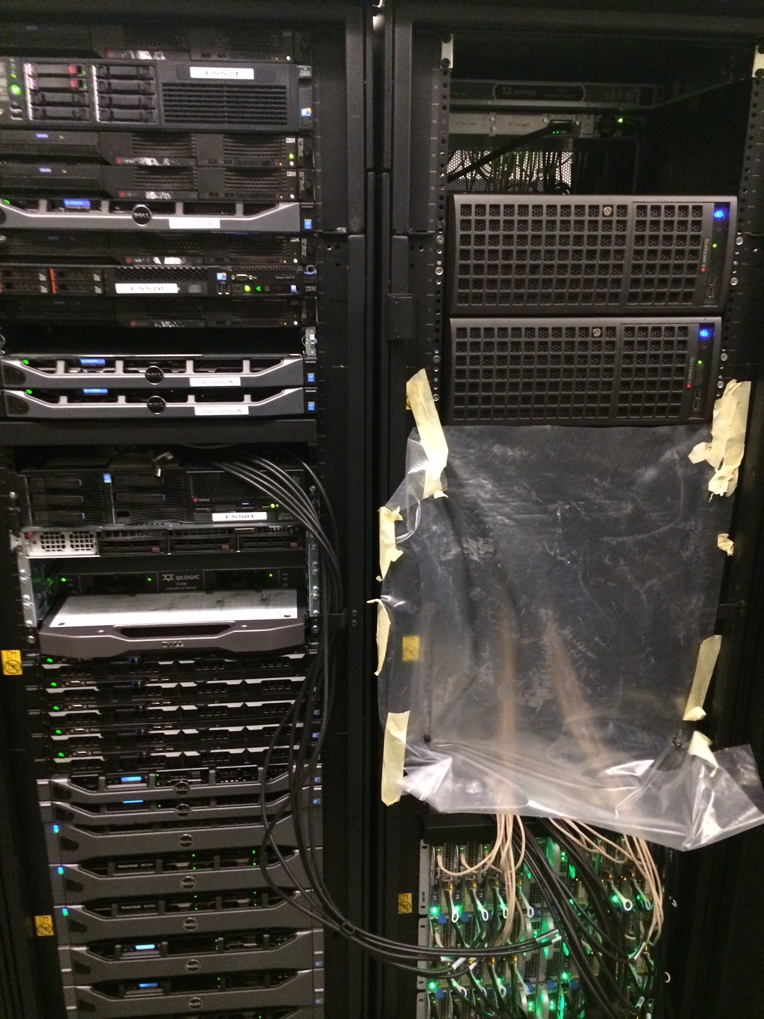
Historic overview of DMSC data centers
05.03.2020 CPH COBIS
02.03.2020 Interim DC
2010
05.03.2020 CUB - Lund

Slide 11
Multi site deployment

Slide 12
End of construction test
Tests performed to ensure DST ready for BOI
Test | Description | Status
Inter-site link | Tests of the inter-site link | Done - Passed
Link capacity | Formal (contractual) provisions in place for dedicated 10Gb/s and upgrade path towards 400Gb/s | Done – NorduNET, DeiC and SUNET reports that 10Gb/s is dedicated for the inter-site link regardless of use. Upgrade to 100Gb/s and 400Gb/s is feasible and little extra cost is expected with the current schedule. Passed
Link performance test | Prolongues bandwidth and latency test using PerfSonar has been conducted. | Done: BW shows 9.0 – 9.3Gb/s sustained. Latency shows 0.5 – 3.0ms n both directions. Passed
Viability test | Testing the viability of the multi site setup of DMSC | Done - Passed
Deployment and provisioning | Machines can be deployed across the Inter-site link | Done: 5 physical machines where deployed using DST internal deployment setup. Passed
File transfer | File transfers using scp, rsync, nfs and fio conducted. | Done: Transfer rate averaged at 931MB/s which is relatively close to the expected 1GB/s. Passed
Data reduction | Using the 5 servers deployed an Mantid reduction of a recorded set of event was performed (setup developed in the LDPC) | Done: Reduction worked as expected. Passed

Slide 13
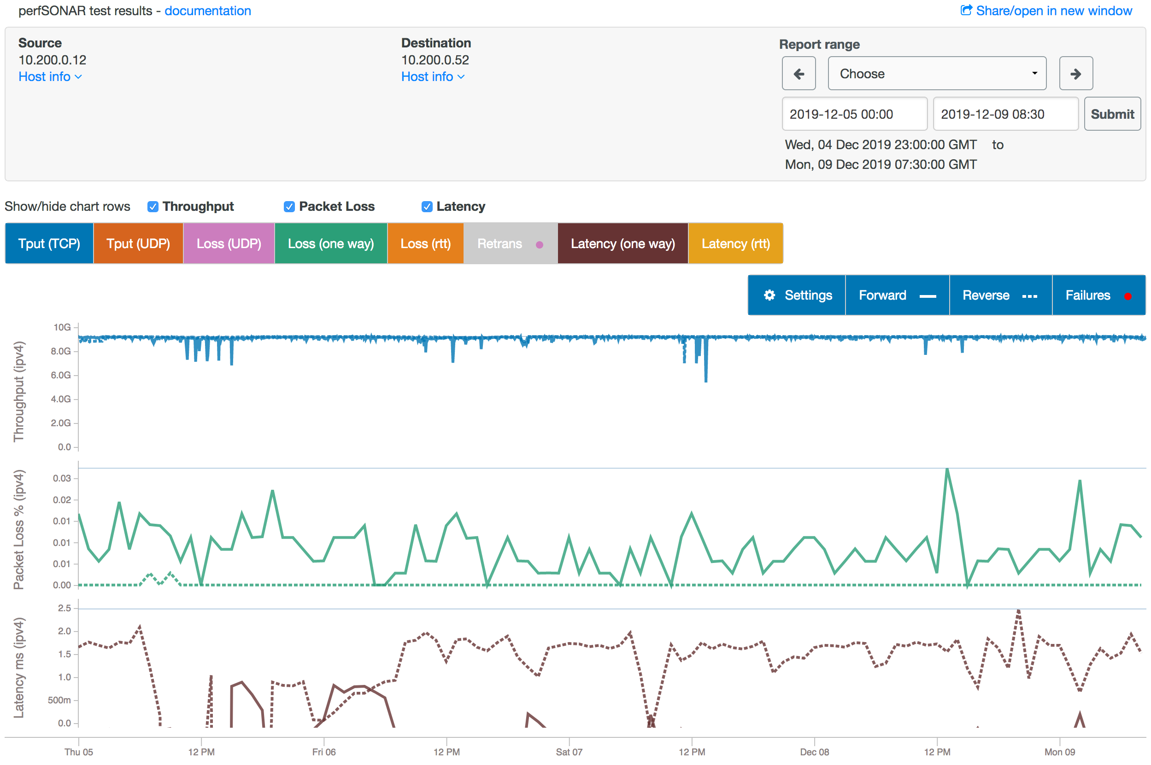
PerfSONAR data for the inter-site link

Slide 14
Screen shot from Mantid live data flow

Slide 15
Work planned for 2020
Worked planned in 2020 H1 – some will finish in H2
Deployment of systems in CUB and COBIS
HPC: Replacement of decommissioned equipment from 2011 (CPH) Q2 2020
VM: Establish multi-site VM environment scaled for data analysis Q2/Q3 2020
Network: Establish relevant DMSC networks at CPH and in the CUB. Q2/Q3 2020
Storage: Fundamental storage systems in place in CPH and CUB. Q3/Q4 2020
Services:
OwnCloud for ESS
InfoSec (ESS)
Integration with IT
Virtuel Desktop Env. for DMSC
Non-CentOS OS provisioning
Federation of identity management ESS wide.
Cold Commissioning prep:
Advancing Network infrastructure (ESS)
Procurement:
Storage - Q2/Q3 2020
HPC - Q2 2020
VM - Q2 2020
Site installations Q3 to Q4 2020
Site network validation Q2 to Q4 2020
Server-hall (CUB). Q2 2020
Data Center Design V Q2 to Q4 2020
PaNOSC:
K8 Deployment
WP4
WP6
WP8
Systems/Technical Debt
DevOps Improvements
Cluster Upgrade Q2 2020
Asset mgt & lifecycle control part 2 Q3 2020
Standard Op. Procedures Q2 to Q4 2020
DevOps:
VM (oVirt) Q3/4 2020
Web services Q2/Q3 2020
Datacenter Operations On going
Monitoring 4 Q2 /Q4 2020
Provisioning (Foreman Smartproxy) Q2/Q3 2020
Increased monitoring efforts Q2 to Q4 2020
Decommission of HCØ server room Q2 2020

Slide 16
Collaboration
Network
Site-to-Site connection established – collaboration with ICS on operations.
Engaging in the network synergy group of ESS consisting of representatives from DMSC, Corporate IT and ICS.
Being an active stakeholder on the design and implementation of the General Purpose Network at the ESS site in Lund. This includes DMSC, Corporate IT and ICS.
External
PaNOSC project on going with DST playing a part in WP4, WP6 and WP8. PaNOSC contacts has already proven valuable for experience on technologies.
Engaging with UCPH on collaboration regarding masters students. Halted due to COVID-19
Engaging with the UCPHs HPC group on sharing experiences on server rooms, HPC systems etc.
Software deployment
Strong collaboration across DMSC in the LDPC
Discussion with IT and ICS - joint DMSC/IT puppet workshop planned for H1 2020 – Postponed due to COVID-19
InfoSec
Playing a proactive role in the InfoSEC working group at ESS. Also providing the LISO function for the Science directorate.
Engaging with the CISO on all matter of security in the ESS organization.
DST has offered off site hosting to both IT and ICS – detailed planning is on-going.

Slide 17
Future technologies
Engaged with vendors presenting current and future solutions on the following subjects:
Recent developments within storages systems from 16 vendors since beginning of 2018.
High performance network solutions.
Virtual environments
Participating in relevant courses:
2 staffers on IBM Spectrum Scale course - IBM Spectrum Scale Expert (Level II):
October 2019 (Alexander Stefanov, Ashok Nulguda)
1 staff member on FitSim course (Lottie Greenwood)
Only online training is expected in 2020 due to COVID-19
Participating in conferences
Likely not possible in 2020 due to COVID-19

Slide 18
Infrastructure schedule
DST is working against current NSS master schedule 4.3

Slide 19
COVID-19 impact on DST
Activity | Description | Impact
Installation of equipment in the CUB data center | Installation of storage, network, VM environment etc. in the CUB server room at the ESS site | This activity is heavily depending on the ESS supply chain. There is a real risk of delays in the order of months.
Installation of equipment in the CPH data center | Installation of storage, network, VM environment etc. in the CUB server room at DMSC server room in Copenhagen | This activity is depending on delays at vendors (which has not yet manifested itself) and on restriction on working closely together (server room work). Mitigation for the latter is in place.
Validation of site fiber infrastructure | While tests for the site fiber infrastructure is in place the actual testing will depend on access to the CUB and to comms rooms. | This activity is heavily depending on the ESS supply chain. There is a real risk of delays in the order of months.
Procurements | Procurements of storage, VM, HPC and network equipment. | Minor delays expected due to the practicalities of VC versus physical meetings.
User support | Support the current DST userbase (approx. 500 users). | Impact is only expected if on-site work is required. This is in the form of transport time from peoples home to DMSC.
Implementation of support systems | IAM collaboration with ICS and IT, INFOSEC collaboration and advancing deployment capabilities at ESS site and Utgaard. | Minor delays are expected due to restriction on working closely together (server room work) and due to the practicalities of VC versus physical meetings.
Staff impact | Impact on staff productivity due to DK staff having to take care of children (home school etc.) as well as psychosocial impact of working from home for an extensive period of time. | Some delays are expected. While it is difficult to mitigate the impact of home schooling, the psychosocial impact is being mitigated (as best we can) by keeping the normal structure af a working week with daily SCRUMS, backlog grooming and retrospective meetings. Also we are encouraging social - non-working interaction on out chat etc.

Slide 20
Thanks for your attention

