Slide 2
Experiment Control and
Data Curation
Group
DMSC STAP
PRESENTED BY Tobias richter

Slide 3
Agenda
Overview of the Group
  Staff and Interfaces after Reorg
  Planning and Governance
Progress in Selected Areas
Summary

Slide 4
Current Staff and Recruitment
Who is who in ECDC
5 Staff at DMSC
  Most core areas covered with the required overlap and redundancy
  3 positions in recruitment mainly to cover NICOS core, customisations and to interface with instruments
  2 more hires coming up later this year to help with installation and commissioning
2 in Lund
  Sample Environment Integration
  Motion Control EPICS interface
2 associated staff in Lund
  Detector Readout Interface
  Chopper Control
Also: In kind at PSI (run until June 2021) and ISIS (runs out around summer 2020)
 | Morten | Morten | Jonas | Matt | Afonso
Event Formation | ● | ● | ○
Timing |  |  | ●
Streaming |  |  | ● | ● | ○
NICOS |  |  |  | ●
Controls Integration |  |  | ● | ●
Testing | ● |  |  |  | ●
Deployment | ○ |  |  |  | ●

Slide 5
Continuation of ECP Workshops
Alignment after Reorganisation
9th ECP (November, on site)
https://confluence.esss.lu.se/display/ECDC/9th+ECP+Workshop
First major event to integrate new group members and find a new identity. Pinpointed some issues to be addressed.
10th ECP (last week, Vidyo)
https://confluence.esss.lu.se/display/ECDC/10th+ECP+Workshop
Excellent engagement from all. More effective, constructive and interactive than expected for a remote workshop.
Next ECP (after summer) will mark the finalising of the STFC streaming in kind package. They will continue to collaborate, but no longer “work for us”.
Alignment with ICS
Since the end of last year there is an open dialogue between the group leaders, initiated by the technical director.
Due to that the relationship has improved above expectations.
We still continue to make improvements to the information flow (both ways), interactions and how we discuss and distribute work.

Slide 6
New ECDC Governance Forum
We deliver and prioritize controls integration for all of NSS and SD, based on NSS priorities, high-level milestones, resources and technical needs.
We seek input on:
Planning and interactions with stakeholders, primarily instruments.
Tracking of progress against the schedule
and the needs of instruments.
Oversight by ECDC Governance Forum (quarterly) with representatives from
  Instruments
  ICS
  Planners
  Management
Other check points:
  ECP Workshops (twice per year)
  DMSC STAP (twice per year)
  Instrument STAPS (many)
  IKON (twice per year)
  Weekly meetings (ECDC, DMT, NSS GL)
  TG3s

Slide 7

Meetings, Kanban and Sprints
Instrument projects
Core Technology Groups
Science Directorate
ECDC
ECDC Governance
2m
ECDC Meetings
1w
ICS WP12 Sprints
2w

Slide 8
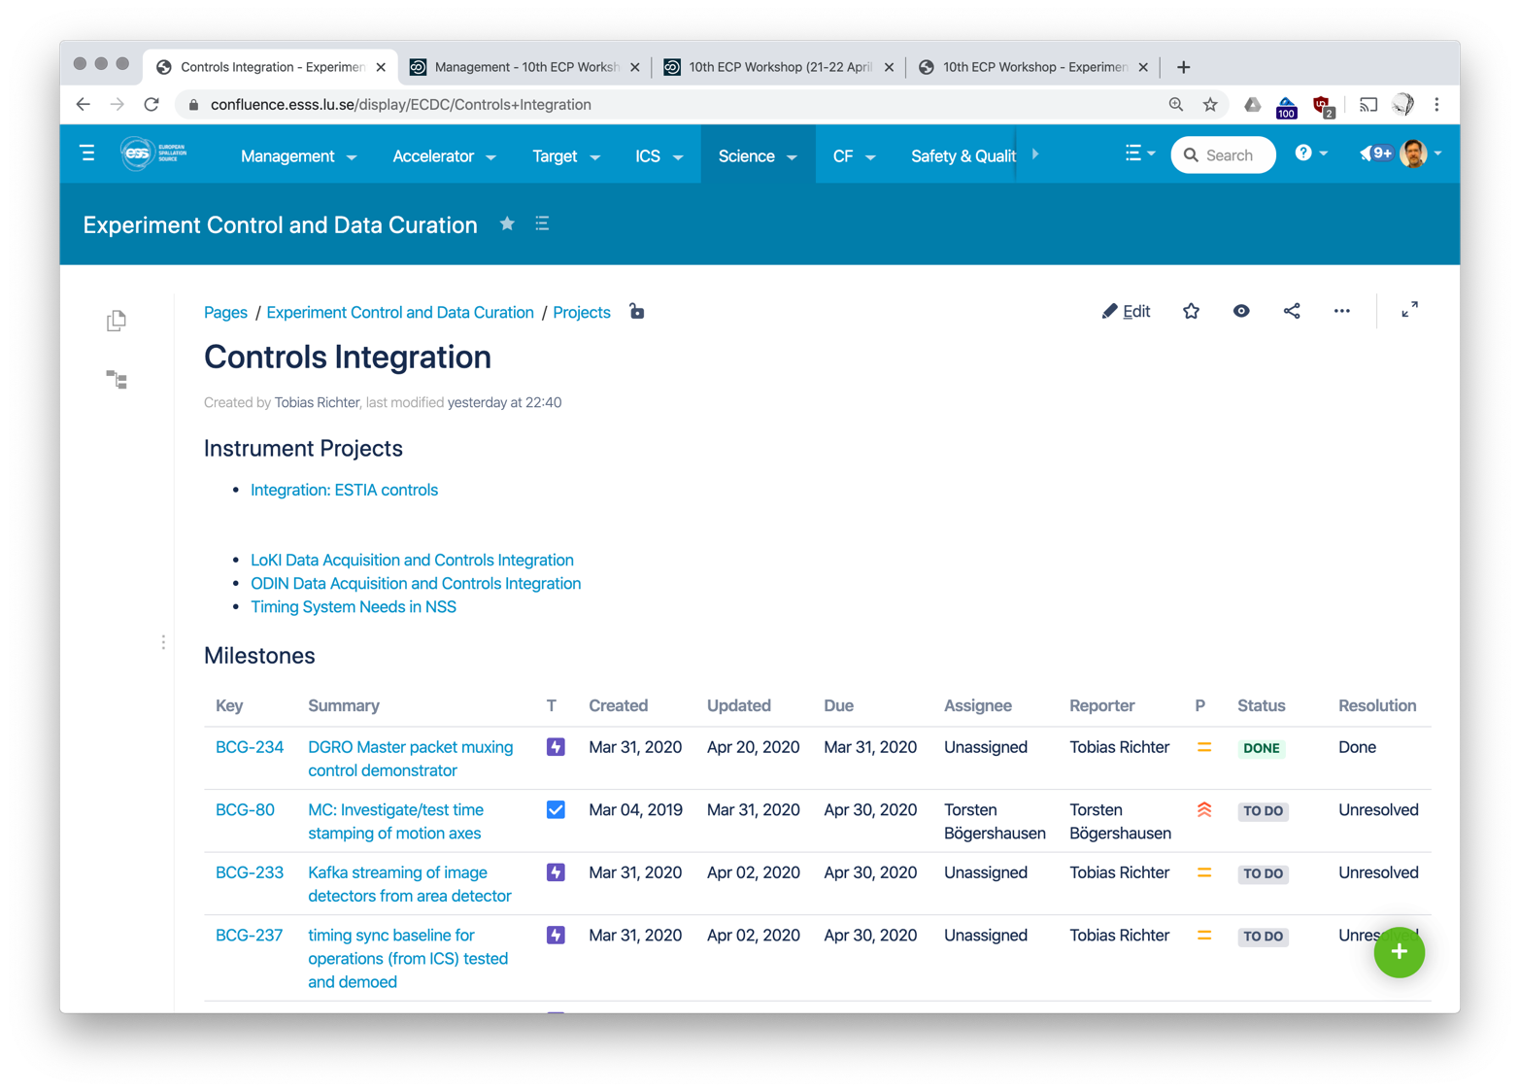
Planning for Instruments
Getting more detailed information for the upcoming phases of the project
Set up joint task force with ICS for extracting requirements and milestones for instruments from TG3 documents.
Those are recorded in Confluence and Jira as tasks and milestones.
Started with three instruments.

Slide 9
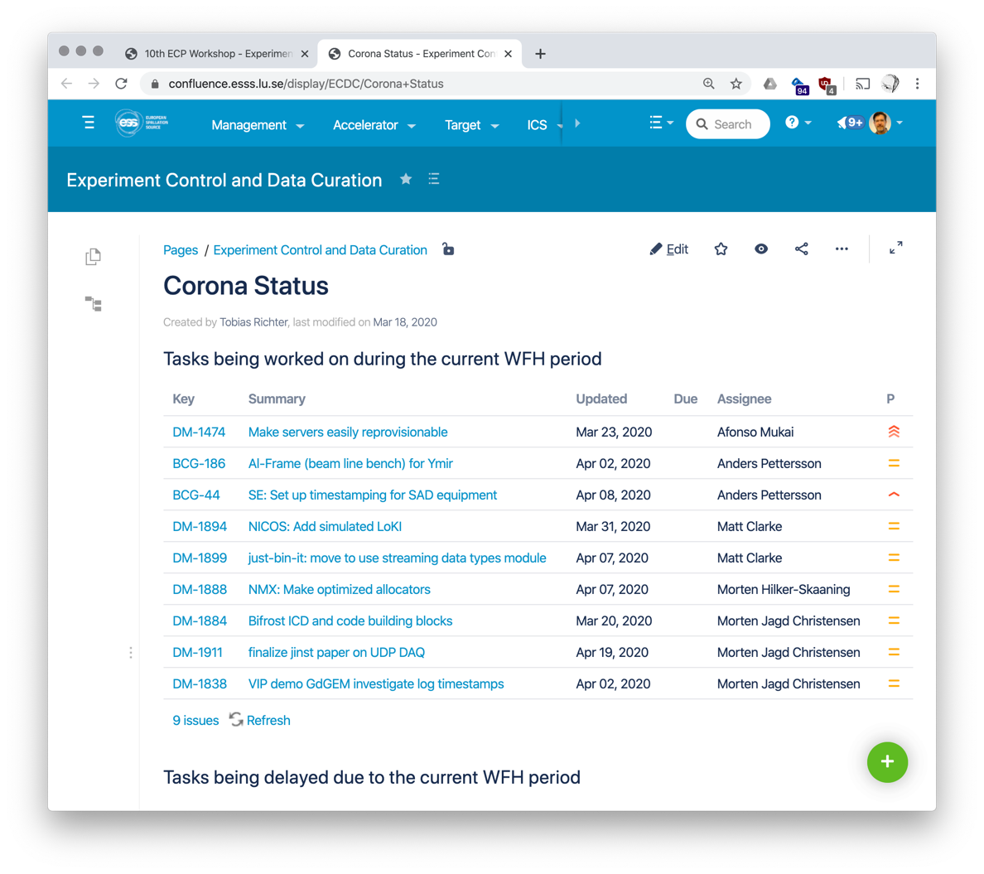
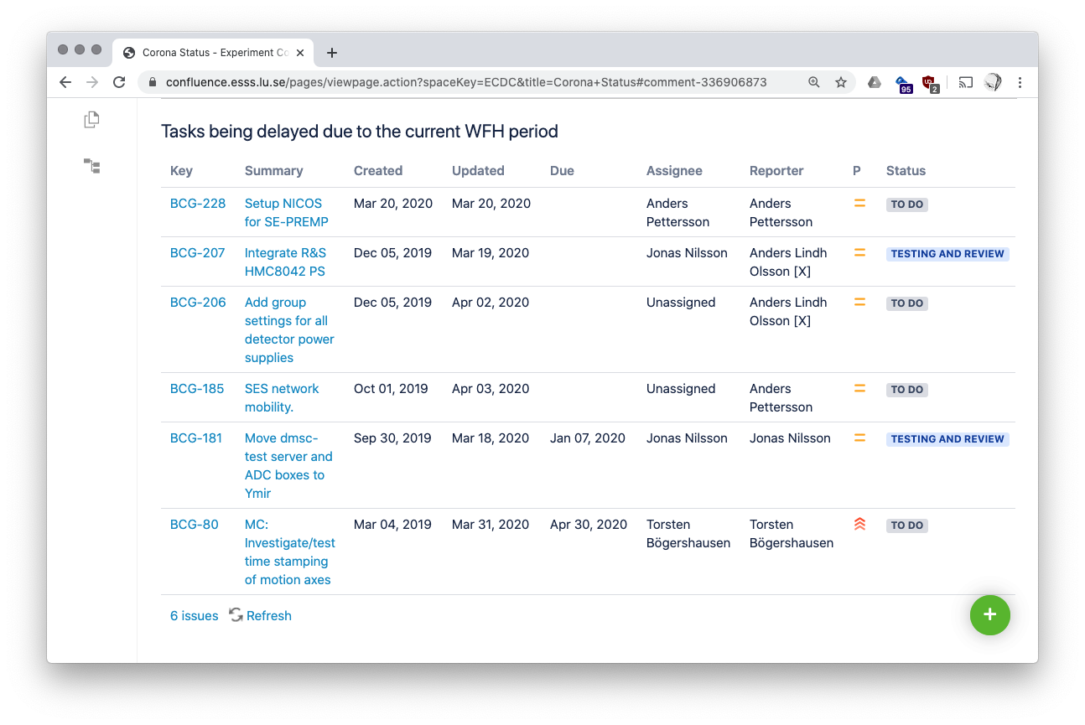
Effects of COVID-19
Tracking potential delays
For ECDC and close collaborators: Progress in Utgård and other lab spaces most affected.
We track what is happening and keep a list of what is not happening.
So far the rest of the project sees more of an impact with production and construction activities being delayed.
No ECDC specific mitigation planned to catch up, but potentially to react to external effects on the schedule.

Slide 10
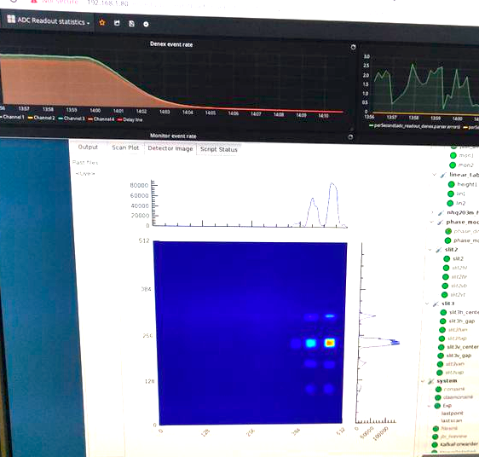
V20 Final Beamtime – December 2019
BER II will be missed
  Recorded last neutrons in Wannsee
  Rolled out new NICOS GUI
  Integration of acquisition with SciChat very welcome by the user
  Lesson from sample environment deployment support the new workflow to have projects initiated by SAD for a better integration and user experience
  Shutter got stuck half way before proper science could be done. Software was not the bottleneck. Identified a significant number of areas for improvement.
  Hard to replicate the same level of commitment and urgency in Utgard/Ymir

Slide 11
Integration, Testing and Demonstration Platform
Utgård and Ymir
Ymir demo beamline for hands-on integration work with
  new bench to mount beamline components (chopper, slits, etc) and work with laser
  equipment being added, somewhat impacted by COVID-19
  planning for realistic network setup and ICS infrastructure deployment under way
IBM Spectrum Scale storage system loan extended. Scalability and robustness tests promising. Will continue to benefit from the system for development.

Slide 12
Detectors
Event Formation and Slow Control
Morten Hilker-Skaaning replaced Martin to help Morten Jagd Christensen on the event formation.
Some progress on the front end and readout master regarding slow control and data format. Some demonstrators now exists. DG is ramping up the engagement with instrument in kind partners.
Loki test experiment at ISIS had to be postponed a few times and work is partially focussing on basic front end functionality.
Improvements on the performance of the NMX EFU pipeline, processing X-ray image data collected with a Gd-GEM prototype.
Work still ongoing on scalability across multiple event formation units.
Source timing information available from prototype readout system (through from MRF) for ”TOF” referencing in the event formation unit

Slide 13
Final Slide
Focus for this Year
Consolidate the DAQ and controls framework
    Eliminate bugs
    Ensure important functionality is robust
    Improve user experience
    Think about operational aspects (deployment, monitoring, debugging)
Continue integration and testing (Ymir)
Engage with instrument projects and prepare for commissioning
Improve planning
Detect forgotten scope, task and requirements while working on the main success scenarios
Begun good transition away from developing core functionality over a focus on delivery for instruments.
Planning for that on the detailed level is still in the early stages and will consume some effort.
Reorganisation was a welcome trigger that allowed us to take a more active role, for example in the Detector Readout controls development.
With hindsight BCT and the positive impact the team had on NSS integration and ICS implementation and delivery, may look like a halfway house to ECDC.

Slide 14
Thanks.

