Slide 2
DRAM Updates - STAP April 2020
PRESENTED BY Thomas holm rod

Slide 3
In Brief
Staff
  Two recruitments out:
    Replacement for resignee
    Instrument data scientist for imaging & engineering diffraction
Current in house dev projects
  DREAM & ODIN software ready for operation
  Scipp
  easyscience
Instrument data scientists
  One recruitment out for img & eng.
  Use in house staff for LSS and diffraction
Training
  Started to provide python training for staff with Jupyter notebook UIs
External funding
  Got additional funding to work on cluster expansion code icet with Chalmers
  Funding from ALC to work on SpinW core
  Applied for funding from Chan Zuckerberg Initiative to support SasView for life science

Slide 4
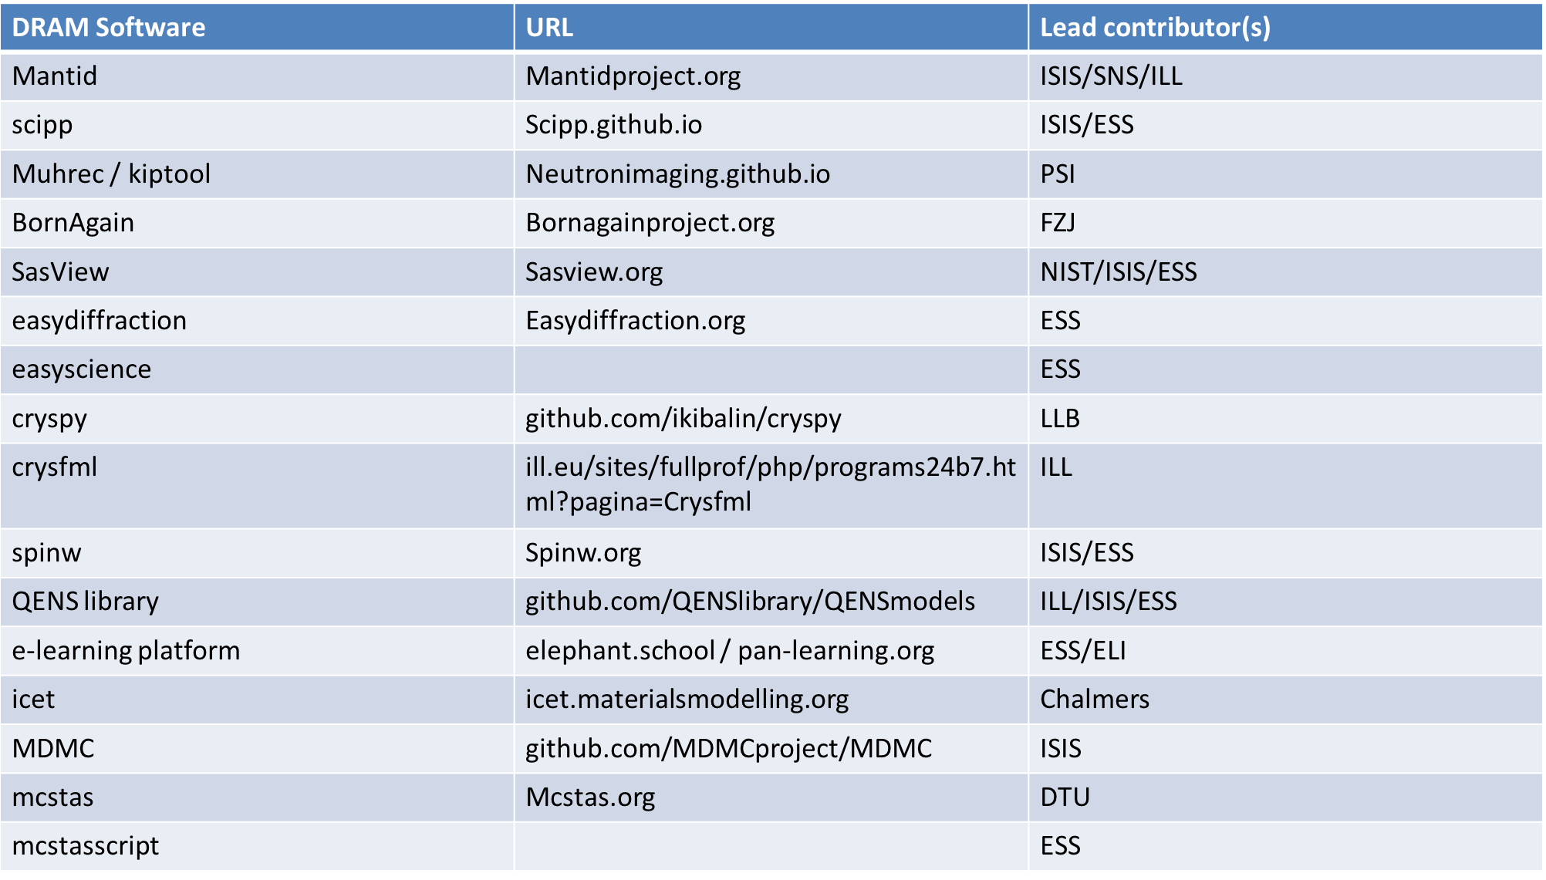
Software Overview

Slide 5
Some remarks
To previous slide
Crucial that partners can and will continue to maintain software (e.g. FZJ for refl)
Important that software remains maintainable
Important to avoid pollution of software suite with many different technologies
  … while allowing for evolution
  ESS software: easydiffraction, scipp, SasView, SpinW
Main activity last six months have been scipp and easydiffration (besides integration)
  Easy to install (but versions < 1.0)
  CI up running and documentation available from the very beginning
  Lessons learned for UX reflected in GUI for easydiffraction
  Crucial that other facilities maintain other software
  Once we have more to show apply for funding, e.g. from CZI or NNF

Slide 6
How we develop data reduction for specific instruments
ESS Test Beamline V20 has been major focus
Other instruments and McStas
Realistic beam profile and chopper cascade + ESS timing system
Integration and ”All-Up” testing of end-to-end software stack. i.e. operated as real beamline
WFM and real-world stitching modes for data
Real experiments covering variety of techniques, Imaging, SANS, Reflectometry, Diffraction …
Live mode operation testing
Work with data and work flows from existing similar instruments, e.g. SANS2D for LOKI, POWGEN & WISH for DREAM & MAGIC
Scale to increased flux for testing live reduction
Use McStas simulations using models mimicking future instruments
  GEANT4 for detectors
  Want to include sample environments
We need to avoid being over precise at this point to make best use of our limited resources and rather ensure that the systems developed can accurately meet long term objectives and handle high-risk aspects of data reduction requirements (enable rapid application development for instrument data scientists)

Slide 7
Instrument Data Scientists
Role:
Bridge the gap between science teams and developers
Elicit and take ownership of requirements
Make decisions (in collaboration) about priorities
Project / product manage DMSC deliverables
Contribute to software development
Assist users
Push and develop domain
Perform own research
Job description in job ad, see:
https://ess.eu/careers/vacancies
Notes:
Some teams have special DMSC interface persons (DREAM and ODIN)
spectroscopy: Céline for QENS, Piotr for NVS, Torben also involved
Currently three positions pending approval (IDS for spectroscopy, IDS for LSS, and one developer) -> IDS for spectroscopy,

Slide 8
2
Picture?
Milestones and timeline

Slide 9
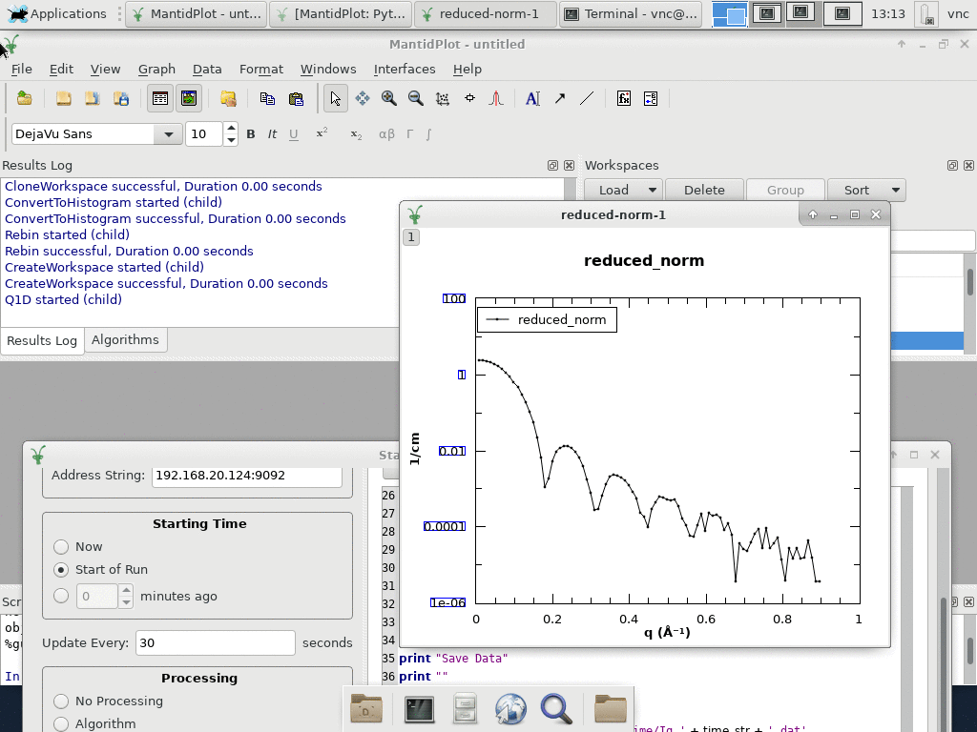
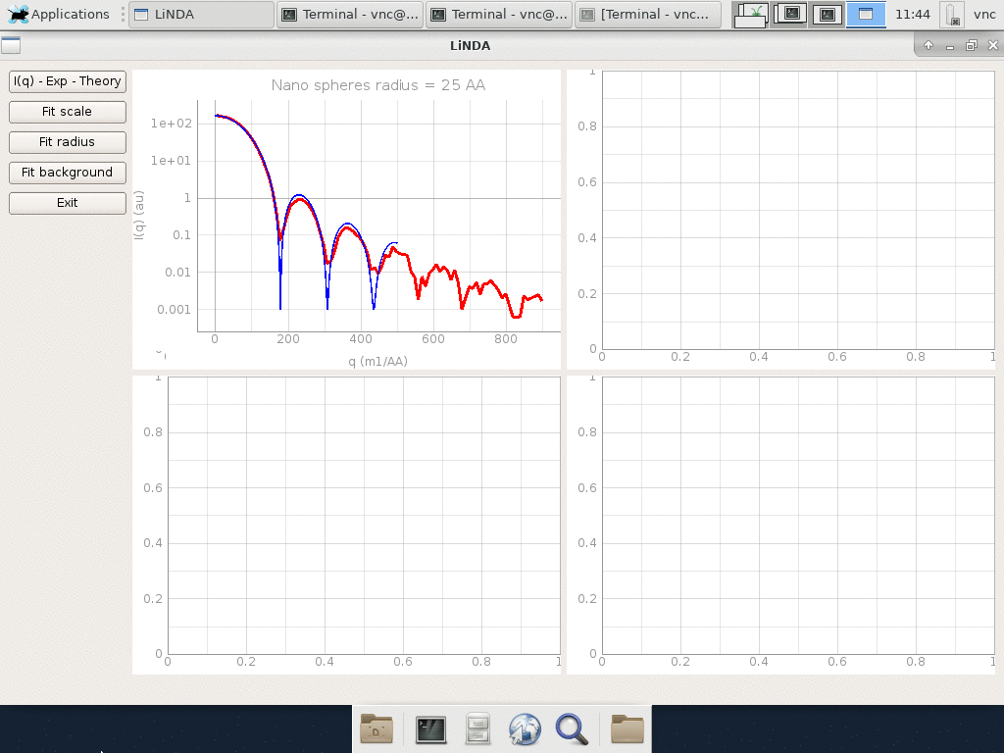
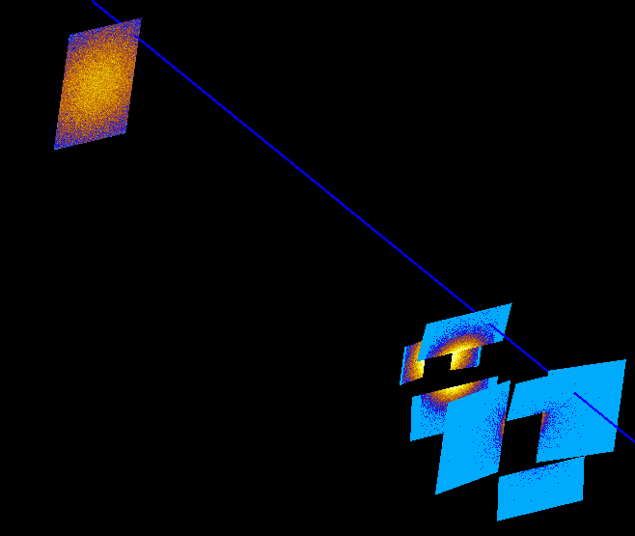
LOKI Live Data Processing
nano spheres radius 25 Å

Slide 10


Data Processing Software Ready for Operation of LoKI
Mantid live reduction of > 10⁷ events/sec and > 1 M detector pixels
SasView 5.0 released
Improved maintainability
Python CLI
New GUI
Batch fitting (via scripting)
Live analysis
Store and retrieve data from SciCat
LoKI specific resolution functions (aiming for end of 2019)
> future (but in progress, collaboration between NID, ISIS, and DMSC)
Two reports in CHESS decribe how the
construction milestones have been achieved:
ESS-1999819
ESS-1979130

Slide 11
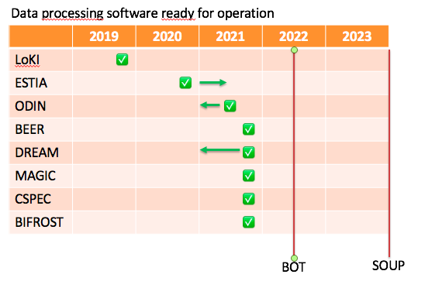
DRAM Timeline and milestones (2020 and beyond)
- Version: Sept. 2019
Associated milestones
2020: | 4 Instrument Data Scientists recruited
2022: | GUI support for data reduction ready

Slide 12
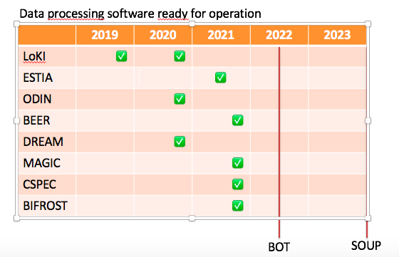
DRAM Timeline and milestones (2020 and beyond)
- Version: April 2020
Associated milestones
2020: | Min 1 Instrument Data Scientists recruited
2022: | GUI support for data reduction ready
Comments:
Current instrument data scientists working on milestones with team, so may change
2020 milestones will only be for the essentials
Lack of instrument data scientist for spectroscopy may delay CSPEC and BIFROST milestones
Notes:
Rght now in planning mode, also rebaselining from NID

Slide 13
3
Picture?
Since last STAP

Slide 14
Changes to Staff
ESS
  Igor resigned. Currently recruiting replacement
  Instrument data scientist position for imaging and engineering advertised
  3 recruitments still pending approval (two instrument data scientists and one core developer)
FZJ
  In kind lead developer quit
  Senior developer and new junior developer assigned to in kind contribution with assistance from rest of group
PSI
  Chiara resigned (a few months before planned termination)
  Agreement on new post doc (50% until end of September 2021)

Slide 15
Organization of DRAM for 2020 going forward (consolidation of ”reorg” in 2019)
DONKI | SCIPP | SWAT
Integration and instrument simulations, PaNOSC tech. Interface to DMSC groups | Focus entirely on SCIPP development | EasyStuff (analysis software)
Torben Peter Mads Lamar (< 5%) | Simon H Dan (ISIS) Piotr NN C++ | Simon W Andrew
🙂 Céline • 🙂 Wojtek • 😏 NN IDS
Instrument
Data scientist
Notes:
SWAT team very thinly resourced
Instrument facing team (DONDI + IDS) and core development team (SCIPP + SWAT) started to emerge

Slide 16
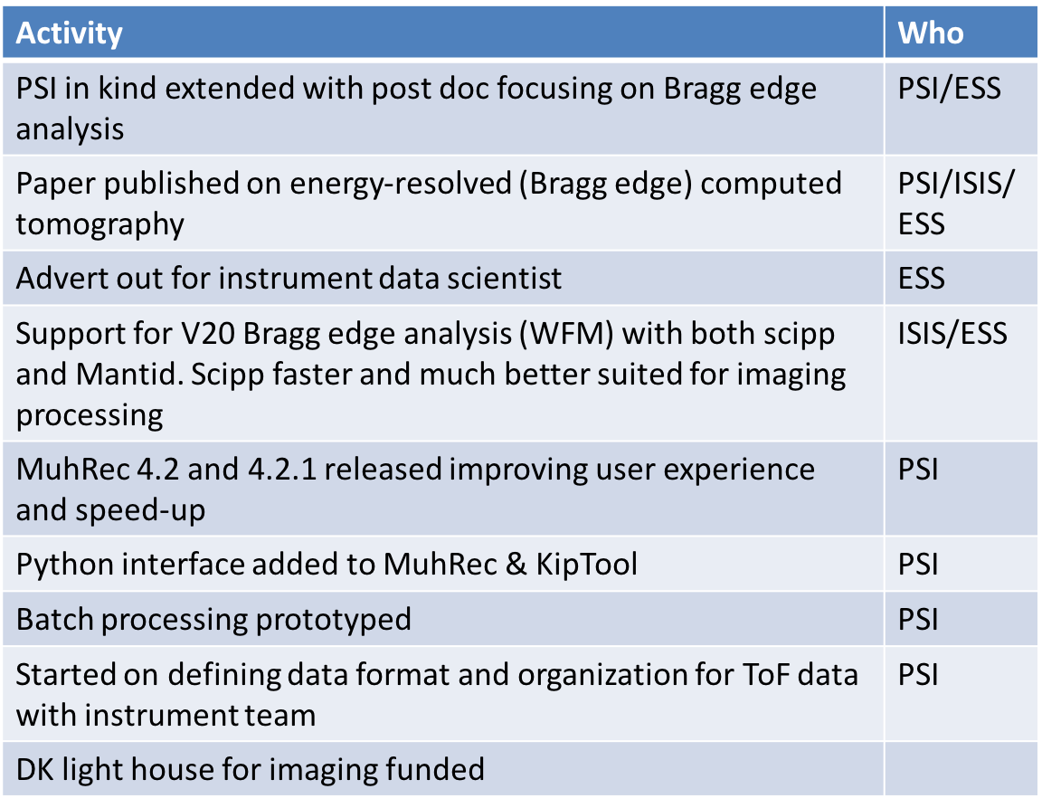
Imaging
Overall good progress in many areas. Working on improving coordination between activities at ESS, PSI, and ISIS incl. mapping out more detailed milestones. Instrument data scientist should be instrumental for this.
Focus area for 2020

Slide 17
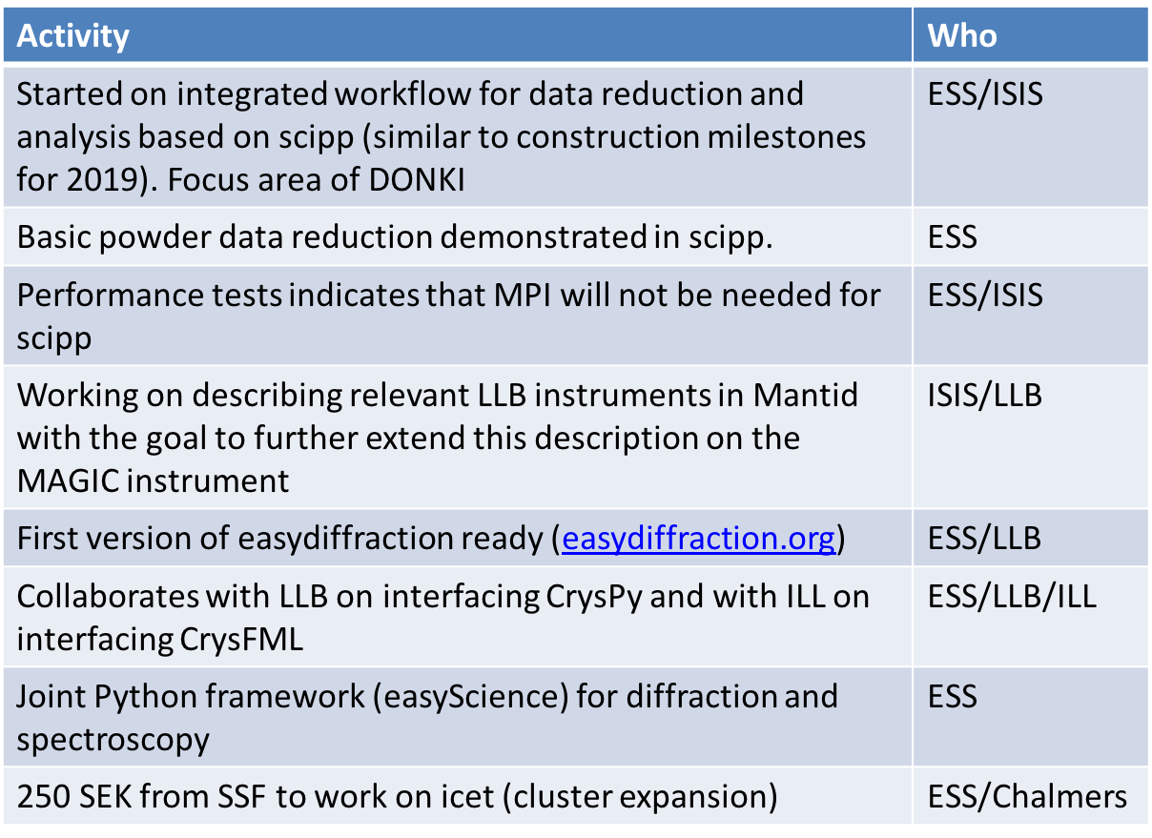
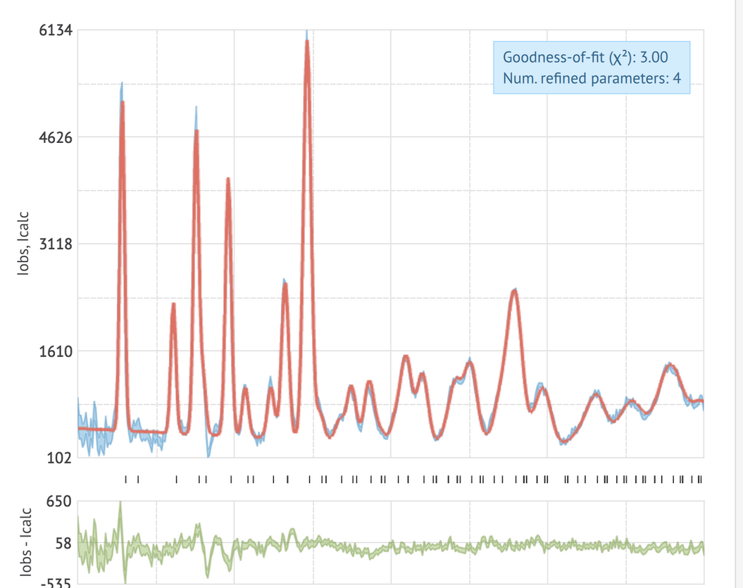
Diffraction
Another focus area for 2020. Started to consolidate strategy for interfacing to various libraries through easy diffraction and easyscience, which will also have an impact for spectroscopy. DREAM is used to drive scipp development.

Slide 18
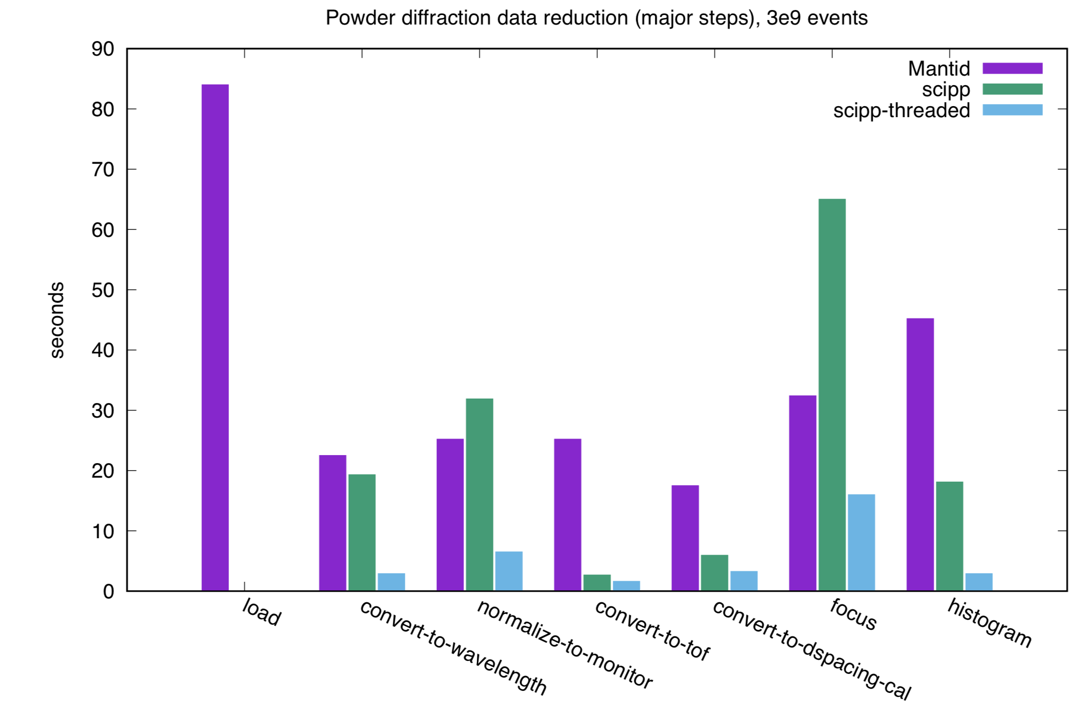
scipp performance comparison
For major steps in powder diffraction workflow

Slide 20
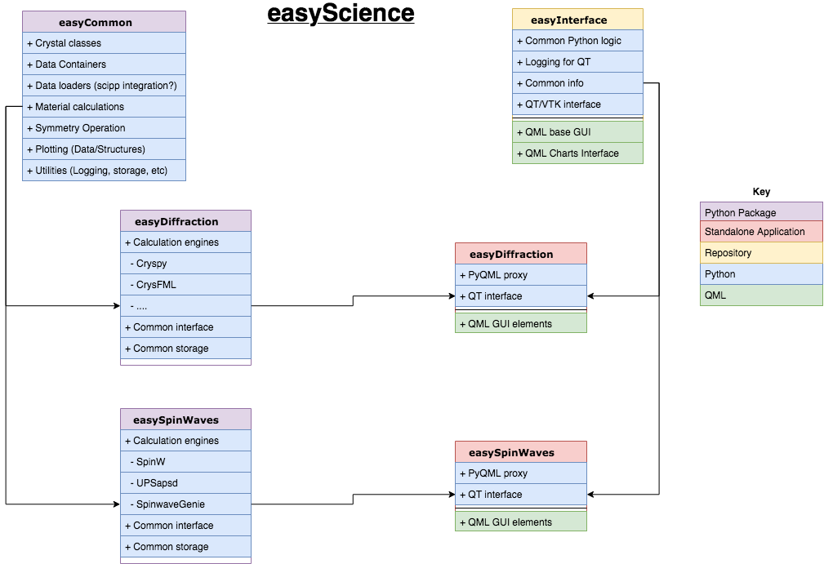
Diffraction (& spectroscopy) EasyInterface
Future design concept

Slide 21
What is easy?
Excellent or ESS or European
Analysis
Software for
You

Slide 22
Large-Scale Structures
Activity | Who
Integrated data treatment solution demonstrated for LoKI in 2029. Two reports ESS-1979130 & ESS-1999810 | ISIS/ESS
Working on appropiate ToF resolution functions with instrument team | ISIS/ESS
Started to develop SANS workflow in scipp
Submitted proposal to Chan Zuckerberg Initiative for supporting life science with SasView | ESS
SasView 5.0.1 released and 5.0.2 release candidate ready | ESS +
Wojtek acting instrument data scientist (50%) | ESS
Staff shortage at FSJ resolved | FZJ
New GUI design for reflectomerty separate from BornAgain and inspired by EasyDiffraction | FZJ/ESS
Good progress on reflectometry algorithms (e.g. roughness, polarization, etc) | FZJ
Consolidation of SANS work (e.g. conversion to scipp and improved resolution functions). FZJ decided to develop new GUI for reflectometry independent of BornAgain and shows good progress.

Slide 23
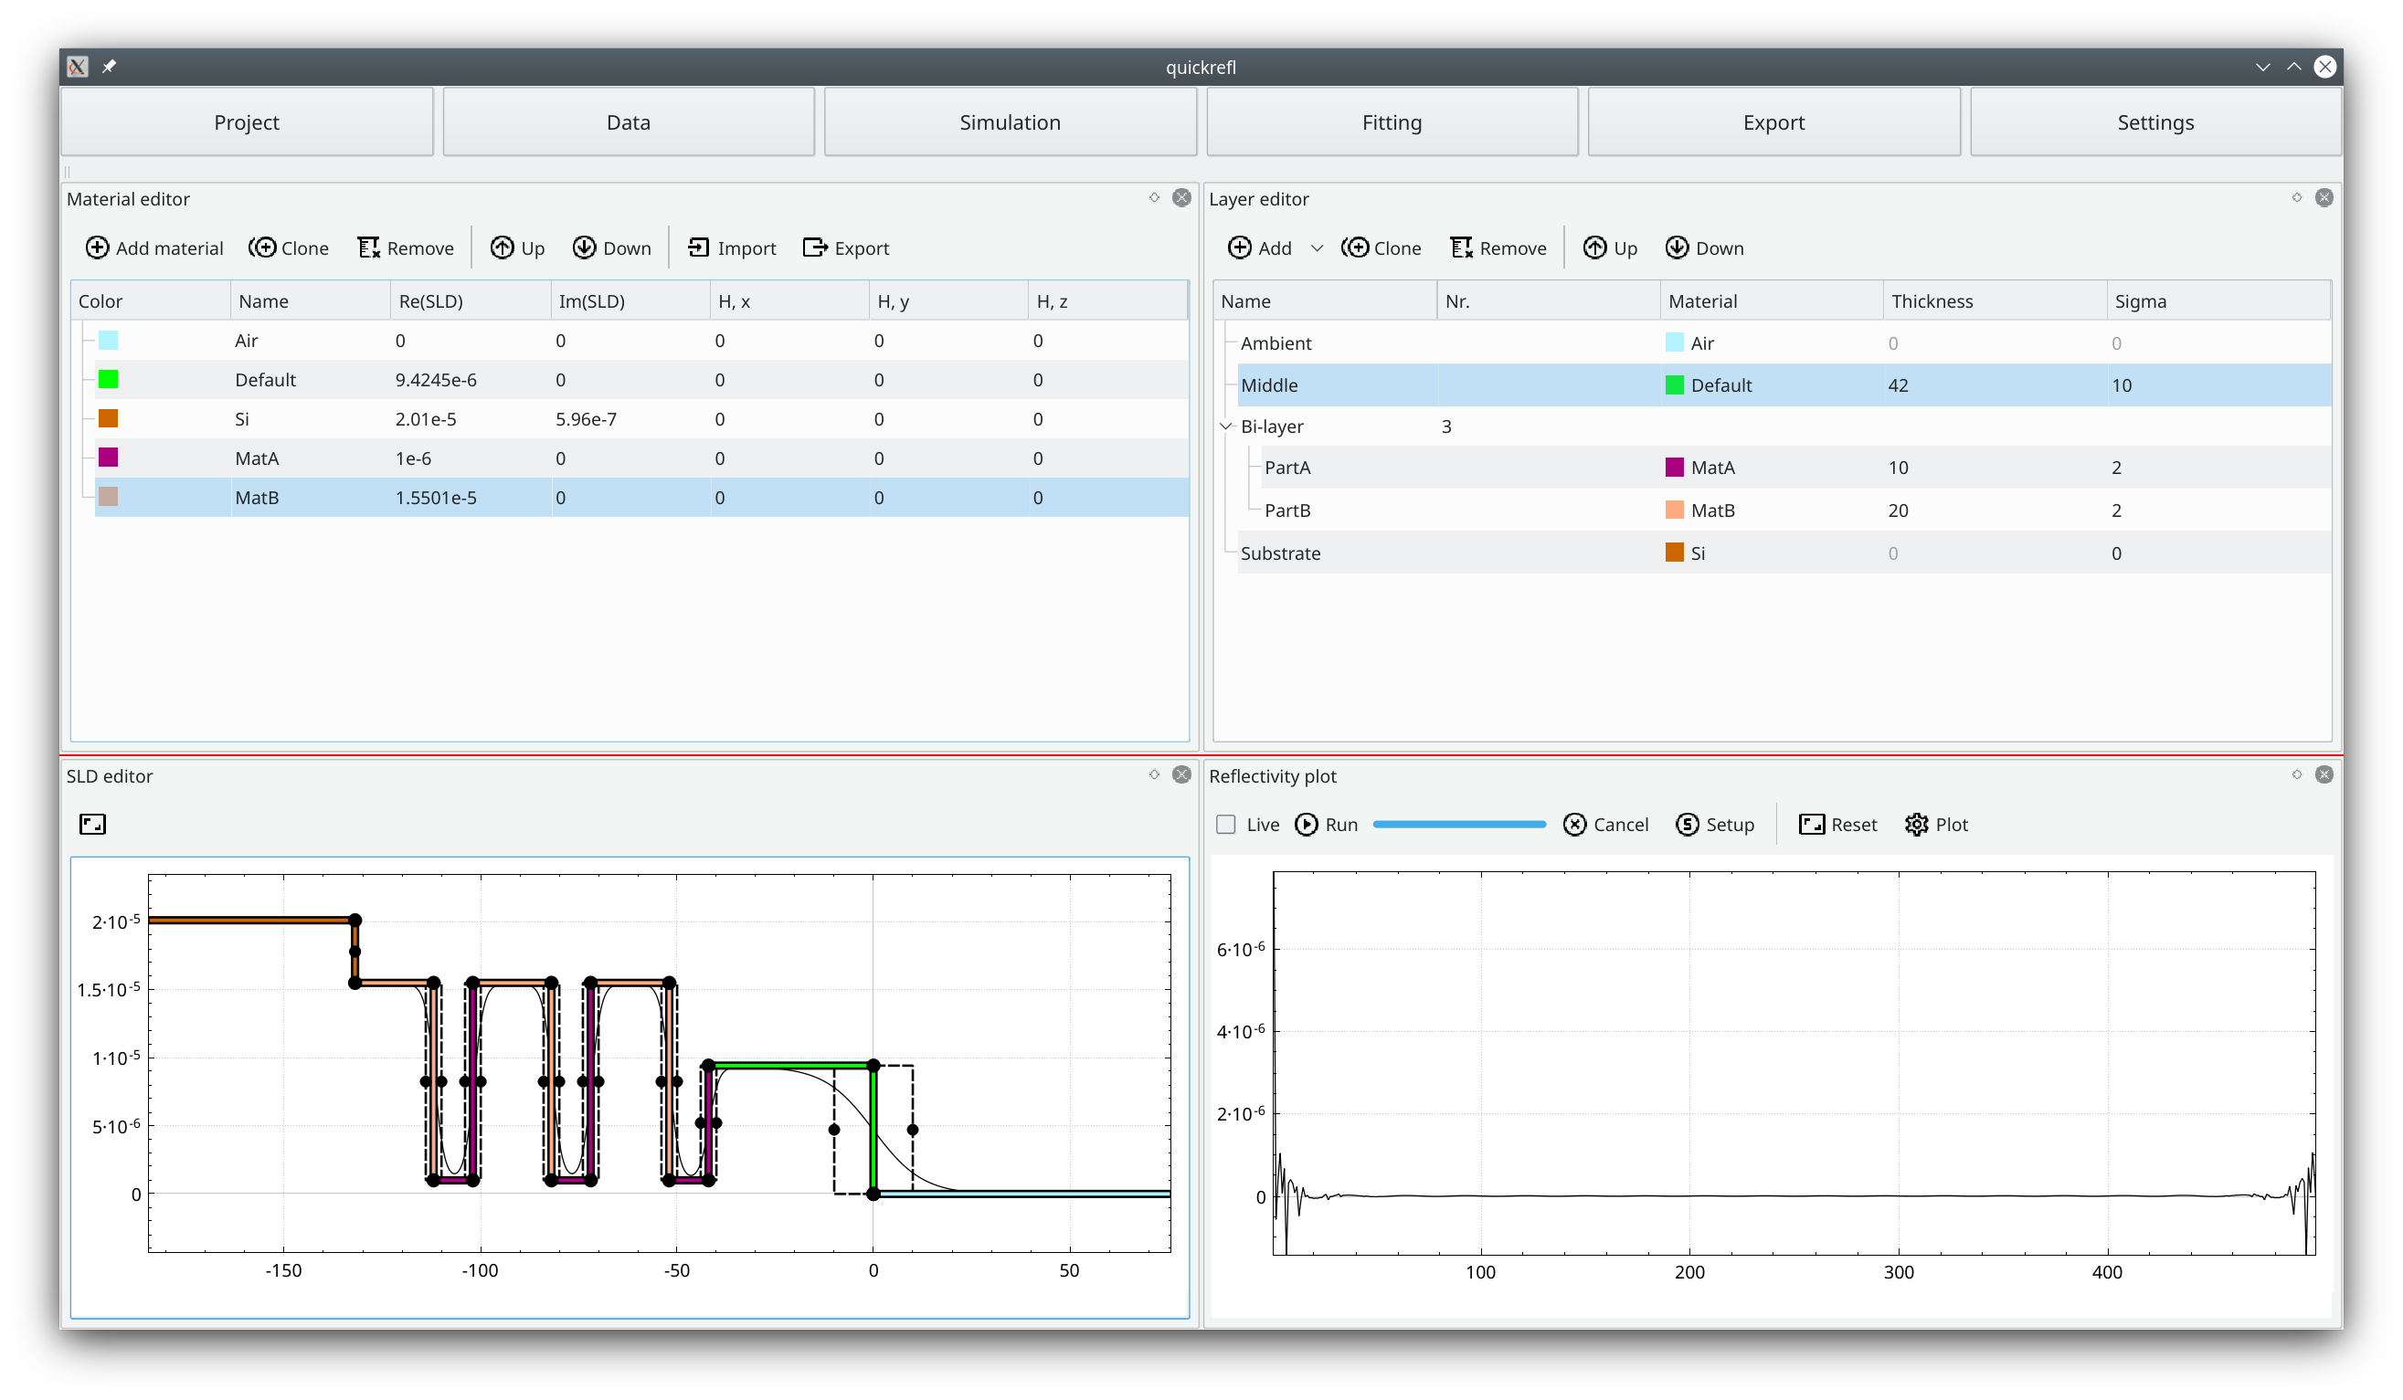
Early draft for reflectometry GUI
Addresses requirements and inspiration from easydiffraction

Slide 24
Spectroscopy
Activity | Who
Continues to collaborate with PACE project. ESS’ major deliverable will be a Python SpinW integrated with PACE | ISIS/ESS
QENS GUI under development at ISIS | ISIS
Started to introduce QENS model library to CSPEC team | ESS
Started work on Python interface for spectroscopy in conjunction with work on Python interface for diffraction | ESS
Organizing MDANSE school | ILL/ISIS/ESS/DTU
DK lighthouse for magnetism structures funded
MDMC for fitting potentials to QENS data continues at ISIS | ISIS/Chalmers/ UCPH/ESS
Has not been highly prioritized. Rely heavily on development at ISIS (QENS GUI in Mantid, PACE, AbINS) and now also funding for SpinW core development. ESS contributes QENS model library and SpinW in return. DK lighthouse for magnetism funded.

Slide 25
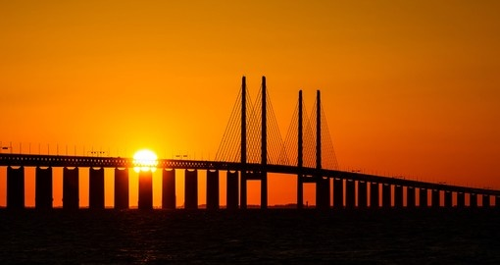
Questions?
QUESTIONS?

Slide 26
Thank you!

