Slide 1
Short Review of ESS Project Status
Workshop – Quality for In-Kind@ CEA/IPNO
Mauro Zambelli
European Spallation Source ERIC
Orly, 27th January 2020

Slide 2
Status of the ESS Project Construction, towards Operations & First Science

Slide 3
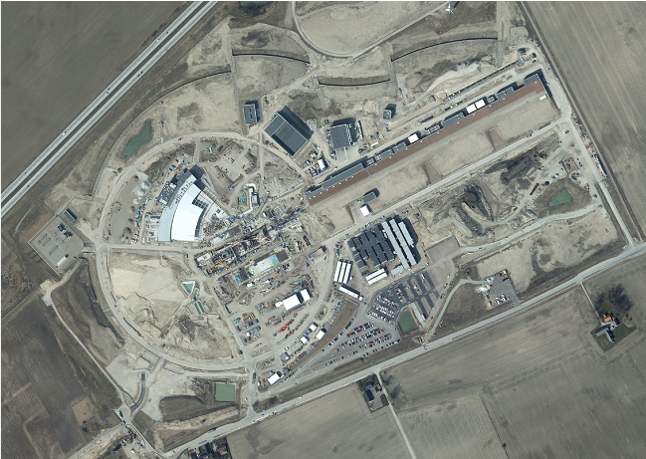
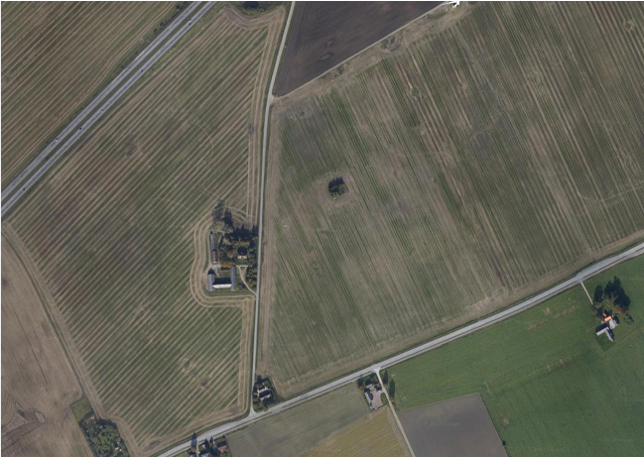
ESS is a “true” green-field Project

Slide 4
Journey to deliver the world’s leading facility for research using neutrons
Construction project is 62% complete
2025
ESS Construction Phase Complete
2019
TODAY
2014
Construction Starts on Green Field Site
2023
ESS Starts
User Program
2009
Decision to Site ESS in Lund
2019
Start of Initial Operations Phase
2012
ESS Design Update Phase Complete
2003
European Design of ESS Completed

Slide 5
A reminder of the ESS Critical Path
2018
2019
2020
2021
2022
2023
2024
2025
BOT
FS
SOUP
EOC
Warm LINAC Commissioning Steps
0.8 GeV Capability Installed
ESS is focused on delivering First Science with three instruments by the end of 2023
Schedule date (no float) is March 2023
Accelerator + ICS
Hi -Beta Install
Beam on Dump
(570 MeV)
Accel RBOT
Accelerator Schedule Float
CF + Target + NSS (Bunker+TBL) + ICS
Access for Monolith Installation
Target RBOT
Bunker & TBL RBOT
15th Instrument Complete (Ready for hot commissioning)
NSS Instruments + ICS
BOT - Beam on Target
RBOT - Ready for Beam on Target
FS - First Science
SOUP - Start of User Programme
EOC - End of Construction project
Instrument Hall Access for Start of Installation
Start beam commissioning for 1st Instruments

Slide 6
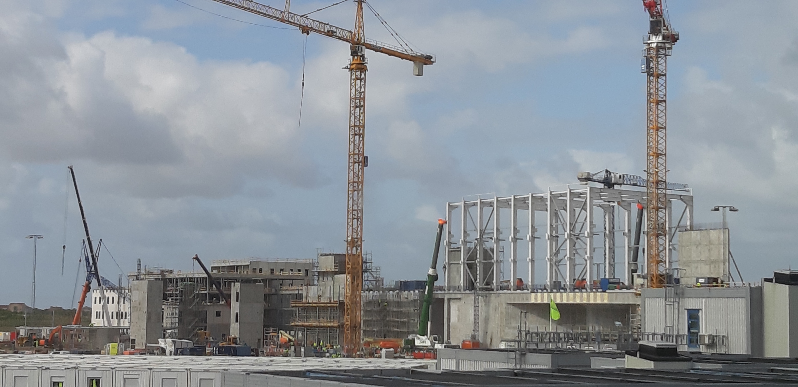
ESS Highlights
Conventional facilities
Civil construction remains on or ahead of schedule
Steelwork erection for target building high-bay and experimental halls now underway

Slide 7
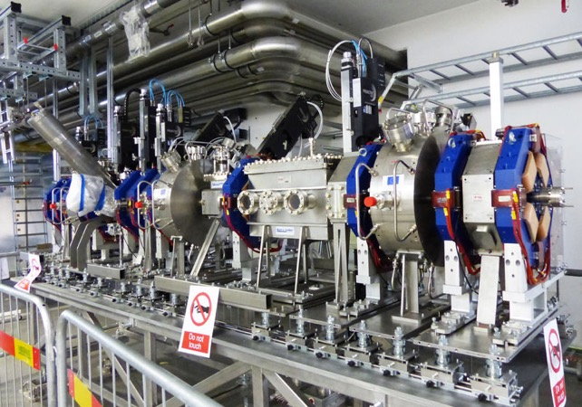
ESS highlights
Accelerator
Accelerator installation proceeding
Ion source and LEBT commissioned
MEBT installed
DTL received and being integrated
RFQ on site
Cryo-test stand permit received

Slide 8
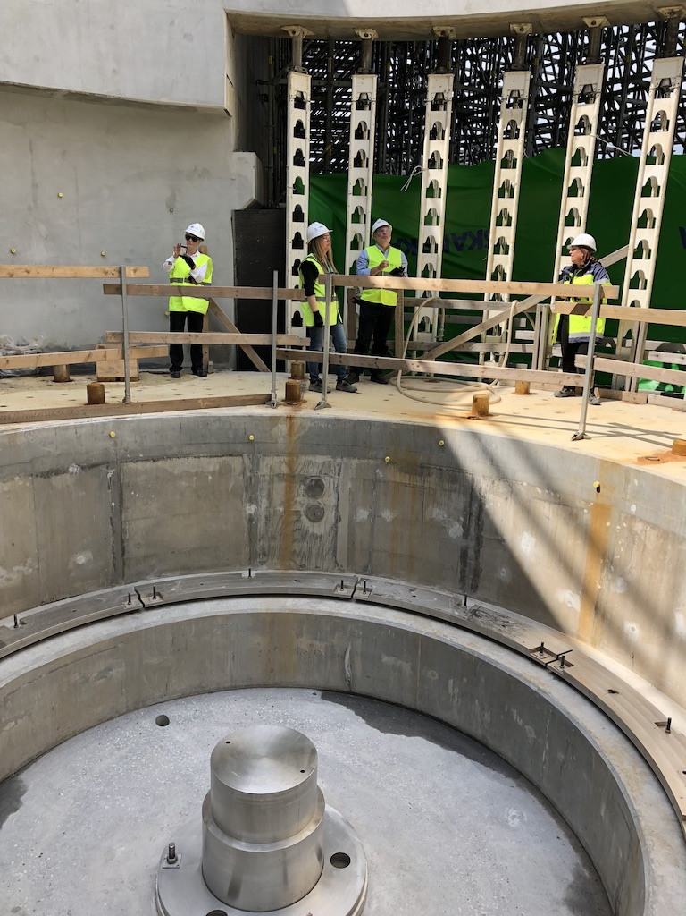
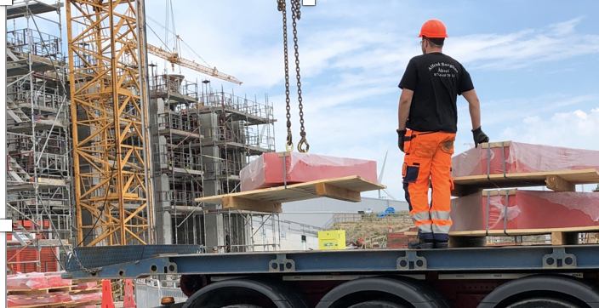
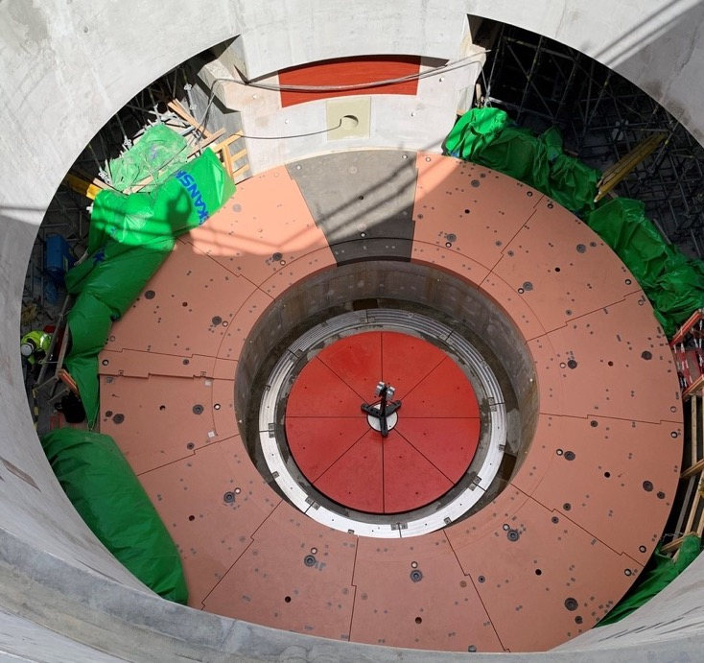
ESS highlights
Target
Target installation proceeding
High bay steelwork
Monolith shielding
Major components in manufacturing
Monolith vessel on track for delivery by end 2019

Slide 9
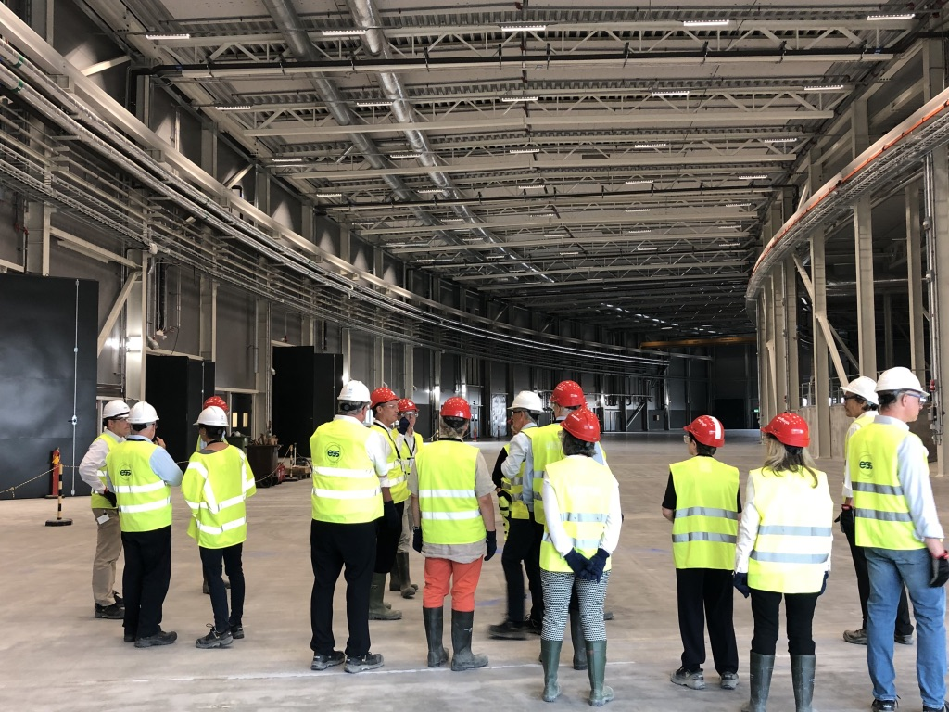
ESS highlights
Instruments
Bunker is in manufacturing
Instruments design phase complete – moving into construction
“First 3” instruments endorsed by IKRC
Common shielding, chopper and beam monitor designs developed to save time and money
Schedule mitigations implemented to reduce impact of port blocks on first science by modifying bunker installation sequence

Slide 10
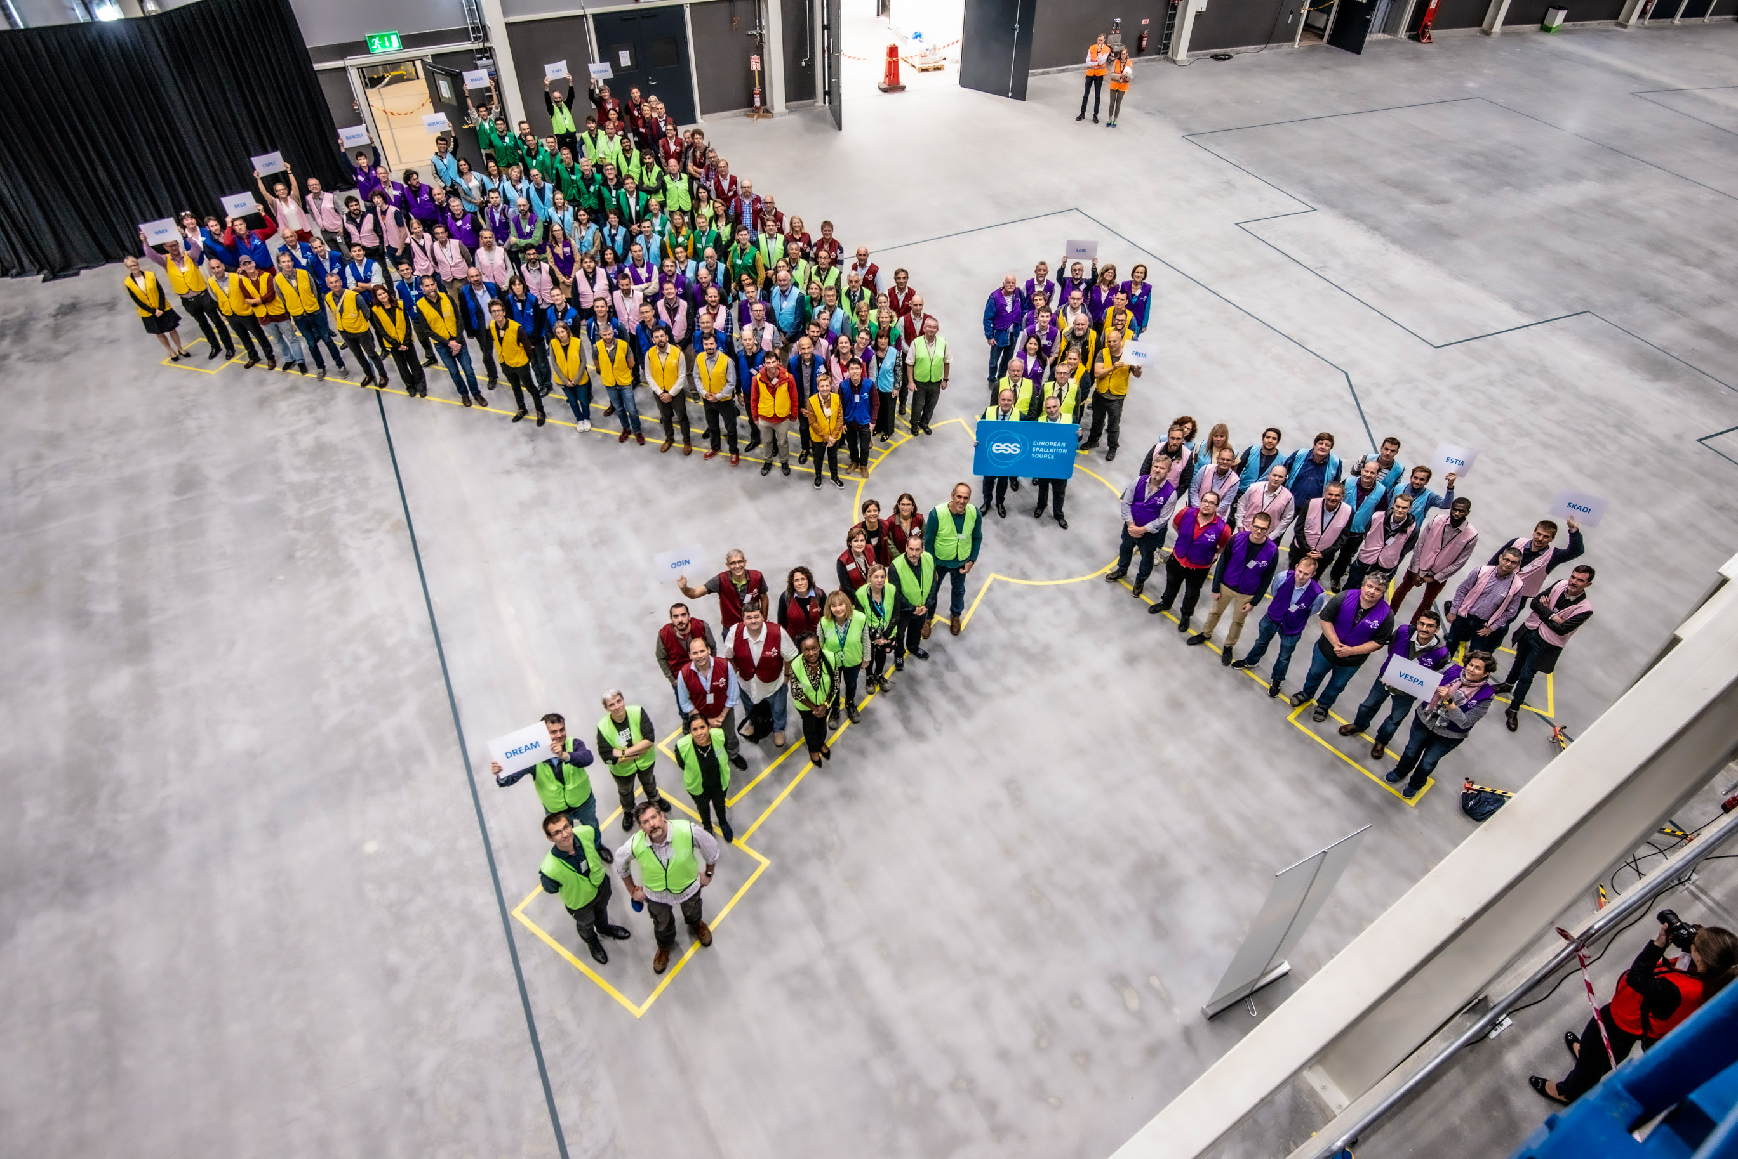
Inauguration of the E01 Experimetal Hall
September 9th, 2019

Slide 11
First eight instruments planned to be ready for commissioning by end of 2022
Diffractometers | Spectrometers | Reflectometers | SANS | Engineering & Imaging
DREAM | BIFROST | ESTIA | LOKI | BEER
MAGIC | C-SPEC |  |  | ODIN
May 2021 Access
BEER
C-SPEC
ODIN
BIFROST
DREAM
MAGIC
Jun 2021 Access
Aug 2019 Access
LOKI
Preferred first
three instruments
Jan 2021 Access
ESTIA
Notes:
There is risk with this plan and we need to revisit it
2 of the 3 choices for first science has the last area access

Slide 12
The IK Environment @ ESS

Slide 13
New challenges for IK management
IK Management @ ESS is rapidly moving from the Contractual phase to the Implementation phase, starting to look forward to the Operation phase
This requires a progressively different approach to the relationship both with the IK Partners and with the relevant Functions inside ESS
Complex issues are now coming into play: logistics, VAT on delivery and installation, quality documentation, CE marking

Slide 14
ESS – IK Provider relationship
The operative relationship between ESS and the IK Provider is essentially (and usefully) focused on the scientific/technical channel (WP Leader)
However, IK is a far more complex process, which requires a “multi-channel” communication and comprehensive interaction between ESS and the IK Partners / IK Provider

Slide 15
Multi-channel communication
IK Contribution Agreements
Technical Annexes and TA amendments
Relationship with Ministries and Funding Agencies
Administrative issues (i.e. Call-Offs payments)
VAT issues (particularly on delivery and installation)
Technical specifications
Project schedule
Logistics (transport, delivery)
Quality Control and quality documentation
CE marking / DOI
Installation and commissioning

Slide 16
ESS – IK Provider relationship
The IK Partners and the relevant sub-contractors must be supported by ESS in order to accomplish their contracts on spec, on time and on budget
ESS must be assured by the IK Partner about its capability to deliver equipment and services according to the specifications and to the schedule agreed

Slide 17
ESS – Organizational issues
In order to increase the effectiveness of the co-operation between ESS and the IK Partners, improvement in the internal organization for IK management are currently under way
In particular the two following concepts have been introduced:
IN-KIND FRAMEWORK MANAGEMENT
IN-KIND SUPPLY CHAIN MANAGEMENT

Slide 18
IK Framework vs. IK Supply Chain
European Spallation
Source ERIC
IKFR (Support)
ESS Project
Partner’s Issues
IK
Partner
ESS Requirements
IKSC (Control)

Slide 19
ESS – Organizational issues
IN-KIND FRAMEWORK MANAGEMENT
General and organizational issues: contracts, amendments, legal issues, liabilities, warranties, VAT, quality, contacts with Funding Agencies, Ministries, National Bodies
Responsibility: Strategy Directorate
IN-KIND SUPPLY CHAIN MANAGEMENT
Schedule and budget control
Responsibility: Project Directorate

Slide 20
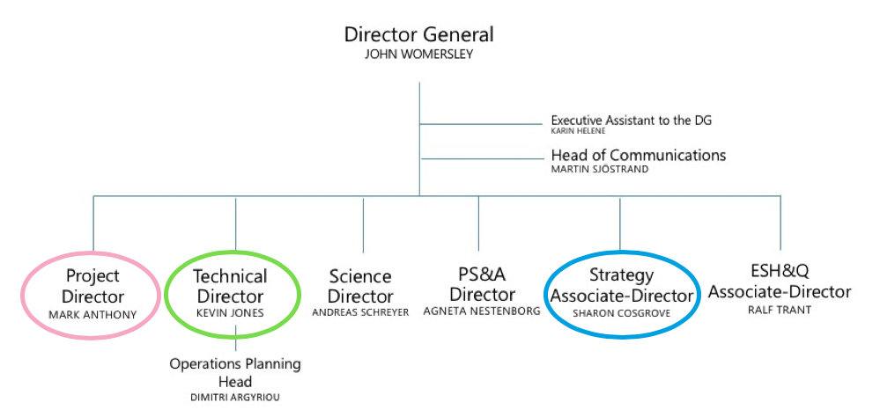
Top Management Structure @ ESS

Slide 21
ESS In-Kind System
FC
FC
FC
FC
FC
BrightnESS² WP3
ESS Work Package Leader
In-Kind
Partner
IK
ACCSYS
IK
ICS
In-Kind TECHNICAL Management
IK
TARGET
IK
NSS
In-Kind SUPPLY CHAIN
Management
In-Kind FRAMEWORK
Management

Slide 22
In-Kind Contributions @ ESS Results, Facts & Figures

Slide 23
IK Status at present
Key Points
To date
308 M€ (106 TAs) approved by Council (including 29 accredited).
145 M € (41 TAs) endorsed by IKRC.
Almost all IK for Accelerator, ICS and Target is approved by Council or endorsed by IKRC.
2015
2017
Ongoing
62 M€ to be agreed for NSS – mostly Instruments (Sample Environment + Neutron Technologies)
4 remaining IKCAs, HGZ (DE), ESS Bilbao (ES), CNR (IT), STFC (UK).
Following 15th Council approval of IK Principles, next step is to establish Procedures for IK Contributions during Operations
End of ESS Construction
550 M€ estimated IK.
Additional c. 28 M€ in collaborations (SE/DK) and c. 14 M€ in direct contracts placed with German Institutes.

Slide 24
Status of Specific IKCAs
Institute | Country | Status | Forecast | Estimated Total IK Value
FZJ | Germany | Jülich Contribution Agreement approved at Council #14 in Dec 2018. Jointly signed agreements with TUM and FZJ. Agreement with HZG is finalized but awaiting agreement on the BEER Instrument TA. | Qtr 2 2020 | 49.8 M€
TUM |  |  |  | 15.3 M€
HZG |  |  |  | 8.0 M€
CNR | Italy | Tri-lateral agreement with INFN and CNR is finalized, pending signature process. Tri-party structure selected for VAT reasons. Agreement ready for presentation at IKRC. | Qtr 1 2020 | 14.9 M€
ESS Bilbao | Spain | ESS Bilbao reviewing IKCA. Involvement of the State Attorney. | -Procure-ments not affected | 45.0 M€
STFC | UK | IKCA with UKRI finalized and agreed. Expected to be signed shortly. Agreement ready for presentation at IKCA. | -Procure-ments not affected | 111.8 M€

Slide 25
IK Status
Status of Agreements

Slide 26
Yearly progress of In-Kind

Slide 27
In-Kind Contributions @ ESS Conclusions

Slide 28
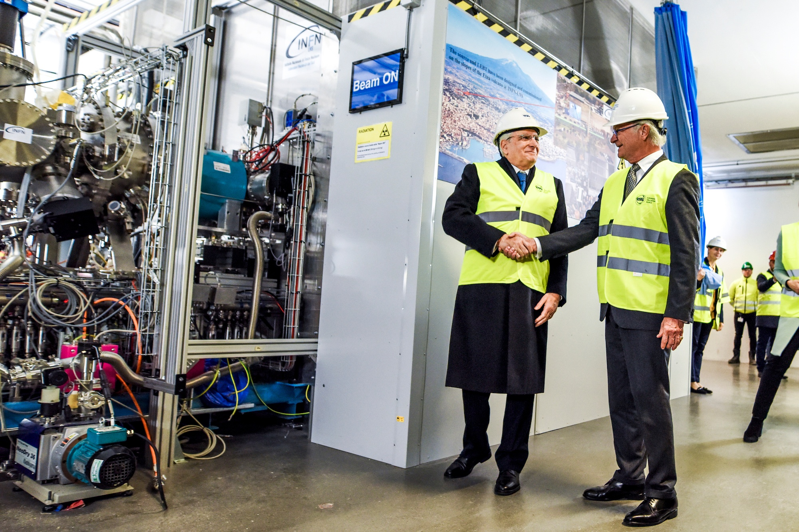
Conclusions
New management for and special focus to IK
Alignment of IK to implementation
IK during Operations being established
Specific issues to be solved (VAT, etc.)

Slide 29
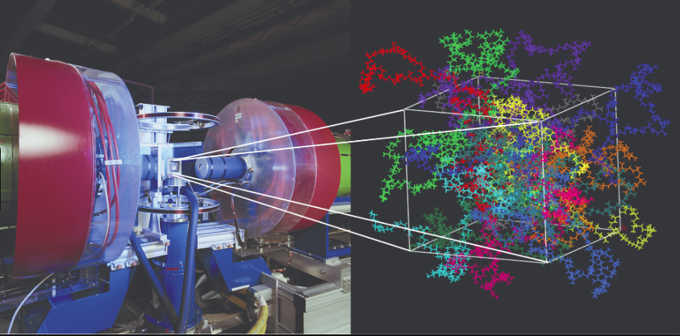
The commitment
ESS In-Kind System
is fully committed to achieve
FIRST SCIENCE in 2023

Slide 30
Thank you!
Mauro.Zambelli@esss.se

