Slide 1
Short Review of Cryomodule Collaborations and QA
Christine Darve
Workshop - Quality for In-kind CEA/IPNO (https://indico.esss.lu.se/event/1379/)
January 27-28, 2020

Slide 2
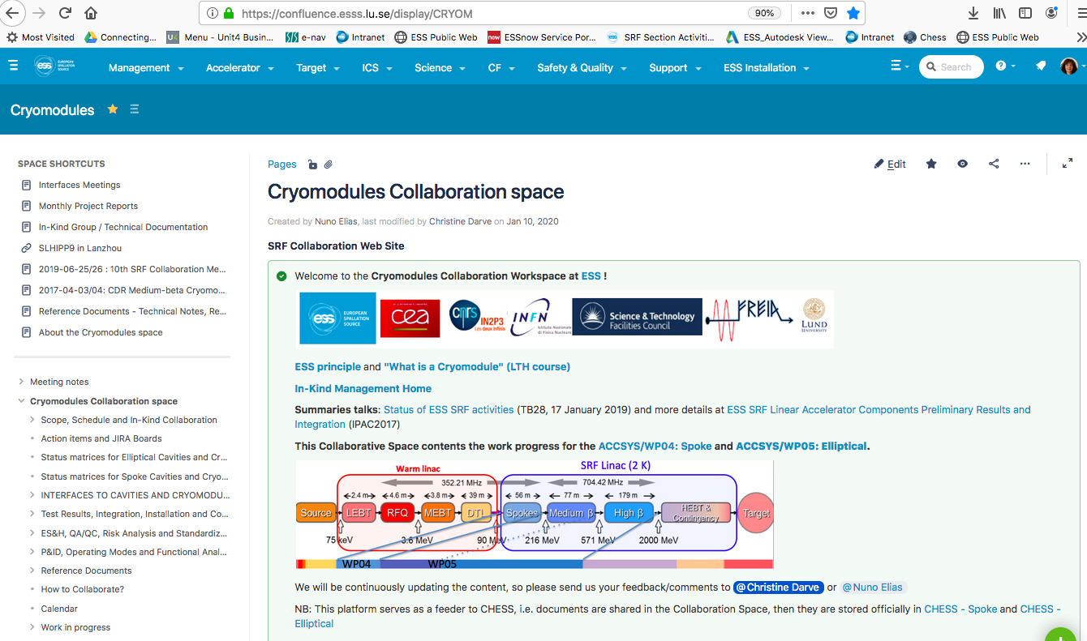
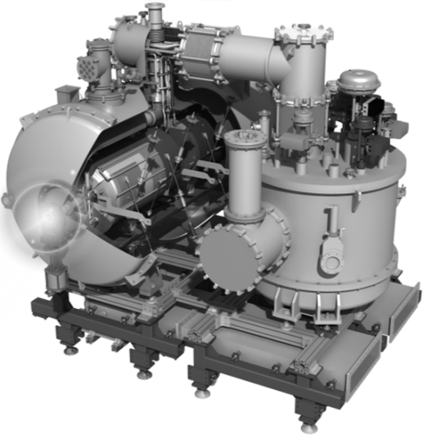
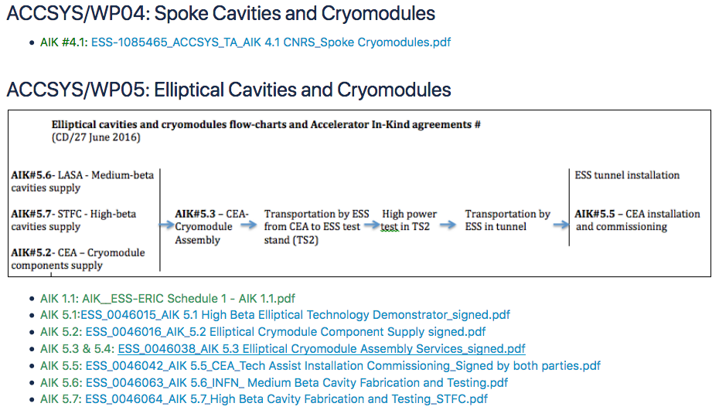
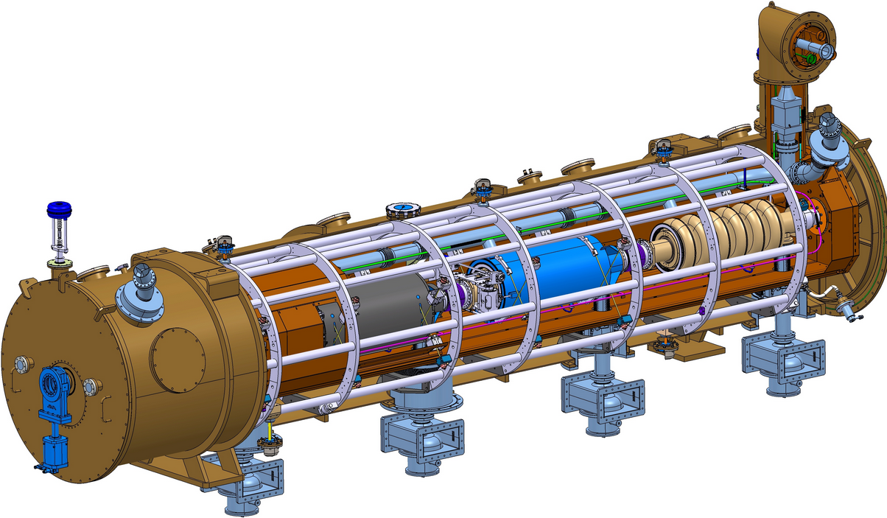
Spoke and Elliptical Cryomodule Collaboration
Notes:
Add cryomodules pictures

Slide 3
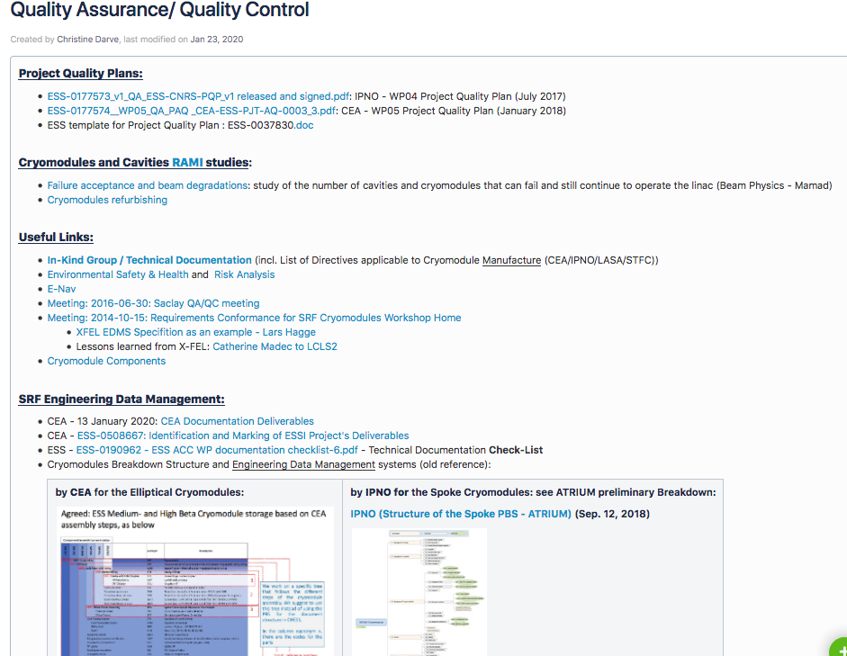
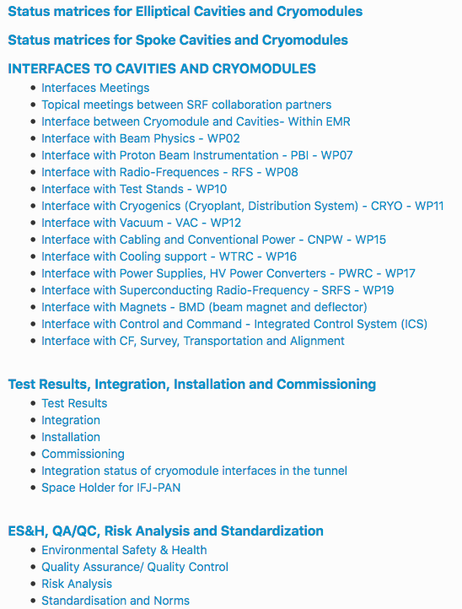
Cryomodule QA/QC

Slide 4
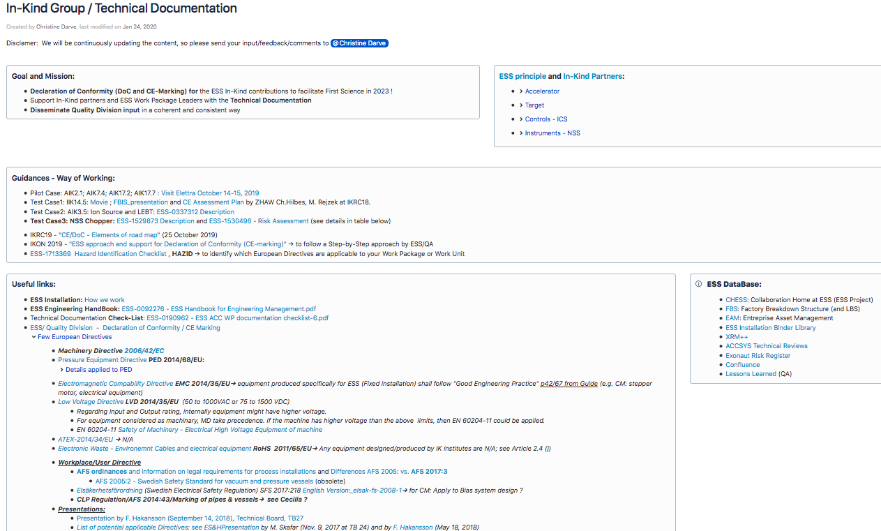
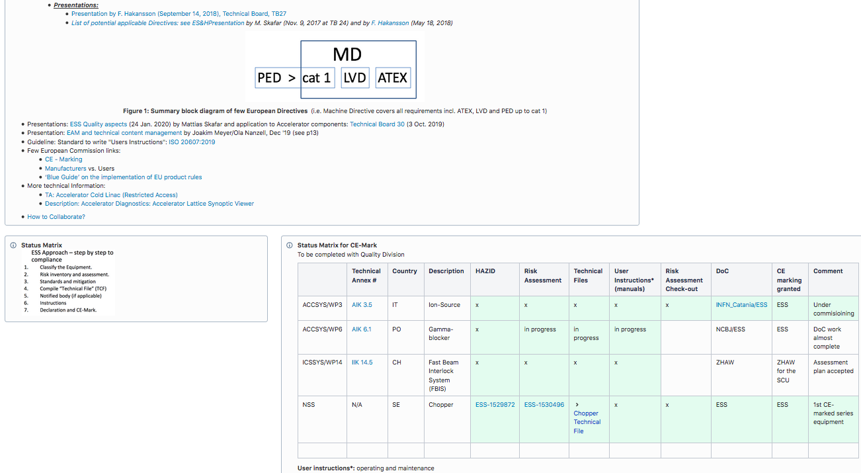
Towards a systematic ESS approach – CE Marking
See Maurice Looft’s presentation

Slide 5
In-Kind Group as a Catalyzer – Define a standard approach
Map the full Projects and Sub-project Breakdown Structures
Work Package and Work Unit
System owners
Create check lists of requested technical documentation (ESS E&SH and Quality):
Technical documentation (incl. operation/calibration, maintenance)
CE marking (HAZID, Technical File and Hazard Assessment): https://confluence.esss.lu.se/pages/viewpage.action?pageId=321272535
Support contact persons to obtain requested technical documentation
Customized approach for a systematic goal… WP by WP support
Develop IT tools to identify and track the requested documents (CHESS folders, JIRA for Risk Management; Confluence)
Complete ESS DataBase: FBS, EAM, Installation binders: https://confluence.esss.lu.se/display/EWO/ESS+Installation+Binder+Library
Empower the BrightnESS² Field Coordinators !
Notes:
Trust and

Slide 6
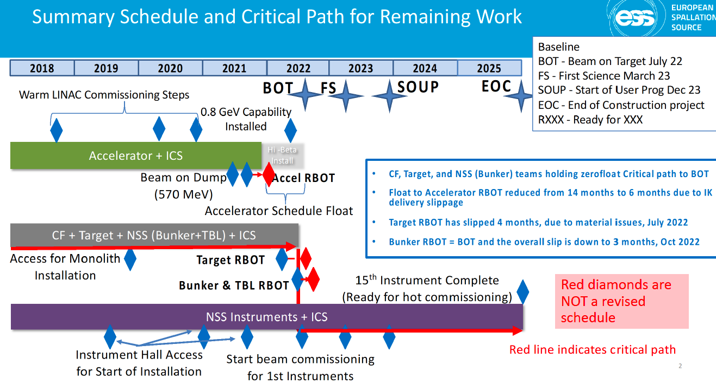

Slide 7
Backup slides

Slide 8
Technical Information Management
How information is connected
CHESS
FBS
Integrated Control System
LBS
ESS
ACC (Accelerator)
ESS-Name (EPICS)
ESS
+ESS.G
MBL
MBL-010Crm:EMR-Crm-001
+ESS.G01
Cryomodule 1
MBL-020Crm:EMR-Crm-001
+ESS.G01.090
Cryomodule 2
+ESS.G01.090.1001
+ESS.G01.090.1001.100
+ESS.G01.090.1001.102
Asset
Installed
M-ECCTD
Cavities
M-ECCTD 003
RF Couplers
Cryostat
Enterprise Asset Management
Part

Slide 9
Management of information from Partners
Handling of documentation
All Facility Documentation shall be mastered in CHESS.
We expect large volumes of documentation coming to ESS over the next few years. Building documentation already started.
Normal flow of documentation transfers
Documentation ready
Request to TCM to transfer documentation
TCM validates documentation
Verifies that it is a legitimate request
IT imports information
Certain filetypes are not permitted
Verifies document structure and type
Request to IT to import
Information is connected to correct structures
Information are connected to correct structures.
Workflows for ESS reviews are populated.

Slide 10
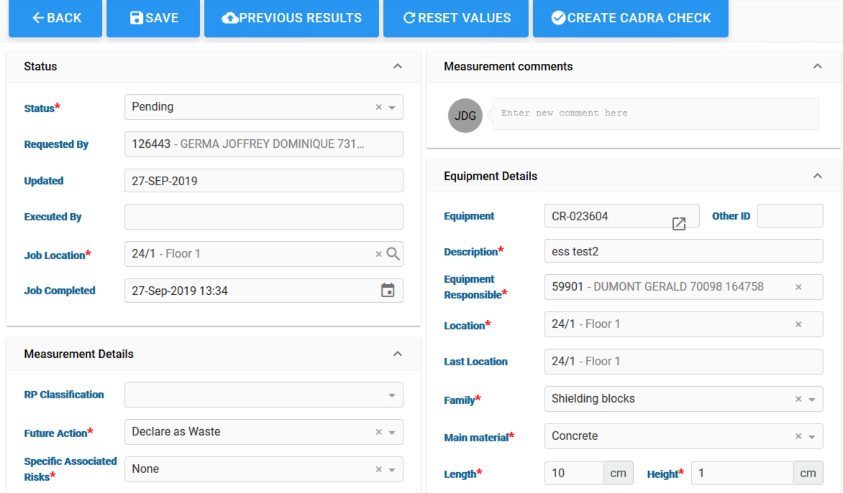
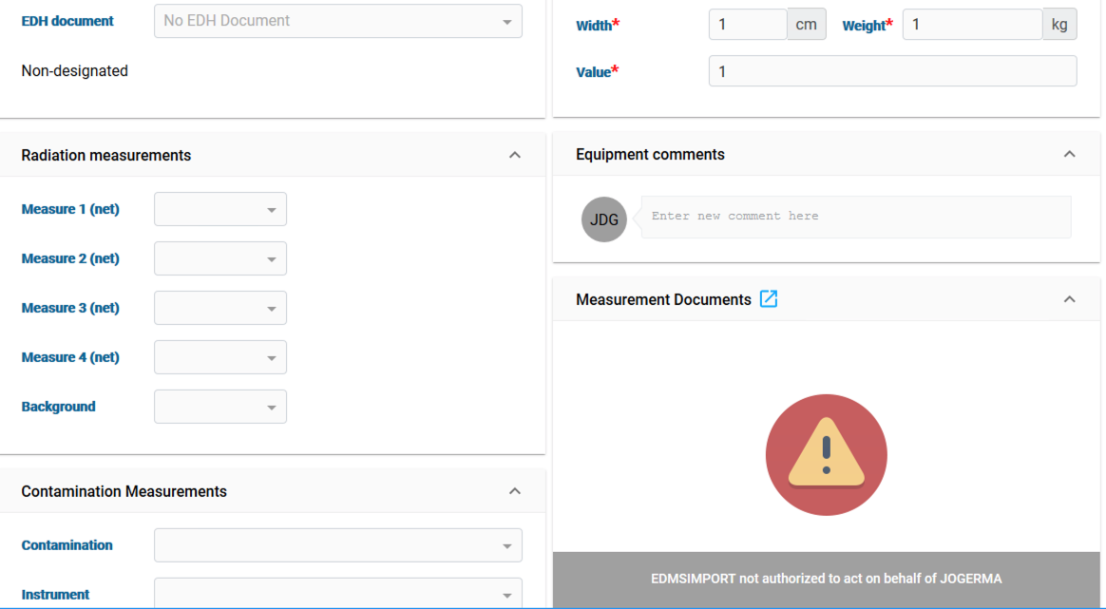
EAM System
Radiation Protection
EAM will support the RP group at ESS with RP surveying for equipment in the facility
Requires us to have the right infomration stored in EAM in order to conduct the survey and process the equipment as possible waste

Slide 11
Need form our partners
ESS Document list gives guidence on where should end up and what kind of information we would need.
Documents shall not cotain versioning information in the filename.
The partner delivers through an agreed intefrace were we clearly can distinguish between old and new documents beeing delivered.
Parts list where we get information on main parts beeing used. (Link to Part template)
Asset list information about what has been defined as assets.
Important that the workpackage feels responsible for the information. Assets and Part information needs to be maintained in EAM once entered.

