Slide 1

An Introduction to fundamental
ISO Standards for Technical DWGs
Beniamino Gentile – EIS Dept
Design Engineer
29.01.2020

Slide 2
Abstract
“(…) we need to present & communicate in a professional & coherent way, as ONE ESS”
J. Womersley
Director General, ESS
Lund, 18 December ‘19

Slide 3
Table of Contect
Introduction
ISO’s presentation
Real Life Case Study
Conclusions
Questions

Slide 4
Introduction: Part vs Assy
Heat treatment
Coating treatment
Priority sequences
MFG processes
Surface roughness
Dimensions precision
Quality check procedure
Part DWG
Graphic representation of part, its shape & dimensions
Study DWG: delivering/showing all technical
solution implemented to fulfill technical specifications;
Assembly DWG: delivering/showing identification &
mutual positioning of all sub-assembly organs & parts of device;
Installation DWG: delivering/showing instruction & procedures
to install the device on site;
Assy DWG
Setting properly DWG to share & transmit information univocally, without any ambiguity
Adequate interpretation of any
technical documentation
Language of Technical Drawings

Slide 5
ISO’s Presentation
ISO 128: Technical DWGs – General Principles of Presentation
ISO 128-1: Introduction & Index
ISO 128-15: Presentation of ShipBuilding DWGs
ISO 128-20: Basic Conventions for Lines
ISO 128-21: Preparation of lines by CAD-systems
ISO 128-22: Basic Conventions & Application for Leaders & Reference Line Lines
ISO 128-23: Lines on Constructions DWGs
ISO 128-24: Lines on mechanical engineering DWGs
ISO 128-25: Lines on ShipBuilding DWGs
ISO 128-30: Basic Conventions for View
ISO 128-34: Views on mechanical engineering DWGs
ISO 128-40: Basic Convention for Cuts & Sections
ISO 128-44: Sections on mechanical DWGs
ISO 128-50: Basic Conventions for Representing Areas on Cuts & Sections
ISO 128-71: Simplified drawing method for mechanical drawings

Slide 6
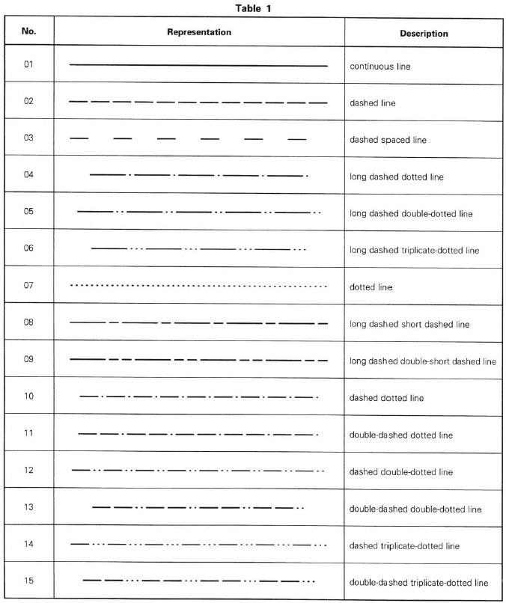
ISO’s Presentation
ISO 128-20: Basic Conventions for Lines

Slide 7
ISO’s Presentation
ISO 128-20: Basic Conventions for Lines
ISO View=Exploded View!

Slide 8
ISO’s Presentation
ISO 128-20: Basic Conventions for Lines

Slide 9
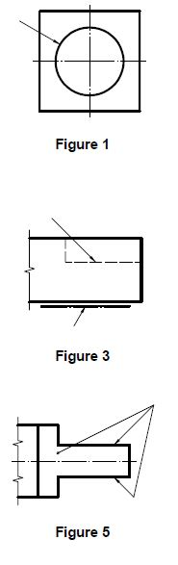
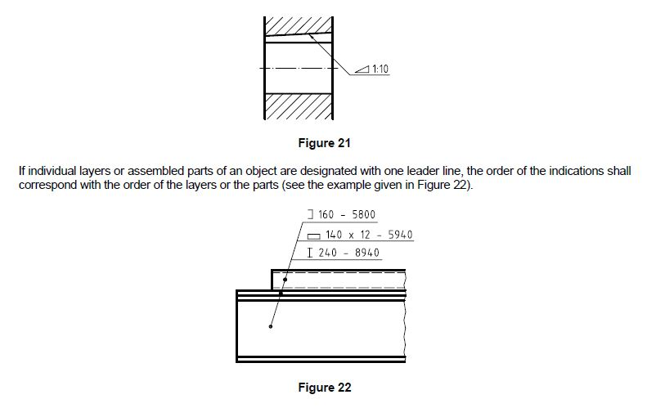
ISO’s Presentation
ISO 128-22: Basic Conventions & Applications for Leader Lines and Reference Lines

Slide 10
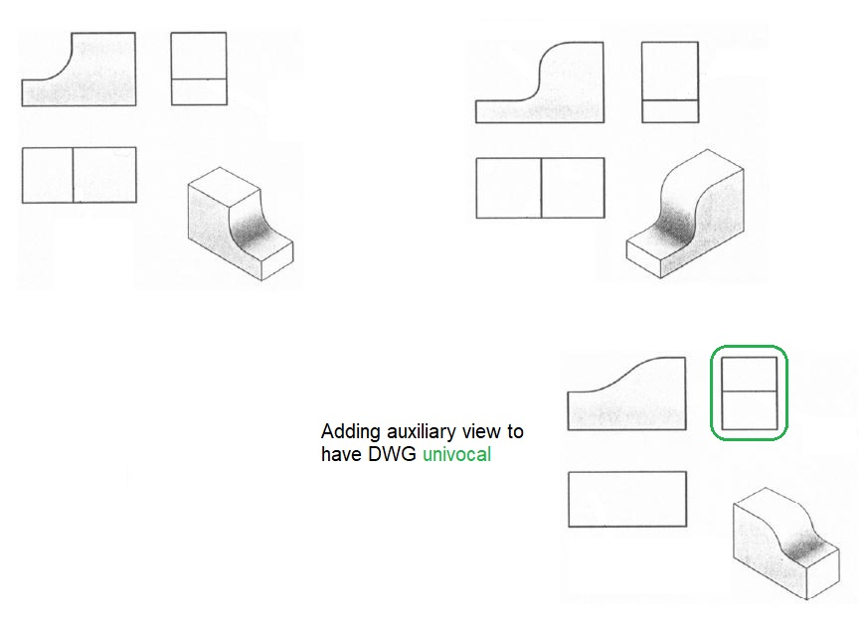
ISO’s Presentation
ISO 128-24: Lines on Mechanical Engineering DWG’s
DWGs Vs Orthogonal Projection Vs Fake Edges

Slide 11
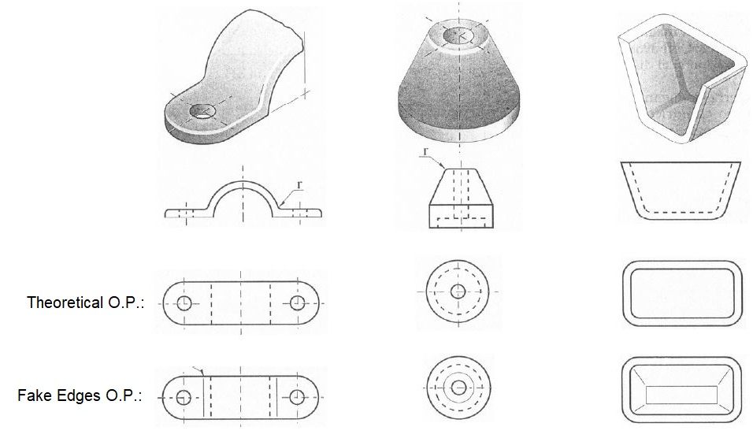
ISO’s Presentation
ISO 128-24: Lines on Mechanical Engineering DWG’s
DWGs Vs Orthogonal Projection Vs Fake Edges

Slide 12
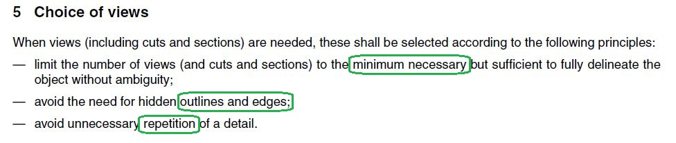
ISO’s Presentation
ISO 128-30: Basic Conventions for Views
Good Sense!

Slide 13
ISO’s Presentation
ISO 128-30: Basic Conventions for Views
If a SW delivers a feature .. it
does not mean you need it!

Slide 14
ISO’s Presentation
ISO 128-30: Basic Conventions for Views
..which DWG is going to get the
best offer during a tender?

Slide 15
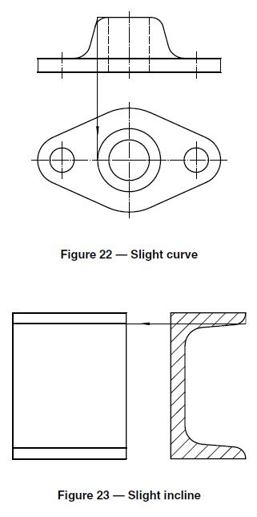
ISO’s Presentation
ISO 128-34: Views on Mechanical Engineering DWGs
Slight Inclines &/or Curves

Slide 16
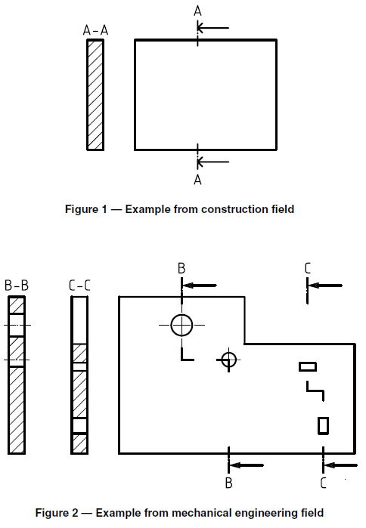
ISO’s Presentation
ISO 128-40: Basic Conventions for Cuts & Sections

Slide 17
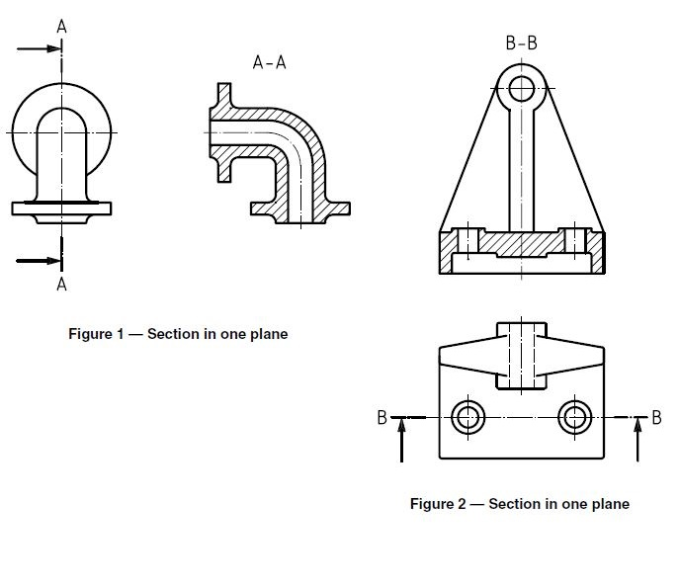
ISO’s Presentation
ISO 128-44: Sections on Mechanical Engineering DWG

Slide 18
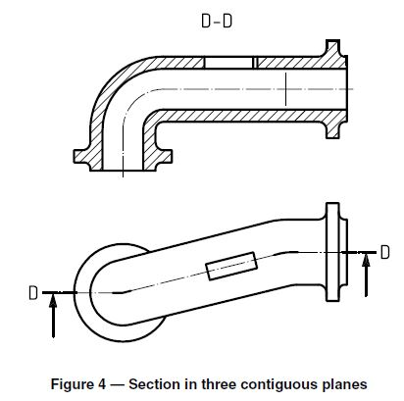
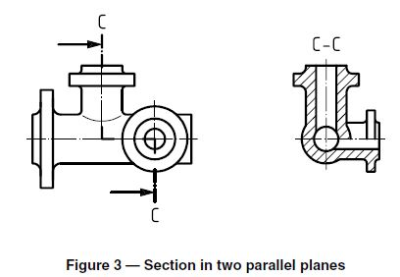
ISO’s Presentation
ISO 128-44: Sections on Mechanical Engineering DWG

Slide 19
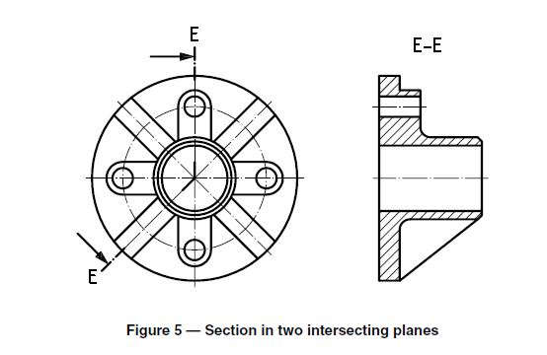
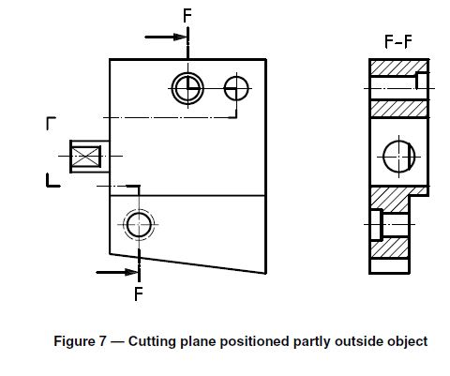
ISO’s Presentation
ISO 128-44: Sections on Mechanical Engineering DWG

Slide 20
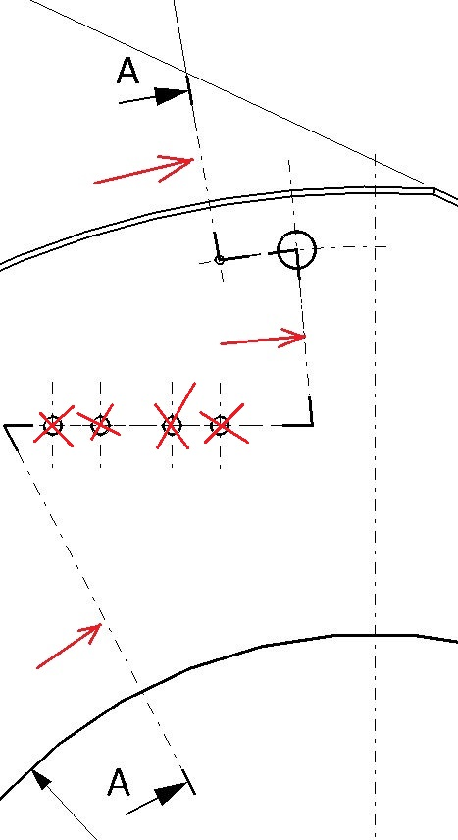
ISO’s Presentation
ISO 128-44: Sections on Mechanical Engineering DWG

Slide 21
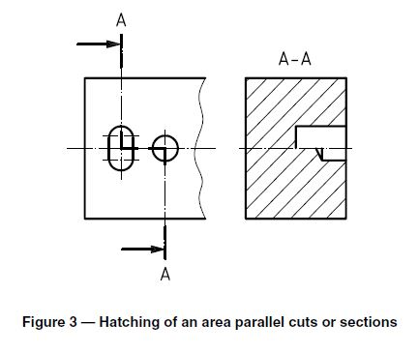
ISO’s Presentation
ISO 128-50: Basic Conventions for representing Areas on Cuts & Sections

Slide 22
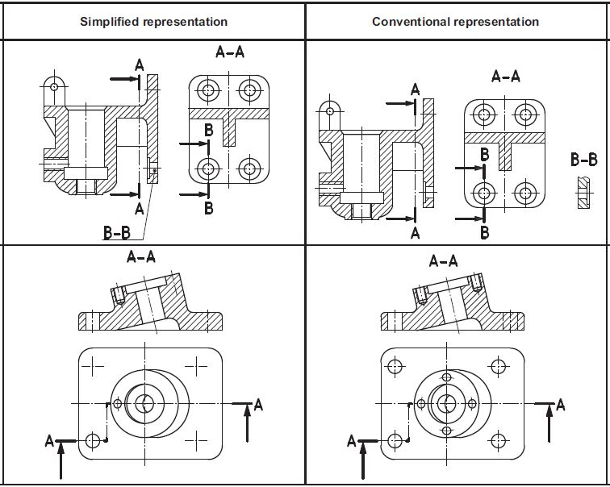
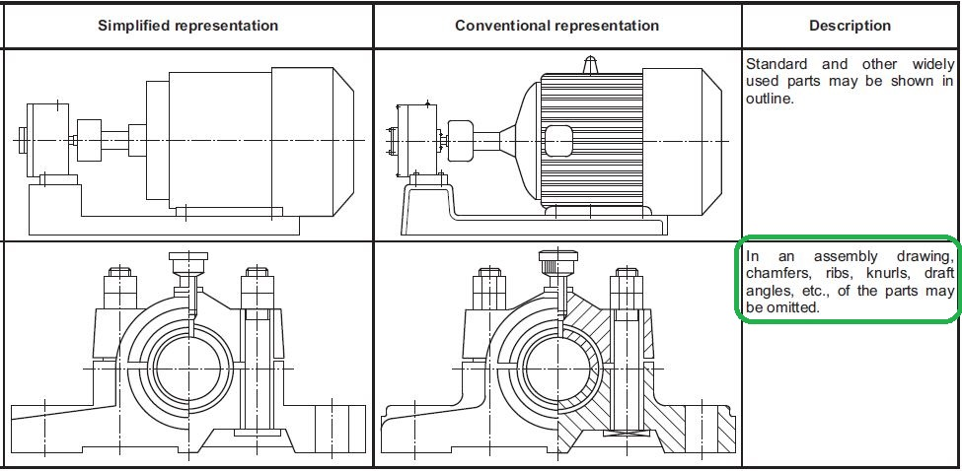
ISO’s Presentation
ISO 128-71: Simplified representation for Mechanical Engineering DWG
Less is Better than More!

Slide 23
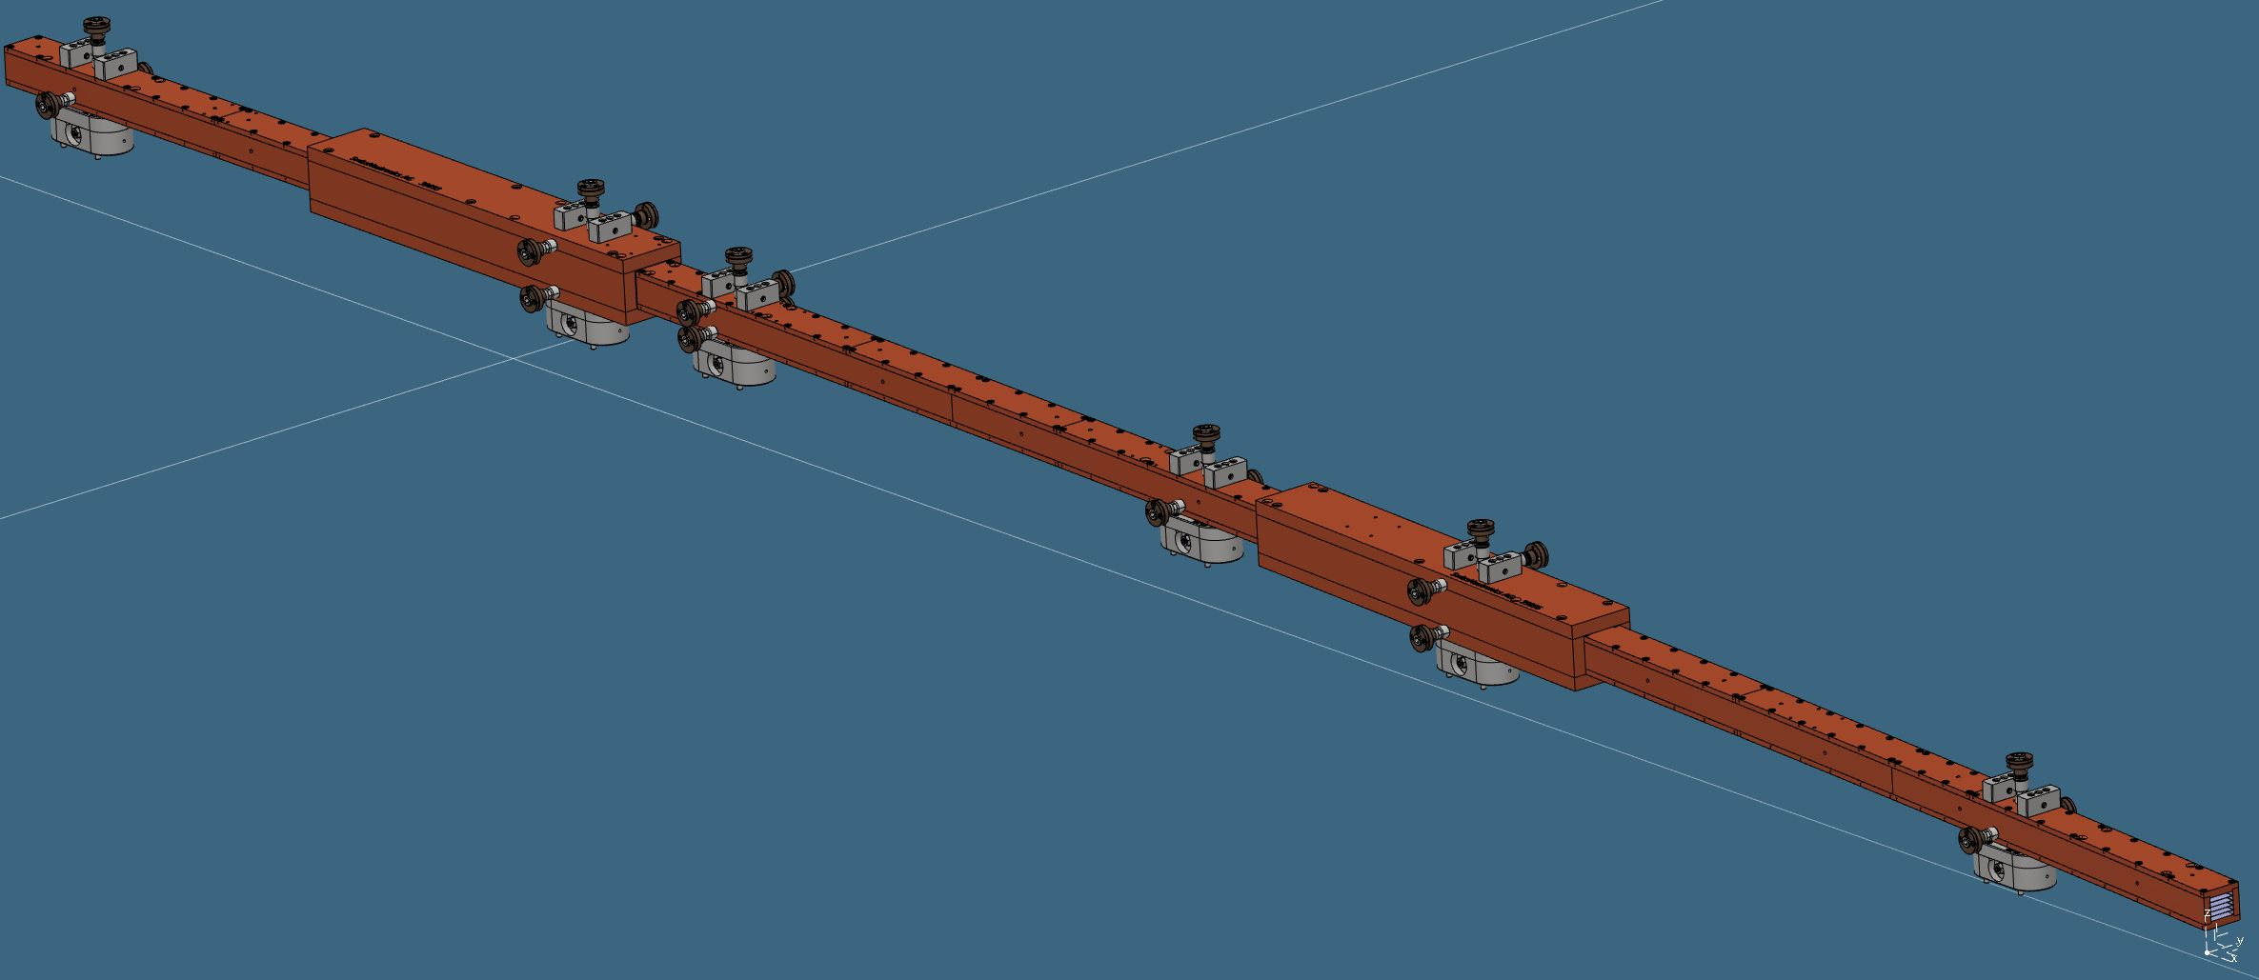
Real Life Case Study:
NBOA MOCK UP
Manufacturing & Technical Review

Slide 24
Real Life Case Study:
NBOA MOCK UP
Manufacturing & Technical Review

Slide 25
Real Life Case Study:
NBOA MOCK UP
Manufacturing & Technical Review
A
B
C

Slide 26
Real Life Case Study:
NBOA MOCK UP
Manufacturing & Technical Review

Slide 27
Real Life Case Study:
NBOA MOCK UP
Manufacturing & Technical Review

Slide 28
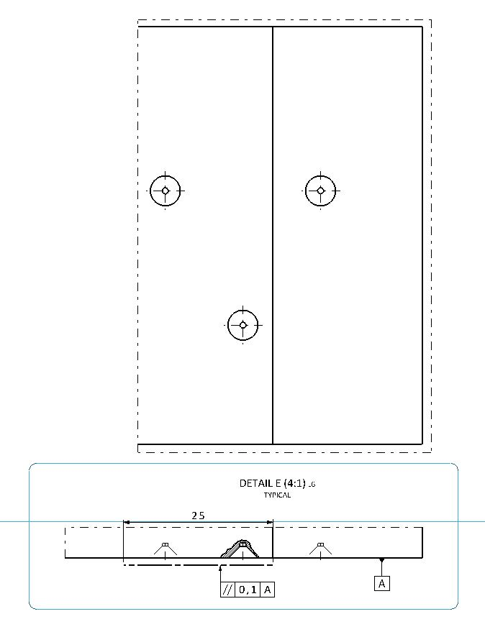
Real Life Case Study:
NBOA MOCK UP
Manufacturing & Technical Review

Slide 29
Conclusion: why a Guideline for ESS Designer?
1-ESS designers should act like ONE, no matter which department she/he belongs to
(same font according to sheet format, same nomenclature for Assy/Part description, same ISO’s list to refer to, same CAD generation, dress-up make-up settings etc etc);
2-ABC of technical DWG with 0 engineering content: just a list of definition to avoid ambiguity between ESS (‘my book says I am right!) & suppliers;
3-ESS Guideline is useful tool but:
Tolerance is CONSEQUENCE not CAUSE of manufacturing processes
(Added Value of Designer: choosing of main views, choosing of mfg processes => applying of tolerances, CAD main generation setting);

Slide 30
Questions
Thanks for Your Attention & Patience!

