Slide 1
STUB fire sealing
Robbin Peterson and Mats Pålsson
www.europeanspallationsource.se
20-01-29

Slide 2
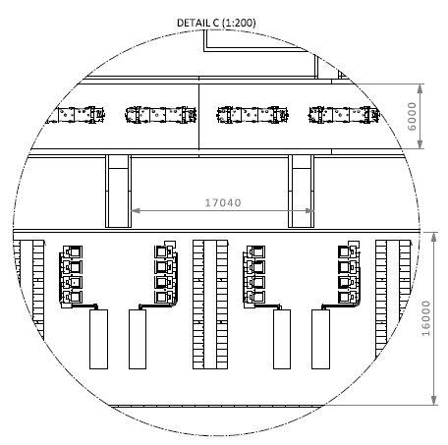
STUB data
How many STUBS
2 Warm Linac
3 Spoke
1 Spoke/Medium Beta
4 Medium Beta
10,5 High Beta
6,5 Contingency
27 STUBS in total
STUB

Slide 3
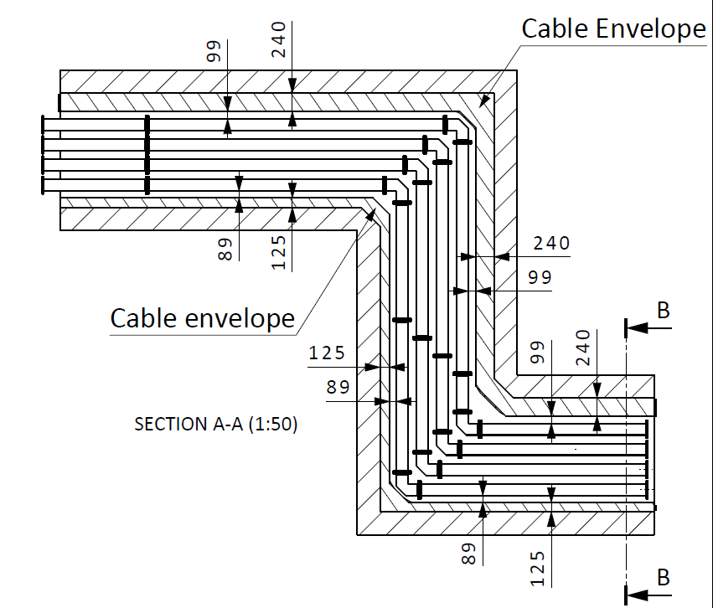
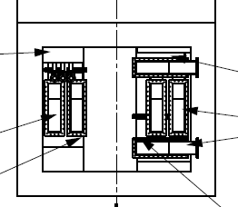
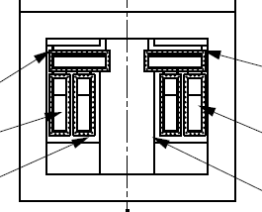
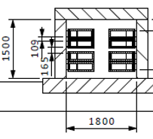
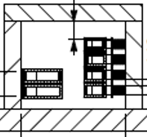
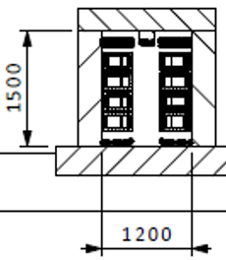
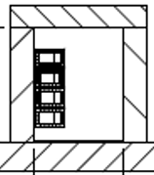
STUB data
Dimensions of STUBS
6 STUB: section W=1800mm, H=1500mm
21 STUB : section W= 1200mm, H=1500mm
Bilbao
Bilbao

Slide 4
STUB data
Content in STUBS
Waveguides for RF distribution
Cables for Power and Signals
PSS sampling pipe
Cassette for Beam Instrumentation components
Radiation “shielding”/ sealing
Fire sealing
Cooling system to handle heat load from WG and Power Cables (design tbd, probably air cooling applied outside the STUB at the gallery side)

Slide 5
STUB data
Content in STUBS
Waveguides for RF distribution
Number of waveguides: 158
Total length of WG in STUBS: approx. 1800 meter

Slide 6
STUB data
Content in STUBS
Cables for Power and Signals
Max number of cables in one STUB: approx. 550
Total number of cables running through the STUBS: approx. 10.000

Slide 7
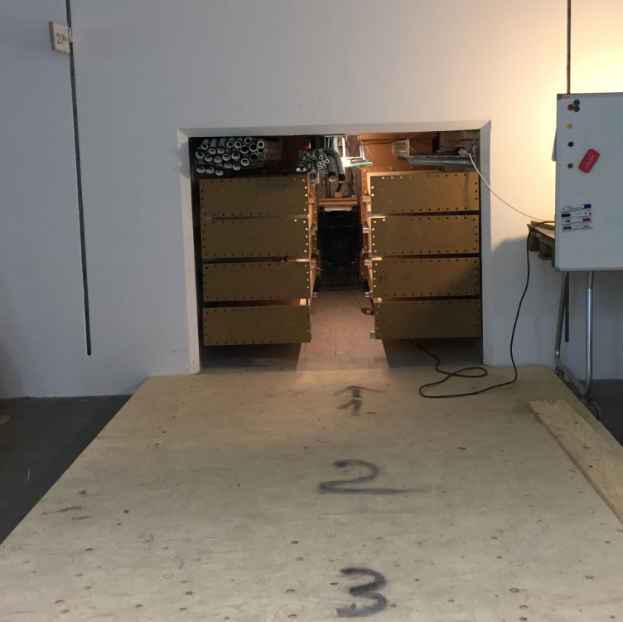
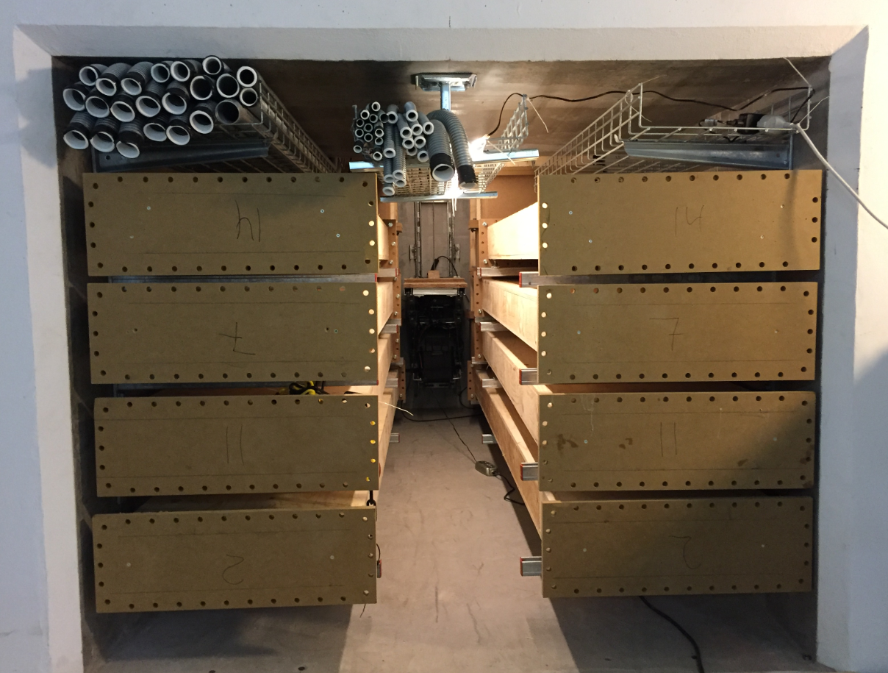
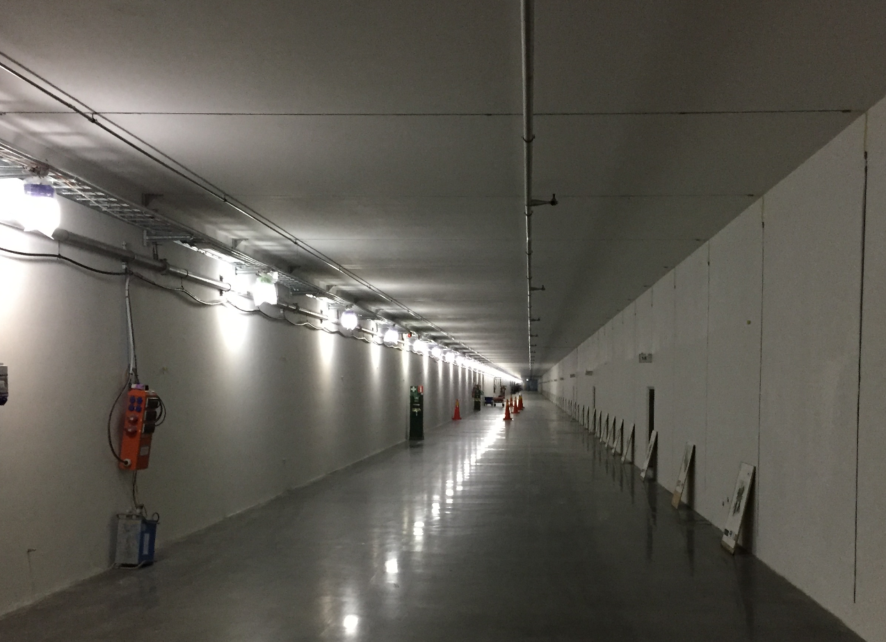
STUB test installation
Waveguides G01 Tunnel side

Slide 8
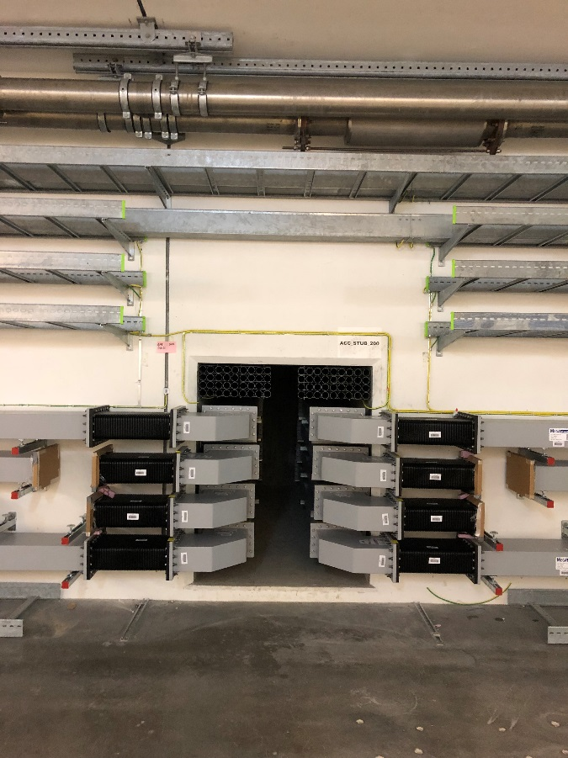
STUB test installation
Waveguides G01 Tunnel side

Slide 9
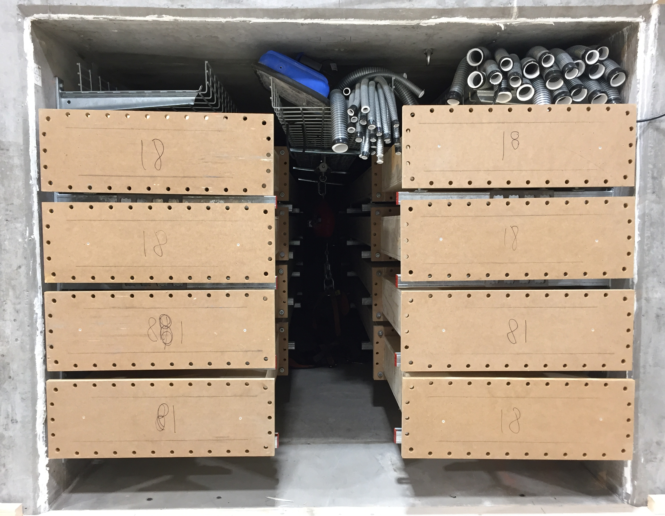
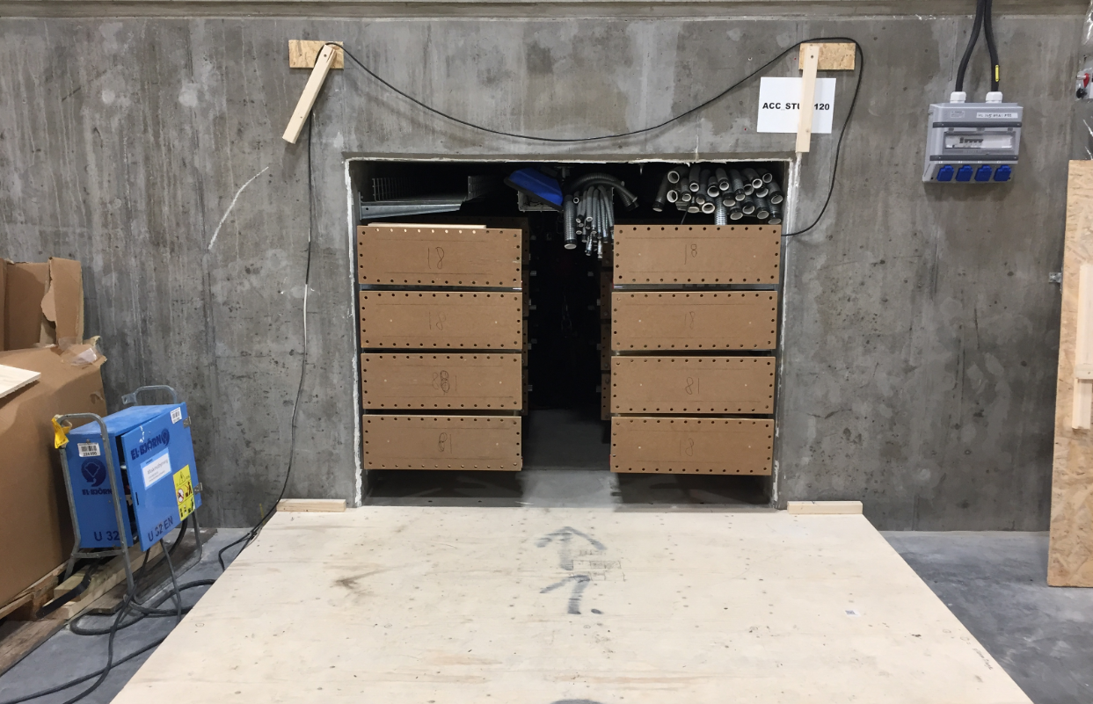
STUB test installation
Waveguides G02 Gallery side

Slide 10
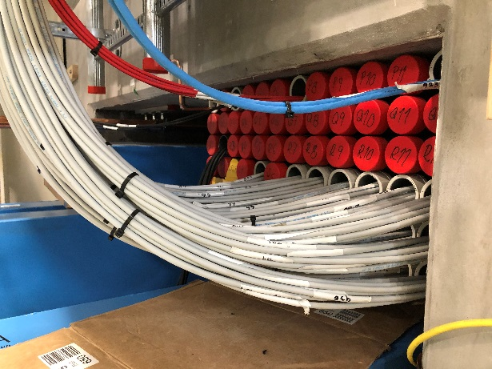
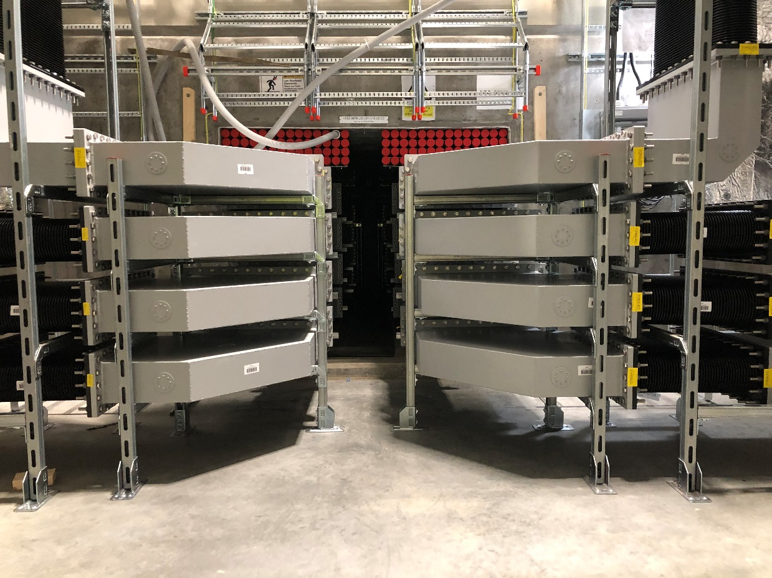
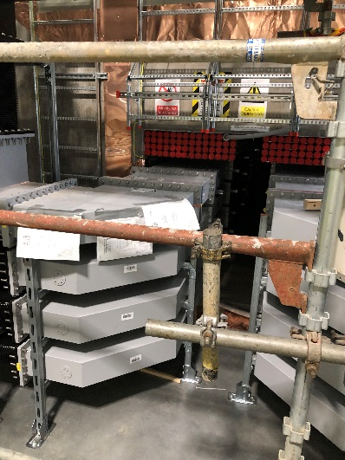
STUB test installation
Waveguides G02 Gallery side

Slide 11
STUB fire sealing
Fire sealing 2 x EI 60
60 minutes fire resistance in both upper and lower end of STUB
”Radiation Sealing”
Leakage rate per Stub not final decide

Slide 12
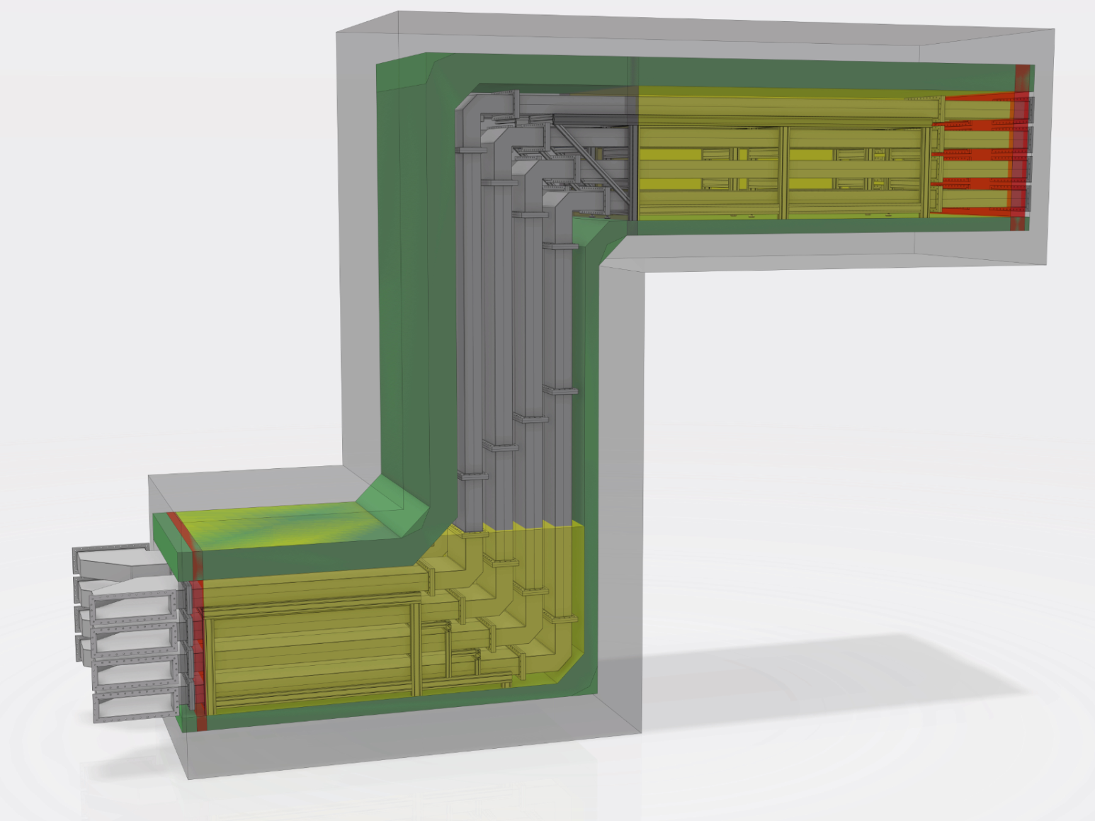
STUB fire sealing

Slide 13
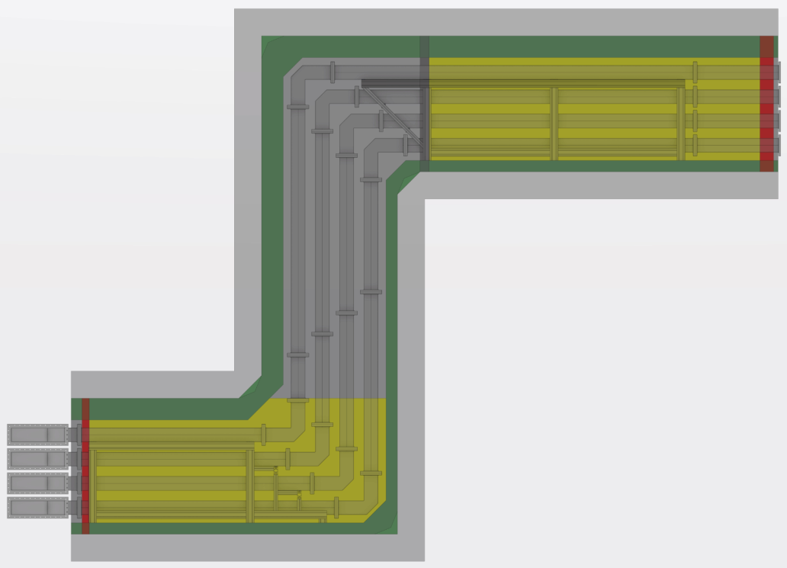
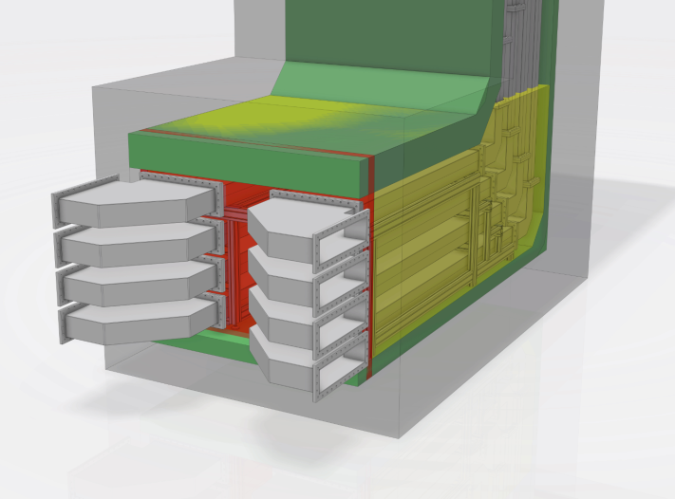
STUB fire sealing
Installation sequence
Installation of Fire sealing

Slide 14
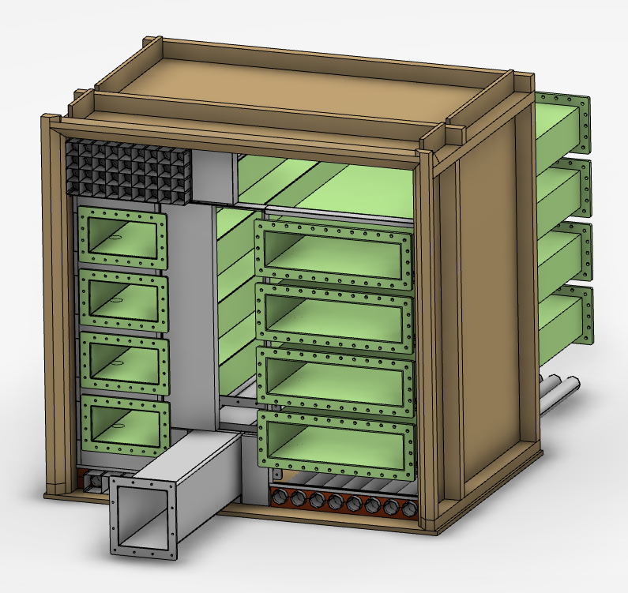
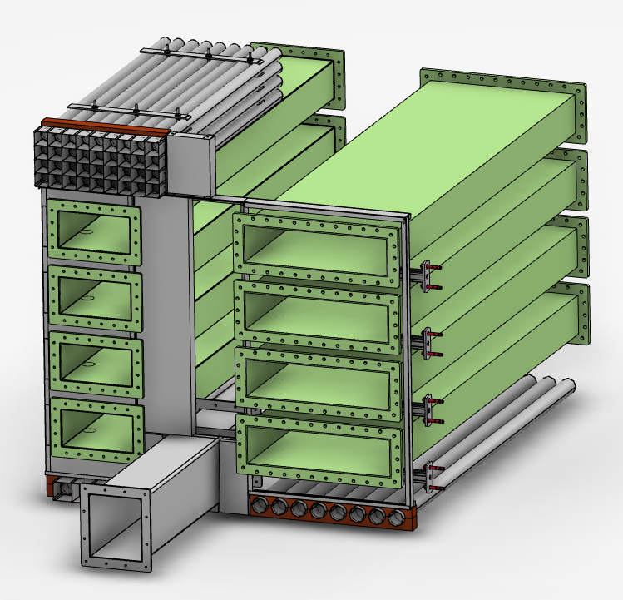
STUB fire sealing
Installation of Fire sealing – Mock Up test

Slide 15
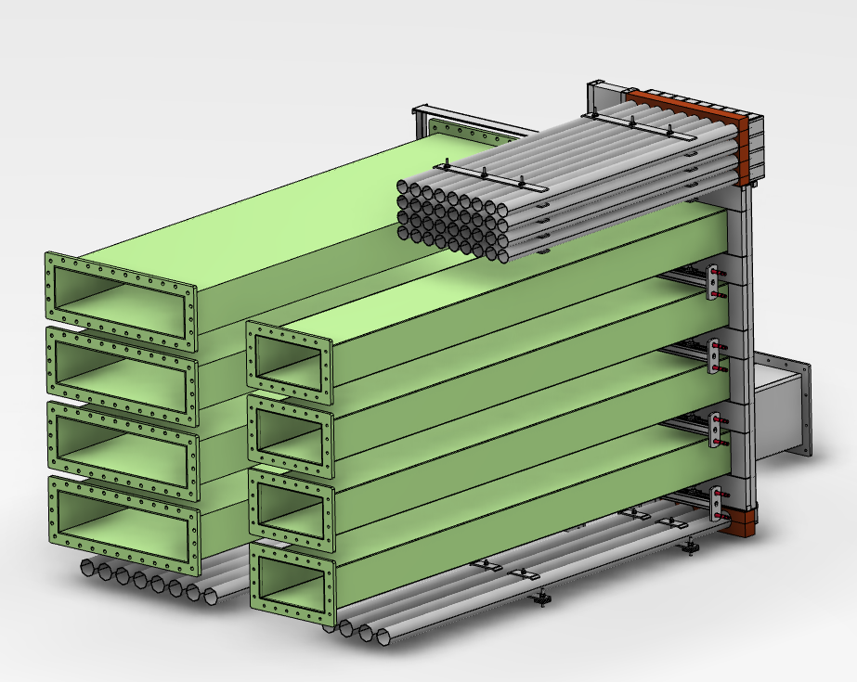
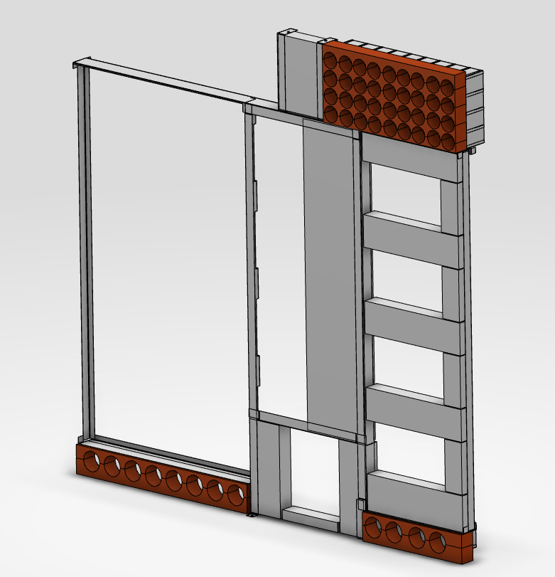
STUB fire sealing
Installation of Fire sealing – Mock Up test

Slide 16
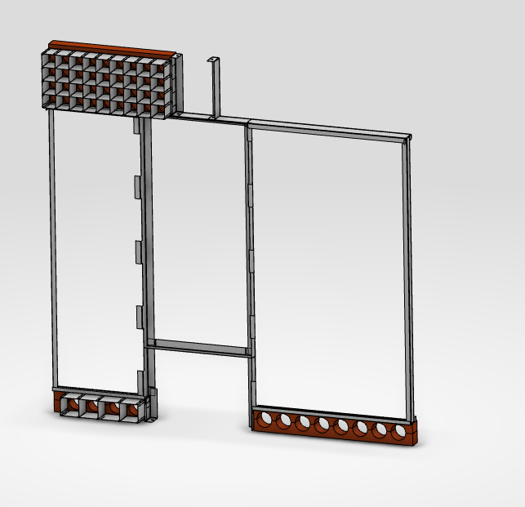
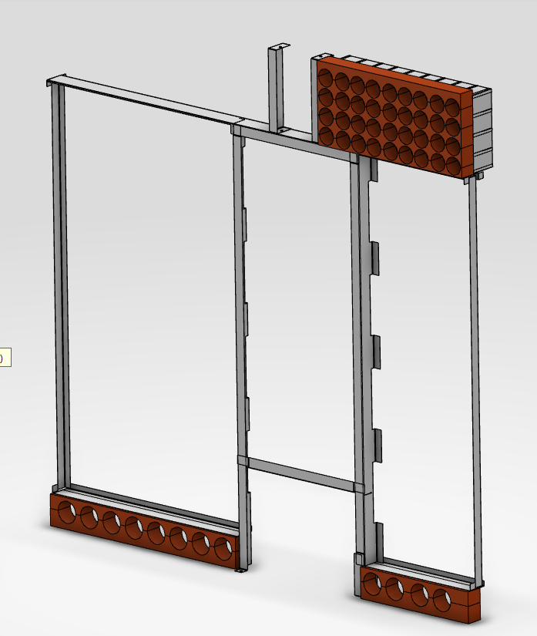
STUB fire sealing
Installation of Fire sealing – Mock Up test

