Slide 1
In-Kind Contributions
Andrew Jackson
LoKI Kickoff Meeting
January 29, 2014

Slide 2
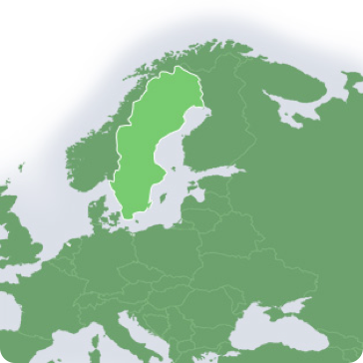
Largest European Research Infrastructure Project
Sweden, Denmark and Norway:
50% of construction 15-20% of operations
European partners: 50% of construction

Slide 3
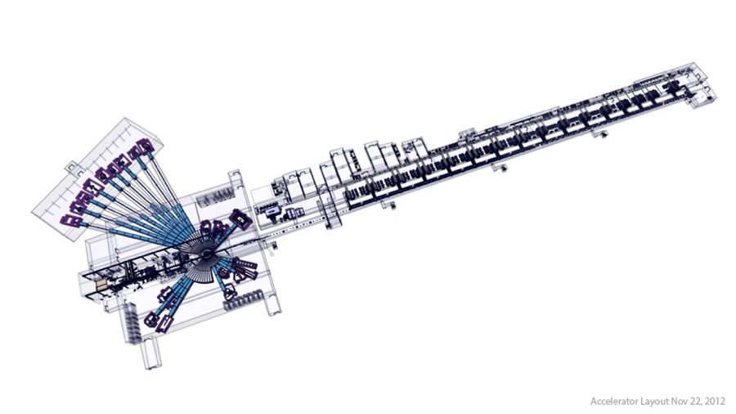
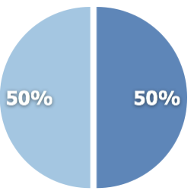
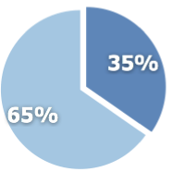
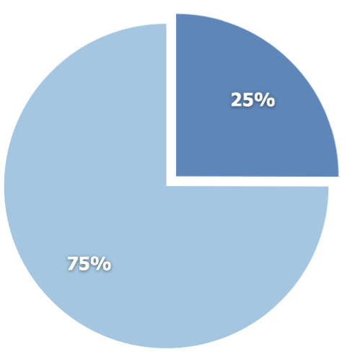
Total construction cost: € 1,84 billion € 666 million IKC or 36%
In-kind potential represents more than one-third of the project value.
Target station €154M
IKC €100M
Accelerator €522M
IKC €392M
In-kind
NSS €350M
IKC €175M
Cash

Slide 4
Procurement a critical success factor in the project for cost and schedule.
Assumptions
Host states pay cash
Partner countries pay
cash (~30%)
in-kind (~70%)
Total Procurement ~ €700M
500+ Procurements > €200k
save it!

Slide 5
In-Kind Participation
Ideas ...
Optics (CH ?)
Shielding design (CH ?)
Detectors ?
Sample Environment (SE, DK ?)
Data Analysis Software (SE, DK, CH ?)

