Slide 1
SAMPLE ENVIRONMENT
Overview of day 1 equipment and possibilities
Daria Noferini
CSPEC ICEB 1, 8th June 2020

Slide 2
Scientific specifications
CSPEC promises to the community
TG2 [ConOps document]
  CSPEC shall probe magnetic excitations in magnetic fields up to 12 T.
  CSPEC should follow kinetic processes with time steps of less than 1 minute.
  The design of the instrument will accommodate the sample environment equipment required to match the science case.
  The systems design shall provide the space and flexibility necessary to host and drive future developments, for instance further focusing optics for smaller sample sizes, possibly integrated into the sample environment, further in-situ sample environment such as secondary characterization (RAMAN or NMR), and polarization analysis.
  Sample environment within the CSPEC scope for the wide range of scientific cases studied on CSPEC should be consistent with the demands of signal to noise.

Slide 3
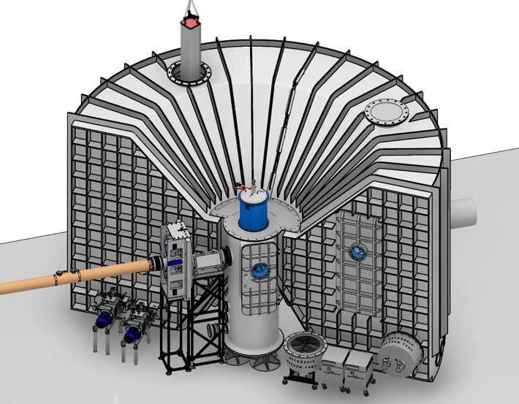
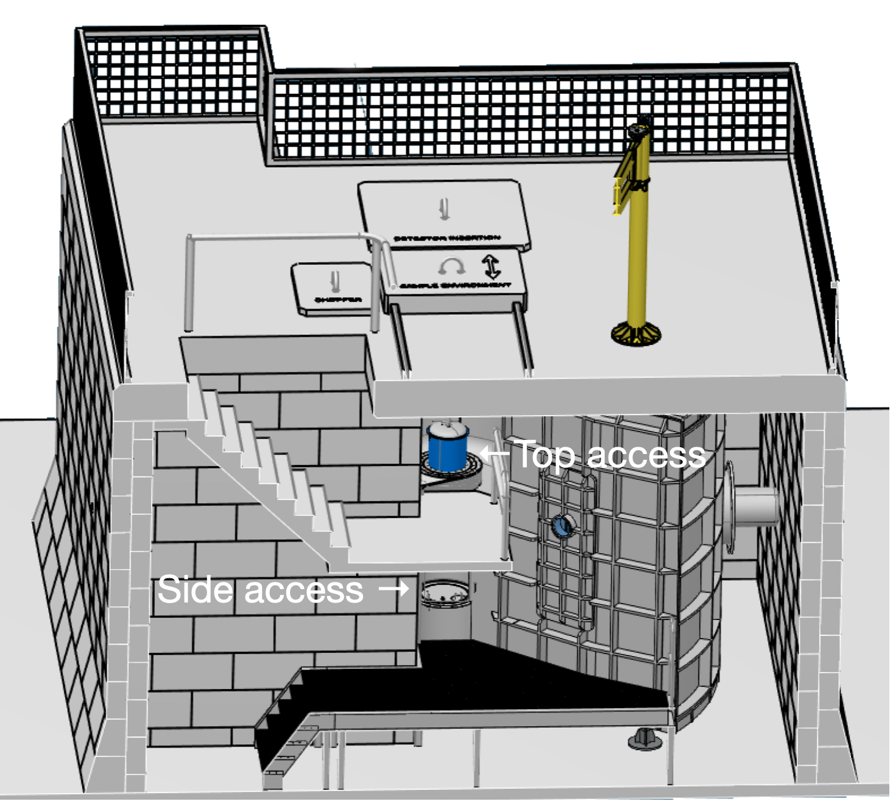
The sample environment pot
Where everything happens

Slide 4
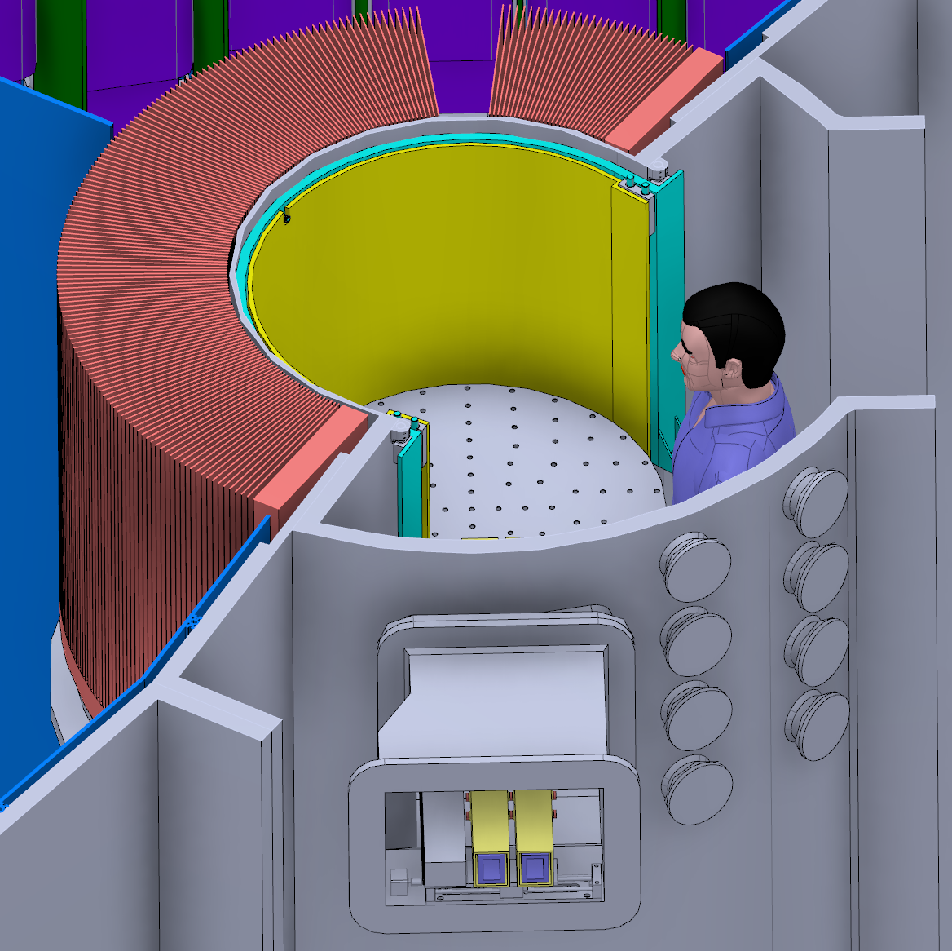
The sample environment pot
Flexibility for science
Gate Valve
(Al, 2.5-4 mm)
high SNR
cryogenic vacuum
/ ambient p
specific scientific case needs
Protective barrier

Slide 5

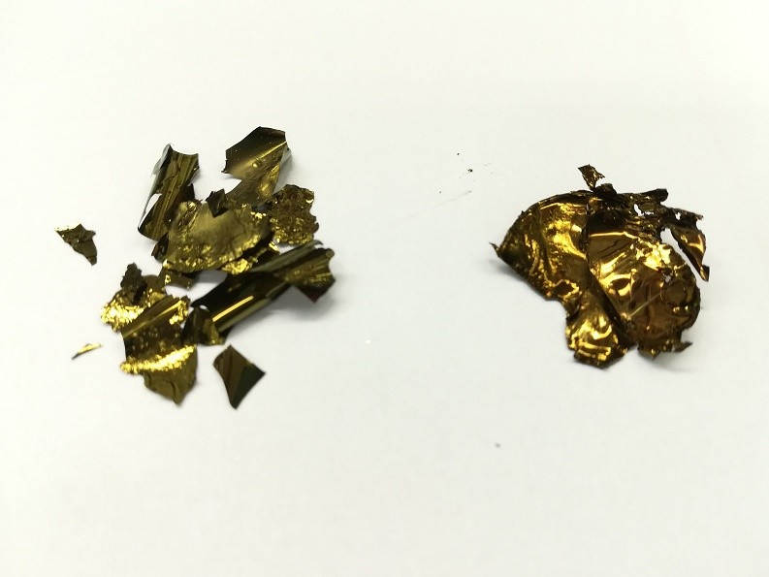
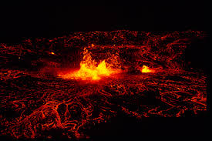

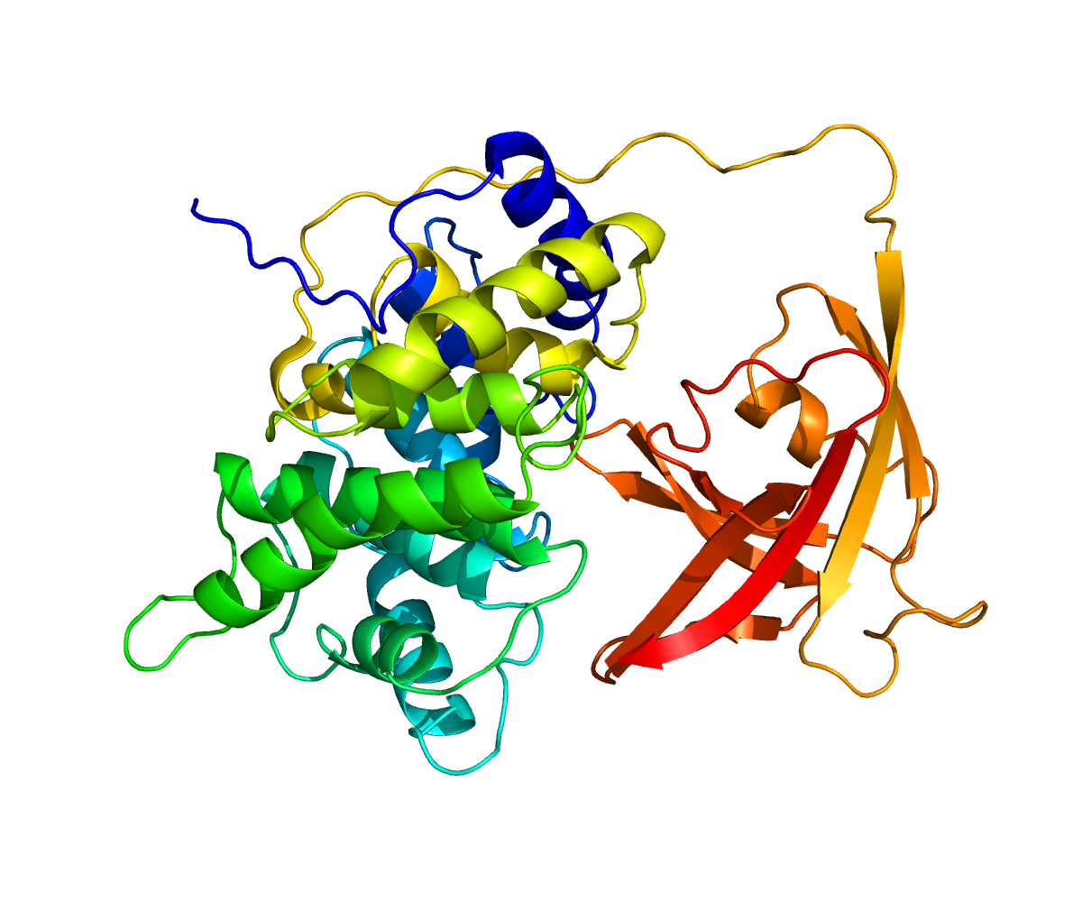
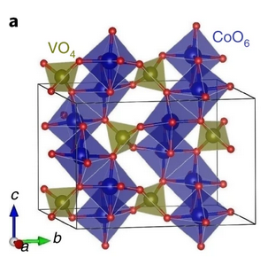
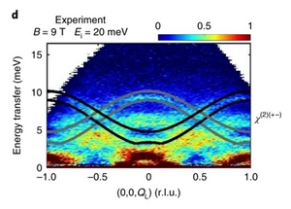
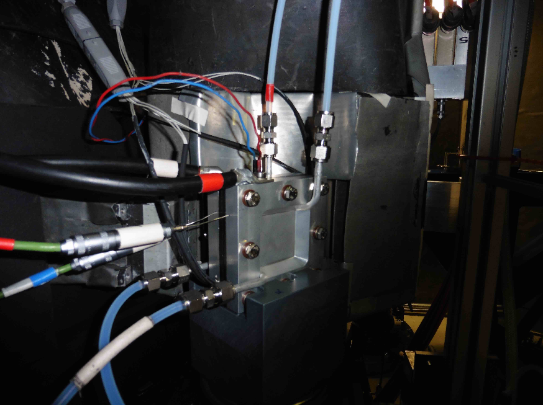
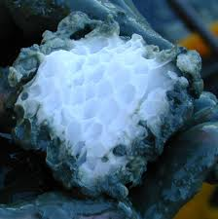
The sample environment pot
Flexibility for science
high pressure
small samples
high temperature
combined characterization
controlled humidity
high magnetic field
operando measurements
gas absorption/desorption

Slide 6
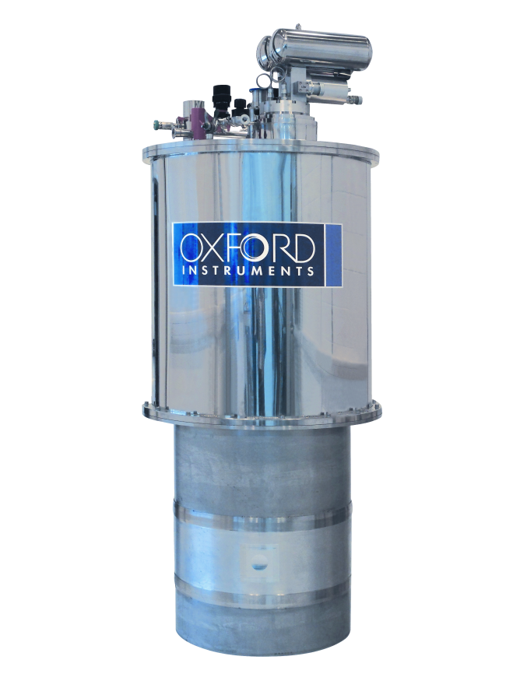
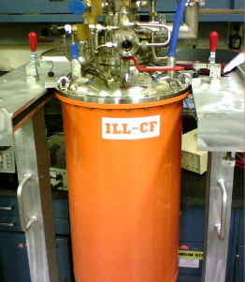
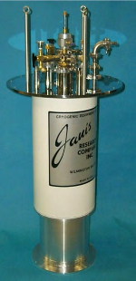
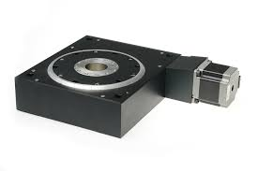
Day 1 equipment (in scope)
Day 1.0
Cryofurnace
T-range 3-600 K
ΔT = 0.1 K
Sample rotation stage and goniometer
ILL
Oxford inst.
6 T magnet
(from HZB)
Janis

Slide 7
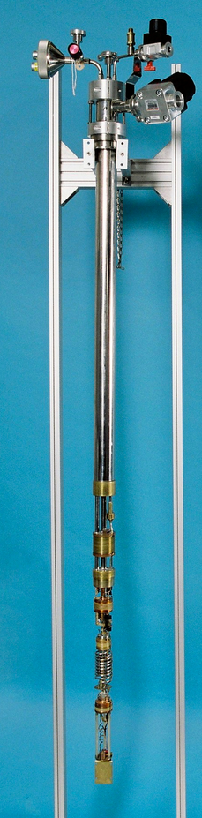
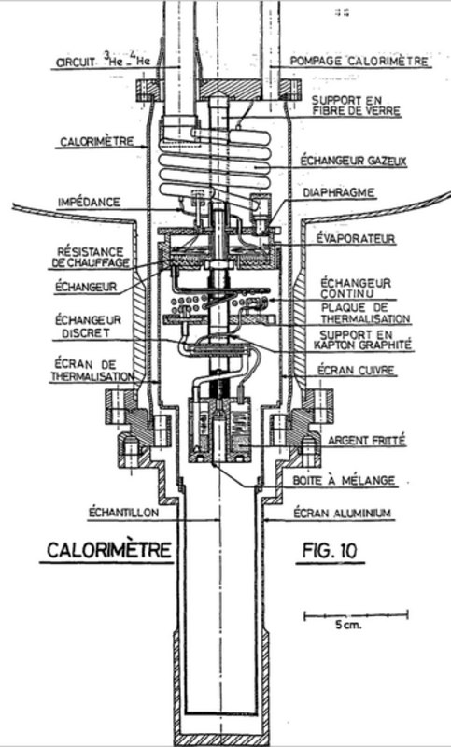
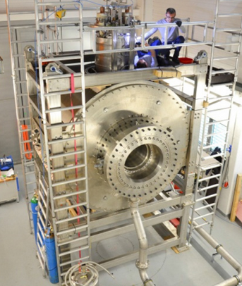
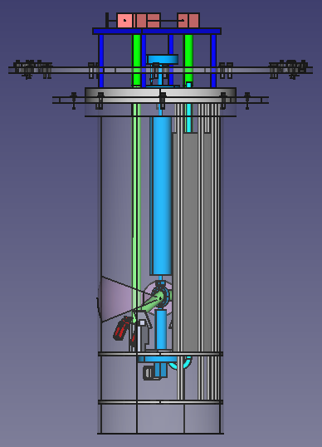
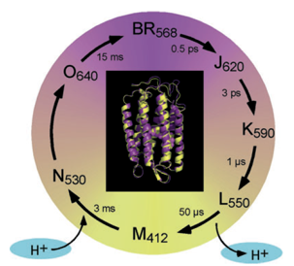
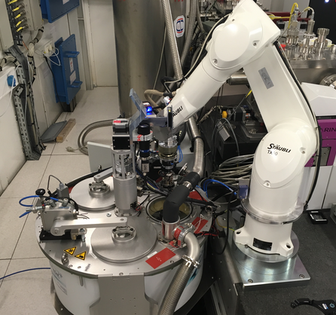
Day 1 equipment (in scope)
Day 1.1
Dilution insert
12 T magnet (access to)
Pump and probe setup
In kind collaboration
J. Pieper, Univ. of Tartu (Estonia)
HZB
ISIS
Michel Caussignac’s
PhD thesis (1980)
Automatic sample
changer
In situ optical activation of the biological function of a membrane protein + time-dependent QENS.
S
A
S
ESRF
S
Details t.b.d (Harald Schneider/SAD)
SNS

Slide 8
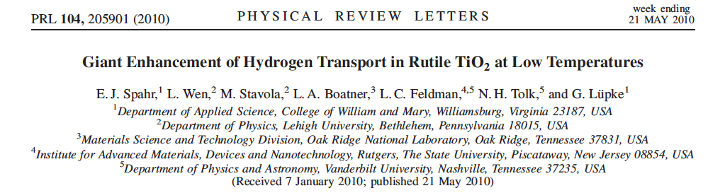
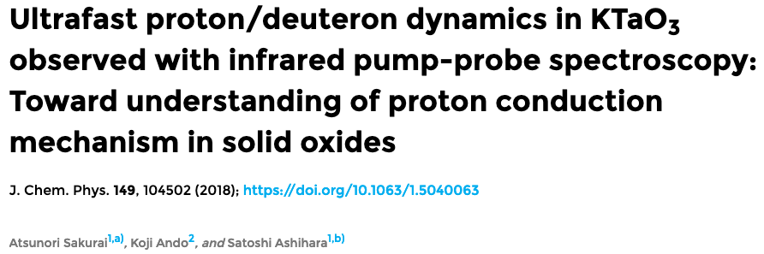
Further (preliminary) ideas
Extend the pump and probe
From proteins to different scientific cases
E.g. Solid electrolytes for intermediate temperature fuel cells

Slide 9
Further (preliminary) ideas
Simultaneous combined characterization
QENS/INS @CSPEC
structure (indirectly)
(especially if long wavelengths are used)
complementary timescale
IR, Raman, DLS, DSC, NMR, dielectric spectroscopy…
Ongoing proposal with Roskilde University (Bo Jakobsen, Kristine Niss, Dorthe Posselt) Focus on soft, glassy and biological matter
Peltier based sub cryostat @ ESS (SANS)
Cell for QENS+dielectric spectroscopy at high pressure @ ILL
Possible other collaborations
E.g. DLS + NSE @ JCNS/RWTH Aachen University

Slide 10
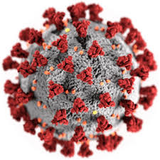

Further (preliminary) ideas
Special sample environment for biology
Hazardous material, controlled humidity, simultaneous characterization…
Covid-19 related grant opportunities across EU
[e.g. Swedish Research Council– VR (SE), Lighthouse (DK) etc.]

Slide 11
Further (preliminary) ideas
From ideas to action
Find interested partners
Continue to identify the needs of scientific communities
Start of the project
Resources &
people
Interaction and coordination with
Other instrument teams
(e.g. T-REX, MIRACLES…)
ESS sample environment
support groups
&

Slide 12
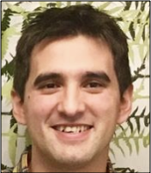
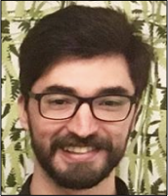
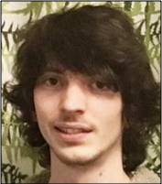
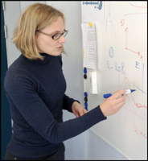
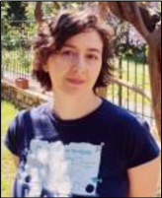
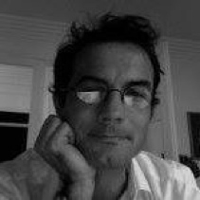
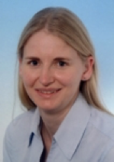
Thank you for attention!
Questions for the team?
People from SAD?

Slide 13
Something more?
(backup slides)

Slide 14
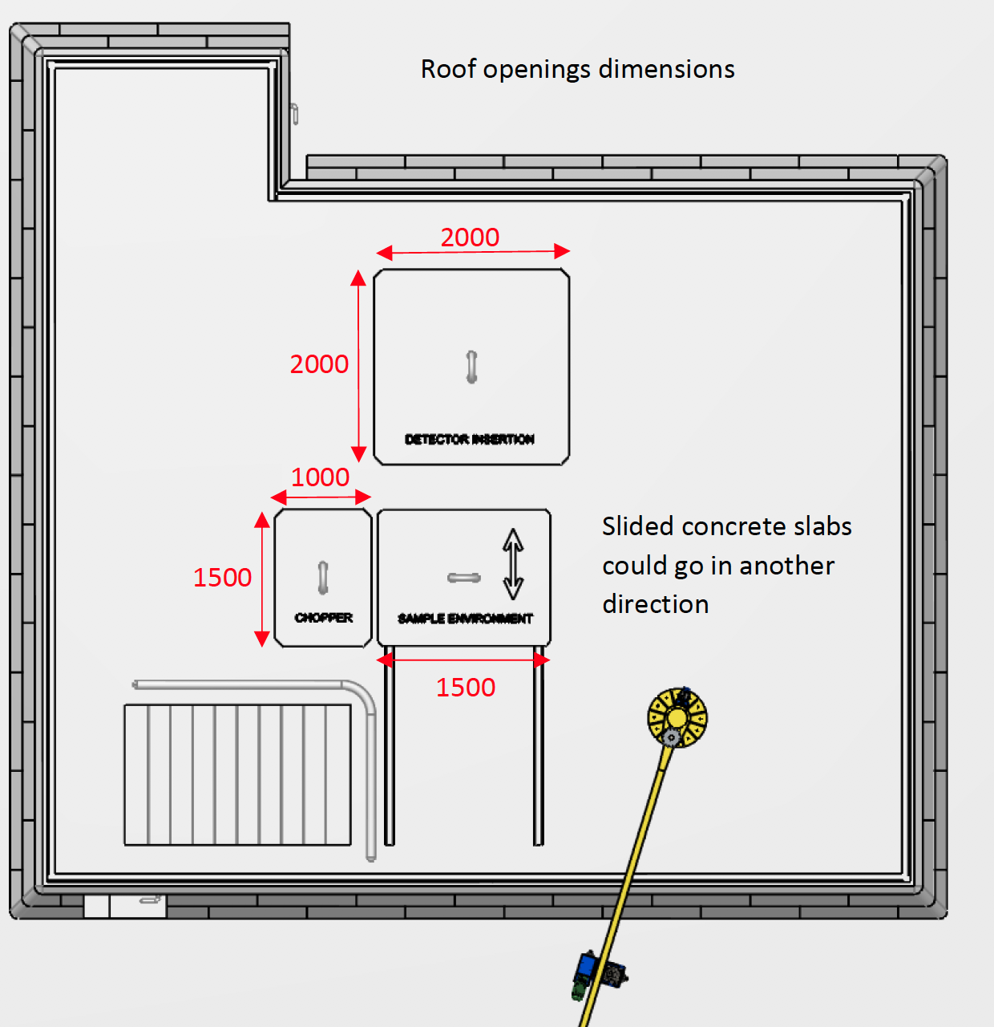

Slide 15
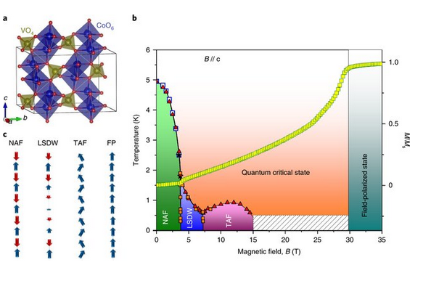

Slide 16
