Slide 1

Cooling and Heat Recovery at the Max IV Research Facility

Slide 2
Background
The starting point was the need of energy for MAX-lab research facility.
It was clear that MAX-lab was going to use a lot of electricity to run its equipment…
… but what about heating, cooling and
air condition?

Slide 3
Background
Max-lab needs both heating and cooling. The demands where divided into three groups:
Heating
Process cooling
Comfort cooling
24 C
34 C
7 C
15 C
Notes:
How can we meet the needs, district heating and district coolning or handle it oure self with heaters and coolingtowers

Slide 4

Background
Can’t we just use some of our excess heat to internal heating?
Heating
Process cooling
Comfort cooling
24 C
34 C
7 C
15 C
Notes:
Well, yes! But the heat might be to cool and its also a question about heating the facility when the reserch equipment is not in use.

Slide 5
Background
Can there be Equipment that can be cooled at higher temperatures?
?
?
90 C
45 C
35 C
70 C
24 C
34 C
7 C
15 C
Notes:
This was only speculations at the time but it cud solve the first part of the problem (of the heat being to cool)

Slide 6

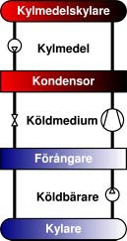
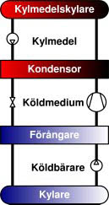
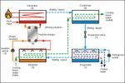
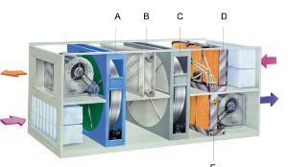
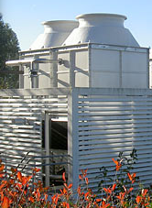
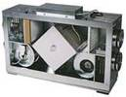
Background
7 C
90 C
90 C
45 C
7 C
15 C
24 C
90 C
33 C
Notes:
We thout alot about what to be done, using heat driven cooling and so on, and so on. Tid/effekt

Slide 7
We needed a solid partner to handle our energy demands and to realize the full potential of heat recovery from our excess heat
90 C
45 C
24 C
34 C
7 C
15 C
Notes:
We needed a

Slide 8
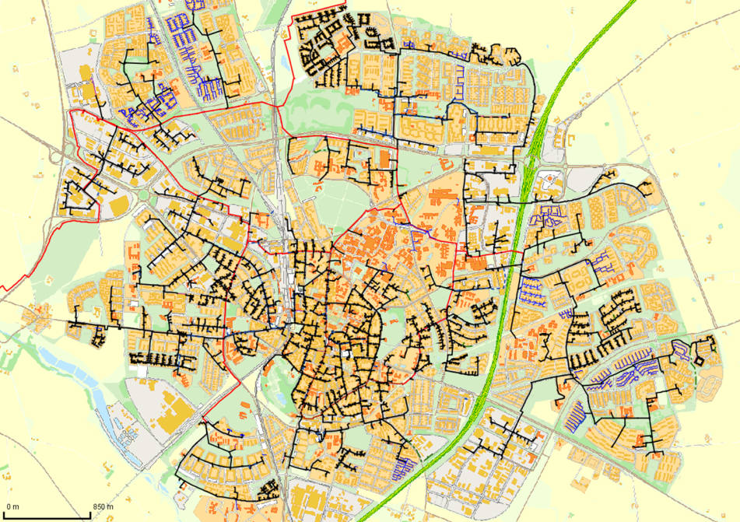
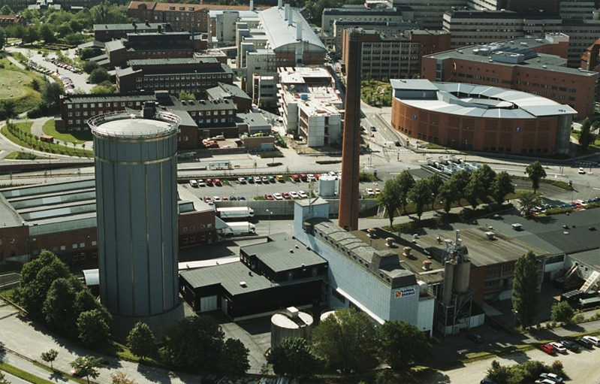
From the perspective of the Energy Company
Background 1: Large District Heating system
Background 2: Large District Cooling system
Background 3: ”Old” Max Laboratory major cooling customer

Slide 9
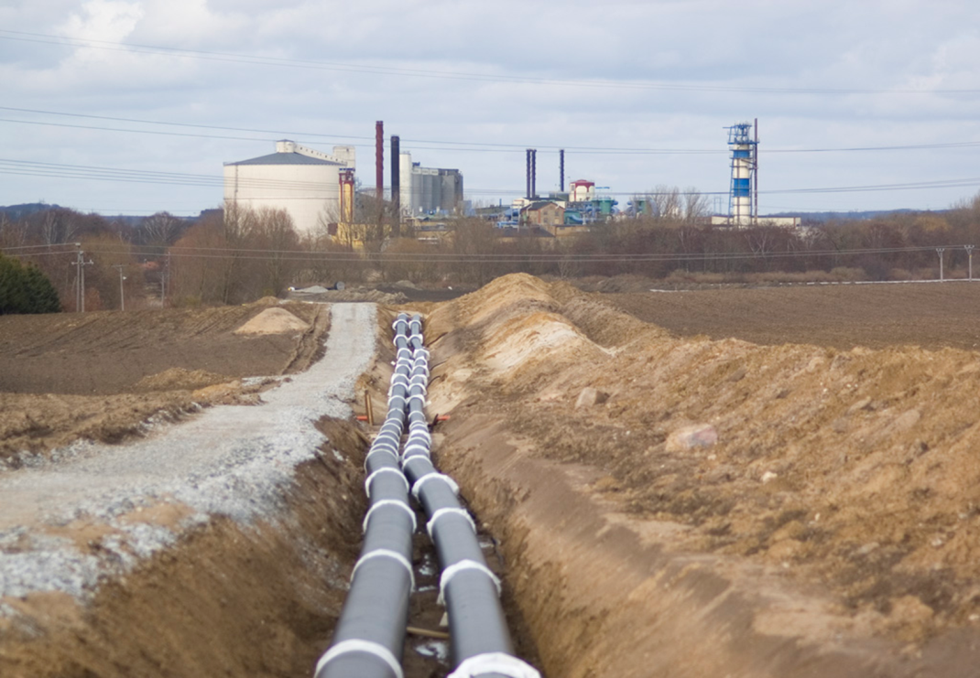

From the perspective of the Energy Company
Background 4: External heat supplier is old news
Background 5: Lund NE

Slide 10
We treated heat recovery as a joint project
Preconditions
Amount of energy
Load levels
Temperature levels
Investment costs
District heating pipes
Redundancy
Heat pumps
Additional cost for pipes
Additional cost for building
Deduction for chiller
Deduction for cooling towers
Variable costs
Electricity for heat pumps (COP)
Deduction for operation of chiller
Deduction for operation of cooling towers
Revenue
$$$

Slide 11
Open book principle
Preconditions
MAX-lab
Kraftringen
Investment costs
Variable costs
Revenue

Slide 12
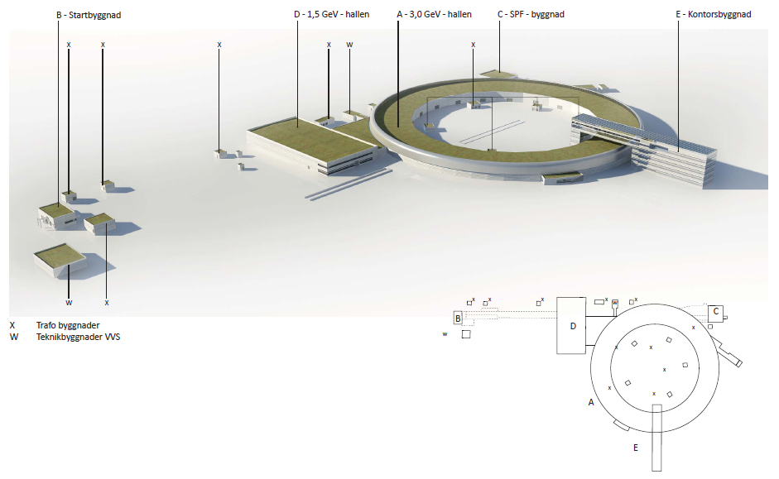
Energy mapping MAX IV, energy flow model
Notes:
In the MAX IV project, We created a dynamic energy flow model over all of the buildings.

Slide 13
Input
Description of energy properties both in and out:
  Building
  Process
  Cooling
    Air / Water
    Temperature quality
    Lasting
Building properties
HVAC & comfort
Cooling
demand
Process
Operating time
Notes:
In the model we described each building regarding their properties like u-value, area, and we also described the hvac and comfort system and their demands.
This together with the process energy input, the process cooling demand divided into different temperature levels and operational time, it is possible to see how much heat power that the facility buildings needs over time and how much excess heat the process produces and needs to be cooled off or recycled somehow.

Slide 14
Output
Based upon output:
Heat recovery / cooling loops:
  7/12 C Comfort
  25/35 C Heatpump
  70/50 C District heating
Cooling demand:
  5 MW
Recovery potential:
  30 000 MWh/yr
    20% high temperature direct to district heating
    80% through heat pump
Energy balance, building level
Total energy balance
Excess energy in cooling water
Total energy balance
Energy balance, building level
Excess energy in cooling water
Notes:
It all ended in an energy balance down to building levels and if I summarized it reflects the total energy balance of the facility.
We also discovered that in similar facilities, some of the equipment, were cooled at higher temperatures and blended in to the low temperature cooling loop.
It pretty soon was evident that it is possible to cool some equipment or parts of equipment at a higher temperature. This combined with the knowledge of temperature levels in the district heating system resulted in a design with three cooling loops in the MAX IV project, 7/12 degrees circuit mainly for comfort cooling, 25/35 cools most of the process equipment and the 50/70 degrees which cools the klystron, modulators and RF.
The total cooling demand of Max IV is 5 MW, resulting in a potential to recover 30 000 MWh/yr of waste heat. Out of these, 20% can be recovered directly into the district heating system in Lund. From the other two cooling circuits the waste heat will be recovered with heat pumps into the district heating system.
With this design we will recover all excess heat and there are no needs for cooling towers and Max IV achieves both environmental and economic benefits from this solution.

Slide 15
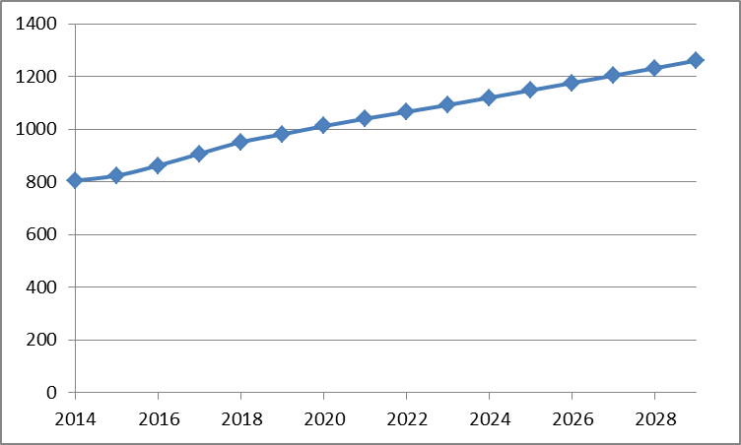
Energy prices
Swedish electricity cost 2014 (800 SEK/MWh):
  Price 425
  Tax 300
  Renewable certificates 25
  Grid fee 50
Value of recovered heat: According to alternative cost to produce the heat
Agreement: Will be calculated monthly according to open book principle

Slide 16
Prediction of energy flows

Slide 17
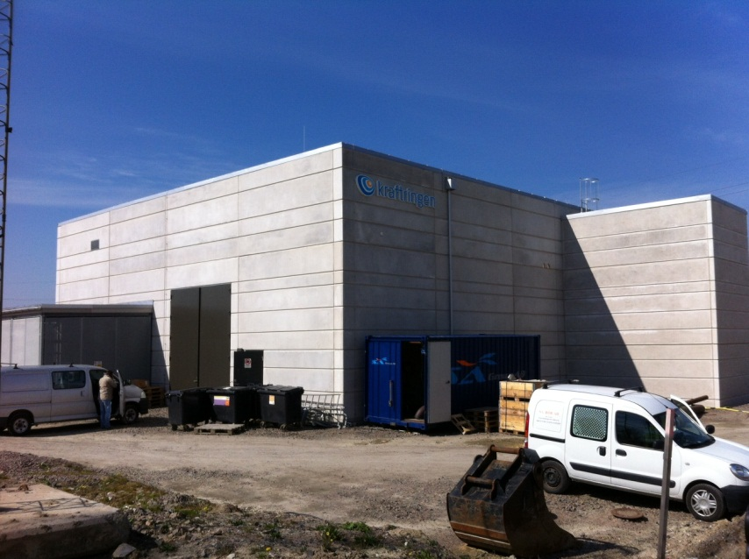
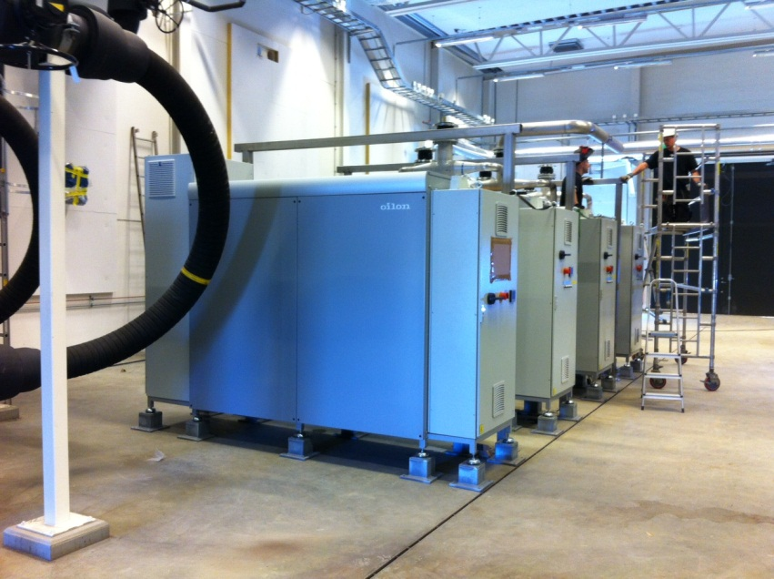
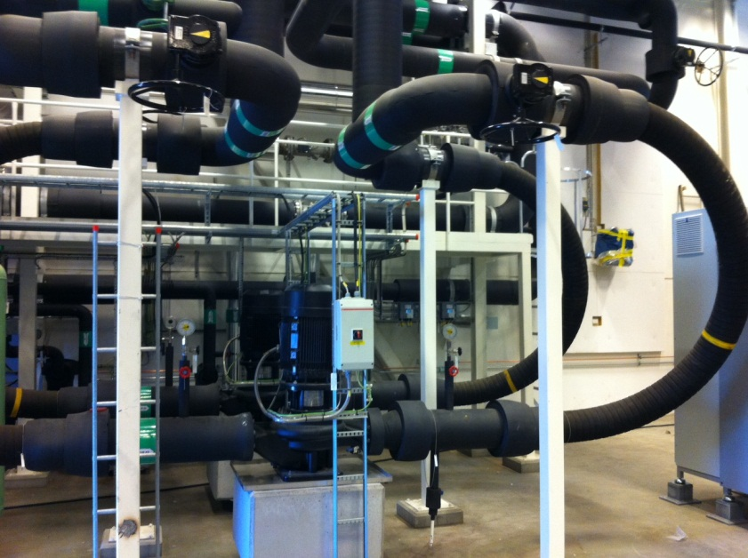
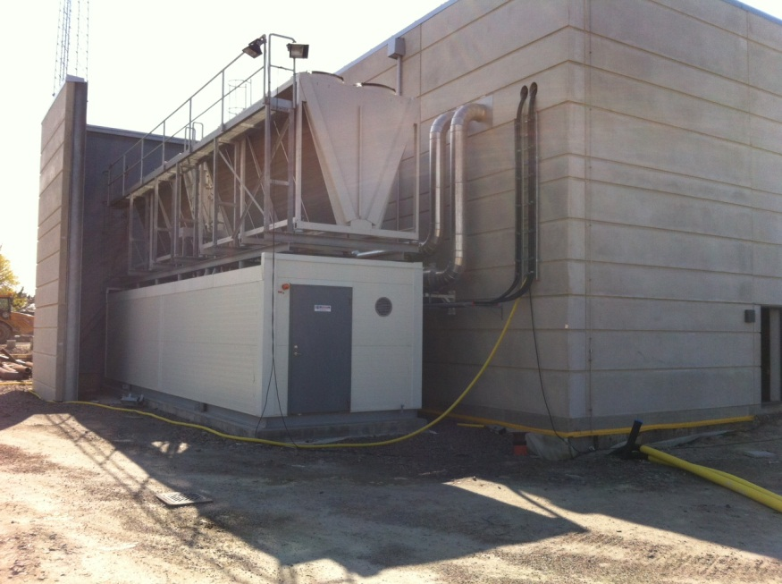
The Energy Central
The building:
The Heat Pumps:
Vibration abatement:
The Backup:

Slide 18
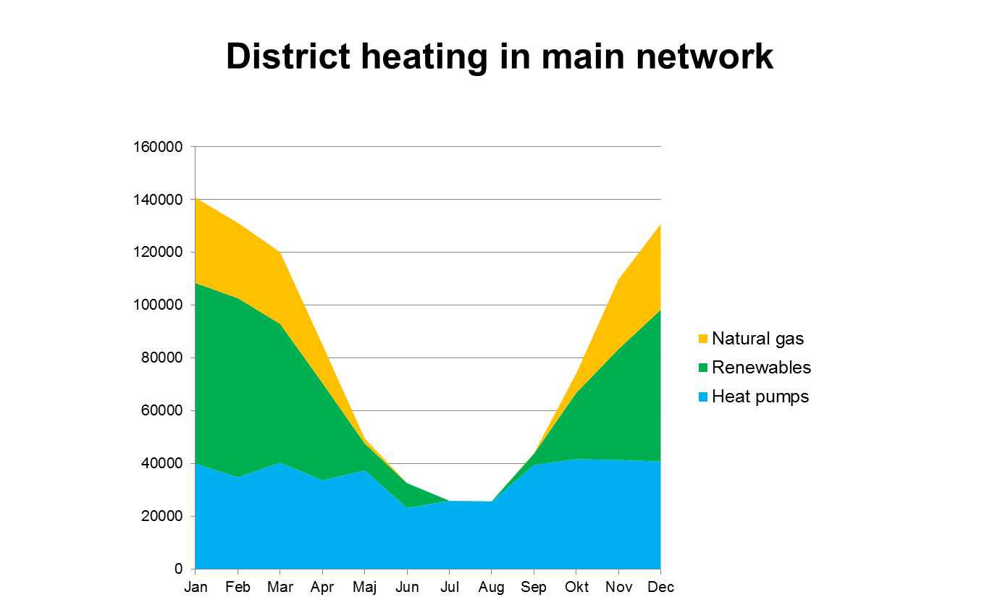
Replaced fuels?

Slide 19
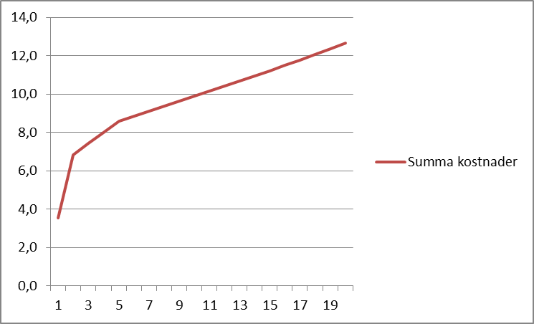
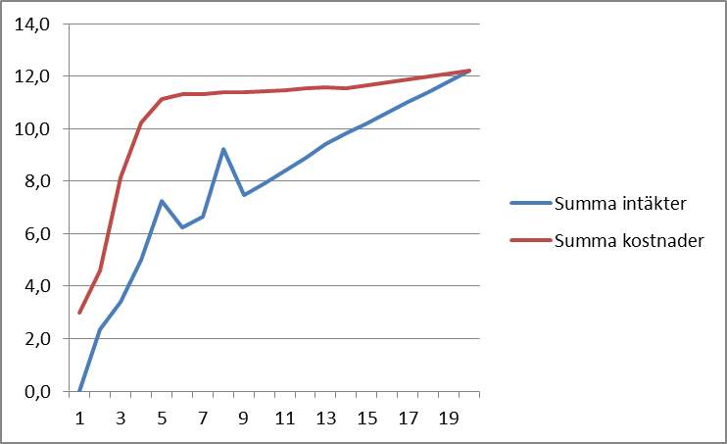
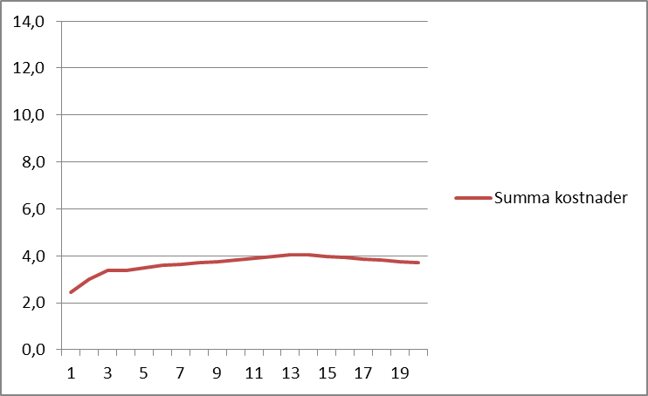
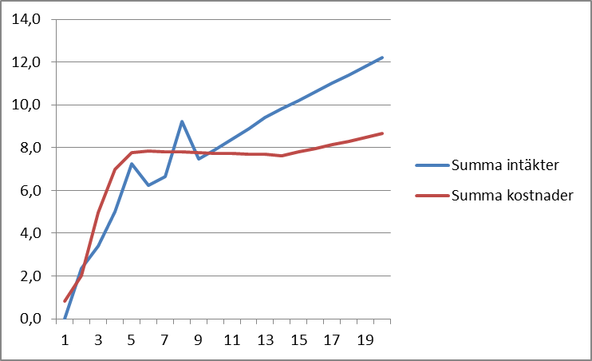
Calculation MAX-lab
District cooling
Heat recovery only
Cooling towers
Heat recovery and no cooling towers
Notes:
Termodynamiskt mer gynsamt

Slide 20
Conclusion
Early start-up of cooperation
Work with temperature quality
Open book principle
Flexible cooling power design

