Slide 1





Energy Saving experience at DaΦne
Ruggero Ricci INFN-LNF Electrical dept. head / Energy Manager
Ugo Rotundo INFN-LNF Fluid Plants dept. head
ruggero.ricci@lnf.infn.it
ugo.rotundo@lnf.infn.it
www.lnf.infn.it
Lund, 29 April, 2014

Slide 2
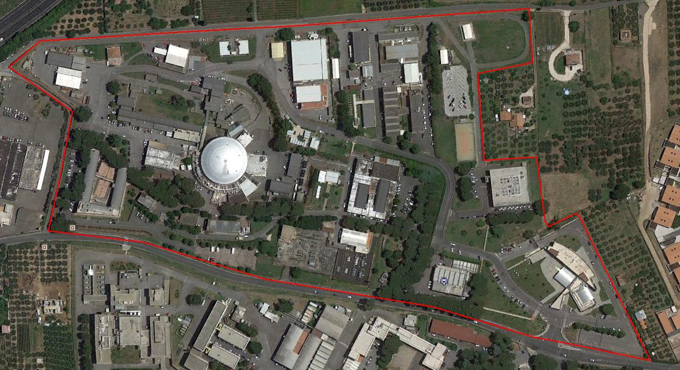
Outlook on Frascati National Labs (LNF)
Site: Frascati (ROME)
Country: Italy
Site area: 135.000 sqm
Building: 38.000 sqm
People: about 400
Facilities:
Dafne
Sparc
Gravitational Antenna
Smaller experiments
Data Center.
Administration
Foundation: mid of 1950’s
Dafne

Slide 3
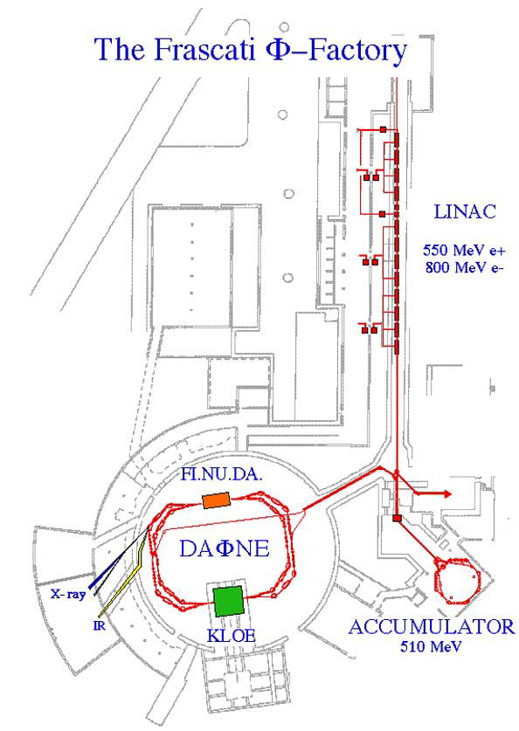
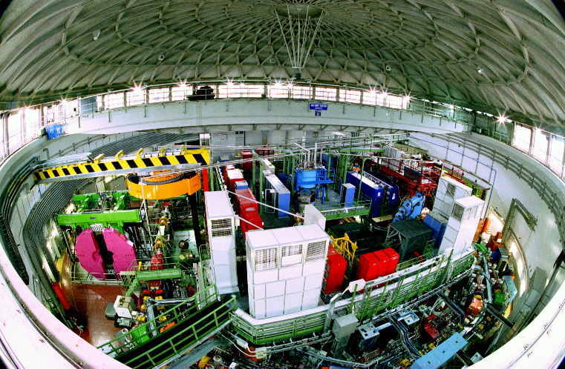
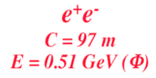
Dafne Accelerator complex
BTF
Synchrotron light from DAΦNE
UV 2 - 10 eV
X-ray 900 - 3000 eV
IR 1.24 meV - 1.24 eV

Slide 4
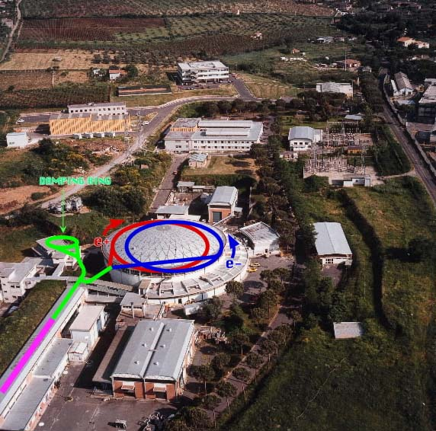
THE Φ-FACTORY COMPLEX

Slide 5
Dafne general Information
Facility/Laboratory: Dafne / Frascati National Laboratories - INFN Closest City/Town: Frascati ( ROMA) Italy
DAΦNE (Double Annular Φ Factory for Nice Experiments), is an accelerator complex consisting of a double ring e+/e- collider working at the c.m. energy of the Φ-resonance (1.02 GeV) and an injection system. In its original configuration the collider consisted of two independent rings, each < 97 m long, sharing two 10 m long interaction regions (IR1 and IR2) where the KLOE and FINUDA or DEAR detectors were respectively installed.
A full energy injection system, including an S-band Linac, 180 m long transfer lines and an accumulator/damping ring, provides fast and high efficiency electron and positron injection also in topping-up mode during collisions.
1991: Design
1993: Adone Decommissioning
1995 Construction started
1998 Day-One commissioning
1999 Machine fully running for experiments
Average annual running program (h): 6000
Approximate operational pattern Continuous operation h24. Usually are planned about 4 maintenance stop of 2 weeks, two of which during winter and summer holidays, longer stop for upgrades, unpredictable stop for faults of devices.

Slide 6
Dafne main rings

Slide 7
Dafne Power Demand
Run KLOE – 2005 : max power demand
 | kW
Magnet Power supplies | 3.984
RF | 524
Linac | 201
Cooling | 600
Criogenic plant | 250
HVAC | 250
KLOE experiment (PS and electronics) | 150
Tot | 5.959
Survey of december 2005
Now 3.3 MW

Slide 8
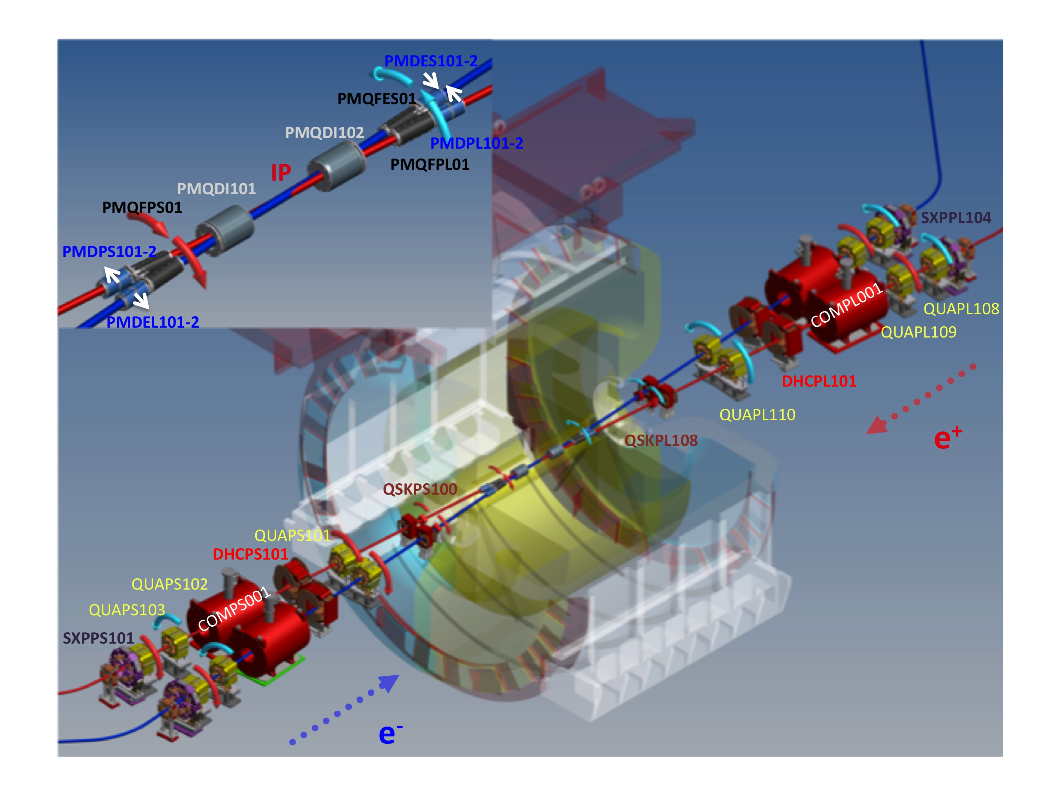
Dafne Upgrades 2007-2012
DAΦNE collider has been upgraded in order to implement a new collision scheme based on large Piwinski angle and cancellation of the synchro-betatron resonances by means of electromagnetic sextupoles (Crab-Waist compensation). The novel approach has proved to be effective in improving beam-beam interaction and collider luminosity.
In this framework, some work has been done also in terms of energy saving.
The new interaction region

Slide 9
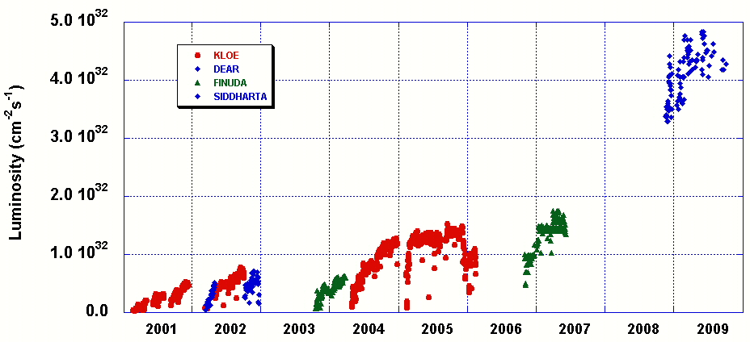
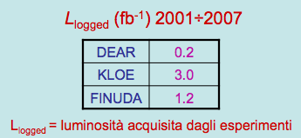
Luminosity at DAΦNE 2001 ÷ 2009
Design Goal
Crab-Waist COLLISION SCHEME
SIDDHARTA (DEAR)

Slide 10
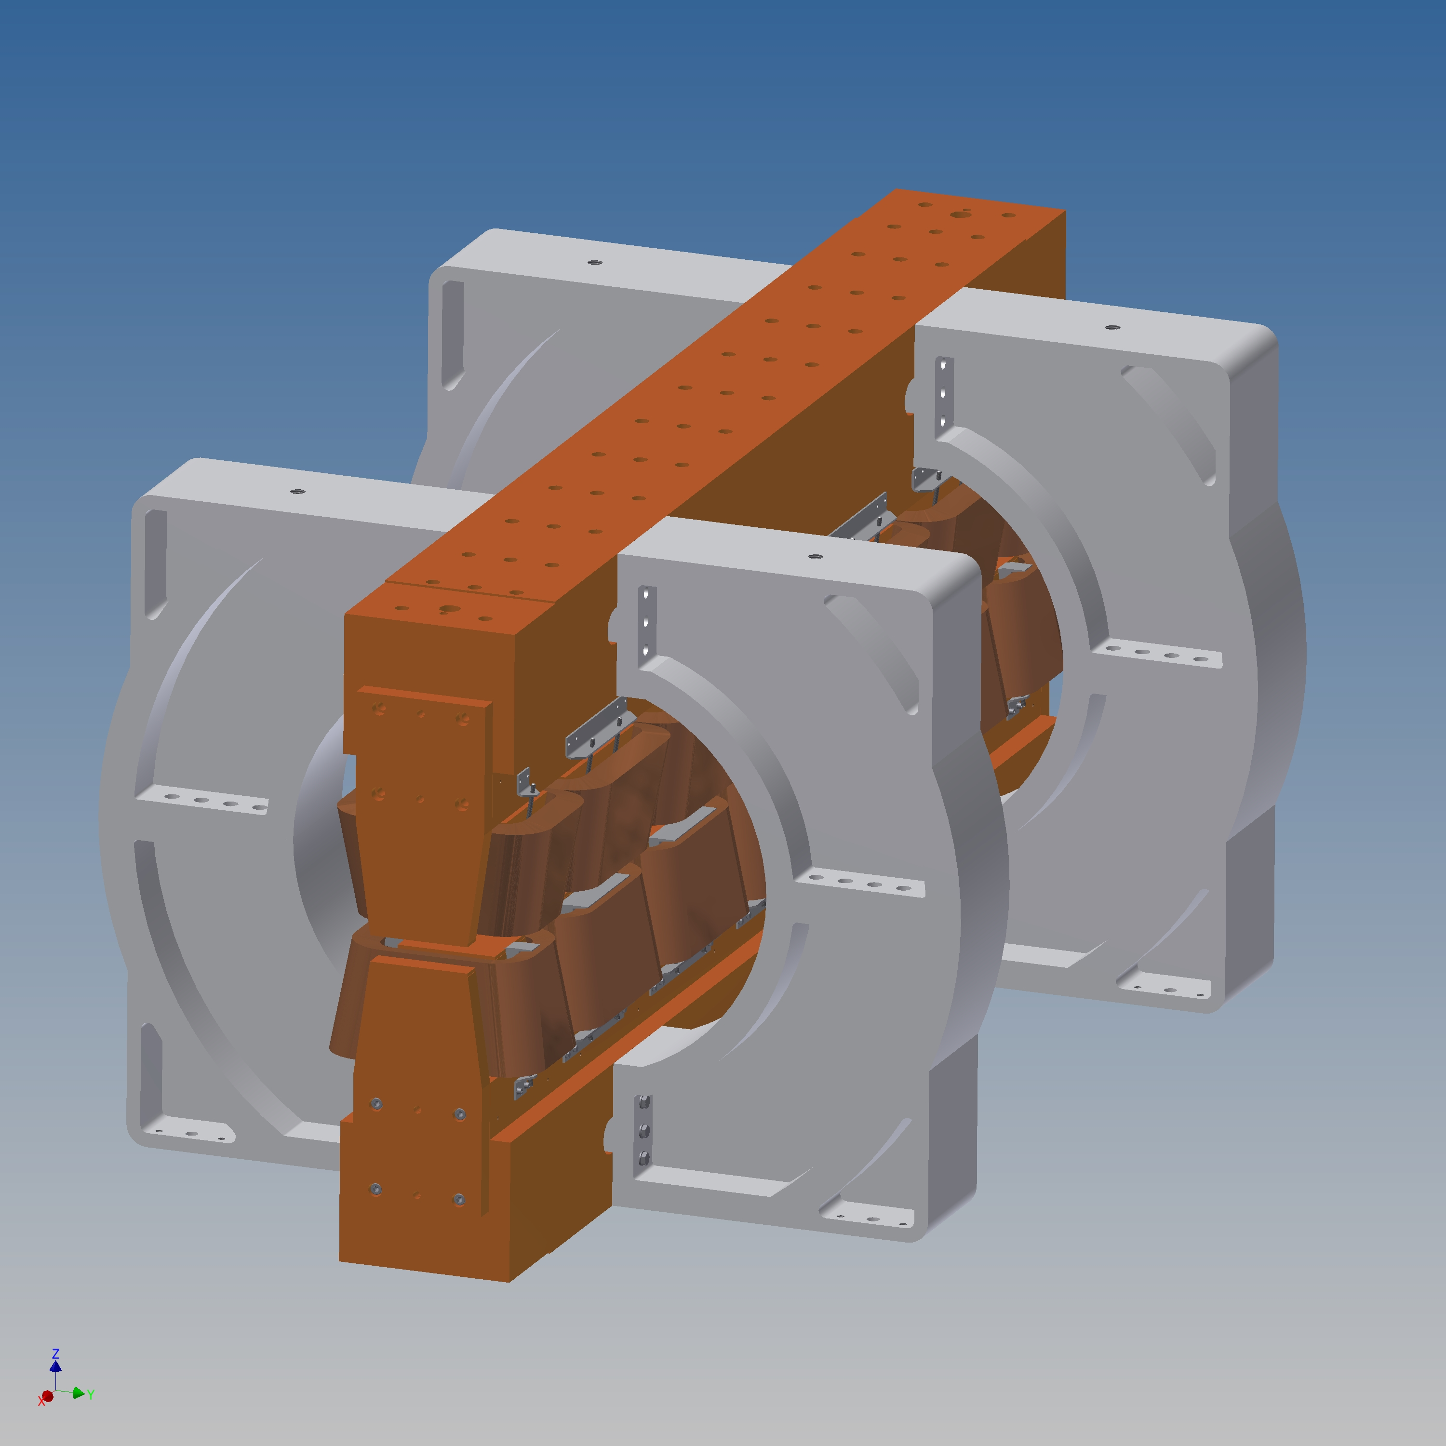
Wiggler magnets upgrades
Dafne main rings use 4+4 normal conducting wigglers designed to reduce the instabilities and control the emittance.
B=1,8 T
Maximum total power demand: about 2,5 MW
Multi step Upgrade performed since 2002 in order to:
Reduce the field non-linearities
Improve the good field region adding shaped pole plates
Reduce the Gap, from 40 to 37 mm: space gained renouncing to early envelope of protective felt, foreseen for baking, not necessary any more
Reduce the maximum required B-field, after machine optics optimization
All the modifications were mainly driven by the upgrading of accelerator physics parameters, but also by efficiency reason and OPEX saving.

Slide 11
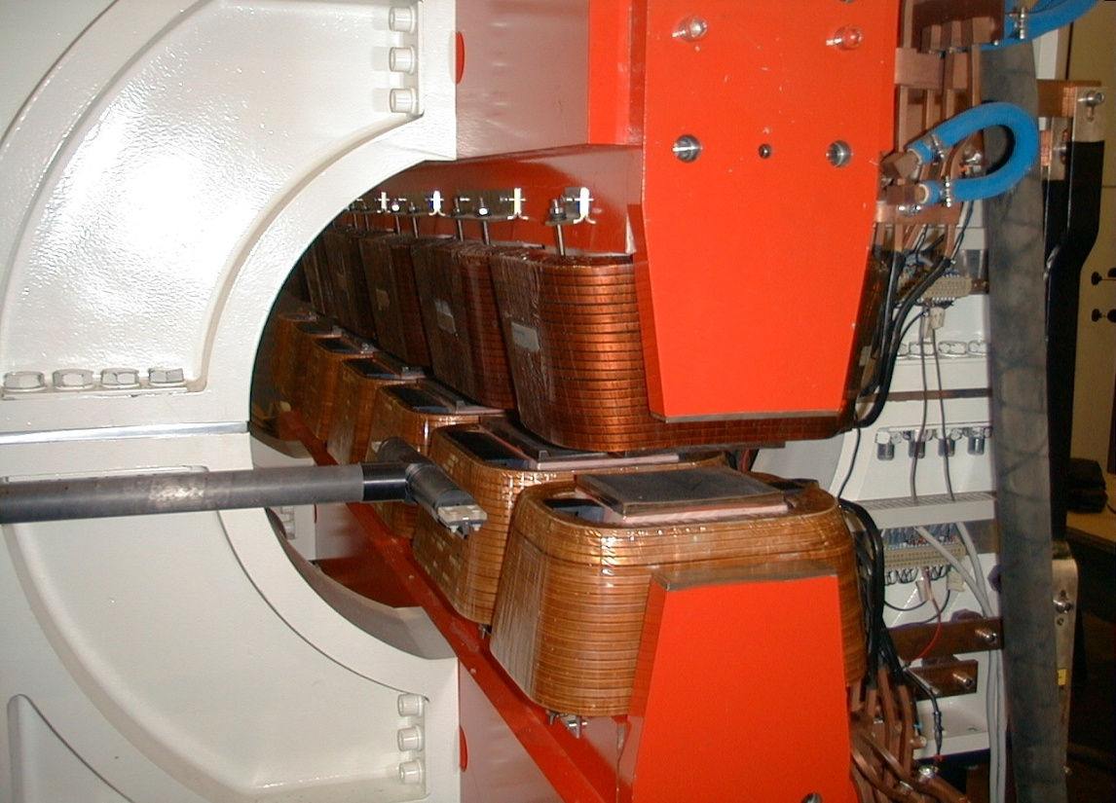
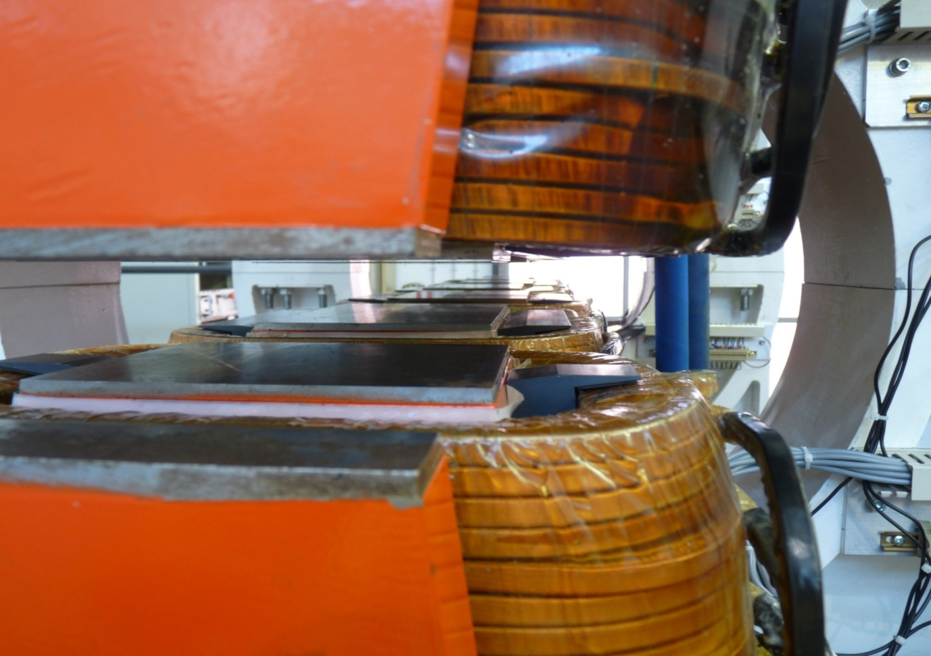
Before modification
Joint effort of different skills:
Accelerator physics, beam dynamics and optic experts working together with
Magnetic calculation and measurements experts and Mechanical engineers
Wiggler pole wiggling
Energy saving benefit
Lower B required
Lower current (from 730 to 400 A)
Result:
1,7 MW of power saving !
After modification

Slide 12
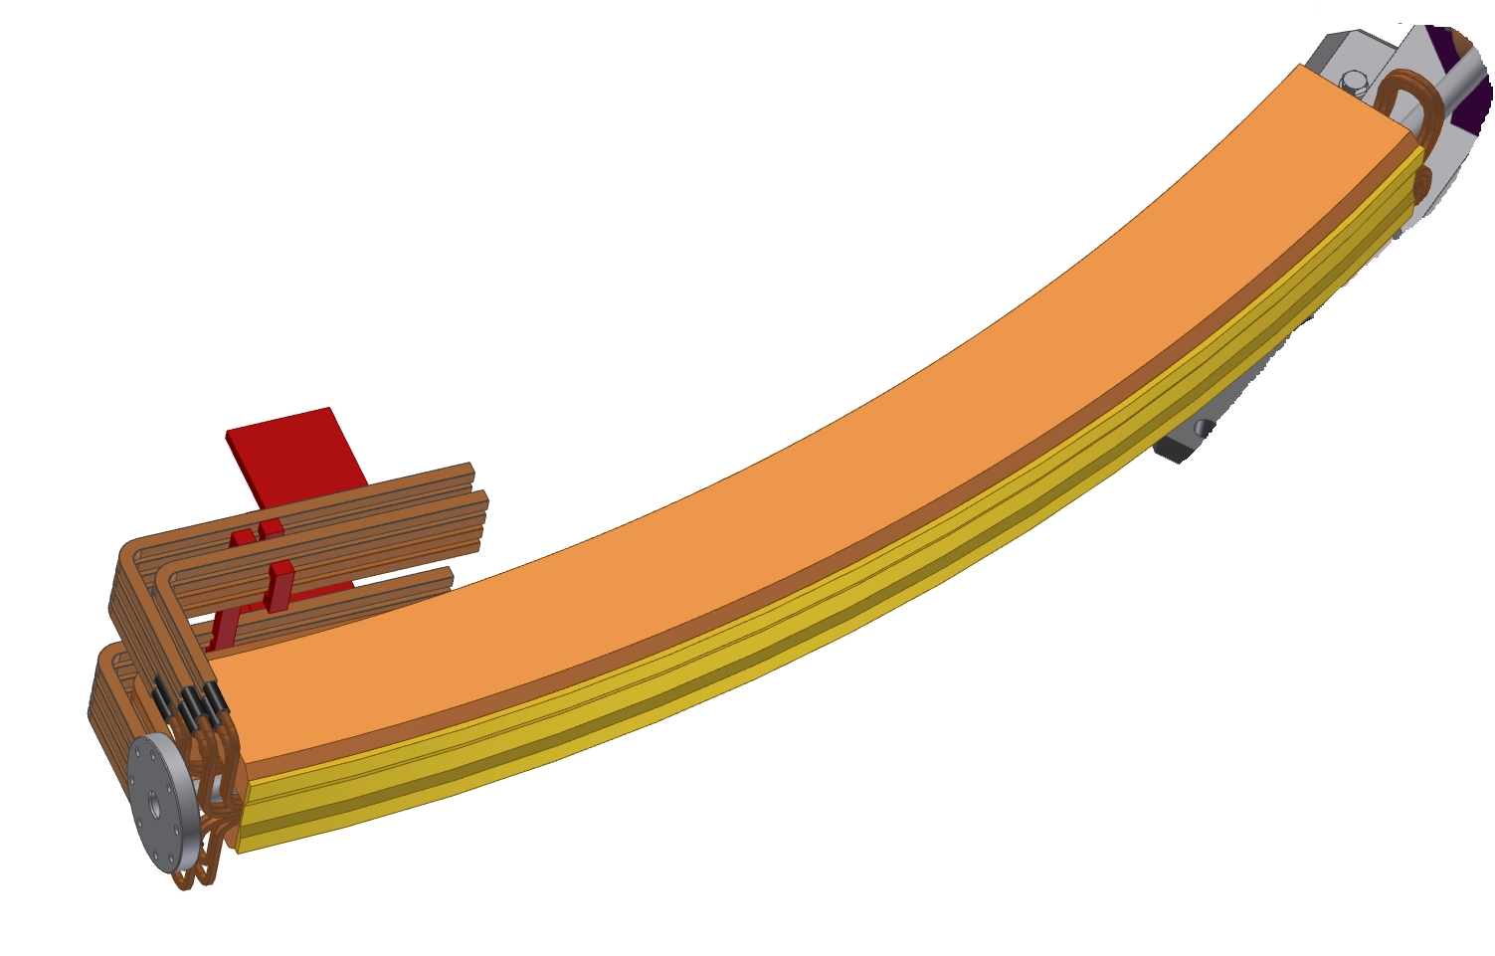
34°Septa magnets modification
n. 4 Injection/ extraction 34° septa: 2125 A – 32 V
Total power demand (AC): 4x110 kW =440 kW
High current density (91 A/mm^2), thermally stressed.
After repetitive water leakage new coils needed
A copper conductor with rectangular section (6.2 mm x 7.0 mm with 3.4 mm diameter inner hole) has been used instead of the original squared one (6.0 mm x 6.0 mm with 3,4 mm inner hole), obtaining 25% resistance reduction.
The original circular beam pipe was squashed with a special tool and iron joke machined in order to reduce the gap (26 mm -> 22 mm).
Result:
- Small reduction in beam acceptance (the good field region is smaller), but admissible
- overheating repetitive trip: fixed
Total power saving: 250 kW

Slide 13
Dafne Energy Saving and run cost
 | kW | €cent/kWh | K€/day | 1 year bill (200 run days) [M€] | Up-to date 1 year bill [M€]
Run KLOE 2005-2006 | 5.900 | 9,8 | 13,88 | 2,78 | 5,12
Run KLOE (Dec 2013) | 3.340 | 18,08 | 14,49 | 2,90 | 2,90
Power demand reduction = | 2.560 |  | 200 days run saving = |  | 2,22
 | dec-2005 | NOW
Magnets Power supplies | 3.984 | 1.850
RF MR | 524 | 320
Linac | 201 | 233
Cooling | 600 | 300
Criogenic plant | 250 | 250
HVAC | 250 | 260
Kloe | 150 | 120
tot | 5.959 | 3.333
Wiggler pole shaping and current reduction (730-> 400 A) | 1700 kW
n. 4 Septa 34° magnets new coils | 250 kW
n. 4 Splitter magnets removal (new interaction zone for the crab-waist) | 160 kW
Dafne RF system optimization | 170 kW
Dafne cooling system optimization | 280 kW
Total power demand reduction | 2.560 kW

Slide 14
LNF Annual Power demand trend [GWh]
Base Load= all the labs excluded Dafne
Trend of the average cost of Power [€/MWh]*
*Total cost: VAT and taxes included
= total bill/energy

Slide 15
Accelerator Cooling Plant
Magnets, RF, Power Supplies, Absorbers, cooled by Demineralised Water (closed circuit, virtually no water consumption) SECONDARY CIRCUIT
PHE transfers the cooling load from the secondary to the primary circuit COOLING TOWERS
DAFNE Cooling: ≈ 3 MW_{th}, 60.000 m³/y
≈ 2 l/s make-up water (70 k€/y),
electricity bill 350 k€ ≈ 6000 h/y Machine On

Slide 16
Cooling Towers
PROs
  Cheap (capex, opex-electrical, reduced mechanical maintenance)
  No particular regulation (f.i. F-Gas for chillers)
CONs
  Chemicals to avoid fooling (20 k€/y)
  Blow down control for discharging to sewage
  Need for PHE chemical washing every 2-5 years
  (10 k€)
  Consumption of tap water (cheap but sustainable?)

Slide 17
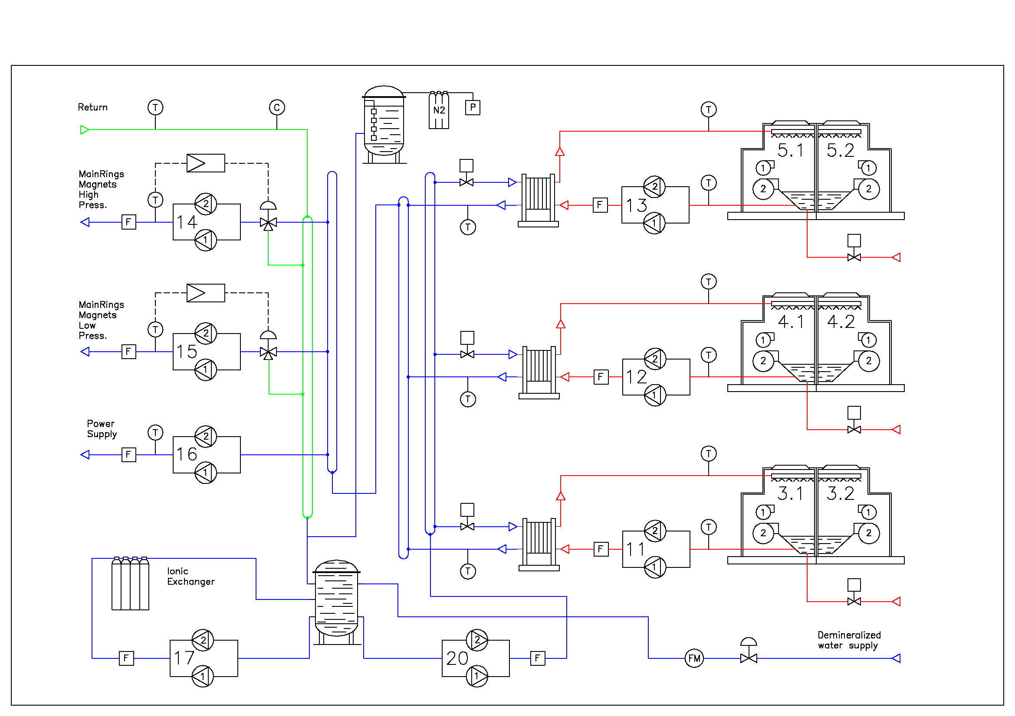
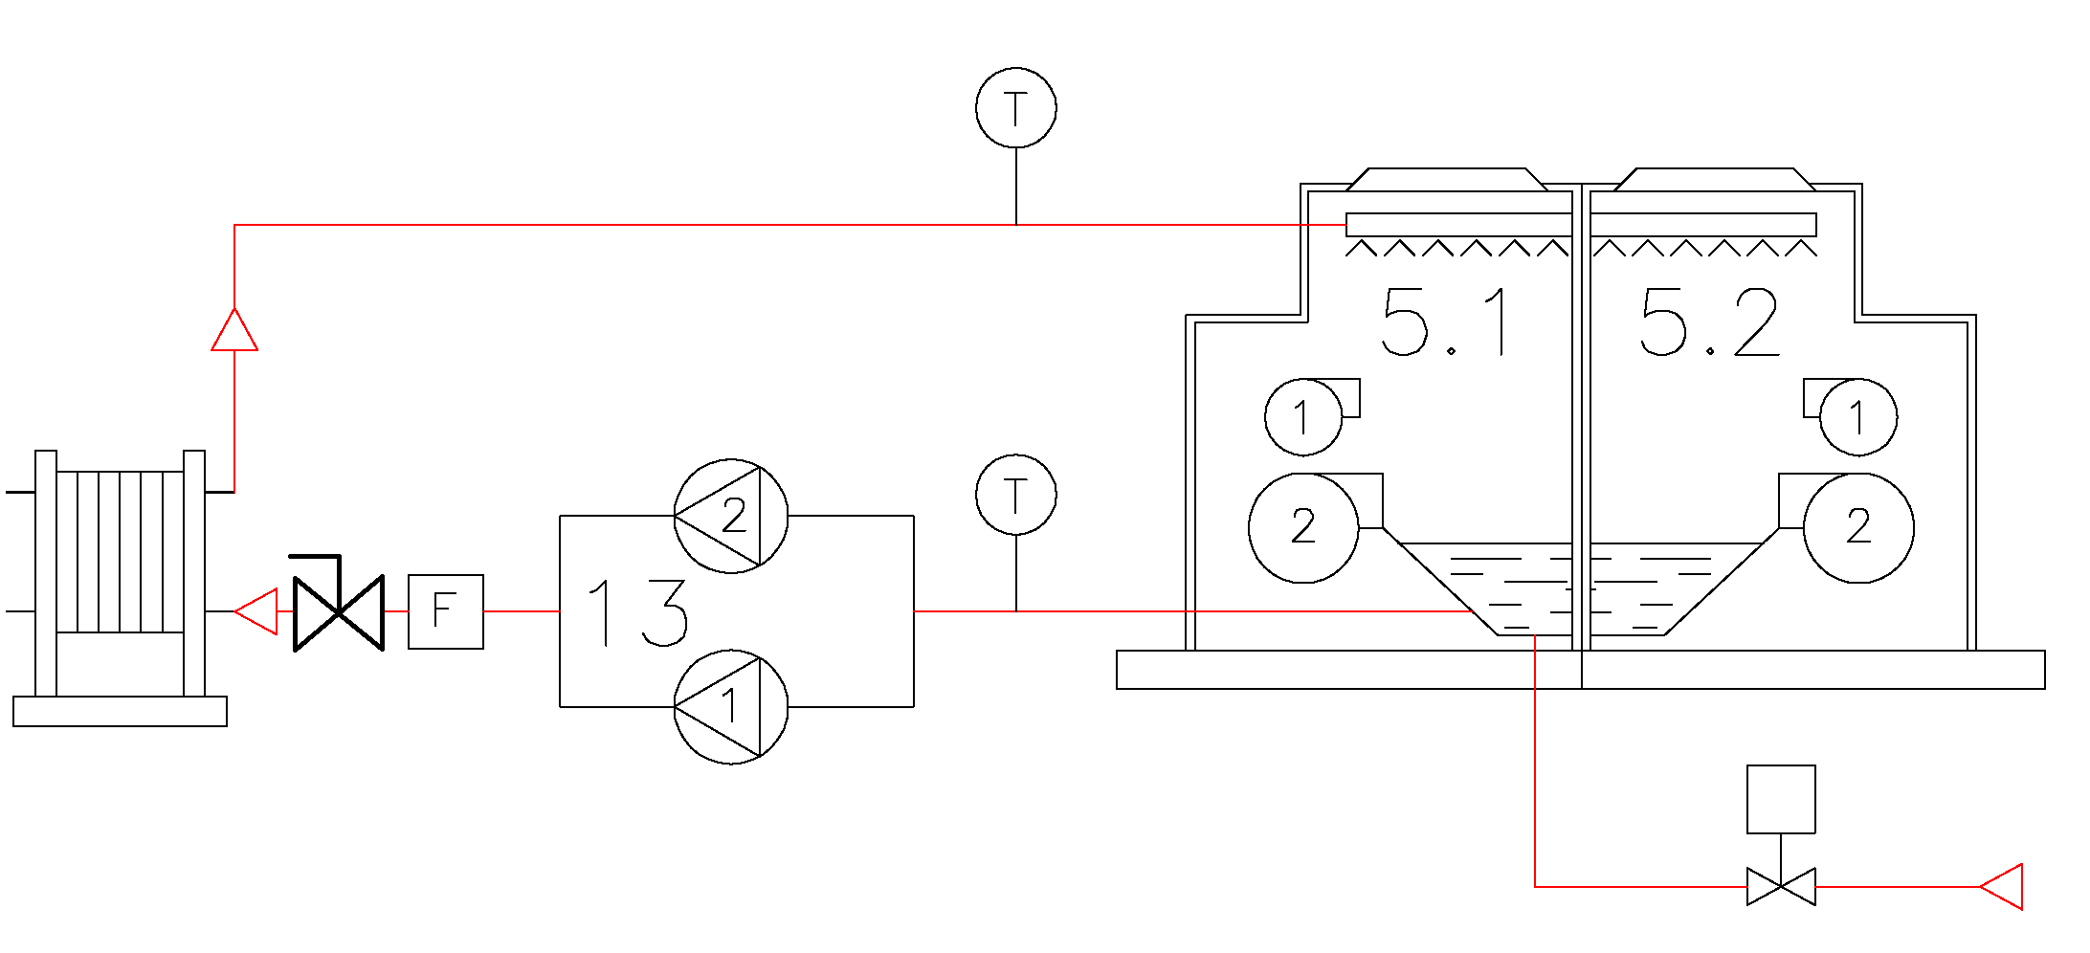
Accelerator Cooling Plant Diagram

Slide 18
CTW Pumping System Review
Studying the diagram and measuring the characteristics of the components (Pressure, Flow, Hydraulic Resistance) 75 kW 1450 rpm Motor (supplying 43 kW) changed with 45 kW 1000 rpm Motor (supplying 13 kW) same frame.
Considering installation costs (15 k€) and operation savings (72 k€/year) Payback Period
2,5 months! (solution studied to minimize the cost of investment, other scenarios taken into account required more work).

Slide 19
Supervisory and Control System Review
During 2013 a retrofit of the control system of the cooling plants and other ancillaries has been performed. The control logic of the functioning of the CTW (fan speed, number of CTW on) and 3WVs has been reviewed in order to consider energy savings, taking into account the huge reduction of power supply request due to more demanding magnets modification.
Also reliability and availability issues have been considered (optimization).

Slide 20
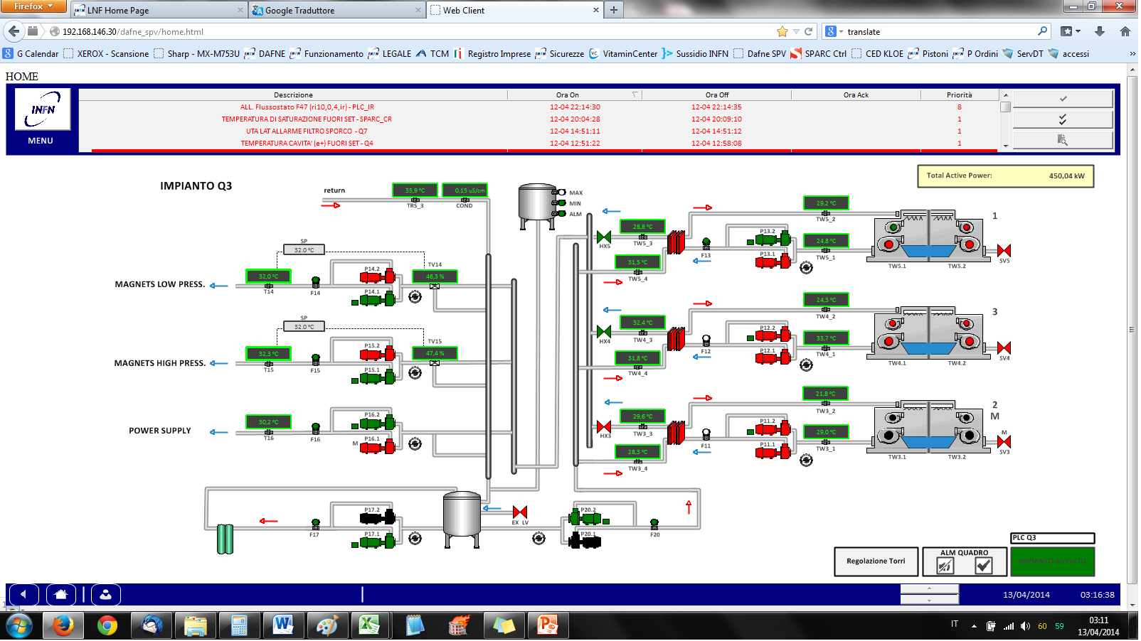

Slide 21
Future developments
Heat recovery from Data Centres to produce hot water for office buildings HVAC.
Moving towards elimination of traditional (old) boilers (CH4) to be substitute by heat pumps with higher efficiency.
Closed circuit cooling scheme under evaluation in order to reduce (virtually eliminate) water consumption (even if electricity bill increases).
Fuel cell (250 kW) installation under evaluation, with the scope of trigeneration.

Slide 22
Thank you for your attention
ruggero.ricci@lnf.infn.it
ugo.rotundo@lnf.infn.it

