Slide 1
Heat recovery at European Accelerator Based Facilities – Possibilities and Opportunities
Johanna Torberntsson
Master thesis student, Department of Energy Sciences, Lund University
www.europeanspallationsource.se
April 28, 2014

Slide 2
Surplus heat recovery as an energy efficient measure
30 000 accelerators in the world
electricity → heat
EuCARD-2 , EnEfficient
Heat recovery from cooling circuits

Slide 3
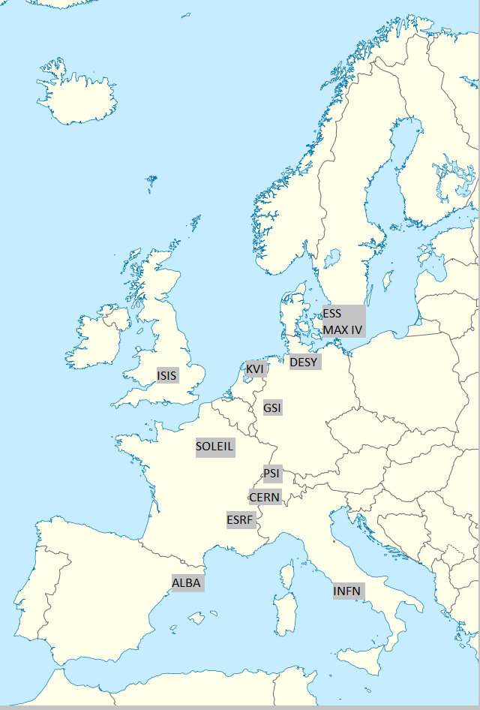
Energy-related parameters are analysed
10 in operation
2 under construction
Energy consumption
Cooling methods
Energy related costs

Slide 4
Surplus heat technologies
Technologies for heat recovery
Survey to industries
Low temperature heat to preferably be used in its current state
Heat and heated water flows

Slide 5
Correlation between electricity sources and price

Slide 6
There are different reasons to the size of the energy budget

Slide 7
How much of the energy budget is spent on other things than the electricity price?

Slide 8
There are large amounts of surplus heat that could potentially be reused

Slide 9
Reduced mixing of flows keep the temperatures high
Heat is dissipated more through the system when only considered an expense
To receive more high-grade heat, less mixing of tempered water flows is required

Slide 10
The most suitable cooling method depends on local prerequisites
COP = Auxiliary electricity/thermal load evacuated
Cooling towers: ISIS, INFN (14%), GSI, CERN (10% LHC), SOLEIL, DESY, KVI
River heat exchanging: PSI (5%), ESRF (10%)
District Heating: ESS (22%), MAX IV

Slide 11
Surplus energy can heat the own buildings
Building heating requirements too low to meet cooling demands for facilities
Internal District Heating

Slide 12
Surplus heat can be utilised in many ways
State of the art techniques
Energy recovery possibly a new research area for accelerator based facilities
Develop concept for other industries
Mainly low temperature heat

Slide 13
High temperature solutions
District Heating - 80°C
Heat-driven cooling - 80°C - large amounts of cooling water - more efficient to produce cooling with heat than to first produce electricity
Organic Rankine Cycle - ca 80°C; Low efficiency but may be an option if the electricity is expensive

Slide 14
Low temperature solutions
Backup – planned and unplanned shutdowns
Heat storage evens out variations

Slide 15
LTDH networks utilises the low tempered heat
Larger accommodation areas
Lystrup: Supply 55°C, return 30-35°C
75 % less heat losses compared to traditional DH
Integration already in design phase
The low-temperature heat enters the economical system

Slide 16
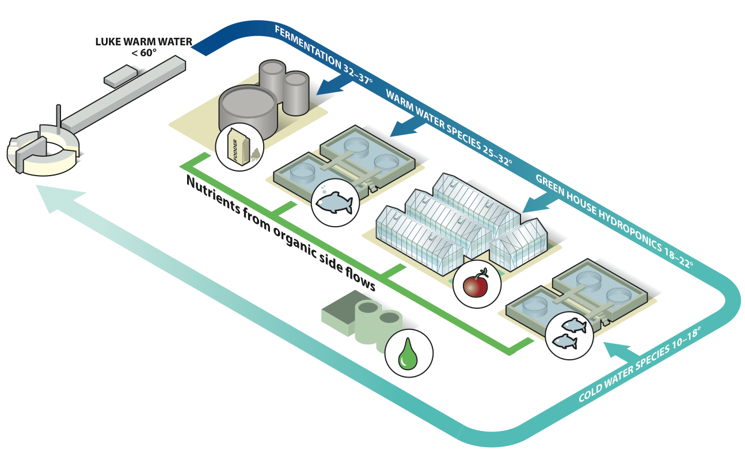
Surplus heat can produce food and fodder
Illustration: Peter Lönnegård & Fredrik Indebetou

Slide 17
40°C can increase the efficiency in several processes
Wastewater treatment
Oxygen, nitrogen separation
Ultrapure water production

Slide 18
Seasonal variations needs to be covered
Ground heating applications will need other method during summer
Also greenhouses have a more even heat demand but there is still need for backup
Wastewater treatment can better follow variations

Slide 19
Heat recovery a new research field?
Energy effective measures during upgrades
Separation of flows – highest possible temperature
Modeling of energy flows
Time optimisation – synchronisation between distributor and reciever of surplus heat

Slide 20
References
Recycling of surplus energy at European Spallation Source:
Danfoss/COWI, 2013-11
EON, 2013-11-15
HotSwap, 2013-11-11
Kraftringen, 2013-11-14
SLU – Swedish University of Agricultural Sciences. R&D-program SSE-C – Swedish Surplus Energy Collaboration, 2013-11-14
VA SYD, 2013-11
Colleagues at the respective facilities:
Bouteille, Jean-Francois, ESRF
Burckhart, Helfried, CERN
Casas, Joan, ALBA CELLS
Claudet, Serge, CERN
De Jong, Jan, KVI
Eymard, Philippe, SOLEIL
Findlay, David, ISIS
Hofstee, Mariet, KVI
Jensen, Jens-Peter, DESY
Lavesson, Lars, MAX IV
Lindenberg, Jan, GSI
Reinhard, David, PSI
Ricci, Ruggero, INFN
Expertise from ESS:
Hjern, Thomas, ÅF consultant at ESS
Lindström, Erica, Project Coordinator, Energy Division, ESS
Parker, Thomas, Head of Energy Division, ESS
Text references:
Energy Inventory, ESS-0003989, Lindström E, 2014-02-24
Study of working fluid selection of Organic Rankine Cycle (ORC) for waste heat recovery, E.H. Wang et al, Energy 36, 2011 http://dspace.imech.ac.cn/bitstream/311007/44862/1/SCI-J2011006.pdf
Thermodynamics – An Engineering Approach, Cengel and Boles, 2008
Thermally driven cooling: Technologies, Develeopment and Applications, Núnez T, Fraunhofer Institute, Freiburg, JOURNAL OF SUSTAINABLE ENERGY, VOL. 1, NO. 4, DECEMBER, 2010 , www.energy-cie.ro/archives/2010/nr_4/v4-03_nunez_thomas.pdf
Energy management for large-scale research infrastructures, Bordry F, Parker T, Rizzuto C, 2011-10-13
Värmedriven kyla, Rydstrand M et al, Energiprocesser KTH, Forskning och Utveckling 2004:112
”DesiCool, Omvandlar värme till kyla”, Munters, www.munters.se
Strategic Sustainability Performance Plan, U.S. Department of Energy 2012
Climate Change Adaptation Plan, U.S. Department of Energy, 2011
Scorecard on Sustainability/Energy, U.S. Department of Energy 2013

Slide 21
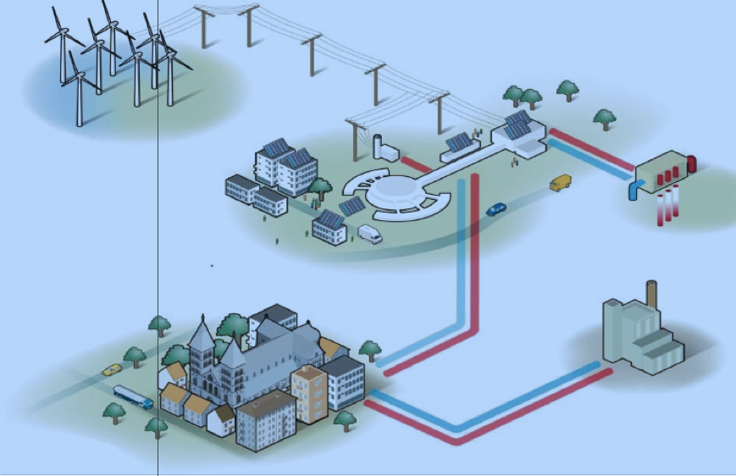
Questions
Thank you for your attention!
100521 ESS Activity report p.18

