Slide 1
Paul Scherrer Institut
Reinhard David
Heat Recycling at PSI, a Project to Cover up to 75% of the Campus`s Heat Consumption
PSI,
28. April 2014

Slide 2
Introduction
Target of the presentation
Presentation of the boundary conditions and interfaces relevant to the realisation of the project
Facts an figures
Project scope, impressions, experiences
Agenda
General
PSI maps, sections and accelerators
Main power consumers
Potentials for efficiency improvements
Heat Recycling
Cooling infrastructure, available heat sinks
Heating and building infrastructure
Potential heat sources for heat recycling
A long term 2-step strategic plan for the heating system of PSI (Measures, Economy, Impressions)
Review of Cooling Efficiency and Optimisation Potential
Potential adsorption cooling

Slide 3
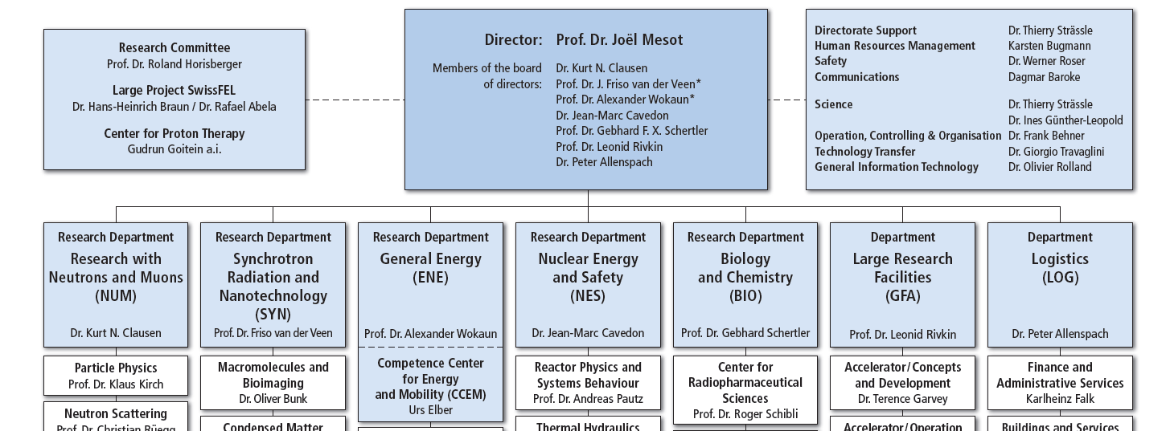
PSI Overview
Number of Employees | 1500
Annual external user | 5000
Annual budget | 365Mio CH Fr
Annual cost of electricity | 3.5-4 % appr.
Annual cost of heat | 2‰ appr.
PSI’s scientific activities are strongly linked with the design, construction and operation of large and complex research facilities

Slide 4
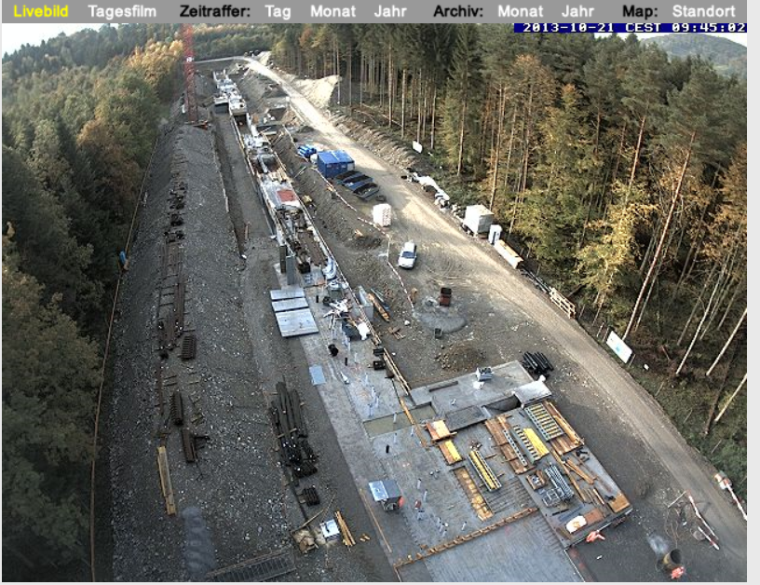
PSI Large Scale Research Facilities
Swiss FEL
Proton Accelerator
(Myons, Neutrones)
Proscan (Proton Therapy)
Snchrotron Light Source: SLS
PSI,
28. April 2014

Slide 5
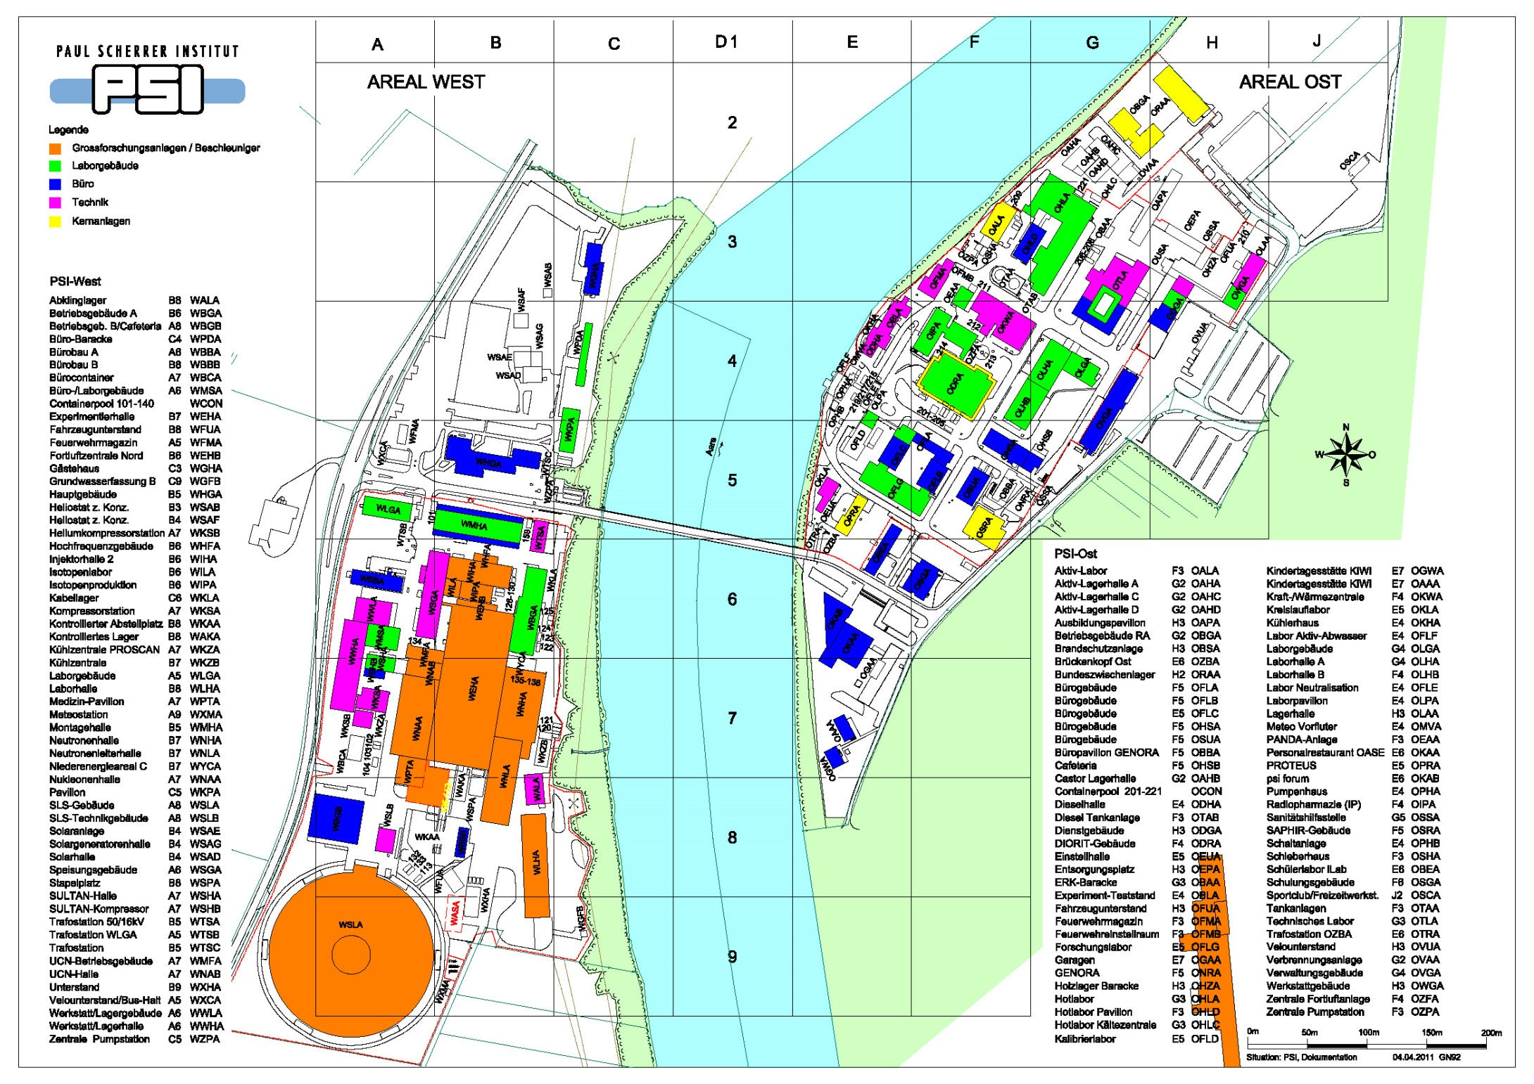
Power Consumers PSI
Main electrical consumers (85%)
SwissFel
6MW

Slide 6
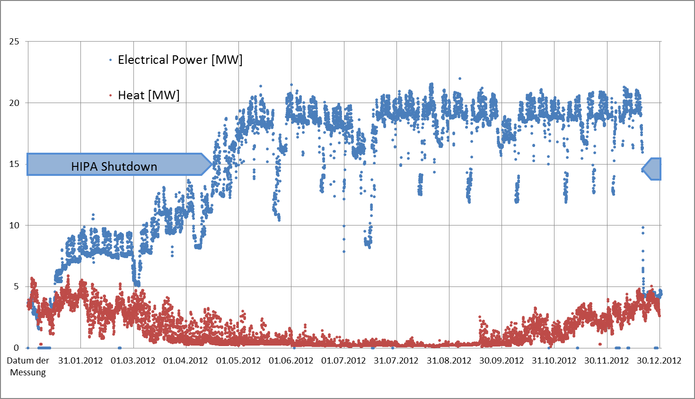
Load Profile Power and Heat

Slide 7
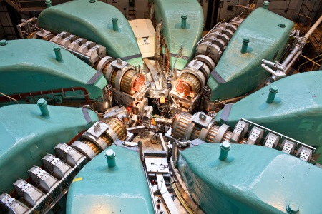
Saving Potential for Accelerators?
Example PSI-HIPA:
10MW total power → 1,3MW proton beam power
RF: 4,1MW | 32% efficiency = already quite good, improvements difficult, potential low high cost
Magnets: 2,6MW | improvements possible, but high investments (new magnets) → not balanced by savings
aux.systems: 3,3MW | improvements possible and undertaken; often high investments
finally: 10MW heat | Heat recovery is investigated and used; often temperature level too low for efficient use of heat
thus important to utilize energy efficient technologies right from the design phase of an accelerator; later improvements are typically expensive and will not amortize
Heat Recycling is an important measure to decrease the use of primary energy

Slide 8
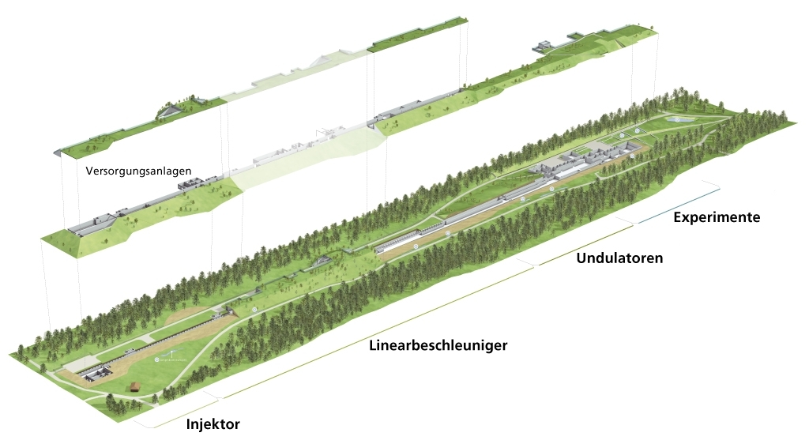
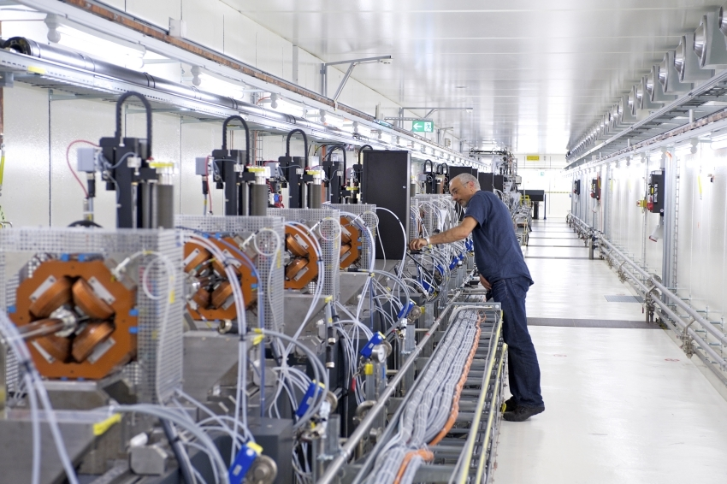
Saving Potential of New Machines (Swiss FEL)?
  Swiss FEL is optimised for low energy consumption!
  compared with SACLA (Japan) reduced by -40%
  compared with LCLS (Stanford USA) reduced by -55%
  (statements from SwissFEL project management, background not subject of presentation)

Slide 9
Saving Potential of New Machines (Swiss FEL)?
  Infrastructure
    Cooling Design (ground water, minimized through cascading temperature levels)
    HVAC concept and design (ventilation efficiency, very limited compression chillers)
    Class A components (Motors, Pumps, Ventilators, Filters, etc.)
    Heat Recycling (focus of this presentation)

Slide 10
Heat Recycling Project
Relevant boundary conditions and criteria's
Existing buildings
Existing heating system
Existing cooling loops and heat sinks
Existing research plants
Integration of future sources

Slide 11
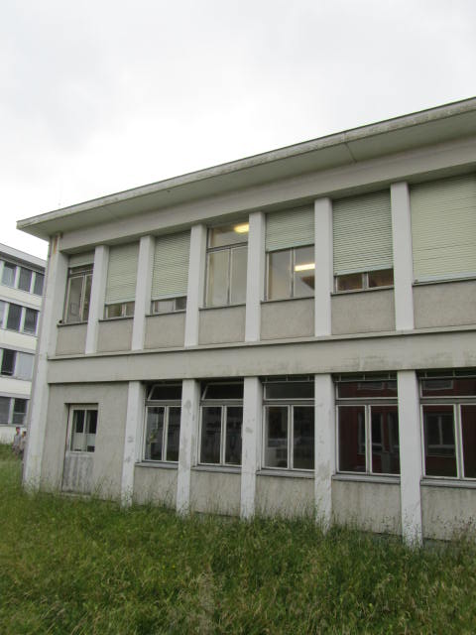
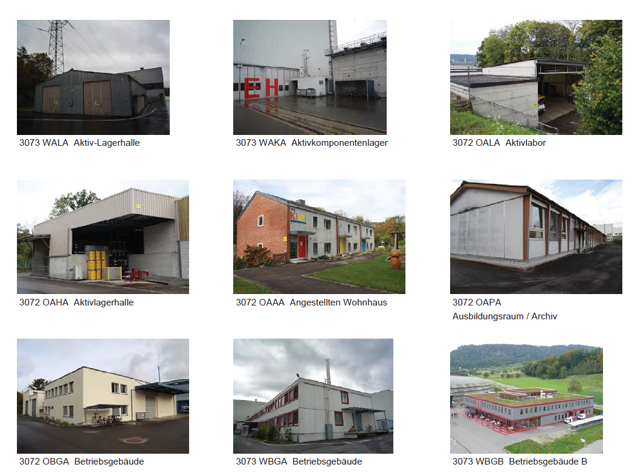
Building Infrastructure of PSI Campus
Building Infrastructure and condition, casing and insulation
Age from 0 to 50 years
Office, laboratories and functional buildings with high internal heat loads
Some huts as permanent interim arrangements
Closed but still legal «research atomic reactor buildings»
Buildings to be removed but ever and ever used
Reduction of heat consumption by passive insulation less effective than waste heat recycling but very costly!

Slide 12
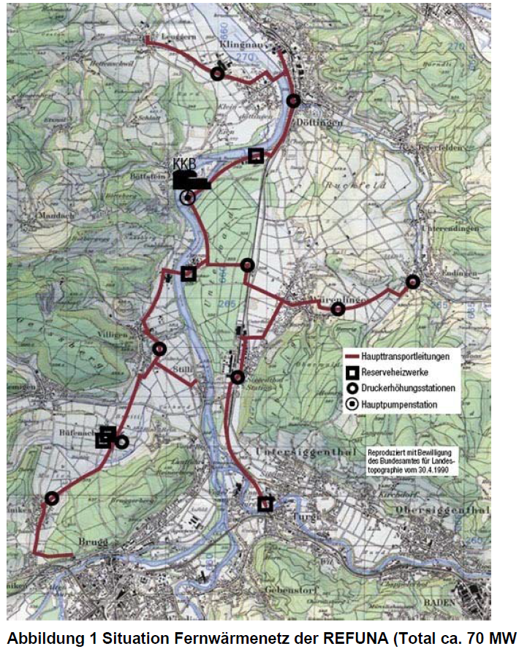
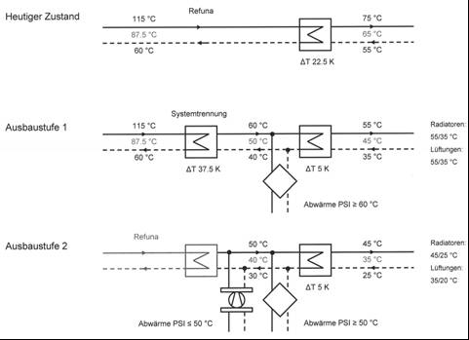
Heating Infrastructure of PSI Campus
District heating system Refuna
System designed for high temperature of 115°C
Heat source nuclear power plant Beznau I+II
Future heat source unknown, today`s low CO2-emission source not further guaranteed!

Slide 13
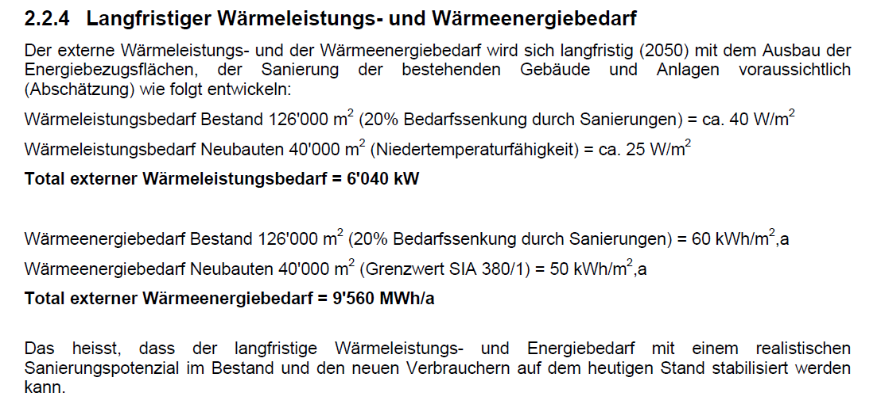
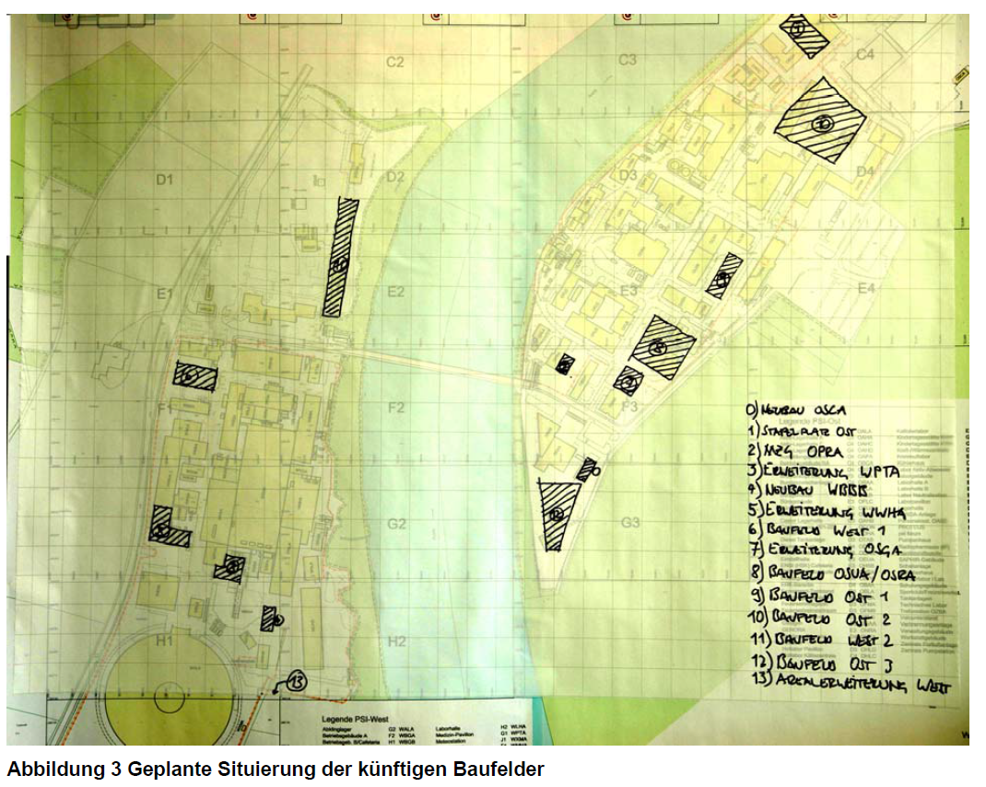
Todays and Future Heat Consumption and Costs
Actual consumption = expected long term consumption=12GWh
  Yearly cost: 750kFr
  Future cost: ??? (actual heat price is based on process heat from nuclear power plant Beznau), price increase very likely!

Slide 14
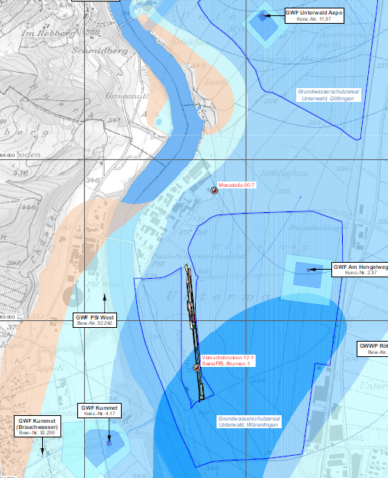
Heat Sinks PSI
River “Aare” 15MW (cavities, magnets, …)
Ground water 5MW (+6MW from 2017 for SwissFEL) (various, 3 cascading circuits )
Air 2.5MW +2.5MW (direct+indirect mainly for HVAC`s only)
Total 25 MW (31 MW incl. SwissFEL)
Rich Groundwater @12°C…14°C
River Aare @ 1…24°C
→Most efficient cooling systems with very little compressing cooling machines in terms of energy! (capacity is ..MW for peak and/or summer loads or redundancy)

Slide 15
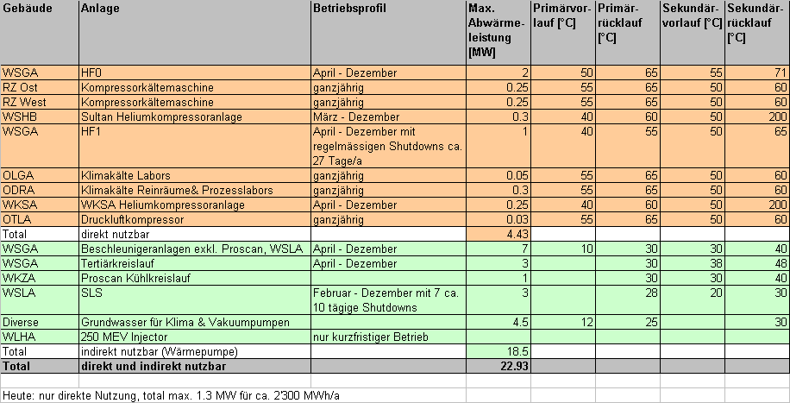
Potential Heat Sources and Demand
Category 1: 4MW @ appr. 60°C
Category 2: 18MW @ appr. 30°C

Slide 16
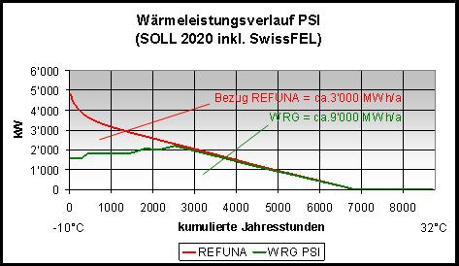
2 Step Strategy - Step 1
Direct use of waste heat category 1 (>60°C)
Increase use of waste heat from 20% to 75% appr.
Projekt in Execution now!
Required Measures
Separation of heating water cycle (Refuna / PSI)
Integration of heat sources category 1
Temperature decrase:
    Modification of building heating stations
    Replacement of Radiators
    Replacement of ventilation heaters

Slide 17
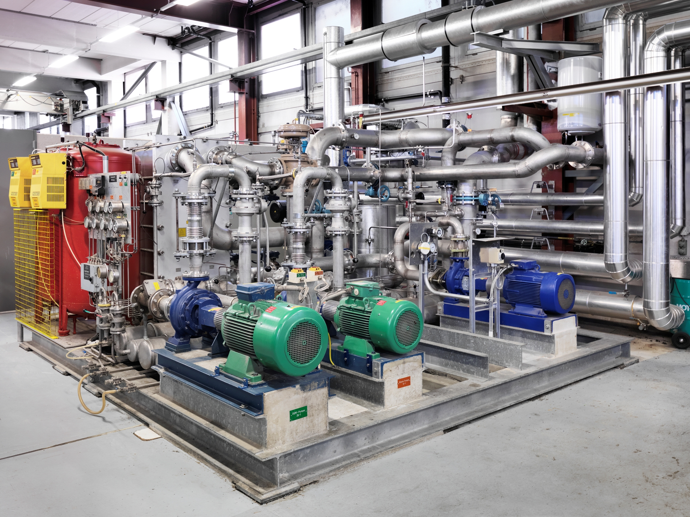
Integration of Heat Sources
Integration of 4 existing sources : 700kFr

Slide 18
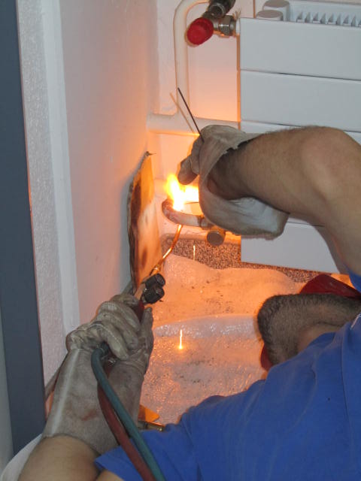
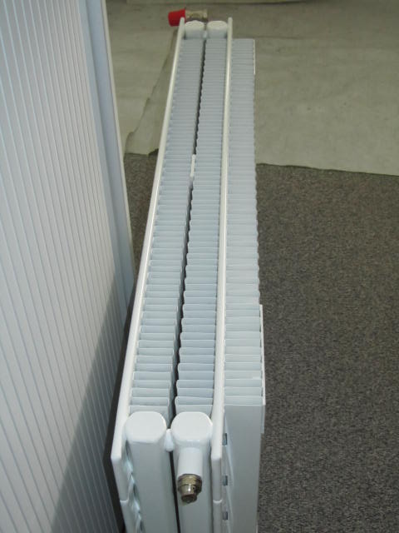
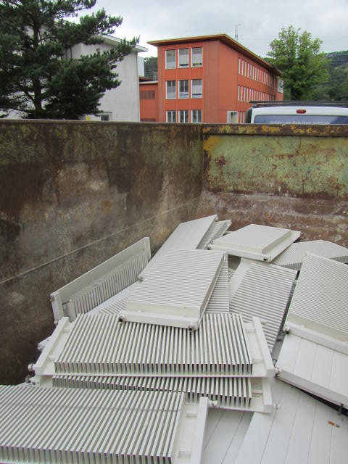
Replacement of Radiators
New Design: 45/30°C
Original Design: 70/50°C
1500 Radiators have to be replaced
Costs: 1500kFr

Slide 19
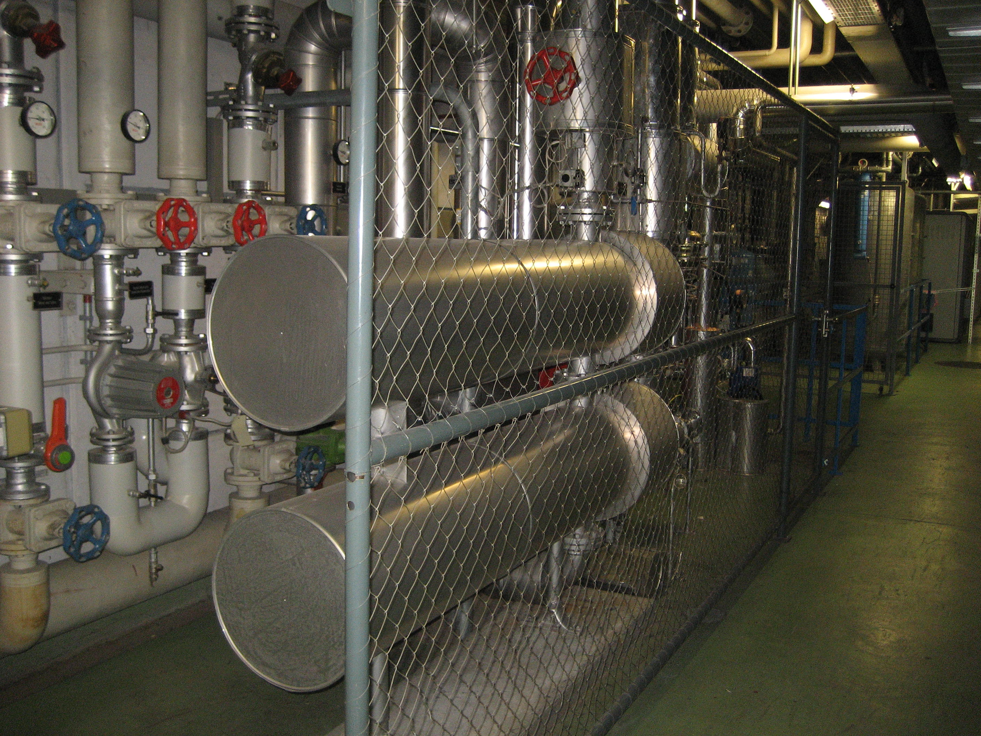
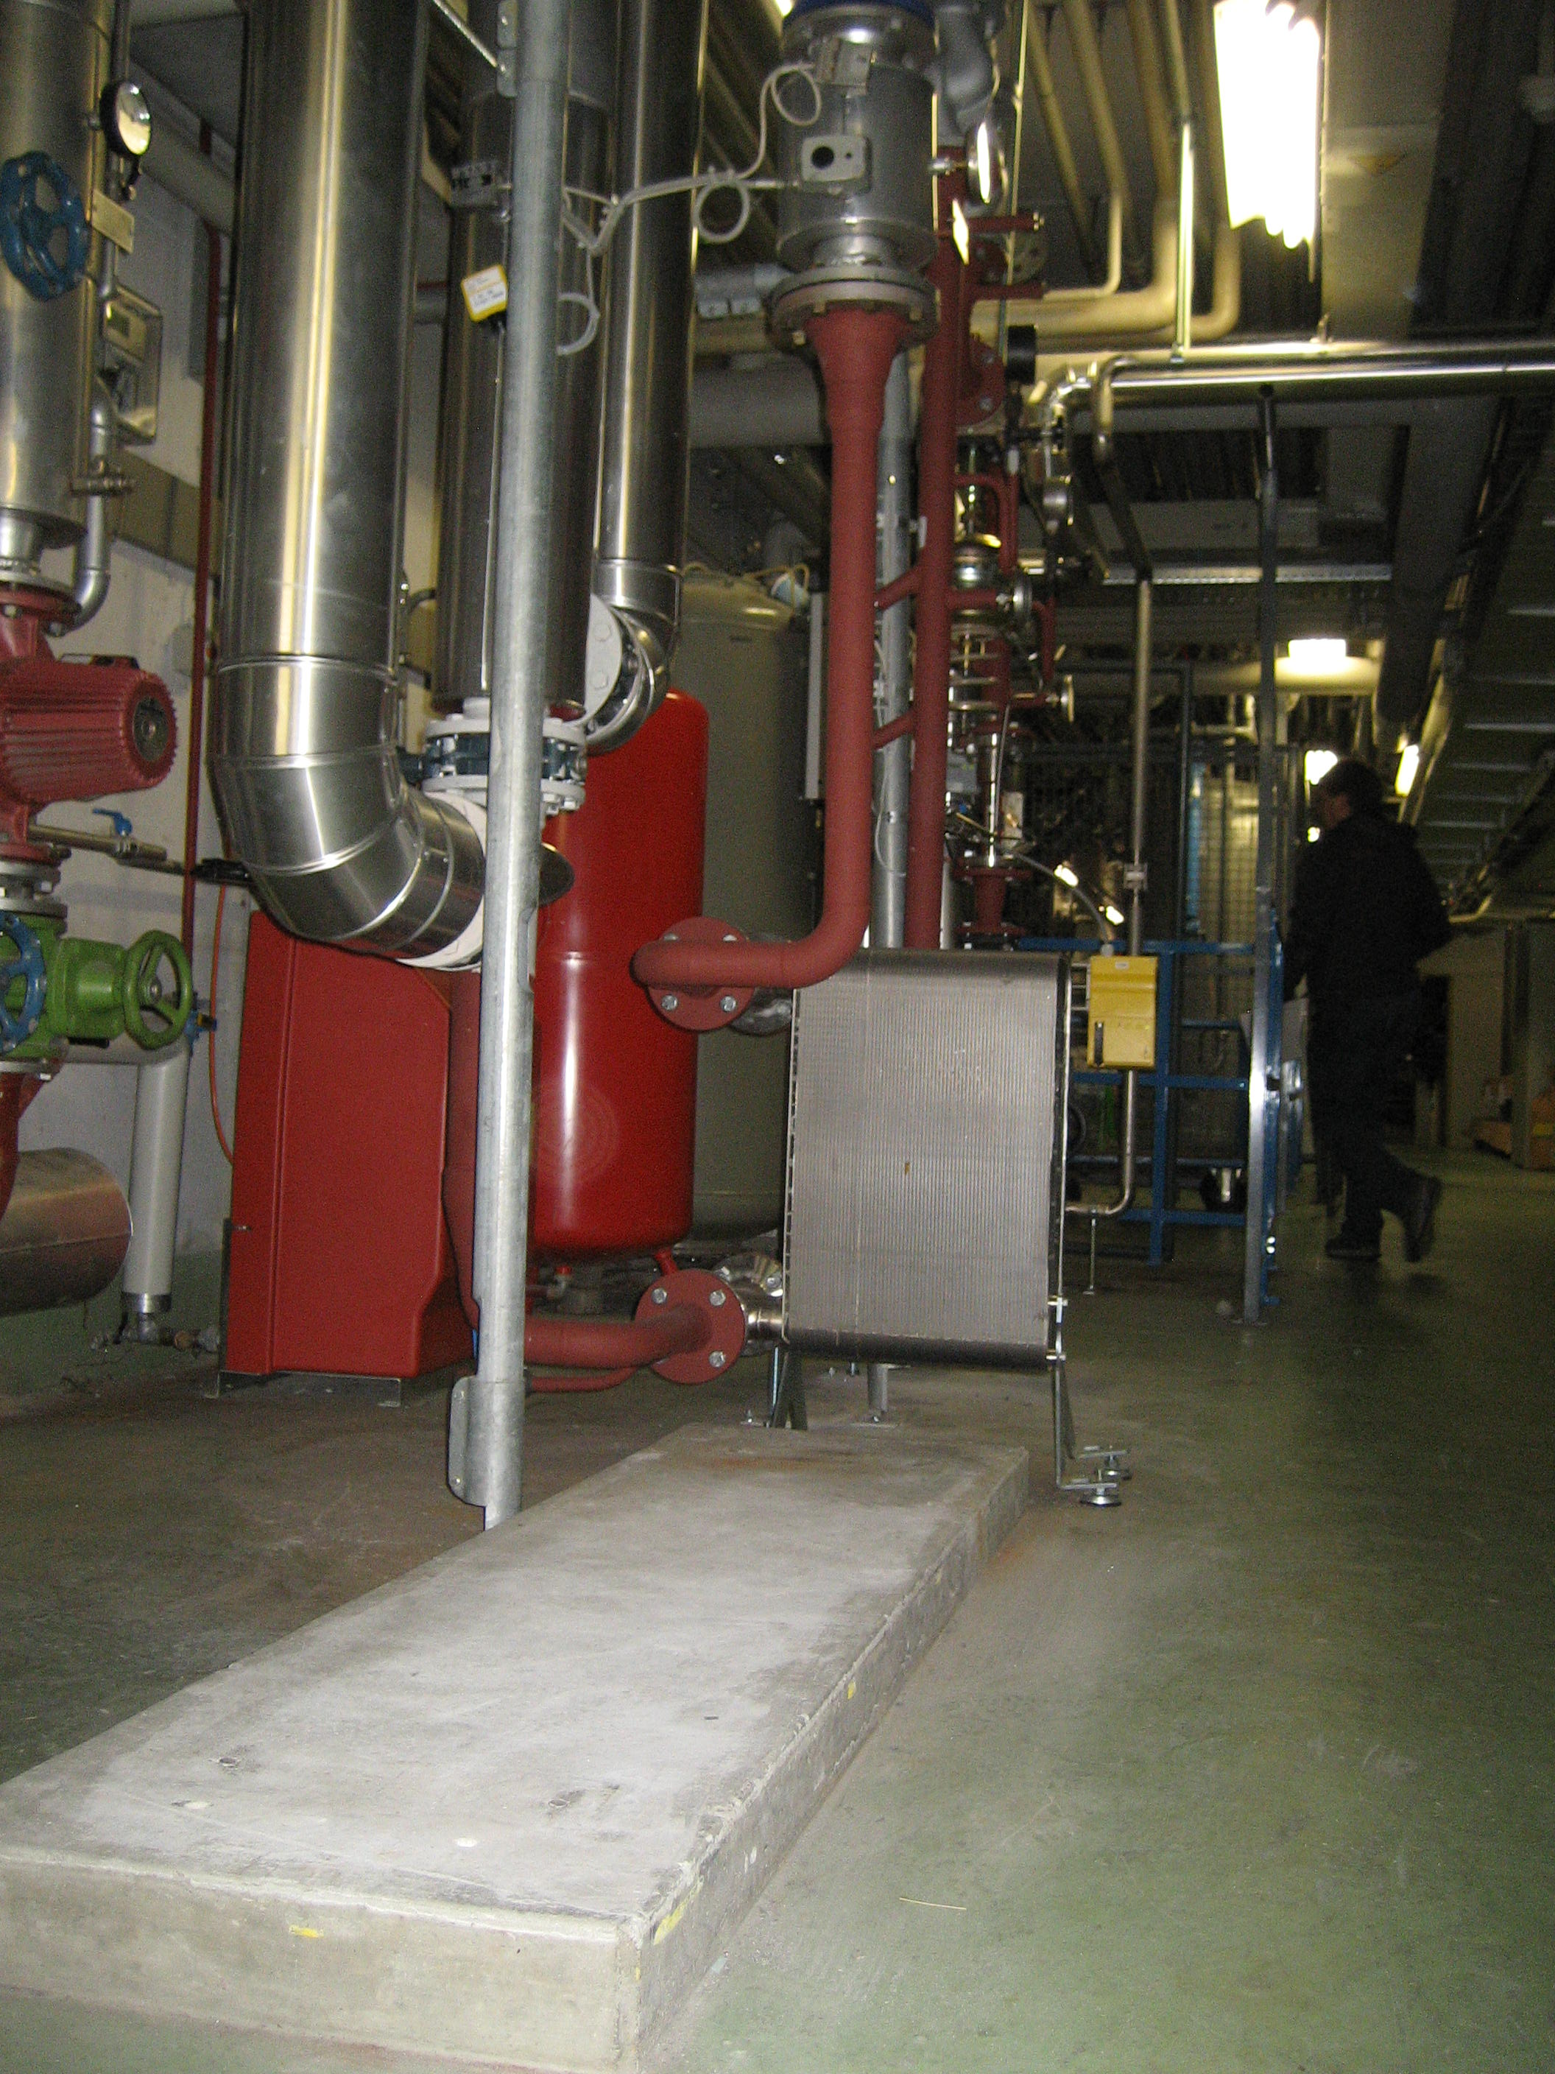
Heat Exchangers of Building Heating Stations
Existing heat exchanger with dTm=22K
(type pipe bundle)
Existing heat exchanger with dTm=5K
(plate type fusion bonded, stainless steel)
→very compact
37 heat transfer stations to be adapted: 700kFr

Slide 20
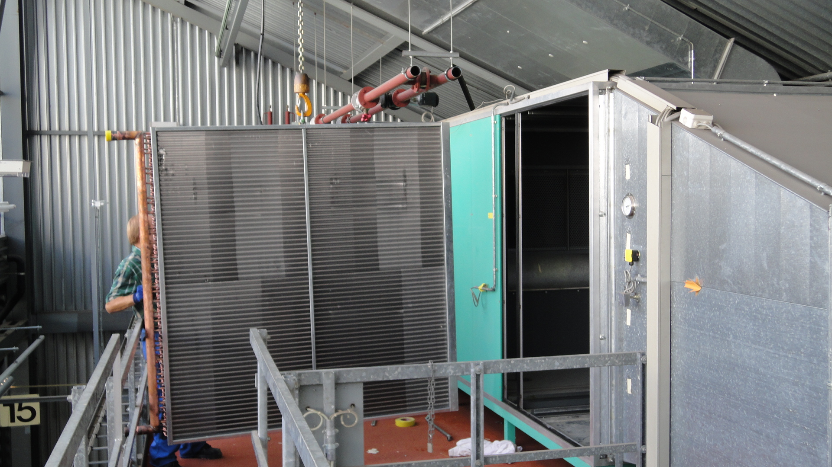
Ventillation Heaters
Original Design Temperature 50…80°C → New Design Temperature 35/20°C
150 heat exchangers to be replaced: 700kFr

Slide 21
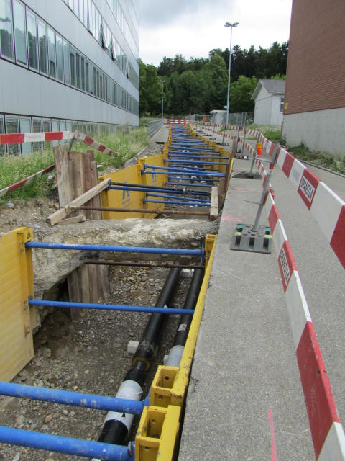
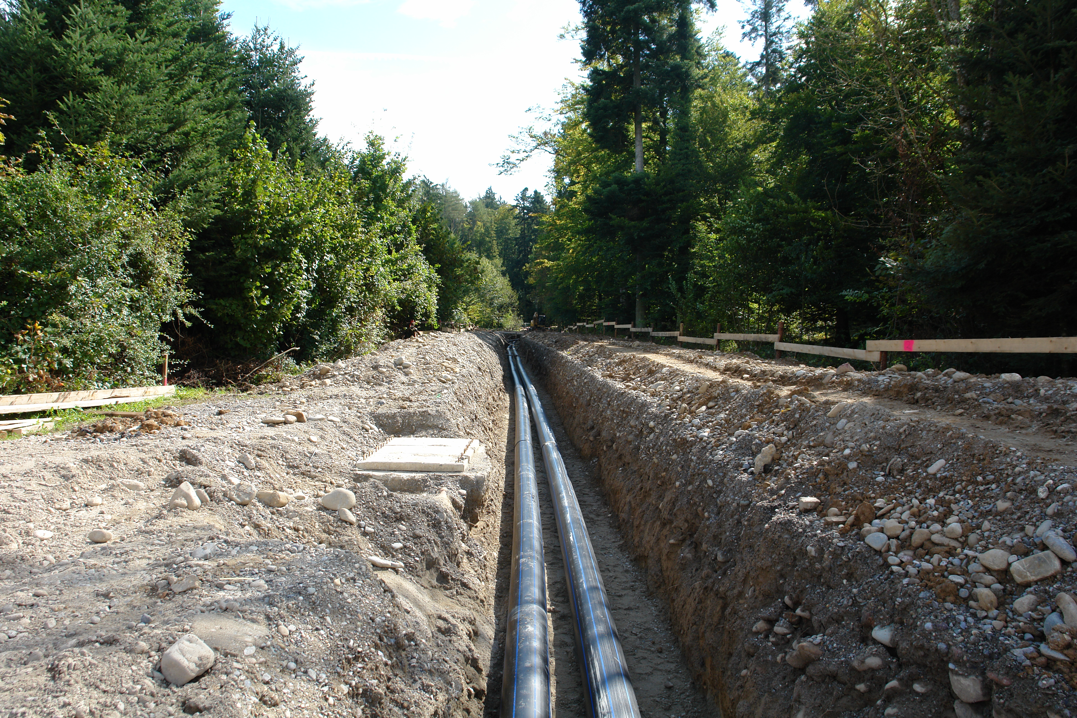
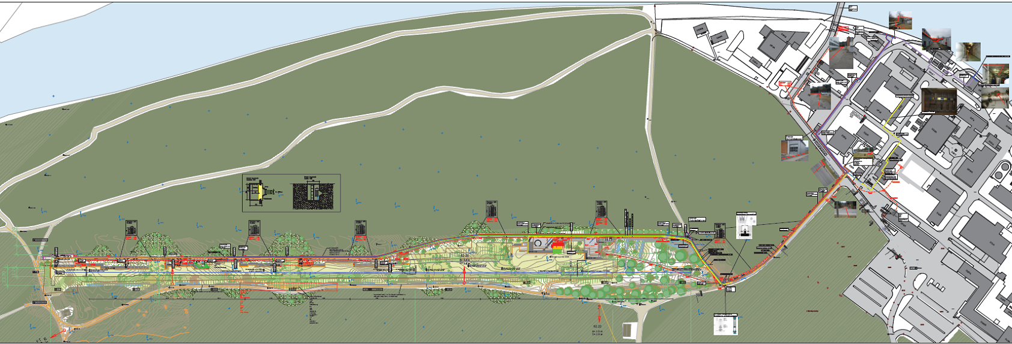
New District Heat Pipe for Waste Heat Swiss FEL
1000m of ground pipe
Costs: 600kFr
(ditch was needed for other puprose as well)

Slide 22
Temperature Decrease to Comply with Heat Sources

Slide 23
Project Heat Recovery Step 2 (Future Option)
    Direct use of heat sources category 1
    Indirect use of heat sources category 2 via heat pumps (Increase 20K)
    oil for peakload /backup)
Future Option!
    Required Measures:
      All measures step 1
      Installation of heat pumps of 3MW approximately

Slide 24
Project Heat Recovery Step 2 (Future Option)

Slide 25
Economy Heatrecovery Step 2
Measures, Costs, timescale, economy, pictures
comparable economy
→ We have an alternative to todays efficient district heating system

Slide 26
Experiences during Project Execution
Decreasing the heating temperature is a Challenge! But essential! (Heating takes over cooling)

Slide 27
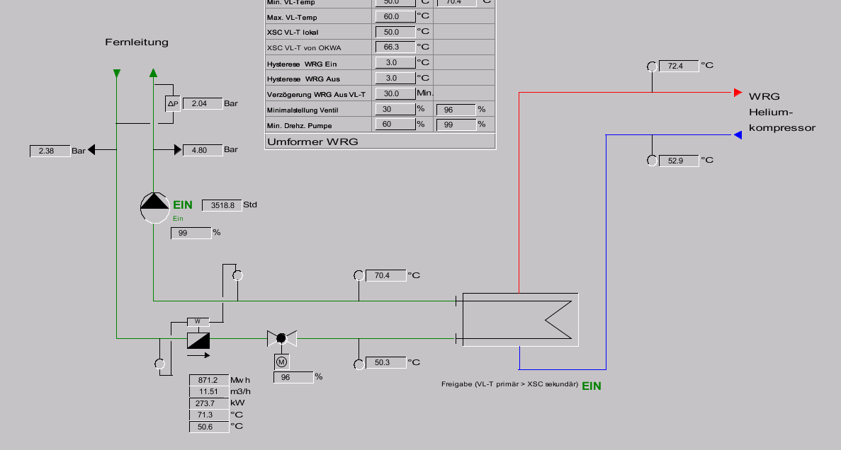
Experiences during Project Execution
Example of a heat source: Potential at current return temperature not fully used

Slide 28
Experiences during Project Execution
Causes for high Return temperatures (after hardware exchange)
  Radiators:
  In theory…

Slide 29
Experiences during Project Execution
Causes for high Return temperatures (after hardware exchange)
  Radiators:
  In reality…

Slide 30
Experiences during Project Execution
Causes for high Return temperatures (after hardware exchange)
  Radiators:
  In reality…

Slide 31
Experiences during Project Execution
Causes for high Return temperatures (after hardware exchange)
  Radiators:
  In reality…

Slide 32
Experiences during Project Execution
Hydraulic circuits:
Existing Systems (such as pass-by systems) need to bee adjusted
Keeping warm lines to be discovered
Wrongly connected heat exchangers are not a rareness! (new and old buildings)
Regulation and Control:
Adjustment of control parameters are not a single action but a approaching process
Availability of programming personal (especially older systems)
Trial and error not possible due to disturbance of facilities and user claims
Regulation of Sources and Consumers
Interaction requires challenging to control. All operation modes and dynamic behaviour to be considered:
Smooth Start up of additional source
Oscillating or switch on of large Consumers (e.g. after night setback)
Trip of a System (Research Plant) requires back up heat source

Slide 33
Experiences during Project Execution
Success Factors for high Efficiency of HVAC-Systems
→Increasing Efficiency need more than working and reliable systems
  Top Down Commitment (Starting with Environmental Guiding Principles, personal commitment of line organisation)
  Smart Engineering and Operation Personal with theoretical and practical knowledge and facilities knowledge
  Capacity during daily business
  Continuity (Permanent monitoring and action)
  Analysis Tools (management control system)

Slide 34
Potential for Absorption Cooling
Angebot und Nachfrage von Kälte und Wärme
Leistung in KW
6000
Durchschnittlicher Kältebedarf
5000
PSI
Heizwärmebedarf PSI
4000
Bandlast Abwärme SwissFEL
1'800kW
Wärmebedarf für Kälte
3000
Heat excess
Wärmebedarf total
2000
1000
Cold water produced with heat: 2200 MWh
0
0
1000
2000
3000
4000
5000
6000
7000
8000
Jahresstunden

Slide 35
Potential for Absorption Cooling
Demand matches availability of cooling circuit for 5 laboratories
Feasibility is given but temperature level is at limit and to find space for installation (recooling!) is a challenge
Estimated costs with 1.8Mio above maximal economical investment of 1.3Mio.

Slide 36
Conclusions
For the PSI it is effective and economic to recycle waste heat
A considerable investment of 4Mio approximately was permitted
Heat recycling is more effective and much more cost efficient than reducing the heat consumption by passive insulation only.
Optimised campus wide energy concepts with a long-term stategy are highly recommended since according our experience more effective than fulfilling typical energy standards for buildings only!
The Project supports
Reduction of Primary Energy
Reduction of Cost for Energy

Slide 37
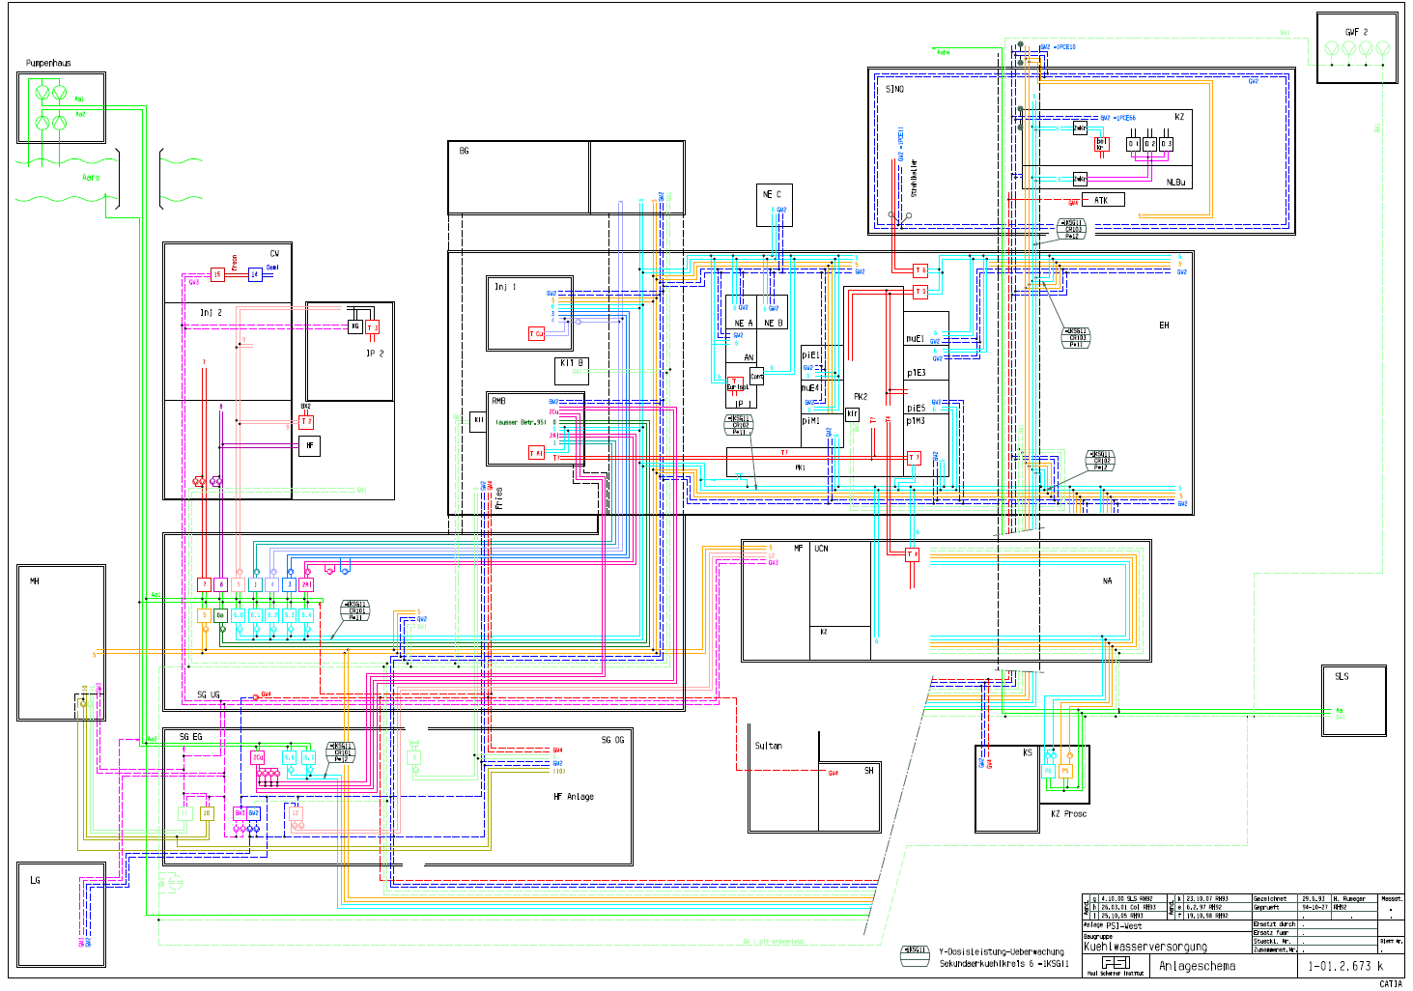
Review of Cooling Power and Potential Optimisation
Current Situation:
Heat sinks river and ground water with Central pumping stations and (official) return locations
Upper limitation of return temperature to river doe to environmental protection (e.g. fishes)
Relatively extensive system with long lifetime components (cooling system + components to be cooled)
New area with individual cooling system built up for swissFEL

Slide 38


Review of Cooling Power and Potential Optimisation
$$P_{pump \text{\sim }}\dot{m×∆p}$$
$$P_{Cooling \text{\sim }}\dot{m×∆T}$$

Slide 39


Review of Cooling Power and Potential Optimisation
$$P_{pump \text{\sim }}\dot{m×∆p}$$
→ to be minimised (inlc. accelerator components Design)
→ maximise dT
$$P_{Cooling \text{\sim }}\dot{m×∆T}$$
→ Efficiency increased by a factor 2

Slide 40
Thank you for jour attention!
PSI,
28. April 2014

