Slide 1
Build on Best Practice Video Workshop Update on ESS and BrightnESS² Status
Mauro Zambelli
European Spallation Source ERIC
27.08.2020, Remote
This project has received funding from the European Union’s Horizon 2020 research and innovation programme under grant agreement No 823867

Slide 2
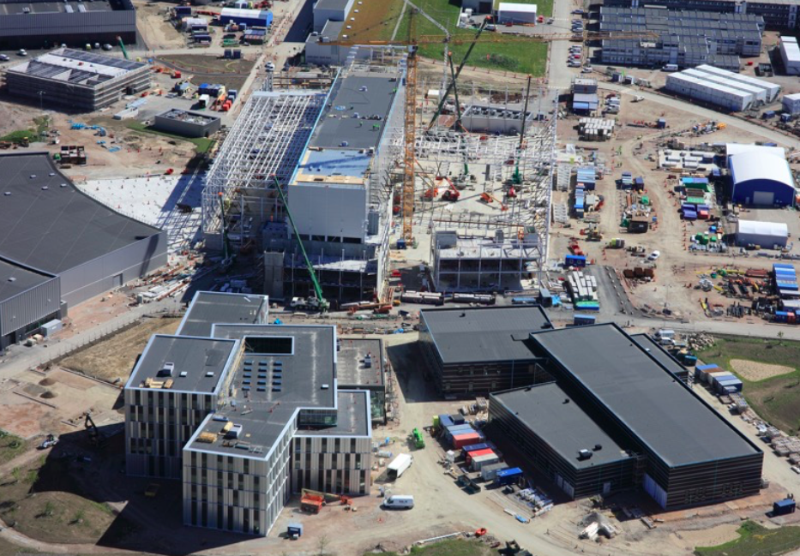

Slide 3
Overview
The second quarter has been defined by the “Business as Unusual” concept
Impact on schedule and costs of COVID-19 pandemic are not fully known at this time
A major survey of the In-Kind Partners has been led on by the Project Office to ascertain this and develop recovery actions
While working under the current restrictions, the project has progressed and reached the milestone of 70% completion

Slide 4
Situation and Perspectives
PAC conclusions:
Despite the many challenges related to COVID-19, ESS has taken decisive actions and has made significant progress on delivering the project, while prioritising the safety and health of the ESS staff
There may be long tails on the COVID-19 impact
Given the overall uncertainty with COVID-19, that it is too early to implement a full rebaseline

Slide 5
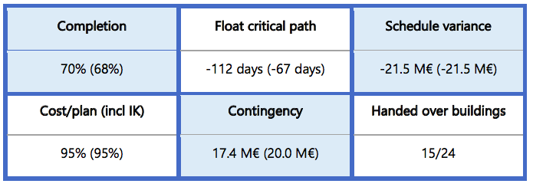
Project Performance Dashboard
Q2 Vs. (Q1)

Slide 6
Risks Management – Top 3 (20/20)
Late IK deliverables and IK Quality issues
Failure to meet device/system/documentation requirements, related to SE regulations /CE marking/ESS rules
Failure to secure sufficient funds to maintain a positive cash-flow until 2025

Slide 7
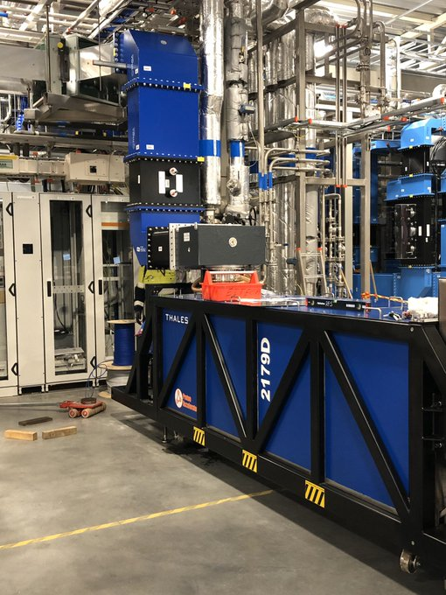
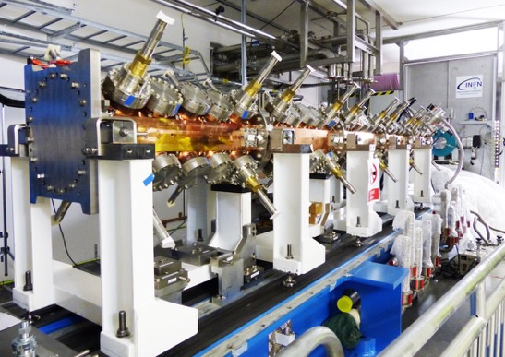
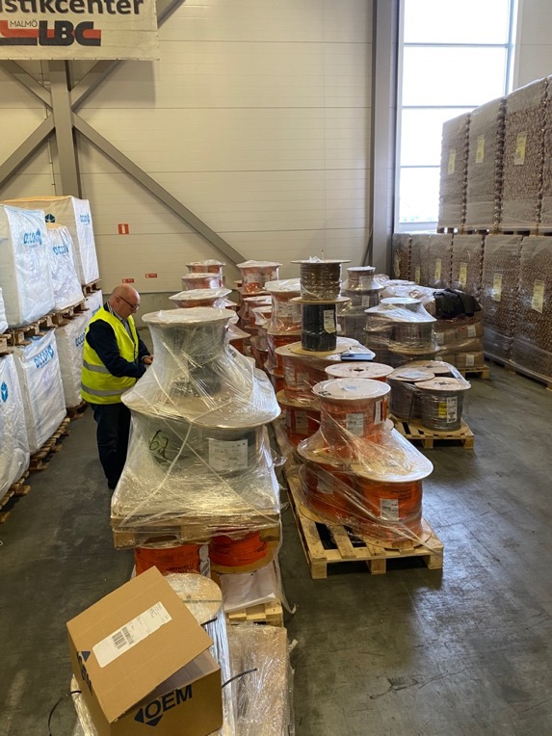
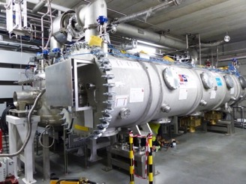
Accelerator
Now installed 8 km of piping, 14 km of raceways and approximately 120 km of cables for the accelerator. Cables for SC Linac now arriving in Lund.

Slide 8
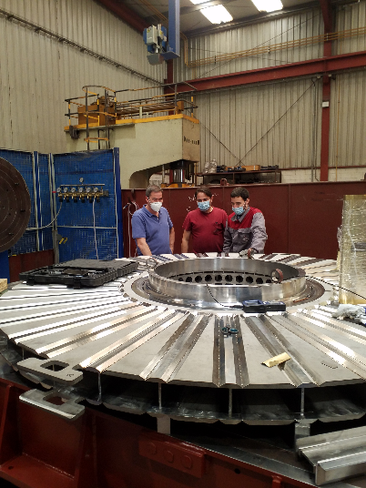
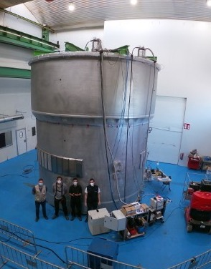
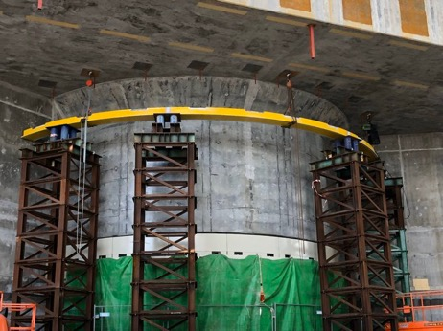
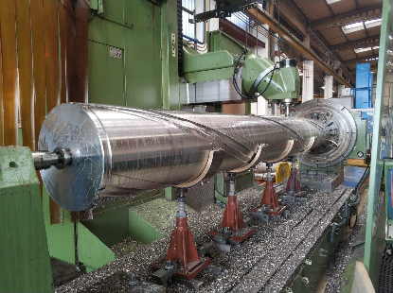
Target
Major components in manufacture, monolith vessel now due in October

Slide 9
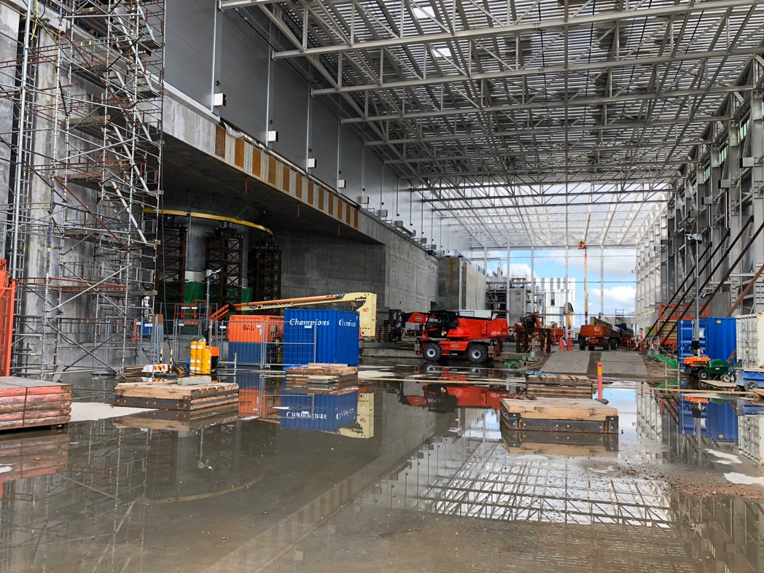
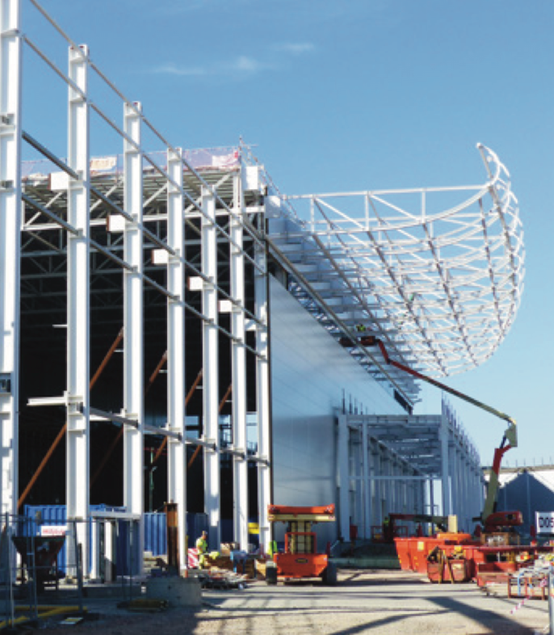
Instrument Halls (1)
Significant progress on D01 and D03 and started the encircling “sombrero” roof

Slide 10
Instruments Halls (2)
The NMX instrument cave (E01) almost completed

Slide 11
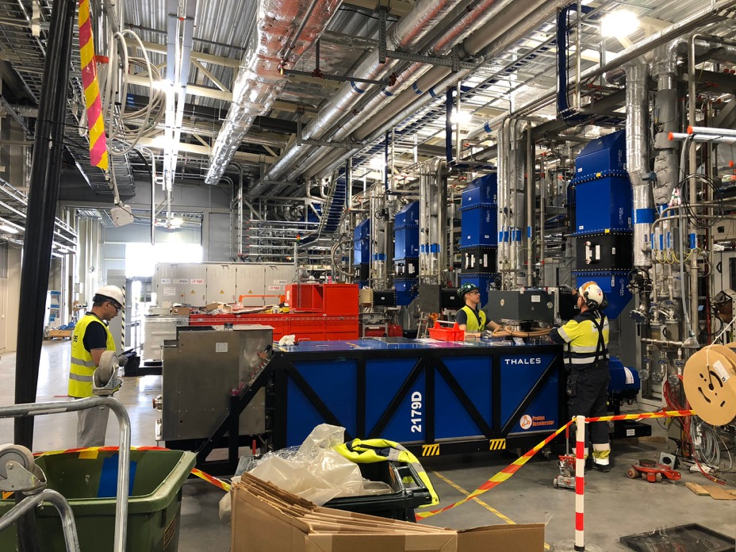
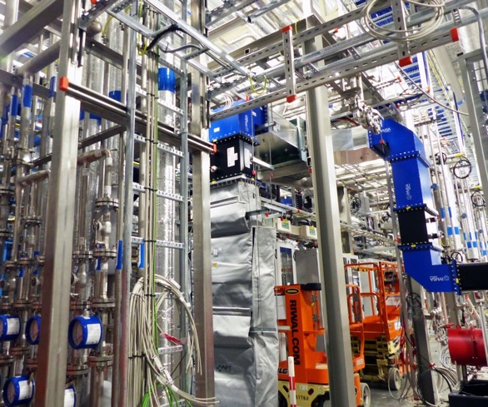
Installation and integration
First Thales klystron, wave guides, piping, cables, cryogenics

Slide 12
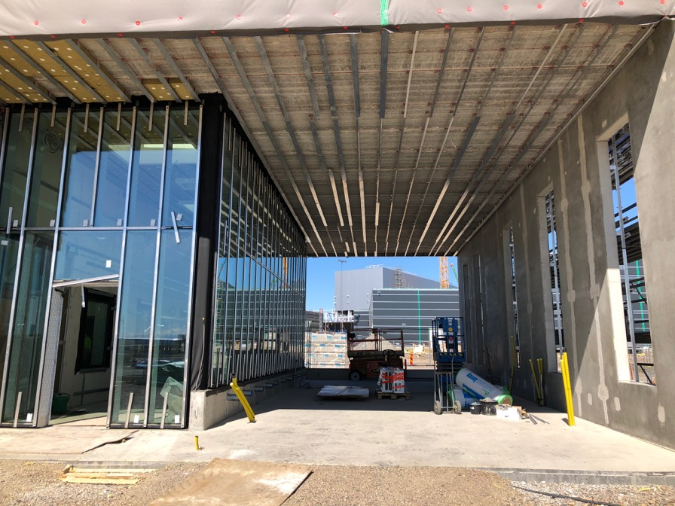
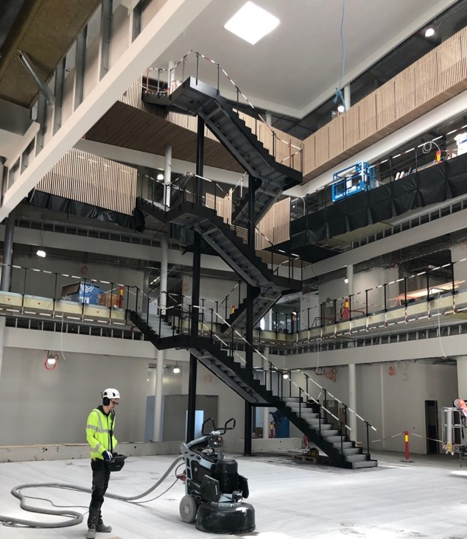
ESS Offices and Laboratories campus
Facades now in place. On schedule for occupancy in Q1 2021
Campus Transition team established, developing the overall plan for transitioning

Slide 13
Some Specific Achievements (1)
Campus project progresses at full speed; hand over the buildings by the end of 2020
Despite challenges in getting the Target building superstructure in place, temporary solutions made the building weather-tight
Successfully commissioning of the Accelerator Cryoplant at its highest capacity, 3 kW at 2 K operating point
The Bunker R6 brackets and the R6 curved beam and pillars completely installed

Slide 14
Some Specific Achievements (2)
Installations in the central ESS server hall completed and the server hall made ready for final testing
Intensive interaction of the ESS licensing coordination Team with the Swedish Radiation Safety Authority (SSM) regarding the permit application for the commissioning of the Normal Conducting LINAC (NCL)
Quality issues related to welding and mechanical, as well as electrical, installations, both for construction and installation of in-kind equipment, identified and successfully dealt with

Slide 15
Some Specific Achievements (3)
ESS Council approval secured of two In-Kind Contribution Agreements, 22 Technical Annexes, with a total value of just below 100 MEUR, and 14 final reports that accredited 6.6 MEUR to In-Kind Partners
A “Certificate for progress towards excellence” issued by EFQM (European Foundation for Quality Management), as a result of an independent assessment of the ESS Management System

Slide 16
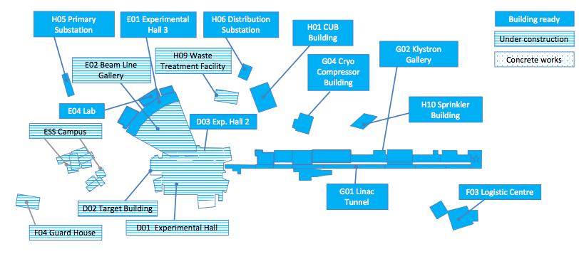
Buildings hand over
15 of the 24 buildings have been handed over to ESS from SEC

Slide 17
Some main challenges (1)
The IK Survey, as a major exercise covering all the active In-Kind partners, across all four Engineering Sub-Projects and over 90 TAs, from an initial analysis shows delays 3 to >6 months to key deliverables due to Covid-19
Any solutions to the problems will need to be developed on a case-by-case basis jointly with each In-Kind Partner (and their suppliers) and ESS. No one-size-fits-all solution is envisaged.
Productivity is still being impacted and things will take longer than in “normal” times

Slide 18
Some main challenges (2)
The installation work for the Target Station is proving to be a considerable challenge as its success relies on timely delivery of systems, components, and their supporting documentation
There are difficulties following the planning for stakeholders with simultaneous adjustments in many parallel activities, and consequently to estimate the appropriate resource allocation for each specific stakeholder activity
Despite efforts to standardise the architecture of control system components, stakeholders, suppliers, and in-kind partners continue using non-standard development patterns in their integration deliverables

Slide 19
Some main challenges (3)
The transition from a mainly construction and installation oriented project to an operation focused project, with increasing commissioning and operations, as well as maintenance activities in parallel, pose a significant organisational challenge
Quality of delivered equipment and execution of installation works will remain a challenge, requiring a collective proactive approach
Reaching final confirmation from the Swedish Tax agency that IK contributions are not liable for VAT. This will be achieved by close dialogue with ESS consultants and discussions with relevant Tax Officers in Stockholm.

Slide 20
Concluding remarks
Given the situation globally, ESS has done very well to minimise the impact on the Staff and the project, while maintaining progress through 2020
ESS is now moving to the next stages of recovery and mitigation, which brings new challenges:
Bringing staff back on site from 31 August while keeping everyone safe
Securing the schedule, In-Kind and supply chain
Securing cash flow for 2021 – and initial operations funding up to 2025
All this in a climate of increased uncertainty and potentially greater economic pressure in the Member States...

Slide 21
Thank you!
Mauro Zambelli, European Spallation Source ERIC
Mauro.Zambelli@ess.eu
This project has received funding from the European Union’s Horizon 2020 research and innovation programme under grant agreement No 823867

