Slide 1
Build on Best Practice Video Workshop Review purpose and method of the meeting
Mauro Zambelli
European Spallation Source ERIC
27.08.2020, Remote
This project has received funding from the European Union’s Horizon 2020 research and innovation programme under grant agreement No 823867

Slide 2
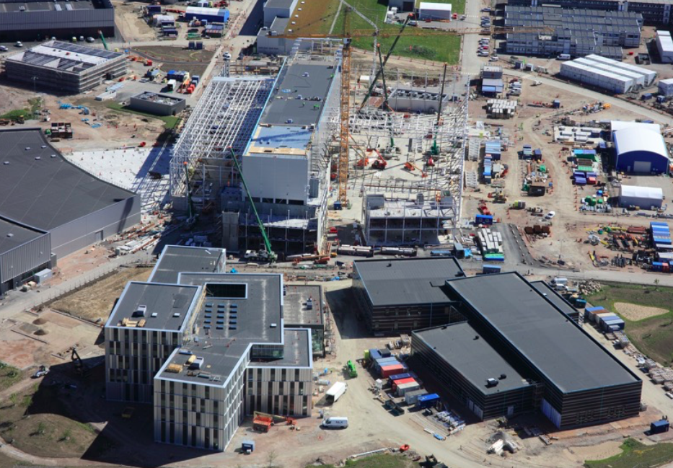
From here...

Slide 3
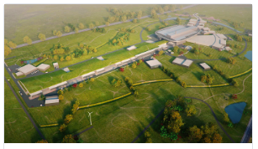
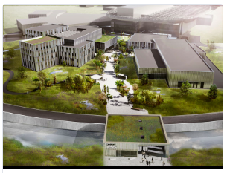
To there!

Slide 4
Purpose of the Workshop
To review Best Practices already put in place on which to build further developments
To identify possible new Best Practices to develop in the near future
To identify success factors to present as WP#3 achievements at the Mid Term review meeting on September 17th

Slide 5
Macro vs. Micro Best Practice
Macro BP
Comparison and benchmarking between different IK Management models in different Research Institutions
Micro BP
Given the ESS IK management model, identify activities and methods that either have shown to be successful or could be improved

Slide 6
WP3 Focus
As far as Best Practice are concerned, BrightnESS² Work Package 3 (namely Task 3.2) addresses “Micro” Best Practices, i.e. activities carried out and methods used for In-Kind Management both at ESS and at the Partner Institutions in the different Hubs
At this stage of the Project no possibilities are left to address “Macro” Best Practice

Slide 7
What is a “Best Practice”
From Wikipedia:
A best practice is a method or technique that has been generally accepted as superior to any alternatives, because it produces results that are superior to those achieved by other means or because it has become a standard way of doing things, e.g., a standard way of complying with legal or ethical requirements
Best practices are used to maintain quality as an alternative to mandatory legislated standards and can be based on self-assessment or benchmarking. Best practice is a feature of accredited management standards such as ISO 9000 and ISO 14001

Slide 8
What does ISO 9000:2015 say?

Slide 9
What does ISO 9000:2015 say?

Slide 10
Where can we find Best Practices?
Procedures
PROCESS
Input
Output

Slide 11
Examples of Processes as BP
To introduce in the organization a standardized workflow for documents approval and filing
To implement a software tool for introducing new functionalities
To change the sequence of activities for receiving goods at the warehouse
To introduce smart working

Slide 12
Examples of Procedures as BP
New standardized coding system for all documents in the organization
New level of responsibilities/authorities for signing purchase orders
Concentration of similar activities in the same functional unit
Updated platform for videoconferencing

Slide 13
Thank you!
Mauro Zambelli, European Spallation Source ERIC
Mauro.Zambelli@ess.eu
This project has received funding from the European Union’s Horizon 2020 research and innovation programme under grant agreement No 823867

