Slide 1
Build on Best Practice Video Workshop Title of the presentation
Artur Glavic, PSI
27.08.2020, Remote
This project has received funding from the European Union’s Horizon 2020 research and innovation programme under grant agreement No 823867

Slide 2
Background
PSI
Extended experience in ESS partnership in instrument project
Leading engineering design project within PSI
Coordinating instrument in-kind contributions to ESS
Not part of BrightnESS²

Slide 3
BP#1 – Document Management

Slide 4
BP#1 – Document Management
Filetype
Storage Medium
Linkable
Indexed (Searchable)
Comparable
Accessible
Access Controlled
Change Controlled
Safe Storage
Usable
Standard Format
Findable
Transferrable
Usable
Work Process
Unique
Released
Tracible
Dated
Usable
Versioned
Signed

Slide 5
BP#1 – Document Management
Filetype
Storage Medium
Shared
Linkable
Indexed (Searchable)
Comparable
Accessible
Technical
Access Controlled
Change Controlled
Safe Storage
Usable
Legal
Standard Format
Findable
Transferrable
Usable
Work Process
Unique
Released
Tracible
Dated
Usable
Versioned
Documentation
Signed
Requires Approval

Slide 6
BP#1 – Document Management
Filetype
Storage Medium
Shared
Linkable
Indexed (Searchable)
Comparable
Accessible
People
Technical
Access Controlled
Change Controlled
Safe Storage
Usable
Legal
Standard Format
have to
Findable
Transferrable
Usable
Work Process
Unique
Released
Tracible
do it!
Dated
Usable
Versioned
Documentation
Signed
Requires Approval

Slide 7
BP#1 – Document Management @ PSI
Assess which requirements apply on creation
Choose system easiest to use for that task
Setup systems from the beginning to be as automatic as possible
Train employees on usage beforehand
Re-evaluate solution after implementation

Slide 8
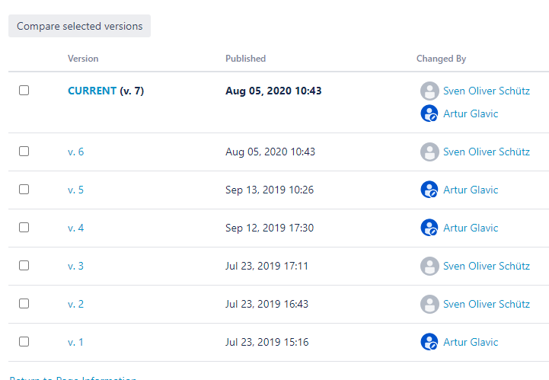
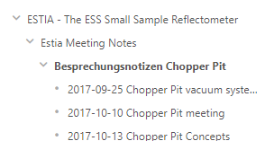
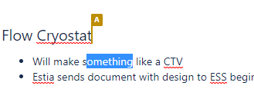
BP#1 – Example 1: Meeting Minutes
Simple text, sharable, concurrent edits during meeting
➔ Confluence
Safe Storage
Usable
Comparable
Findable
Standard Format
Tracible
Transferrable
Accessible
Linkable
Concurrent Edits
Versioned
Dated

Slide 9
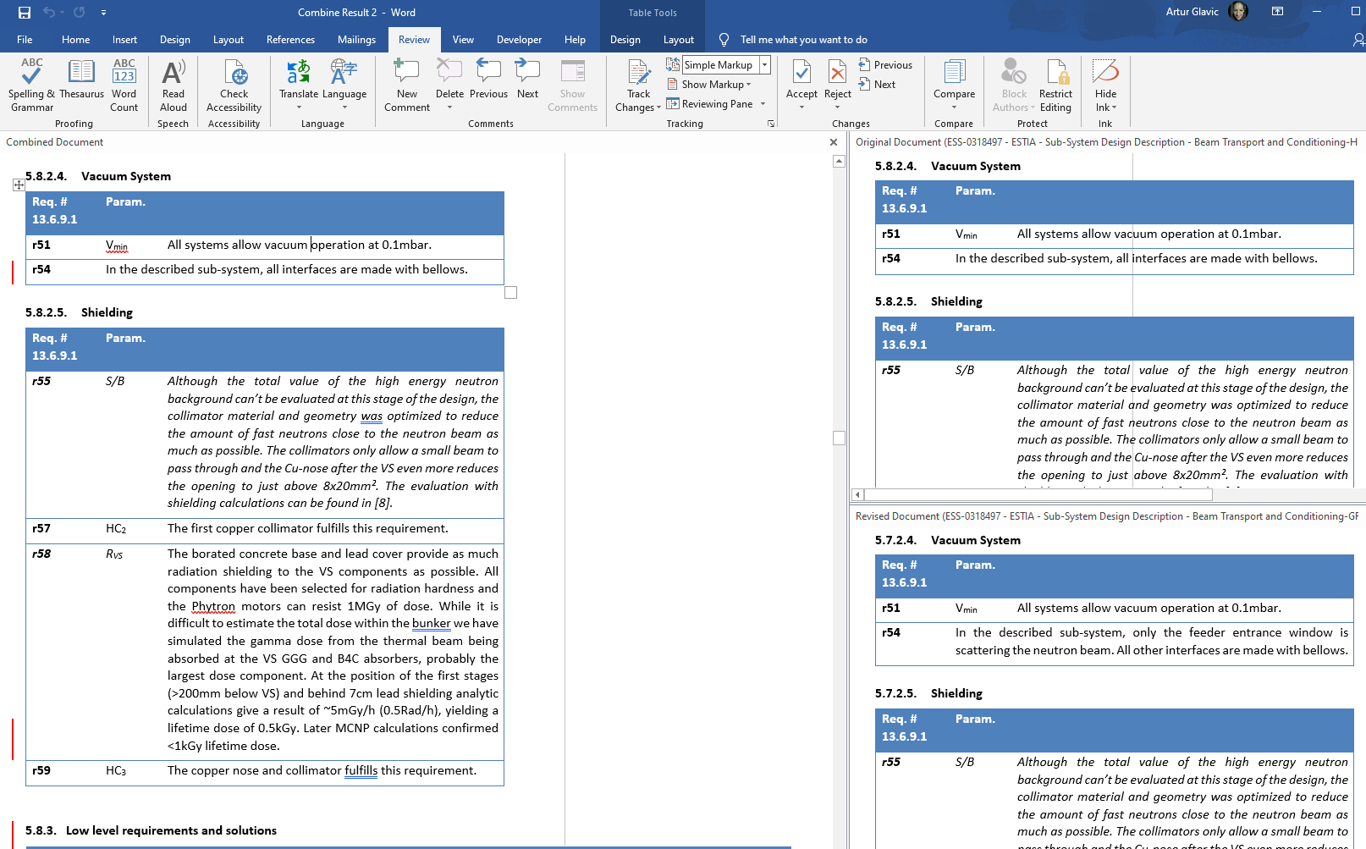
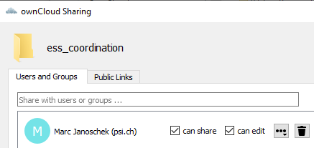
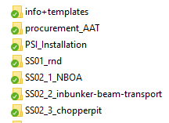
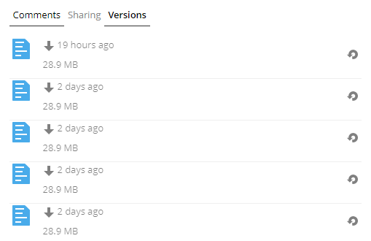
BP#1 – Example 2: Technical Documents
MS Office + X Docs, off-line access, several users
OwnCloud/SWITCHdrive
+ Define folder structure and procedures
Standard Format
Safe Storage
Usable
Findable
Versioned
Dated
Transferrable
Accessible
(Access Controlled)
(Unique)
(Comparable)

Slide 10
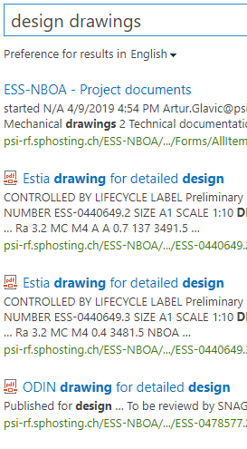
BP#1 – Example 3: Procurement Specifics
Indexed (Searchable)
MS Word, non-public, legal + approved
➔ Alfresco/SharePoint
Transferrable
Usable
Accessible
Access Controlled
Safe Storage
Findable
Standard Format
Dated
Tracible
Unique
Change Controlled
Released
Versioned
Signed

Slide 11
BP#1 – When things go wrong: TAs
No document responsible
No process
Local storage
➔ Unclear about date and location of latest versions
Signed
Dated
Unique
Safe Storage
Findable
Versioned
Accessible

Slide 12
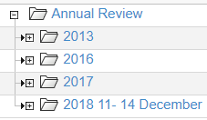
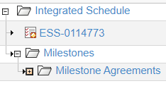
BP#1 – When things go wrong: CHESS
Suffers from poor usability
Based on 10 year out-dated technology (Java-plugins)
Extreme complexity, only a hand full used/needed
Efficient categorization and search missing
Integration of document macros implemented badly
Accessible
Linkable
Dated
Indexed (Searchable)
Safe Storage
Unique
Usable
Findable
Standard Format
Not Used Regularly
Change Controlled
Access Controlled
Tracible
Versioned
Released
Transferrable
Signed

Slide 13
BP#2 – Work Specification
How a sub-project/work package starts determines how is progresses/ends
Roles and responsibilities need to be clear
Goals need to be clear
State expectations
Define success!
Define feedback/communication procedure

Slide 14
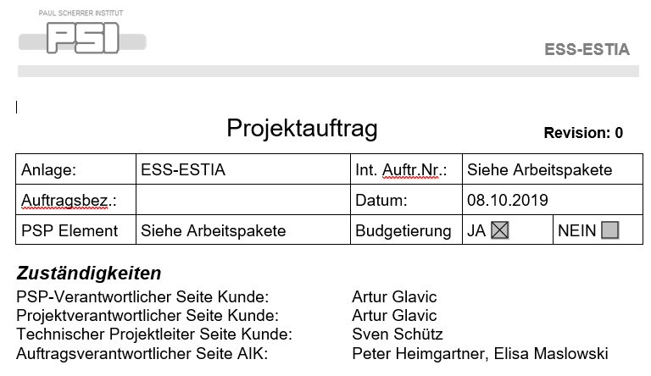
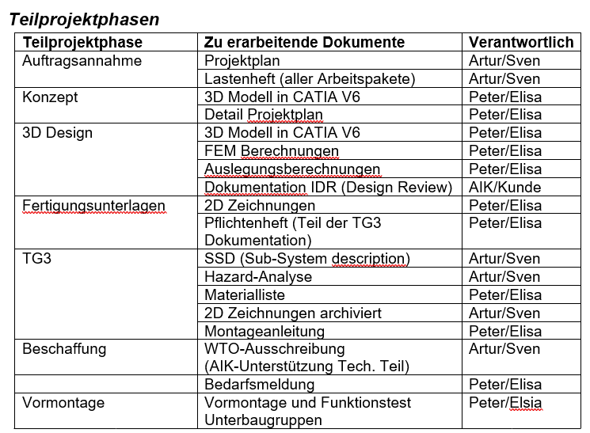
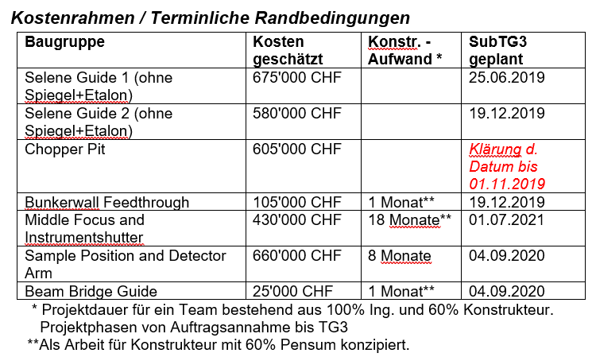
BP#2 – Example 1: Design Resources

Slide 15
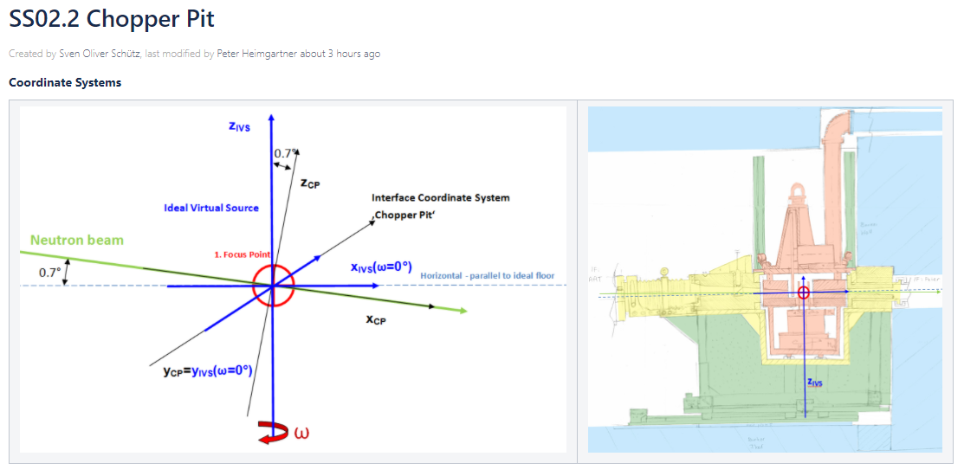
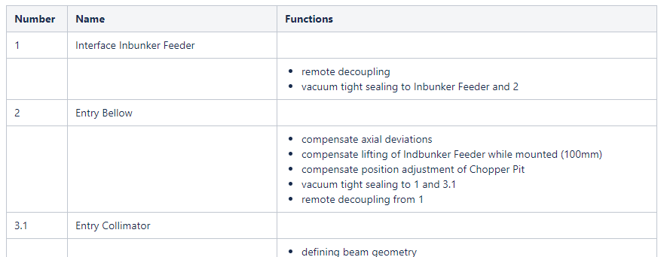
BP#2 – Example 2: Design Specification

Slide 16
Thank you!
Artur Glavic, PSI
Artur.Glavic@psi.ch
This project has received funding from the European Union’s Horizon 2020 research and innovation programme under grant agreement No 823867

