Slide 1
Matt’s Code Dojo I
PRESENTED BY Matt

Slide 2
Preamble
Setting up
Need Python 3 installed if not already.
Clone repo:
git clone https://github.com/mattclarke/code_dojo_tcr.git
Follow instructions in the README
Check the tests pass

Slide 3
Code Dojo
Deliberate practice
A safe environment
A chance to try things without pressure
Stretch goal
Something challenging
Unlikely to finish in the time available
Not aiming for perfection
Fun
Hopefully!
Clone repo:
git clone https://github.com/mattclarke/code_dojo_tcr.git
Follow instructions in the README
Check the tests pass

Slide 4
Code Dojo
Pair or solo
Normally these sort of exercises are done in pairs, but COVID19
Options:
Do it solo
Remote pairing
VSCode with the Live Share plugin for “screen-sharing” and Slack for audio
Slack screen-sharing
etc.
Completely your choice!
Clone repo:
git clone https://github.com/mattclarke/code_dojo_tcr.git
Follow instructions in the README
Check the tests pass

Slide 5
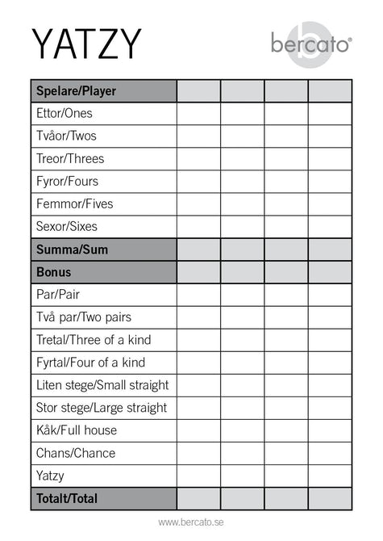
Code Dojo
Yahtzee Yatzy Scoring
https://en.wikipedia.org/wiki/Yatzy
Just the scoring:
Individual hands
Bonuses
Total score
Clone repo:
git clone https://github.com/mattclarke/code_dojo_tcr.git
Follow instructions in the README
Check the tests pass

Slide 6
Code Dojo
The catch
test && commit || revert
Restrictions:
The aim is to get and keep 100% code coverage with the tests
We use test && commit || revert*
Don’t cheat: if it gets reverted then treat it as gone forever
Try to run the tests at least every few minutes
*actual command:
pytest --cov . && git commit -am working || git reset --hard

Slide 7
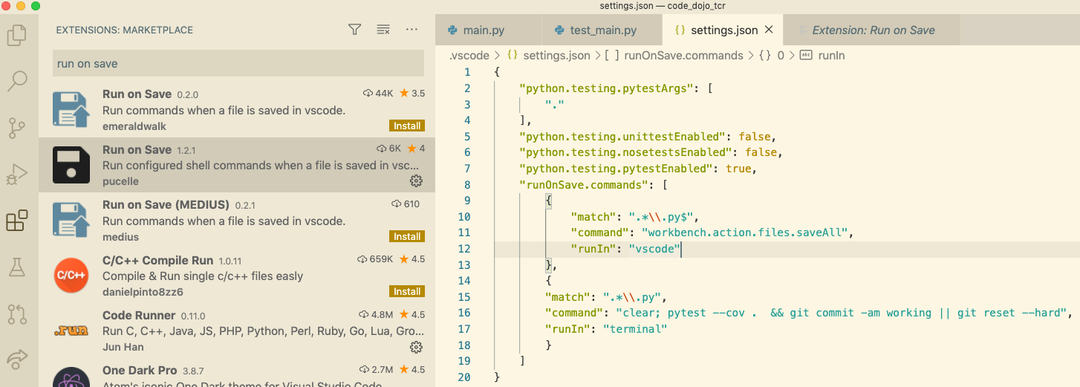
Code Dojo
VS Code
VS Code can be configured to run “test && commit || revert” automatically when saving
Settings

Slide 8
Code Dojo
Demo
Fizzbuzz
Restrictions:
The aim is to get and keep 100% code coverage with the tests
Try to run the tests at least every few minutes
We use test && commit || revert*
Don’t cheat: if it gets reverted then treat it as gone forever
*actual command:
pytest --cov . && git commit -am working || git reset --hard
Notes:
Okay, I’m pretty sure I can write this in one go but let’s play the game just to get an idea of how it works

Slide 9
Code Dojo
Let’s do it!
https://en.wikipedia.org/wiki/Yatzy
Just the scoring:
Individual hands
Bonuses
Total score
Restrictions:
The aim is to get and keep 100% code coverage with the tests
Try to run the tests at least every few minutes
We use pytest --cov . && git commit -am working || git reset --hard
Don’t cheat: if it gets reverted then treat it as gone forever

