Slide 1
Science Directorate
Instrument Technologies division
Neutron Chopper Group
TAP 5-2014
Requirements of Instrument suite
Iain Sutton
Neutron Chopper Group Leader
www.europeanspallationsource.se
23 April, 2014
Notes:
Good morning
My name is Iain Sutton
I am currently the Group leader for Neutron choppers
And In the following 10mn I will attempt to present the Status and strategy of NG Tech work package

Slide 2
A preliminary review of chopper systems included in current proposals
Proposal round 2013
Notes:
Turning aside from the current preparations for construction I would like to share with you a brief look at some of chopper systems might look like

Slide 3
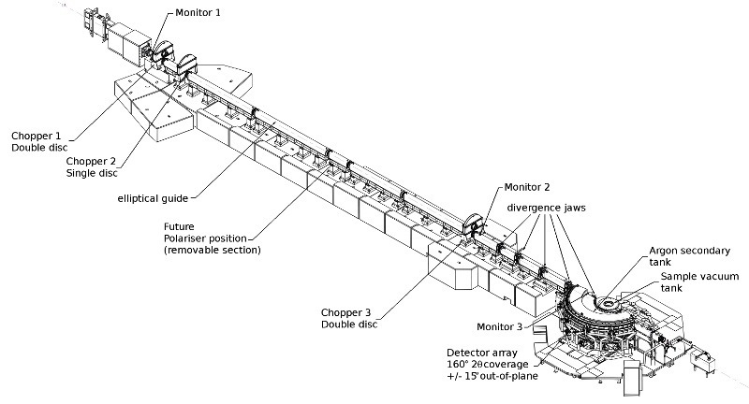
Spallation source instruments
BEAM SHUTTER
-HEAVY
DETECTOR
-BEAM MONITOR
Cut away of LET on TS2
Courtesy of ISIS
NEUTRON OPTICS
- IN MONOLITH GUIDE
BEAM LINE SHIELDING
PHOTO ISIS Instrument
- overlay schematic components
CHOPPER 1
CHOPPER 2
DETECTOR
-BEAM MONITOR
BEAM SHUTTER
-LIGHT
NEUTRON OPTICS
- GUIDE
NEUTRON OPTICS
- COLLIMATION
NEUTRON OPTICS
- POLARIZER
FLIGHT TANK
SAMPLE
ENVIRONMENT
CHOPPER 3
DETECTOR
-BEAM MONITOR
DETECTOR
-ARRAY
Notes:
----- Meeting Notes (2/26/14 12:36) -----
The basic anatomy of a neutron spectrometer at a spalation source
Suffice to say that choppers are one of the principal components of most of them and that is unlikely to change at ESS

Slide 4
NMX
Chopper system schematic
Status: P1-P.Design
EQUIP ACCESS ZONE
CLASS : BLACK
EQUIP ACCESS ZONE
CLASS : GREEN
Sector: W
Beam-port: W12
2PA-02 (FTF)
2PA-02 (FTF)
BEAM PORT
GUIDE
GUIDE
GUIDE
L 20 50 156
# 1-2 3-4
FUNCTION
BW SELECTION
BW SELECTION
NOTES
14Hz, D700
14Hz, D700
Notes:
Wide range of designs and system complexities
Ranging from No choppers to more than 20
These are simple ‘stick representations’ and I do not propose to analyse them at length
But flick though a number to give you an over view
Source on the left
Sample on the right

Slide 5
CS/ VOR
Sector: Beam port: NA
Schematic
Phase 0: Proposal
COMMON SHIELDING
2PA-01-M-350 (CR)
2PA-01-M-!$) (FTF)
2PA-01-M-400(CR)
2PA-01-M-350 (CR)
PA-02 (-M-14)
SHUTTER
GUIDE
BEAM PORT
SHUTTER
GUIDE
GUIDE
# 1-2 3-4 5 6-7 8-9
L 8 16-16.05
POSSIBLE SHUTTER POSITION
POSSIBLE SHUTTER POSITION
FUNCTION
PULSE SHAPING
RRM
PHASE(D) / CO
MONOCHROMATOR
BAND WIDTH
NOTES

Slide 6
RF/ FREIA v2.0
Schematic
Sector: E/N Beam-port: ?
Status: P0-Proposal
EQUIPT ACCESS CLASS : ORANGE
EQUIPT ACCESS CLASS : GREEN
2PA-02 (FTF)
PA-02 (DC)
2PA-02 (FTF)
PA-02 (DC)
PA-02 (DC)
2PA-02 (FTF)
GUIDE
2PA-02 (UO)
BEAM PORT
GUIDE
GUIDE
GUIDE
GUIDE
GUIDE
GUIDE
L 6.5/6.6 7.1/7.5 8,5 10/10.1 11.1 15 15,6 25
# 1-2 3 -4 5 6-7 8 9-10 11
WAVELENGTH BAND DEFINING
WAVELENGTH BAND DEFINING
WAVELENGTH BAND DEFINING
FUNCTION
PULSE SHAPING
FRAME OVERLAP
FRAME OVERLAP
FRAME OVERLAP
NOTES
56Hz, D1300
7-14Hz, D1300
7-14Hz, D1300
7-14Hz, D700
56Hz, D1300
42Hz, D1300
28Hz, D1500

Slide 7
PD/ HEIMDAL
Schematic
Status: P0-Proposal
EQUIPT ACCESS CLASS : BLACK
EQUIPT ACCESS CLASS : TBD
PA-02 (DC)
2PA-02 (FTF)
PA-02 (DC)
BEAM PORT
GUIDE
GUIDE
GUIDE
PA-02 (DC)
PA-02 (DC)
PA-02 (DC)
L 6,5 7 9 13 78 78,6 S = 169m
# 1 2 3 4 5 6 7
PULSE SELECTION (CT2)
BAND DEFINITION (CC1)
FRAME OVERLAP (CC3)
FRAME OVERLAP (CC3)
FRAME OVERLAP (CT3)
PULSE SHAPING (CT1)
FUNCTION
NOTES
280Hz, D700
14Hz, D1360
14Hz, D1280
14Hz, D1280
14Hz, D1280
14Hz, D700
Notes:
The typical number of choppers on a concept is 7.5
This figure is 3 time higher than the average of instruments at reactor sources and twice that of short pulse spallation sources
The is nothing surprising in this, it is a result of techniques required to get the most out of a long pulse

Slide 8
Schematic
Status: P1-P.Design
Sector: S
Beam-port: S12
IM-ODIN
EQUIP ACCESS ZONE
CLASS : BLACK
2PA-02 (FTF)
EQUIP ACCESS ZONE
CLASS : GREEN
2PA-02 (FTF)
2PA-02 (FTF)
2PA-02 (FTF)
2PA-02 (FTF)
2PA-02 (UO)
2PA-02 (UO)
2PA-02 (FTF)
2PA-02 (FTF)
BEAM PORT
GUIDE
GUIDE
GUIDE
GUIDE
GUIDE
GUIDE
GUIDE
PA-10 (PPSc)
GUIDE
L 6,5 7 9,25 10 11 12 16 20 30 40 60
# 1-2 3-4 5 6-7 8-9 10-11 12-13 14-15 16-17 18-19
FUNCTION
SUB FRAME OVERLAP
SUB FRAME OVERLAP
BAND WIDTH
SUB FRAME OVERLAP
PULSE SHAPING
SUB FRAME OVERLAP
SUB FRAME OVERLAP
PULSE SHAPING
PPS
BAND WIDTH
NOTES
56Hz, D700
56Hz, D700
28Hz, D700
3,5-14Hz, D700
3,5-14Hz, D700
14-42Hz, D700-2000
14-42Hz, D700-2000
14-42Hz, D700-2000
14-42Hz, D700-2000
14-42Hz, D700-2000

Slide 9
SUMMARY

Slide 10
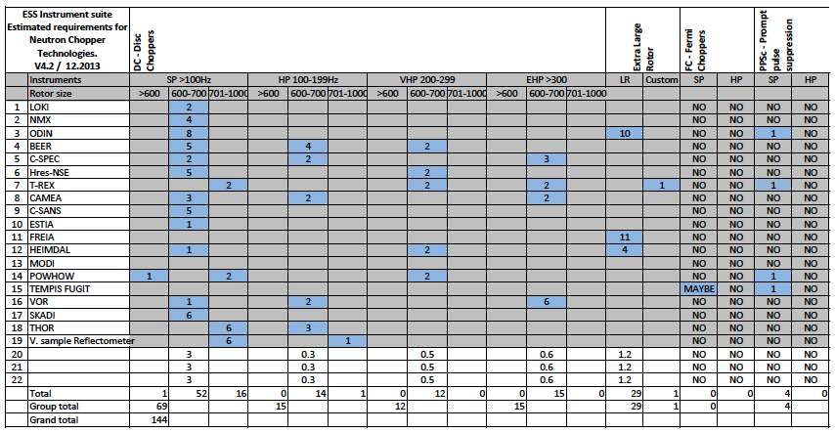
A Summary of Choppers
for 22 Instruments, based on 3+16 instrument concepts
22 Instruments = 150 – 160
Notes:
Average choppers 7.5
Which 22 inst 150 -160 axis
By configuration, performance and requirements can be sub divided into 6 broad families
Small rotored disc chopper
Low / intermediate / high speed
Large rotored choppers

Slide 11
Summary
Average 7.5 Choppers per beam line.
2 > 3 times more than Short pulse or Reactor sources
Disc choppers
  40 high speed disc choppers
  Max rotor speed 400+Hz
  70 Low speed disc choppers
  30 Choppers with a rotor diameter of 2m +
  3m diameter rotor under consideration
Prompt pulse suppression
  3 or 4 instruments
Fermi Choppers
  None !
NEW
  Fan Chopper

Slide 12
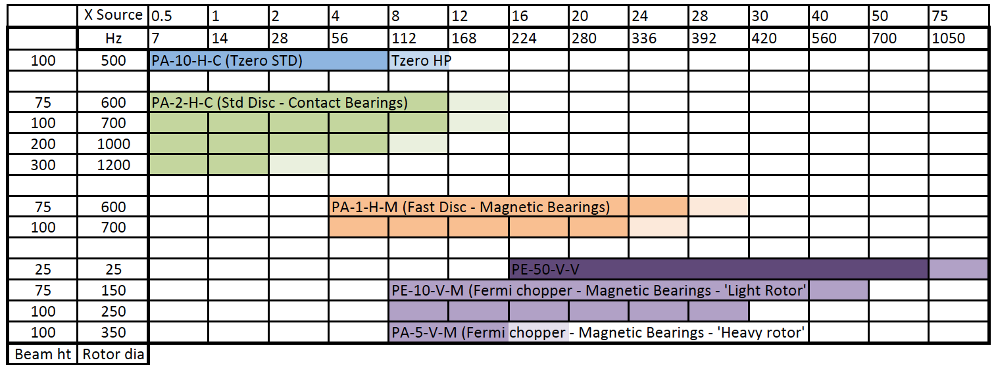
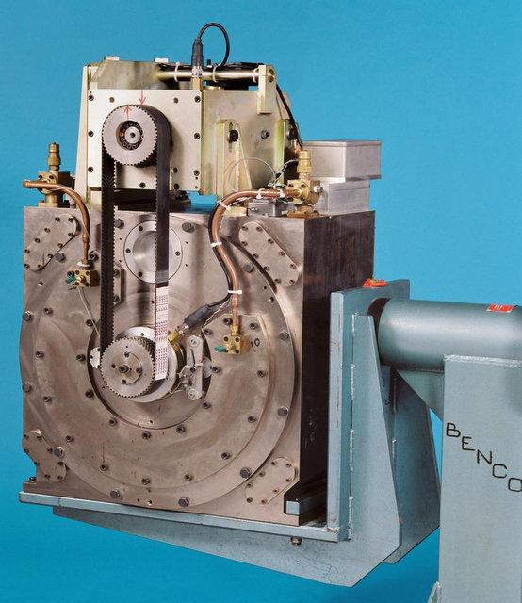
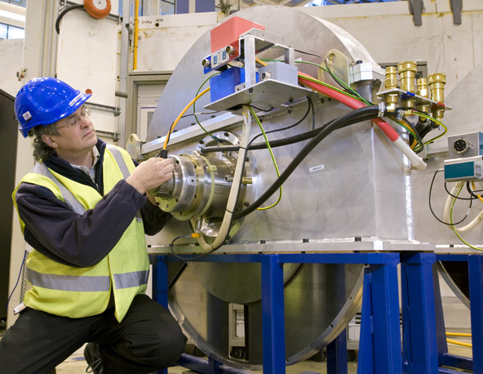
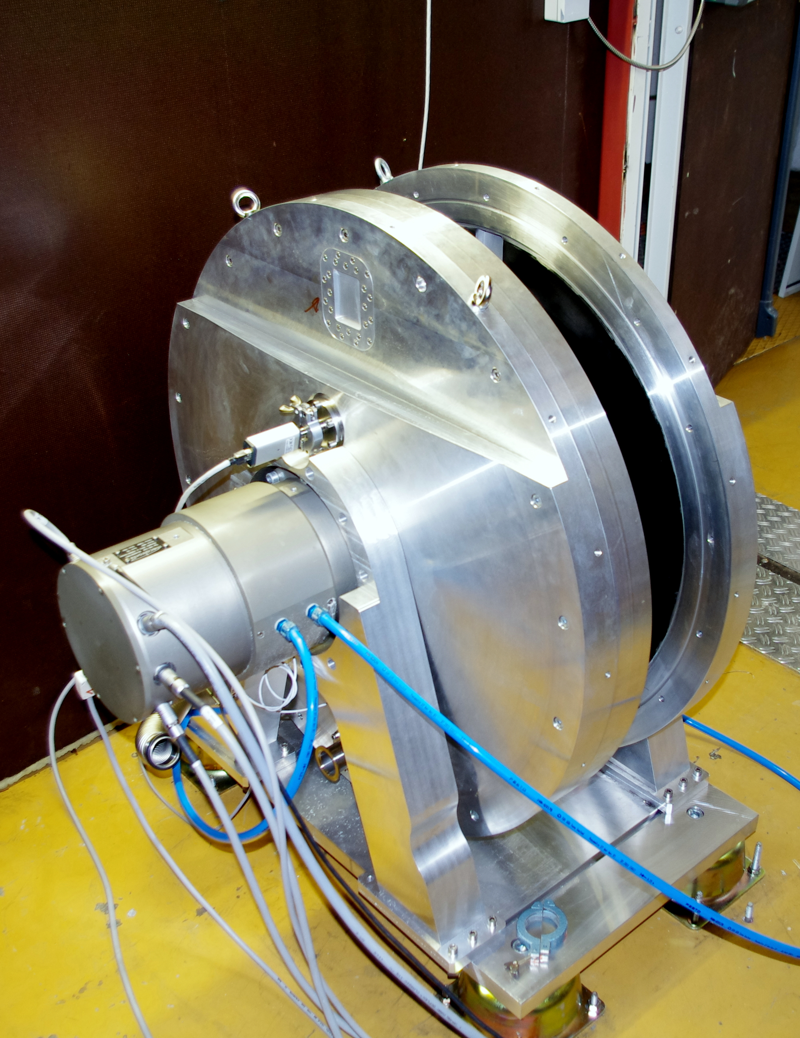
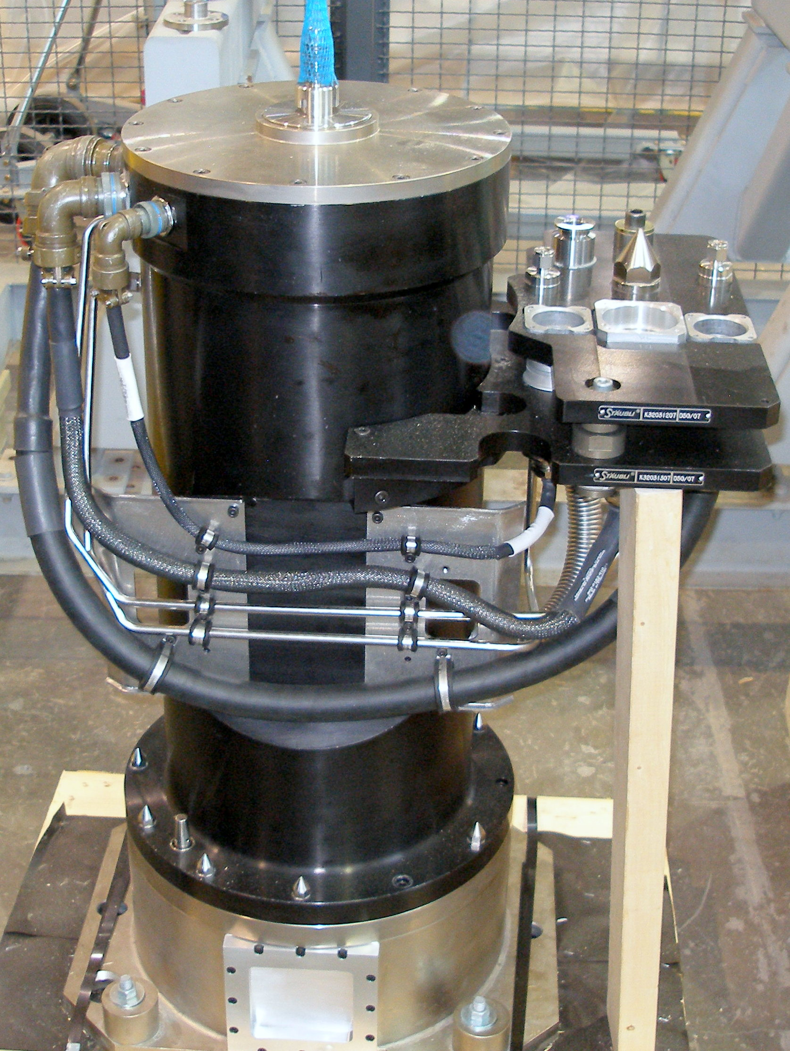
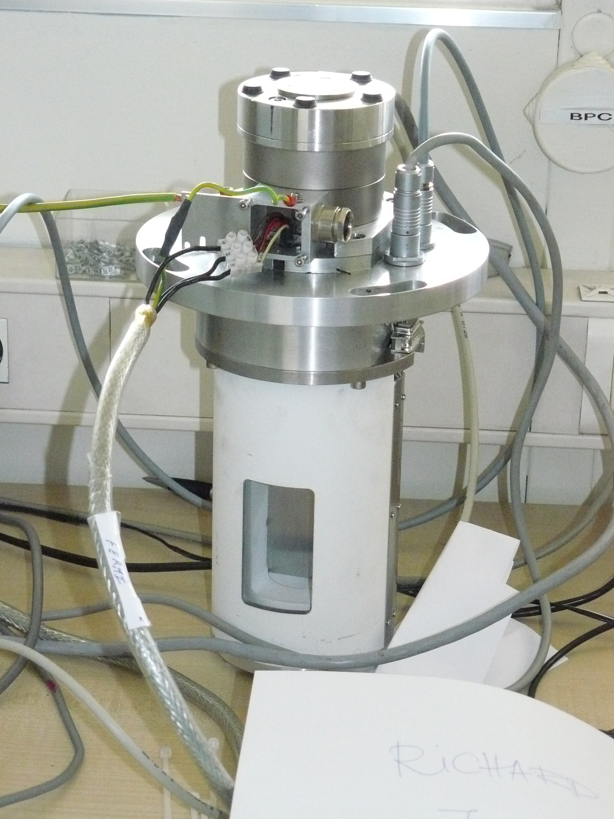
Chopper performance
PA-5-H-S
PA-2-H-C
PA-1-H-M
PE-5-V-M
PE-10-V-M
Notes:
We looked around the world at chopper systems …

Slide 13
A suite of Choppers for ESS
Preliminary estimations

Slide 15
A Suite of Choppers… for 16 Instruments,
based on current instrument concepts
LOW
SPEED
INTERMEDIATE
SPEED
HIGH
SPEED
LARGE
ROTOR
FAN
PPSc
(20)
(18)
(24)
(3)
(6)
(48)
2PA-02 (FTF)
2PA-02 (UO)
PA-02 (-M-14)
PA-02 (-M-14)
PA-10 (PPSc)
16 Instruments ~ 120 axis
Notes:
Average choppers 7.5
Which 22 inst 150 -160 axis
By configuration, performance and requirements can be sub divided into 6 broad families
Small rotored disc chopper
Low / intermediate / high speed
Large rotored choppers

Slide 16
‘Tendency’
No ‘Fermi’ Choppers
  Except Tempis fugit ‘rotating mono array’
The ‘Fan Chopper’
  Several groups now expressing interest…
Requests for 3m rotors is declining
Request for a ‘compact’ PPS chopper
Requests for ‘movable’ choppers
  Variable separation
  Out of beam

Slide 17
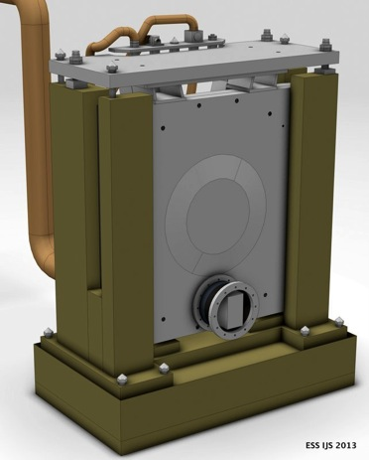
Platform 1
Disc chopper – Small rotor – Low speed
Key requirements
Rotation speed: Low ( 7 - 96 Hz)
Openings: Large
Attenuation at short wavelengths
High reliability in radiation environment
Low lifetime cost
Principal characteristics
Type: PA-1-H- (horizontal axis disc)
Rotors : Simple + Robust
Diameter: 600-1000mm
Enabling Technologies .
Rotors materials: Metallic
Bearings: Magnetic
DC-SR
(50-70)

Slide 18
Platform 2
Disc chopper – Small rotor – Intermediate speed
Key requirements
Rotation speed: (96-192 Hz)
Openings: (Multiple) Small or Large
High reliability in radiation environment
Principal characteristics
Type: PA-1-H- (horizontal axis disc chopper)
Rotors: Simple or Optimized
Diameter: 600-800mm
Enabling Technologies .
Rotor material: CFRP / Alu
Bearings: Magnetic
DC-SR
(15-35)

Slide 19
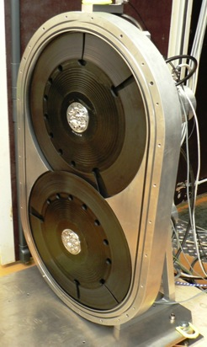
Platform 3:
Disc chopper – Small rotor – High speed
Key requirements
Rotation speed: 192- 400+ Hz
Openings: (Multiple) Small
Minimal guide interruption
High reliability in radiation environment
Principal characteristics
Type : PA-1-H- (horizontal axis disc)
Rotors design: Optimised
Diameter : 600-700mm
Enabling Technologies .
Rotor material: CFRP / Ti / MMC
Bearings: Magnetic
DC-SR-VHP
(25-35)
2.PA-1-H-M

Slide 20
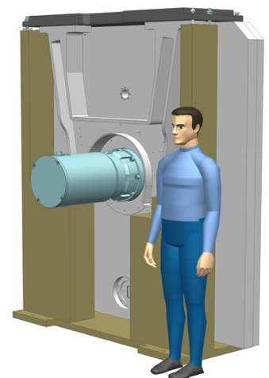
Platform 4:
Disc chopper – Large rotor
Key requirements
Rotation speed: (7 - 56 Hz)
Openings: Multiple V.Large, Asymmetric
High closing speed
High reliability in radiation environment
Principal characteristics
Type: PA-1-H- (horizontal axis disc chopper)
Rotors: Optimized
Diameter: 1200 - 2000mm
Enabling Technologies .
Rotor material: CFRP / Alu
Bearings: Magnetic or Contact
DC-LR
(25-35)

Slide 21
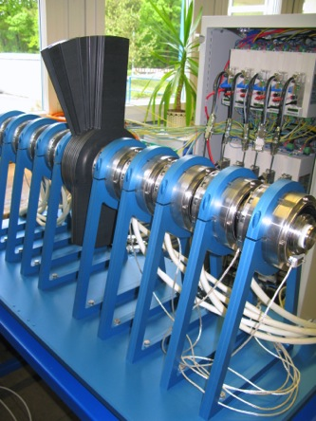
Platform 5:
Disc chopper – Fan
Key requirements
Rotation speed: (7 - 56 Hz)
Openings: Variable width, Asymmetric
Principal characteristics
Type: XPA-1-H- (horizontal axis disc chopper)
Rotors: multiple concentric ‘Fan’
Diameter: 500 - 800mm
Enabling Technologies .
Rotor material: Aluminium
Bearings: Contact
DC-SR-FAN
(3-5)

Slide 22
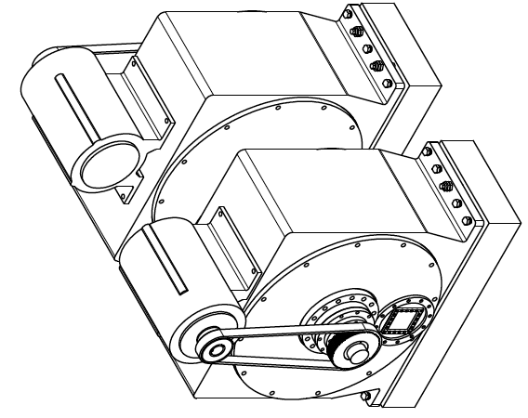
Platform 6:
Prompt pulse suppression chopper PPSc
Key requirements
Rotation speed: (7 - 56 Hz)
Closure: 3ms, Symmetric or Asymmetric
Attenuation : 90% @ Prompt pulse energies
Extreme radiation resistance
Principal characteristics
Type: PA-10-H- (horizontal axis chopper)
Rotors: 300 – 400 thick , single or double
Diameter: 500 - 600mm
Enabling Technologies .
Rotor material: Nickel alloy / Tungsten
Bearings: Magnetic
PPSc
(4-8)
PA-10 (PPSc)

Slide 23
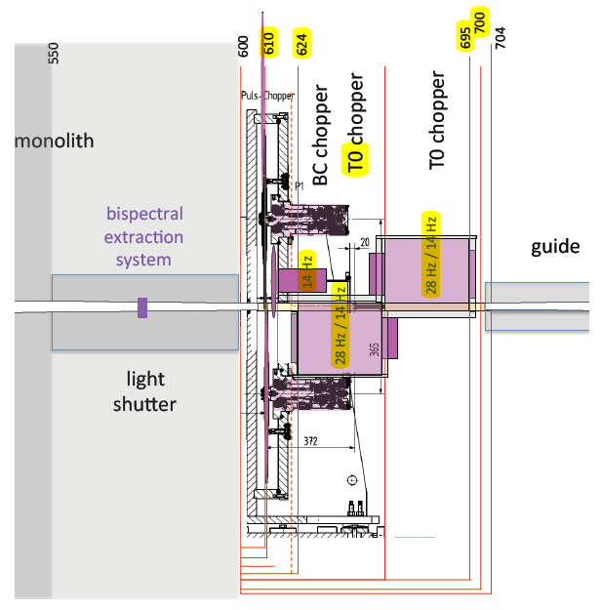
Platform 56
‘Instrument specific developments’
Support the development of ‘one off, instrument specific choppers’ which can not be achieved within platform approach.
Support in integration into ESS systems
  Control
  Support systems
  Pit systems
Active collaboration in engineering design process and decisions.
Examples
  PST
  Compact PPSc

Slide 24
MEETING FACILITY GOALS
Best service – Least cost
Reliability/Availability/Serviceability
Life time cost

Slide 25
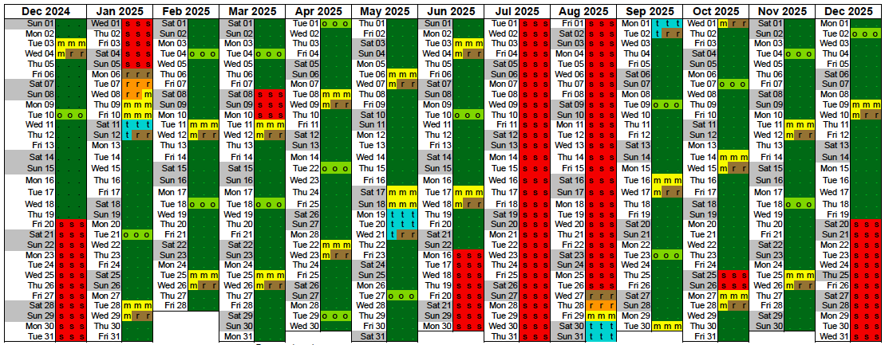
Balancing act
  Aggressive operating schedule
  (225 beam days)
  Complex instruments
  (130+ choppers)
  Availability > 95% (?)
Notes:
ESS Instrument availability target = 95%
(Availability = Beam time – Down time)
This is very ambitious for a spallation source and comparable to the best reactors.
Target mean time to repair 24hrs IMPORTANT POINT!
Very challenging, will require 24/7 technical support and full parts backup on site.

Slide 26
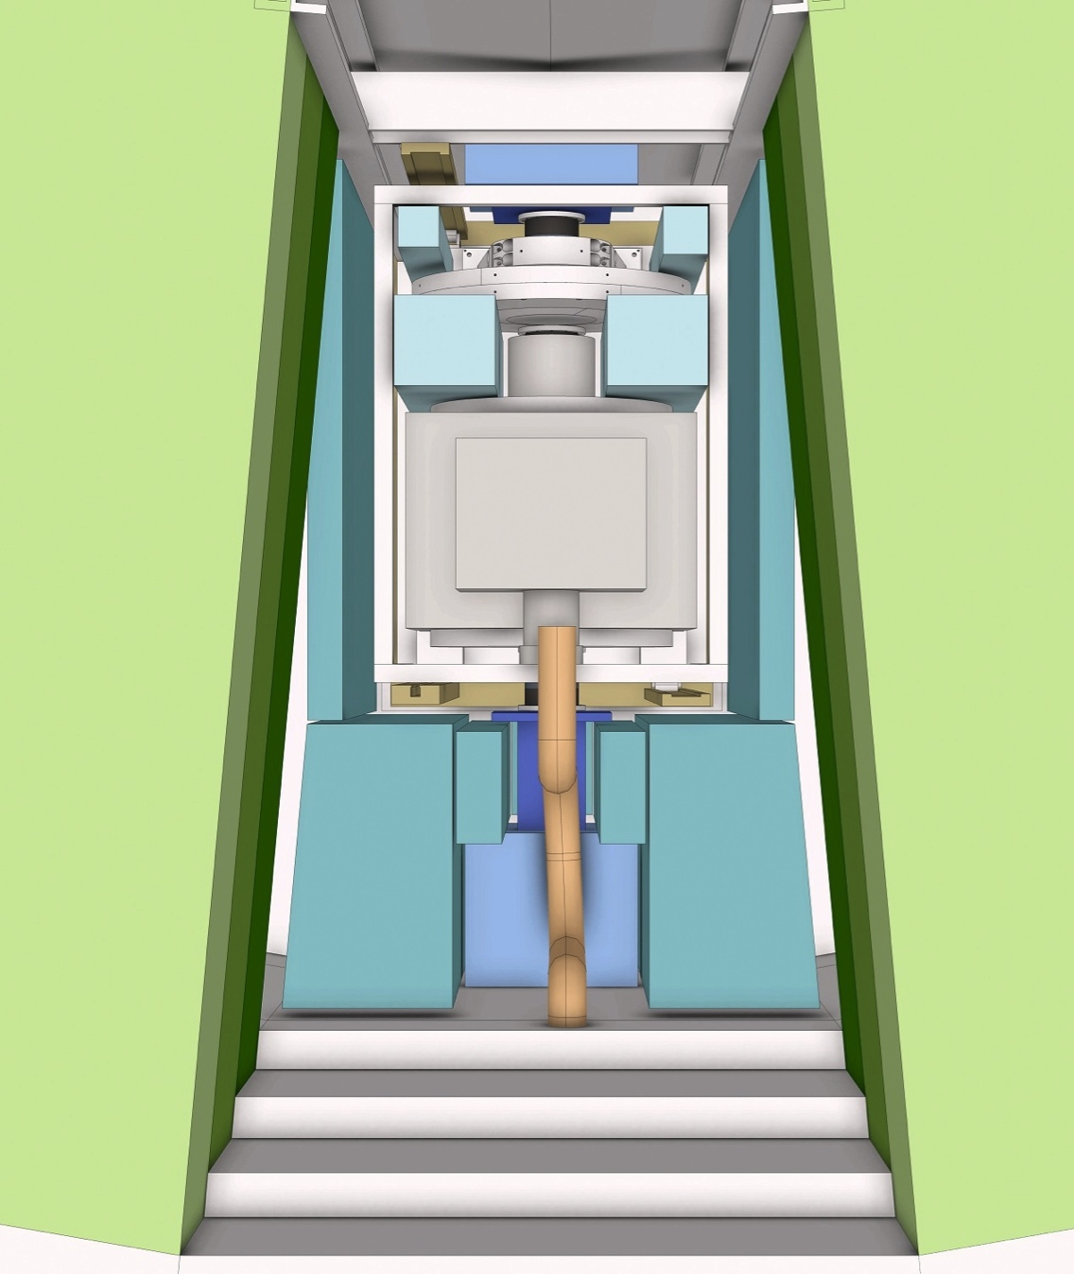
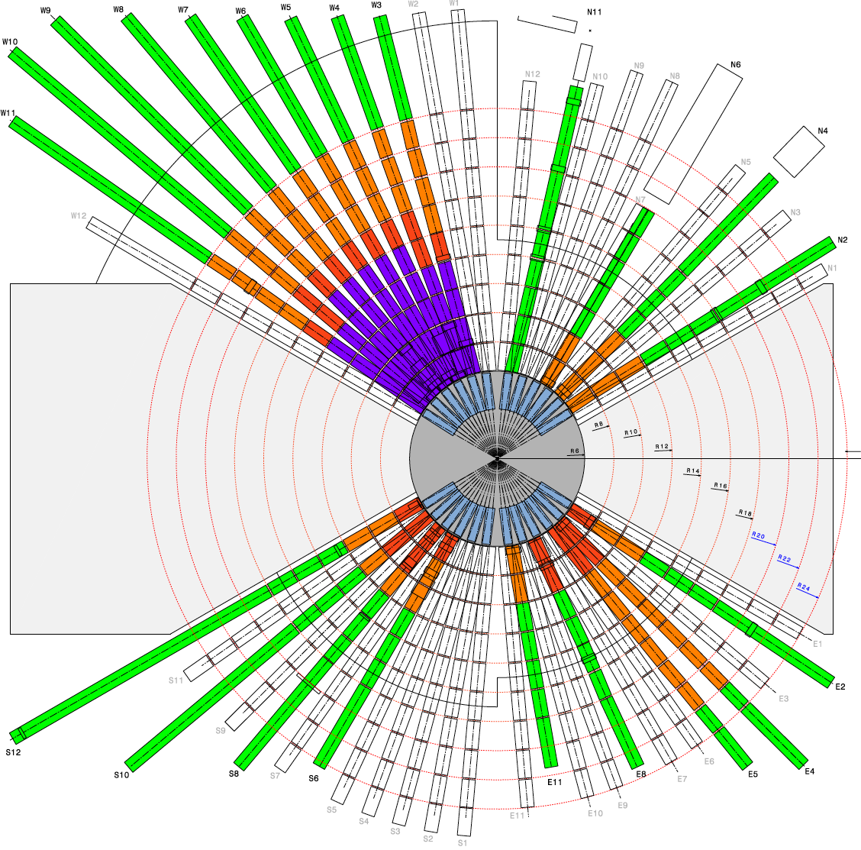
Instrument suite model
TARGET MONOLITH
INSTRUMENT 01
INSTRUMENT 03
INSTRUMENT 02
< 5 degree >
<-------------- 15 degree ------------- >
Notes:
Beam lines were divided up into 2m long ‘modules’ from R = 2 to R = 24.
Conditions required for access considered with Proton beam on target.
Consider mechanical components only
Optical and steady state components are assumed to be reliable ie MTBF >100 x Mechanical components

Slide 27
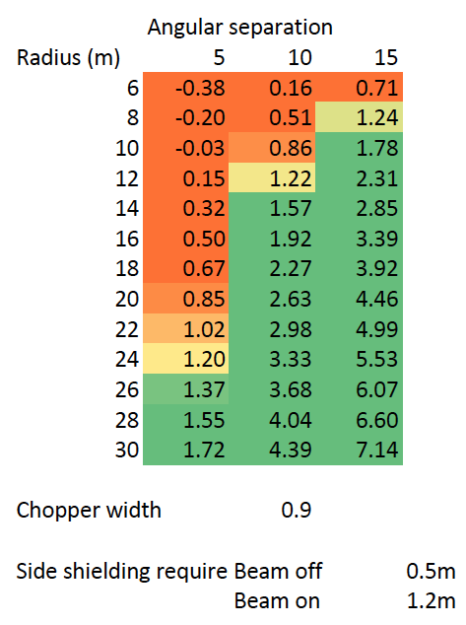
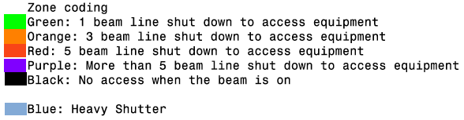
Serviceability
Lateral shielding
Access levels
Mean Time To Repair (MTTR)
Time to access (zone dependent)
Time to repair (equipment dependent)
Notes:
Evaluate for each 2m section of each beam-line
Quantity & Type of equipment installed
Level of accessibility (p-beam ON)
Access time

Slide 28
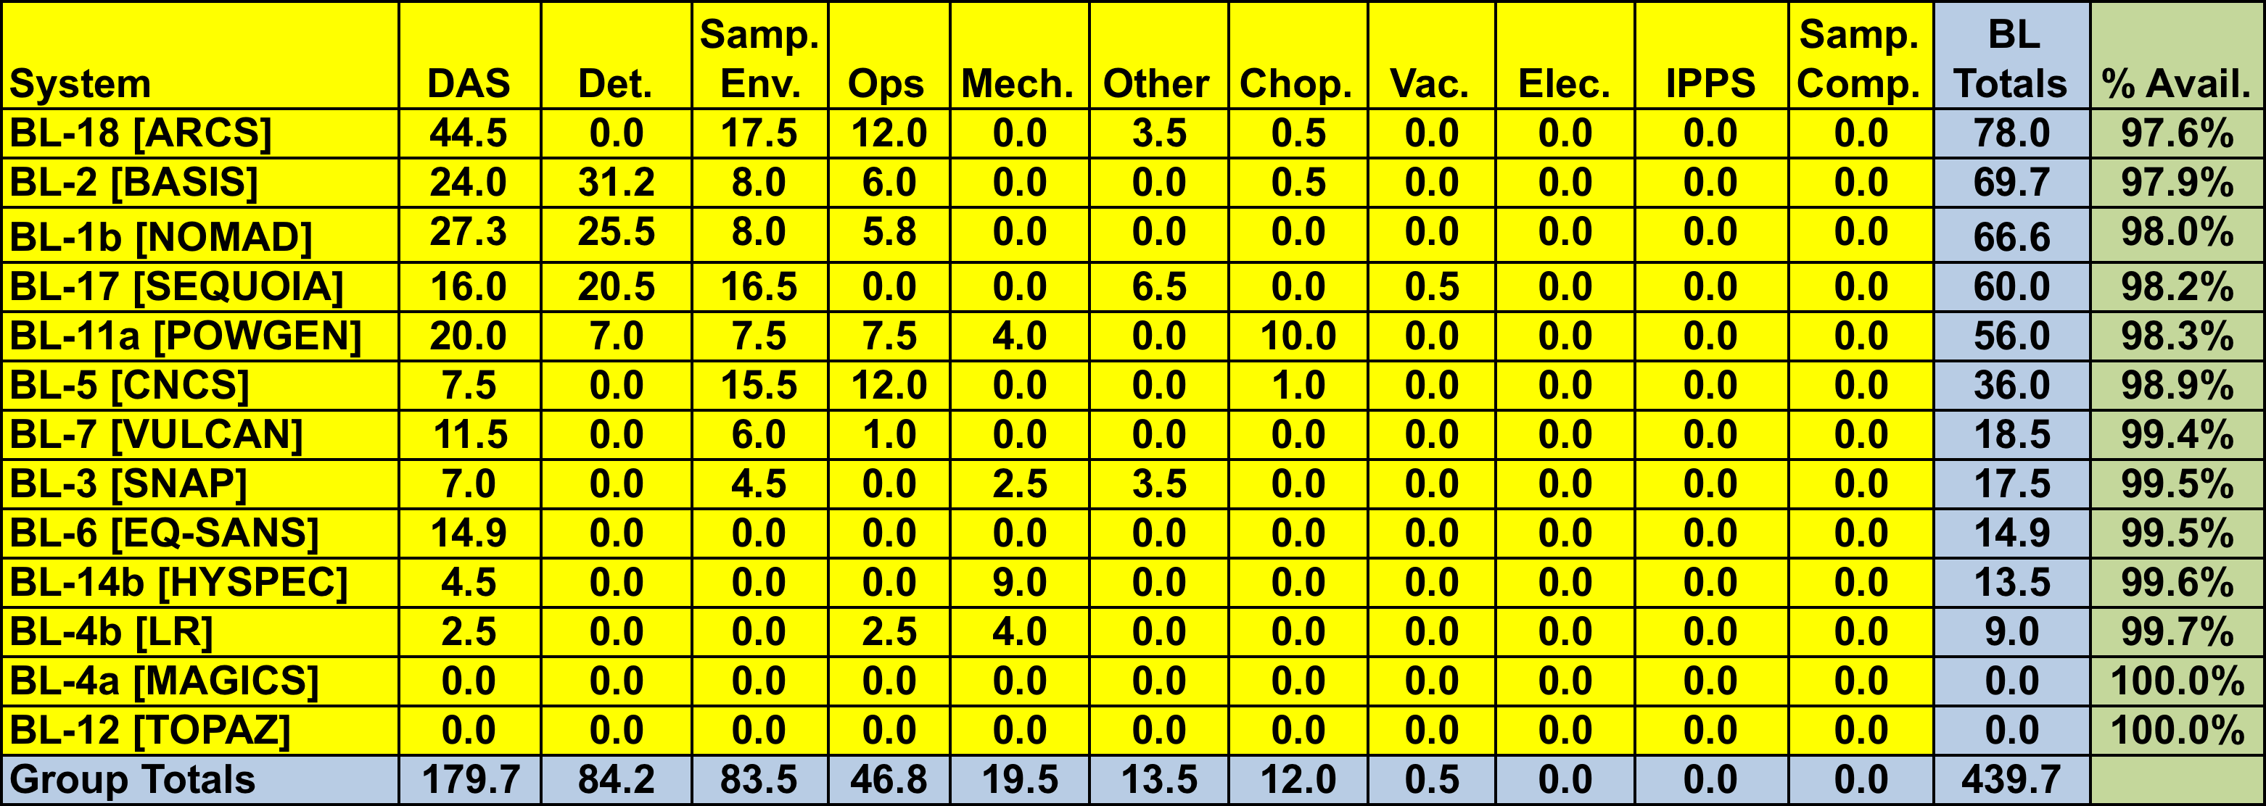
SNS Beam line/Group totals & availability – FY13 thru June 2, 2013
Instrument suite downtime
“SNS neutron beamline/instrument availability is about 89%”
Instrument suite downtime
Data from ISIS, TS1 & 2 (2007-2011)
CAUSE OF STOPPAGE
BLUE Chopper system
RED Other component
GREEN At request of I.S.
Cycles (Normalized to 35 day)
~ 3 ‘significant’ interruption per 100 beam days
+3.5 uses of shutters to effect ‘running repairs’
Beam interruptions
Notes:
As I have said we were interested in modeling reliability
So went out search for data
From the other facilities reactor or spallation sources
ISIS
SNS
J-PARC
ILL
Frequency of shutdowns
Duration
Cause

Slide 29
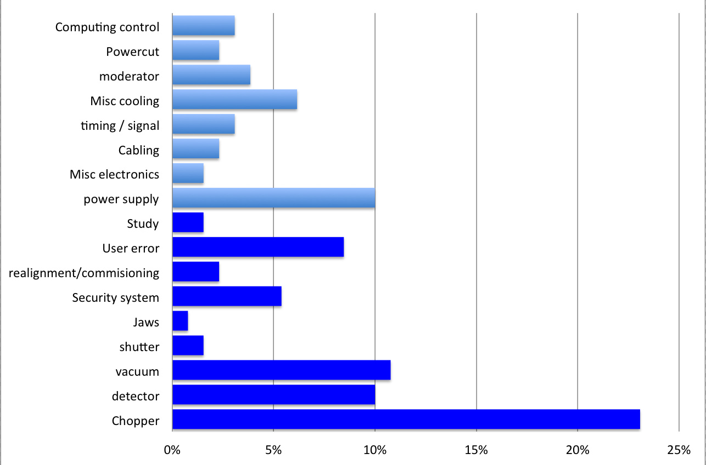
RELIABILITY
Instrument related causes of beam loss
Causes not requiring access within heavy shielding for repair
Causes often requiring access within heavy shielding for repair
Instrument MTBF ~598 days
Instrument suite MTBF ~35 days
Note: excluding - Sample environments, Computing & Motion control
Source: ISIS
Notes:
Calculated failure rates for existing instruments and equipment
And from that
Factoring in the increase comlexity of ESS instruments tried to come up with some estimates for our own instruments
Failure of a specific instruments every 3 or 4 years
Failure of ‘An’ instrument each 35day cycle

Slide 30
Simulated ESS Instrument availability
(averaged across suite )
Notes:
This is what we came up with – the red bars
By tweaking the schedule to improve the distribution of maintainaince periods were able to reduce the time that instruments risk to remain idle following a serious brakdown.
And for the cost of a few days of beamtime we currently have this E
It’s not yet there – there is a shortfall
but what is important is that we are aware of it and can now feed this into the design of instruments …

Slide 31
ESS Equipment reliability targets
 |  | Working hours |  |  | shutter option
Reliability Classification |  | MTBF |  | MTBR | Name |  | Distribution |  | Typical components
Class A |  | 72000 (10-15yrs) |  | 36 | Very reliable - quick fix |  | 70% |  | Std choppers, Vacuum systems, Fixed Collimation, Std optics
Class B |  | 72000 |  | 168 | Very reliable – slow fix |  | 10% |  | Special Choppers Special optics
Class C |  | 3600 (8-12mnths) |  | 36 | Reliable – quick fix |  | 15% |  | diaphragms
Class D |  | 3600 |  | 136 | Reliable – slow fix |  | 5%
Note
These figures concern only
Equipment installed within the common shielding area (radius 24m)
Equipment presenting a significant risk of breakdown - ie no supports, shielding
Equipment critical to instrument performance - options and non essentials have been excluded
Notes:
Estimates of MTBR for shutter option A – F will always be shutdown within 3days in order to effect repairs. This requires that the 'cost of the shutdown' be multiplied by the number of beams shutdown

Slide 32
MEETING PROJECT GOALS
Requirements from a different set of stakeholders …

Slide 33

Project Drivers
Raising Performance
  Neutronic performance
  Availability
Reducing Costs
  Procurement
  Operations
In-kind
  Harness experience
  Maximise contribution
  Equitable distribution

Slide 34
EARLY SUCCESS
Success will be measured early (within 3 years)
Tranche Instruments must be receiving users and publishing major papers by 2021 ….
Priority Trinity
Construction
Commissioning
Early Operations

Slide 35
Instrument projects overview
 | 2014 | 2015 | 2016 | 2017 | 2018 | 2019 | 2020 | 2021 | 2022 | 2023 | 2024 | 2025 | 2026 | 2027 | 2028
Operations Schedule
#1
#2
#3
#4
#5
#6
#7
#8
#9
#10
#11
#12
#13
#14
#15
#16
1st Neutrons
Initial Design | Final Design | Procurement & Fabrication | Construction | Installation | Cold Commissioning | Hot Commissioning

Slide 36
Chopper & Instruments
The ‘first 3’
Target Operations Schedule
T-60m T-48m T-36m T-24m T-12m T0
#1
#2
#3
Development
Delivery, Integration & Test
1st Neutrons
On site Installation
Commissioning Interventions
Procurement
Initial Design | Final Design | Procurement & Fabrication | Construction | Installation | Cold Commissioning | Hot Commissioning

Slide 37
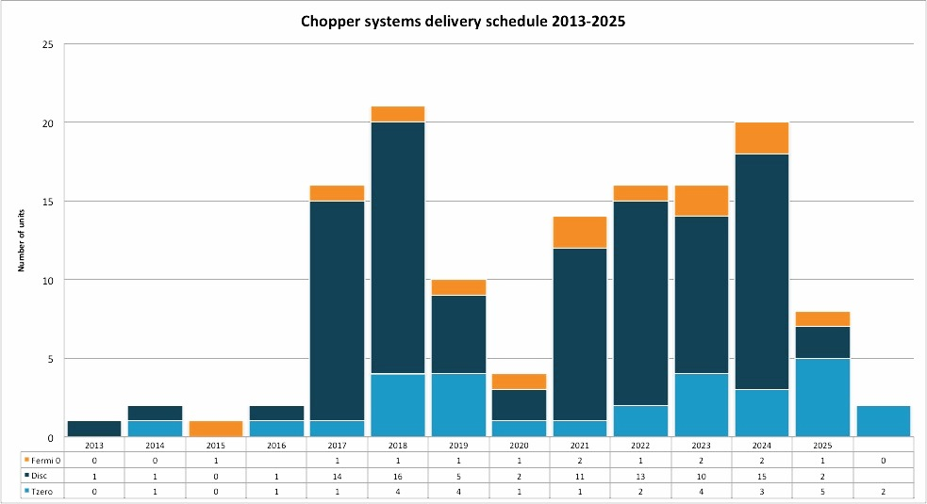
HOW MANY & WHEN
Period | Phase | PPS | Disc | Fermi
2013-2016 | Technologies development | 4 | 3 | 1
2017-2019 | Build program ‘Day 1 suite’ | 2 | 35+ | 3
2020-2025 | Build program ‘Full suite’ | 4 | 85+ | 6
2025 > | Total choppers in service | 6 | 125 | 10
2013-2016
2017-2019
2020-2025
Notes:
The number are quiet staggering
The total requirements are in excess of that of any existing facility by a factor of around 2 to 3
This is not totally unexpected and many of the techniques which the long pulse makes possible RRM and WFM require a large number of choppers to be employed …
What is sure is that is a whole lot of choppers….. and that we are going to need a lot of help developing solutions and then supplying the need.
We need partners to pull this off both academic and industrial and in order to help us work together effectively we need good organization and a central plan.

Slide 38
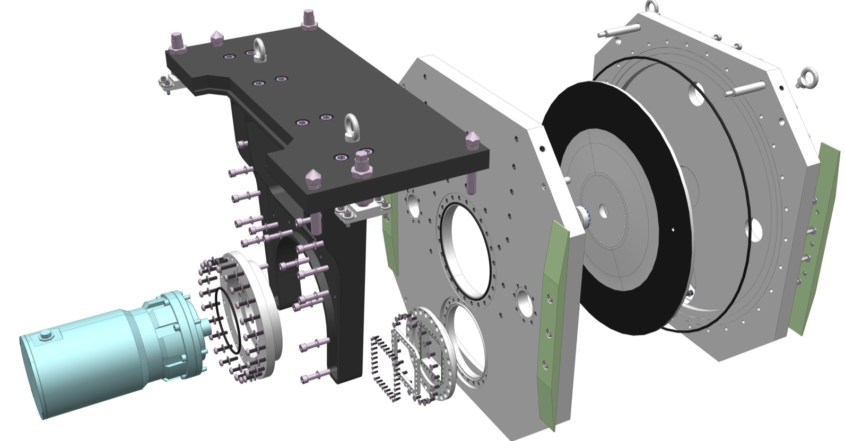
THE END
Thank you for you attention

