Slide 1

NCG14 TAP
Equipment standardisation
9-4-2014
Notes:
The impact of instrument reliability on the scientific output and reputation of a research facility will be explored using examples from recent studies carried out at the ESS. The argument is made that the design of long pulse spallation sources coupled with the changing expectations of the user community will raise the importance of instrument reliability, availability and serviceability issues to the same level as that of pure neutronic performance as drivers for the design of the next generation of neutron instruments.

Slide 2

Drivers
Raising Performance
  Neutronic performance
  Availability
Reducing Costs
  Procurement
  Operations
In-kind
  Harness experience
  Maximise in-kind potential
  Equitable distribution

Slide 3
FACILITY GOAL
Instrument Availability
Operations phase
ESS Instrument availability target = 95%
Target mean time to repair 24hrs (!)
Reducing operating costs spares & interventions
Looking further ahead
Facilitating Upgrades
Managing obsolescence
Notes:
Existing spallation facilitiy MTTR is 2 – 3 days

Slide 4
CROSS CUT APPROACH
‘5 Pillars’
Systems thinking, modular design.
Targeted development
Component standardization & interchangeability
Full cost & full cycle
Coordinated procurement

Slide 5
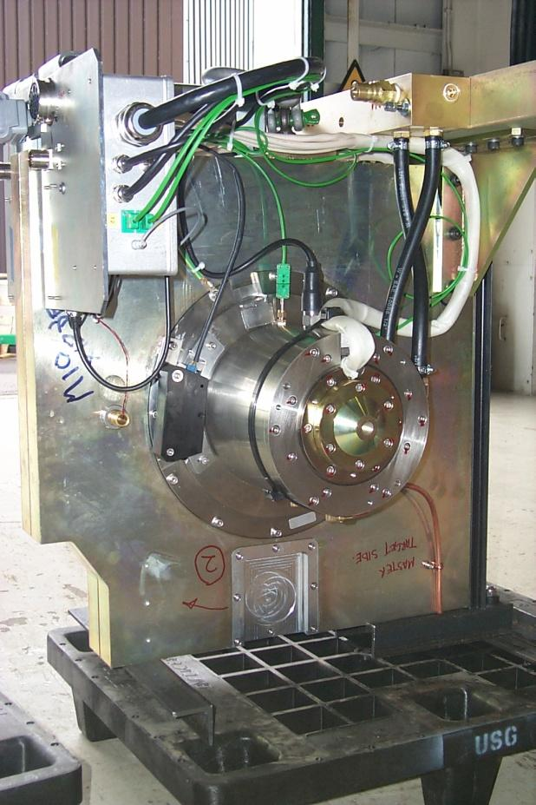
STANDARDS & COMMONALITY
Common approach
  Standardise where it makes sense …
  else facilitate optimisation
High level
  Component platforms
Standardised interfaces
  Mechanical
  Electrical
  Control

Slide 6
Other factors

Slide 7
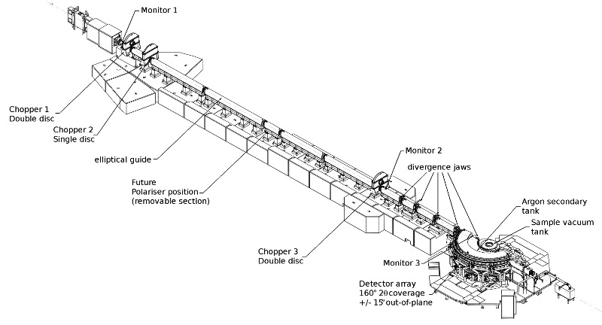
Spallation source instruments
BEAM SHUTTER
-HEAVY
DETECTOR
-BEAM MONITOR
NEUTRON OPTICS
- IN MONOLITH GUIDE
BEAM LINE SHIELDING
PHOTO ISIS Instrument
- overlay schematic components
CHOPPER 1
CHOPPER 2
DETECTOR
-BEAM MONITOR
BEAM SHUTTER
-LIGHT
NEUTRON OPTICS
- GUIDE
NEUTRON OPTICS
- COLLIMATION
NEUTRON OPTICS
- POLARIZER
FLIGHT TANK
SAMPLE
ENVIRONMENT
Instrument
Shielding
Choppers
Sample area
Detectors
Control systems
Optics
CHOPPER 3
DETECTOR
-BEAM MONITOR
DETECTOR
-ARRAY

Slide 8
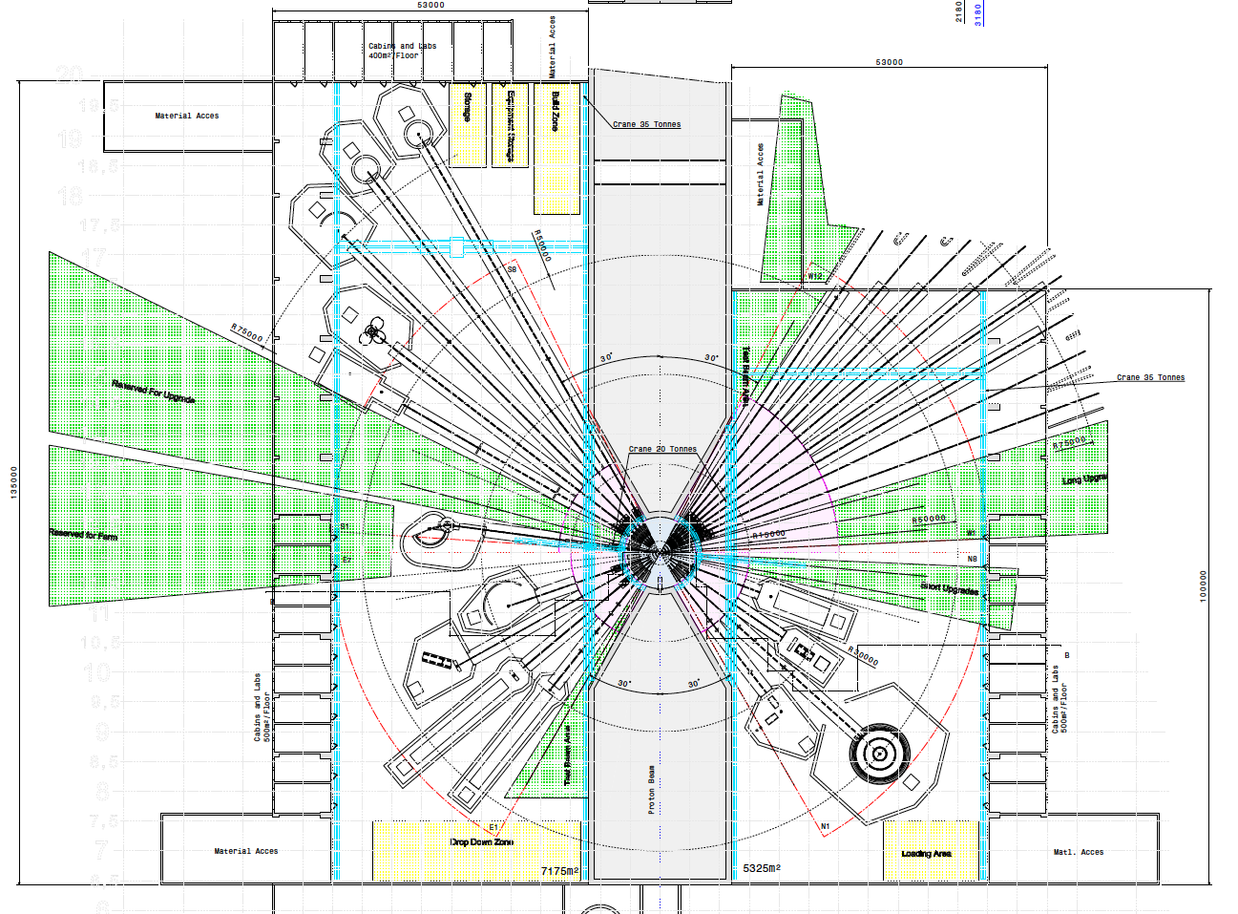
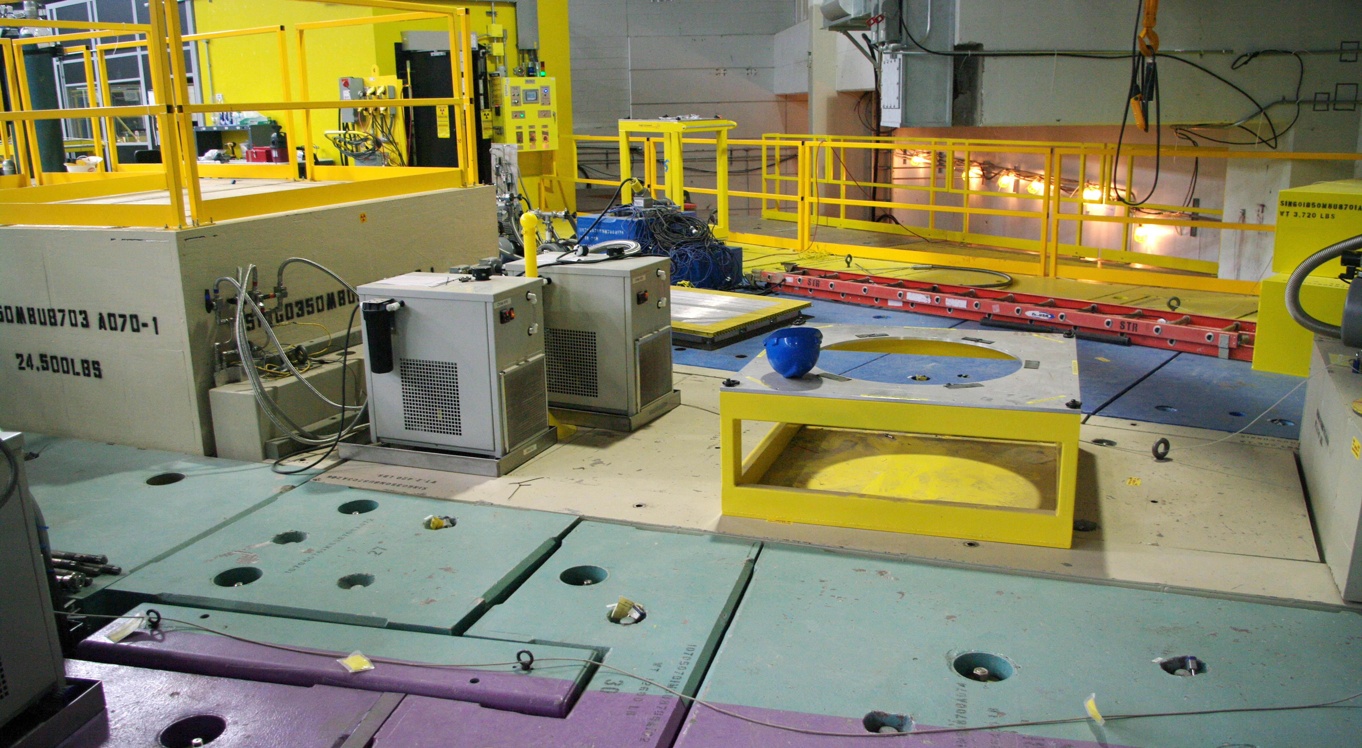
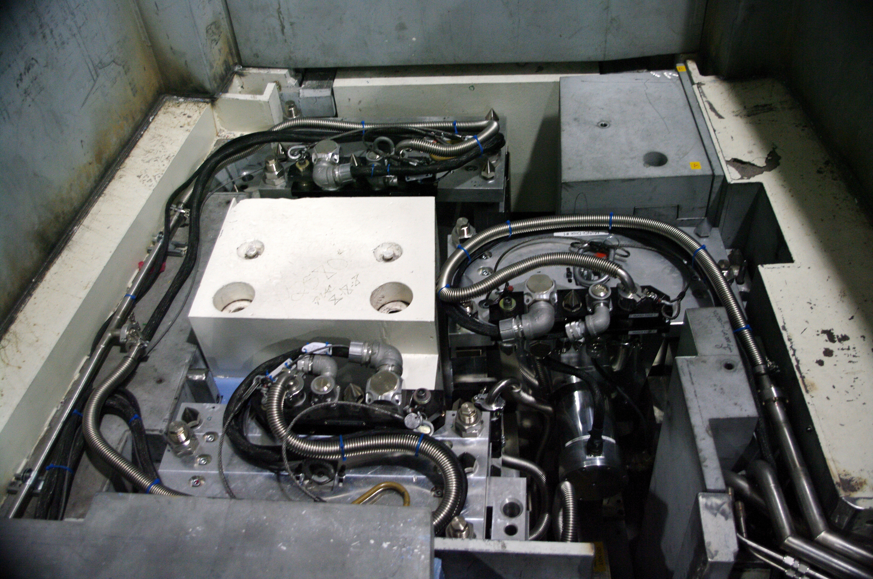
The instrument access conundrum
 | Beam Separation | Beam lines shutdown for access
ISIS | 15 degrees | 3
ESS | 10 degrees | 5 +
 | 7.5 or 5 | 8 (whole sector)
Notes:
Because ESS is going to be a little difference from everything that has gone before
I little more powerful
A few more instruments (in the same space)
And a whole new pulse
And taken together that means a lot more complexity

Slide 9
Coherent policies on common issues
Access , Interfaces , RAS
  ABOVE ONLY!
  CHOPPERs ABOVE GUIDE
  CHOPPERS DECOUPLED FROM GUIDES
  ADVANTAGES
  Does not requires side access for removal
  Chopper Extraction from TOP
  Fastest intervention time
  Small sideways footprint
  DISADVANTAGES
  Long support path for choppers
  Large vertical footprint
    More complicated shielding?
ACCESS & REMOVAL
> ICDs & GUIDELINES for Instruments
Notes:
What ever measures are made to improve equipment reliability
one issue that we must take concrete action on is to ensure the best access to it possible.

Slide 10
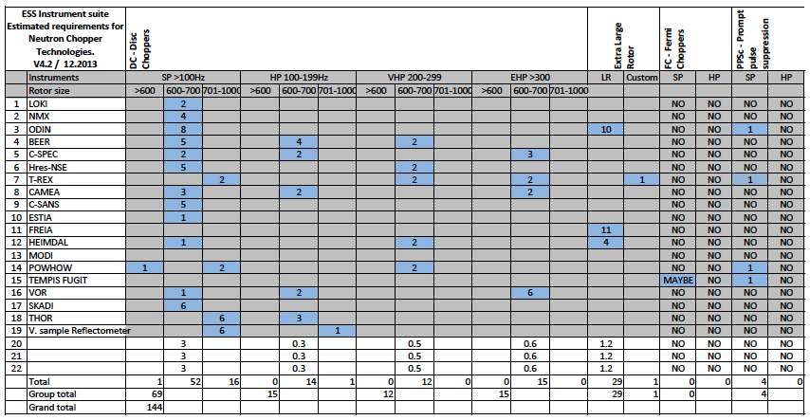
Common component platforms
LOW
SPEED
INTERMEDIATE
SPEED
HIGH
SPEED
LARGE
ROTOR
FAN
PPSc
2PA-02 (FTF)
2PA-02 (UO)
PA-02 (-M-14)
PA-02 (-M-14)
PA-10 (PPSc)
6 ‘platforms’
Notes:
Average choppers 7.5
Which 22 inst 150 -160 axis
By configuration, performance and requirements can be sub divided into 6 broad families
Small rotored disc chopper
Low / intermediate / high speed
Large rotored choppers

Slide 11
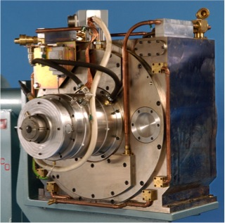
Platform
Within each platform….
A common mechanical & control architecture.
Motor & Drive
Rotor fixation
Support structures
Support systems
Control commands (?)
Monitoring system
MPS & PPS functions

Slide 12
Control interfaces
ISSUES
Instrument control
Timing
Machine protection systems
Personal safety systems
Integration @ 3 levels
Chopper system
Instrument
Facility
HARDWARE
&
SOFTWARE

Slide 13
CONTROL SYSTEM - PPSChopper

Slide 14
ESS Integrated CONTROL SYSTEM
– Choppers as ‘devices’
DEVICE 01
(SKF DC-SR)
DEVICE 02 (Julich DC-SR-VHP)

Slide 15
CONTROL SYSTEM – Responsibilities
NCG / E&E / DMSC
NCG / E & E Group
NCG / E& E / Integrated Control Systems
NCG & SUPPLIER

Slide 16
Electrical interfaces
Cabling standards Bay to Chopper.
Power supply
Electrical noise suppression
Remote handling ready connector plates

Slide 17
SNS connection plate

Slide 18
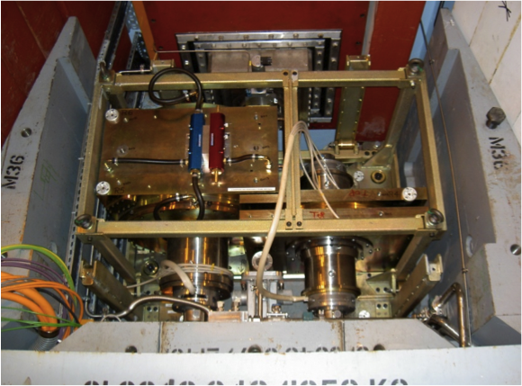
Mechanical interfaces
Load bearing structure
Vibration isolation
Maintenance tooling
Alignment & Lifting
Interface with guides
Interface with shielding

Slide 19
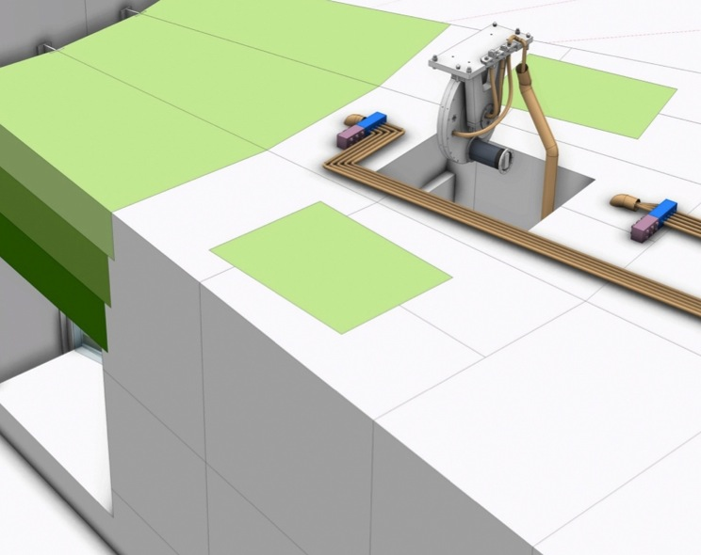
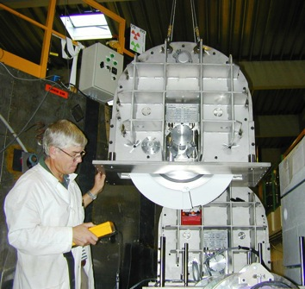
Interfaces: Chopper-Optics-Shielding
Key Objectives
  Highest neutronic performance for instruments
  Low back ground @ Detector
  Highest instruments availability
  Lowest lifetime costs
Input to instrument construction projects
  Interface definitions
    Chopper-Optics
  Guidelines for design
    Installation
    Access / Serviceability
    Integration of shielding
  Policies
    Alignment /Vacuum /Access /Activation
  Equipment standards for procurement
Common housing strategies
Vertical split
Guide removed with Choppers
Horizontal split
Guide remains in lower housing
Notes:
Very obvious and real interface Choppers / Guides
With the increased complexity of ESS choppers systems the number of these interfaces is increased
Intergration
with guides
with shielding
Ensuring serviceability within shielding…
The list goes on…
The result of this effort will be condensed into a number of documents – many in the form of guidelines for instruments
Its important to the design of each instrument
But equally to the operation of the instrument as a whole
We do …. so you do not have to.

Slide 20
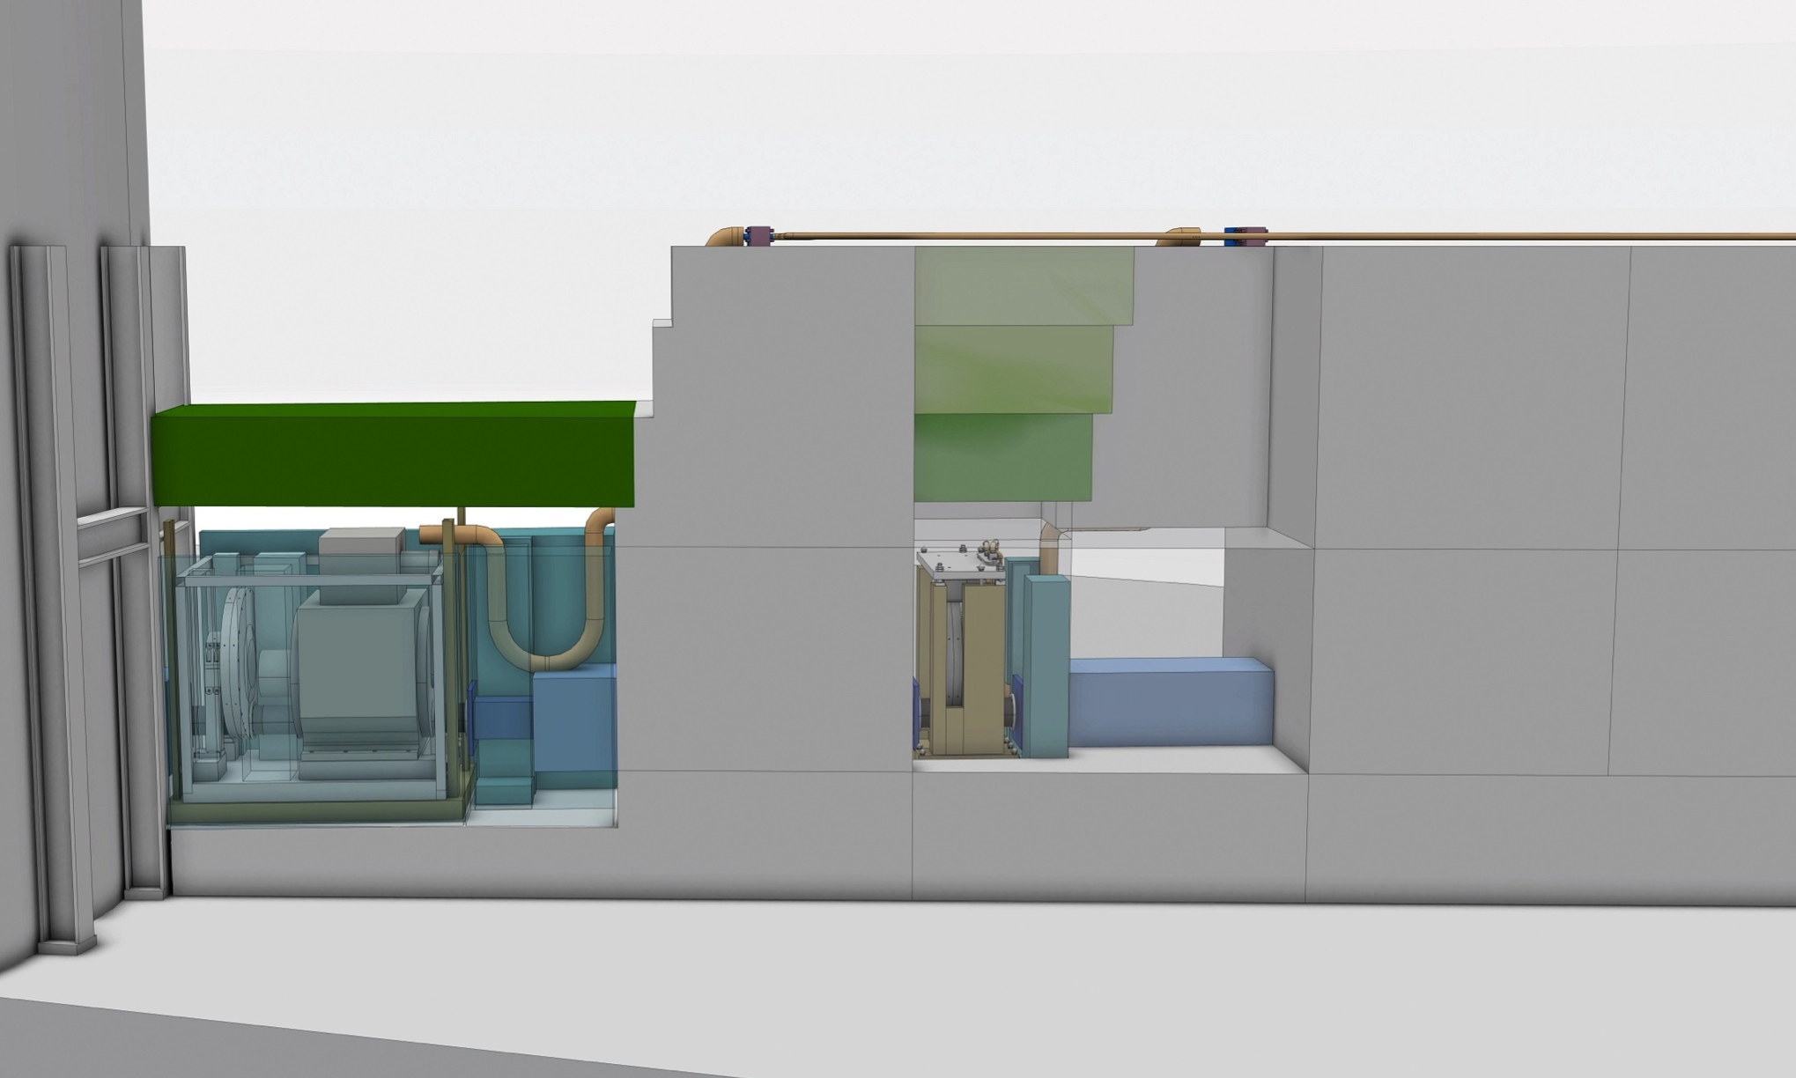
COMMON INTERFACES & COMMMON APPROACH
HAS IMPLICATIONS FOR INSTRUMENT ARCHITECTURE !
BUNKER CRANE 20t
HALL CRANE 30t
ACCESS PATH
HAND-OFF
AREA
Position
Guide/Chopper
Chopper above
Guide
Vertical Extraction
Sideways
Extraction
Chopper by side
Guide
Sideways or vertical Extraction
Chopper below Guide
Notes:
Take roof off
If 5 ton max with chicanes the n probably 3 layers of steel 1500mm
Or 2 steel 1 concrete
6 lifts with shielding crane - 6 with hall crane
2-3hrs work

Slide 21
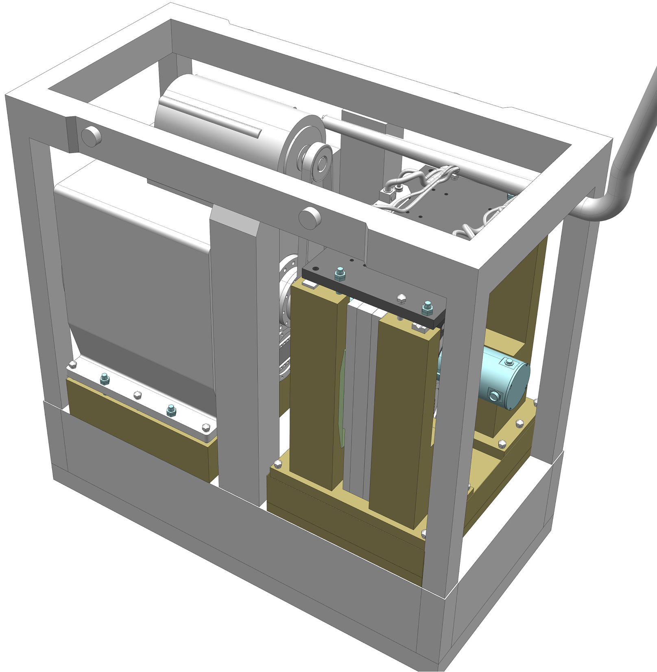
ESS Integrated Chopper/Guide/Shielding concepts
Key Features
Integrated shielding
Remote handling ready
Installation from above
Build for serviceability
Notes:
Inspired by the best of what is done else where

Slide 22
i.Safety
Personal Safety Systems
Machine Protection Systems
Integration @ 3 Levels
  Chopper systems
  Instrument
  Facility

Slide 23
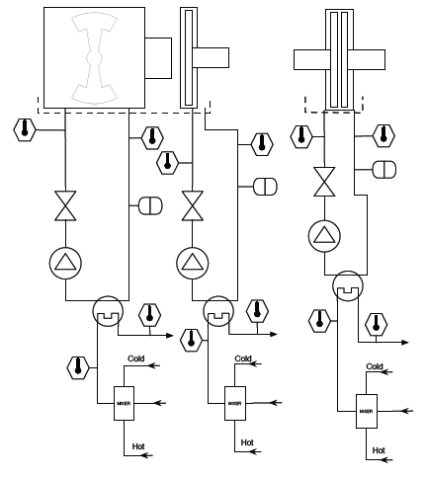
i.SUPPORT
Monitoring systems
Cooling
Environment
  Vacuum
  Inert atmosphere
Primary loop
Closed -Activated
Secondary loop
Open - Clean
ESS Chopper cooling loops

Slide 24
OPERATIONS INTERFACES
Service connections
  Air
  Water
  Electricity
Handling facilities
  Hall crane 25t
  Bunker crane 10t
Waste
  Activated components
Service function
  Fault reporting
  Op’s staff for 24/7 call out.
  Tooling
  Spares

Slide 25
THE END
Thank you for you attention

