Slide 1
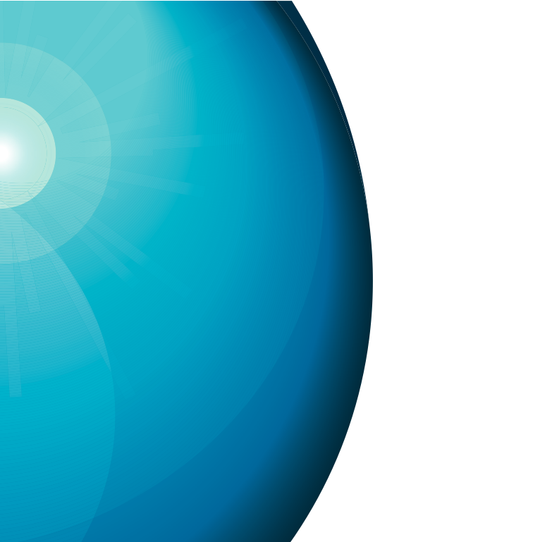




Longitudinal Bunch Shape Monitor
Andreas Jansson
2012-03-21

Slide 2
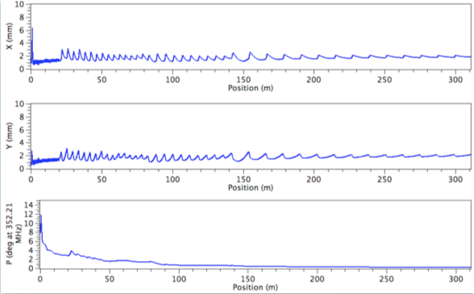
ESS Bunch Length

Slide 3
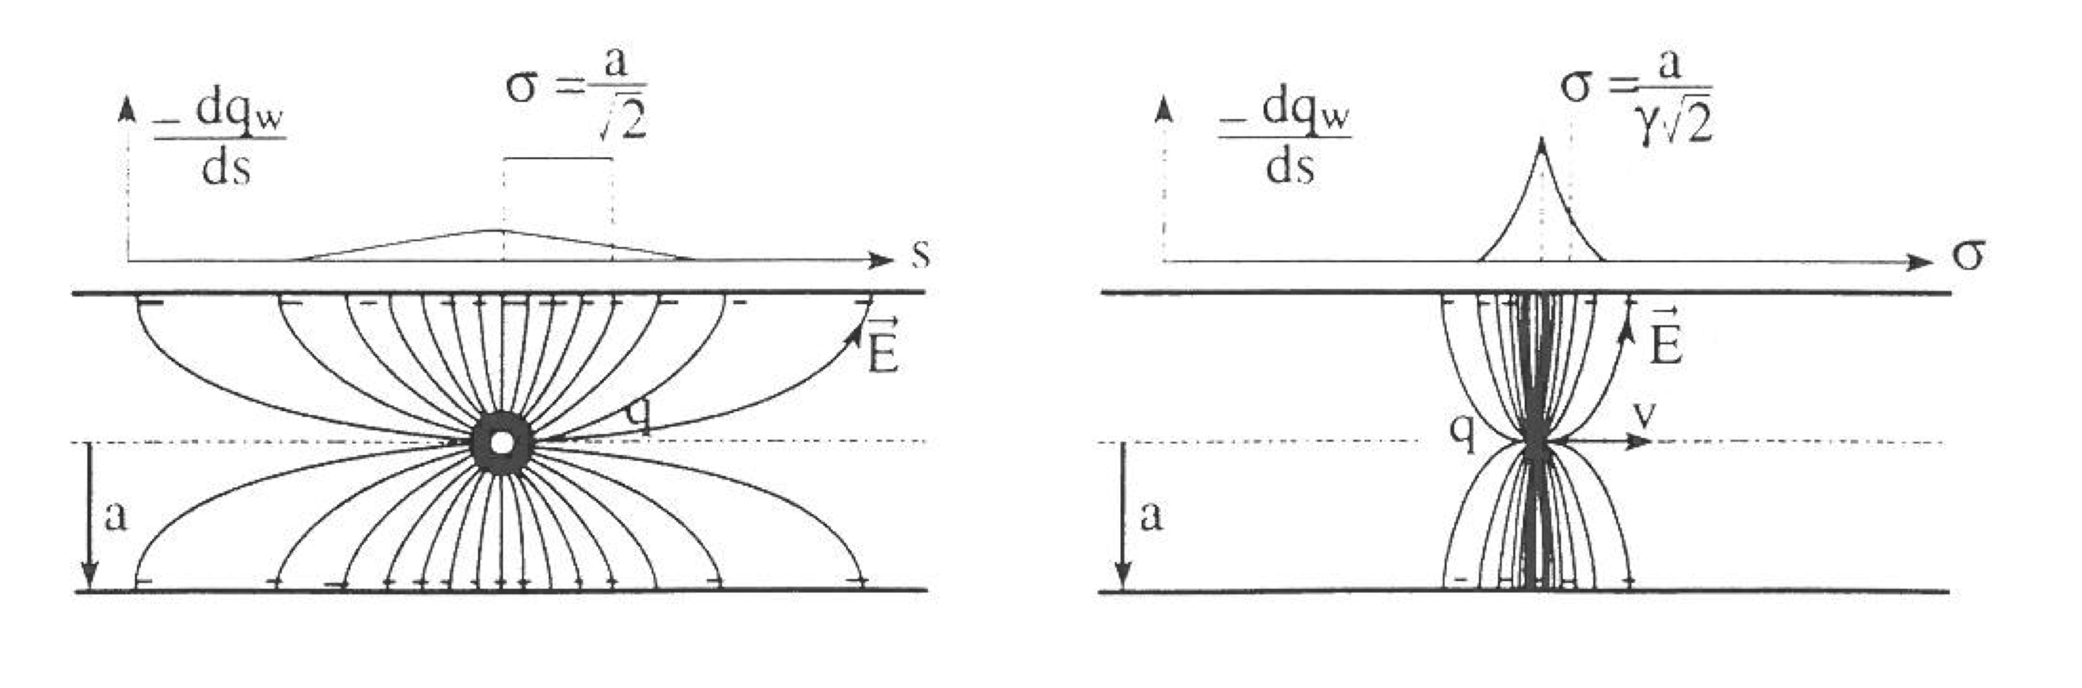
Bunch Shape Measurement
At low beta, field is not transverse, and wall current not longer reflect beam pulse
R=20mm
R=30mm
R=50mm

Slide 4
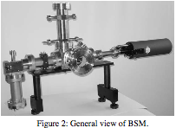
Feshenko Bunch Shape Monitor
The Feschenko monitor (first Faraday cup award) make use of secondary electrons from a wire in the tail of the beam distribution.
  Very fast (ps) process
A high bias voltage accelerate the electrons towards a slit, and an RF deflector turns time-of-arrival into position
A. Feschenko, Bunch Shape Monitors using Low Energy Secondary Electrons, PAC’92

Slide 5
GSI (Forck) Variant
The GSI variant uses ionization electrons instead of secondary electrons – no wire!
Unresolved issues with background
Space charge sensitive, since uniform electric field.
P. Forck et al, Measurement with a Novel Non-Intercepting Bunch Shape Monitor
at the High Current GSI LINAC, DIPAC’05

Slide 6
ANL (Ostroumov) Variant
The ANL variant uses x-rays, which are turned into electrons at a photocathode.
Space charge not an issue
Wire or gas target could be used.
P. Ostroumov et al, Bunch Length Detector Based on X-Ray Produced Electrons, PAC’09

Slide 7
Collaboration possibility
It seems many labs are interested in BSM development
  ESS, GSI, GANIL, SNS, Fermilab…
Possible area of collaboration
  Share information
  Pool resources

