Slide 1
ESS
20 March-2012, Beam instrumentation workshop
Mats Lindroos
Head of accelerator division and projects

Slide 2
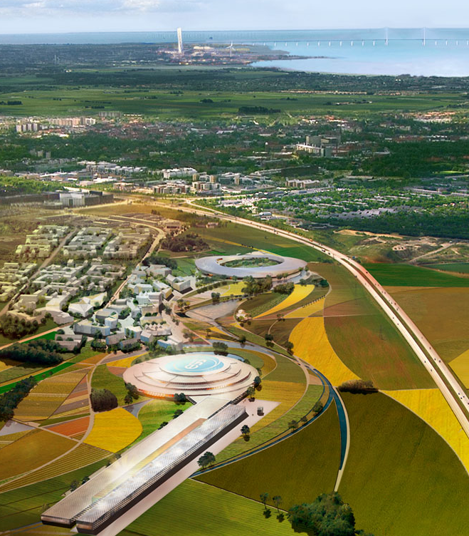
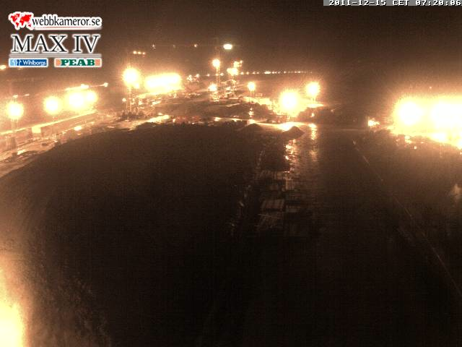
ESS , MAX-IV and Medicon Village

Slide 3
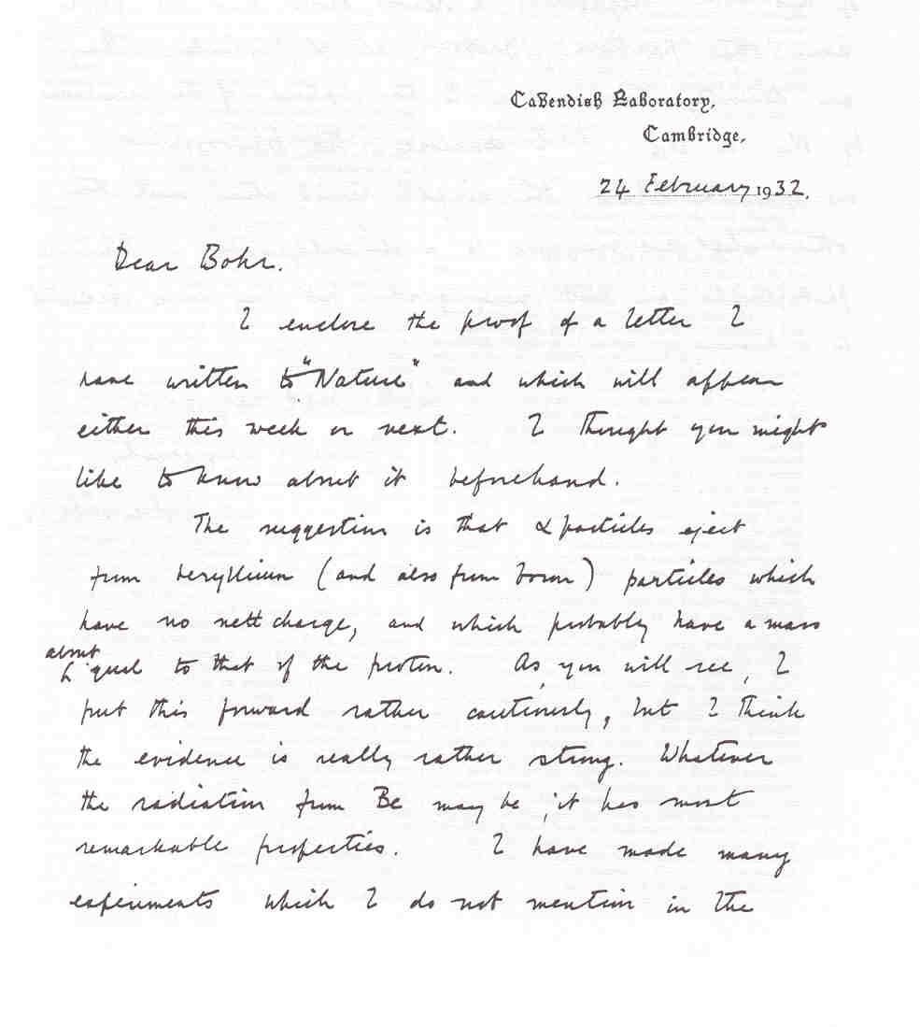
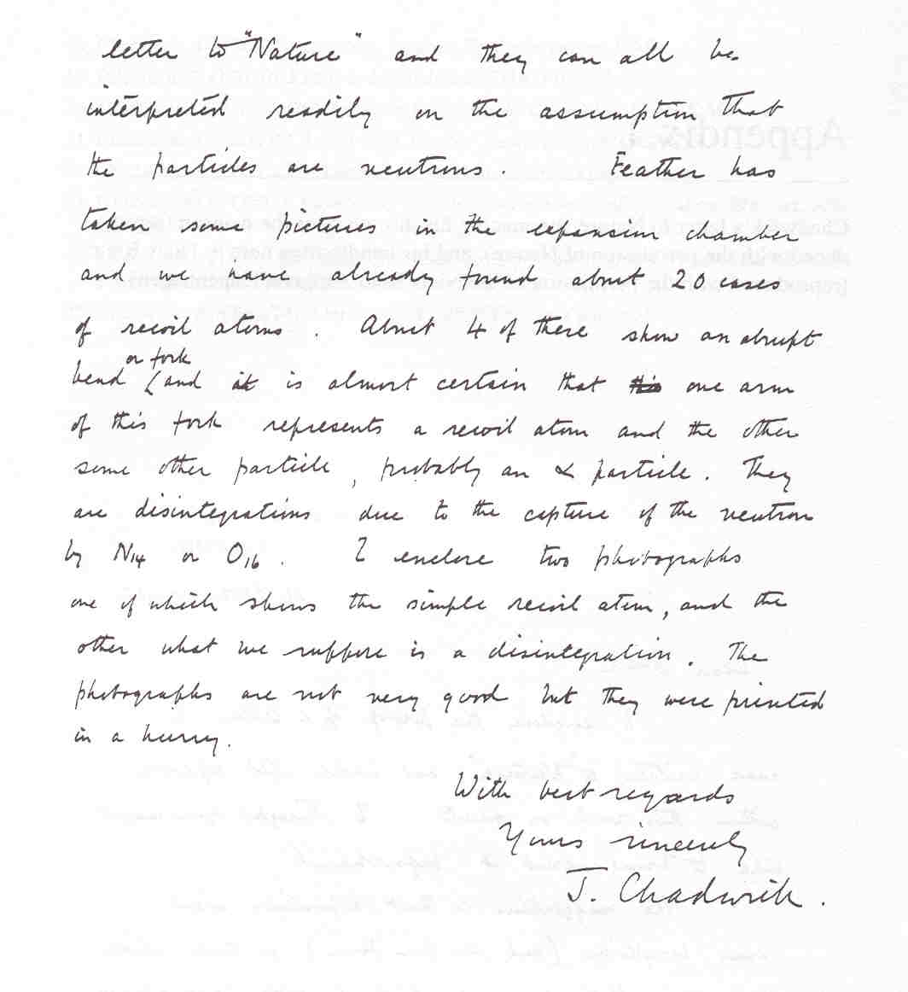
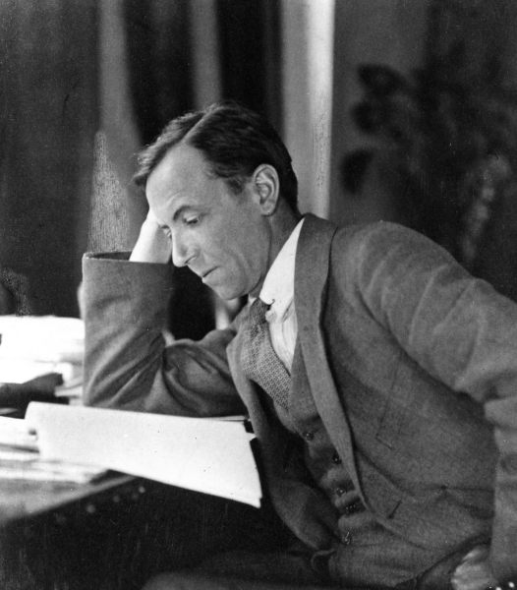
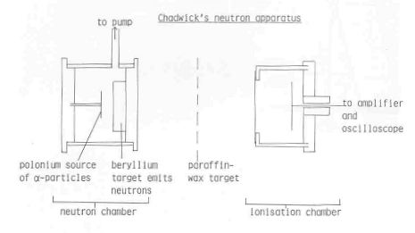
“Whatever the radiation from Be may be,
it has most remarkable properties”
Neutrons
Its discovery
James Chadwick
1932
(α,n) reaction
α
?
p

Slide 4
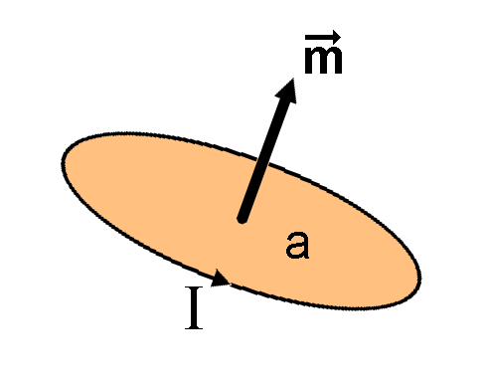
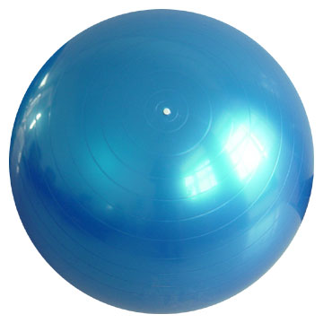
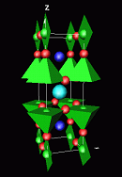
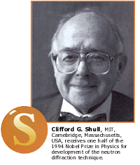
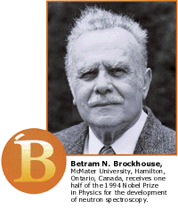
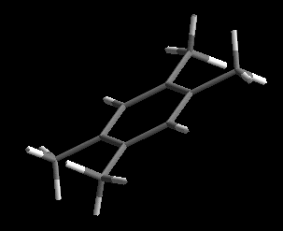
Neutrons are beautiful !
Wave Particle Magnetic moment Neutral
Diffractometers - Measure structures
– Where atoms and molecules are
1 - 10 Ångström
Spectrometers - Measure dynamics
– What atoms and molecules do
1 - 80 meV

Slide 5
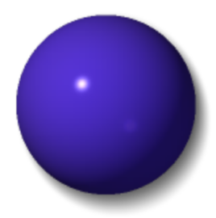
Neutrons see the nuclei..
H
Li
C
O
S
Mn
Zr
Cs
X-rays
neutrons

Slide 6
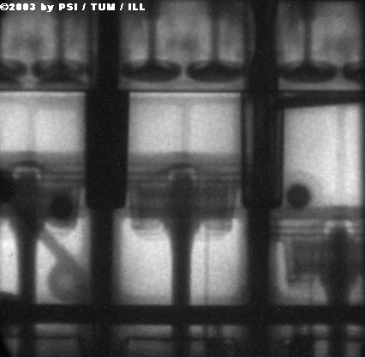
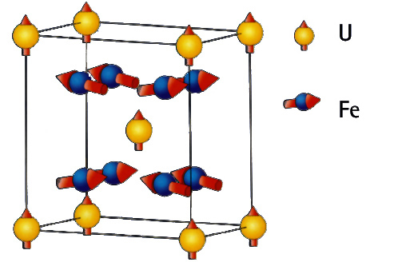
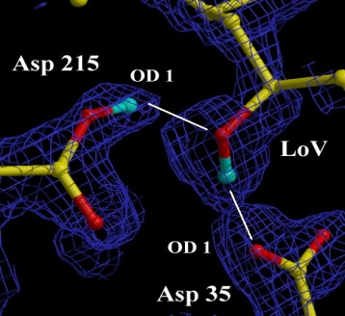
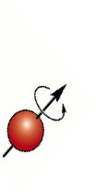
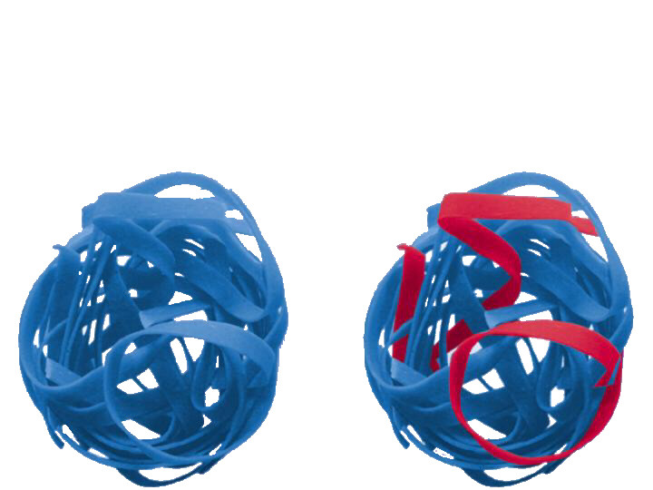
Neutrons and x-rays are complementary - neutrons…
..see magnetic atoms
..see inside materials
..see light atoms
..see atoms move
..see isotopes
Coutsey of Ian S. Anderson
Notes:
Brief description:
Neutron scatter from the nucleus and not the electrons -> penetrating, see light atoms, and magnetic structures.
Top clockwise:
Neutron Radiograph (from Munich) of an operating BMW engine
X-rays reveal the protein crystal structure – neutrons reveal the positions of the H atoms which are key to the catalytic activity
Isotope contrast (H/D in this case) allows specific strands to be picked out in this complex polymer
Neutrons have mass similar to atoms – and can measure dynamics easily. This is a CH4 electrolyte – the H is transferred via a rotation and cross over mechanism – revealed by neutrons
Neutrons have a magnetic moment. Most magnetic structures have been determined with neutrons. Can also be applied to magnetic dynamics e.g. Spin waves – important in studies of high Tc materials.

Slide 7
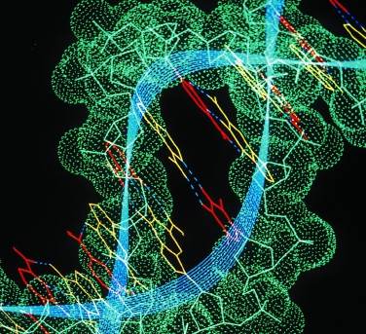
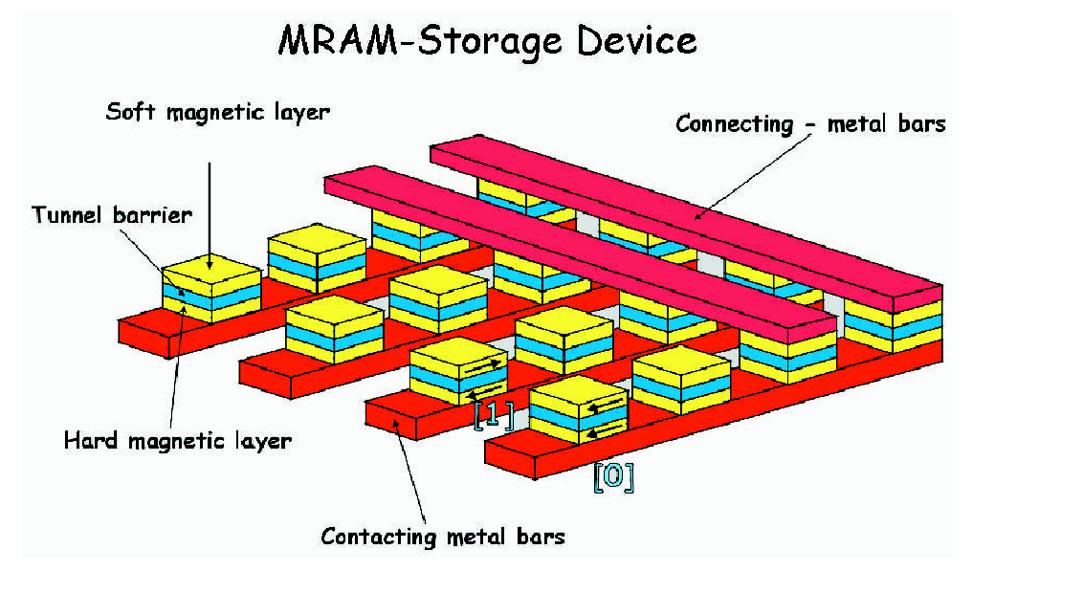
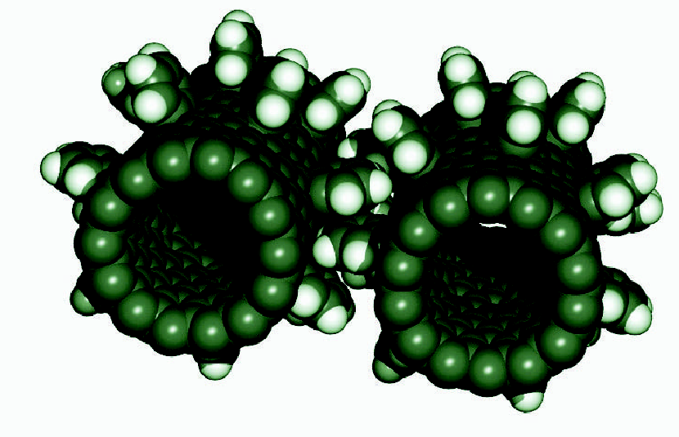
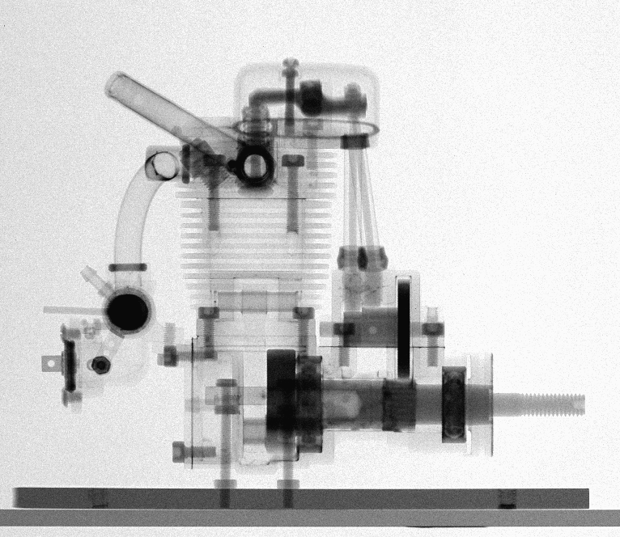
ESS – multi-science with neutrons
Materials science Bio-technology Nano science
Energy Technology Hardware for IT Engineering science
Neutrons can provide unique and information on almost all materials.
Information on both structure and dynamics simulaneously. ”Where are the atoms and what are they doing?”
6000 primary users in Europe today and 6000 secondary users. Access based on peer review.
- Science with neutrons is limited by the intensity of today’s sources
Notes:
The development of neutron scattering over the past 40 years has been from the initial studies of basic solid state physics in model systems, to detailed studies of complex systems with applications. Similar development can be xepceted in the next 40 years.

Slide 8
ESS program Goal
Neutrons at ESS in Lund before the end of the decade!

Slide 9
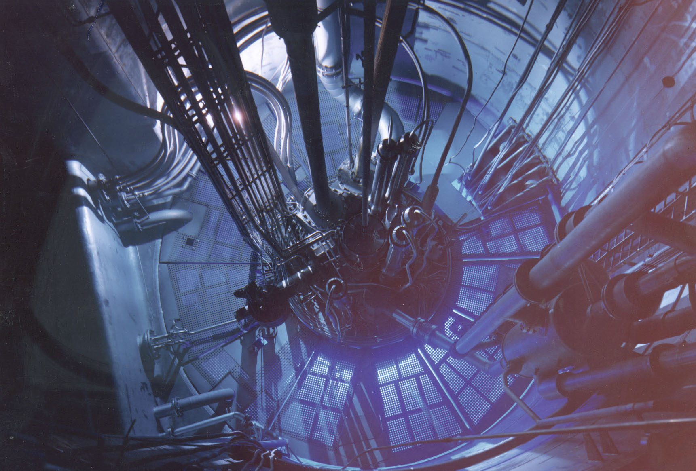
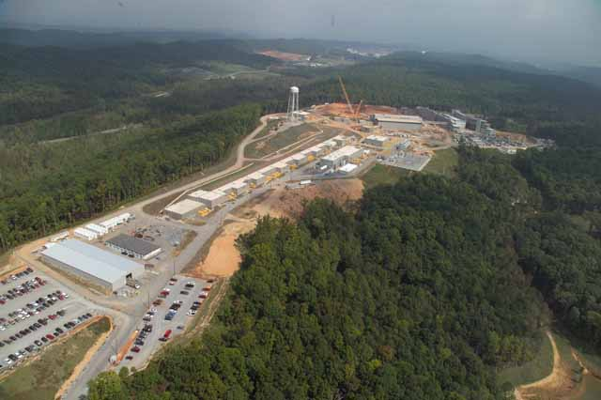
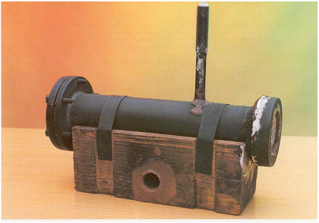
Why ESS? - High time average and peak flux
Evolution of the performance of neutron sources
ESS
10²⁰
SNS
ISIS
10¹⁵
MTR
NRU
HFIR
ILL
J-PARC
NRX
HFBR
ZINP-P/
IPNS
FRM-II
X-10
WNR
KENS
SINQ
Effective thermal neutron flux n/cm²-s
ZINP-P
10¹⁰
CP-2
CP-1
10⁵
Berkeley 37-inch cyclotron
350 mCi
Ra-Be source
Steady State Sources
Pulsed Sources
1
Chadwick
1930
1940
1950
1960
1970
1980
1990
2000
2010
2020
(Updated from Neutron Scattering, K. Skold and D. L. Price, eds., Academic Press, 1986)

Slide 10
Why ESS? – Long Pulse and cold neutrons
Many research reactors in Europe are aging and will be closed before 2020
Up to 90% of the use is with cold neutrons
There is a urgent need for a new high flux cold neutron source in Europe
The vast majority of users will profit from a pulsed structure
A large fraction of the users are fully satisfied by a long pulse source (approx 2 ms, 20 Hz)
Existing short pulse sources (ISIS, JPARC and SNS) can supply the present and imminent future need of short pulse users
14
1,6x10
14
“Pulsed cold neutrons will always be long pulsed as a result of the moderation process”
1,4x10
14
300 kj/pulse
1,2x10
14
/s/str/Å]
1,0x10
2
13
8,0x10
13
6,0x10
13
Instantaneous brightness [n/cm
4,0x10
13
2,0x10
0,0
0
500
1000
1500
2000
2500
3000
μ
Time [
s]
F. Mezei, NIM A, 2006

Slide 11
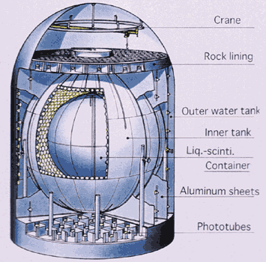
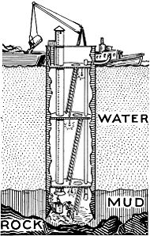
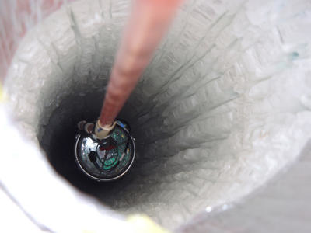
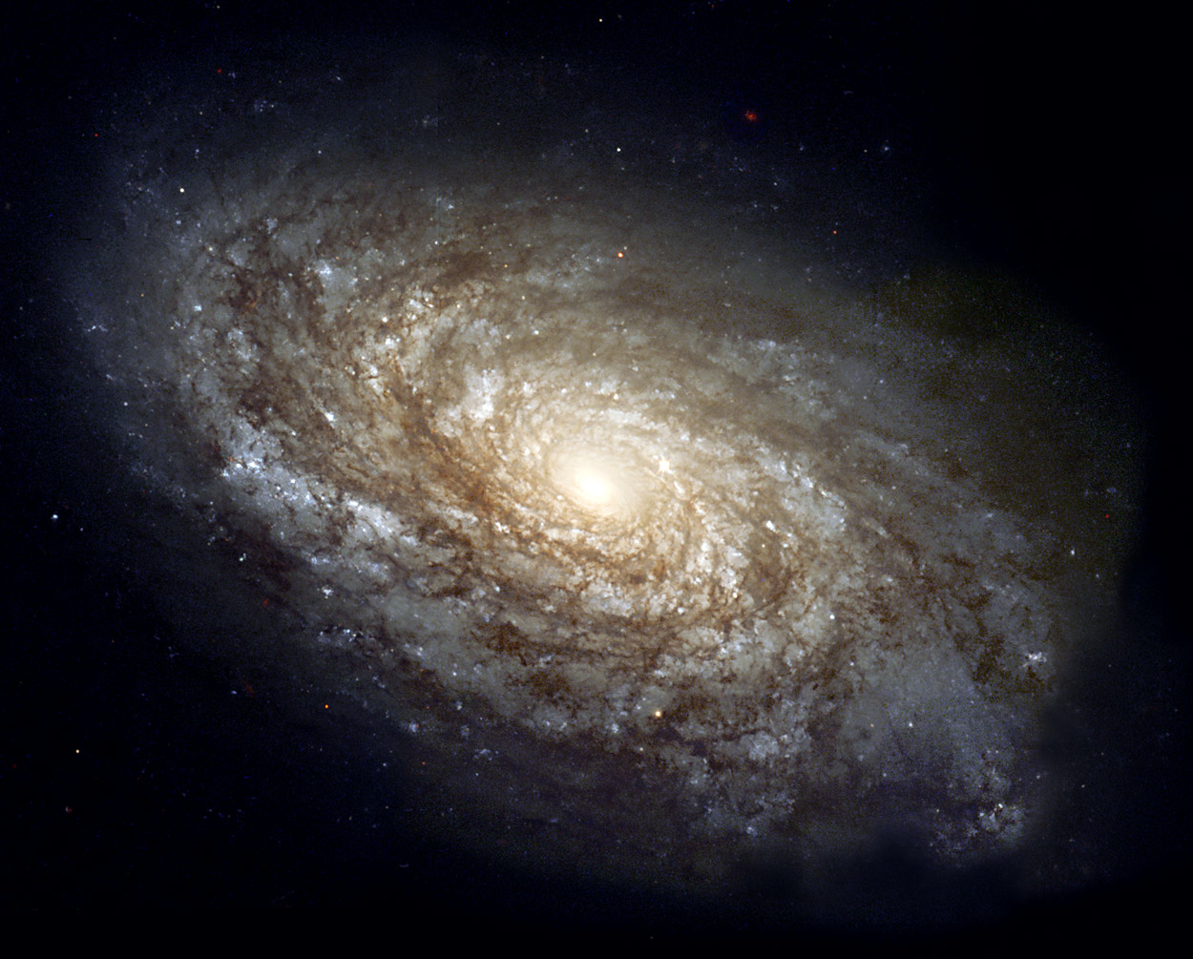
Fundamental physics at ESS
2019: What are they doing in Lund?
Workshop on fundamental physics at ESS held in Lund in December 2009 on possibilities for Neutron, Nuclear, Neutrino, Muon and medical physics at ESS
All presentation available at 3N2MP website: http://indico.hep.lu.se//conferenceDisplay.py?confId=896

Slide 12
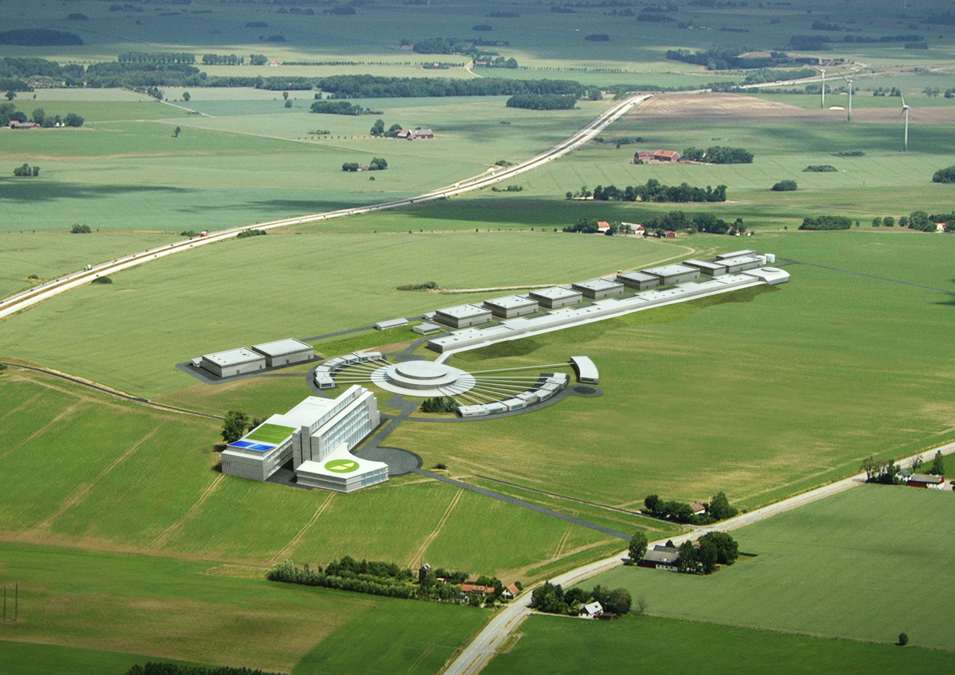
ESS accelerator design High level objectives
ESS accelerator high-level technical objectives:
5 MW long pulse source
-2.86 ms pulses
-50 mA pulse current
-14 Hz
-Protons (H+)
-Low losses
-High reliability, >95%
-Low heat loss cryostats
for minimum energy
consumption
-Flexible design for
a future power upgrade

Slide 13
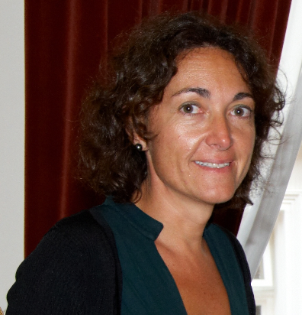
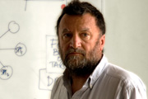
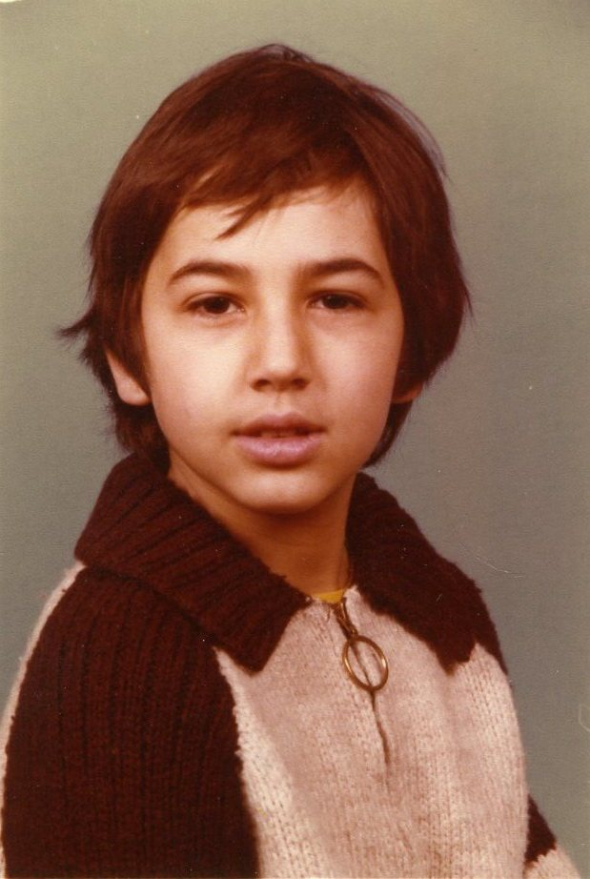
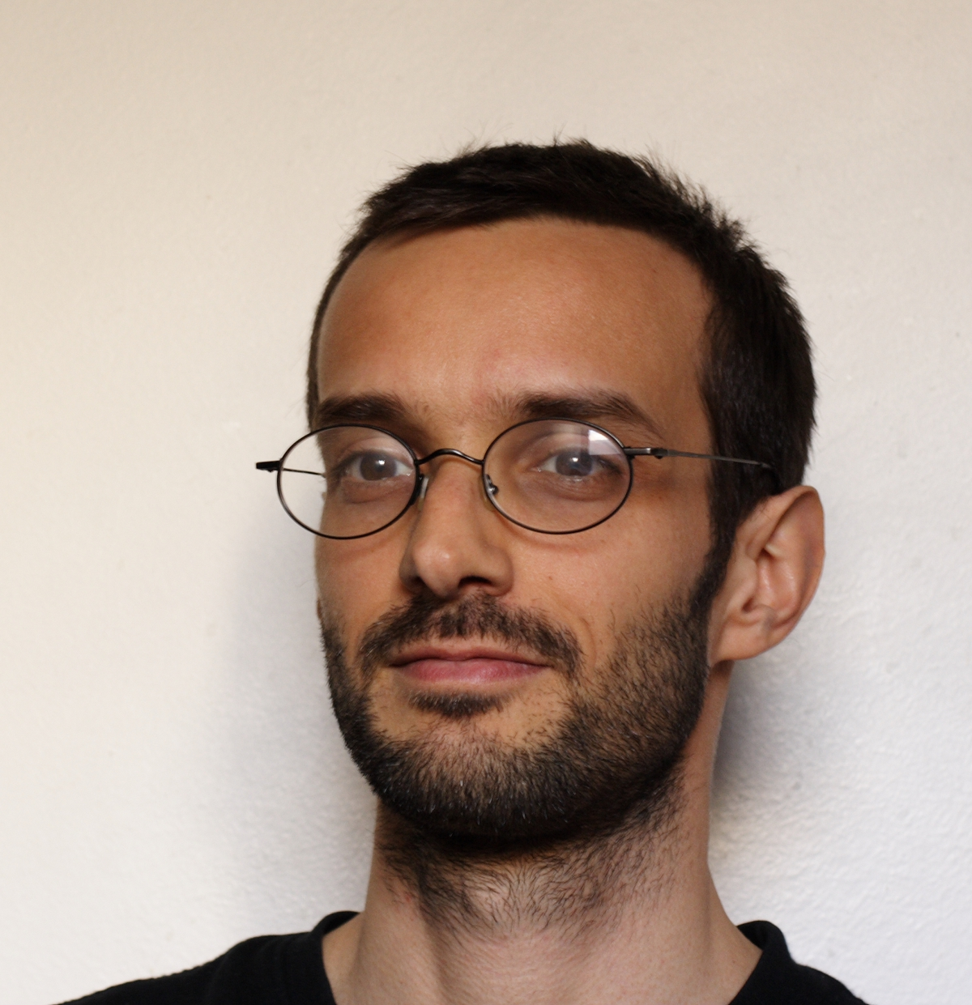
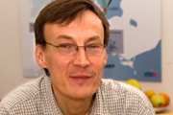
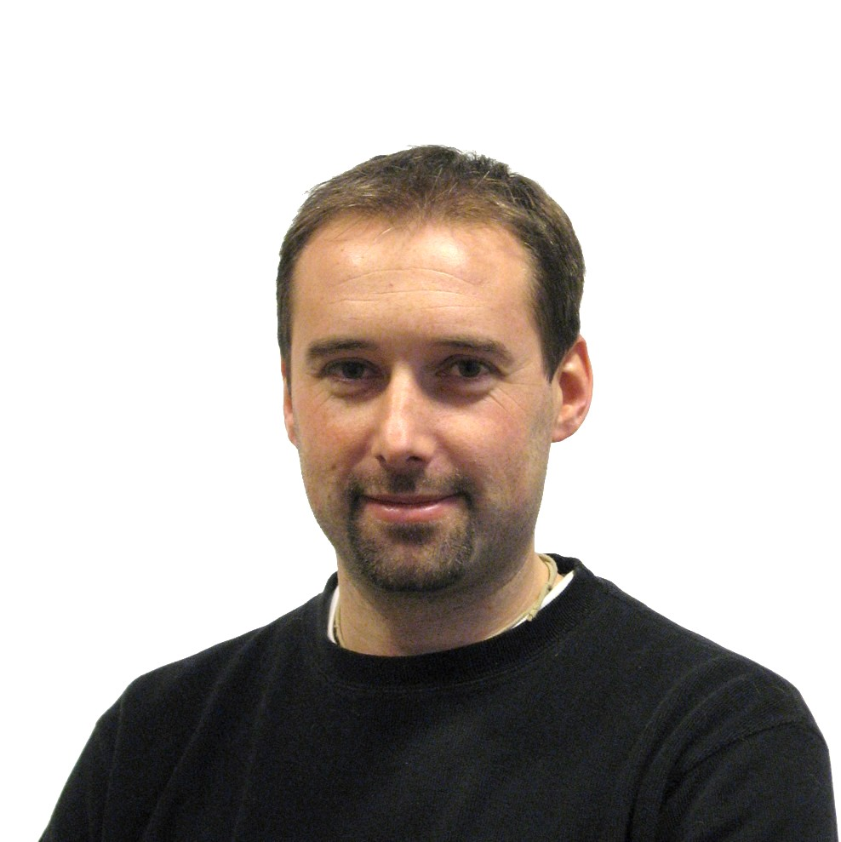
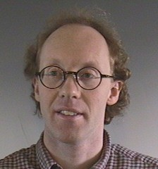
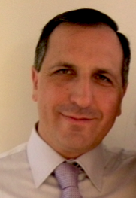
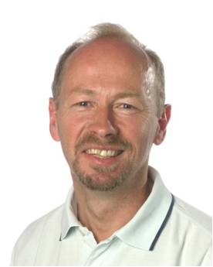
Accelerator Design Update
Steve Peggs
Cristina Oyon
David McGinnis
Work Package (work areas)
1. Management Coordination – ESS AB (Mats Lindroos)
2. Accelerator Science – ESS AB (Steve Peggs)
(3. Infrastructure Services – now ESS AB!)
4. SCRF Spoke cavities – IPN, Orsay (Sebastien Bousson)
5. SCRF Elliptical cavities – CEA, Saclay (Guillaume Devanz)
6. Front End and NC linac – INFN, Catania (Santo Gammino)
7. Beam transport, NC magnets and Power Supplies – Århus University (Søren Pape-Møller)
8. RF Systems – ESS AB (Dave McGinnis)
19. P2B: Test stands – Uppsala University (Roger Ruber)
Romuald Duperrier (30 years ago)
Guillaume Devanz
Mats Lindroos
Sebastien Bousson
Roger Ruber
Søren Pape Møller
Santo Gammino

Slide 14
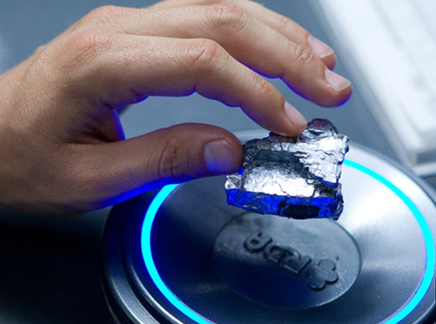
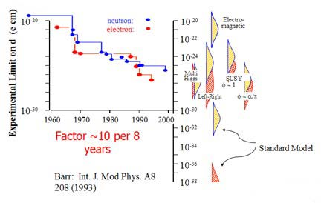
The visions – some of the “Higgs” of ESS
Room Temperature Super Conductors
Sterile neutrinos
Hydrogen storage substrate
Neutron electric dipole moment
Efficient membrane for fuel cells
Flexible and highly efficient solar cells
Carbone nano-tubes for controlled drug release
Self healing materials – smart materials
Spin-state as a storage of data (10²³ gain in capacity)
CO₂ sequestration
Unobtainium
Avatar

Slide 15
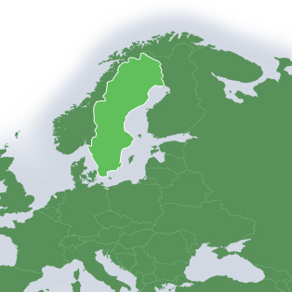
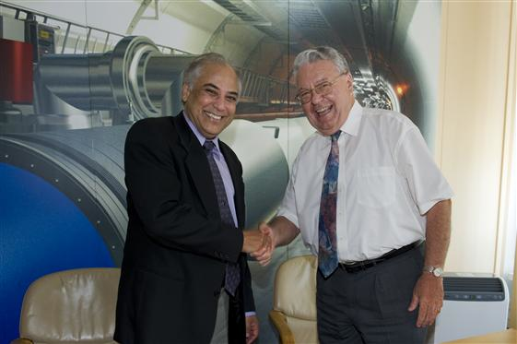
International collaboration
Sweden, Denmark and Norway
covers 50% of cost
17 Partners today
The remaining ESS members states together with EIB covers the rest!

Slide 16
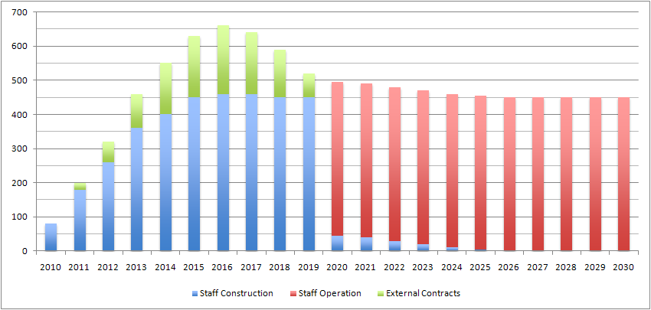
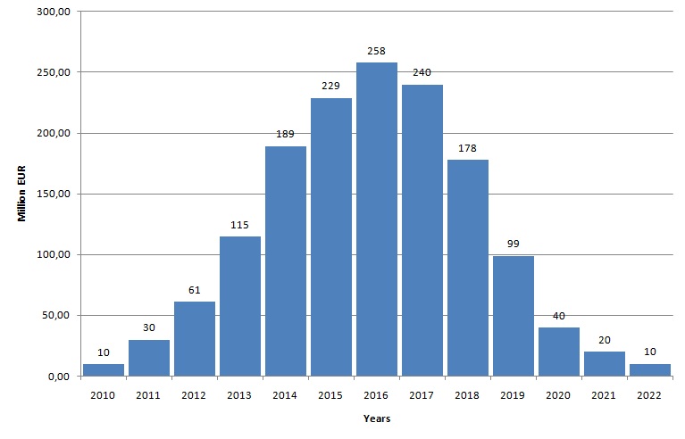
ESS construction cost estimates
Investment: 1478 M€ / ~10y
Operations: 106 M€ / y
Decomm. : 346 M€
(Prices per 2008-01-01)
Personel:
Investment:

Slide 17
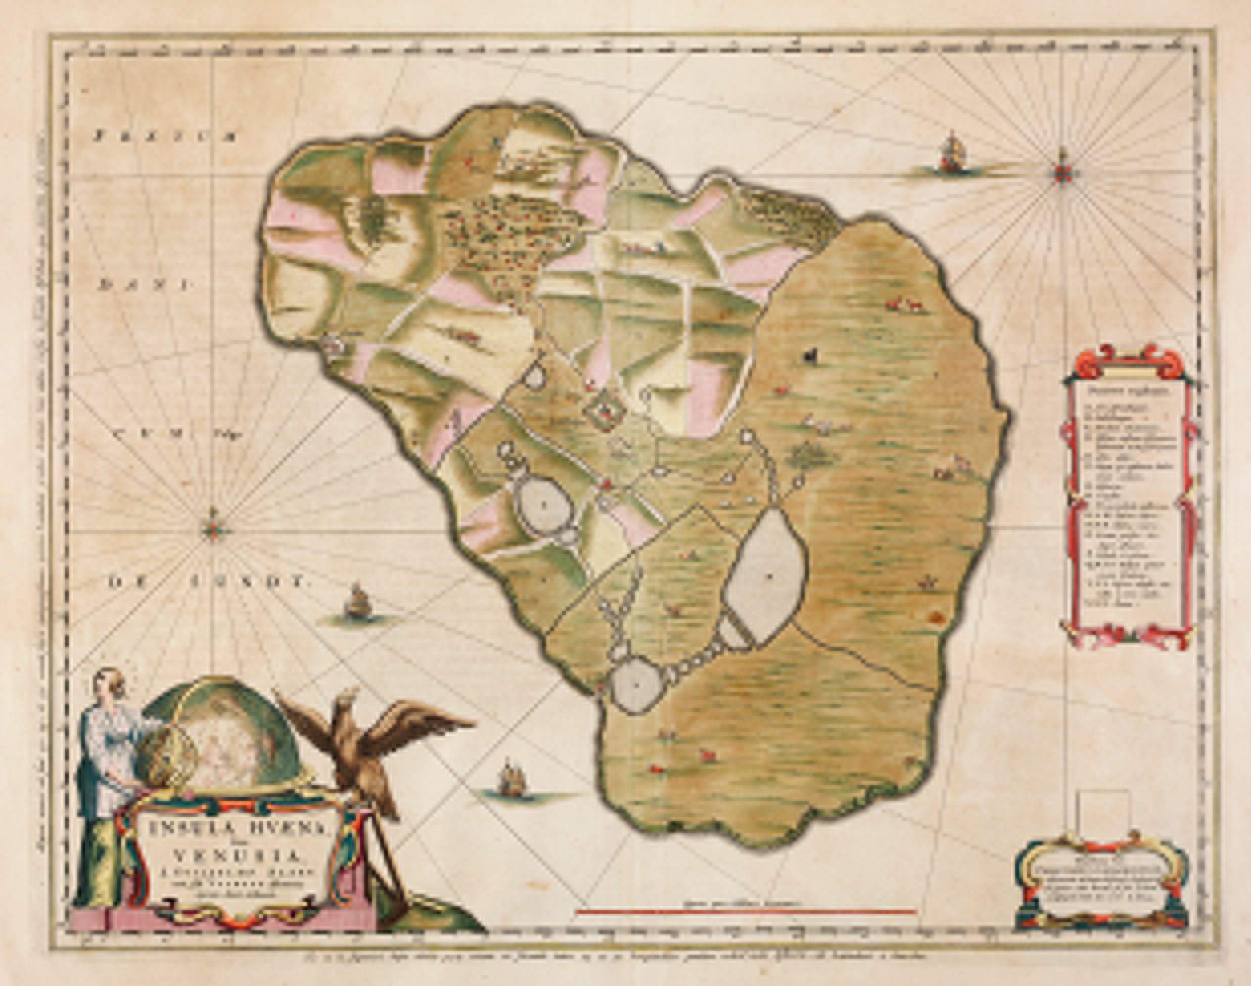
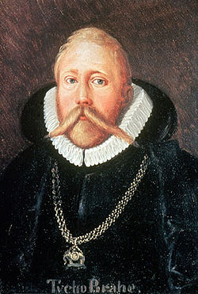
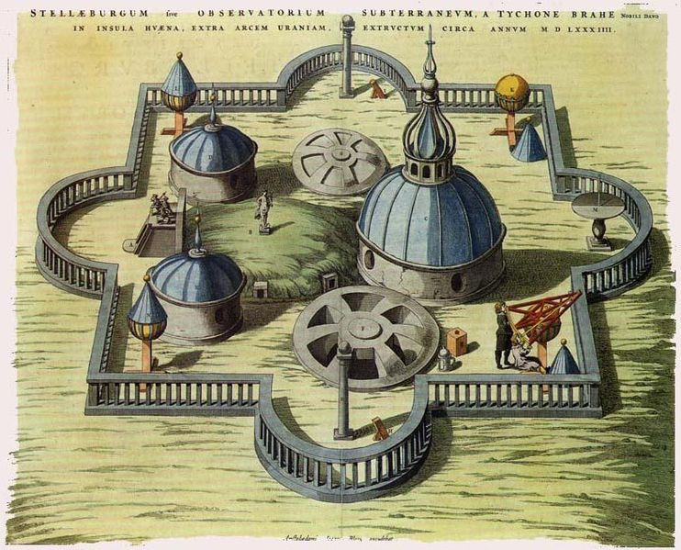
1.5 Billion Euros:
Biggest investment in Science ever in Scandinavia?
In modern time, definitely YES!
However, Tycho Brahe’s Stjärneborg costed the Danish king 1% of the state budget in 1580.
Or you could for 1.5 Billion Euros pay the US bankers bonuses for 24 days!
Notes:
1% would be 1.7 Billion Dollars in 2011

Slide 18
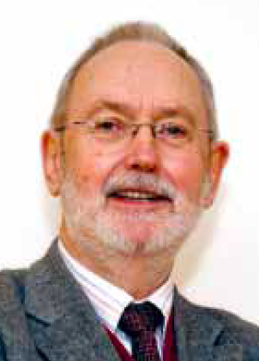
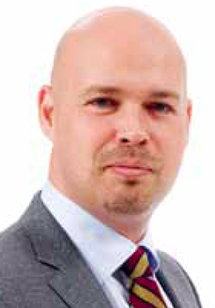
ESS Programme Organisation
ESS AB Board
Steering Comm (STC)
Adm Financial Comm
CEO
C. Carlile
Administration
Director
Collaboration Partners
Programme Director
Machine Director
Science
Director
Technology Adv. Comm
Science Adv. Comm
Programmme Office
Accelerator
Target
Conventional Facilities
Instruments
Neutron Science
Data Management
Preconstruction
Construction
Operation Phase

Slide 19
ESS Master Programme Schedule
 | 2009 | 2010 | 2011 | 2012 | 2013 | 2014 | 2015 | 2016 | 2017 | 2018 | 2019 | 2020 | 2021 | 2022 | 2023 | 2024 | 2025
ESS Program Phases, Gates and Milestones Program level
Accelerator
Target
Instruments
Conventional Facilities
PG 1
PG 2
PG 3
PG 4
Program Initiation
Program Set-up
losure
Delivery of Contsruction phase
Pre-construction phase
First Neutrons
to Instruments
Full beam power on target
Construction
Technical Design Report
Operations
Pre Construction Report
Design Update
Prepare to Build
Installation
Construction
Design Update
Prepare to Build
Installation
Construction
Concepual Design
# 7
List
Design and Manufacturing 22 instruments
Ground Break
Installation 1-22
Design Update
First Building
Site preparation
Construction

Slide 20
Programme Committees
Programme Director
EPG
Board, ,STC, AFC, SAC, TAC Programme Decisions
Programme Reviews
Programme Budget
CCB Machine
Programme Planning
Configuration control
Preparation of EPG Decisions
Definition of deliverables
Programme Office
CCB Facilities
Project Managers
Accelerator
Target
Instruments
DMSC
Facilities
Licensing
Pre-Construction
ESS line organisation
Construction
Operations
De-Commissioning

Slide 21
Linac R&D in progress
LINAC 4
IPHI RFQ at CEA-Saclay
SC 5 cell cavity for 704 MHz, CEA and CNRS
SC single spoke cavity, IPNO (CNRS)

Slide 22
FNAL-RRCAT/ Tom
IPNO/Patxi
1054
1021
Discussing collaboration with RRCAT on CM design

Slide 23
Cryo Infrastructure
Linac cryoplant: 2K LHe for SC cavities estimated size appx. 10 kW @4.5K
Target cryoplant: 20K He for LH2 moderators estimated size appx. 2 x 8.3 kW @20K
Central liquefier: LHe for instruments estimated production appx. 45 l/h
Liquid nitrogen: LN2 for instruments estimated consumption appx. 1500 m³/a
23
2012-02-16, W. Hees, ESS

Slide 24
A sustainable research facility
Responsible
Carbondioxide:
- 30 000 ton/year
Renewable
Carbondioxide: - 120 000 ton/year
Recyclable
Carbondioxide:
- 15 000 ton/year
Notes:
Högsta temp: 118 GWH
All värme: 215 GWh = 10 000 villor

Slide 25
Heat from accelerator and Helium system
Klystrons
Liquifiers
Heat:
69 GWh
Ion source
Instruments
Heat:
7 GWh
Heat:
5 GWh
Accelerator
Heat:
123 GWh
Target station:
Heat:
11 GWh
Notes:
Tre värmenivåer

Slide 26
Upgrades
The mandate is to build a 5 MW long pulse source!
The presently favored upgrade scenario is a power upgrade to higher power with maintained time structure (Max. 3.5 Gev and/or 100 mA)
Renewed interest recently in a 5 MW “short pulse” source with extraction from a ring of a bunch train over >100 microsceonds
We will study how this can be prepared within the present 5 MW baseline
The additional cost should be understood and made apparent in the costing of the 5 MW baseline
First technical studies and financial estimates for the upgrade itself should be done as part of the ADU project

Slide 27
ESS Project Strategy
P2B
assures a stringent project framework for prototyping the design choices in the technical design
a continuous transition from design to construction and keeps the collaborations intact through the construction decision process
P2B projects
Design Updates
Construction projects
2011 | 2012 | 2013 | 2014 | 2015 | 2016 | 2017 | 2018 | 2019
International convention signed
First
neutrons
TDRs with cost and Schedule
Cryomodule production starts
Const.
First protons
P2B
Const.
P2B
DU
DU
P2B
P2B

Slide 28
Construction
UPPSALA
First meeting with CEA 3/2 on production of cavities and CMs
First meeting with DESY 21/2 on cavity testing and CM testing
Discussions on-going with Uppsala and IPNO of acceptance test of Spoke CMs
LUND
DESY
CEA/IPNO

Slide 29
Frozen accelerator design Falsterbo December 2011

Slide 30
Summary
The European Spallation Source will be built in Lund
The Design will permit a long life with many upgrades
The accelerator design, prototyping and construction are done in a collaboration
Good progress – general comment at the last TAC meeting was:
You are really going to build it!
Welcome to contribute!

