Slide 1


DESY and European XFEL
Dirk Nölle
DESY, MDI
XFEL, WP-17
Beam Diagnostic Mini Workshop
at ESS AB ( Linneasalen )
Notes:
How to edit the title slide
Upper area: Title of your talk, max. 2 rows of the defined size (55 pt)
Lower area (subtitle): Conference/meeting/workshop, location, date,
your name and affiliation,
max. 4 rows of the defined size (32 pt)
Change the partner logos or add others in the last row.

Slide 2





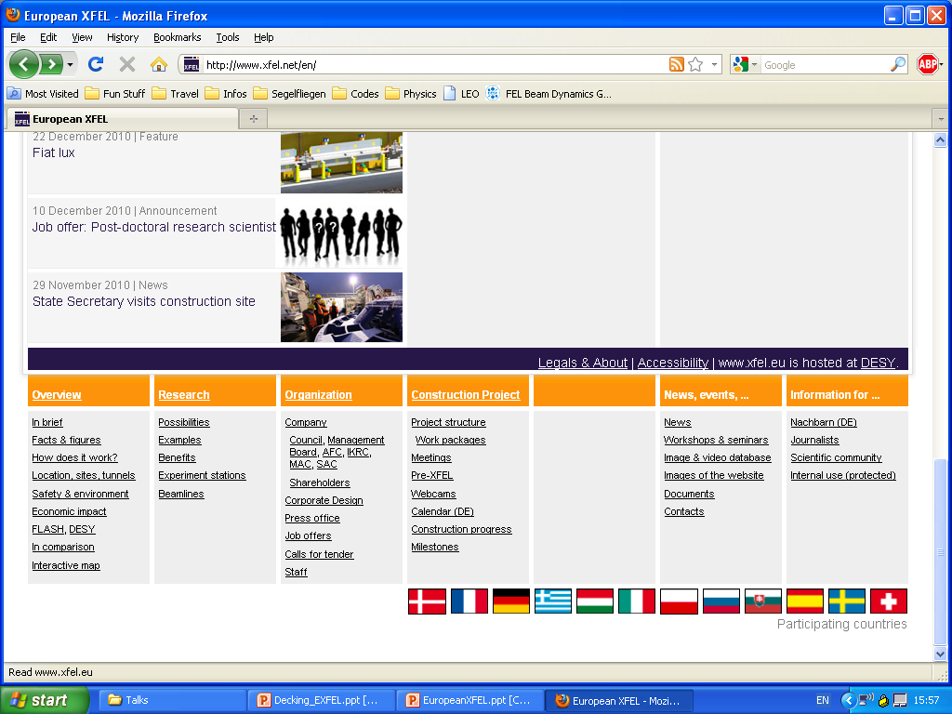



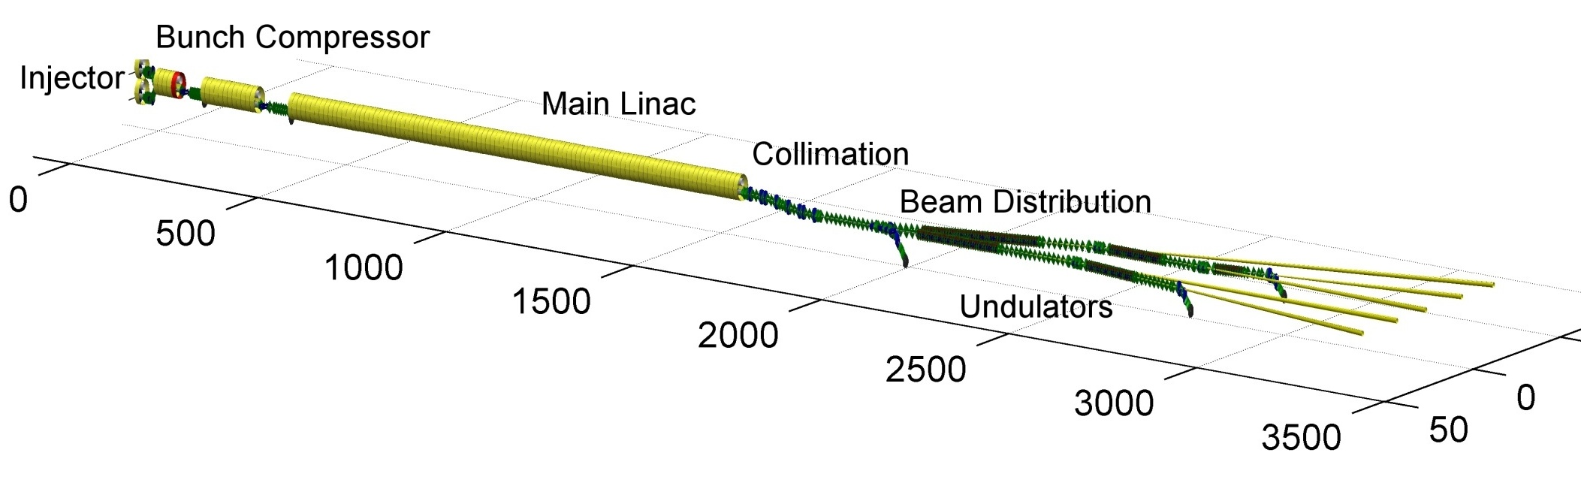










Accelerator Consortium
Notes:
How to edit the title slide
Upper area: Title of your talk, max. 2 rows of the defined size (55 pt)
Lower area (subtitle): Conference/meeting/workshop, location, date,
your name and affiliation,
max. 4 rows of the defined size (32 pt)
Change the partner logos or add others in the last row.

Slide 3
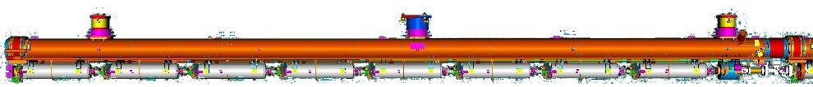
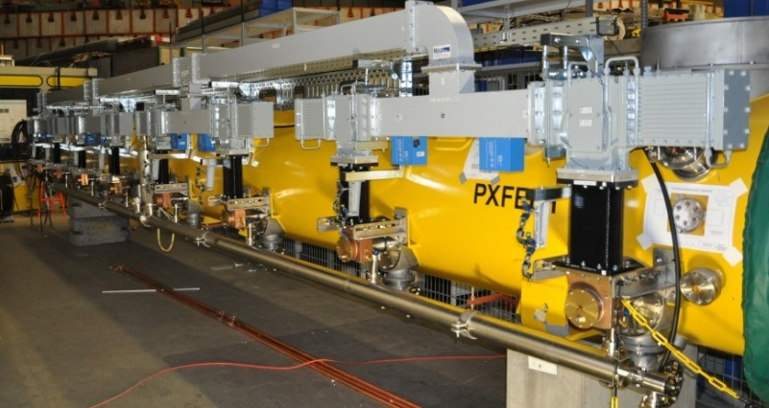
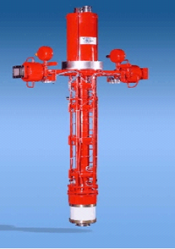





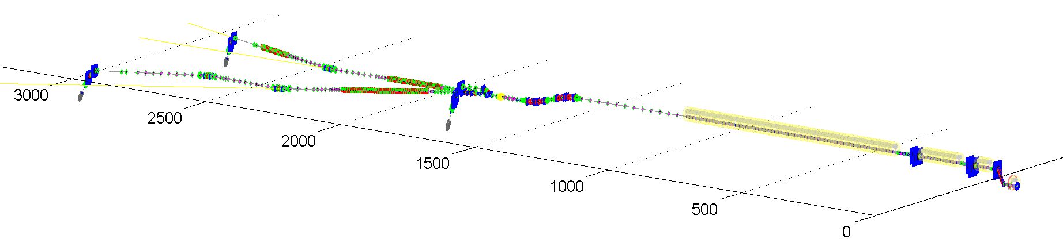
Accelerator Complex:
17.5 GeV Start -up Version
100 accelerator modules
800 accelerating cavities
1.3 GHz / 23.6 MV/m
25 RF stations 5.2 MW each

Slide 4
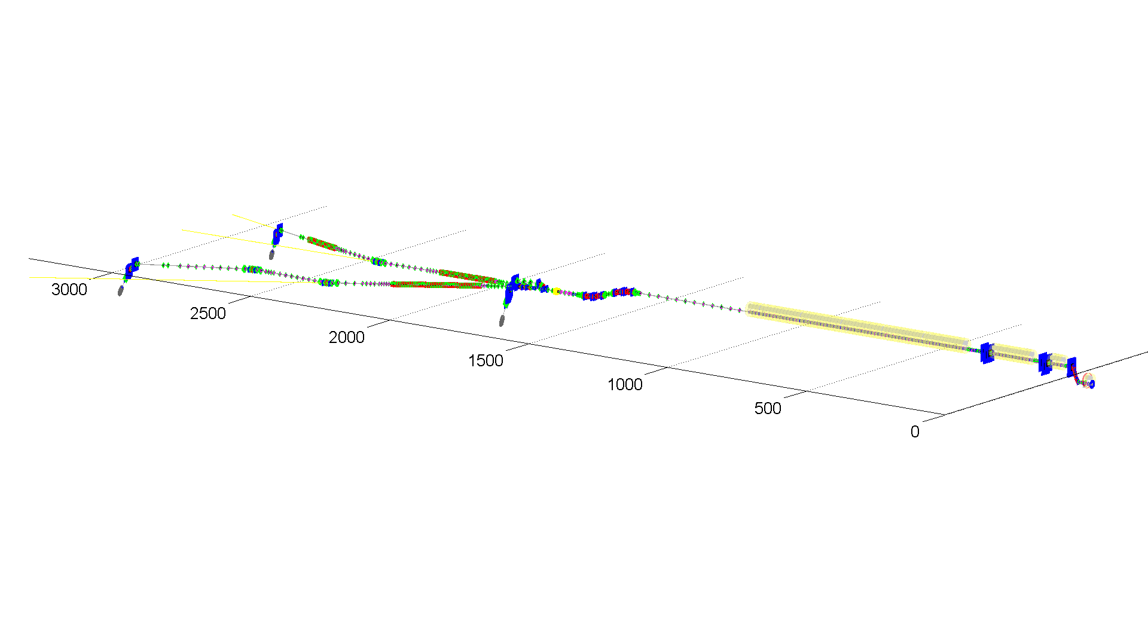
XFEL – Parameter Set
 | Baseline | New Parameter Set
Electron Energy | 17.5 GeV | 10.5/14/17.5 GeV
Bunch charge | 1 nC | 0.02 - 1 nC
Peak current | 5 kA | 5 kA
Slice emittance | < 1.4 mm mrad | 0.4 - 1.0 mm mrad
Slice energy spread | 1.5 MeV | 4 - 2 MeV
Shortest SASE wavelength | 0.1 nm | 0.05 nm
Pulse repetition rate | 10 Hz | 10 Hz
Bunches per pulse | 3000 | 2700

Slide 5
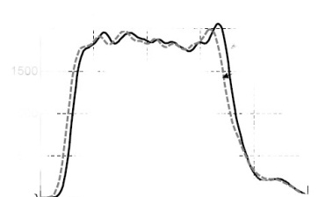
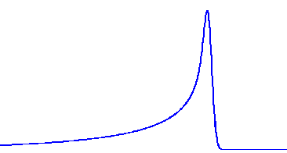
E-XFEL/FLASH Time Structure: High Duty Cycle
Repetition rate
Macro-pulse
Bunch
Slice
I
Duty cycle ~ XFEL 0.65%
1-5 mA
100ms
t
I
XFEL 600μs
Macro-pulse duration
t
I
XFEL 222ns
bunch spacing
t
I
2.5kA
1 nC
100-500 fs
Up to 27000 Bunches/s
FLASH and E-XFEL will have the same time structure

Slide 6
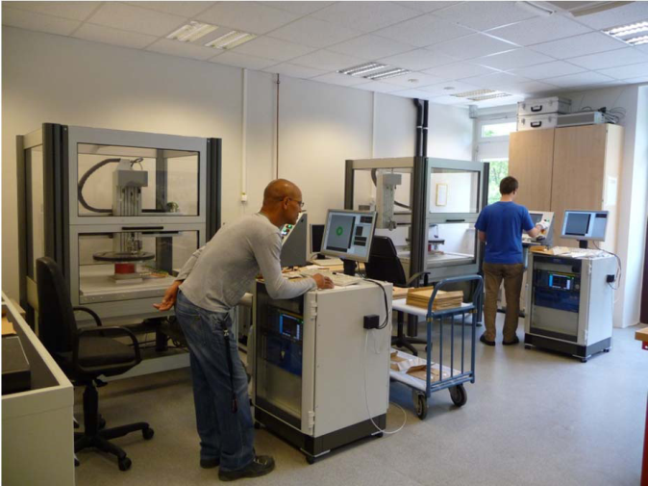
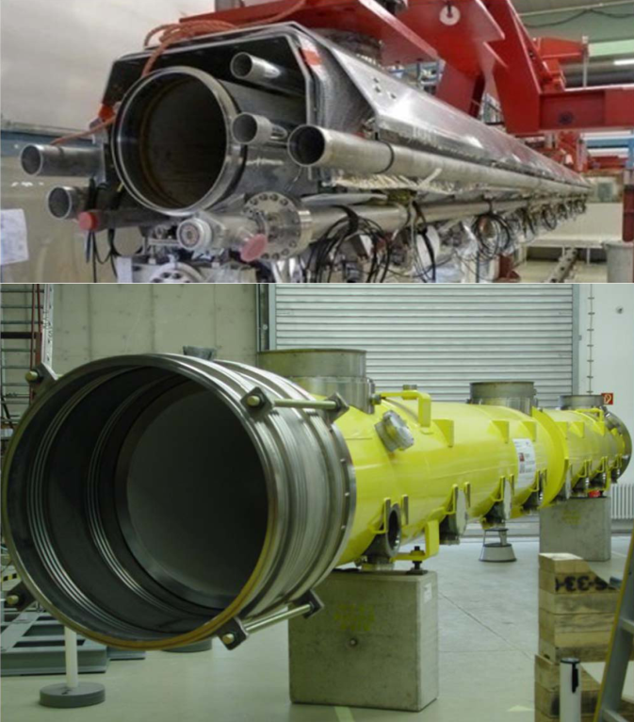
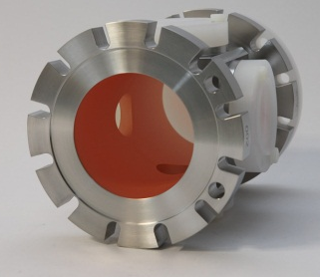
Status Accelerator Modules
material for production of 640 cavities almost completely delivered and quality checked
remaining material ordered
weekly meetings with involved companies
83 cryostats and cold masses ordered
call for tender for remaining 20 by Q1/2012
contracts for cold magnets, current leads, HOM absorbers, frequency tuners, couplers, BPMs awarded with delivery of pre-series and series components matched to module production schedule

Slide 7
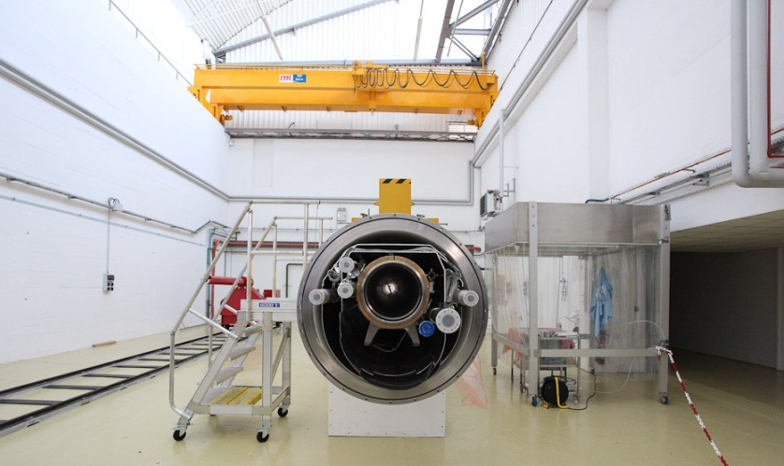
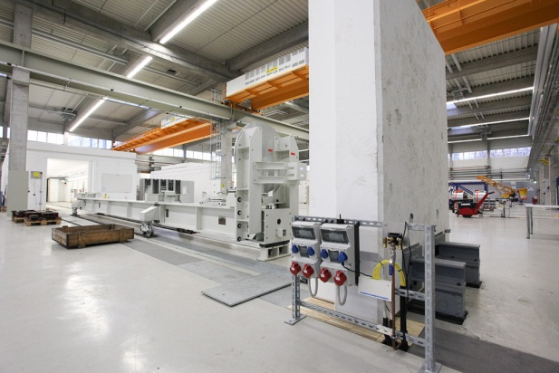
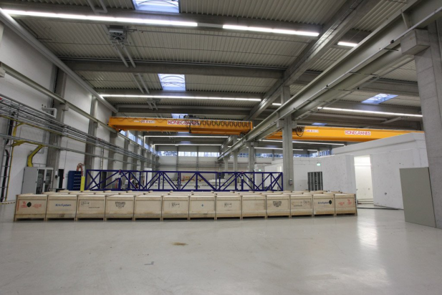
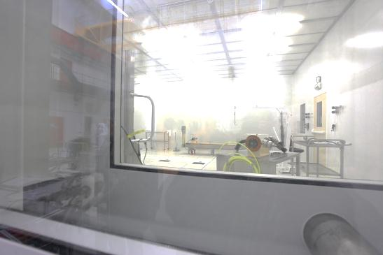
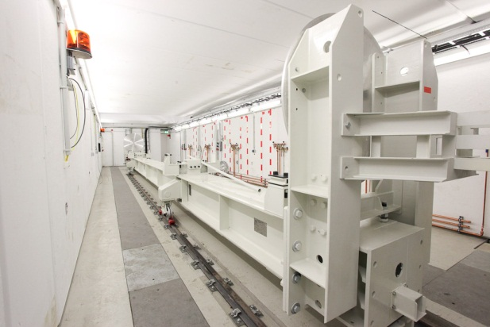
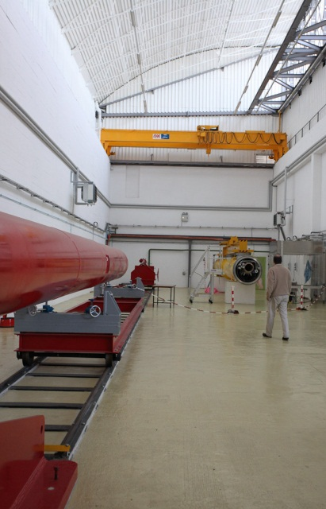
Accelerator Modules
Almost all infrastructure for the series production in place
‘XFEL village’ at Saclay:
string & module assembly
training with prototype modules ongoing
first pre-series assembly planned Q1/2012
Accelerator module test facility at DESY:
cavity, magnet & module tests,
klystron and waveguide tests
cryogenics installation ongoing
training with prototypes
first cavities tests planned Q2/2012
first module tests planned Q3/2012

Slide 8
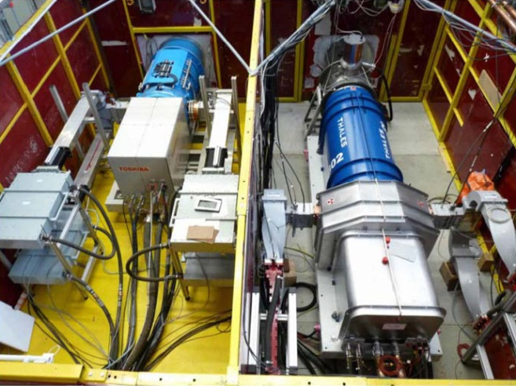
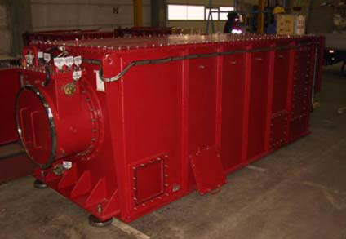
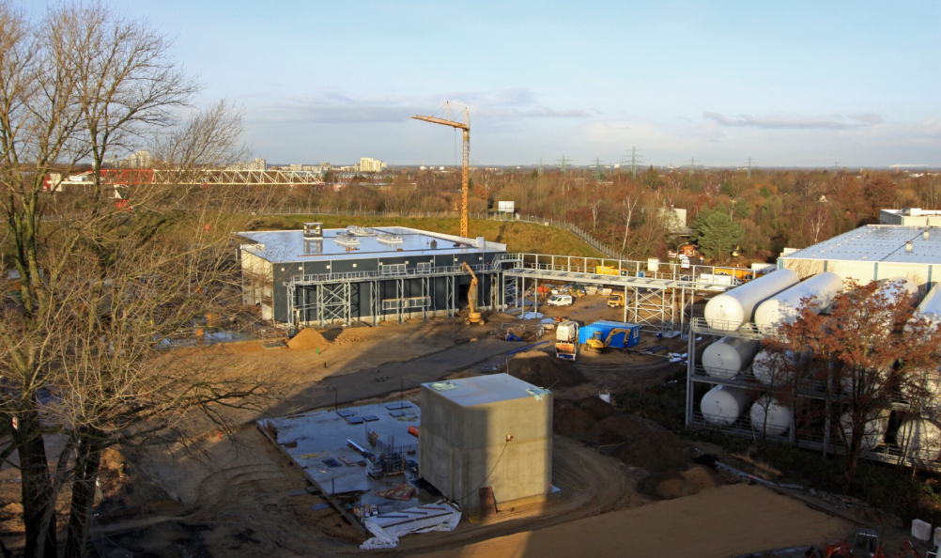
Cold Linac Infrastructure
Contracts for klystrons, modulators, pulse cables awarded
Pulse transformers to be awarded Q1/2012
Modulator hall constructed

Slide 9
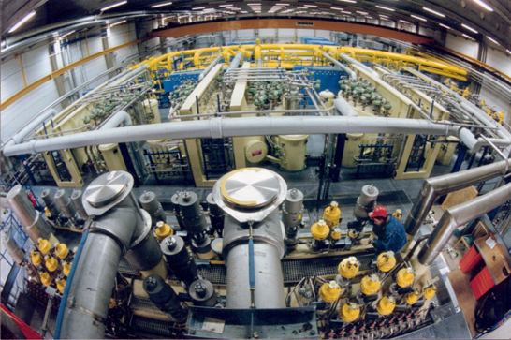
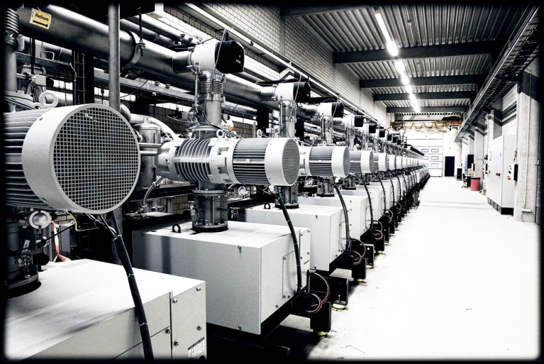
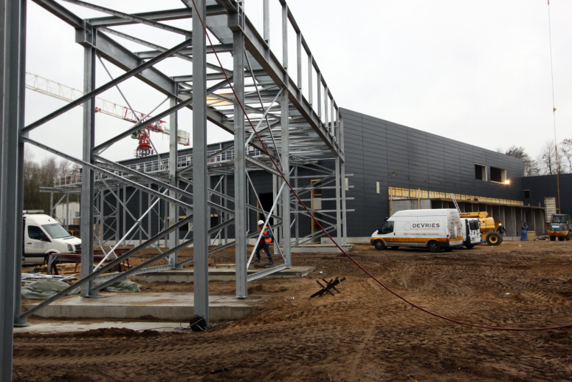
Cold Linac Infrastructure
Refurbishment of HERA cryo plant started
Challenging schedule because of early operation start in 2014 to operate the XFEL injector
Planning, production and installation of cryogenic equipment for accelerator and AMTF continued

Slide 10
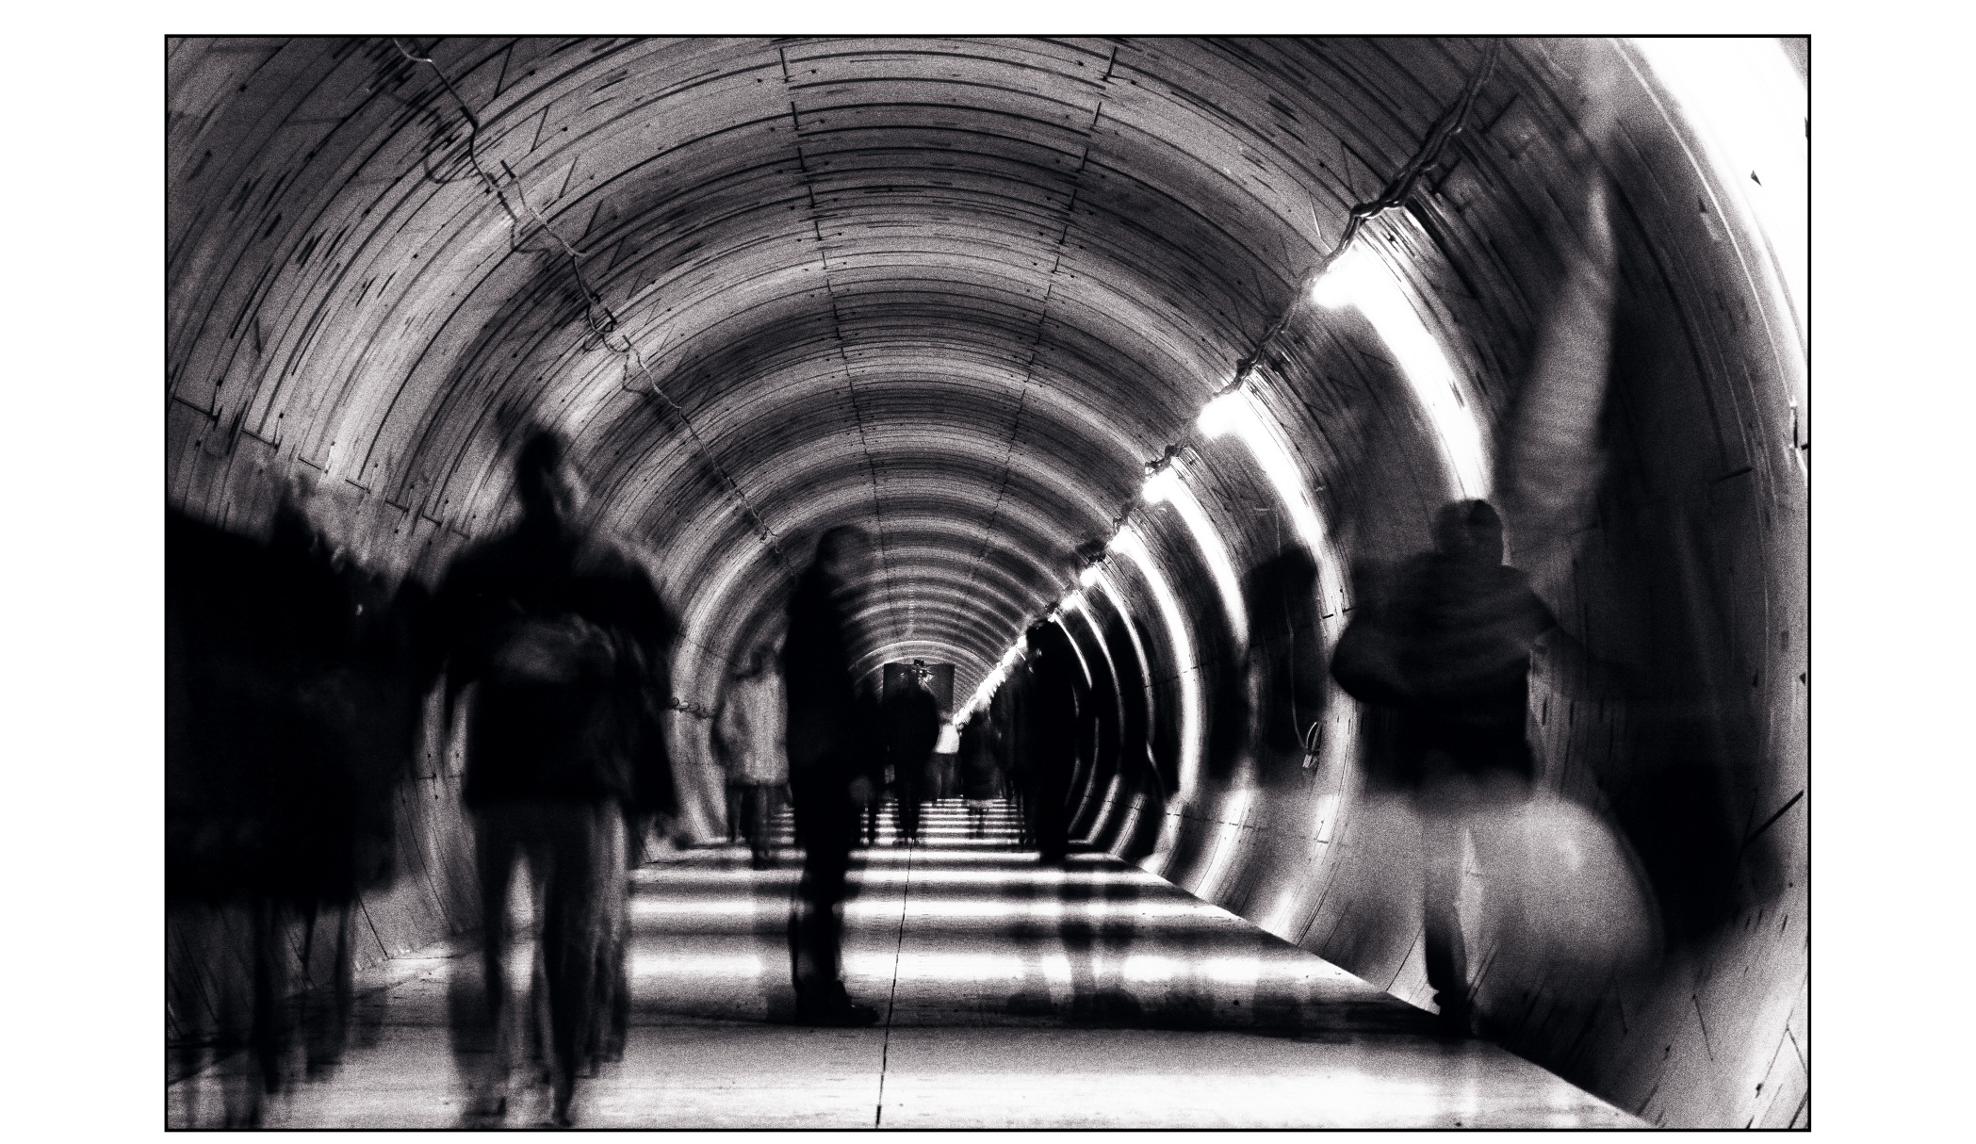
Tunnel
Tunneling is almost finished, about 6 km of tunnel have been build

Slide 11
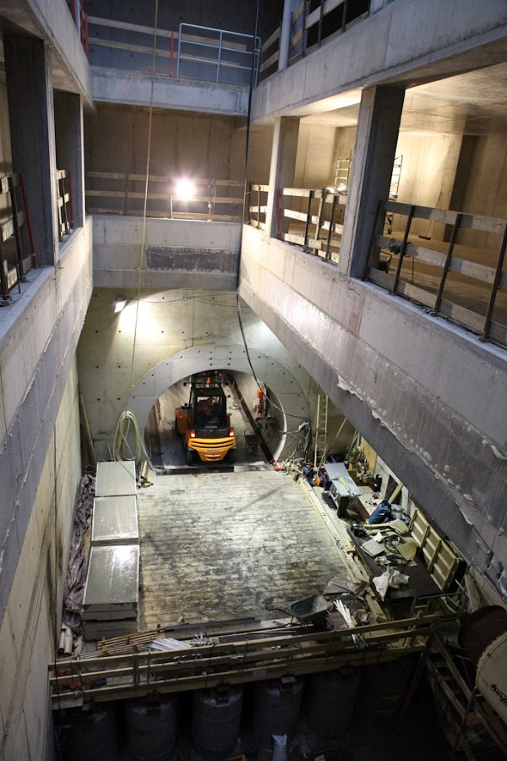
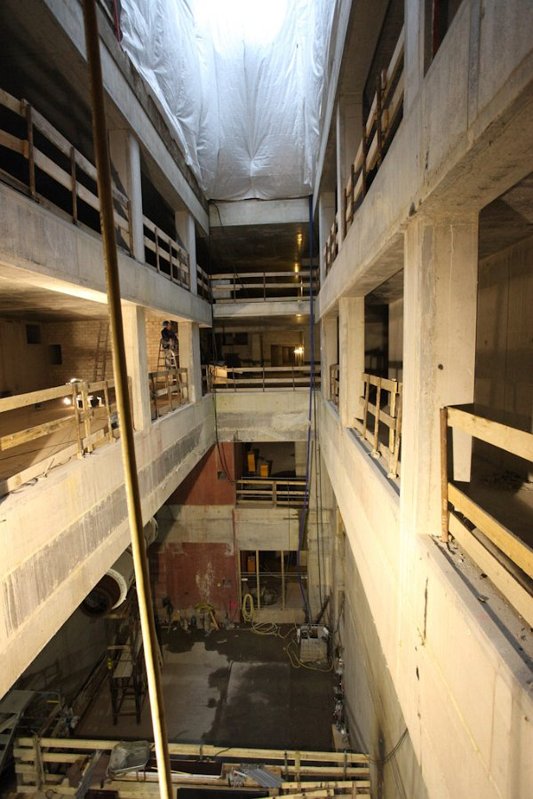
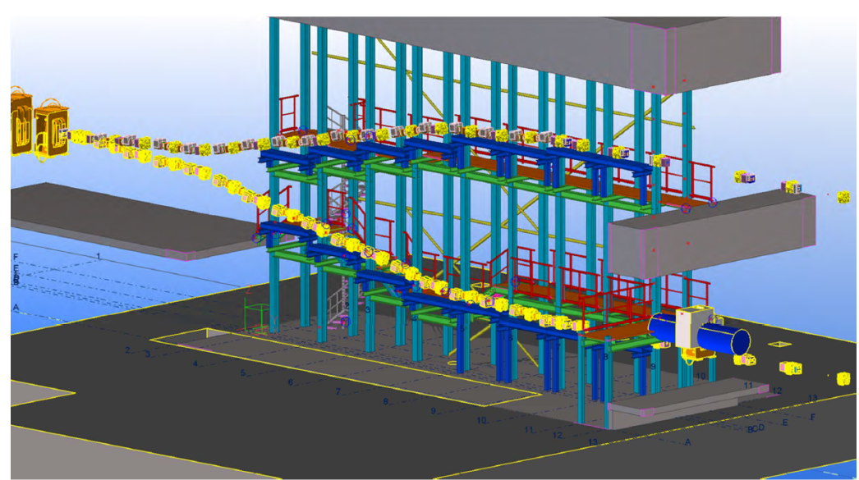
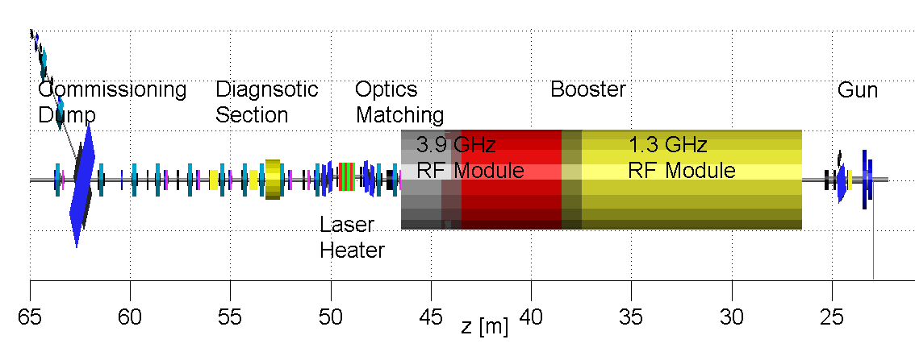
Injector
Injector access shaft (XSI)
junction of 1st and 2nd injector
(only one built for start-up)

Slide 12
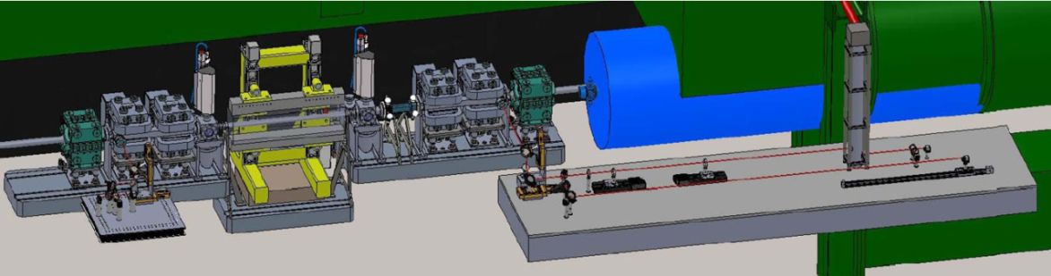
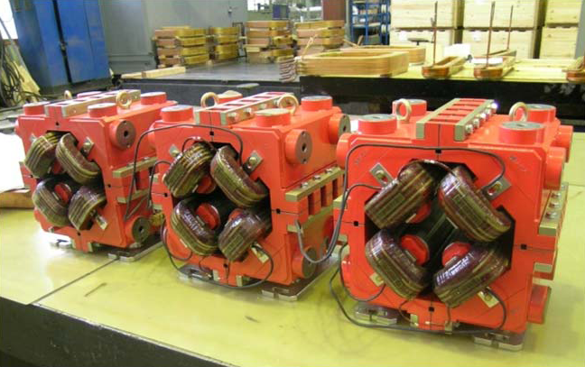
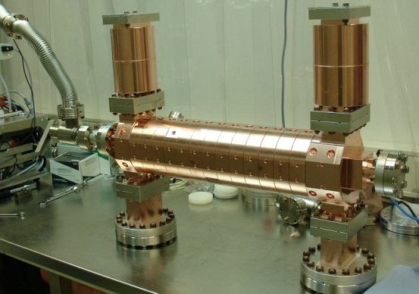
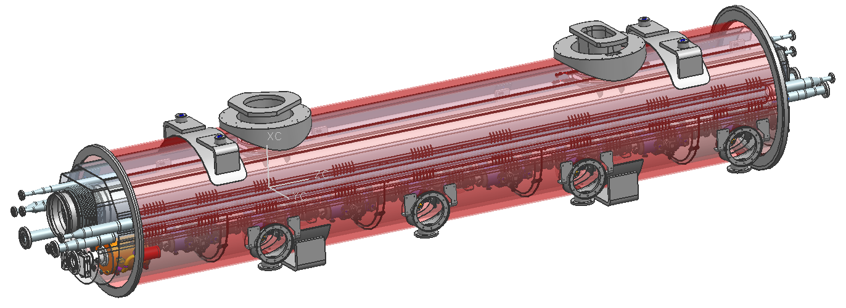
Injector
Laser heater mechanical design matured, first components tendered
Low remanence focusing quadrupoles produced
Prototype of transverse deflecting structure produced, to be installed at PITZ
3.9 GHz accelerator module (for bunch length control), design finished, prototype cavities in test
Start Commissioning End 2014

Slide 13
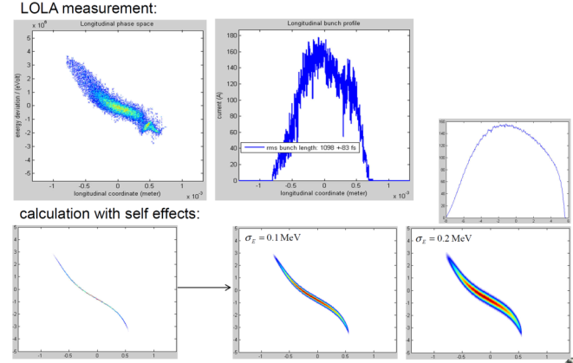
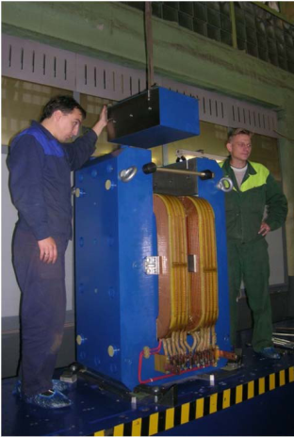
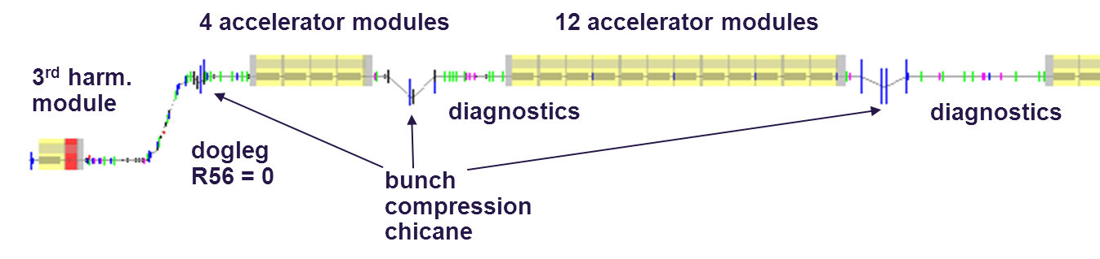
Bunch Compression
3 stage bunch compression for wide range of compression scenarios and minimized sensitivities to RF-regulation imperfections and electron beam driven instabilities
R56=60-120mm
R56=
60-120mm
R56=30-100mm
σ_{σ} = 2 mm
I_{peak}= 50 A
σ_{Ε} = 0 %
E = 130 MeV
σ_{σ} = 1 mm
I_{peak}= 100 A
σ_{Ε} = 1.5 %
E = 130 MeV
σ_{σ} = 0.1 mm
I_{peak}= 1 kA
σ_{Ε} = 1 %
E = 500 MeV
σ_{σ} = 0.02 mm
I_{peak}= 5 kA
σ_{Ε} = 0.3 %
E = 2000 MeV

Slide 14
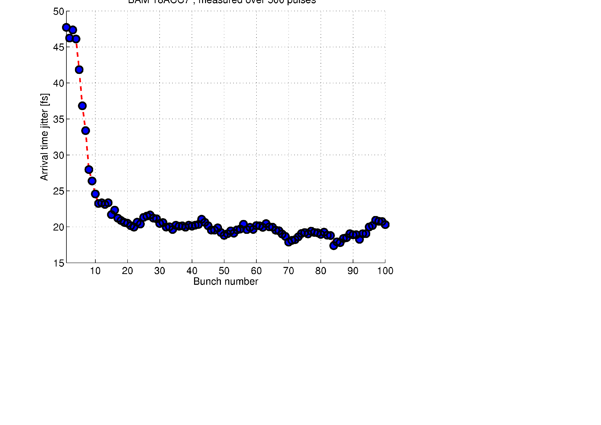
Bunch Compression
Beam Based Feedbacks for control of longitudinal parameters
Measurements of beam arrival time (BAM) and bunch compression (BCM) feedback on RF parameters
Concept implemented and tested at FLASH
Laser
R56=180mm
R56=43mm
~
BC3
~
R56=0.8mm
Gun
ACC1
3rd
BC2
ACC2
ACC3
ACC4
ACC7
FLASH 1
A φ
A φ
BAM
BCM
BAM
BCM
LLRF
LLRF
LLRF
BAM
FLASH 3
FLASH 2
LLF + BLC + MIMO + BBF at ACC1/ACC23
(act still on setpoint)
< 75fs pkpk
with adaptive SP correction
< 20fs rms arrival jitter
without adaptive SP correction
Notes:
Before you start editing the slides of your talk change to the Master Slide view:
Menu button “View”, Master, Slide Master:
Edit the following 2 items in the 1st slide:
1) 1st row in the violet header:
Delete the existent text and write the title of your talk into this text field
2) The 2 rows in the footer area: Delete the text and write the information
regarding your talk (same as on the Title Slide) into this text field.
If you want to use more partner logos position them left
beside the DESY logo in the footer area
Close Master View

Slide 15
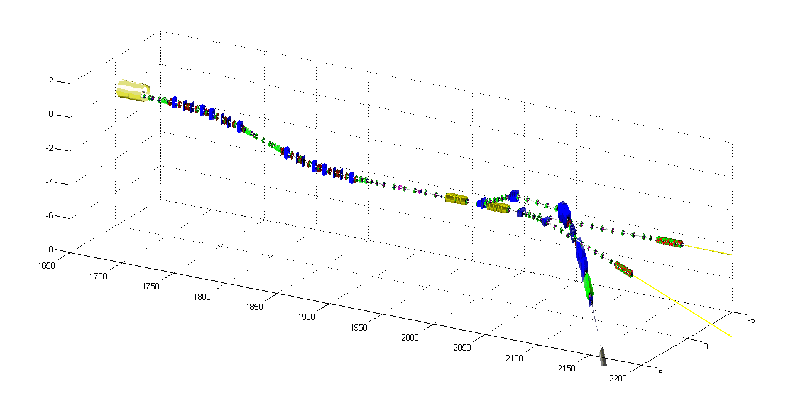
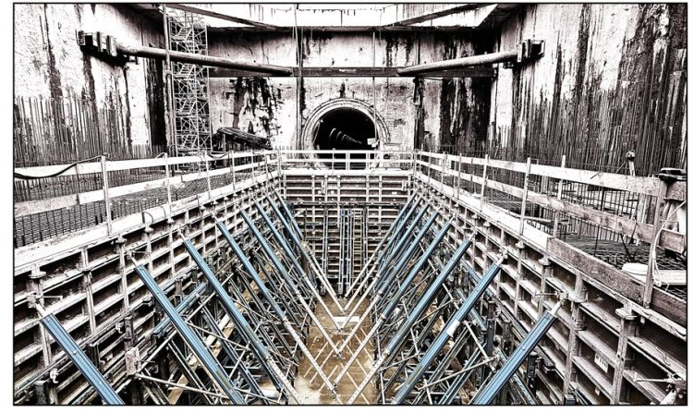
Collimation & Beam Distribution
Collimation
Feedback
Collimation system for beam halo cleaning and emergency beam stop
Transverse Intra-Bunch Feedback
Flexible beam distribution system for quasi-simultaneous operation of two primary electron beam lines
Distribution
Undulators
Dump

Slide 16
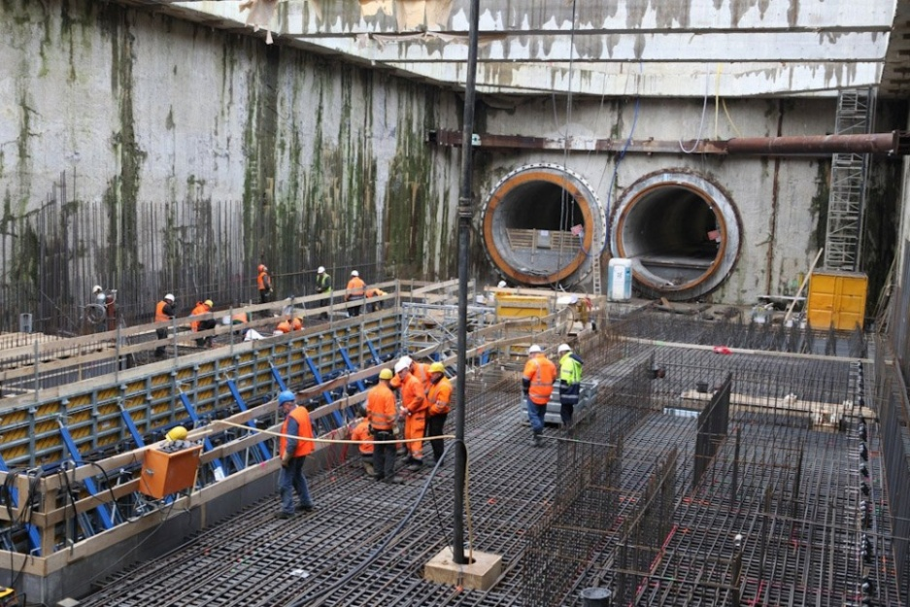
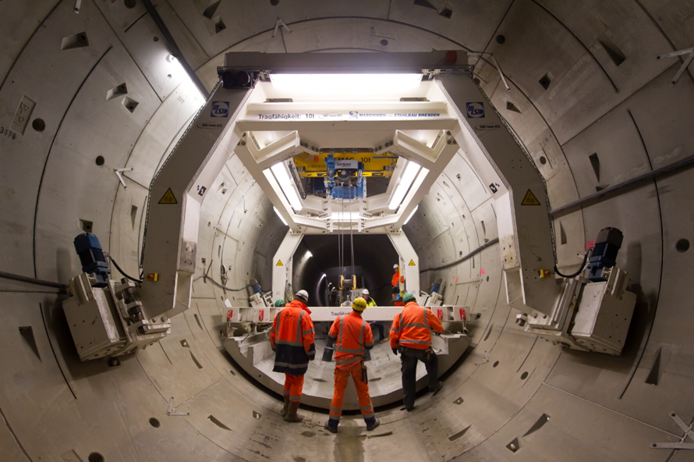
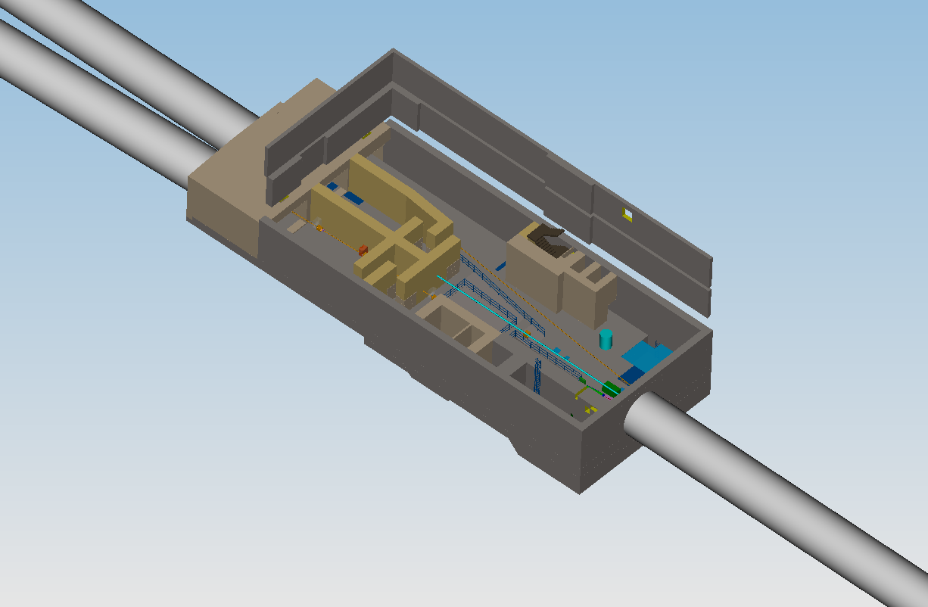
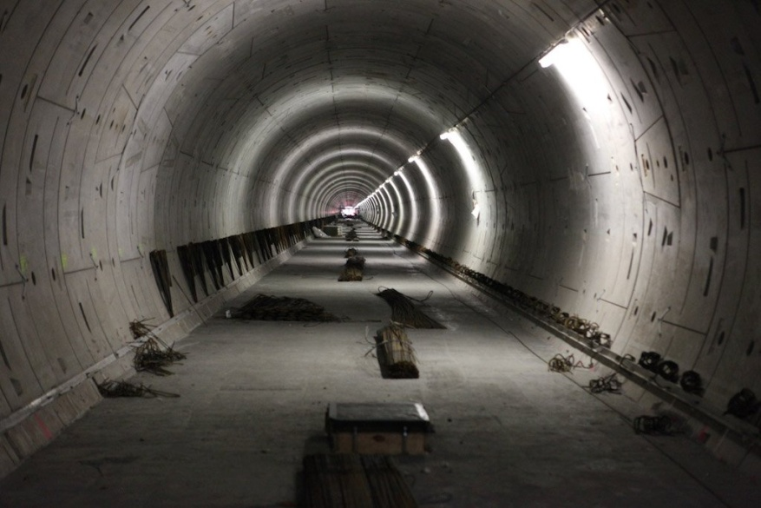
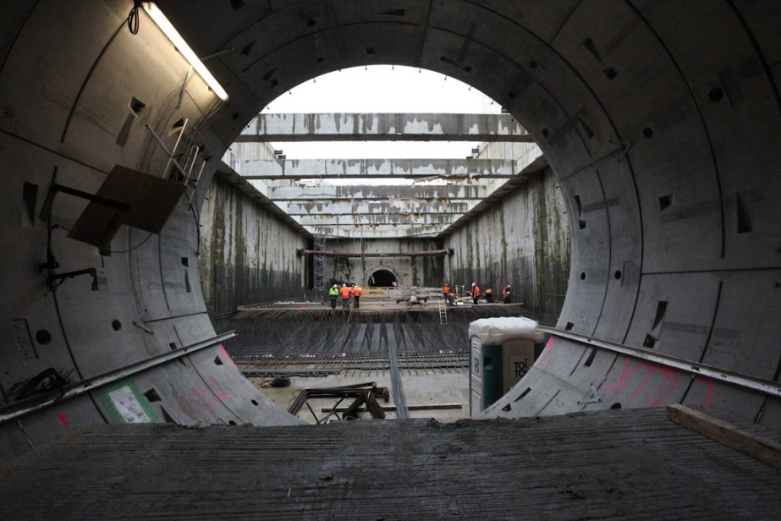
Beam Distribution Shaft – XS1

Slide 17
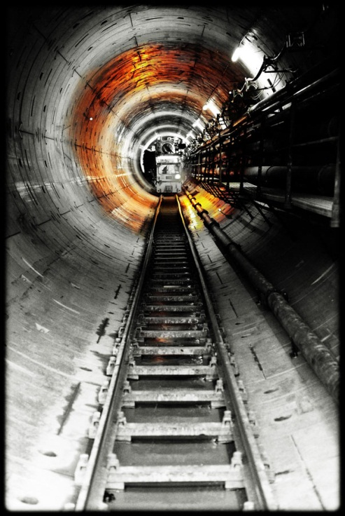
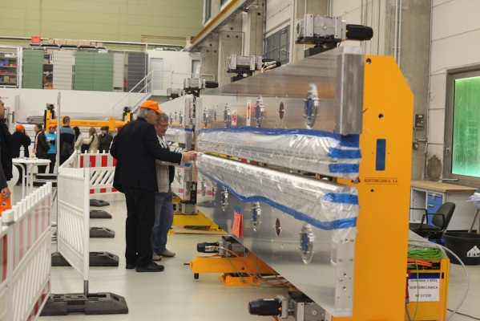
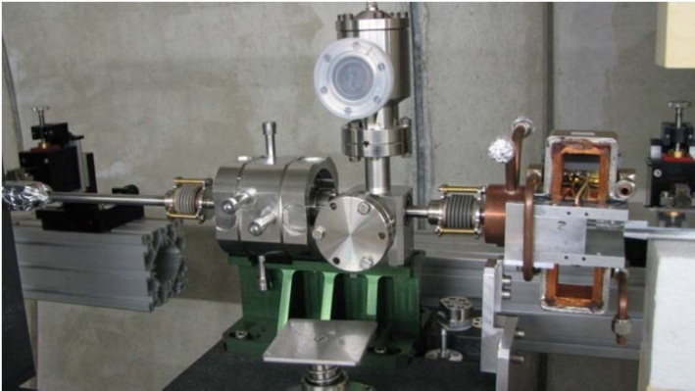
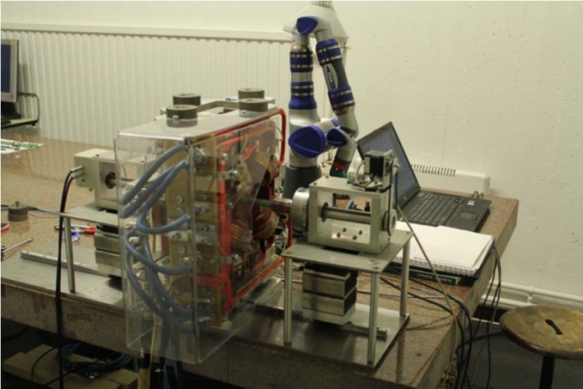
European XFEL – Undulators
Tendering process for > 450 m undulator started
Focusing quadrupoles manufactured and shipped for precision fiducialization
Prototype of undulator intersection set-up in mock-up tunnel

Slide 18
Schedule
Tremendous progress of construction, infrastructure planning and ramp up of accelerator component fabrication
Working hard to finish installation in time for
  start of injector commissioning mid 2014
  start of linac commissioning mid 2015
  observe first SASE by end of 2015

Slide 19
Touch Points ESS - XFEL
What are fields, where development can be reused by,
or easily adapted to ESS?
Crate System: MTCA.4
LLRF: System Design suited, Frequency needs Adaption
Timing System: Similar Time Structure/Requirements
Machine Protection System: Very Similar Requirements
Diagnostics: Some Common Requirements
  (Cold) BPMs
  Beam Loss Monitors
  Beam Size Measurements
    Screens
    Wire Scanners
  Dosimetry System

Slide 20

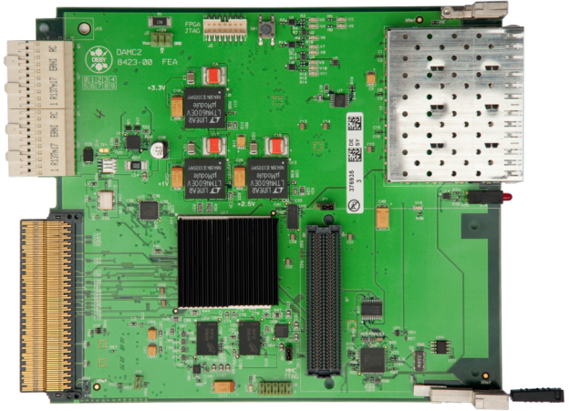
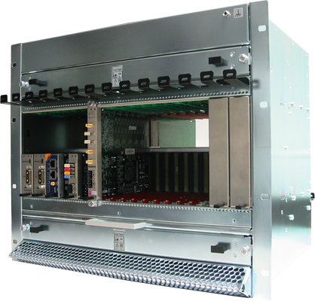

XFEL goes µTCA (MTCA.4)
XFEL will be based on the new MicroTCA.4 standard
  Double size AMC modules with PCIe link to CPU
  Rear Transition Modules for signal conditioning
All Diagnostic Systems (except BPM) go for µTCA
  Best integration to
    XFEL timing system
    Machine Protection System
    Use common firmware framework and
      server infrastructure
  Use Standard Boards
    DESY DAMC02
    Struck 8300: 10x16 Bit, 125 MHz ADC
    Industrial Boards are coming up
  Custom made rear transition modules (RTM)

Slide 21
µTCA: Clocks, Triggers and Interlocks
2 radial clocks per AMC,
Low jitter, configurable direction
8 bussed M-LVDS lines,
For triggers, clocks and interlocks
Backplane
MCH
AMC
Timing
AMC
ADC
AMC
ADC
Cross-
Point-Switch
Enc.Clock
Enc.Clock
Cross-
Point-Switch
Trigger
Trigger
Interlock
Interlock
Ethernet
and PCIe
To Timing Distribution
MTCA.4

Slide 22



MicroTCA Remote Management
Online status of modules:
Inserted, fault
Temperatures, voltages
Reset, power on/off
Act. Power consumption

Slide 23


Compact and unified accelerator controls @ MTCA.4
High reliability /hot-swap /remote diagnostics /shelf management
High data rate / flexible in configuration
Display of a MicroTCA crate with actual status
Shows e.g. LEDs and temperatures
One AMC with details
Open with click on module
Defines the remote management on all system levels (AMCs, RTMs, fans, power supplies)
µTCA rear transition modules
  Rear management (30W max)
  Double size AMC with Zone 3 plug to RTM
Clock and trigger distribution on the backplane
  Allow data acquisition with ps stability
  Trigger multiple AMCs from a bus
  Distribute interlocks on the backplane
Provides low latency links between FPGAs (point-2-point)
Common data distribution to FPGA on a bus
µTCA backplane (MTCA.4):
  µTCA standard Ethernet
  µTCA standard SATA
  µTCA standard PCIe, 4 lanes
  4 bi-directional point-2-point
  8 term. M-LVDS bus lines
  2 radial clocks
  1 PCIe clock

Slide 24




LLRF and MTCA.4
ΔA/A=3e-5
FLASH and XFEL Low Level RF system
  32 cavities @ 10MW RF klystron station
  >100 RF signals real time processed per RF station
  Controller: adaptive feed-forward / MIMO feedback
  Beam loading 5mA with flexible bunch pattern
  Automatic cavity frequency tuning + Piezo compensation LFD
  Q_{L} tuning, flat gradient operation, quench detection
  Klystron life time management system
  Compact (need to reduce space x 6)
  Stability requirements: dA/A < 0.01%, dϕ < 0.01 deg
Δϕ=4mdeg

Slide 25



Compact and unified accelerator controls @ MTCA.4
LLRF layout cost optimized for large number of RF channel
Rear transition module
Advanced Mezzanine Card
Down-converter:
f= 100MHz-4GHz
Klystron driver:
f = 100MHz-4GHz
10xDown-converter
10x16bit/125MSPS ADCs
RF in
ZONE 3
for XFEL x 6 DAQ units
are used
Cost optimized version
1 or 2 cavity control:
Combine DWC & Klystron driver
Combine ADC & Controller
⇒ 2 boards instead of 4
cost reduction for LLRF
controls
Approx. hardware costs:
~ 25 kEuro per RF station
(includes: 6xRF, 1VM, 2xPZT driver, LO,
12 slot crate, MCH, PS, CPU, Timing,
MPS, Stepper motor, RF backplane,
+ 6 free slots for BPM/HOM/KLM/others)
AMC Backplane
Klystron Driver
Controller
ZONE 3
RF out
Up-Conversion Section
AMC Backplane

Slide 26




XFEL Timing System
New timing system
  Fiber optic links 1.3GHz
  with drift compensation
  AMC prototype is receiver
  and transmitter
  ps stability (< 5ps RMS)
  Clock, trigger and
  event distribution
1.3GHz
Clock
Data

Slide 27

XFEL Timing System
Distributed system connected by compensated LWL links
1.3 GHz Line Speed with 130 Mb/s data rate
Deliver Triggers and Clocks
Provide deterministic data transfer of Pulse related data
Stongly tied to the MPS system

Slide 28

Maschine Protection System
Distributed, fast and configurable OR Gate
Collects fast and slow interlock signals for complete Machine Status
  Fast within RF Pulse: BLM, Transmission Interlock; Couplers; LLRF (Quench Protection) …
  Slow from Pulse to Pulse: Magnets, RF; Valves; Screens, …
Beam Operation only if matched to Machine Status
Cut RF Pulse in case of fast Interlocks
MPS Boards based on µTCA (DAMC02)
LWL based independent communication between the modules
Beam termination by switching off Drive Laser, RF systems, and Kickers
Suited to operate with Beam Switches

Slide 29


Machine Protection System
Operator dials in requested bunch pattern
MPS „ANDs“ Bunch Pattern with Machine Status
  Depending on Screens, Scanners, Magnets, …
Allowed Pattern info distributed via Timing System
  Pattern checked by Laser and Charge diagnostics, inconsistent with prediction -> abort
  Transmission, BLM, Coupler or any fast alarm -> abort
Alarm Masking on XFEL bunch level
Two Abort Locations/Mechanisms
  Stop Injector: Stop Beam Production
  Distribution Kicker System to Dump
Reaction Time about 15 µs (worst case, dominated by signal travel.)

Slide 30

Charge Monitor System
XFEL Operation Range 0.02 – 1 nC
  Charge monitors provide noise level of less than 1 pC, and
  will run up to 2 nC
~ 40 Conventional transformers (Toroids)
Location: Between „functional sections“ of the machine
Toroids are connected by a fast network to interlock on transmission failures (TPS)
Detect
  “Poor transmission”
  Bunch pattern failure
  Bunch distribution failure

Slide 31






Cold BPM, Buttons
String of PXFEL3
Button
2 Types of Cold BPM (Button, Re-entrant Cavity)
Modest Resolution: 50 µm
Operation at few k Level (connected to cold quad)
Close to the Cavities -> Clean room Class 10!
Installed in XFEL Prototype Accelerator Modules
Series Production of Bodies ongoing
First Feed-throughs (about 100) delivered

Slide 32






BPM Mechanics
Potential for In-house BPM Design and Construction
  BPM bodies (Buttons, Cavities, Striplines)
  Feedthroughs
    RF designs: In-House
    Fabrication in Industry (some also In-House)

Slide 33

BPM Electronics
DESY has a long tradition in BPM Electronics Design
With exception of PETRA III (ITECH) and XFEL (In-kind Contribution PSI) all machines use in house BPM electronics
Recent Development:
Low Charge Button BPM electronics for FLASH II
RTM to be used with SIS800 16 bit, 125 MHz ADC
Single Bunch Electronics using the delay line principle
Uses processing power of VIRTEX5 on the SIS800
Prototyping will be finished in Summer
Commissioning of FLASH II planned for Spring 2013

Slide 34




Beam Size Measurements
Hotspots for Screens/WS
4 stations with known phase advance
for optics characterization
Vert. Wire scanner
Hor. Wire scanner
Two systems:
  ~ 50 Screens
  12 (fast) Wire scanners
  Some installed at the “same” place
FLASH result -> OTR not usable for compressed Beams, => extensive R&D Program for luminescent Screens
Wire scanners
  Triggered, Fast scans within a bunch train (1 m/s)
  Also Slow Scans
  Will be compatible to ISO5 (CRC 100)
Both DESY In-House developments, parts purchased from industry
Beam
Light
Screen Mover

Slide 35




Screen Systems: Screen Mover for low particle installations
Design for ISO5 (CRC100)
Separated vakuum/motor part
Easy to adapt to different stroke
Connection to MPS

Slide 36


Beam Loss Monitor System for XFEL
micro-TCA crate
Beam Loss Monitor
Readout
Electronics
Scintillator
PMT
Alarm (to Machine Protection System)
DAMC02 with custom RTM
8 Channel/board; double width
Comparator, ADC, Alarm Generator
Test Pulse Driver
HV driver for Cockcroft Walton
Fast Interface to MPS
HV
Power supply
e,γ,n⁰
~350 Beam Loss Monitors (More than half – in undulator area)
BLM will use mostly Scintillators some Cherenkov radiators
Use electromagnetic showers
Prototypes of BLMs build and tested in FLASH
Production of housings and scintillators subcontracted to IHEP
Electronics production In House (via DESY ZE)

Slide 37



Dosimetry – system components & setup
DESY AMC2 (µTCA)
Dosimetry mezzanine card (FMC) on AMC motherboard for the Machine-Protection-System (MPS) carries dosimetry for measurements inside shielded electronic racks
Host platform
integration
Frontpanel interface allows connection of external dosimetry sensors
FMC
mezzanine
card slot
(12-slot µTCA
production-crate)
Sensor chip (γ)
Frontpanel interface of AMC board conducts undulator dosimetry signals
Notes:
Before you start editing the slides of your talk change to the Master Slide view:
Menu button “View”, Master, Slide Master:
Edit the following 2 items in the 1st slide:
1) 1st row in the violet header:
Delete the existent text and write the title of your talk into this text field
2) The 2 rows in the footer area: Delete the text and write the information
regarding your talk (same as on the Title Slide) into this text field.
If you want to use more partner logos position them left
beside the DESY logo in the footer area
Close Master View

Slide 38
Thank you
For your attention
And thanks also to all the colleagues, who supplied me with material

