Slide 1
SNS Beam Diagnostics
A. Aleksandrov
Spallation Neutron Source, Oak Ridge, USA

Slide 2
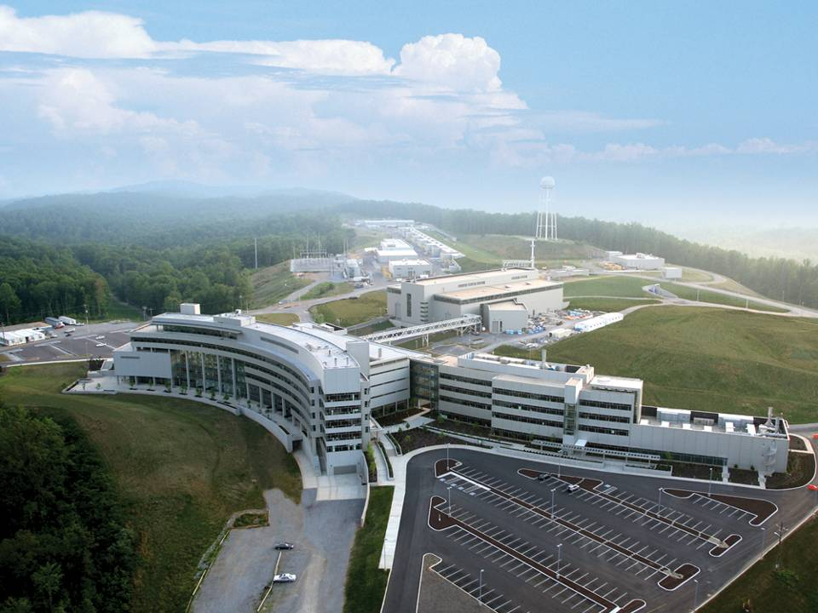
The Spallation Neutron Source:
is an accelerator-driven user facility for neutron scattering research
at Oak Ridge National Laboratory in USA

Slide 3
Design Beam Parameters
P beam on target : 1.4 MW
I beam average: 1.4 mA
Maximum Beam energy: 1 GeV
Duty factor: 6%
I beam peak: 40 mA
Rep. rate: 60Hz
Pulse width: 1ms

Slide 4
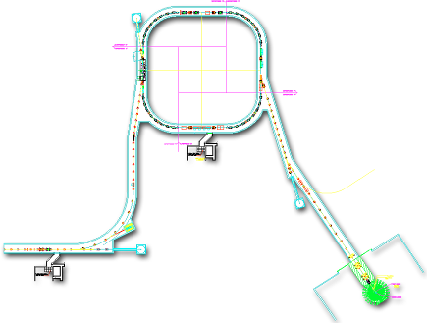

SNS Accelerator Complex
1 GeV LINAC
Collimators
Front-End:
Produce a 1-msec long, chopped, H- beam
Injection
Extraction
RF
1000 MeV
RTBT
2.5 MeV
HEBT
Front-End
LINAC
Liquid Hg Target
Chopper system makes gaps
945 ns
mini-pulse
Current
1 ms macropulse
1 ms macropulse

Slide 5
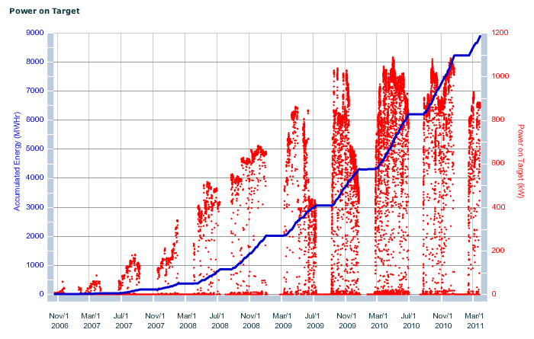
Beam Power History
1000
Beam Power (kW)

Slide 6
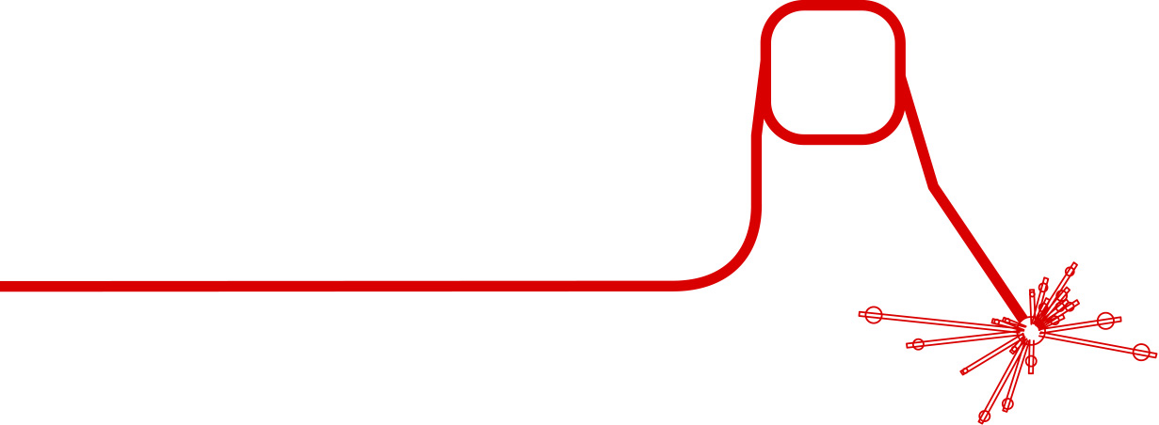
SNS Beam Instrumentation Systems
are Numerous, Diverse and Growing in Number
BCM, BLM, BPM, BSM, WS….
IDump
3 Position
1 Wire
6 Loss
2 Current
2 Video
RING
44 Position
54+ Loss
1 Current
12 Fast Loss
5 Electron Detectors
2 Electron Profile Scanner
2 Transverse BTF
15+ systems
MEBT
6 Position and Phase
2 Current
5 Wires
1 CHUMPS
1 Emittance
CCL
10 Position and Phase
9 Wires
48 Loss
1 Faraday Cup
4 Bunch Shape
10 Neutron Detectors
HEBT
29 Position and Phase
26+ Loss,
3 Fast Loss
10 Wires
4 Current
2 Bunch Shape
6 Scrapers Charge
1 Laser emittance
EDump
1 Current
4 Loss
1 Wire
MDump
4 Loss
2 Current
1 Wire
LDump
6 Loss
6 Position
2 Wire
RTBT
17 Position
26 Loss
5 Wires
4 Current
1 Harp
3 Fast Loss
1 Target Imaging
DTL
10 Position and Phase
5 Wire
4 Loss
5 Faraday Cup
6 Current
18 Neutron Detectors
SCL
34 Position and Phase
33+ Loss
9 Laser Wire
24 Neutron Detectors

Slide 7
Outline
Status and development activities for selected systems:
  Neutron Production
    Beam Loss Monitors
  Machine Tuning
    Beam Position and Phase Monitors
  Machine Study and Loss Reduction
    Transverse Profiles and Halo
    Transverse Emittance
    Longitudinal Profiles

Slide 8
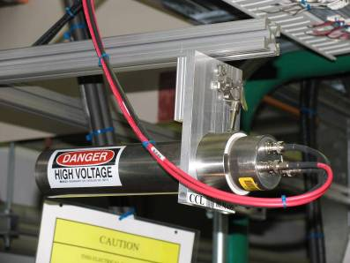
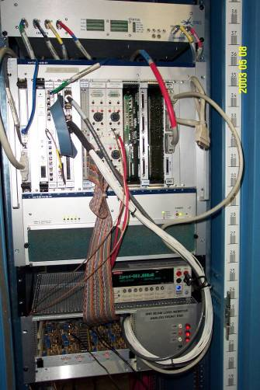
Beam Loss Monitors (BLMs)
Major tool for machine protection and tune up
Ionization Chamber Detectors (307)
Scintillation Detectors (55)
  Neutron detectors
  Fast loss detectors
Multi-channel analog front-end VME cards
Digital electronics in VME
VxWorks software
Very reliable
Hardware obsolescence is looming problem
Short term solution: stock up on spares
Long term solution: new system

Slide 9
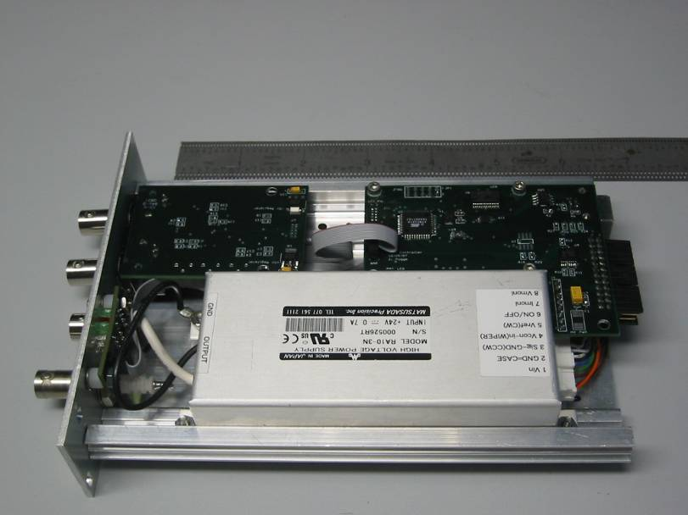
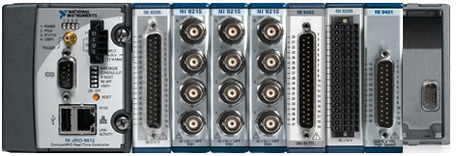
New BLM development
Courtesy of A. Zhukov
Guiding Principles:
  Compatible with existing EPICS and MPS infrastructure
  Less custom, more off-the-shelf components
  No major functionality changes
Analog Front End:
  Single channel Individual cards
  Provision for analog background subtraction
  Generic chassis
New analog front-end card
Digital Processing:
  Have not decided yet on what to use
  National Instruments Compact RIO chassis is under consideration
  Have new Compact RIO FPGA processor for HEBT scrapers installed
    requirements are similar to BLM
NI CRIO chassis

Slide 10
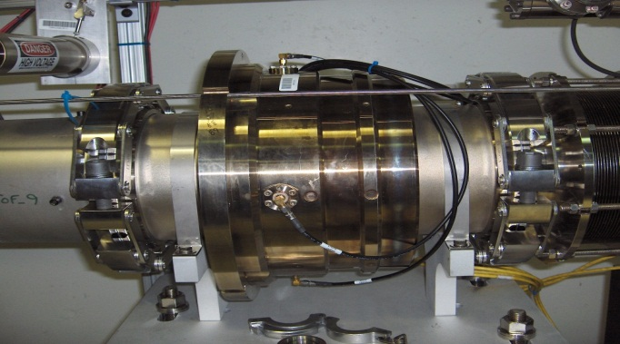
Beam Position and Phase Monitors (BPMs)
Main tool for machine tune-up and troubleshooting
  Phase measurements for linac tune-up
  Position measurements for trajectory correction
160 strip-line pick-ups
  96 “linac type” operate at 402.5MHz and 805MHz
  64 “ring type” operate at low frequency
Custom made PCI analog front-end and digital cards
LabView software under embedded Windows XP on individual PCs (one per pick-up), 1-6Hz trigger rate
Meets all accuracy specs but reliability is poor
BPM pick up
PCI board
Hardware obsolescence is major problem
  Parts, cards, PC motherboards, OS upgrades
Short term solution: stock up on spares
Long term solution: new system
BPM PC

Slide 11
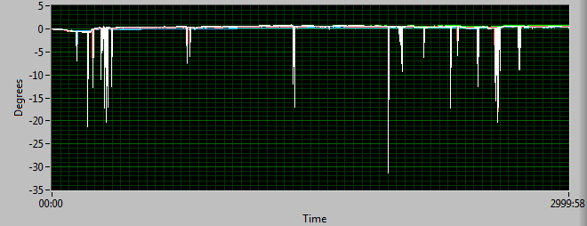
New BPM development
Guiding Principles:
  Compatible with existing EPICS and Reference RF infrastructure
  Less custom, more off-the-shelf components
  No major functionality changes but 60Hz capable
Analog Front End:
  As similar to SNS LLRF front-end card as possible
  Investigating need for continuous TDR self-calibration
  Generic chassis
  Plan to have 1 chassis for testing by end of FY12
History of BPM TDR self-calibration data
Digital Processing:
  Have not decided yet on what to use
  needs more processing power than BLM
  National Instruments Flex RIO in PXIe chassis is under consideration
  Plan to have 1 chassis for testing by end of FY12

Slide 12
Beam Study Diagnostics
Goal is to improve performance through machine knowledge
  Understand initial 6-D beam distribution
  Understand beam dynamics in real machine
  Tune / validate beam model
  Optimize beam transport
Demands to diagnostics
  Complex beam pulse structure requires fine time resolution
  Small beam loss requires large dynamic range
  Measure as many projections as possible: transverse profiles, longitudinal profiles, 2-D projections
    Direct measurement of 6-D distribution is not practical
  As many measurement locations as possible
We can not meet all demands in one diagnostic – use variety of complimentary measurements

Slide 13
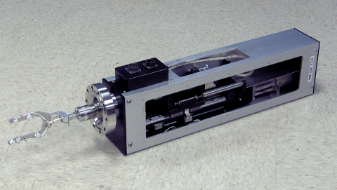
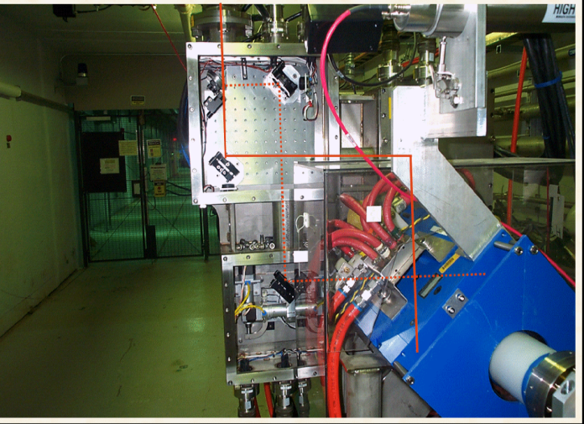
Transverse 1-D Profile Measurements
Wire scanners in warm linac and transport lines (41)
  Interceptive: max pulse width = 50us
  10us time resolution
  Dynamic range = 10,000
Laser Wire in super-conducting linac (9+1)
  Non-interceptive
  10ns time resolution
  Dynamic range = 100
Wire scanner
Laser Wire
station

Slide 14
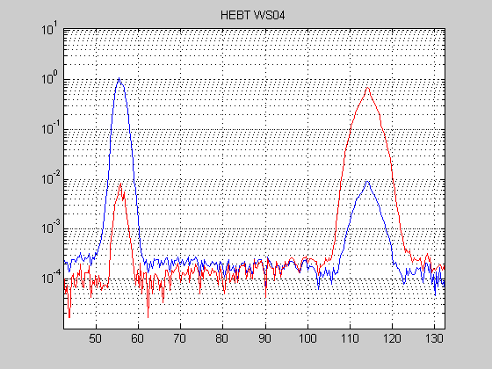
Wire scanners plans
  Increase scan speed
  Investigate and mitigate dynamic range limitations
High resolution wire scan in HEBT
Laser Wire plans
  Investigate and mitigate dynamic range limitations
Typical laser wire scan in SCL

Slide 15
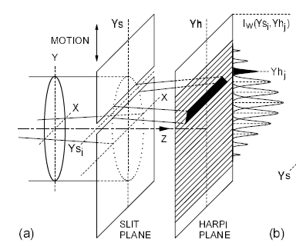
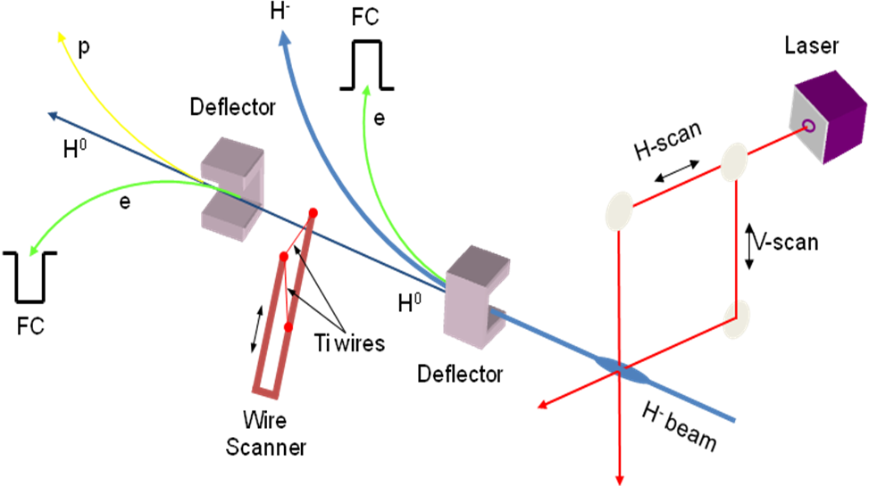
Transverse 2-D Emittance Measurements
Slit – harp emittance station in MEBT
  Interceptive: max pulse width = 50us
  10us time resolution
  Dynamic range = 1,000
  Slit-slit option is being developed for better time resolution and larger dynamic range
Laser emittance station in HEBT
  Non-interceptive
  10ns time resolution
  Dynamic range = 100
Tomographic reconstruction using wire scanners
  Interceptive: max pulse width = 50us
  10 us time resolution
  Dynamic range = ?
MEBT emittance scanner principle of operation
HEBT laser emittance scanner principle of operation

Slide 16
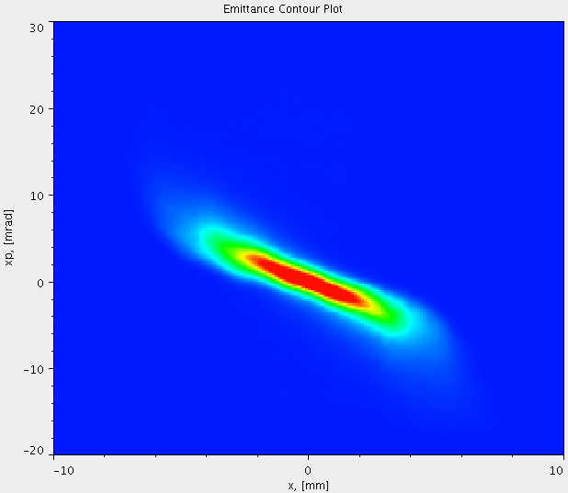
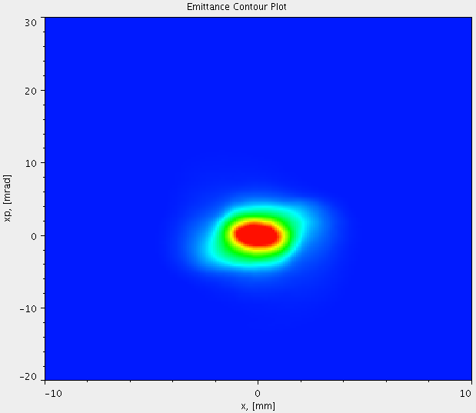
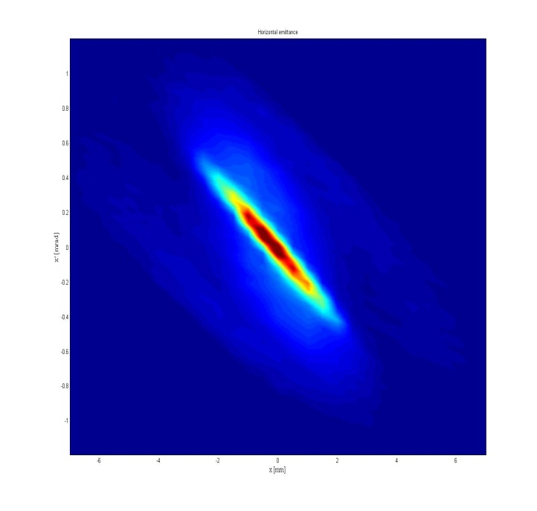
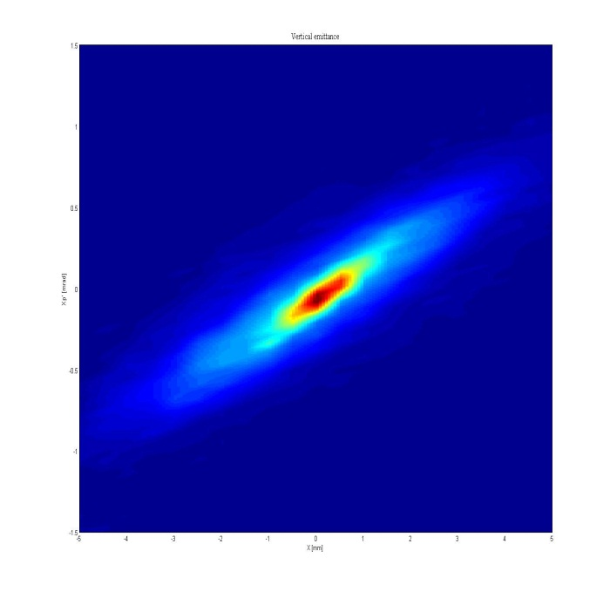
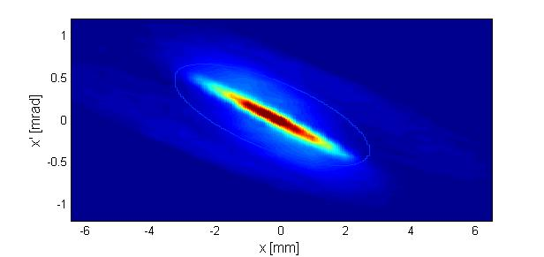
Emittance Evolution in Linac
MEBT horizontal
MEBT vertical
HEBT horizontal
HEBT vertical

Slide 17
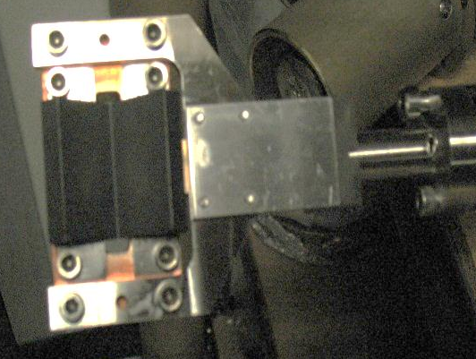
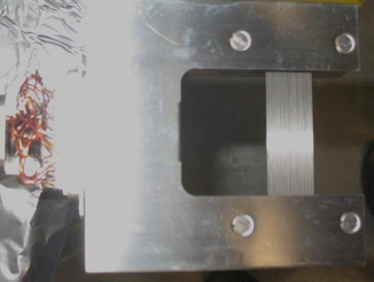
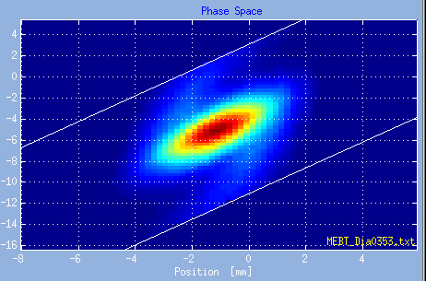
MEBT emittance scanner
slit
harp

Slide 18
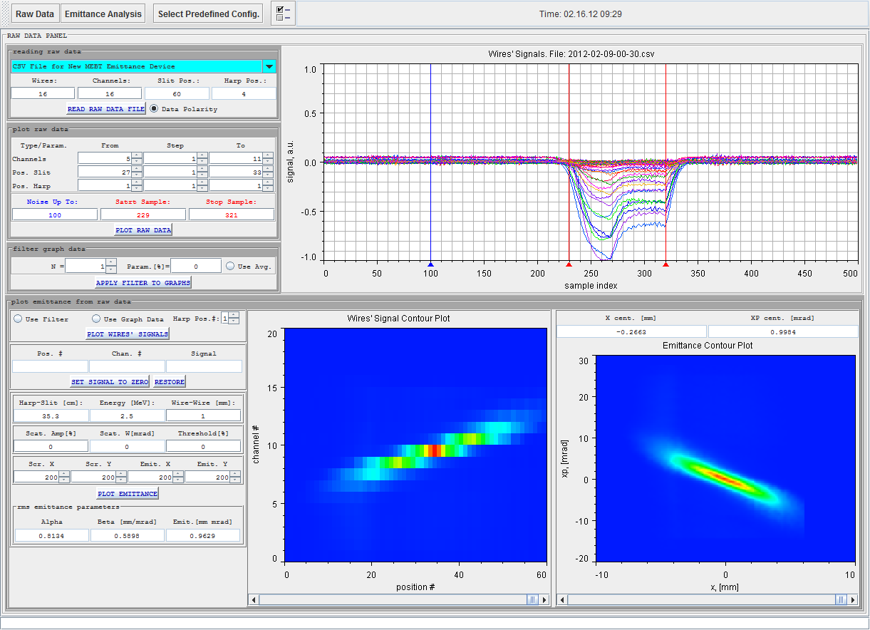
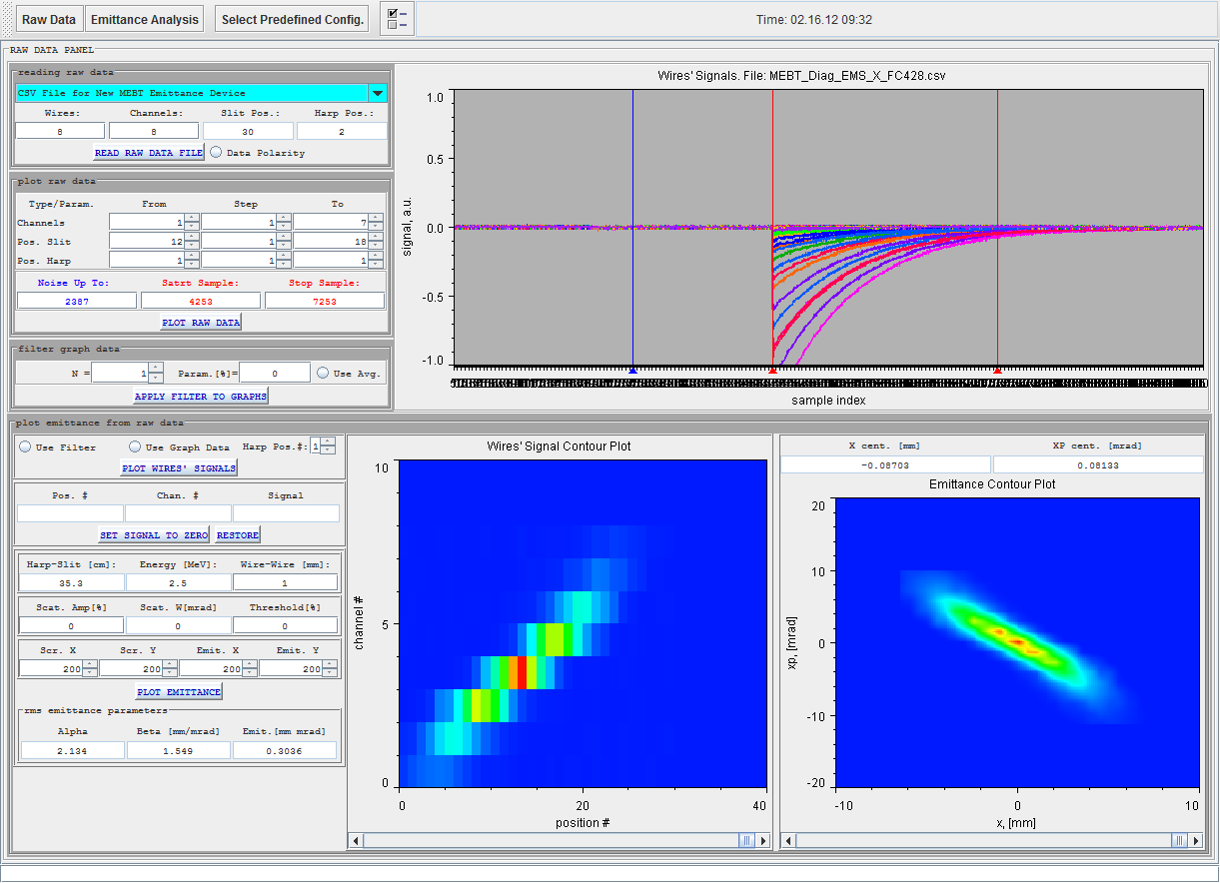
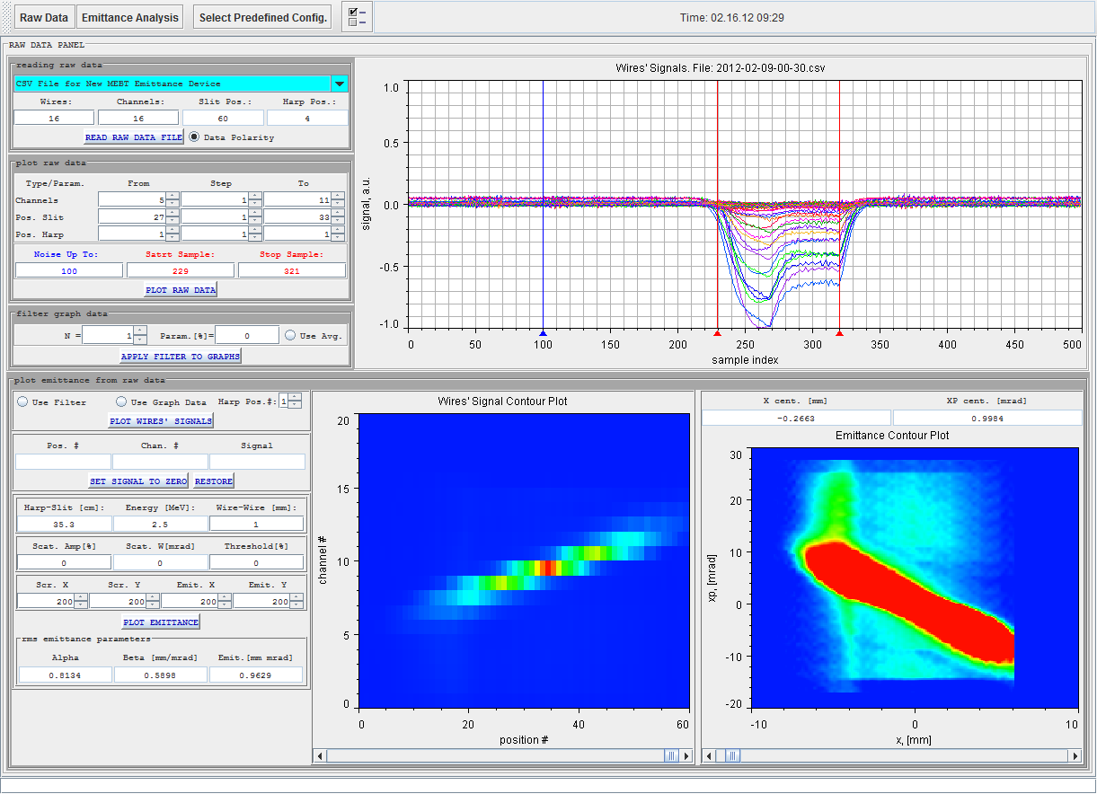
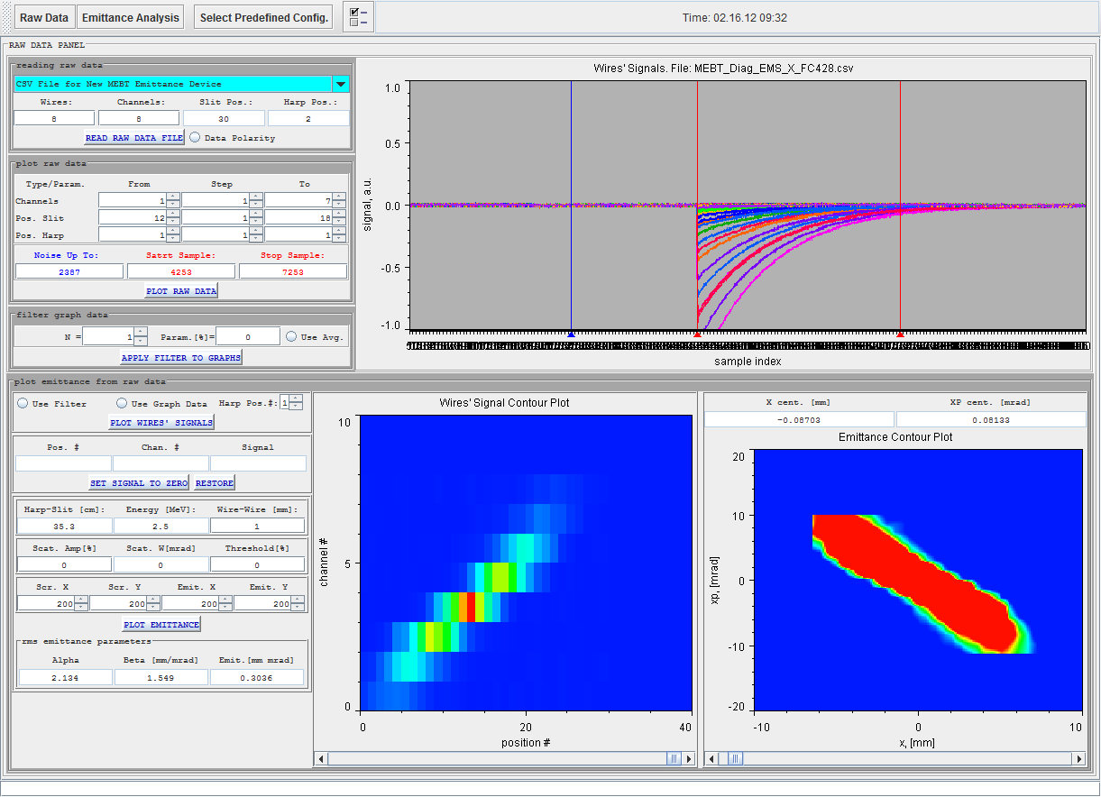
slit-harp
slit-slit

Slide 19
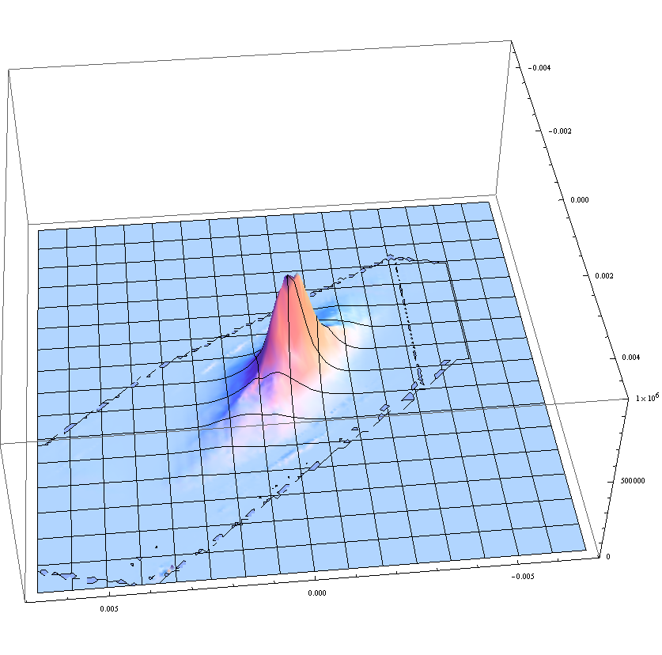
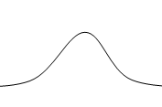


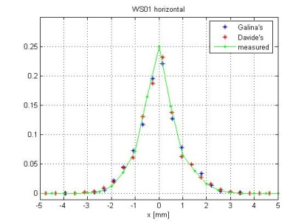
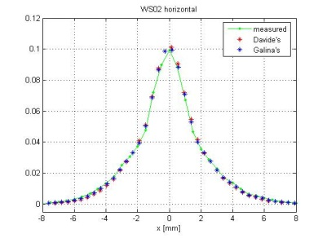
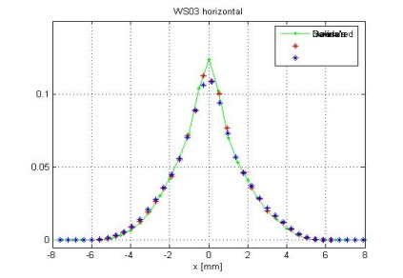
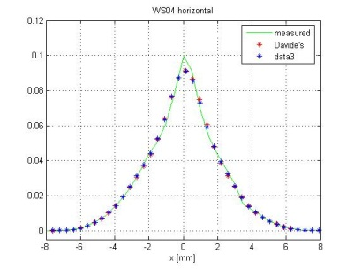
MENT Tomographic Reconstruction of 2-D Emittance from 1-D Profiles
Courtesy of T. Gorlov
Reconstructed 2-d distribution
Reconstruction seems to work very well in HEBT
  Need to verify using laser emittance measurements
  High resolution of wire scan data help with algorithm convergence
Plan to extend to SCL, Warm Linac, MEBT
  Requires good transport model
  Problem of space charge
Comparison of measured and reconstructed profiles

Slide 20
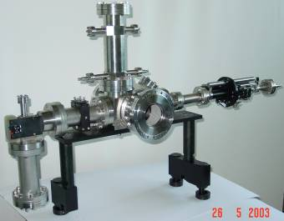
Longitudinal 1-D Bunch Profile Measurements
I(φ)
Analyzed beam
Beam Shape Monitors (aka Feschenko monitor ) in CCL and HEBT (4+3)
  Interceptive: max pulse width = 50us
  ~1° @805 MHz ( 3.5 ps) intra-bunch resolution
  10us averaging time
  Dynamic range = 10,000
Mode-lock-laser monitor in MEBT (1)
  Non-interceptive
  ~ 3° @402.5 MHz (20ps) intra-bunch resolution
  10us averaging time
  Dynamic range = 100
  Non-operational currently
U_{targ}
Secondary
electrons
I(z)
1
2
3
4
5
B
Z
X
Y
X
BSM principle of operation
6
7
Signal
CCL BSM

Slide 21
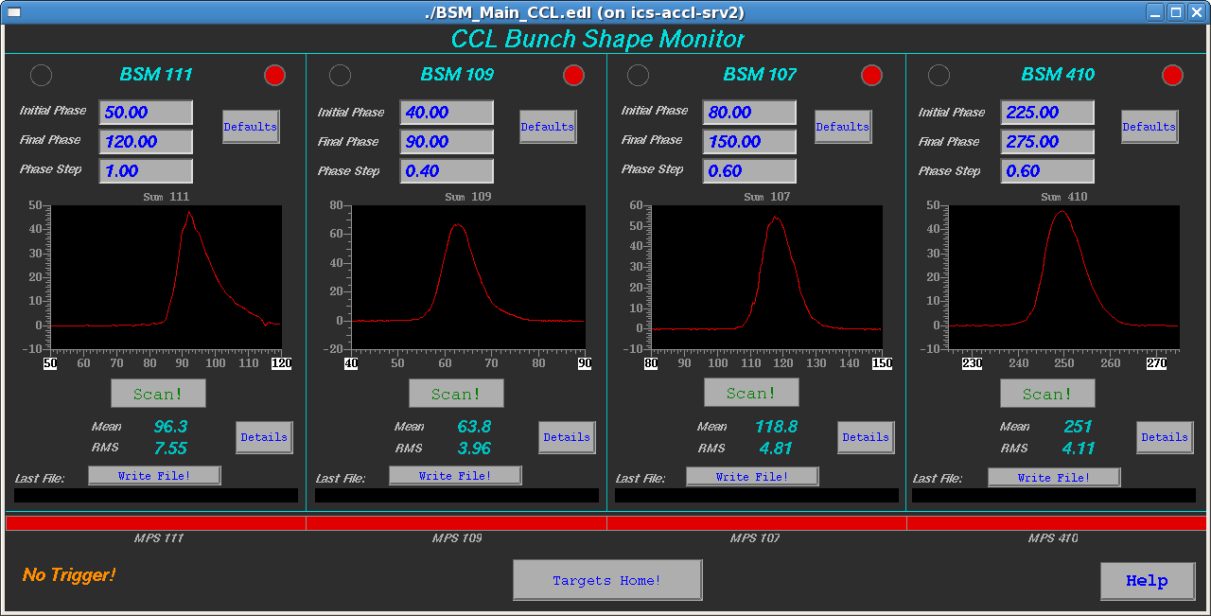
New BSM EPICS GUI
Fully independent parallel scans
Extensive set of troubleshooting and tuning tools
Courtesy of R. Dickson

Slide 22
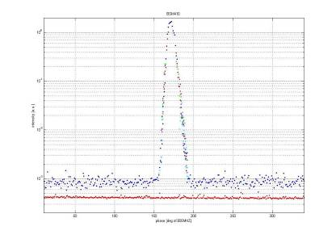
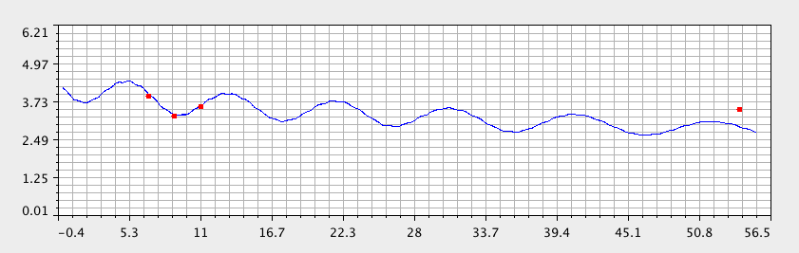
BSM Plans
amplitude [a.u.]
  Study and mitigate resolution limitations
  Collaborate with INR (Feschenko) on laser BSM development
no beam
phase [deg]
Typical longitudinal bunch profile
1º
.5º
rms phase width [deg]
Distance [m]
Measured longitudinal bunch size vs. model

Slide 23
Other diagnostics systems
Beam stops
Faraday cups
Scrapers
Apertures
Nano Current Detectors (10⁴ dynamic range, 20ns rise time)

Slide 24
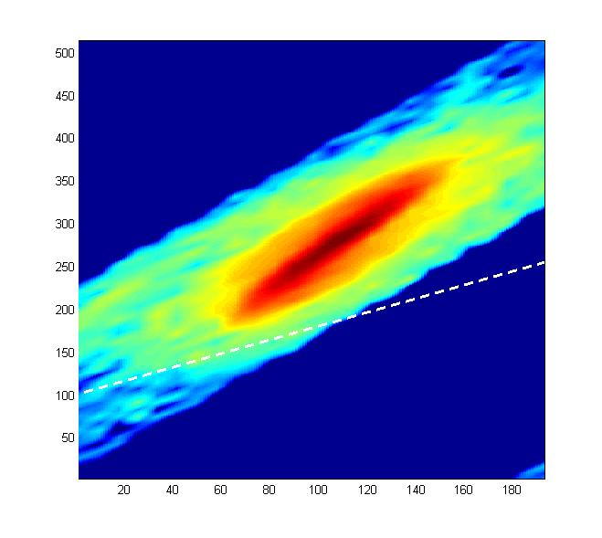
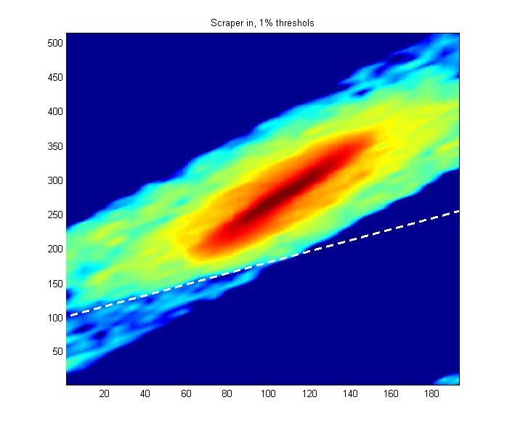
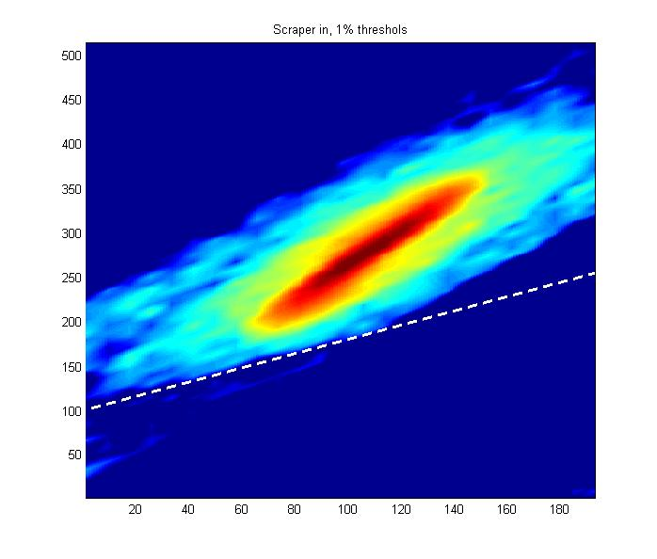
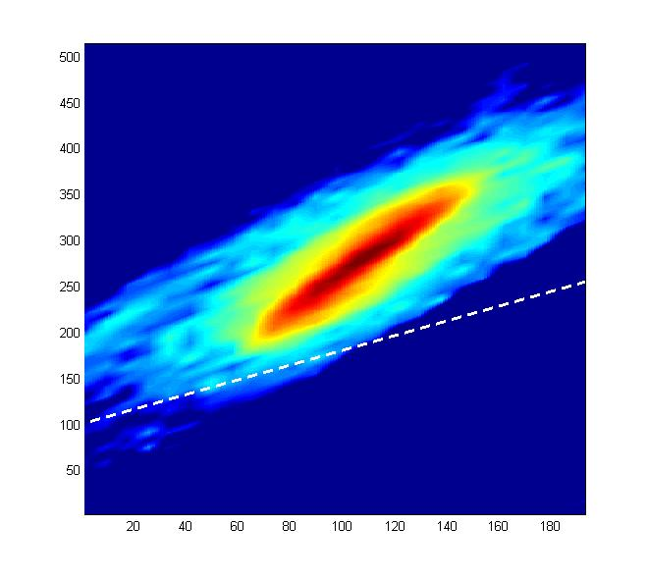

Slide 25
Development priorities
Reliability
User friendliness
  GUI
  Data analysis
Performance
  Dynamic range
  Time resolution
Speed of measurements
Novel techniques & methods

Slide 26
Thanks for your attention

