Slide 1




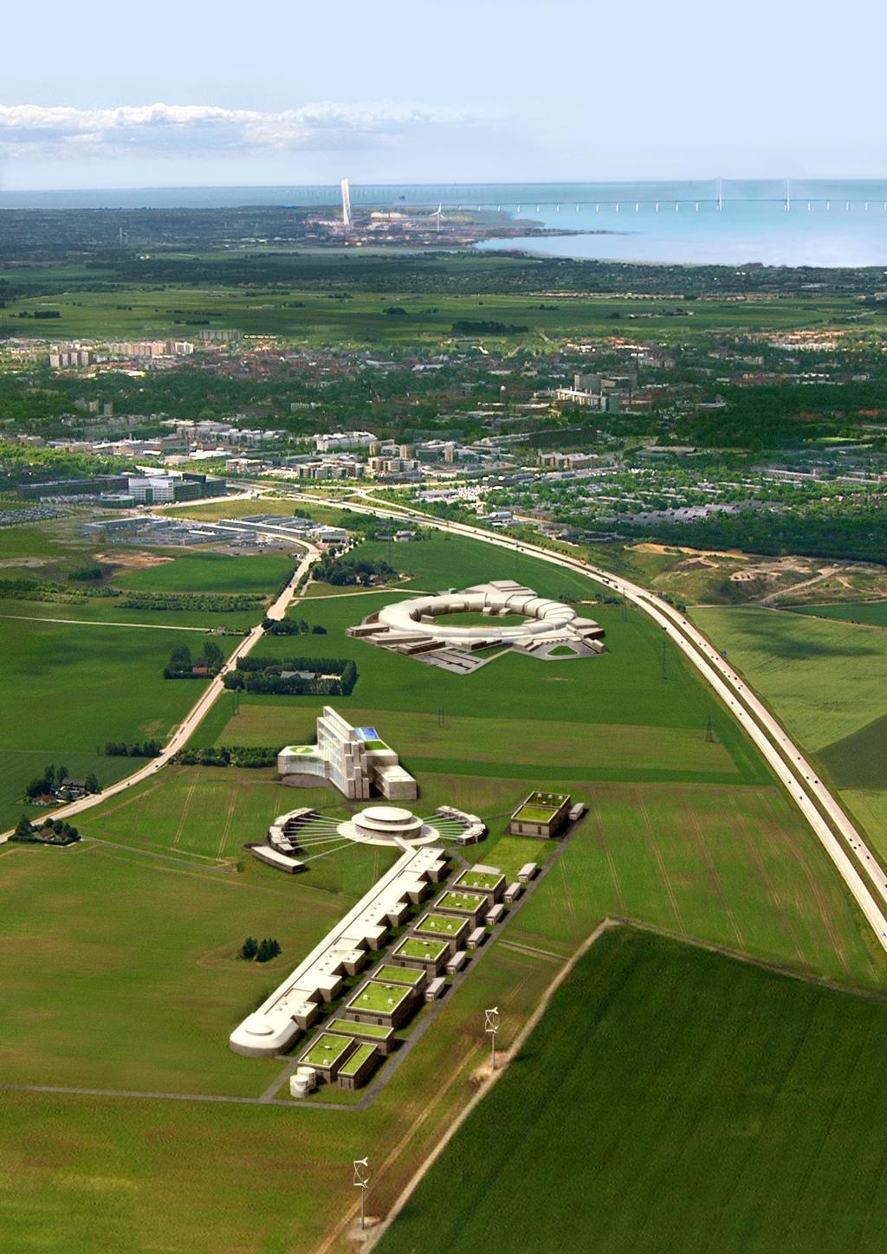
ESS Front End diagnostic
Benjamin Cheymol
Beam diagnostic workshop, Lund 2012-03-21

Slide 2
Outline
Warm linac layout
LEBT instrumentation
MEBT instrumentation
DTL intertank region
Transition DTL-Cold linac
Collimation
Issue

Slide 3
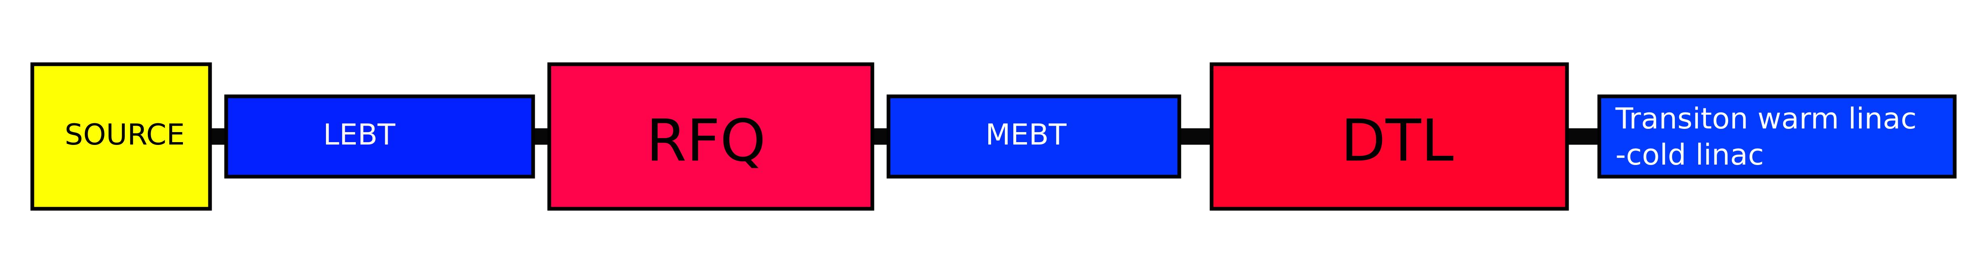
Warm Linac layout
Profile
Position
Current
E=75 keV
E=3 MeV
E≈80 MeV
Source monitoring
Transverse emittance measurement
Measurement of the 6D phase space

Slide 4
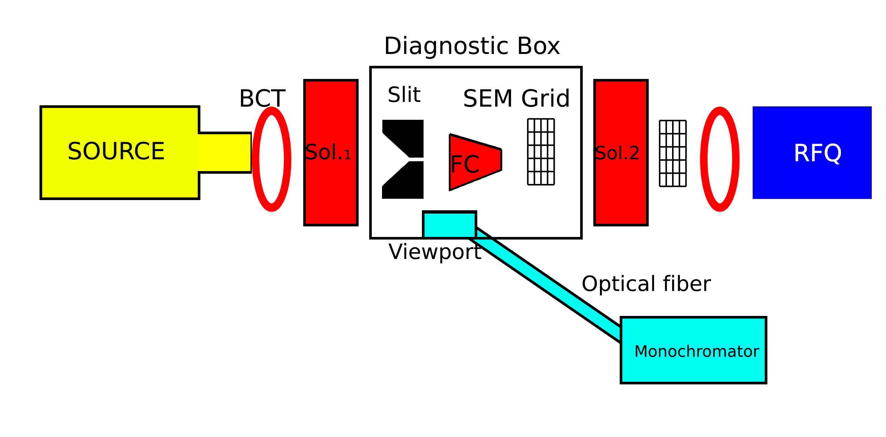
LEBT-Instrumentation layout
Proposal for BI integration:
  Current measurement
      2 BCTs and one Faraday cup
  Beam profile
      2 SEM grids (H+V)
  Emittance
      Slit and grid system (grid used also for profile measurement)
  Ions species fraction
      Viewport +monochromator

Slide 5
LEBT transverse measurement
4 SEM grids in total needed (2H+2V)
    Used for profile and emittance measurement
        2 pitch needed
    One channel per wire for both H & V plane
    Limitation on the number of electronic channel
        Use switch to select the pitch
Slit machined on blade
    2 independent slits
    Thermal load has to be estimated
        Cooling
        Pulse reduction

Slide 6
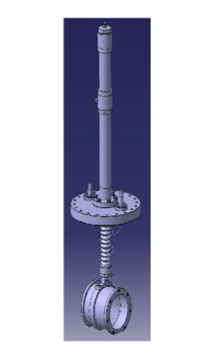
LEBT current measurement
Measure with BCT and Faraday cup
    One BCT is mandatory at the RFQ entry
    Faraday cup will be installed between the solenoid
    A second solenoid can be installed at the source exit for source monitoring

Slide 7
LEBT extra measurement
Beam purity monitor
    Aim: measure the fraction of ions species
    Based on optical measurement
    Used in IPHI and IFMIF LEBT
Profile with slit and Faraday cup
    Add an other position for beam profile
Non interceptive profile measurement
    Add 2 viewport for future beam profile measurement with IPM.

Slide 8
MEBT
Make a permanent test line in the MEBT
    Transverse emittance
    Longitudinal beam profile
    Beam current
    Beam position
    TOF
    Beam profile
    Transverse halo
    Fast chopping efficiency
A beam stopper is needed for dedicated studies of the MEBT

Slide 9
MEBT-Space requirement
Transverse emittance measurement with Slit&grid system
    60 cm of drift space is needed
Beam shape monitor (i.e Feschenko) for longitudinal measurement*
    20-30 cm are requested
Beam current transformer*
    2 BCT at the beginning and at the end of MEBT
Position and TOF*
    BPM will be inserted in Quads, no need for extra space
Beam profile with wire scanner
    Each wire scanner required 5-10 cm, 4 profilers can be installed
    Two of them can be used as halo monitor with a dedicated electronic.
* See next talks for more details

Slide 10
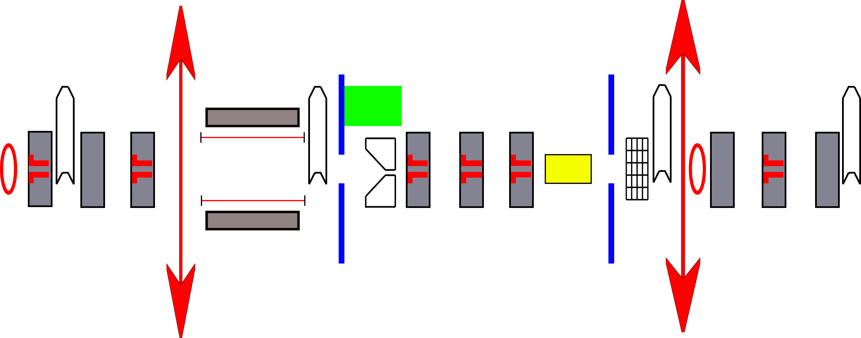



MEBT
Buncher Cavities
Chopper Dump
Chopper
 | BPM (position and TOF)
 | Wire scanner
 | BSM
 | Collimator
 | SEM grid
 | BCT
 | Slit
 | Quad

Slide 11
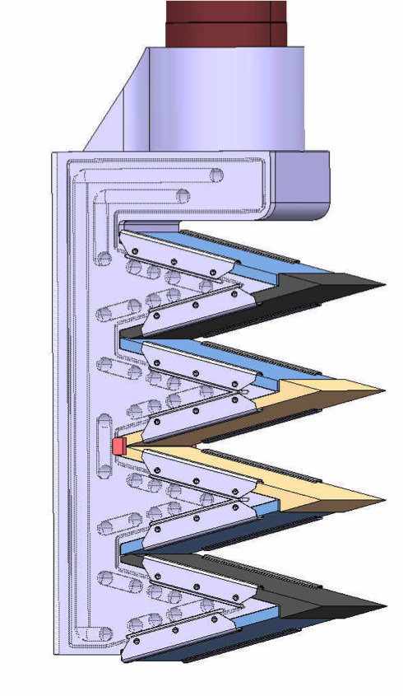
MEBT
Slit based on LINAC4 design
Graphite blade on Copper block
Beam parameter at the MEBT
σ_{x}=3.1 mm, σ_{y}=3.5 mm
I=65 mA
Pulse length =100 μs
T_{max}=1400 K, limits of graphite reached
BEAM
Carbon or tungsten wire for the grid
Bias polarization under discussion

Slide 12
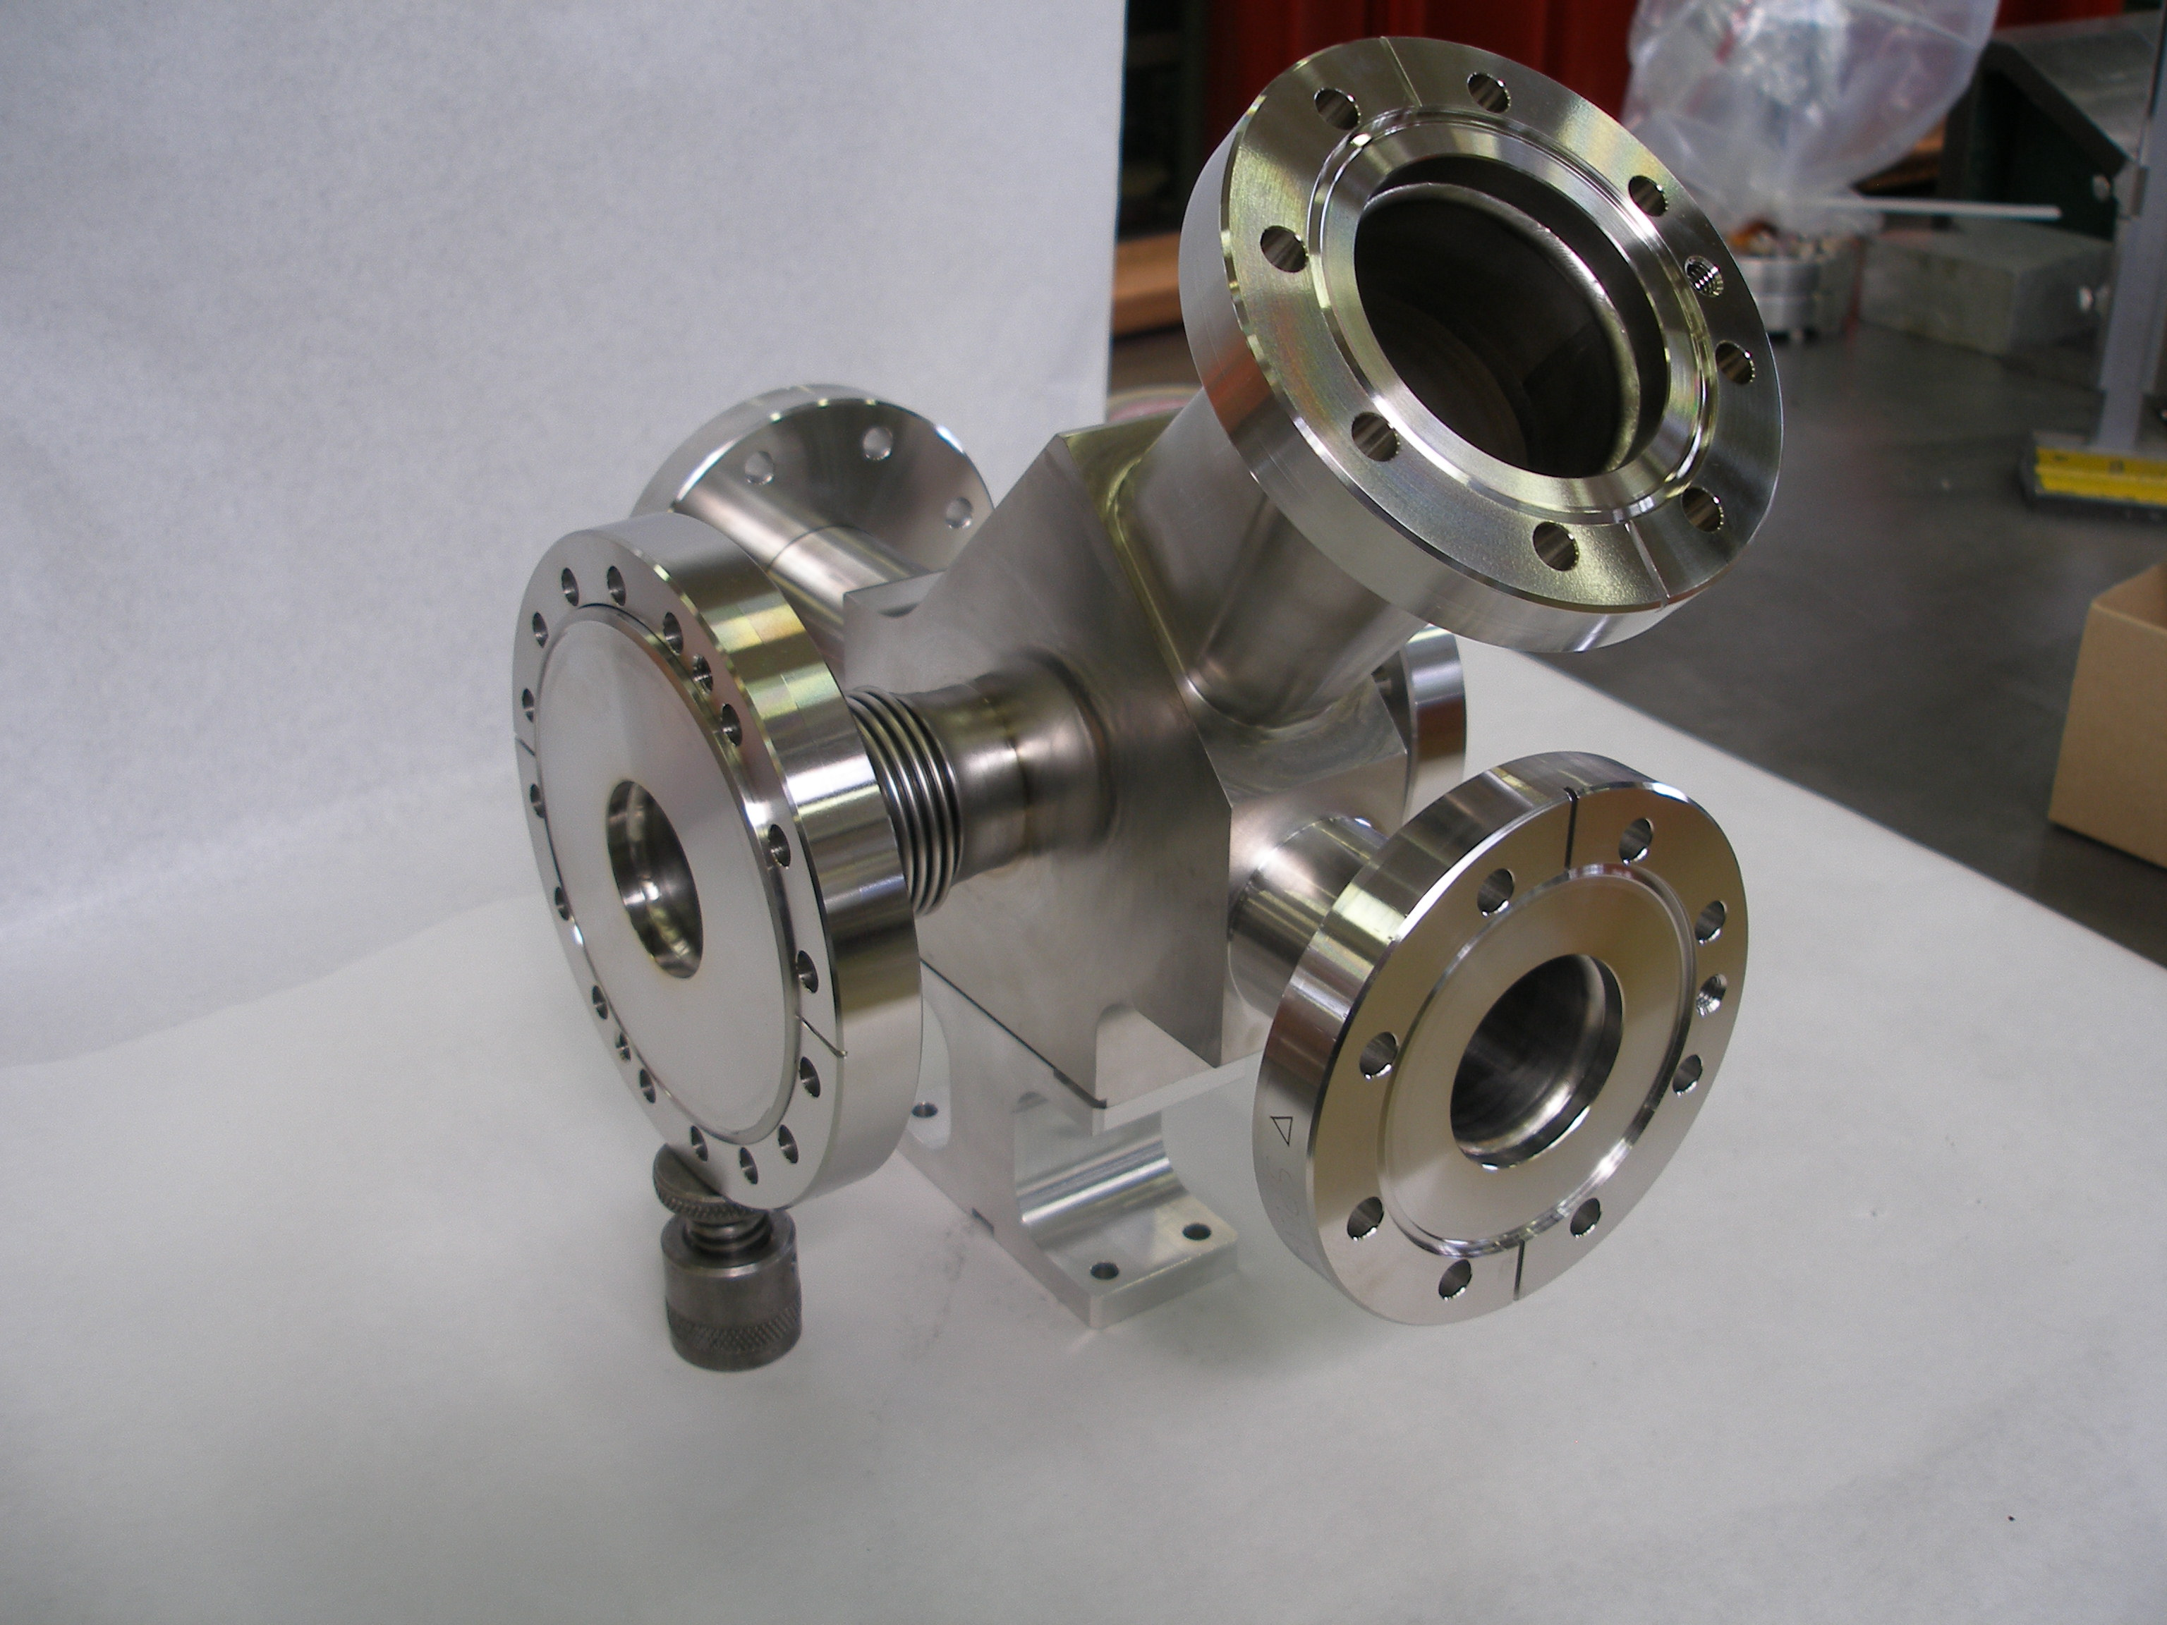
MEBT- Wire scanner
Wire scanner will be used for profile and halo measurement
Thermal load Issue
    Carbon wire must be used
    Reduce pulse to 100 μs
Expected beam sizes are needed for signal and temperature increase estimation
Example of wire scanner tank installed in LINAC4

Slide 13
DTL Intertank region
DTL design concept has moved from Linac4 style to SNS style (FODO cell).
Inter-tank diagnostics box
  Faraday cup (fast?)
  Wire scanner
In-tank BPMs
BCT inserted in the Tank
In addition BLM will be installed as close as possible to the beam

Slide 14
DTL BI layout
Tank 1
Tank 2
BLM
Beam
BLM
FC
FC
WS
WS
0
Tank 3
BLM
Tank 4
WS
FC
Symbol
Number of units
Name
Number of units
Name
Symbol
DTL Tank
6
BPM / Phase detector in DT
10
Wire Scanner
5
Current Monitor (Toroid)
6
Beam Loss Monitor
6
Faraday cup (Beam stop)
5
BLM
FC
Energy degrader
5
14

Slide 15
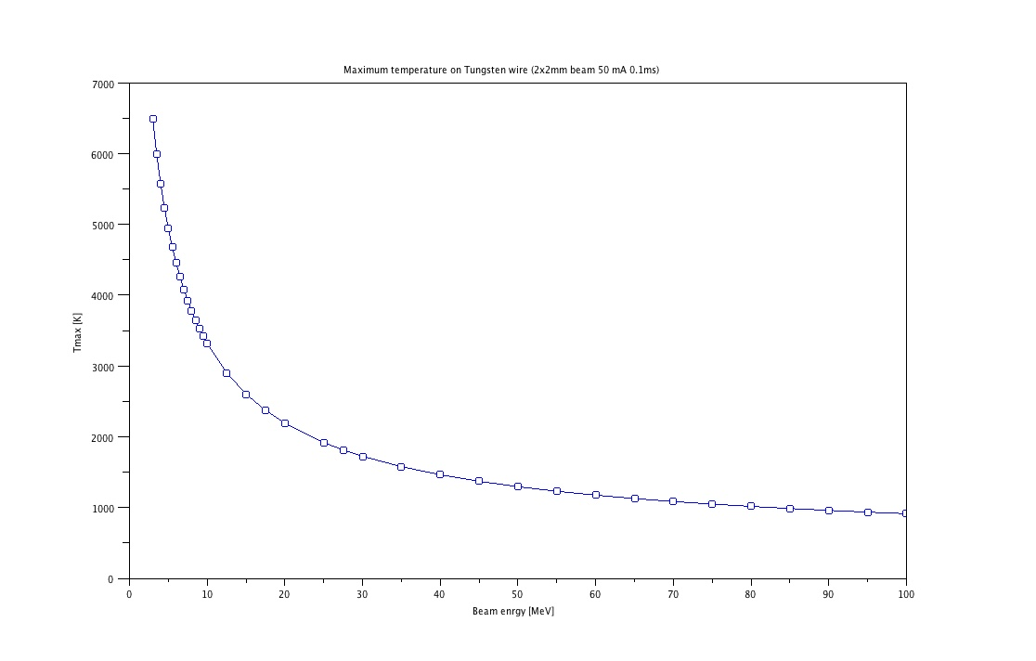
DTL wire scanner
Similar mechanical design as the MEBT
Thermal load implies to reduce the beam pulse to 100 μs
Carbon is the best candidate for wire material
7000
6000
Tungsten wire 50 mA, 100 μs
σ_{x}=σ_{y}=2mm
5000
4000
Tmax [K]
3000
2000
1000
10
Beam Energy [MeV]
100

Slide 16
Transition Warm linac –Cold linac
As for the MEBT, our proposal is to have a permanent test line with:
    BSM
    Emittance measurement with Quad scan method
    Current measurement with BCT
    Beam position and TOF
    Profile and halo measurement with wire scanner
A beam stopper is needed in order to avoid losses in cold linac during measurements.

Slide 17
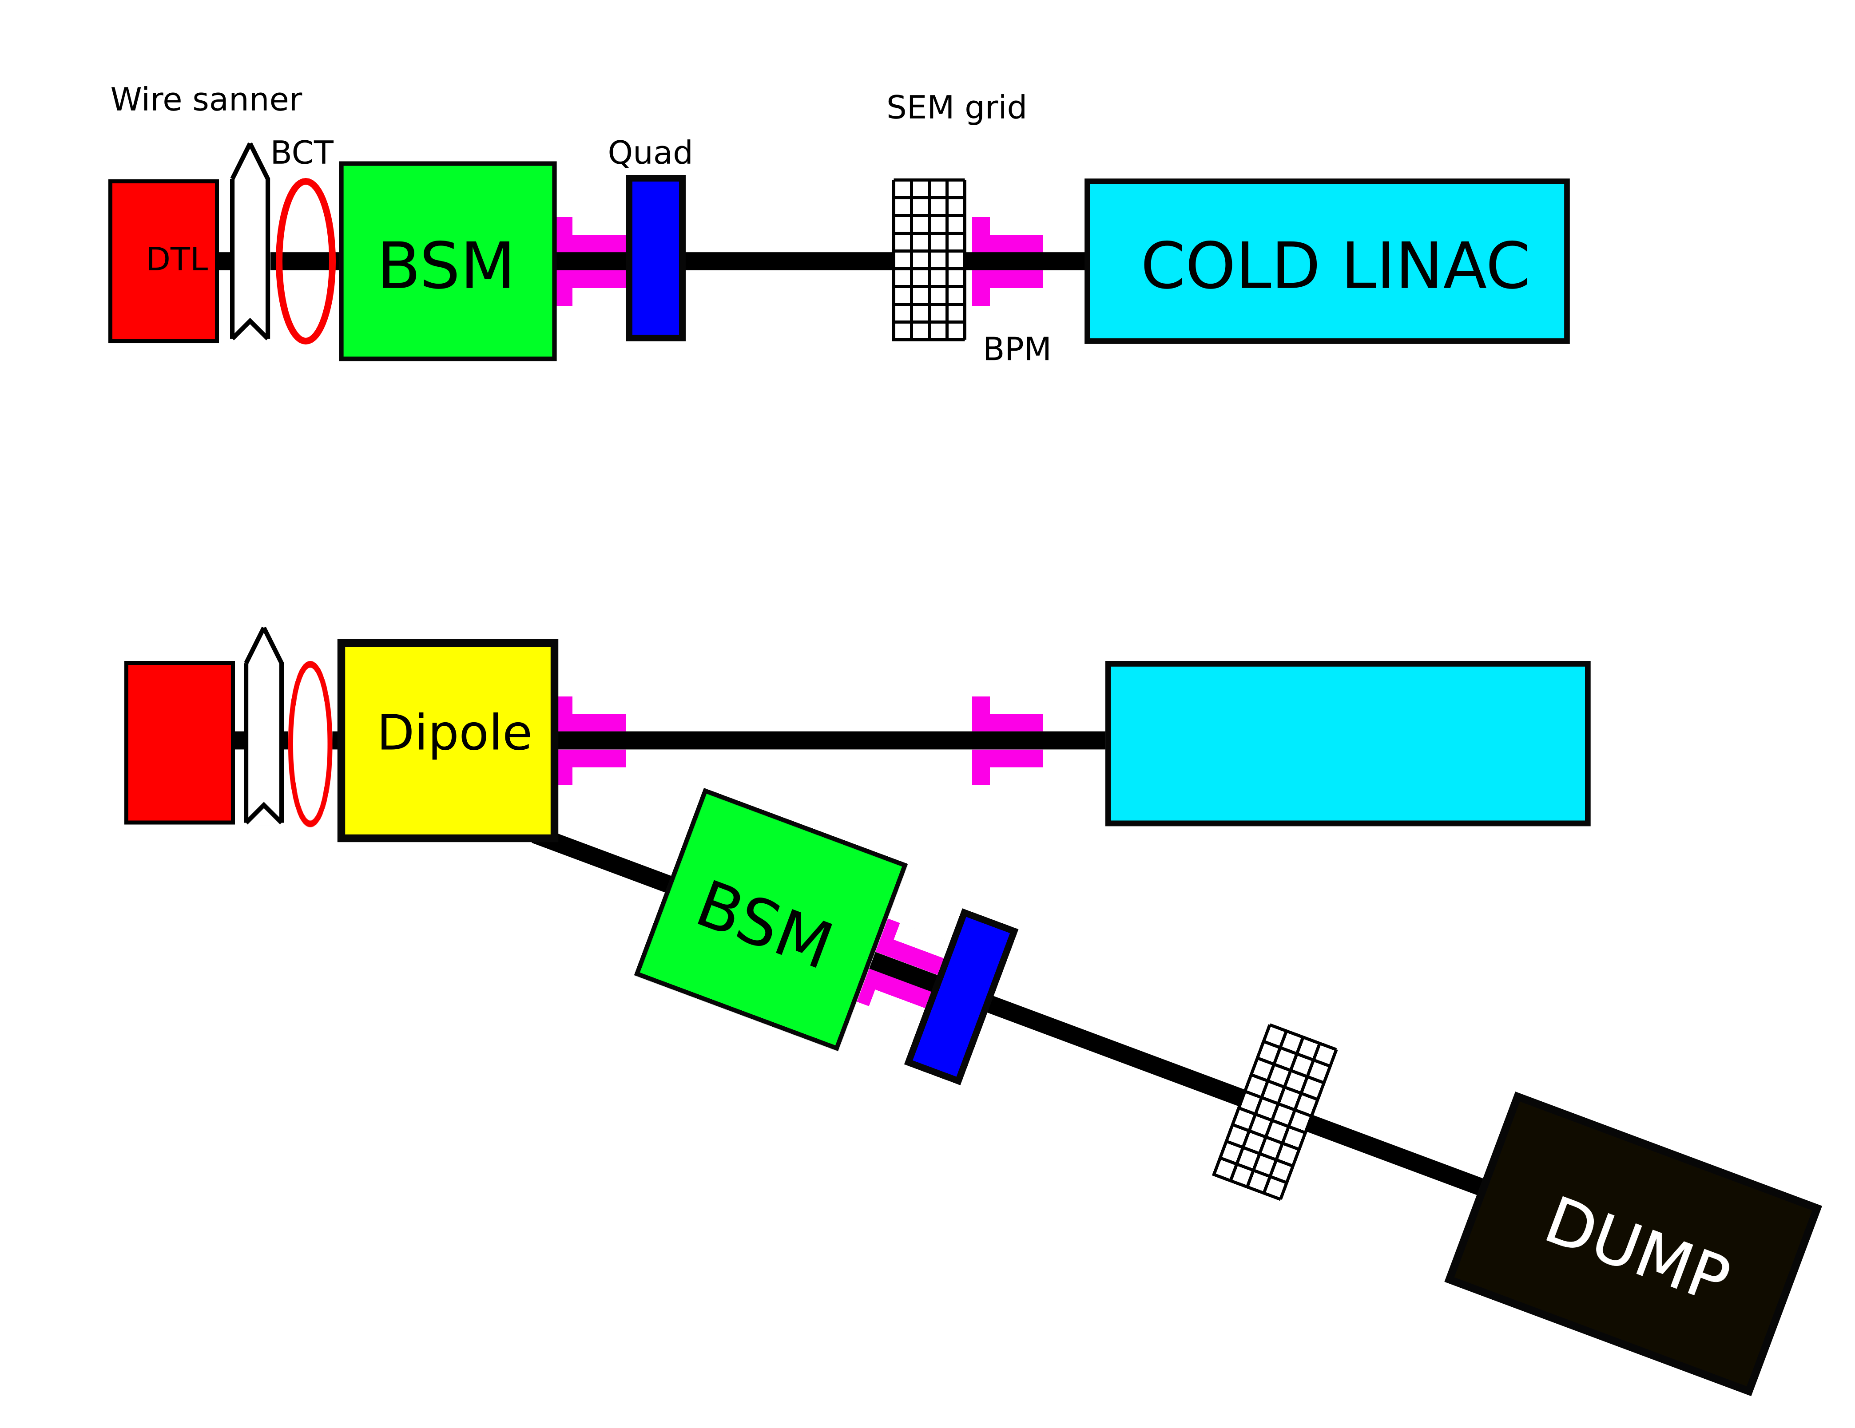
Transition Warm linac –Cold linac
BI line at the exit of DTL

Slide 18
Collimation
Collimation with scrappers
    Graphite scrapper in the MEBT
    Check the possibility of using graphite close to the cryo module
    Thermo mechanical analysis to be done

Slide 19
Issue
Space limitation in the MEBT and in the transition warm/cold linac
    New MEBT design is under study
    Layout of the transition region to be completed
Thermal load on interceptive device
    Pulse length has to reduced
    Carbon can be used in warm linac

Slide 20
Thanks for your attention

