Slide 1


Non-Invasive Beam Profile Measurement
Overview of evaluated methods

Slide 2
Goal
Beam profile measurements in the high-energy part of the linac
Requirements:
  The beam profile should be measured within 10% for nominal beam width.
  The beam profile might be measured over a beam pulse or even over several pulses combined. The overall integrating time must not exceed several (5) seconds.

Slide 3
Methods in Evaluation
Residual Gas Luminescence
Residual Gas Ionization
  Detection of Ions
  Detection of Electrons
Crossed Particle Beam Interaction
  Electron Beam
  Ion Beam

Slide 4
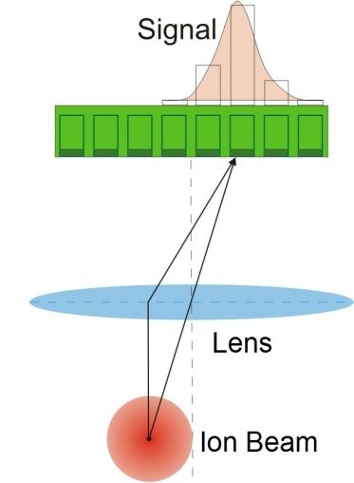
1. Residual Gas Luminescence
Ion beam interacts with residual gas in a way, the gas emitts light
This light is detected and a profile calculated
Picture: Balalykin, N. I. et al., Development of beam position and profile monitor based on light radiation of atoms excited by beam particles, Dubna, Russia: XIX Russian Particle Accelerator Conference, 2004.

Slide 5
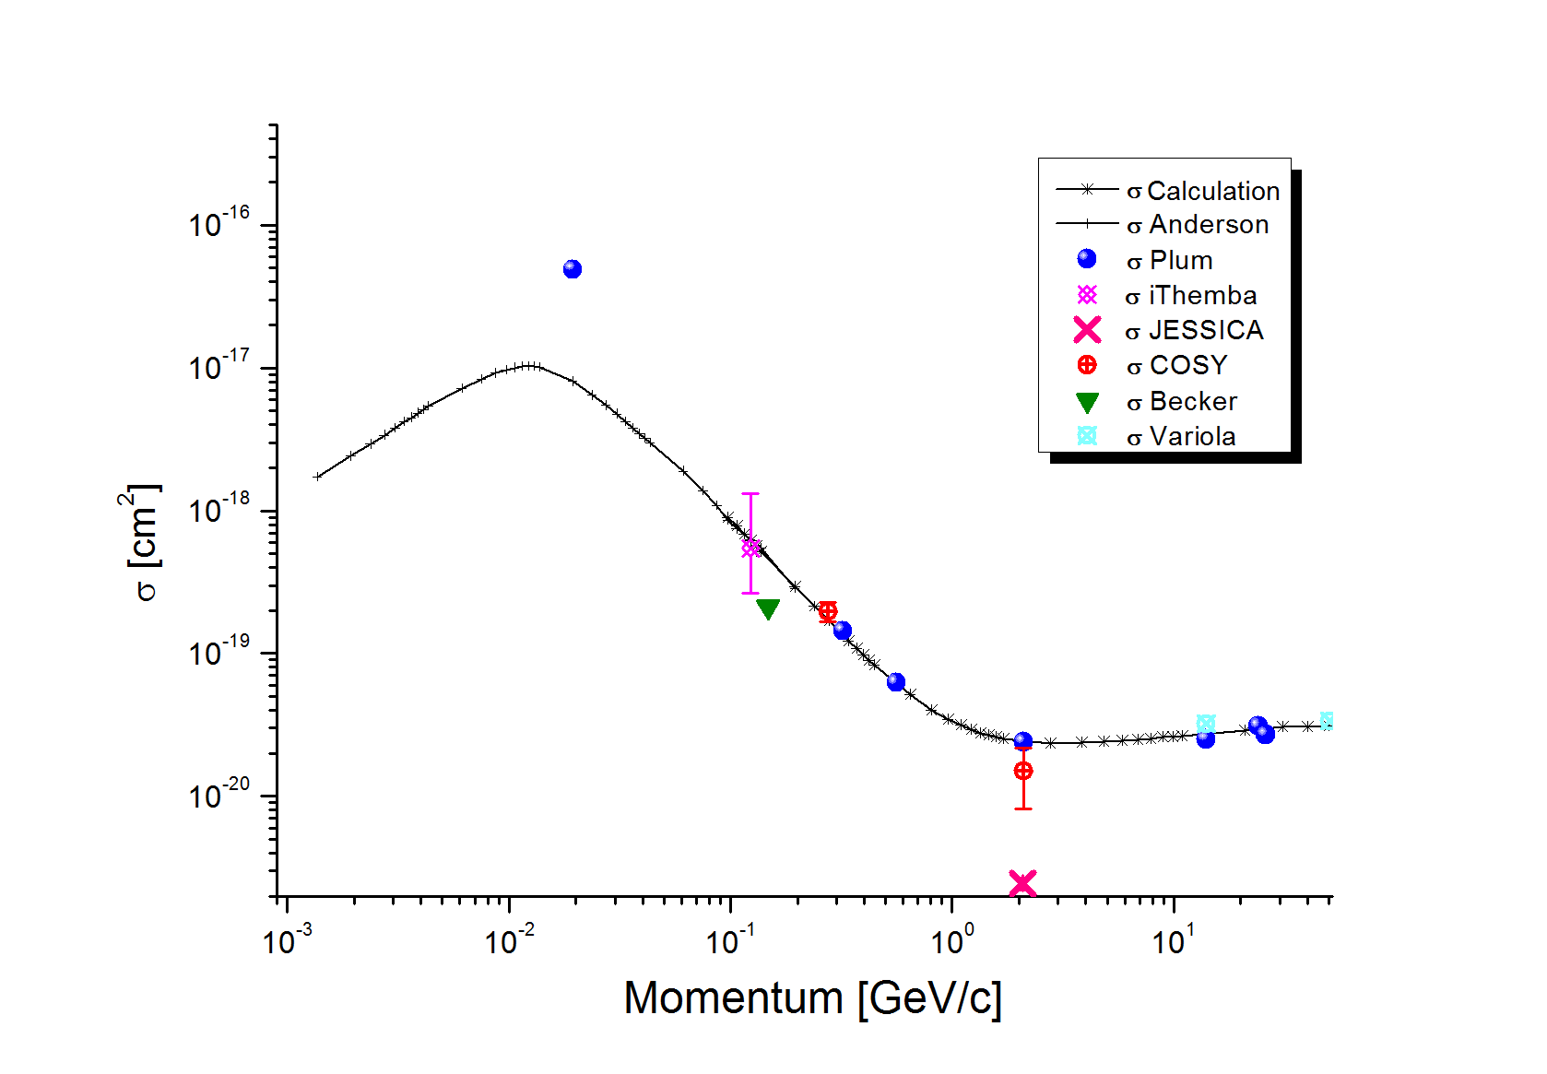
1. Residual Gas Luminescence
Problem of this method: small cross section
Estimated photon count in ESS cryogenic section (without additional gas): <10/s

Slide 6
1. Residual Gas Luminescence
Amount of resulting photons depends on
    Cross section (particle energy)
    Amount of incoming protons
    Residual gas density
Only residual gas density can be changed
A pressure of 10⁻⁹ mbar with 5% N₂ is assumed
→ 5*10⁻¹¹ mbar N₂
Increase to 5*10⁻¹⁰ would boost countrate in a region, measurements can be achieved
Because of cryogenic components nearby additional gas might not be wanted.

Slide 7
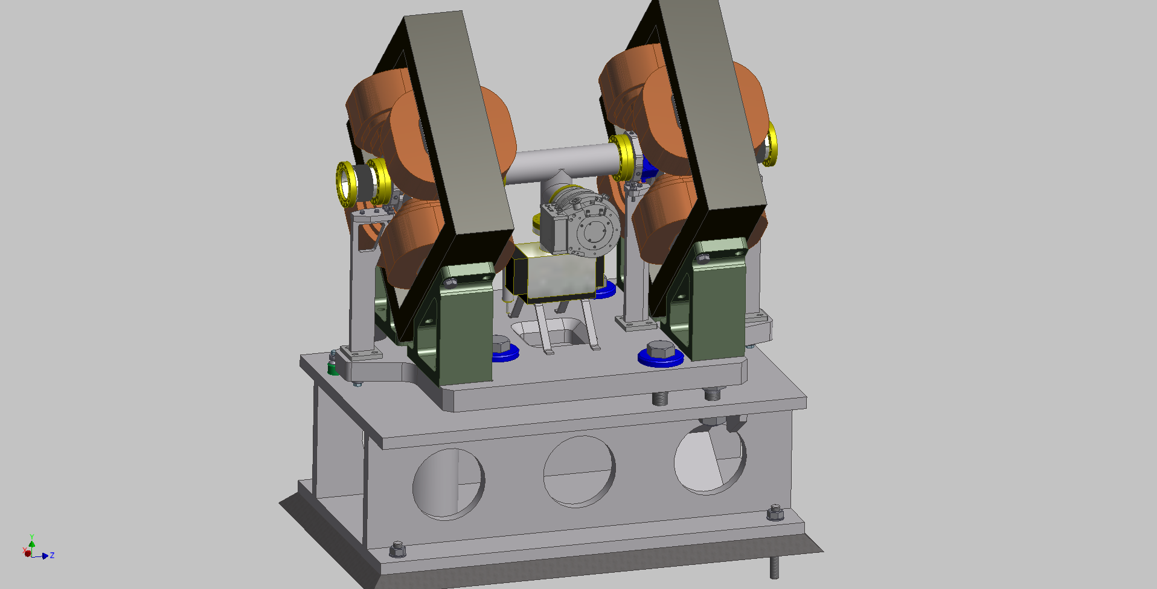
1. Residual Gas Luminescence

Slide 8
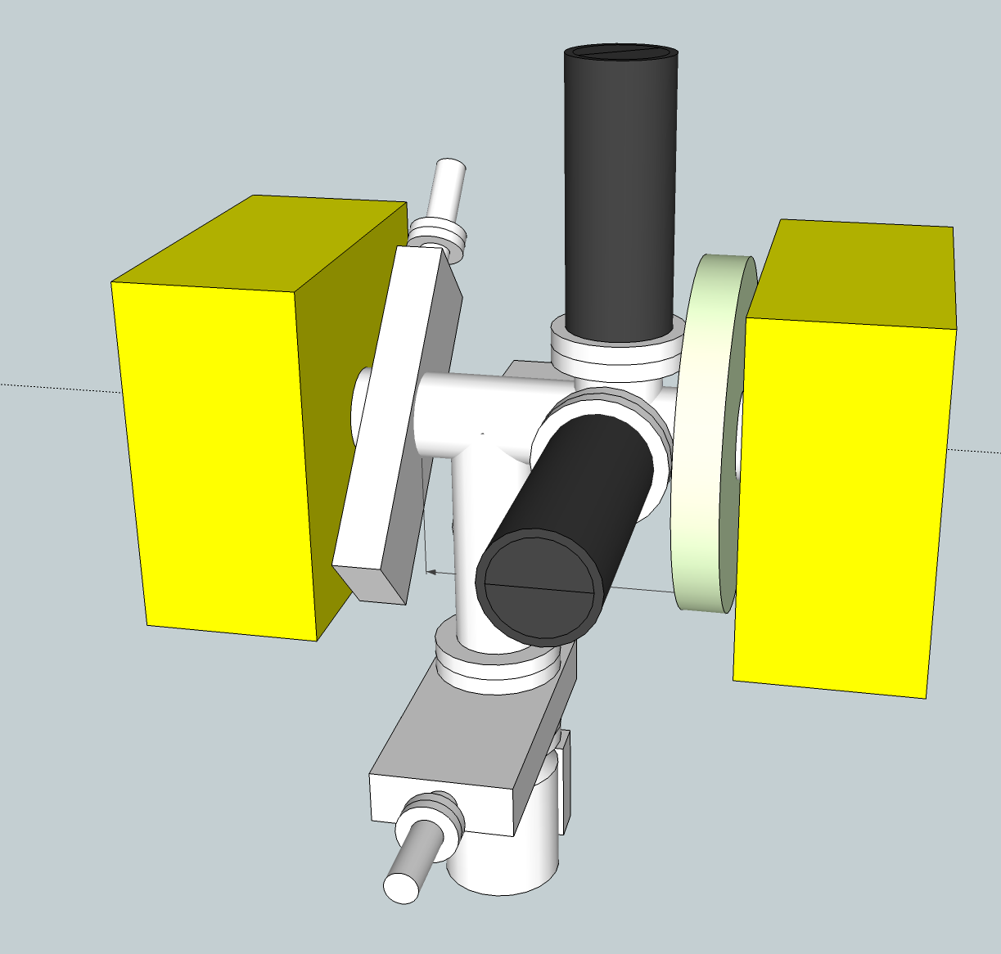
1. Residual Gas Luminescence
Wire Scanner
WS Detector
Issues with vacuum components probable
Issues with shielding of wire scanner detector

Slide 9
1. Residual Gas Luminescence
Preferred method because of uncomplex setup
Low predicted countrate might turn this method unfeasible in cold section
At other positions this method might be still prefered for online profile measurement
Planned to test predictions of cold section at SNS in summer 2012

Slide 10
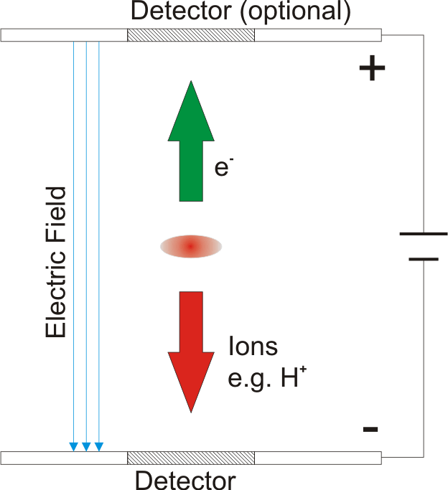
2. Residual Gas Ionization
Ion beam interacts with the residual gas in a way the gas gets ionized
Ions and/or electrons* are accelerated by an electric field towards a detector
Charge is multiplied and measured for profile determination

Slide 11
2. i. Residual Gas Ionization
Estimated count rate <450/(s*cm)
Using MCPs limits operational lifetime
Other detectors (wire, silicon strip)
  Higher lifetime
  Less resolution
  Not symetrical voltage
Beam space charge might influence the beam imaging process

Slide 12
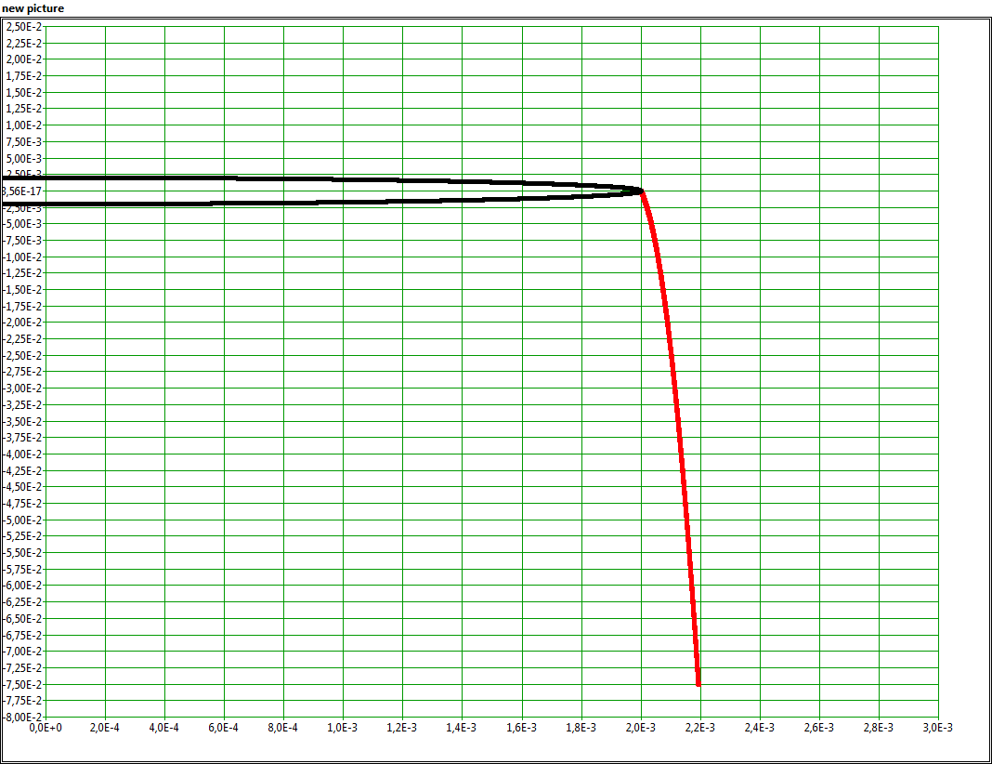
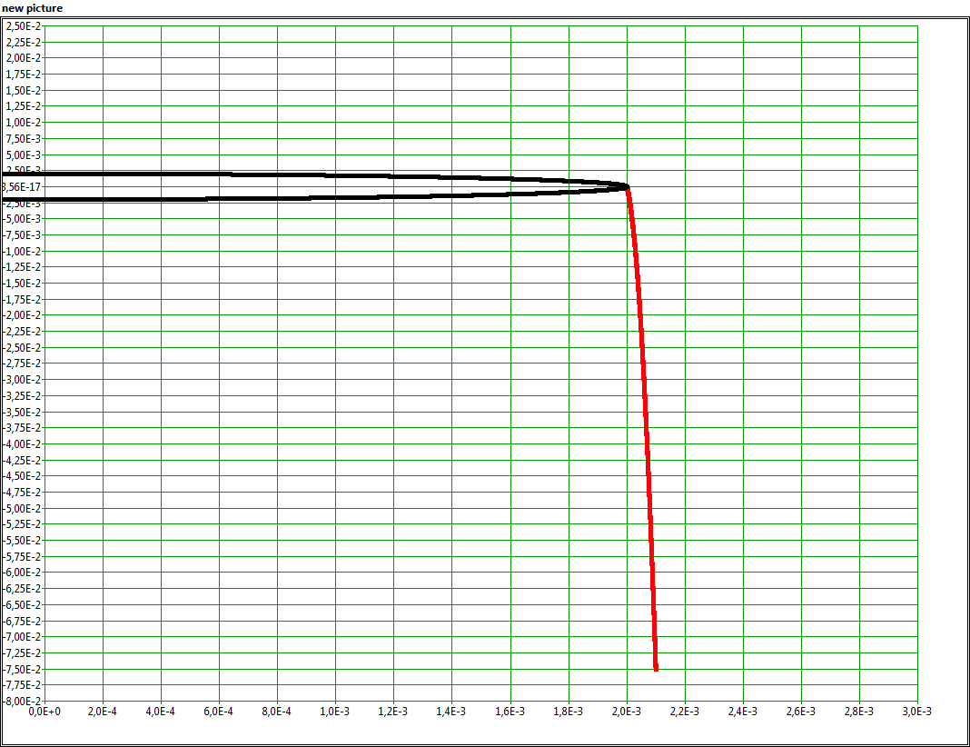
2. i. Residual Gas Ionization
160 kV/m,
Proton,
9.96% drift
320 kV/m,
Proton,
5.2% drift
320 kV/m,
He⁺,
4.82% drift
640 kV/m,
He⁺,
2.49% drift

Slide 13
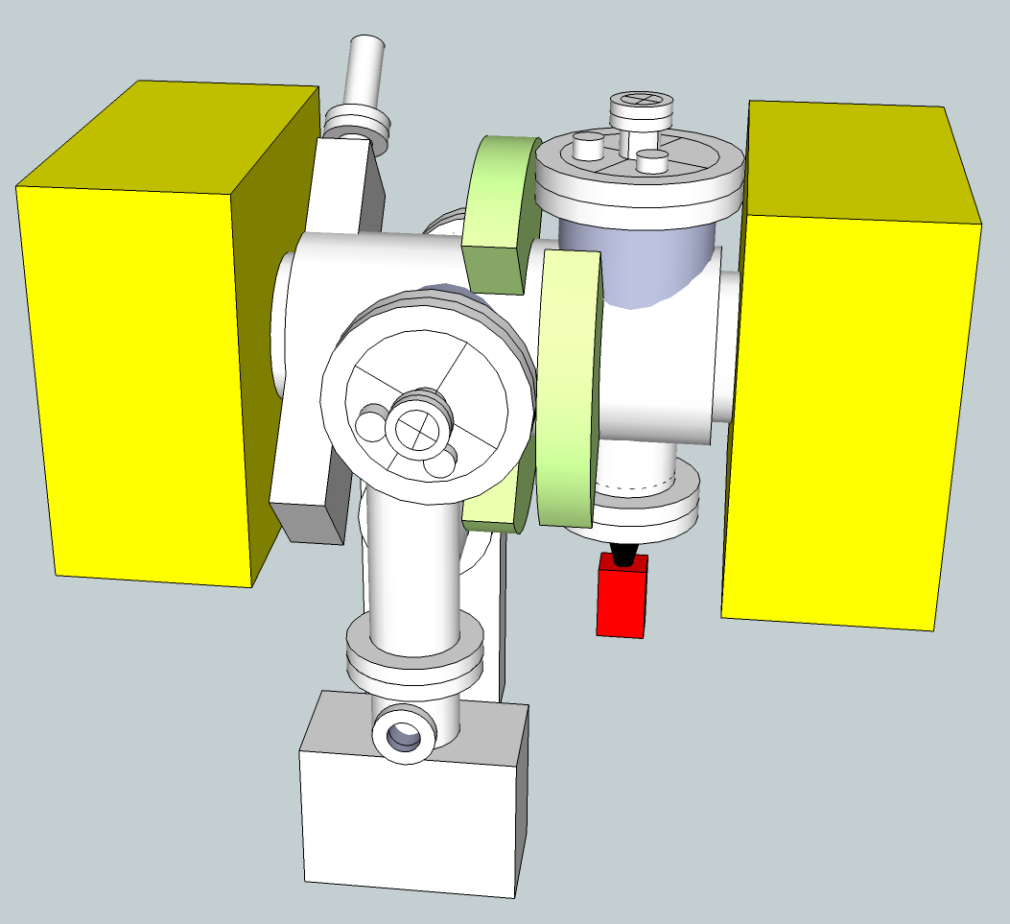
2. i. Residual Gas Ionization
Space issues for fitting measurement for 2 plains in one box
5 cm between WS and 1st plain
5 cm between 2nd plain and wall
7 cm between the two IPMs

Slide 14
2. ii. Residual Gas Ionization
For use of electrons a magnetic field must be overlayed
Additional magnets must be introduced to bend the beam back to its position.
This field must be in the region on 0.1 T
With a 0.5 m magnet this leads to roughly 1° bending angle of the beam.

Slide 15
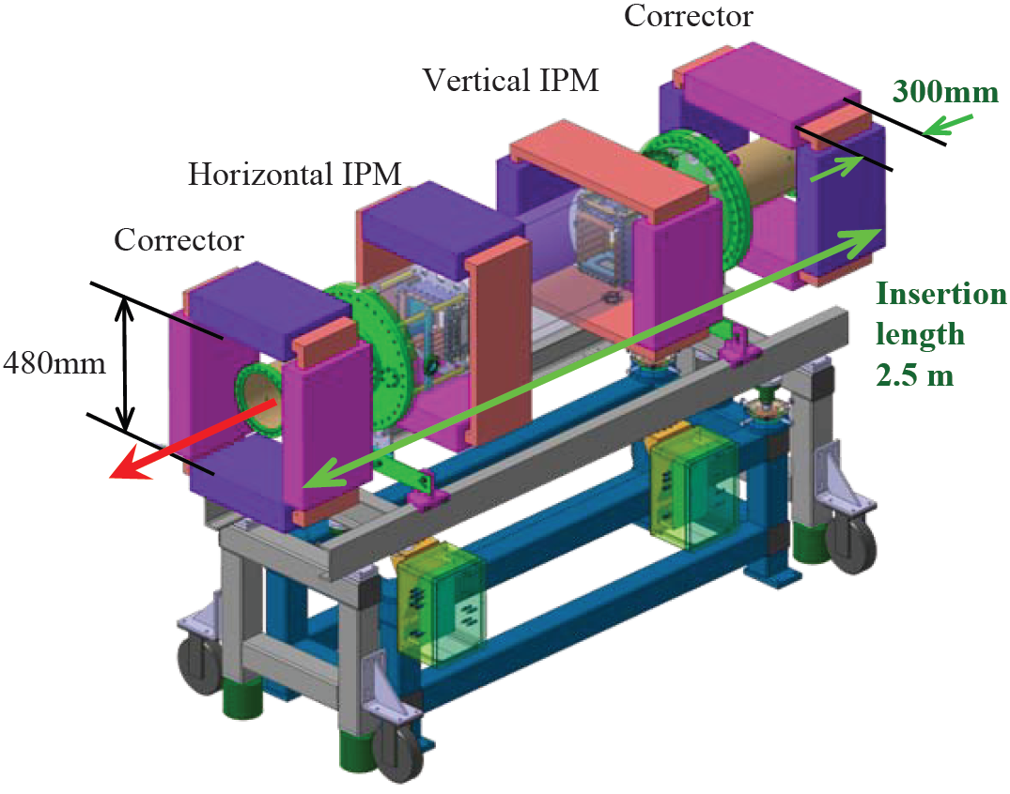
2. ii. Residual Gas Ionization
Shown: GSI concept
At ESS the distance between corrector and main magnet is up to 13 m.
This leads to about 20 cm displacement of the beam
Picture: Peter Forck, Minimal Invasive Beam Profile Monitors for High Intense HadronBeams, IPAC 2010 Kyoto

Slide 16
2. Residual Gas Ionization
Low imaging disturbance due to beam space charge
High speed measurements not requested
Magnetic fields for electrons add aditional complications
Result: Ionization monitor with electrons not prefered method

Slide 17
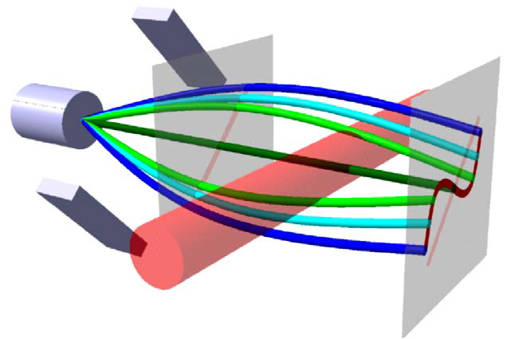
3. Particle Beam
A particle beam (electrons, ions) is send perpendicular to the ion beam
Due to coulomb interaction the particle beam is deflected
This deflection can be
used to calculate the
beam profile
Picture: Peter Forck, Minimal Invasive Beam Profile Monitors for High Intense HadronBeams, IPAC 2010 Kyoto

Slide 18
3. Particle Beam
SNS uses electron beam to ‚scan‘ through the ion beam
Beam bunch length might be to short for this method at ESS
Particle „sheet“ might
be a possibility.

Slide 19
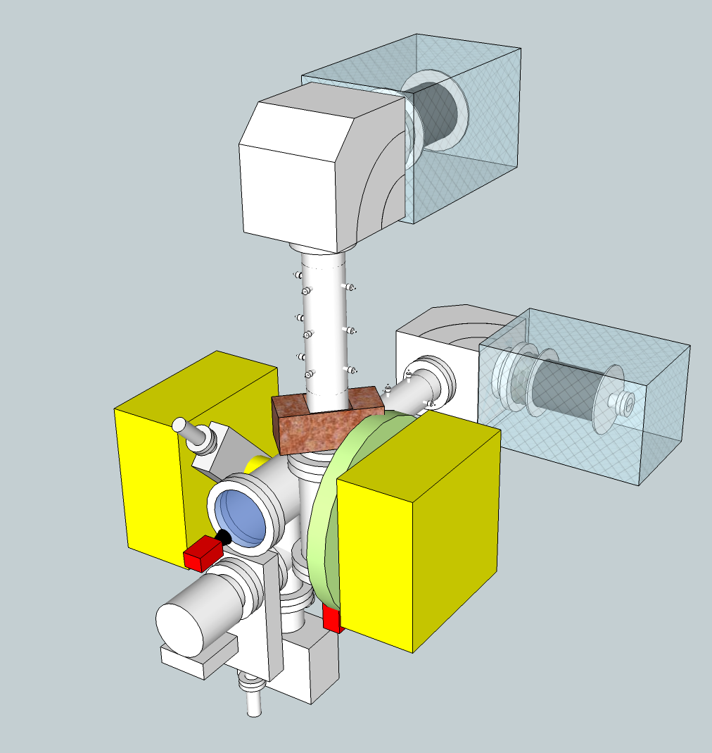
3. Particle Beam
Rough illustration using ions to visualize the dimensions.
Beam consisting of electrons leads to a smaller setup

Slide 20
Conclusion
Luminescence might be hard to achieve for cold part, maybe useful at other positions
Magnets for ionization (electrons) add another layer of complexity, which is not necessary
Ionization (ions) and particle beam most promising for cold linac

Slide 21
Questions for discussion
Ionization: Changing EM-Fields and the influence on the ions?
Agreement with my conclusion?
Other possible methods not in evaluation yet?
...

